Slide 1
제 6 장 Part 1 – Process Operation
이번 장에서는 Process에 대한 내용을 소개합니다.
관련된 System Call들도 함께 다루도록 합니다.
- <숫자> -

Slide 2
제 6장 목차
Process
Process Start
Process Termination
Command-Line Arguments
Environment Variables
Memory Layout of a program
Memory Allocation
setjmp() / longjmp()
- <숫자> -

Slide 3
6.1 Process
Process – a program in execution
Concept of process is gradually advanced
Program is a passive substance
A saved file in disk
Process is an active substance(프로세스는 능동적인 객체이다. 파일이 정적이라면)
Has a program that specifies next running instructions
- <숫자> -

Slide 4
6.1 Process
Process
Program code (text section)(머신레벨)
Program counter (PC)
Address of instruction which is to be executed next in program
Stack: save temporary, automatic variables, etc.
Data section: save global variables
- <숫자> -

Slide 5
6.1 Process
Master memory device
CPU registers
OS
CS
Pc counter
(PC)
Code area
DS
Data area
Process
SS
Stack area
- <숫자> -

Slide 6
6.1 Process : State
While the process runs, the state changes
New: process is being created
Running: instructions are being executed
Waiting: process is waiting for some event to occur
Ready: process is waiting to be assigned to a processor
Terminated: process has finished execution
- <숫자> -

Slide 7
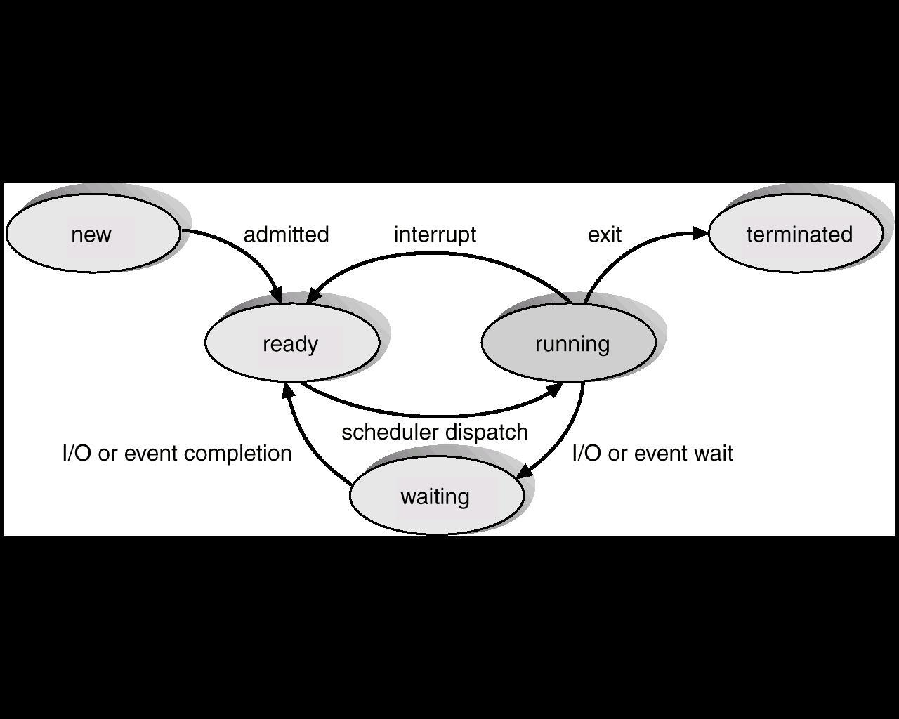
6.1 Process : State
- <숫자> -

Slide 8
6.1 Process : Process Control Block
Contents of PCB(프로세스의 모든정보)
Process state: new, ready, running, waiting
Program counter: counter indicates the address of the next instruction to be executed for the program(현재 실행 되어야 할 프로세스)
CPU registers
CPU-scheduling information: process priority, pointer to scheduling queues
Memory-management information: base and limit resisters, page tables, segment tables (page -> virtual memory)
Accounting information: amount of CPU and real time used9(cpu에 있던 시간), time limits, job or process number
I/O status information: list of I/O devices allocated to this process
page in, page out(하드디스크에 있는 메모리 메인 메모리로 and )
실제로 page와 segment혼합해서 사용함
가상주소를 실제주소로 바꿔줄때 봐야하는 table TLB
- <숫자> -

Slide 9
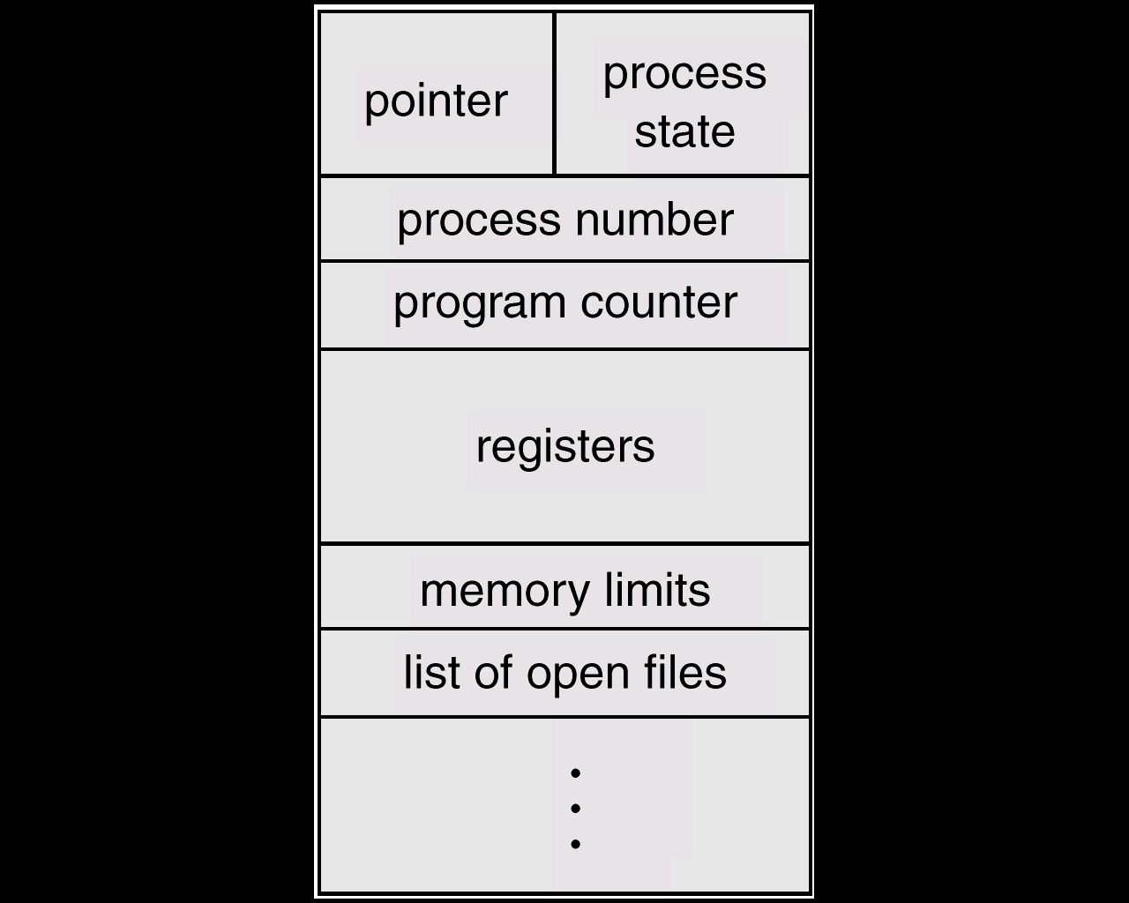
6.1 Process : Process Control Block
- <숫자> -

Slide 10
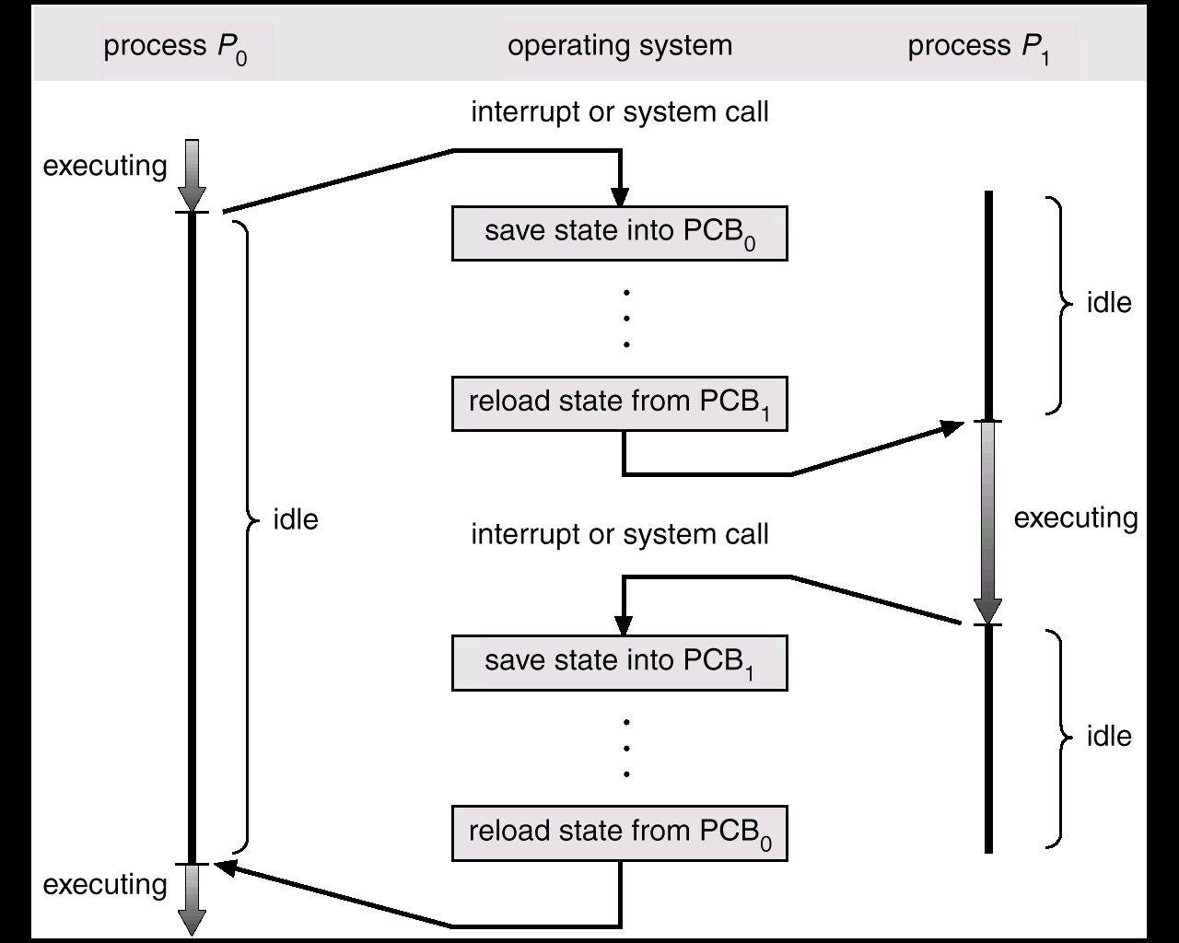
6.1 Process : Process Control Block
Context switching
- <숫자> -

Slide 11
6.1 Process : Creation
A process may create several new processes
Creating process: Parent process
Newly created process: Child process
Resource sharing(부모와 자식)
The parent and the child process share resources to accomplish tasks
The child shares partial resource of the parent
일정 부분은 공유하고 자식이 해야 할 부분은 독립적으로
부모와 자식은 같은 일을 시킬 수 있지만, 전혀 다른 것이다.(메모리가 다르기 때문)
- <숫자> -

Slide 12
6.1 Process : Creation
Execution
The parent and the child execute together
The parent wait until the termination of the child
부모가 먼저 죽으면 init process가 child의 부모가 된다.
그런 프로세스를 demon process라고 한다.
Address space
The child’s address space overlaps with parent’s address space
The child loads a program in its own process address space
일부는 공유하지만 자식의 고유해야할일은 자신의 영역에 로드한다.
Example – Unix
fork() system call creates a new process
exec() system call loads a new program in a process address space made by fork
wait() system call waits until the termination of the child
- <숫자> -

Slide 13
6.1 Process : Exit
A process terminates when it finishes executing its final instruction
It asks the Operating System to delete itself by using the exit() system call
The process may return data to its parent process (via the wait() system call)
All the resources of the process (including physical and virtual memory, open files, and I/O buffers) are deallocated by the Operating System
A process can cause the termination of another process via an appropriate system call (for example, abort())
User terminate the process at his/her discretion (kill)
- <숫자> -

Slide 14
6.2 Process Start
Kernel
exec system call
C start-up routine
call
return
int main(int argc, char * argv[]);
- <숫자> -

Slide 15
6.2 Process Start
int main(int argc, char *argv[]);
arc : the number of command-line arguments
argv[] : an array of pointers to the arguments
C start-up routine
Started by the kernel (by the exec system call)
Take the command-line arguments and the environment from the kernel
Call main
- <숫자> -

Slide 16
6.3 Process Termination
Normal termination(정상 종료):
return from main()
calling exit() :
calling _exit()
Abnormal termination(비정상 종료)
calling abort()
terminated by a signal
- <숫자> -

Slide 17
6.3 Process Termination : exit()
#include <stdlib.h>
void exit(int status);
Termination of a normal process
Execution of clean-up processing
Close all streams open
Write contents of output buffer to disk
status
the exit status of a process
exit 어떤 값을 주면 그 값은 부모한테 간다.exit 에서 넘어가는 값은
parent 에서 wait 할때 얻는 child status 값에 저장됩니다.
그렇다고 바로 그 값이 저장되는 것은 아니고, status 값이 여러 다른 것도 포함해서 저장됩니다. 그 값이 OS마다 다르기때문에 표준으로 제공하는 macro를 통해서 구해야합니다.
반면, parent가 shell 이라면,
echo $?
로 그 값을 바로 확인 할 수 있습니다
- <숫자> -

Slide 18
6.3 Process Termination : _exit()
#include <unistd.h>
void _exit(int status);
Termination of a normal process
Immediately return to kernel
exit은 일정부분 클린업 작업을 하고 넘기고, _exit은 클린업 작업 안하고 즉시 넘김
- <숫자> -

Slide 19
6.3 Process Termination : atexit()
#include <stdlib.h>
void atexit(void (*func)(void)); exit하기전에 fuc하고 exit해라
Enrolls an exit handler defined by users
Up to 32 per process(프로세스 1개당 32개 함수 등록 가능하다.)
func
an exit handler
a function pointer
exit() calls exit handler in the reverse order of their registration(등록된 역순으로 실행, atexit(1), atexit(2)이면 2번 부터 실행됨)
In case of abnormal termination (abort), function enrolled by atexit doesn’t execute
Termination by abort → Termination by signal
- <숫자> -

Slide 20
6.3 Process Termination :
C Program Start and Termination
_exit
user
function
exit handler
call
return
return
call
exit
(does not return)
……
_exit
exit
(does not return)
exit
function
call
return
main
function
user
process
exit handler
return
call
exit
(does not return)
call
return
최종적으론 무조건
_exit실행됨
C start-up
routine
standard I/O
cleanup
_exit
exec
kernel
- <숫자> -

Slide 21
6.3 Process Termination : atexit() 예제
#include <stdio.h>
static void my_exit1(void), my_exit2(void);
void err_sys(const char *message);
int main(void) {
if (atexit(my_exit2) != 0)
err_sys("can't register my_exit2");
if (atexit(my_exit1) != 0)
err_sys("can't register my_exit1");
printf("main is done\n");
return 0;
}
Void return을 이용해서 if 활용하기
- <숫자> -

Slide 22
6.3 Process Termination : atexit() 예제
static void my_exit1(void) {
printf("first exit handler\n");
}
static void my_exit2(void) {
printf("second exit handler\n");
}
void err_sys(const char *message)
{
fputs(message, stderr);
fputc(‘\n’, stderr);
exit(1);
}
- <숫자> -

Slide 23
6.4 Command-Line Arguments
exec() can pass command-line arguments to a new program
Part of normal operation of Unix shells
argv[argc] is a NULL char (ANSI, POSIX.1)
- <숫자> -

Slide 24
6.4 Command-Line Arguments : 예제
// #include <ourhdr.h> /* Appendix B in Stevens' Book – 필요한 헤더*/
#include <stdio.h>
#include <stdlib.h>
#include <unistd.h>
#include <string.h>
int main(int argc, char *argv[]) {
int i;
for (i = 0; i < argc; i++) /* echo all command-line args */
printf("argv[%d]: %s\n", i, argv[i]);
exit(0);
}
- <숫자> -

Slide 25
6.4 Command-Line Arguments : 예제
// #include <ourhdr.h> /* Appendix B in Stevens' Book – 필요한 헤더*/
#include <stdio.h>
#include <stdlib.h>
#include <unistd.h>
#include <string.h>
int main(int argc, char *argv[]) {
int i = 0;
char **p = argv;
while (*p)
printf("argv[%d]: %s\n", i++, *p++);
exit(0);
}
- <숫자> -

Slide 26
6.5 Environment Variable
Environment variable is transmitted from the parent process to the child process
Environment variable set up in files (.bashrc, .login, or .cshrc)
cat .bash_profile
more 우리 수업에서는 여기에 환경변수 path
env
- <숫자> -

Slide 27
6.5 Environment Variable
Environment variable: name = value
$ env
USER=lsj
LOGNAME=lsj
HOME=/user1/lsj
PATH=/bin:/usr/bin:/usr/local/bin:/usr/ccs/bin:/usr/ucb:/usr/openwin/bin:/etc:.
MAIL=/var/mail/lsj
SHELL=/bin/csh
- <숫자> -

Slide 28
6.5 Environment Variable : Environment list
Using global variable “environ”, access environment variables:
#include <stdlib.h>
extern char ** environ;
Each environment variable is made up of strings of the form “name=value”
Each string ends with ‘\0’
Last environment variable list is null pointer.
Same structure as argv
- <숫자> -

Slide 29
6.5 Environment Variable : Environment list
environment
pointer
environment
list
environment
strings
environ:
"USER=lsj"
"LOGNAME=lsj"
"HOME=/user1/lsj"
"PATH=/bin:/usr/local…"
"MAIL =/var/mail/lsj"
...
"SHELL=/bin/csh"
NULL
- <숫자> -

Slide 30
6.5 Environment Variable : 예제
#include <stdlib.h> /* viewenv.c */
#include <stdio.h>
extern char **environ;
int main()
{
char **env = environ;
while(*env){
printf(“%s\n”,*env);
env++;
}
exit(0);
}
- <숫자> -

Slide 31
6.5 Environment Variable : 예제
$ printenv
PWD=/root/process
HOSTNAME=localhost.localdomain
PVM_RSH=/usr/bin/rsh
QTDIR=/usr/lib/qt3-gcc2.96
LESSOPEN=|/usr/bin/lesspipe.sh %s
XPVM_ROOT=/usr/share/pvm3/xpvm
USER=root
LS_COLORS=no=00:fi=00:di=01;34:ln=01;36:pi=40;33:so=01;35:bd=40;33;01:cd=40;33;
1:or=01;05;37;41:mi=01;05;37;41:ex=01;32:*.cmd=01;32:*.exe=01;32:*.com=01;32:*.
tm=01;32:*.bat=01;32:*.sh=01;32:*.csh=01;32:*.tar=01;31:*.tgz=01;31:*.arj=01;31
*.taz=01;31:*.lzh=01;31:*.zip=01;31:*.z=01;31:*.Z=01;31:*.gz=01;31:*.bz2=01;31:
.bz=01;31:*.tz=01;31:*.rpm=01;31:*.cpio=01;31:*.jpg=01;35:*.gif=01;35:*.bmp=01;
5:*.xbm=01;35:*.xpm=01;35:*.png=01;35:*.tif=01;35:
MAIL=/var/spool/mail/root
INPUTRC=/etc/inputrc
BASH_ENV=/root/.bashrc
LANG=en_US.iso885915
- <숫자> -

Slide 32
6.5 Environment Variable : 예제
LOGNAME=root
SHLVL=1
SHELL=/bin/bash
USERNAME=root
HISTSIZE=1000
LAMHELPFILE=/etc/lam/lam-helpfile
PVM_ROOT=/usr/share/pvm3
HOME=/root
TERM=linux
SSH_ASKPASS=/usr/libexec/openssh/gnome-ssh-askpass
PATH=/usr/kerberos/sbin:/usr/kerberos/bin:/usr/local/sbin:/usr/local/bin:/sbin:
bin:/usr/sbin:/usr/bin:/usr/X11R6/bin:/root/bin
_=./a.out
OLDPWD=/root
- <숫자> -

Slide 33
6.5 Environment Variable : getenv()
#include <stdlib.h>
char *getenv(const char *name);
Returns : pointer to value associated with name, NULL if not found
Searches for the environment list for a string with the given name
When a match is found, returns the value associated with that name
It will return null if the requested variable doesn’t exist
- <숫자> -

Slide 34
6.5 Environment Variable : putenv()
#include <stdlib.h> 추가해라
int putenv(const char *str);
Returns: 0 if OK, nonzero on error
Takes a string of the form name=value
Adds it to the current environment list
- <숫자> -

Slide 35
6.5 Environment Variable : 예제
The first lines after the declaration of main ensures that the program is called correctly:
#include <stdlib.h> /*environ.c*/
#include <stdio.h>
#include <string.h>
int main(int argc, char *argv[])
{
char *var, *value;
if(argc == 1 || argc >2) {
fprintf(stderr,"usage: environ var [value]\n");
exit(1);
}
- <숫자> -

Slide 36
6.5 Environment Variable : 예제
After that, we fetch the value of the variable from the environment, using getenv:
var = argv[1];
value = getenv(var);
if (value)
printf("Variable %s has value %s\n", var, value);
else
printf("Variable %s has no value\n", var);
}
- <숫자> -

Slide 37
6.5 Environment Variable : setenv() / unsetenv()
#include <stdlib.h> 셋팅
int setenv(const char *name, const char *value, int rewrite); Returns: 0 if OK, nonzero on error
void unsetenv(const char *name); 프로그램 실행동안만
setenv enroll environment variable name = value
If environment variable of the same name exists
rewrite != 0 → change new value
rewrite = 0 → not change
unsetenv eliminate environment variable name
- <숫자> -

Slide 38
Lab #6
시스템 호출 getenv, setenv, 등을 사용하여 환경 변수 PATH 의 현재 값에 “.” 을 추가하는 프로그램을 작성하라
turnin lab6 env_path.c
- <숫자> -

Slide 39
6.6 Memory Layout of a Program
Low address
executable
text
initialized data
initialized to zero by exec
uninitialized data
(bss)
heap
stack
command-line arguments
and environment variables
High address
- <숫자> -

Slide 40
6.6 Memory Layout of a Program
Text segment: Machine instructions (read-only, sharable)
Initialized data segment:
e.g. int maxcount = 99; (initialized)
Uninitialized data segment or bss (block started by symbol)
e.g. long sum[1000];
Initialized to 0 or null pointer by exec before program start executing
Heap:
dynamic memory allocation (malloc, etc.)
Stack:
Automatic(local) variables, temporary variables, return address, caller's environment (registers)
- <숫자> -

Slide 41
6.6 Memory Layout of a Program : Shared library
Static linking library
Library routines add to the executable file
Size of executable file increase
lib.a (lib*.a 형태) – (ar rcs libmean.a calc_mean.o)
Shared library
Library routines are included to execute file in executing stage
Library routines are loaded to shared memory and they are shared in execution
Program size is not increased
When it executes first, it incurs overhead
Lib.so (lib*.so 형태) – (gcc -c -fPIC calc_mean.c -o lib_calc_mean.so)
- <숫자> -

Slide 42
ar rcs - archive rcs(replace create s?)
ar - The archiver, also known simply as ar, is a Unix utility that maintains groups of files as a single archive file. Today, ar is generally used only to create and update static library files that the link editor or linker uses; it can be used to create archives for any purpose, but has been largely replaced by tar for purposes other than static libraries.
rcs
r says insert the given object files in to the archive (replacing any older versions of the same thing)
c says create the archive if it isn't already there (normally this happens anyway, but this option suppresses the warning).
s says to write an object-file index into the archive.
For example, to create an archive from files class1.o, class2.o, class3.o, the following command would be used:
- ar rcs libclass.a class1.o class2.o class3.o
- <숫자> -

Slide 43
-fpic (-fPIC) option
-fpic
Generate position-independent code (PIC) suitable for use in a
shared library, if supported for the target machine. Such code
accesses all constant addresses through a global offset table
(GOT). The dynamic loader resolves the GOT entries when the pro-
gram starts (the dynamic loader is not part of GCC; it is part of
the operating system). If the GOT size for the linked executable
exceeds a machine-specific maximum size, you get an error message
from the linker indicating that -fpic does not work; in that
case, recompile with -fPIC instead. (These maximums are 16k on
the m88k, 8k on the SPARC, and 32k on the m68k and RS/6000. The
386 has no such limit.)
Position-independent code requires special support, and therefore
works only on certain machines. For the 386, GCC supports PIC
for System V but not for the Sun 386i. Code generated for the
IBM RS/6000 is always position-independent.
-fPIC
If supported for the target machine, emit position-independent
code, suitable for dynamic linking and avoiding any limit on the
size of the global offset table. This option makes a difference
on the m68k, m88k, and the SPARC.
- <숫자> -

Slide 44
6.7 Memory Allocation
#include <stdlib.h>
void *malloc(size_t size);
void *calloc(size_t nobj, size_t size);
void *realloc(void *ptr, size_t newsize);
returns : nonnull pointer if OK, NULL on error
void free(void *ptr);
Dynamic allocation of memory on heap
Provides suitable alignment
ex) double’s must start at the addresses that are multiples of 8
Library manages memory pool
- <숫자> -

Slide 45
6.7 Memory Allocation
malloc():
Allocates specified number of bytes
Initial value of memory is not determined
calloc():
Allocates specified number of objects of specified size
Initialized to all 0 bits
realloc():
Changes the size of previously allocated memory
Initial value of new area is not determined
- <숫자> -

Slide 46
6.8 setjmp() / longjmp()
#include <setjmp.h>
int setjmp(jmp_buf env);
returns : 0, if called directly
None zero, if returning from a call to longjmp
void longjmp(jmp_buf env, int val);
Jump across function call (nonlocal goto)
Useful for dealing with error conditions in deeply nested function calls
When an error occurs, we want to print an error, ignore rest of input, and return to main()
Large number of levels → handle return at each level for each error
Direct nonlocal goto: setjmp, longjmp
주로 stack point, base pointer, program counter 값을 jmp_buf 구조체를 갖는 변수에 “setjmp” 함수를 이용해 저장해 놓았다가 “longjmp” 함수를 사용해서 현재 프로그램의 어느 곳 또는 어느 함수에서 실행하고 있었든지 관계없이 “setjmp”에 저장된 값으로 돌아가도록 하는데 이용한다.
- <숫자> -

Slide 47
6.8 setjmp() / longjmp()
setjmp: store information for return to setjmp point at env
returns 0 if called directly
returns nonzero val if returning from a call to longjmp
longjmp: use env to jump to setjmp point and val as a return value
Several longjmp can use the same setjmp location with different val
normally env is a global variable since it can be referenced from another function
- <숫자> -

Slide 48
6.8 setjmp() / longjmp() : 예제
#include <setjmp.h> /* testjmp.c */
#include <stdio.h>
#include <unistd.h>
static void f1(int, int, int);
static void f2(void);
static jmp_buf jmpbuffer;
int main(void) {
int count;
int val;
int sum;
count = 2; val = 3; sum = 4;
printf(“Initial values: count = %d, val = %d, sum = %d\n", count, val, sum);
if (setjmp(jmpbuffer) != 0) {
printf("after longjmp: count = %d, val = %d, sum = %d\n", count, val, sum);
exit(0);
}
count = 97; val = 98; sum = 99; /* changed after setjmp, before longjmp */
f1(count, val, sum); /* never returns */
}
static void f1(int i, int j, int k) {
printf("in f1(): count = %d, val = %d, sum = %d\n", i, j, k);
f2();
}
static void f2(void) {
longjmp (jmpbuffer, 1);
}
- <숫자> -

Slide 49
6.8 setjmp() / longjmp() : 예제
$ gcc testjmp.c
$ ./a.out
Initial value: count = 2, val = 3, sum = 4
in f1(): count = 97, val = 98, sum = 99
after longjmp: count = 97, val = 98, sum = 99
- <숫자> -

