Slide 1
System Programming Fork, Wait, Exec

Slide 2
Contents
Fork()
Wait()
Execl()
Lab9++

Slide 3
Process
Process – a program in execution
Every process has a unique process ID, a nonnegative integer
Pid_t getpid();
Pid_t getppid();

Slide 4
Fork()
#include <sys/types.h>
#include <unistd.h>
pid_t fork(void);
Returns: 0 in child, process ID of child in parent, -1 on error
fork() is the ONLY way to create a process in Unix kernel
child process is the new process created by fork()
fork() is called once, but returns twice!
returns 0 in child process
returns the child process ID in parent process

Slide 5
Fork()
Process
cid =
ProcessID
of Child
Process
cid = fork();
Child Process
cid = 0;

Slide 6
fork2.c
#include <stdio.h>
#include <unistd.h>
#include <sys/types.h>
int main(void) {
pid_t childpid;
childpid = fork();
if (childpid == -1){
printf("Failed to fork");
return 1;
}
if (childpid == 0)
printf("I am child %ld\n", (long)getpid());
else
printf("I am parent %ld\n", (long)getpid());
return 0;
}
//result
I am child *****
I am parent *****

Slide 7
Wait()
When a child terminates
Kernel sends SIGCHLD signal to the parent
an asynchronous event
Actions taken by the parent
Default action: “ignore”
Alternatively, the parent can call signal handlers defined by users
A process that calls wait or waitpid can
block (if its children are still running), or
return immediately with the termination status of a child, or
return immediately with an error (if it doesn’t have any child processes)

Slide 8
Wait()
statloc
a pointer to an integer address to store the termination status
Wait() blocks until all the children are finished
Waitpid() can choose not to block.
It can have a number of options
힌트:
int status;
wait(&status);
#include <sys/types.h>
#include <sys/wait.h>
pid_t wait(int *statloc);
pid_t waitpid(pid_t pid, int *statloc, int options);
Both return: process ID if OK, 0, or -1 on error

Slide 9
exec : Program Execution
When a process calls one of the exec functions
That process is completely replaced by the new program: Loading text, data, heap, and stack segments onto parent’s address space
New program starts at its main function
New program uses the same PID as its caller
execl(“파일위치”,”argv0”,”argv2”…, (char*)0);
#include <unistd.h>
main(){
printf (“executing ls\n”);
execl(“/bin/ls”, ”ls”, “-l”, (char *) 0);
exit(1);
}

Slide 10
Lab9++
준비
cp /tmp/hello .
Fork()와 wait(), execl()을 이용하여 fork.c를 작성하라:
부모 프로세스는 두개의 자식 프로세스를 생성한다: Child 1, Child 2
부모 프로세스는 wait() 를 실행하며 자식 프로세스들이 끝나기를 기다린다. Wait()를 실행하기 전 “Parent: Waiting for children” 하고 출력한다
각각의 자식 프로세스는 execl()을 이용하여 “hello”를 실행하여 “This is Child 1(또는 Child 2)”를 출력한다.
부모 프로세스는 종료하는 각 자식 프로세스를 식별하여 메시지(“Parent: First (또는 Second) Child: “)와 함께 종료 상태(status)로 자식 번호를 출력한다. Ex) First Child: 1
자식 프로세스들이 끝나면 부모는 “Parent: All Children terminated” 를 출력한다

Slide 11
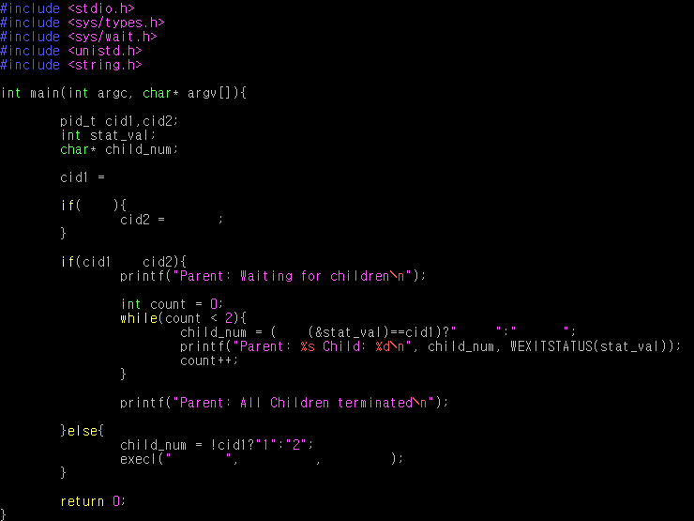
Hint: fork.c

Slide 12
Hello.c
#include <stdio.h>
#include <stdlib.h>
int main(int argc, char* argv[]){
if(argc != 1){
printf("error: number of args.\n");
return 1;
}
printf("This is Child %s\n",argv[0]);
return atoi(argv[0]);
}

Slide 13

결과 화면 & 제출
제출: submit labjkh fork.c hello
확인: showlab labjkh

Slide 14
힌트: 각 function 사용법
Fork
fork(); //자식 프로세스 생성
반환값은
부모: 생성된 자식의 processID
자식: 0
Wait
Int status; //종료상태를 저장할 변수
wait(&status);
반환값은 종료한 ProcessID
Execl
execl(“실행할 파일위치”,”인자1”,”인자2”,(char*)0);
인자는 필요한 만큼 넣는다. 마지막은 0으로 표시

