Slide 1
CN2Algorithme

Slide 2
CN2 is a rule-based algorithm that produces an ordered list of if-then rules, rather than an
unordered set of rules like the one generated by other types of rule-based classiers (like
RULES, PRISM or RISE).
Other characteristics of this classier are that it constructs rules
from the more general to the more specic, and that the constructed rules don't always
have a precision of 100%.
To understand how this algorithm works, there are a few concepts that we must define:
selector: a selector is the pair Attributei = Valueij (for example: age = young);
complex: a complex is a combination of selectors (for example: age = young AND
deciency = myopia);
best complex: the best complex is the best combination of selectors; the CN2 algo-
rithm creates rules from continually searching the best complex. The procedure for
nding the best complex is an heuristic search algorithm, which keeps the best K
complex found (k-beam), where K is dened by the user;

Slide 3
Induction of Rules
Rules → popular symbolic representation of knowledge
derived from data.
Standard form of rules
IF Conditions THEN Class (possible inspection by human)
Other forms: Class IF Conditions; Conditions → Class
A set of rules – a disjunctive set of conjunctive rules.
Using Disjunctive Normal Form (DNF) :
(p ∧ q ∧ r) ∨ (p ∧ ¬q ∧ r ∧ s)
Selectors
Complex
Covers

Slide 4
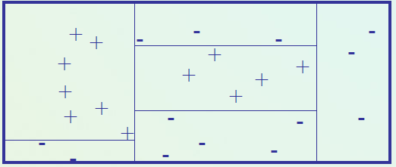
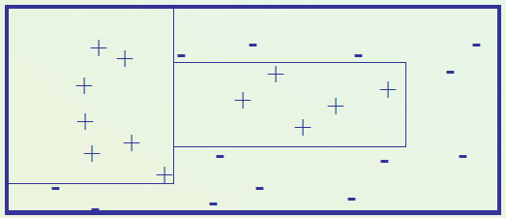
Why Decision Rules :
Decision rules are more understandable and natural for human.
• Better for descriptive perspective in data mining.
• Can be nicely combined with background knowledge and more
advanced operations
Decision rules vs. decision trees:
Trees – splitting the data space (e.g. C4.5)
Rules – covering parts of the space (AQ, CN2)
Decision boundaries of decision trees
Decision boundaries of decision rules

Slide 5
Formal notations of a Rule corresponding to class Cj is represented as:
IF P Then Q
where P = w1 and w2 and … and wm is a condition part and Q is a decision part (object x satisfying P is
assigned to class Cj)
Selector operator are : =,<, ≤, ≥ , >.
[P] is a cover of a condition part of a rule
A subset of examples satisfying P
Example : if (a2 = small) and (a3 ≤ 2) then (d = C1) {x1,x7}

Slide 6
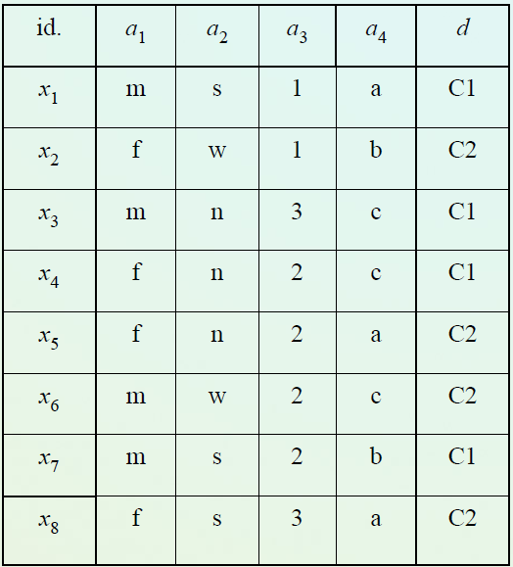
S : a set of examples from Cj
A rule [if P then Q ] is discriminant if
[P]=⎧⎫ [wi]⊆ S,
otherwise (P∩S≠∅) the rule is partly discriminating
Rule accuracy (or confidence): #P∩C/#C
Example of rules induced from data table :
Minimal set of rules :
if (a2 = s) ∧ (a3 ≤ 2) then (d = C1) {x1,x7}
• if (a2 = n) ∧ (a4 = c) then (d = C1) {x3,x4}
• if (a2 = w) then (d = C2) {x2,x6}
• if (a1 = f) ∧ (a4 = a) then (d = C2) {x5,x8}
Partly discriminating rule:
if (a1=m) then (d=C1) {x1,x3,x7 | x6} freq :3/4

Slide 7
How to learn decision rules?
Typical algorithms based on the scheme of a sequential covering and heuristically generate a minimal set of rule
covering examples .
Example :AQ, CN2
sequential covering and heuristically
Specific optimization(genetic approaches)
Transformations of other representations (Trees)
Satisfying some requirements (Explore, Brute Force )

Slide 8
Covering algorithms
A strategy for generating a rule set directly from data: for each class in turn find a rule set that covers all examples
in it (excluding examples not in the class).
The main procedure iteratively repeated for each class
Positive examples from this class vs. negative examples
This approach is called a covering approach because at each stage a rule is identified that covers some of the
instances.
For a given class it conducts in a stepwise way a general to specific search for the best rules (learn-one-rule) guided
by the evaluation measures(A sequential approach)

Slide 9
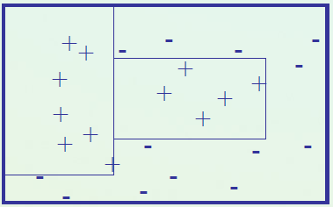
Original covering idea (AQ, Michalski 1969, 86)
for each class Ci do
Ei := Pi U Ni (Pi positive, Ni negative example)
RuleSet(Ci) := empty
repeat {find-set-of-rules}
#find-one-rule R covering some positive examples
and no negative ones
add R to RuleSet(Ci)
delete from Pi all pos. ex. covered by R
until Pi (set of pos. ex.) = empty
Find one rule:
Choosing a positive example called a seed.
Find a limited set of rules characterizing
the seed → STAR.
Choose the best rule according to LEF criteria.

Slide 10
CN2 algorithm
Combine ideas AQ with ID3 a Top Down Induction of Decision Trees (TDIDT)
IDEA:
Search as in AQ ( Beam Search )
Additional evaluation criteria or pruning as for TDIDT
Tips
AQ depends on a seed example
Basic AQ has difficulties with noise handling
Principles
Covering approach (but with stopping criteria )
Learning one rule - not so much example-seed driven
Two options :
Generating an unordered set of rules (First Class, then conditions).

Slide 11


entropy: this is the heuristic that is used to compare two complexes to see which is
'better' than the other. CN2 uses the information theoretic entropy measure:
signicance: this is the second heuristic used in the evaluation of the complex; by this measure, a complex is signicant if it nds a correlation between attribute values and classes that is unlikely to have occurred by chance. To test signicance the system uses the likelyhood ratio statistic, which is given by:
where the distribution F = f1,...,fn is the observed frequency distribution of examples
among classes satisfying a given complex and E = e1,...,en is the expected frequency
distribution of the same number of the examples under the assumption that the com-
plex selects examples randomly [2]. For this measure, the lower the score, the more
likely it is that the apparent regularity found by the complex is due to chance.

Slide 12
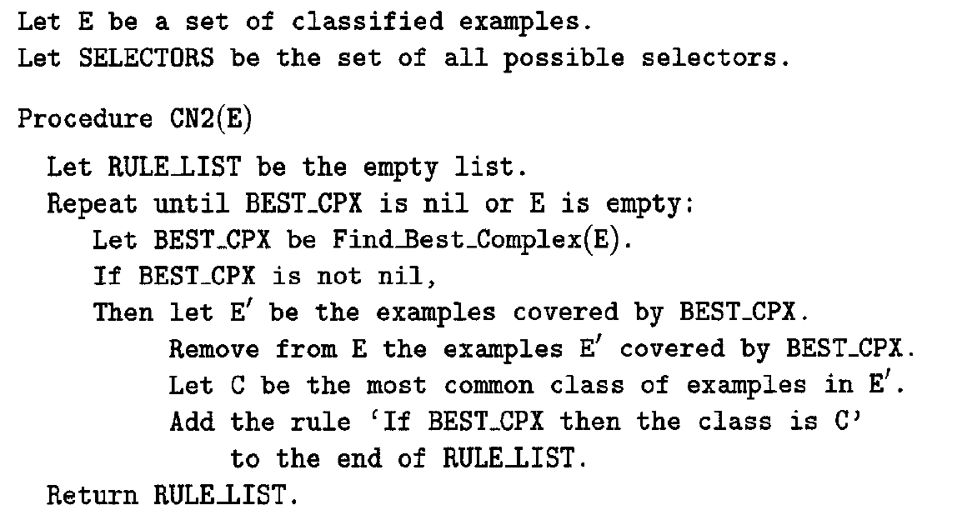
The CN2 induction algorithm

Slide 13
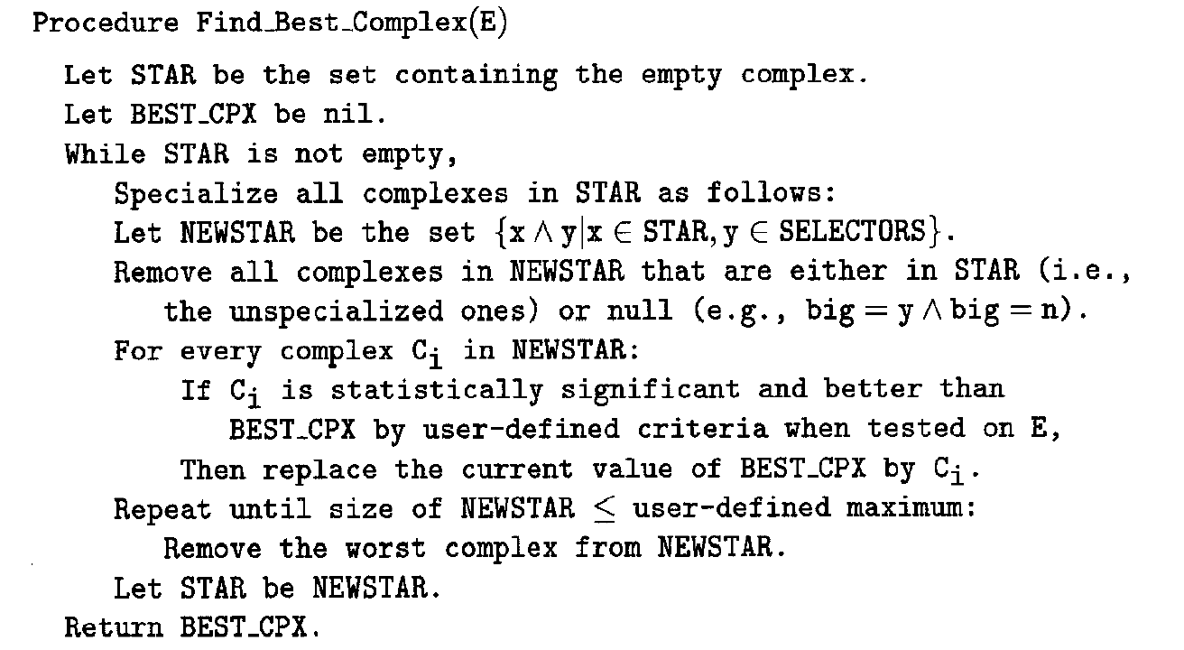

Slide 14
What the algorithm presented above does is to continually compute the best complex
(BEST CPX), based on the available examples from the training set, and for each best com-
plex found, it creates a rule that says that if the conditions of the best complex are satised,
then the assigned class for those instances which satisfy the complex will be the most com-
mon class of the training examples covered by the complex. After the rule is added at the
end of the rule list (this is very important, since CN2 creates an ordered set of rules, so
each new rule must be added at the end), all the training example that are covered by the
complex are removed from the list of remaining examples, and this process repeats until all
the training data has been covered. In the end, a default rule will be added, to which the
most common class of the training set will be assigned (this rule will be useful in case none
of the previous rule is activated when trying to predict the class of a test example).

Slide 15
For the computing of the best complex, the algorithm starts by analyzing each of the
selectors, creating a subset of complexes which elements are the k 'best complexes', where
k is a user dened maximum for the size of this subset, and the 'best complexes' are
the complexes (in this rst iteration the selectors) which have a signicance higher than
a threshold and the lowest entropy between all the other complexes. The best of these
complexes will become the best complex.

Slide 16
client | credit history | debt level | collateral | Income Level | Risk Level
0 | bad | high | none | low | high
1 | unknown | high | none | medium | high
2 | unknown | low | none | medium | moderate
3 | unknown | low | none | low | high
4 | unknown | low | none | high | low
5 | unknown | low | adequate | high | low
6 | bad | low | none | low | high
7 | bad | low | adequate | high | moderate
8 | good | low | none | high | low
9 | good | high | adequate | high | low
10 | good | high | none | low | high
11 | good | high | none | medium | moderate
12 | good | high | none | high | low
13 | bad | high | none | medium | high

Slide 17
[[(' credit histroy ', 'unknown')], [(' credit histroy ', 'bad')], [(' credit histroy ', 'good')], [(' debt level ', 'low')], [(' debt level ', 'high')], [(' collateral ', 'none')], [(' collateral ', 'adequate')], [(' Income Level ', 'low')], [(' Income Level ', 'medium')], [(' Income Level ', 'high')]]
Nex_STAR
(4-0-0)
(0-1-5)
STAR
[(' Income Level ', ‘low)]
[(' Income Level ', 'high')]
[(' Income Level ', 'low'), (' credit histroy ', 'unknown')], [(' Income Level ', 'low'), (' credit histroy ', 'bad')], [(' Income Level ', 'low'), (' credit histroy ', 'good')], [(' Income Level ', 'low'), (' debt level ', 'low')], [(' Income Level ', 'low'), (' debt level ', 'high')], [(' Income Level ', 'low'), (' collateral ', 'none')], [(' Income Level ', 'low'), (' collateral ', 'adequate')],
[(' Income Level ', 'high'), (' credit histroy ', 'unknown')], [(' Income Level ', 'high'), (' credit histroy ', 'bad')], [(' Income Level ', 'high'), (' credit histroy ', 'good')], [(' Income Level ', 'high'), (' debt level ', 'low')], [(' Income Level ', 'high'), (' debt level ', 'high')], [(' Income Level ', 'high'), (' collateral ', 'none')], [(' Income Level ', 'high'), (' collateral ', 'adequate')]]
.
.
.
.
.
.

Slide 18
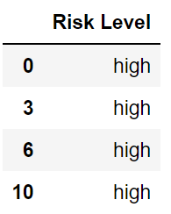


best_complex_significance:, 1.69
covered_examples # index coved by the complex
[0, 3, 6, 10]
classes
covered_num_instances = len(classes) =4
covered_counts :
high 4 ,moderate 0 ,low 0
train_probs (ei)
covered_probs (fi)
high 1.0
Low 0
Moderate 0

Slide 19
Significance = 2( 1 *log(1/0.48571) + 0* log(0/0.357143) + 0* log(0/0.214286) = 1.6945957207744073
best_complex_entropy: -0.0
covered_probs (pi)
high 1.0
Low 0
Moderate 0
Entropy = - ( 1 log2(1) + 0log2(0) +0log2(0))

Slide 20
Pick the best complex without loosing entropy
best_complex [(' Income Level ', 'low')]
best_complex_entropy:, -0.0
best_complex_significance:, 1.6945957207744073
RULE NUMBER 1

Slide 21
credit histroy debt level collateral Income Level Risk Level
1 unknown high none medium high
2 unknown low none medium moderate
4 unknown low none high low
5 unknown low adequate high low
7 bad low adequate high moderate
8 good low none high low
9 good high adequate high low
11 good high none medium moderate
12 good high none high low
13 bad high none medium high

Slide 22
covered_examples # index coved by the complex
[4,5,6,7,8,9,12]
classes
Risk Level
covered_num_instances = len(classes) = 5
4 low
5 low
7 moderate
8 low
9 low
covered_counts :
high 0 ,moderate 1 ,low 4
train_probs (ei)
covered_probs (fi)
High 0
Low 4/5 =0.8
Moderate 1/5 = 0.2

Slide 23
best_complex_entropy:, -0.0
best_complex_significance:, 2.0592388343623163
best_complex [(' Income Level ', 'high'), (' credit histroy ', 'unknown')]
(0,0,2)
covered_examples # index coved by the complex
[4,5]
classes
Risk Level
covered_num_instances = len(classes) = 2
4 low
5 low
covered_counts :
high 0 ,moderate 0 ,low 2
train_probs (ei)
covered_probs (fi)
High 0
Low 2/2 =1
Moderate 0

Slide 24
Significance = 2( 0*ln(0/0.48571) + 1* ln(1/0.357143) + 0* ln(0/0.214286) = 2.0592388343623163
best_complex_entropy: -0.0
covered_probs (pi)
high 1.0
Low 0
Moderate 0
Entropy = - ( 1 log2(1) + 0log2(0) +0log2(0)) = 0

Slide 25
[[(' credit histroy ', 'unknown')], [(' credit histroy ', 'bad')], [(' credit histroy ', 'good')], [(' debt level ', 'low')], [(' debt level ', 'high')], [(' collateral ', 'none')], [(' collateral ', 'adequate')], [(' Income Level ', 'low')], [(' Income Level ', 'medium')], [(' Income Level ', 'high')]]
Nex_STAR
(0-1- 5)
(0-1-3)
STAR
[(' Income Level ', 'high')]
[(' credit history ', 'good')]
[(' Income Level ', 'high'), (' credit histroy ', 'unknown')], [(' Income Level ', 'high'), (' credit histroy ', 'bad')], [(' Income Level ', 'high'), (' credit histroy ', 'good')], [(' Income Level ', 'high'), (' debt level ', 'low')], [(' Income Level ', 'high'), (' debt level ', 'high')], [(' Income Level ', 'high'), (' collateral ', 'none')], [(' Income Level ', 'high'), (' collateral ', 'adequate')]
[(' credit histroy ', 'good'), (' debt level ', 'low')], [(' credit histroy ', 'good'), (' debt level ', 'high')], [(' credit histroy ', 'good'), (' collateral ', 'none')], [(' credit histroy ', 'good'), (' collateral ', 'adequate')], [(' credit histroy ', 'good'), (' Income Level ', 'low')], [(' credit histroy ', 'good'), (' Income Level ', 'medium')], [(' credit histroy ', 'good'), (' Income Level ', 'high')]
.
.
.
.
.
.

Slide 26
best_complex [(' Income Level ', 'high'), (' credit histroy ', 'unknown')]
Pick the best complex without loosing entropy
(0-0- 2)
best_complex_entropy:, -0.0
best_complex_significance:, 2.0592388343623163
RULE NUMBER 2

Slide 27
credit histroy debt level collateral Income Level Risk Level
1 unknown high none medium high
2 unknown low none medium moderate
7 bad low adequate high moderate
8 good low none high low
9 good high adequate high low
11 good high none medium moderate
12 good high none high low
13 bad high none medium high

Slide 28
[[(' credit histroy ', 'unknown')], [(' credit histroy ', 'bad')], [(' credit histroy ', 'good')], [(' debt level ', 'low')], [(' debt level ', 'high')], [(' collateral ', 'none')], [(' collateral ', 'adequate')], [(' Income Level ', 'low')], [(' Income Level ', 'medium')], [(' Income Level ', 'high')]]
Nex_STAR
(0-1-3)
(0-1-3)
STAR
[[(' credit histroy ', 'good')]
[(' Income Level ', 'high')]]
[(' credit histroy ', 'good'), (' debt level ', 'low')], [(' credit histroy ', 'good'), (' debt level ', 'high')], [(' credit histroy ', 'good'), (' collateral ', 'none')], [(' credit histroy ', 'good'), (' collateral ', 'adequate')], [(' credit histroy ', 'good'), (' Income Level ', 'low')], [(' credit histroy ', 'good'), (' Income Level ', 'medium')], [(' credit histroy ', 'good'), (' Income Level ', 'high')]
[(' Income Level ', 'high'), (' credit histroy ', 'unknown')], [(' Income Level ', 'high'), (' credit histroy ', 'bad')], [(' Income Level ', 'high'), (' credit histroy ', 'good')], [(' Income Level ', 'high'), (' debt level ', 'low')], [(' Income Level ', 'high'), (' debt level ', 'high')], [(' Income Level ', 'high'), (' collateral ', 'none')], [(' Income Level ', 'high'), (' collateral ', 'adequate')]
.
.
.
.
.
.

Slide 29
Pick the best complex without loosing entropy
best_complex [(' credit histroy ', 'good'), (' debt level ', 'low')]
(0,0,1)
best_complex_entropy:, -0.0
best_complex_significance:, 2.0592388343623163
RULE NUMBER 3

Slide 30
credit histroy debt level collateral Income Level Risk Level
1 unknown high none medium high
2 unknown low none medium moderate
7 bad low adequate high moderate
9 good high adequate high low
11 good high none medium moderate
12 good high none high low
13 bad high none medium high

Slide 31
[(' credit histroy ', 'unknown')], [(' credit histroy ', 'bad')], [(' credit histroy ', 'good')], [(' debt level ', 'low')], [(' debt level ', 'high')], [(' collateral ', 'none')], [(' collateral ', 'adequate')], [(' Income Level ', 'low')], [(' Income Level ', 'medium')], [(' Income Level ', 'high')]
Nex_STAR
(0,1,0)
(0,1,2)
STAR
[(' debt level ', 'low')]
[(' credit histroy ', 'good')]
[(' debt level ', 'low'), (' credit histroy ', 'unknown')], [(' debt level ', 'low'), (' credit histroy ', 'bad')], [(' debt level ', 'low'), (' credit histroy ', 'good')], [(' debt level ', 'low'), (' collateral ', 'none')], [(' debt level ', 'low'), (' collateral ', 'adequate')], [(' debt level ', 'low'), (' Income Level ', 'low')], [(' debt level ', 'low'), (' Income Level ', 'medium')], [(' debt level ', 'low'), (' Income Level ', 'high')]
[(' credit histroy ', 'good'), (' debt level ', 'low')], [(' credit histroy ', 'good'), (' debt level ', 'high')], [(' credit histroy ', 'good'), (' collateral ', 'none')], [(' credit histroy ', 'good'), (' collateral ', 'adequate')], [(' credit histroy ', 'good'), (' Income Level ', 'low')], [(' credit histroy ', 'good'), (' Income Level ', 'medium')], [(' credit histroy ', 'good'), (' Income Level ', 'high')]
.
.
.
.
.
.

Slide 32
best_complex [(' debt level ', 'low')]
best_complex_entropy:, -0.0
best_complex_significance:, 3.080890081894298
RULE NUMBER 4

Slide 33
credit histroy debt level collateral Income Level Risk Level
1 unknown high none medium high
9 good high adequate high low
11 good high none medium moderate
12 good high none high low
13 bad high none medium high

Slide 34
[(' credit histroy ', 'unknown')], [(' credit histroy ', 'bad')], [(' credit histroy ', 'good')], [(' debt level ', 'low')], [(' debt level ', 'high')], [(' collateral ', 'none')], [(' collateral ', 'adequate')], [(' Income Level ', 'low')], [(' Income Level ', 'medium')], [(' Income Level ', 'high')]
Nex_STAR
(1,0,0)
(1,0,0)
STAR
[(' credit histroy ', 'unknown')],
[(' credit histroy ', 'bad')]
(' credit histroy ', 'unknown'), (' debt level ', 'low')], [(' credit histroy ', 'unknown'), (' debt level ', 'high')], [(' credit histroy ', 'unknown'), (' collateral ', 'none')], [(' credit histroy ', 'unknown'), (' collateral ', 'adequate')], [(' credit histroy ', 'unknown'), (' Income Level ', 'low')], [(' credit histroy ', 'unknown'), (' Income Level ', 'medium')], [(' credit histroy ', 'unknown'), (' Income Level ', 'high')]
[(' credit histroy ', 'bad'), (' debt level ', 'low')], [(' credit histroy ', 'bad'), (' debt level ', 'high')], [(' credit histroy ', 'bad'), (' collateral ', 'none')], [(' credit histroy ', 'bad'), (' collateral ', 'adequate')], [(' credit histroy ', 'bad'), (' Income Level ', 'low')], [(' credit histroy ', 'bad'), (' Income Level ', 'medium')], [(' credit histroy ', 'bad'), (' Income Level ', 'high')]
.
.
.
.
.
.

Slide 35
best_complex_entropy:, -0.0
best_complex_significance:, 1.6945957207744073
best_complex [(' credit histroy ', 'unknown')]
RULE NUMBER 5

Slide 36
credit histroy debt level collateral Income Level Risk Level
9 good high adequate high low
11 good high none medium moderate
12 good high none high low
13 bad high none medium high

Slide 37
[(' credit histroy ', 'unknown')], [(' credit histroy ', 'bad')], [(' credit histroy ', 'good')], [(' debt level ', 'low')], [(' debt level ', 'high')], [(' collateral ', 'none')], [(' collateral ', 'adequate')], [(' Income Level ', 'low')], [(' Income Level ', 'medium')], [(' Income Level ', 'high')]
Nex_STAR
(1,0,0)
(0,0,1)
STAR
[(' credit histroy ', 'bad')]
[(' collateral ', 'adequate')]
[(' credit histroy ', 'bad'), (' debt level ', 'low')], [(' credit histroy ', 'bad'), (' debt level ', 'high')], [(' credit histroy ', 'bad'), (' collateral ', 'none')], [(' credit histroy ', 'bad'), (' collateral ', 'adequate')], [(' credit histroy ', 'bad'), (' Income Level ', 'low')], [(' credit histroy ', 'bad'), (' Income Level ', 'medium')], [(' credit histroy ', 'bad'), (' Income Level ', 'high')]
[(' collateral ', 'adequate'), (' credit histroy ', 'unknown')], [(' collateral ', 'adequate'), (' credit histroy ', 'bad')], [(' collateral ', 'adequate'), (' credit histroy ', 'good')], [(' collateral ', 'adequate'), (' debt level ', 'low')], [(' collateral ', 'adequate'), (' debt level ', 'high')], [(' collateral ', 'adequate'), (' Income Level ', 'low')], [(' collateral ', 'adequate'), (' Income Level ', 'medium')], [(' collateral ', 'adequate'), (' Income Level ', 'high')]
.
.
.
.
.
.

Slide 38
best_complex:, [(' credit histroy ', 'bad')]
best_complex_entropy:, -0.0
best_complex_significance:, 1.6945957207744073
RULE NUMBER 6

Slide 39
credit histroy debt level collateral Income Level Risk Level
9 good high adequate high low
11 good high none medium moderate
12 good high none high low

Slide 40
[(' credit histroy ', 'unknown')], [(' credit histroy ', 'bad')], [(' credit histroy ', 'good')], [(' debt level ', 'low')], [(' debt level ', 'high')], [(' collateral ', 'none')], [(' collateral ', 'adequate')], [(' Income Level ', 'low')], [(' Income Level ', 'medium')], [(' Income Level ', 'high')]
Nex_STAR
(0,0,1)
(0,1,0)
STAR
[(' collateral ', 'adequate')]
[(' Income Level ', 'medium')]]
[(' collateral ', 'adequate'), (' credit histroy ', 'unknown')], [(' collateral ', 'adequate'), (' credit histroy ', 'bad')], [(' collateral ', 'adequate'), (' credit histroy ', 'good')], [(' collateral ', 'adequate'), (' debt level ', 'low')], [(' collateral ', 'adequate'), (' debt level ', 'high')], [(' collateral ', 'adequate'), (' Income Level ', 'low')], [(' collateral ', 'adequate'), (' Income Level ', 'medium')], [(' collateral ', 'adequate'), (' Income Level ', 'high')]
[(' Income Level ', 'medium'), (' credit histroy ', 'unknown')], [(' Income Level ', 'medium'), (' credit histroy ', 'bad')], [(' Income Level ', 'medium'), (' credit histroy ', 'good')], [(' Income Level ', 'medium'), (' debt level ', 'low')], [(' Income Level ', 'medium'), (' debt level ', 'high')], [(' Income Level ', 'medium'), (' collateral ', 'none')], [(' Income Level ', 'medium'), (' collateral ', 'adequate')]
.
.
.
.
.
.

Slide 41
best_complex:, [(' collateral ', 'adequate')]
best_complex_entropy:, -0.0
best_complex_significance:, 2.0592388343623163
RULE NUMBER 7

Slide 42
credit histroy debt level collateral Income Level Risk Level
11 good high none medium moderate
12 good high none high low

Slide 43
[(' credit histroy ', 'unknown')], [(' credit histroy ', 'bad')], [(' credit histroy ', 'good')], [(' debt level ', 'low')], [(' debt level ', 'high')], [(' collateral ', 'none')], [(' collateral ', 'adequate')], [(' Income Level ', 'low')], [(' Income Level ', 'medium')], [(' Income Level ', 'high')]
Nex_STAR
(0,1,0)
(0,0,1)
STAR
[(' Income Level ', 'medium')]
[(' Income Level ', 'high')]
[(' Income Level ', 'medium'), (' credit histroy ', 'unknown')], [(' Income Level ', 'medium'), (' credit histroy ', 'bad')], [(' Income Level ', 'medium'), (' credit histroy ', 'good')], [(' Income Level ', 'medium'), (' debt level ', 'low')], [(' Income Level ', 'medium'), (' debt level ', 'high')], [(' Income Level ', 'medium'), (' collateral ', 'none')], [(' Income Level ', 'medium'), (' collateral ', 'adequate')]
[(' Income Level ', 'high'), (' credit histroy ', 'unknown')], [(' Income Level ', 'high'), (' credit histroy ', 'bad')], [(' Income Level ', 'high'), (' credit histroy ', 'good')], [(' Income Level ', 'high'), (' debt level ', 'low')], [(' Income Level ', 'high'), (' debt level ', 'high')], [(' Income Level ', 'high'), (' collateral ', 'none')], [(' Income Level ', 'high'), (' collateral ', 'adequate')]
.
.
.
.
.
.

Slide 44
best_complex:, [(' Income Level ', 'medium')]
best_complex_entropy:, -0.0
best_complex_significance:, 3.080890081894298
RULE NUMBER 8

Slide 45
credit histroy debt level collateral Income Level Risk Level
12 good high none high low
best_complex:, [(' credit histroy ', 'good')]
best_complex_entropy:, -0.0
best_complex_significance:, 2.0592388343623163
RULE NUMBER 9
Rules:
If Income Level =low, then class=high [covered examples = 0.6666666666666666, precision = 1.0]
If Income Level =high and credit histroy =unknown, then class=low [covered examples = 0.4, precision = 1.0]
If credit histroy =good and debt level =low, then class=low [covered examples = 0.2, precision = 1.0]
If debt level =low, then class=moderate [covered examples = 0.6666666666666666, precision = 1.0]
If credit histroy =unknown, then class=high [covered examples = 0.16666666666666666, precision = 1.0]
If credit histroy =bad, then class=high [covered examples = 0.16666666666666666, precision = 1.0]
If collateral =adequate, then class=low [covered examples = 0.2, precision = 1.0]
If Income Level =medium, then class=moderate [covered examples = 0.3333333333333333, precision = 1.0]
If credit histroy =good, then class=low [covered examples = 0.2, precision = 1.0]
Default: class=high [covered examples = 1.0, precision = 0.42857142857142855]

