Slide 1
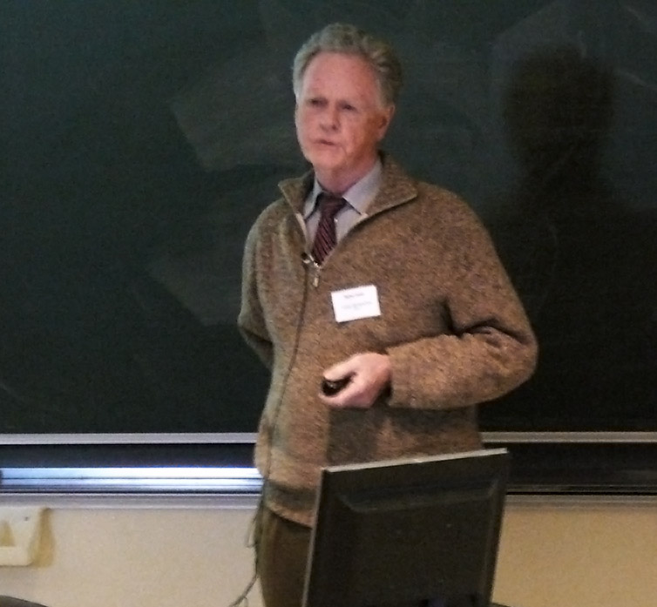
Project
Dempster-Shafer Theory for Classification
By : Hamza Chokri

Slide 2

Outline :
⚫Introduction about the theories of uncertainty
⚫Dempster-Shafer (DS) theory
⚫Dempster-Shafer Theory for Classification
⚫Conclusion
Notes:
Notre plan sera repartir comme suit : commançant par

Slide 3
Introduction about the theories of uncertainty .
Dempster-Shafer theory
Fuzzy Sets
Rough Sets
Imprecise probability
Probability theory
Possibility Theory
Theories of uncertainty

Slide 4
Dempster-Shafer (DS) theory
“ Called also evidence theory, theory of belief functions ” .
A formal framework for reasoning with partial (uncertain, imprecise) information.
Has been applied to :
Expert Systems
Information Fusion
Statistical Inference
Classification
Clustering
Etc

Slide 5
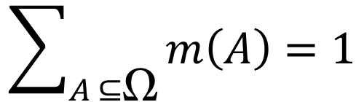

Mass function
Let be a finite set called a frame of discernment.
A mass function m, called a basic belief assignment (BBA) in Ω is defined as :
m :
$$2^{\text{Ω} }$$
[ 0 , 1 ]
With :
$$\sum_{A ⊆\text{Ω}}{m\left(A\right)=1}$$
The subsets A of such that m(A) ≠ 0 are called the focal sets of $\text{Ω}$ .
If m(∅) = 0, m is said to be normalized (usually assumed) .

Slide 6
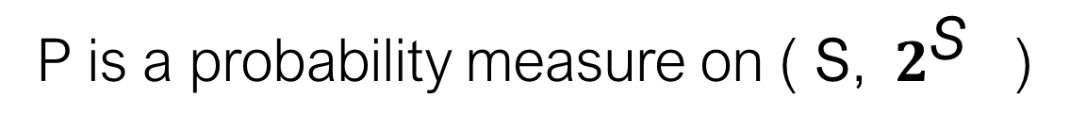
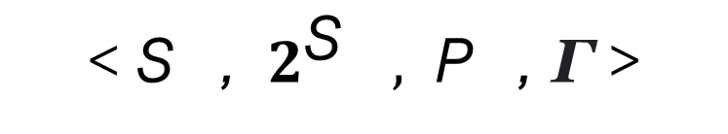
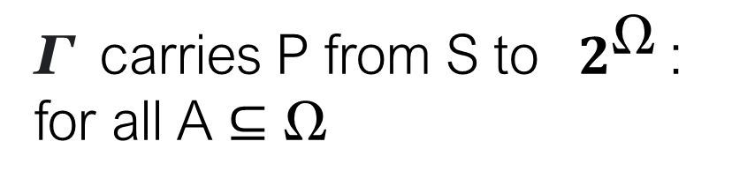
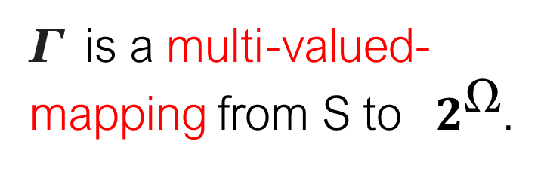
Mass function
A mass function induced by a source was defined by four-tuple .
< S ,${ 2}^{\text{S} },$ P , Γ >
Γ is a multi-valued-mapping from S to ${ 2}^{\text{Ω}}$.
S is a finite set (set of interpretations of an evidence )
Parts of S
P is a probability measure on ( S,${ 2}^{\text{S} }$)
Γ carries P from S to ${ 2}^{\text{Ω}}$: for all A $⊆\text{Ω}$
m(A) = P({s ∈ S | Γ(s) = A })

Slide 7
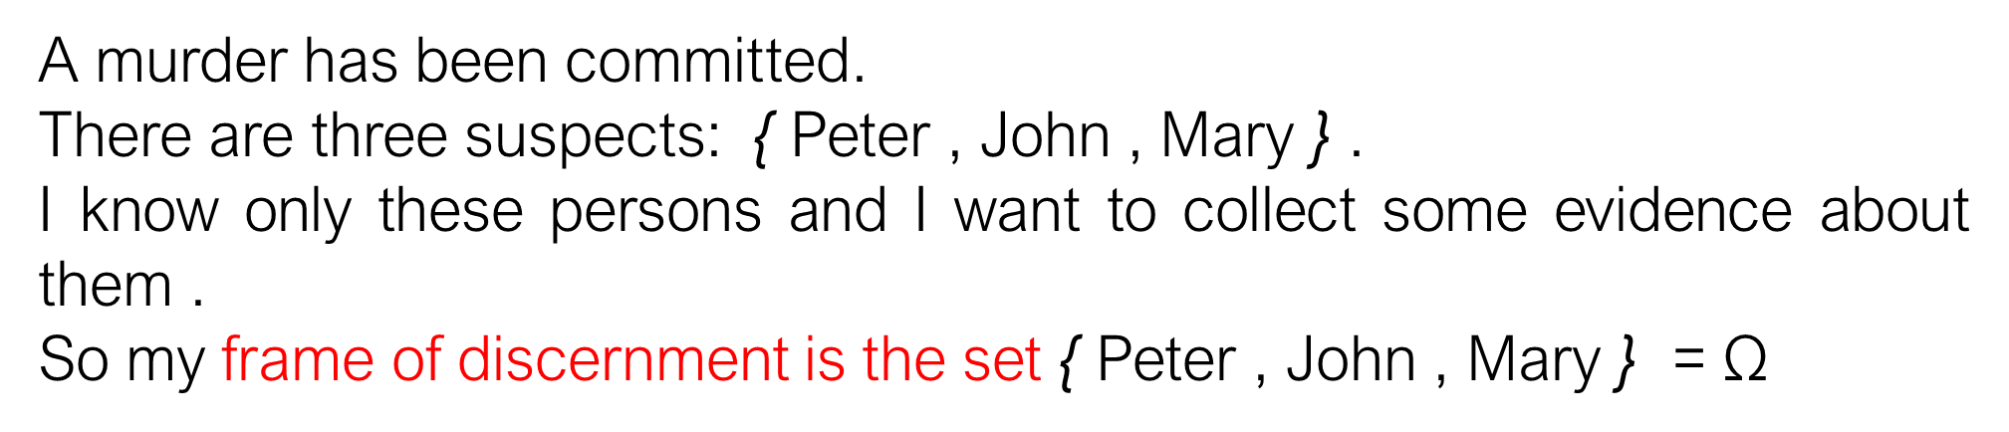
Example
A murder has been committed.
There are three suspects: { Peter , John , Mary } .
I know only these persons and I want to collect some evidence about them .
So my frame of discernment is the set { Peter , John , Mary } = $\text{Ω}$
A witness saw the murderer going away, but he is short-sighted
and he only saw that it was a man. We know that the witness is
drunk 20 % of the time
Evidence

Slide 8


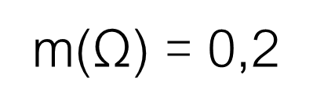
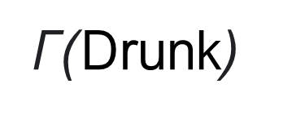
m(Drunk) + m(Not Drunk ) = 1
$$S$$
set of interpretations
Not Drunk
Drunk
P(Not Drunk) = 0.8
P(Drunk) = 0.2
Γ(Not Drunk)
Γ($\text{Drunk}$)
m({Peter; John}) = 0,8
m($\text{Ω}$) = 0,2
Peter
Mary
$$\text{Ω}$$
John
frame of discernment

Slide 9
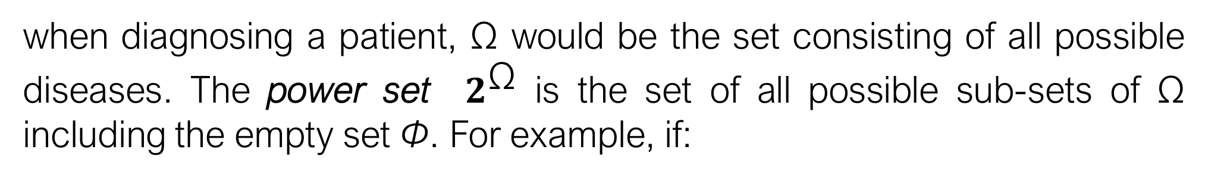


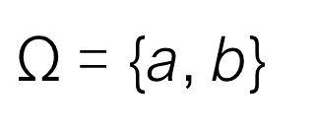
Example 2
The D-S theory begins by assuming a frame of discernment ($\text{Ω}$)
when diagnosing a patient, $\text{Ω}$ would be the set consisting of all possible diseases. The power set ${ 2}^{\text{Ω}}$ is the set of all possible sub-sets of $\text{Ω}$ including the empty set Φ. For example, if:
$\text{Ω}$= {a, b}
Then ${ 2}^{\text{Ω}}$ = { Φ ,{ a },{ b }, $\text{Ω}$}
The proposition “the disease is infectious”
Gives rise to the set of elements of $\text{Ω}$ that are infectious and contains all and only the states in which that proposition is true.

Slide 10

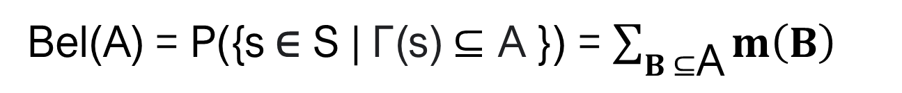
Belief function
Belief functions denoted by bel :
For any $A ⊆\text{Ω}$ , it represents the probability that the evidence supports the interpretation µ ∈ A
Bel(A) = P({s ∈ S | Γ(s) $⊆$ A }) = $\sum_{B ⊆\text{A}}{m\left(B\right)}$
Plausibility functions denoted by Pl:
The probability that the evidence is consistent with (does not contradict) the interpretation µ ∈ A
Pl(A) = P({s ∈ S | Γ(s)∩A ≠ ∅ }) =1- Bel(-A)

Slide 11
The uncertainty interval for a given hypothesis
For the subset A, pl(A) and bel(A) represent upper and lower bounds of the probability interval respectively .
The interval [bel(A), pl(A)] represents the probability range or uncertainty.
Note that it is always true that: m(A) ≤ bel(A) ≤ pl(A).

Slide 12



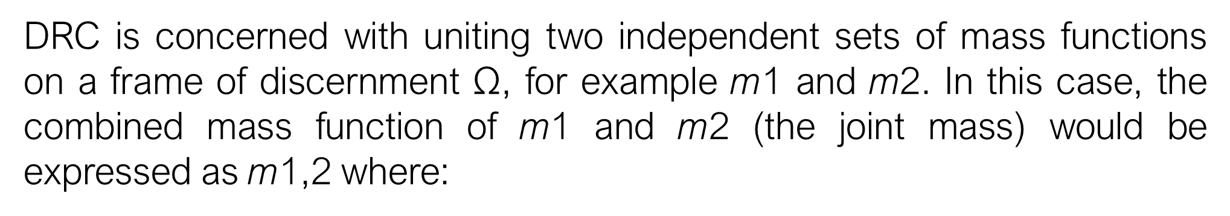
Dempster’s rule of combination (DRC)
DRC is concerned with uniting two independent sets of mass functions on a frame of discernment $\text{Ω}$, for example m1 and m2. In this case, the combined mass function of m1 and m2 (the joint mass) would be expressed as m1,2 where:
And
Where k , a measure of the conflict between the two mass sets , to given by :

Slide 13

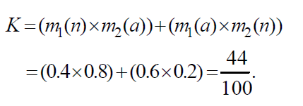

Example DRC calculation
suppose the mass values in the set M1 are m1(n) = 0.4, and m1(a) = 0.6, and the mass values in the set M2 are m2(n) = 0.2, and m2(a) = 0.8, where n represents the hypothesis normal and a represents the hypothesis abnormal.
K is calculated by multiplying those masses for which the intersect is the empty set, and summing the results:

Slide 14

PROs and CONs of D.S
No fixed rules regarding how the mass functions should be constructed
How the data combination should be organized
One can build mass functions that are as simple or as complex as desired
DRC can be applied many times using different strategies
Notes:
This is a distinct advantage in that it allows the creation of systems tailored towards a given problem domain, but it may be argued that it is also a disadvantage, since it does not permit the generalization of results to all domains.

Slide 15
PROs
A definite advantage of D-S is that no a priori knowledge is required, making it potentially suitable for classifying previously unseen information.
CONs
There are two major problems associated with D-S, namely:
• The computational complexity problem .
• The conflicting beliefs management problem .

Slide 16
Why selecting the Dempster-Shafer Theory ?
⚫ The relatively high degree of theoretical development among the non traditional theories for characterizing uncertainty.
⚫The relation of Dempster-Shafer theory to traditional probability theory and set theory.
⚫The large number of examples of applications of Dempster-Shafer theory in engineering in the past.
⚫The versatility of the Dempster-Shafer theory to represent and combine different types of evidence obtained from multiple sources.

Slide 17

Dempster-Shafer Theory for Classification using Python
⚫Machine Learning is dominated by Automated Neural Network which require a large training data set of labelled data to learn a classification model.
⚫When only a small data set is available, the decision tree and its variant random forests dominated the classification.
⚫With Dempster-Shafer Theory we could classify a small data set, where classification is operated on the principle of combining pieces of evidence.
Tools and Environment : python , pyds Module

Slide 18
pyds Module
(Qi Chena, Amanda Whitbrooka, Uwe Aickelina and Chris Roadknight )
pyds is a Python library for performing calculations in the Dempster-Shafer theory of evidence. This is the best and most comprehensive in the following aspects .
⚫Support for normalized as well as unnormalized belief functions
⚫Different Monte-Carlo algorithms for combining belief functions
⚫Measures of uncertainty
⚫Methods for constructing belief functions from data

Slide 19
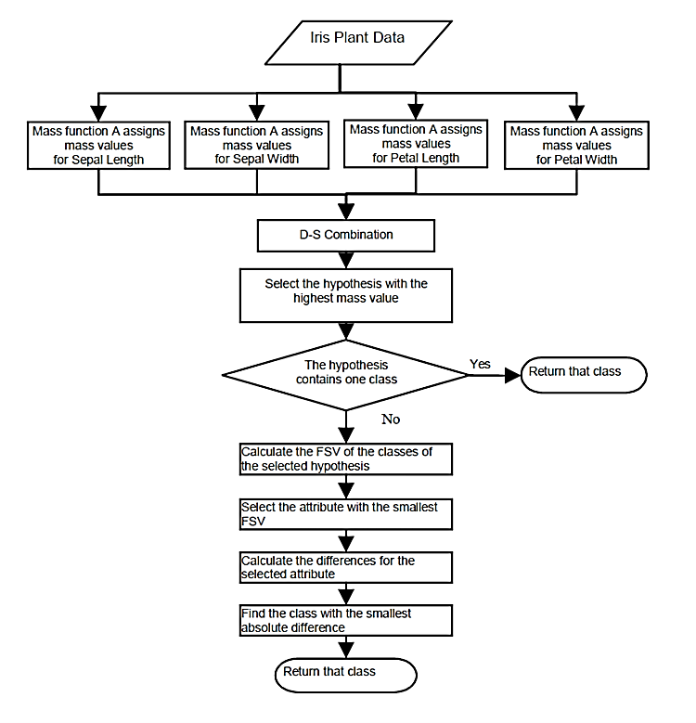
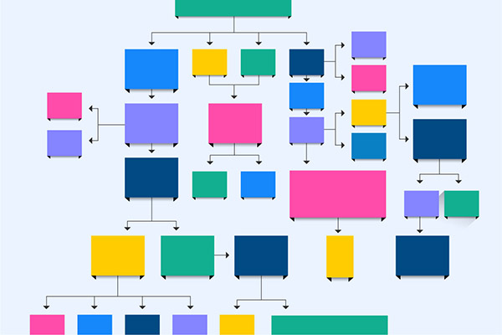
System flowchart for classification

Slide 20

https://github.com/chokrihamza/Project-Dempster-Shafer-Theory-for-Classification/blob/master/Dempster-Shafer%20Theory%20%2C%20classification.ipynb
20/22

Slide 21
Conclusion
The designs of classification system are very data dependent
it is not possible to make generalized statements about D-S as a single, rigid, classifier
This may be considered a disadvantage in that there
are no strict guidelines for the detailed design of such systems .

Slide 22
Thank You

