Slide 1


SPOTIFY WRAPPED ANALYSIS
Independent Study (Jan–May 2025)
Jeet Choksi
Advisor: Professor Abel Iyasele
05/05/2025

Slide 2
OVERVIEW
Introduction & Objectives
RAG Chatbot & API
Data Acquisition
Dashboard
Data Engineering Pipeline
Evaluation & Results
Modeling
Challenges & Mitigations
Deployment & CI/CD
Future Work and Conclusion

Slide 3
INTRODUCTION
Motivation: Personal deep‑dive into my own listening habits
Gaps addressed:
Combine audio, lyrical topics, and metadata
Provide an interactive dashboard + RAG‑powered chat
Objectives:
Ingest & preprocess Spotify data
Engineer features (audio + lyrics)
Train genre classifier & popularity regressor
Forecast weekly play counts
Build RAG index + API
Deploy Streamlit dashboard

Slide 4
DATA ACQUISITON
Spotify Web API:
Top 50 tracks (6 mo), 50 recently played, ~1 000 “Liked Songs”
User profile & playlists metadata
External:
Million Song Dataset (genres_v2.csv)
Kaggle lyrics+K‑means topics
Key points:
OAuth + rate‑limit backoff for reliable ingestion
Raw JSON persisted once for reproducibility

Slide 5
DATA ENGINEERING PIPELINE
Stages:
Clean audio features (21 cols → 21 clean)
Merge lyrics topics with track metadata
Audio feature engineering (25 new, 18 normalized)
Lyrical feature engineering (44 total cols)
Utilities:
get_project_root() bootstrap in scripts & notebooks
Robust logging of row counts & timings

Slide 6
FEATURE ENGINEERING & MODELING
Genre Classifier:
RandomForest with grid search (n_estimators: 50–200, max_depth: 5–15)
Test accuracy ~65 %
Popularity Predictor:
RF regressor, RMSE ≈ 14.8, R² ≈ 0.56
SHAP analysis: “artist_hotness” top feature, then danceability, energy

Slide 7
TIME‑SERIES FORECAST & RAG CHATBOT
ARIMA Forecast:
Weekly aggregated plays (only 3 data points)
ARIMA(1,1,1) fitted, 4‑week forecast unstable
RAG Chatbot:
Indexed audio+lyrics docs (50 recent plays)
Sentence‑Transformer → Chroma DB
API endpoint via FastAPI (≤ 1 s latency on CPU)

Slide 8
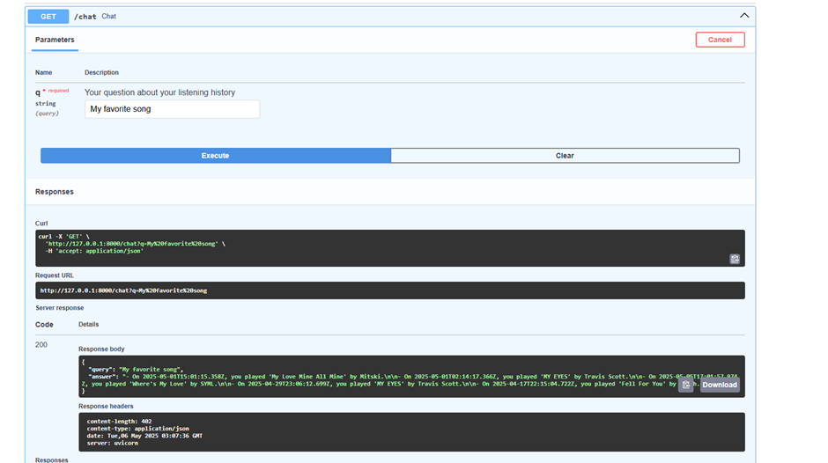

Slide 9
STREAMLIT DASHBOARD
Key metrics: total plays, unique artists, avg danceability
Visualizations:
Histogram (danceability)
Weekly play counts (time series)
Top genres (bar)
Design choices: easy filtering by date, modular Plotly functions

Slide 10
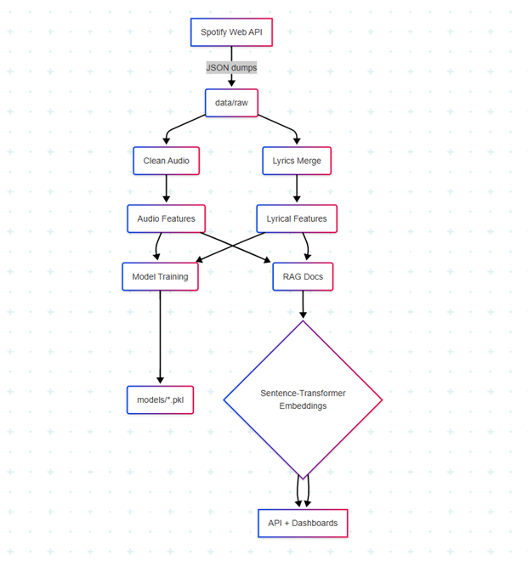
ARCHITECTURE DIAGRAM
Data flow:
A: Spotify API → raw JSON
B–D: Cleaning & feature pipelines
E–F: Model training & RAG indexing
G: Models & embeddings → API & dashboard
Highlights:
Multi‑stage Docker builds
Separation of concerns (ML vs. API vs. UI)

Slide 11
EVALUATION & RESULTS
Genre classifier:
High precision (> 0.8) on EDM sub‑genres (dnb, techno)
Confusion in rap sub‑labels
Popularity model: R² ≈ 0.56 → audio+lyrics moderately predictive
Forecast: insufficient history → consider Prophet & exogenous features
RAG Chatbot: < 1 s answers on CPU

Slide 12
DEPLOYMENT & CI/CD
Dockerized services:
Dockerfile.api, .ml, .dash + docker‑compose.yml
Git history cleanup: moved model .pkl → Git LFS, purged > 100 MB blobs
CI pipeline: GitHub Actions lint & smoke‑test on push
Env management: .env.example documents required vars

Slide 13
CHALLENGES & MITIGATIONS
Large model artifacts → Git LFS + git filter‑repo
LangChain breaking changes → pinned langchain==0.3.24, added langchain‑community
Sparse time‑series points → acknowledged limitation; future switch to Prophet
Notebook import errors → get_project_root() helper
Heavy Docker images → multi‑stage builds, .dockerignore

Slide 14
FUTURE WORK
Model improvements: oversample minority genres, tune class weights
Forecasting: migrate to Prophet, include listener behavior regressors
Dashboard extensions:
Tempo distribution by hour
Personalized recommendations widget
Productization: integrate service into Slack/Discord bot

Slide 15
CONCLUSION
Built end‑to‑end pipeline uniting audio, lyrics, and metadata
Delivered genre & popularity models, time‑series forecast, RAG chatbot, dashboard
Deployed with Docker & CI, documented for reproducibility
Pipeline is extensible for future enhancements

Slide 16
ACKNOWLEDGEMENTS
Advisor: Professor Abel Iyasele
Libraries: Spotipy, pandas, scikit‑learn, statsmodels, LangChain, Chroma, Streamlit
Data: Spotify Web API, Million Song, Kaggle corpora

Slide 17
Thank You

