Slide 1


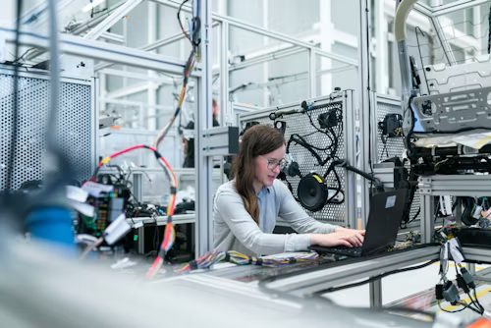
CLINICAL NATURAL LANGUAGE TECHNOLOGY FOR HEALTHCARE: PAST, PRESENT, & FUTURE APPROACHES
Overview and Proof of Concept

Slide 2
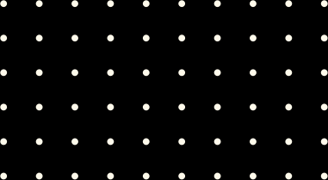
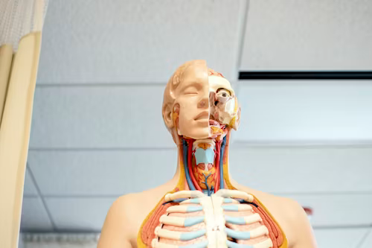
Welcome to my presentation on leveraging advanced technologies for healthcare analysis. This project integrates Optical Character Recognition (OCR), Natural Language Processing (NLP), and deep learning-based image classification to enhance the extraction and analysis of medical documents and images, providing valuable insights and improving healthcare delivery.

Slide 3
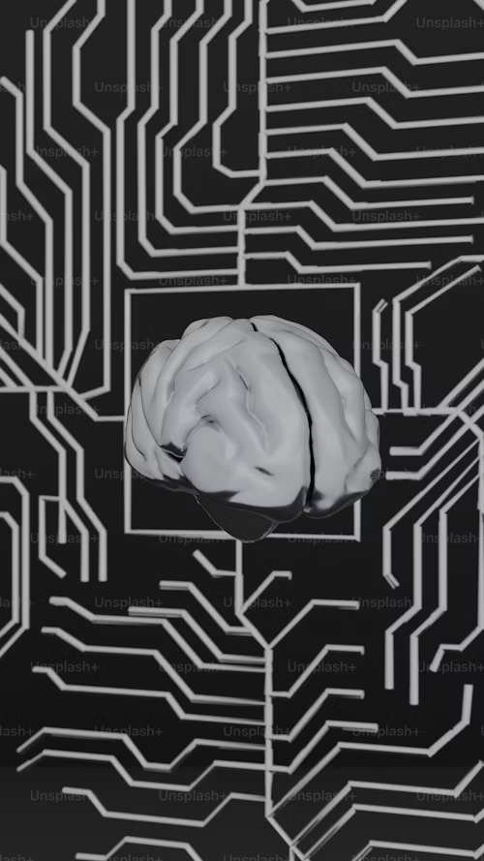


Introducction
Clinical NLP
The use of Natural Language Processing (NLP) specifically in the healthcare sector to analyze and interpret unstructured medical text data.
Relevance
In modern healthcare, technologies like NLP, Optical Character Recognition (OCR), and Computer Vision are crucial for automating data extraction from medical documents and images, enabling faster and more accurate diagnoses, and improving patient care.

Slide 4




Overview of Clinical NLP
01
Clinical NLP involves the application of NLP techniques to healthcare data, including patient records, clinical notes, and medical literature.
02
Natural Language Processing (NLP): Analyzes and interprets human language.
What is Clinical NLP?
Optical Character Recognition (OCR): Converts different types of documents, such as scanned paper documents or PDFs, into editable and searchable data.
03
04
Computer Vision: Enables machines to interpret and make decisions based on visual inputs, like medical images.
These technologies are used for tasks such as extracting patient information from documents, summarizing clinical notes, and classifying medical images.
05

Slide 5
Historical Context: past approaches
Evolution of Clinical NLP
Challenges
Advancements
Initially relied on rule-based systems, where predefined rules were used to extract information from text.
Early methods struggled with limited accuracy, high dependency on domain expertise, and difficulties in processing large volumes of unstructured data.
Over time, there has been a shift towards more sophisticated approaches, incorporating statistical models and machine learning techniques.

Slide 6

CURRENT TRENDS: present approaches
Deep Learning: Leverages large datasets and neural networks for better accuracy in NLP tasks.
Large Language Models (LLMs): Such as GPT and BERT, which can understand and generate human-like text.
Large Multimodal Models (LMMs): Integrate both text and image data for more comprehensive analysis.
Integration of NLP, OCR, and Computer Vision: Combines textual and visual data processing, enabling more powerful and versatile healthcare applications.
Examples:
Automatic Summarization: Generates summaries of clinical notes.
Entity Recognition: Identifies key medical terms and entities in text.
Image Classification: Assists in diagnosing diseases through medical imaging.

Slide 7
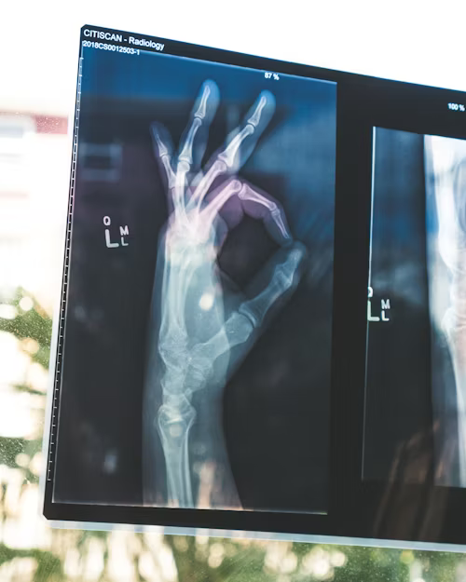
FUTURE DIRECTIONS
Future Opportunities and Trends
Enhanced Data Handling: Better techniques for processing diverse and complex healthcare data.
Real-Time Analysis: Instant processing and analysis of patient data during consultations.
Data Privacy Concerns: Ensuring patient data is securely handled.
Ethical Considerations: Balancing the benefits of AI-driven healthcare with the need to protect patient rights.
Predictions: Expect further advancements in the ability to handle unstructured and multilingual data, as well as the integration of real-time analytics in healthcare systems.

Slide 8
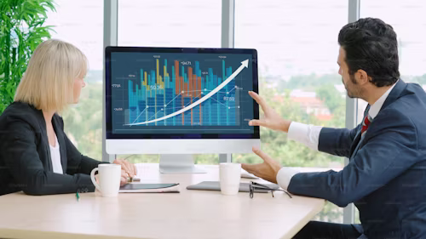
STRATEGIC RECOMMENDATIONS
Investment in Technology: Cotiviti should consider investing in the development of NLP, OCR, and Computer Vision technologies to enhance their healthcare analytics solutions.
Data Analysis Tools: Improve existing tools with advanced AI capabilities.
AI-Driven Solutions: Develop new healthcare solutions powered by machine learning to provide more accurate and efficient patient care.
Competitive Edge: These investments can position Cotiviti as a leader in healthcare technology.

Slide 9
PROOF OF CONCEPT:
POC Description: The POC demonstrates how NLP, OCR, and Computer Vision can be integrated into a single system for analyzing medical documents and images.
Technologies Used:
Flask: Web framework for deploying the application.
Pytesseract: OCR tool for extracting text from images.
Spacy: NLP library for processing and analyzing text.
ResNet (torchvision): Deep learning model for image classification.
Transformers: Advanced NLP models for tasks like summarization and entity recognition.
Key Functionalities:
Text Extraction: OCR processes images and extracts text.
Text Analysis: NLP analyzes the extracted text for key medical entities and summaries.
Image Classification: Computer Vision classifies medical images, assisting in diagnostics.

Slide 10
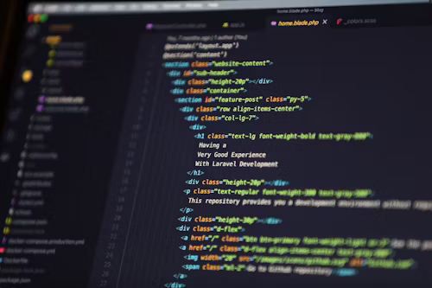
POC ARCHITECTURE:
The architecture includes modules for OCR, NLP, and Computer Vision, each interacting to process and analyze input data. The OCR module extracts text from medical documents, which is then analyzed by the NLP module for entity recognition and summarization. The Computer Vision module classifies any accompanying medical images.

Slide 11
POC Demonstration:
Upload: A medical document or image is uploaded to the system.
OCR: The document undergoes OCR to extract text.
NLP: The extracted text is processed using NLP techniques for entity recognition and summarization.
Image Classification: If an image is uploaded, it is classified using the Computer Vision model.

Slide 12
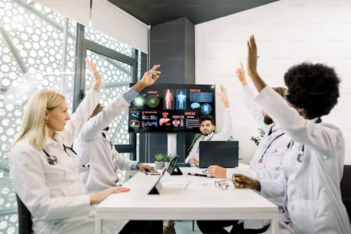
CONCLUSION
Summary: Clinical NLP, OCR, and Computer Vision are transforming healthcare by enabling the efficient analysis of medical documents and images. The POC illustrates the potential of integrating these technologies.
Importance of Investment: Reiterate the need for continued investment in these areas to stay ahead in the healthcare technology field.
Future of Healthcare: Clinical NLP and related technologies will play a crucial role in the future of healthcare, improving patient outcomes and operational efficiency.

