Slide 1

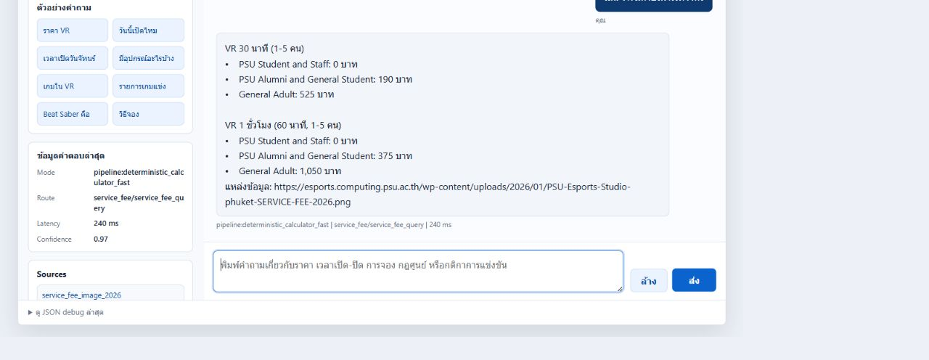
นายภาสวุฒิ ชูติประชากิจ | PSU Esports Studio - Phuket | Trainee ID 600584
AI Chatbot for Multi-Route Hybrid
Esports Knowledge Base
LOCAL-FIRST WEBSITE CHATBOT
A local-first FAQ assistant combining exact routing, semantic retrieval and gated generation
42 games | Website | Local AI | Max 2 LLM calls | Target <= 10s
CHALLENGE & OBJECTIVE
LIVE DEMO
QUESTION
CHALLENGE
เล่น VR มีค่าบริการเท่าไหร่
PSU Esports information spans fixed facts, rules and long documents. A purely rule-based bot is fast but difficult to extend, while a fully generative bot adds latency and hallucination risk.
ROUTE
OBJECTIVE
Deterministic calculator
service_fee_query
Answer the exact question with verified evidence, support newly added knowledge and clarify ambiguity without guessing.
TRACE
EXACT FACTS
Fast + Structured
240 ms latency
0.97 confidence
Verified source attached
NEW CONTENT
BGE-M3 Semantic RAG
Real output from the local website and API; no LLM call was required.
COMPLEX TASKS
Gated Typhoon Assist
SYSTEM OVERVIEW
WEB CHAT
UNDERSTAND
SELECT ROUTE
EXECUTE
EVIDENCE
TYPHOON
FINAL CHECK
Request ID
Admission control
Session context
→
Resolve references
Intent + target
Ambiguity check
→
Candidate score
Tool conditions
Evidence check
→
Fast / Structured
BGE-M3 RAG
Safe Outcome
→
Attach sources
Build factual draft
No new claims
→
Review or plan
Compose if useful
Otherwise bypass
→
Answer Contract
Bounded repair
Hard Veto
FAST + STRUCTURED
BGE-M3 SEMANTIC RAG
SAFE OUTCOME
Exact games, prices, zones and opening hours. No LLM queue.
Rules, documents, news and newly added knowledge.
Clarification or no-answer when evidence is insufficient.
METHODOLOGY
DETERMINISTIC BACKBONE
SEMANTIC RETRIEVAL
GATED LOCAL LLM
ANSWER SAFETY
FAST + STRUCTURED
BGE-M3
TYPHOON2.5 QWEN3 4B
GUARDS + CONTRACT
Aliases, rules and structured tools return exact operational facts and deterministic calculations.
Embeds long or newly added content, retrieves relevant evidence and optionally reranks candidates.
Reviews intent, plans dependent questions and composes from verified evidence only.
Boundary, Ambiguity and Source checks precede Answer Contract, bounded repair and Final Hard Veto.
Intent
Exact record
Draft
Query
BGE-M3
Evidence
Evidence
Typhoon
Draft
Check
Repair
Veto
0 LLM CALLS | NO QUEUE
EMBEDDING | OPTIONAL RERANK
MAX 2 CALLS | CONCURRENCY 1
CLARIFY OR NO-ANSWER
SHARED CONTROLS Global deadline | Session context | Source trace | Max 2 LLM calls | Final answer in Thai
RESULTS
CONCLUSION
PRODUCT STATUS
1,600+
94.75%
SPEED
Exact facts bypass the LLM queue.
FAQ CHATBOT
READY
EVALUATION CASES
PASS RATE
COVERAGE
BGE-M3 handles long and new content.
CHECK SLOT
WAITING API
2.31 s
12.53 s
CONTROL
Typhoon composes from evidence only.
ADMIN INPUT
DESIGNED
AVERAGE LATENCY
P95 LATENCY
MAIN PRODUCTION RISK
BOOKING
FUTURE
LATENCY AGAINST 15-SECOND SCALE
Tail latency and concurrent-user queueing.
Average
2.31s
FUTURE WORK
SOURCES
Target
10.00s
P95 below 10s | Multi-user load test
Shared LLM queue | WordPress Slot API
Dual-publish content workflow
PSU Esports Studio website
Typhoon2.5-Qwen3-4B model card
BGE-M3 paper (arXiv:2402.03216)
Project Flow 43 and evaluation logs
P95
12.53s
Average meets the target; P95 remains above 10 seconds.
Notes:
[Sources]
Official A0 background supplied by the user: D:/Download New/SuperAI6_PosterA0-Template_PNG.png
PSU Esports Studio logo supplied by the user: C:/Users/Chokhun/Downloads/Sticker.pdf.png
Visual references supplied by the user: D:/Download New/_Real-Time Conversational AI Pipeline Poster.pdf; C:/Users/Chokhun/AppData/Local/Temp/1 (1).png; C:/Users/Chokhun/AppData/Local/Temp/codex-clipboard-87f022f8-ae93-4fb6-ac1a-bdf3e8bf6451.png; C:/Users/Chokhun/AppData/Local/Temp/codex-clipboard-229e80da-b71e-4918-b0e7-6795627ddaae.png; C:/Users/Chokhun/AppData/Local/Temp/codex-clipboard-0328a6ea-5873-4fd6-9dbc-432c04c6616d.png
Live demo screenshot captured from the local PSU Esports website and API on 2026-08-28. Question: เล่น VR มีค่าบริการเท่าไหร่. Route: deterministic calculator. Latency: 240 ms. Confidence: 0.97.
Project architecture and evaluation: Project Flow 43, project docs, and daily logs dated 2026-08-27 to 2026-08-28.
PSU Esports Studio official website: https://esports.phuket.psu.ac.th/
Typhoon model card: https://huggingface.co/typhoon-ai/typhoon2.5-qwen3-4b
BGE-M3 paper: https://arxiv.org/abs/2402.03216

