Slide 1

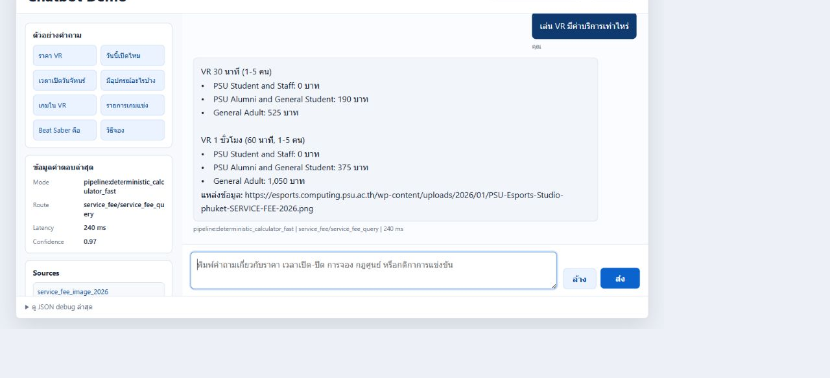
Passawut Chutiparcharkijg | Trainee ID 600584 | PSU Esports Studio - Phuket
AI Chatbot for Multi-Route Hybrid
Esports Knowledge Base
Local-first FAQ assistant with exact routing, semantic retrieval and gated generation
42 games | BGE-M3 | Typhoon2.5 Qwen3 4B | Target <= 10 seconds
Abstract
Project Objective
PSU Esports information includes exact operational facts, rules and long-form documents. A purely rule-based chatbot is fast but difficult to extend, while unrestricted generation increases latency and hallucination risk. This system combines deterministic routes, semantic retrieval and a gated local LLM, then validates every answer before delivery.
Build a local-first website assistant that answers the intended question from verified PSU evidence, supports newly added knowledge and asks for clarification when the target cannot be resolved.
EXACT FACTS NEW CONTENT SAFE OUTCOME
Fast + Structured BGE-M3 RAG Clarify / No-answer
Architecture
Every request follows the same guarded backbone; only the answering path changes.
1
WEB INPUT
2
UNDERSTAND
3
SELECT ROUTE
4
EXECUTE
5
EVIDENCE + LLM
6
FINAL CHECK
Question + session ID
Request guard
9s backend deadline
→
Resolve references
Split questions
Intent + target
Ambiguity check
→
Candidate scoring
Tool preconditions
Source availability
Confidence margin
→
→ Fast / Structured
→ BGE-M3 RAG
→ Safe Outcome
→
Attach sources
Build factual draft
Typhoon assists only
when useful
→
Answer Contract
Bounded Repair
Final Hard Veto
Thai response
FAST FACTS BYPASS THE LLM QUEUE | RAG SUPPLIES EVIDENCE | TYPHOON CANNOT CREATE NEW PSU FACTS
Max 2 LLM calls per request | LLM concurrency 1 | Global request timeout 20s | Product target <= 10s
Methodology
01
DETERMINISTIC BACKBONE
02
SEMANTIC RETRIEVAL
03
GATED LOCAL MODEL
04
ANSWER QUALITY
FAST + STRUCTURED
BGE-M3
TYPHOON2.5 QWEN3 4B
GUARDS + CONTRACT
Aliases, rules and structured tools answer exact questions about games, prices, zones, equipment, opening hours and deterministic fee calculations.
New rules, documents and long-form knowledge are embedded and retrieved by meaning. Relevant candidates can be reranked before use.
The local LLM reviews weak intent, plans dependent questions and composes only from verified evidence. Clear deterministic answers bypass it.
Boundary, Ambiguity and Source checks precede the Answer Contract. Bounded Repair gets one controlled chance before the final veto.
Intent
→
Exact record
→
Draft
Query
→
BGE-M3
→
Evidence
Evidence
→
Typhoon
→
Draft
Check
→
Repair
→
Veto
0 LLM CALLS | NO MODEL QUEUE
EMBEDDING | OPTIONAL RERANK
MAX 2 CALLS | CONCURRENCY 1
CLARIFY OR RETURN NO-ANSWER
Live Website Demo
Results & Conclusion
Demo Link
1,600+
94.75%
EVALUATION CASES
PASS RATE
PLACE QR CODE
HERE
2.31 s
12.53 s
AVERAGE LATENCY
P95 LATENCY
Conclusion
Structured routes deliver exact, fast answers. BGE-M3 expands coverage for new content, while Typhoon remains optional and evidence-constrained. Average latency meets the target, but P95 and concurrent-user queueing remain the main production risks.
Replace this box with the final
Demo or project URL QR code.
Real local response | service_fee_query | 240 ms | confidence 0.97 | verified source
FAQ READY | SLOT API PENDING | ADMIN INPUT DESIGNED | BOOKING FUTURE
NEXT MILESTONES
P95 below 10s → Multi-user load test → Shared LLM queue → WordPress Slot API → Dual-publish content workflow
SOURCES
PSU Esports Studio website | Typhoon2.5-Qwen3-4B model card | BGE-M3 paper (arXiv:2402.03216) | Project Flow 43 and evaluation logs
Exact facts stay deterministic. New knowledge becomes searchable. Generation remains gated by evidence.
Notes:
[Sources]
Official A0 background supplied by the user: D:/Download New/SuperAI6_PosterA0-Template_PNG.png
PSU Esports Studio logo supplied by the user: C:/Users/Chokhun/Downloads/Sticker.pdf.png
Academic poster structure reference supplied by the user: C:/Users/Chokhun/AppData/Local/Temp/codex-clipboard-3fac84c0-ddbe-48cb-a0e1-8e40439c4573.png
Live chatbot screenshot captured from the local PSU Esports website and API on 2026-08-28. Route: service_fee_query. Latency: 240 ms. Confidence: 0.97.
Project architecture and evaluation: Project Flow 43, project docs, and daily logs dated 2026-08-27 to 2026-08-28.
PSU Esports Studio official website: https://esports.phuket.psu.ac.th/
Typhoon model card: https://huggingface.co/typhoon-ai/typhoon2.5-qwen3-4b
BGE-M3 paper: https://arxiv.org/abs/2402.03216

