Slide 1

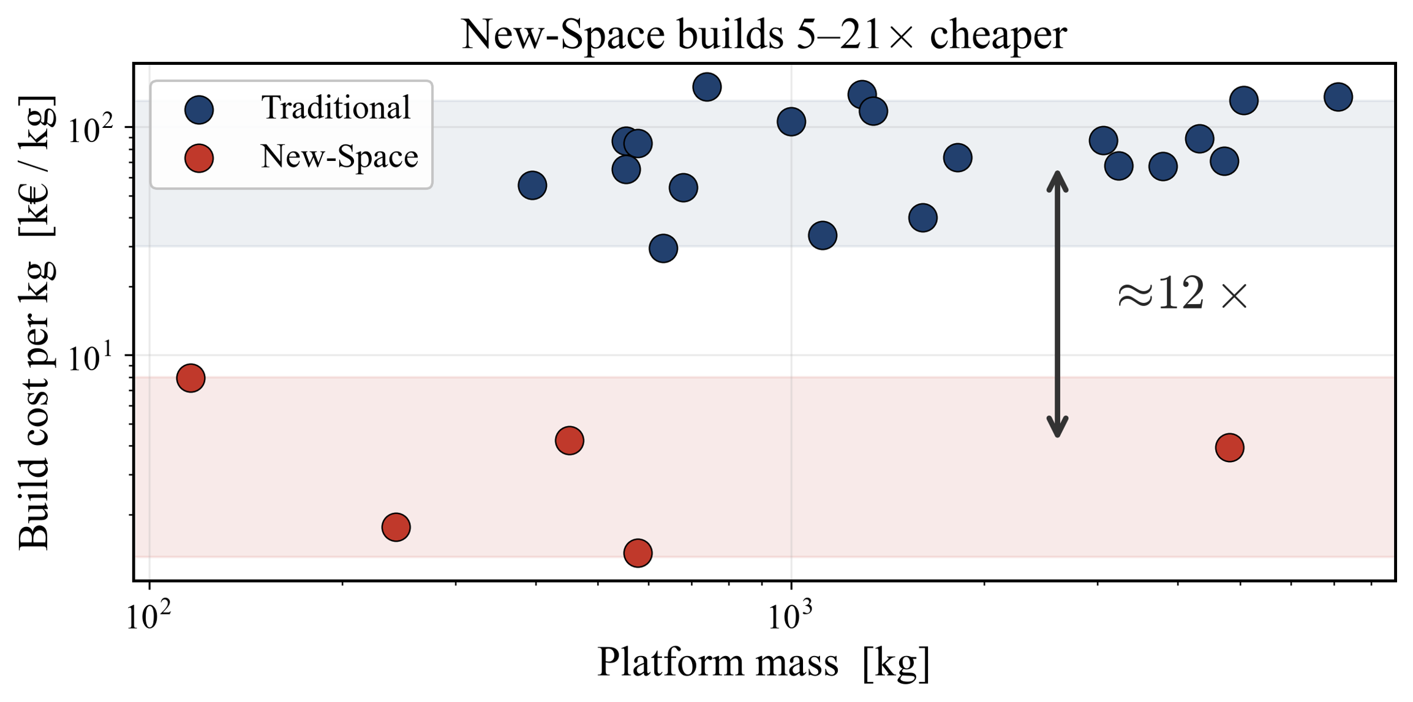
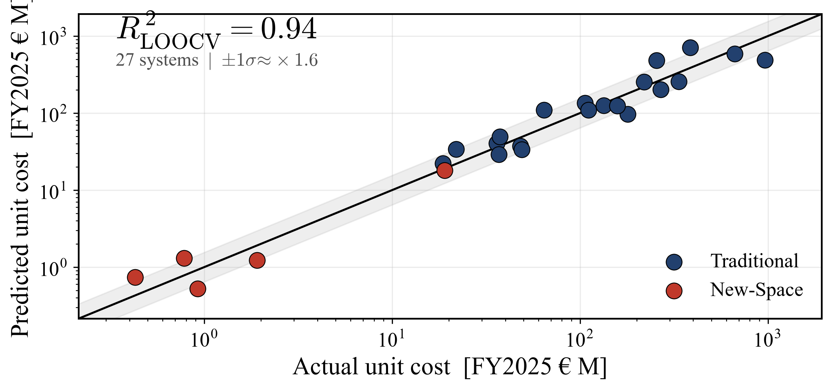
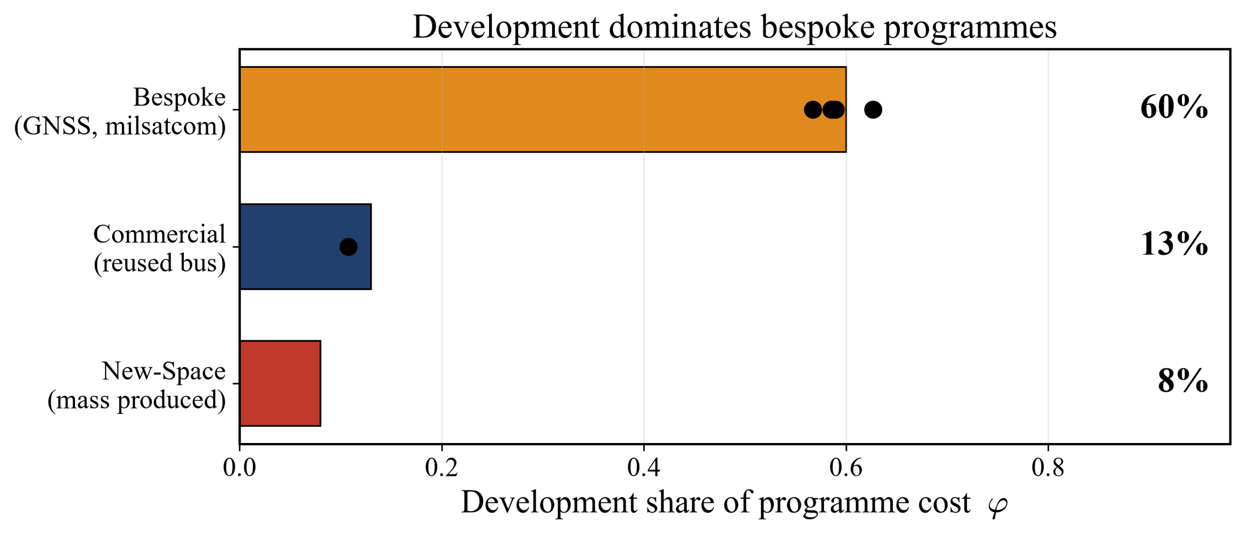
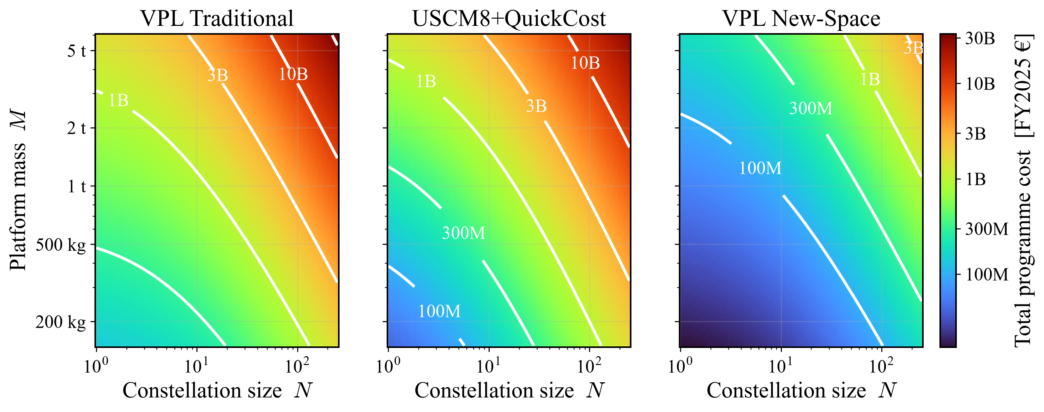



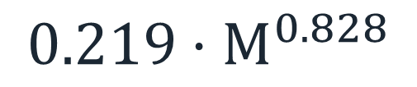


VPL: A Novel Cost Model for Earth and Mars-Orbit Navigation and Communication Constellations
M. Cholevas (TU München) • G. Vardanikas (TU Delft)
ESA/CNES Cost Engineering Conference 2026
The problem
The resolved CER model
Main metrics
Limited public unit-cost data for navigation and communication constellations. Legacy models (SMAD USCM8, QuickCost) rest on data up to the early 2000s. We build a cost model on 25 systems (1997–2025), that also covers New-Space systems.
$$COST(M,N) = F·g·[ DEV(M) + PFM(M)·N^{LRE} ]$$
M = platform mass [kg],
N = units, cost in FY2025 €M.
LRE = 1 + ln(0.9)/ln(2) = 0.848
$g$ = 1 traditional, 0.118 New-Space.
F = 1 Earth, 1.14 Mars.
0.94 cross-validated R²
5–21× New-Space cheaper
≈ USCM8+QuickCost on traditional;
but SMAD over-predicts New-Space ~7×
$$5.99·M^{0.613}$$
$$0.219·M^{0.828}$$
Cost-Plus vs New-Space Economy
Validation
New-Space mass-produced builds are 5–21× cheaper per kg than traditional cost-plus bespoke systems.
Leave-one-out cross-validation over 27 systems. The CER tracks unit cost across three orders of magnitude (R² = 0.92 pooled, 0.81 traditional-only).
Development vs production
Cost vs mass and constellation size
The DEV/PFM split is fixed by disclosed programme budgets (US SARs, ESA, GAO), not by the fit.
Iso-cost contours of TOTAL(M,N). VPL Traditional tracks the SMAD benchmark, with VPL New-Space a full band below.
Planetary cost factor
Operations
A subsystem bottom-up estimate gives a Mars bus-cost increase of 10% ± 4.5%, adopted as F = 1.14 (Earth F = 1). This replaces SMAD/QuickCost's blanket 1.29 planetary factor. Sources: RAND TR-418; Jones (ICES 2015).
Mission operations use the SME-SMAD Table 11-28 model: €159 M for 31 satellites over 5 years. Drivers: flight and ground software maintenance (SLOC), 19 engineers + 4 technicians, facilities and ground-hardware maintenance.
Data and code
Autor Contact
GitHub repository with the dataset, per-number sources, the Python model, the reproduction notebook, this poster and a detailed report.
github.com/cholevasm/vpl-cost-model
Minas Cholevas
Giannis Vardanikas

