Slide 1

Simply online
Simple way to connect

Slide 2
Agenda
1. Introduction
2. Problem Statement
3. Project Diagram
4. Technologies
5. Personas
6. Project Schedule
7. Retrospective
8. Wiki Page

Slide 3

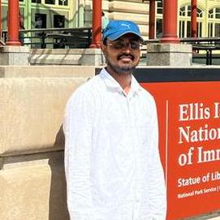
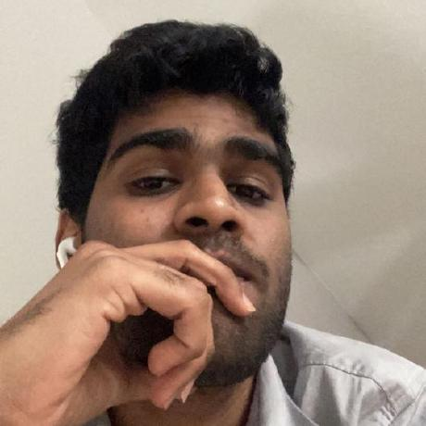

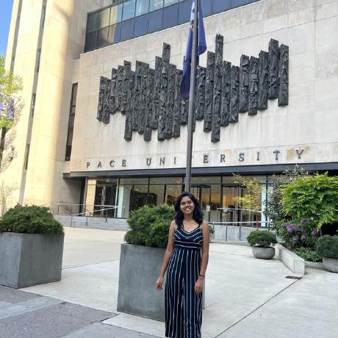
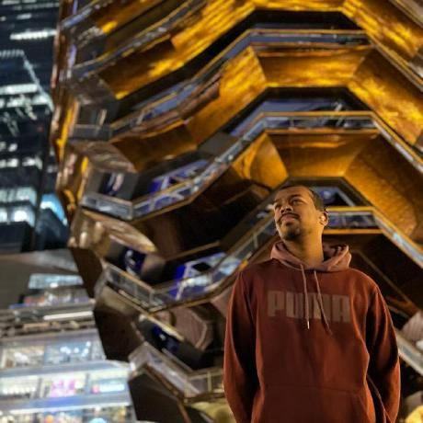
Team members and roles
Ajay Kumar
Full Stack Developer
Amarendra Reddy
Scrum Master/ Developer
Pruthvi Raj Reddy
Database Administrator
Ravi Teja Reddy
Developer
Sreeja Reddy
Quality Analyst
Mounik
Developer

Slide 4
Introduction
Simply Online is a web application that allows lecturers to create virtual rooms and conduct online classes. In addition, Simply Online offers a hassle-free attendance management system, where attendance will be marked by using facial recognition technology, eliminating the need for manual tracking.

Slide 5
Problem Statement
Online attendance marking systems have a vulnerability wherein students can mark attendance without attending the class, leading to inaccuracies and affecting the credibility of attendance records.
The Process of taking online attendance consumes a significant amount of time. This can result in delays in starting the class, wasting valuable teaching time.

Slide 6
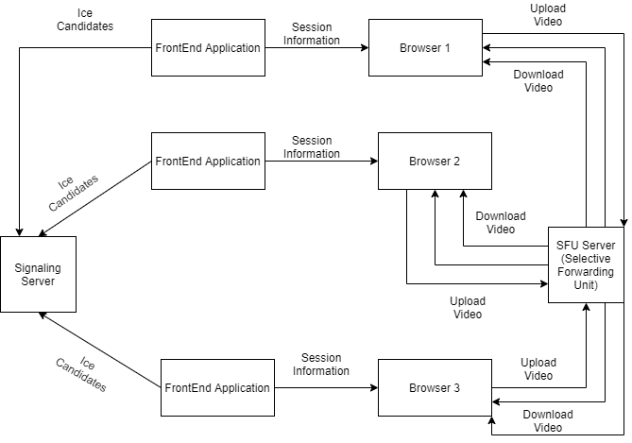
Project design

Slide 7






Technologies

Slide 8
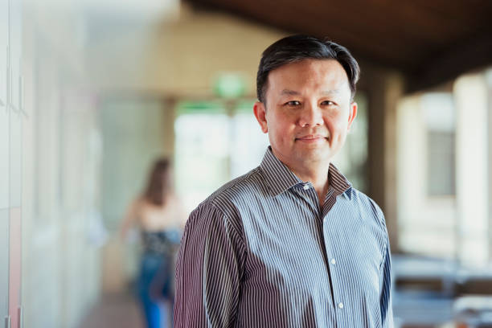
Persona
Profile:
James is a tenured professor in the Computer Science department at a large university. He teaches both undergraduate and graduate-level courses and conducts research in his field. Due to the COVID-19 pandemic, his classes have been moved online, and he uses various platforms to deliver lectures, holds office hours, and communicate with his students. He lives with his spouse and two children, who are also attending school virtually.
Name: Professor James
Age: 45
Occupation: University Professor
Goals and Motivations:
Deliver high-quality lectures and course material to his students Engage his students and create a dynamic and interactive virtual classroom environment.
Ensure that his students are keeping up with the coursework and meeting their learning objectives.
Provide effective feedback and support to his students.

Slide 9

Persona
Profile:
Sarah is a full-time student pursuing a degree in psychology. Due to the COVID-19 pandemic, her classes have been moved online, and she uses Zoom to attend lectures, participate in group discussions, and communicate with her professors and classmates.
She lives in a small apartment with roommates and shares a room with one of them.
She has a busy schedule and often has to balance her coursework with a part-time job and other responsibilities.
Name: Sarah
Age: 24
Occupation: College student
Goals and Motivations:
Attend all her classes and be an active participant in class discussions Stay organized and manage her time effectively to meet assignment deadlines.
Have a reliable and user-friendly platform for attending virtual classes Connect with her professors and classmates, and build a community within her course Challenges:

Slide 10
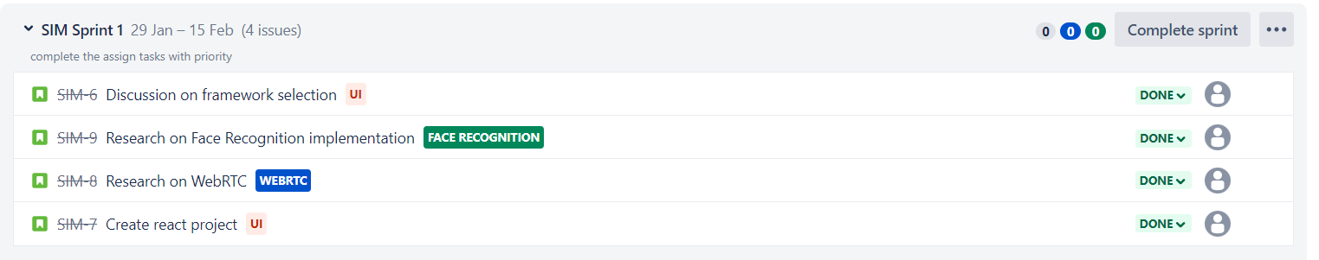
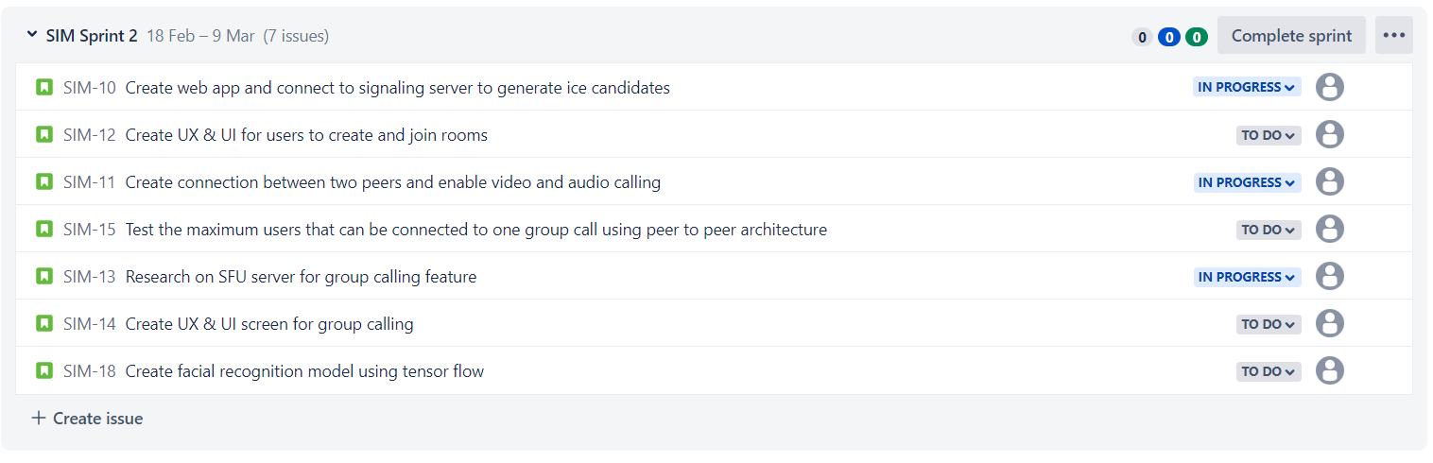
Project Schedule

Slide 11
Team working Agreement:
Participation:
All the team members are expected to involve in project discussions and attend the meetings promptly. Absence during multiple meetings will affect the team’s performance and efficiency.
The team member can discuss beforehand with the team leader if he/she is going to miss the meeting or make it up for it before the next meeting is scheduled.
Communication:
The team will communicate with each other using WhatsApp group and meetings will be scheduled on Zoom.
Jira software will be used to track the assigned tasks. For any dependency on another task, mention it in the task comments.
Task management, bugs, sprint planning, and meeting minutes will be tracked in Jira.
To share the final deliverables, Google docs will be used where all the team members can edit the document.
Work Division:
The entire project work should be divided into equal parts, and equal responsibilities should be given to all the team members.
Each team member should complete their division of work before the deadline. If they are unable to complete the work on time, that hinders the performance of the entire team. If in case a team member is facing trouble and issues at some point, they can share it with others so that they can help each other and complete the work before the deadline.
Meetings:
All the team members will meet on zoom virtually every Tuesday and Friday. All the team members must be present, as attendance is mandatory unless there is an exceptional case.
The team leader would be responsible for sending meeting details and conducting the meeting.
A meeting track or meeting minutes report would be listed after every meeting to keep track of the project and its progress.
Every team member is expected to come up with ideas, participate in the discussion, and give an update on their progress for their part of the work.
Signed by Team

Slide 12
Retrospective
What went well
The project has been finalized and completed research on the architecture and implementation of the project.
The team has done research on different aspects of the project and came to conclusion on what tech stack to use.

Slide 13
What Should be Improved
Lack of Communication: Should have communicated early with the lecturer regarding the complexity of the project and should have selected the project early. Due to misunderstandings between team members project selection took time.
Poor Planning: Should have planned well before the sprint and submitted the deliverables on time.

Slide 14
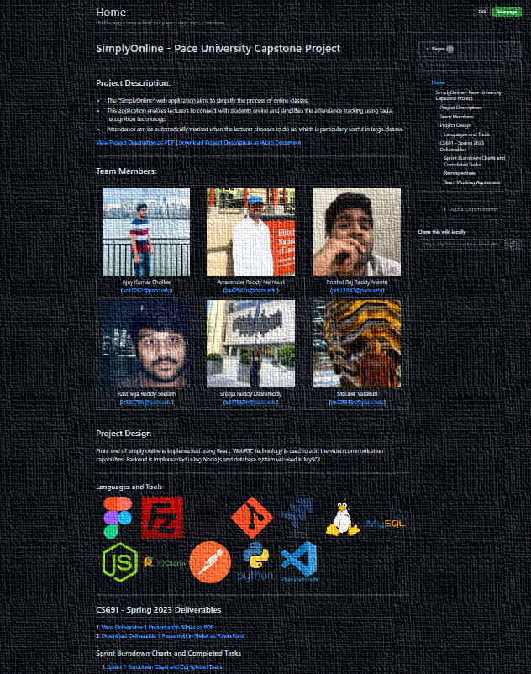
WIKI PAGE
https://github.com/htmw/SimplyOnline/wiki

Slide 15

Thank you

