Slide 1

Retrospective
Sprint-1

Slide 2
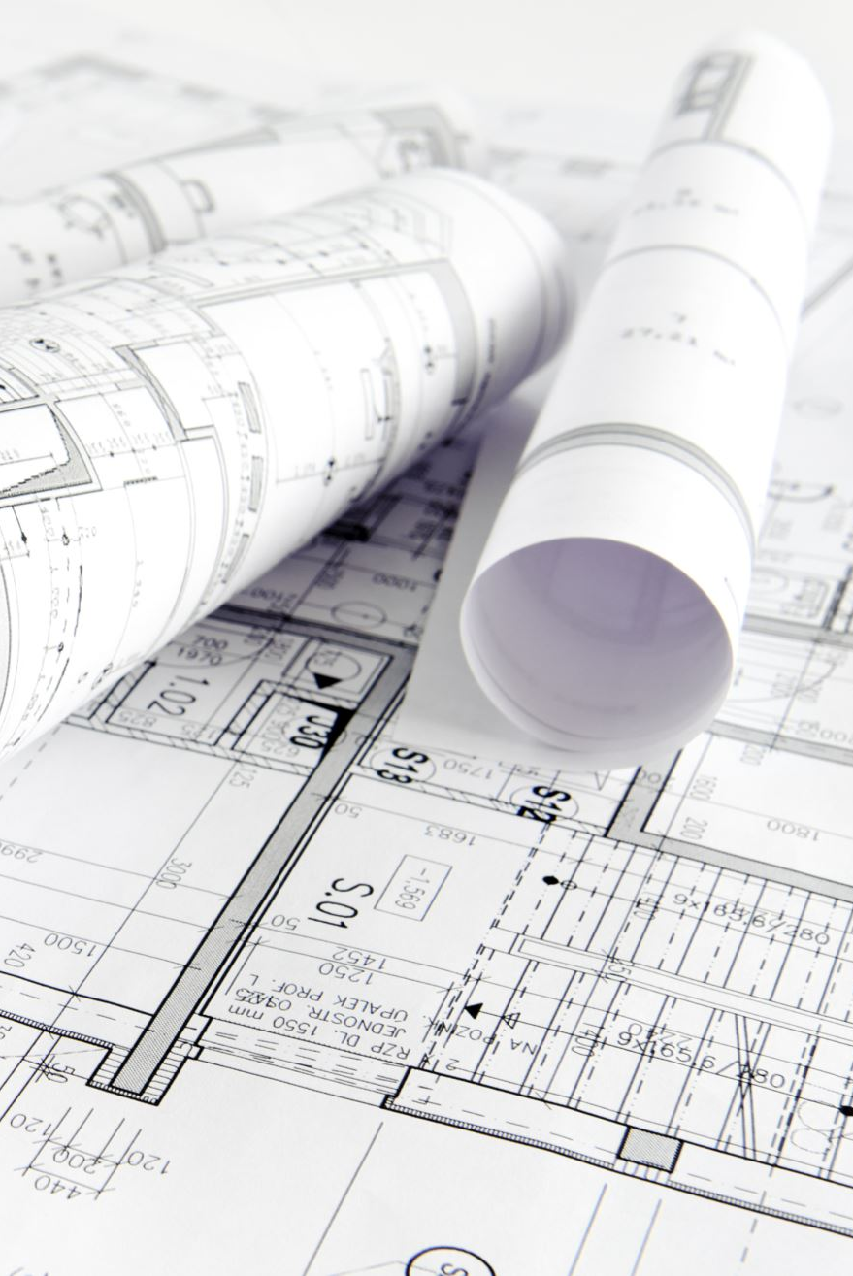
What went well
The project has been finalized and completed research on the architecture and implementation of the project.
The project has been finalized and completed research on the architecture and implementation of the project.

Slide 3
What Should be Improved
Lack of Communication: Should have communicated early with the lecturer regarding the complexity of the project and should have selected the project early. Due to misunderstandings between team members project selection took time.
Poor Planning: Should have planned well before the sprint and submitted the deliverables on time.

Slide 4
What we want to try next
Need to do a POC on all the selected technologies and get in-depth understanding

