Slide 1
Simply Online
Simple way to connect online

Slide 2
Agenda
Discuss about the project design, architecture, tech stack and use cases.
1
Update on the current status of the project. A minimum viable product to demonstrate current status.
2
Product Backlog, Completed user stories, Pending user stories and roadblocks faced.
3

Slide 3

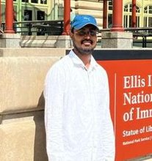
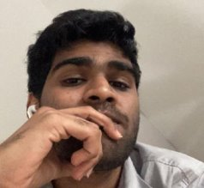
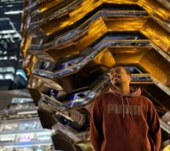
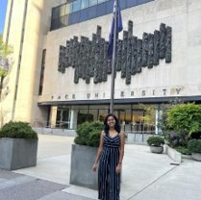

Ajay Kumar
Full Stack Developer
Amarendra Reddy
Developer
Pruthvi Raj Reddy
Database Administrator
Mounik
Developer
TEAM MEMBERS
Sreeja Reddy
Quality Analyst
Ravi Teja Reddy
Developer

Slide 4
Project Description
Simply online is a web application that aims to simplify the process of online classes. This application allows lecturers to create virtual rooms and share the room id with their students for seamless connectivity.
Using webrtc technology, simply online allows group video-sharing features and screen-sharing capabilities. This application allows lecturers to easily take attendance with just a click of a button. This platform automatically marks attendance, eliminating the need for manual tracking.
Overall, simply online offers a comprehensive and user-friendly solution for educators and students to enhance their online learning experience

Slide 5
Team Working Agreement
Participation:
All the team members are expected to involve in project discussions and attend the meetings promptly. Absence during multiple meetings will affect the team’s performance and efficiency.
The team member can discuss beforehand with the team leader if he/she is going to miss the meeting or make it up for it before the next meeting is scheduled.
Communication:
The team will communicate with each other using WhatsApp group and meetings will be scheduled on Zoom.
Jira software will be used to track the assigned tasks. For any dependency on another task, mention it in the task comments.
Task management, bugs, sprint planning, and meeting minutes will be tracked in Jira.
To share the final deliverables, Google docs will be used where all the team members can edit the document.
Work Division:
The entire project work should be divided into equal parts, and equal responsibilities should be given to all the team members.
Each team member should complete their division of work before the deadline. If they are unable to complete the work on time, that hinders the performance of the entire team. If in case a team member is facing trouble and issues at some point, they can share it with others so that they can help each other and complete the work before the deadline.
Meetings:
All the team members will meet on zoom virtually every Tuesday and Friday. All the team members must be present, as attendance is mandatory unless there is an exceptional case.
The team leader would be responsible for sending meeting details and conducting the meeting.
A meeting track or meeting minutes report would be listed after every meeting to keep track of the project and its progress.
Every team member is expected to come up with ideas, participate in the discussion, and give an update on their progress for their part of the work.

Slide 6
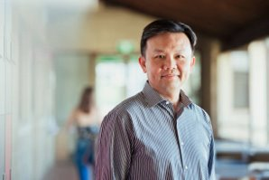
Persona
Name: Professor James​
Age: 45​
Occupation: University Professor​
​
Profile:
James is a tenured professor in the Computer Science department at a large university. He teaches both undergraduate and graduate-level courses and conducts research in his field. Due to the COVID-19 pandemic, his classes have been moved online, and he uses various platforms to deliver lectures, holds office hours, and communicate with his students. He lives with his spouse and two children, who are also attending school virtually.
Goals and Motivations:
Deliver high-quality lectures and course material to his students Engage his students and create a dynamic and interactive virtual classroom environment.
Ensure that his students are keeping up with the coursework and meeting their learning objectives.
Provide effective feedback and support to his students.

Slide 7

Persona
Name: Sarah
Age: 24
Occupation: College student
Profile:
Sarah is a full-time student pursuing a degree in psychology. Due to the COVID-19 pandemic, her classes have been moved online, and she uses Zoom to attend lectures, participate in group discussions, and communicate with her professors and classmates.
She lives in a small apartment with roommates and shares a room with one of them.
She has a busy schedule and often has to balance her coursework with a part-time job and other responsibilities.
Goals and Motivations:
Attend all her classes and be an active participant in class discussions Stay organized and manage her time effectively to meet assignment deadlines.
Have a reliable and user-friendly platform for attending virtual classes. Connect with her professors and classmates, and build a community within her course

Slide 8
Minimal Viable Product (MVP)
The following are the features that we are covering in our MVP:
Homepage
JOIN ROOM
CREATE ROOM
Peer to Peer connection

Slide 9
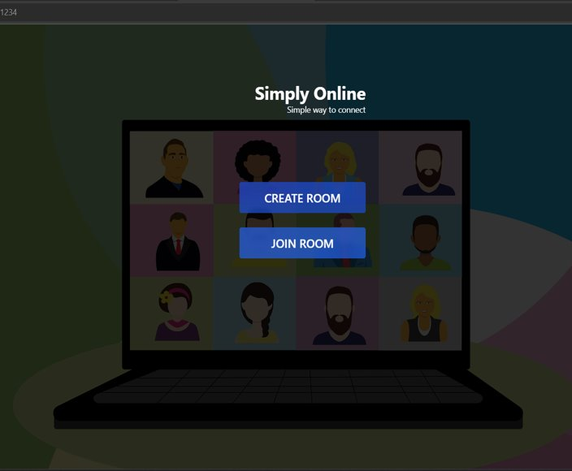
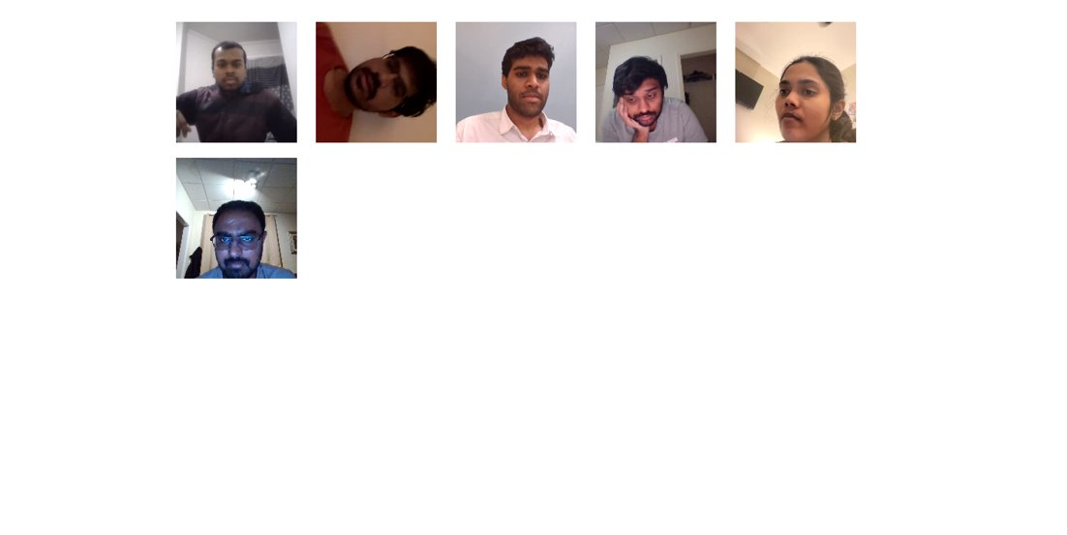
Minimal Viable Product (MVP)

Slide 10















Technologies

Slide 11
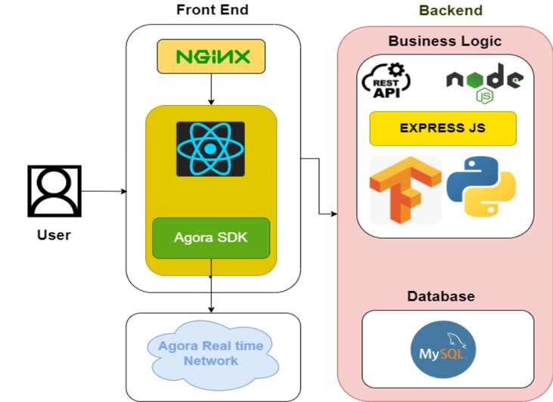
Architecture Diagram

Slide 12
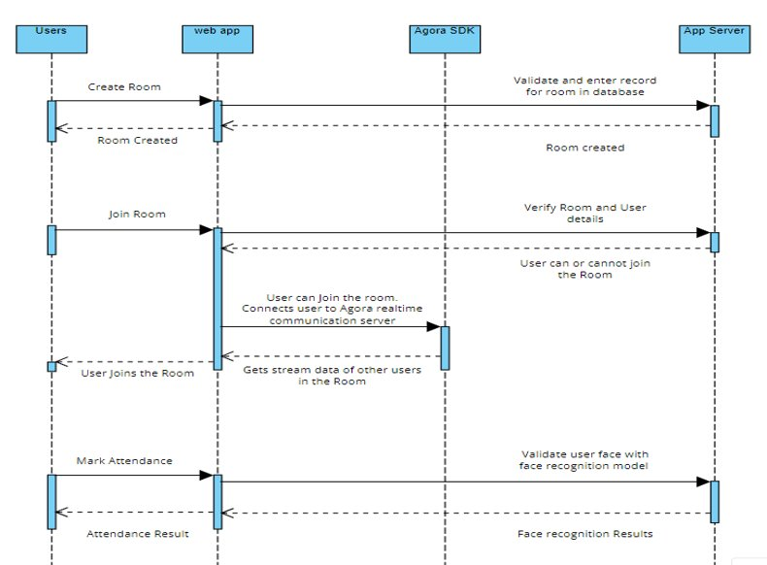
Sequence Architecture Diagram

Slide 13
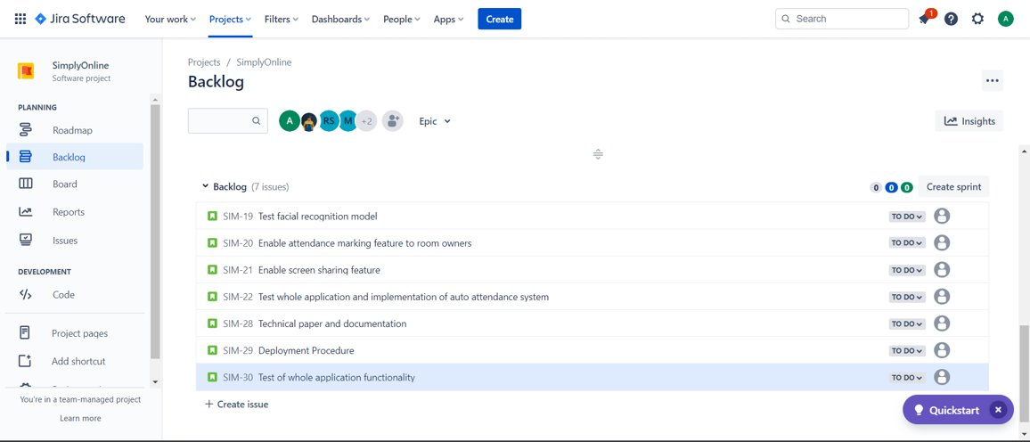
Product Backlog

Slide 14
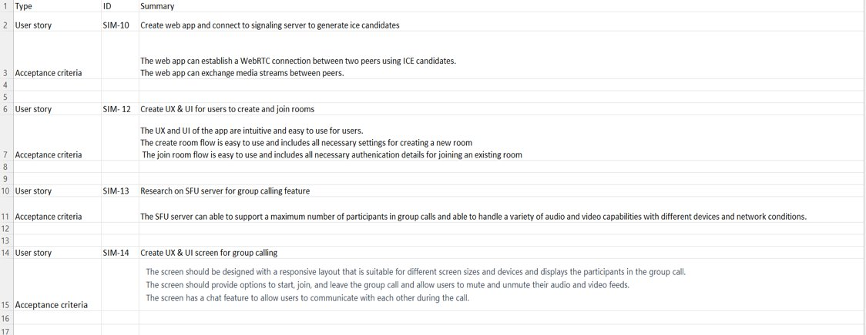
User Stories & Acceptance Criteria

Slide 15
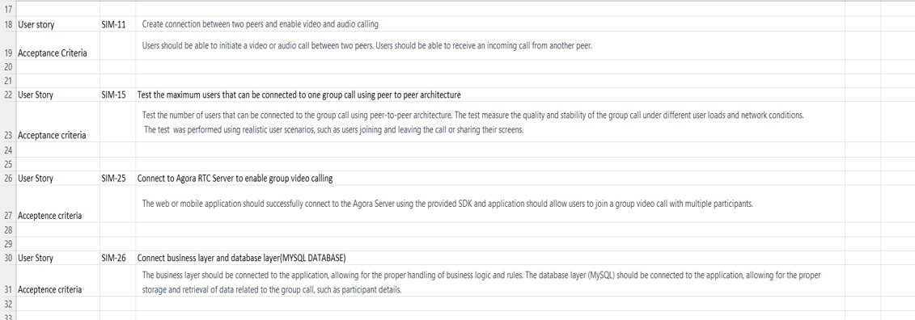
User Stories & Acceptance Criteria

Slide 16
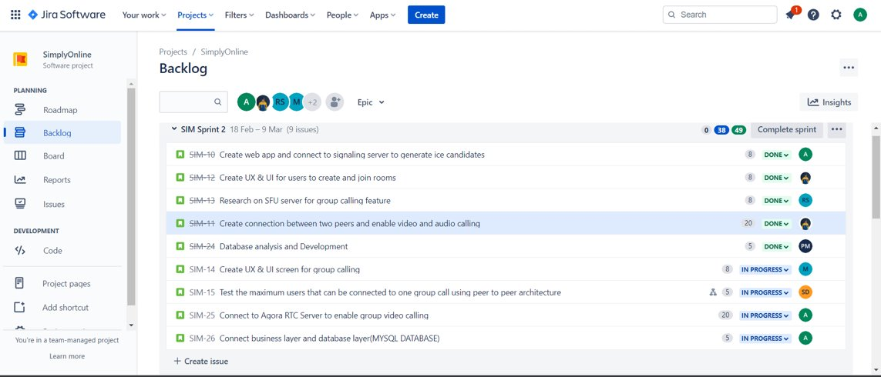
Sprint 2

Slide 17
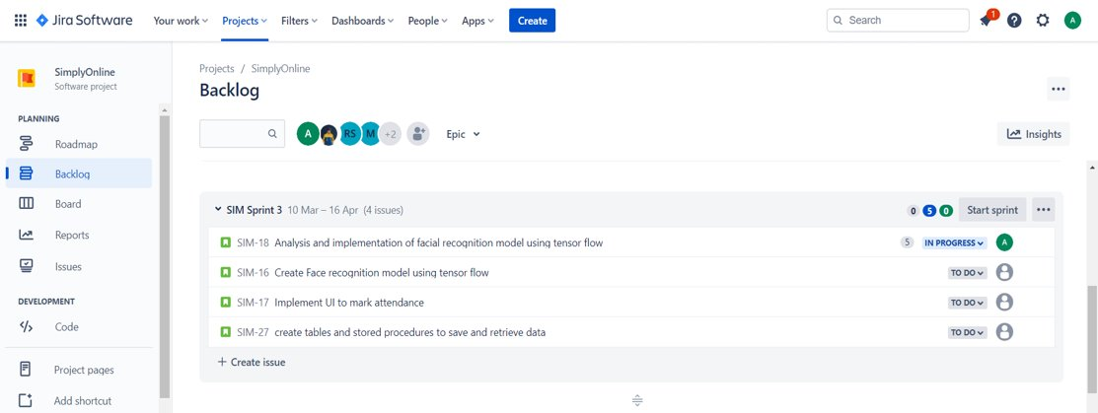
Sprint 3 Backlog

Slide 18
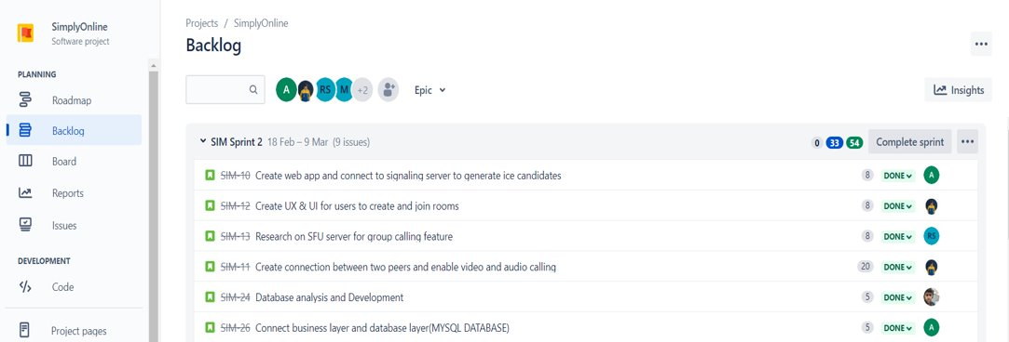
Sprint 2 – Completed Tasks

Slide 19
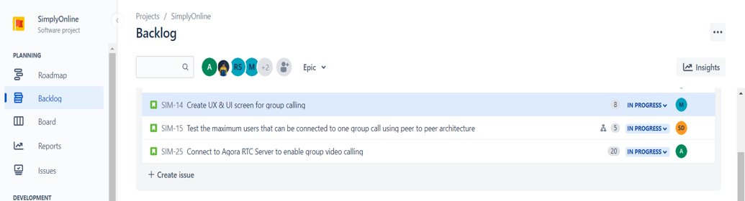
Sprint 2 – Pending Tasks

Slide 20
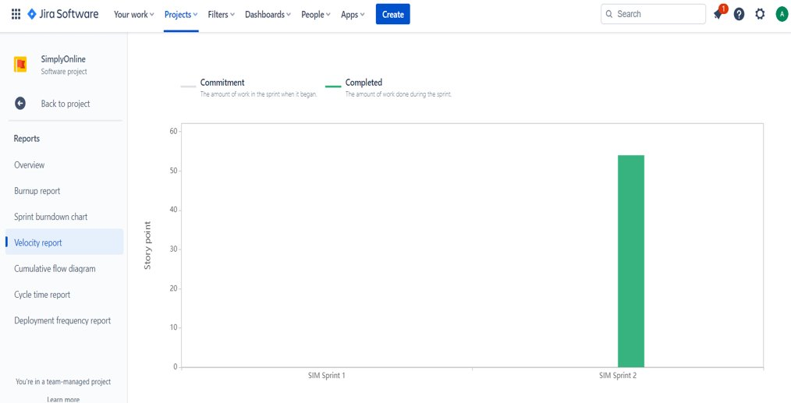
Metrics Velocity Report

Slide 21
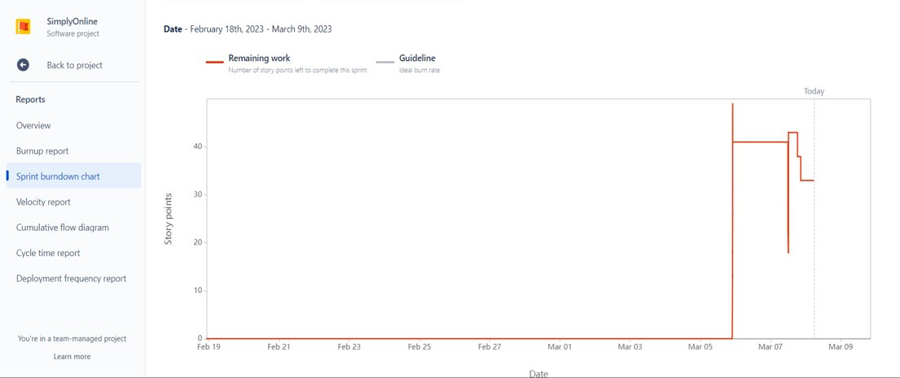
Sprint 2 Burnout Chart

Slide 22
What went well
The team has demonstrated good collaboration and communication, with team members working together effectively and openly sharing information and being proactive in identifying and addressing issues or blockers that arose during the sprint.
Points need to improve
The team needs to improve their estimation and planning skills to better anticipate the amount of work that can be completed within a sprint, and to avoid overcommitting or underdelivering.
The team needs to improve their focus and time management, to ensure that they are making the most of their available time and prioritizing their work effectively.
Retrospective

Slide 23
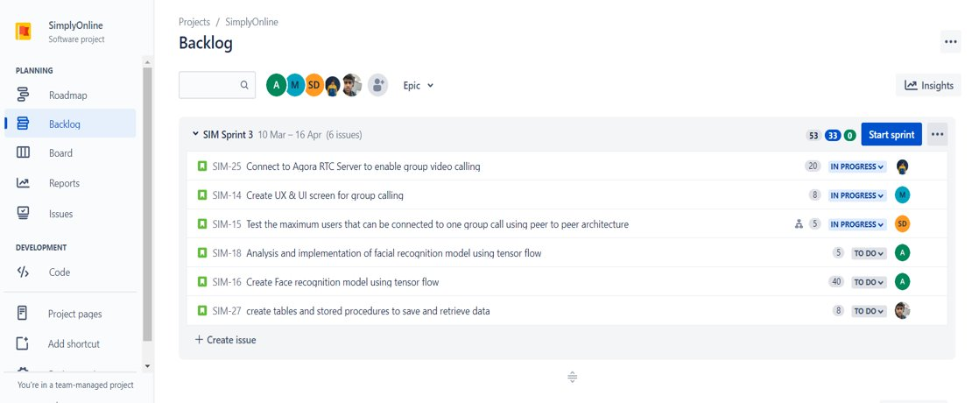
Stories for Sprint 3

Slide 24
Project Demo

Slide 25
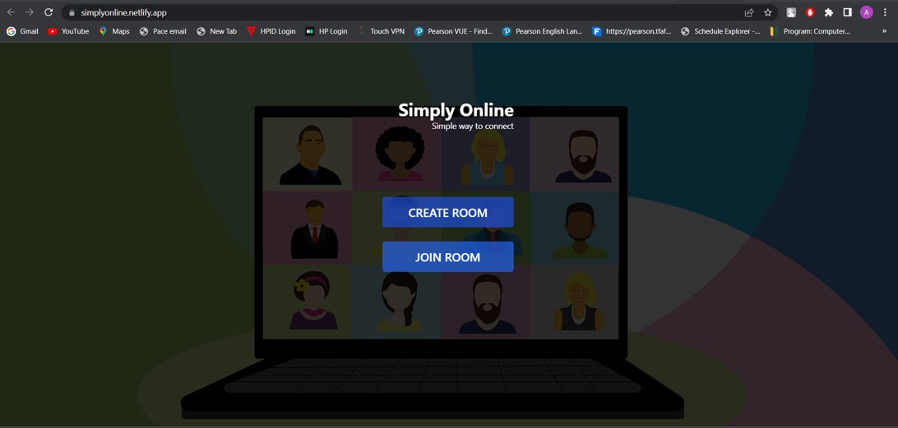

Slide 26
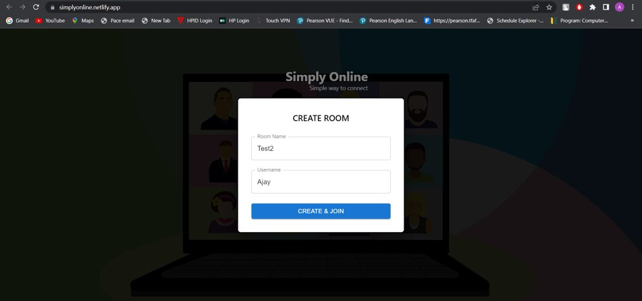

Slide 27
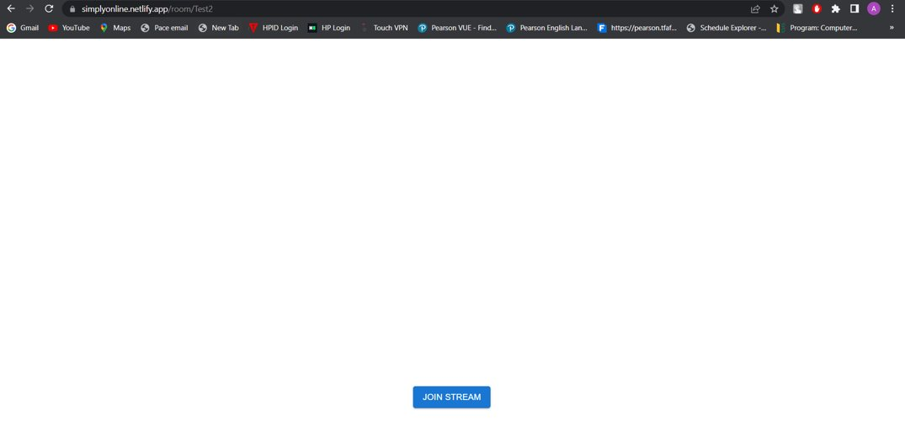

Slide 28
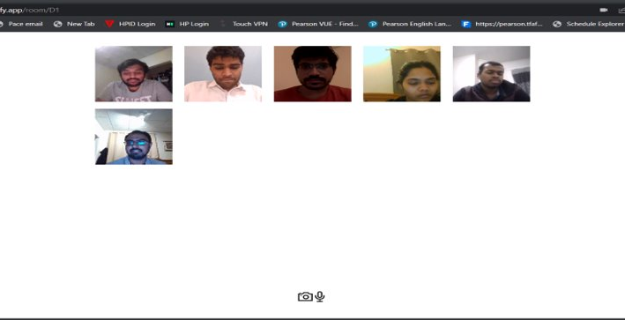

Slide 29
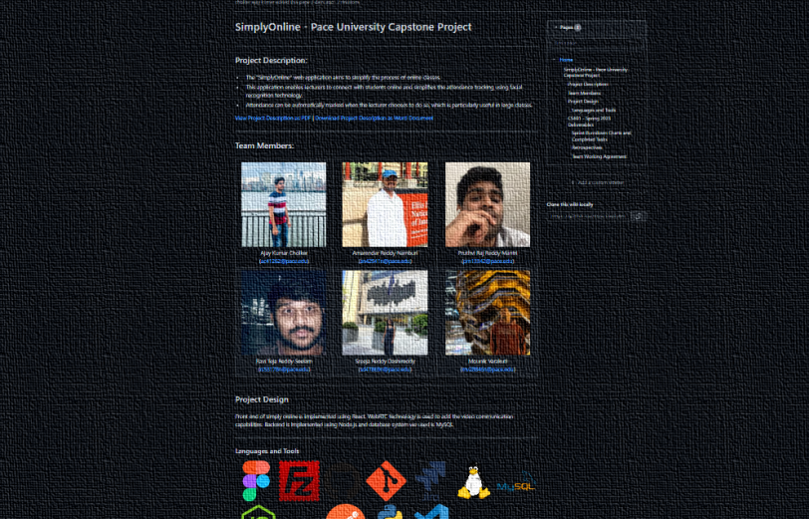
https://github.com/htmw/SimplyOnline/wiki
https://simplyonline.netlify.app/

Slide 30
Thank You

