Slide 1
DSC520 Term project
Is Linux More Secure Than Windows
Chad Homan

Slide 2
The Variables

Slide 3
The Chosen Variables
Ubuntu Linux
Desktop and Server
Windows 10
Desktop
Windows 2016 Server
Server
Windows 2019 Server
Server
MacX OS
Desktop

Slide 4
How I Chose
I will be pulling 3 windows variables (win10, win2016, and win2019), 1 linux variable (ubuntu linux) and finally 1 mac variable. This will be one of the primary challenges. Let me explain.
First off, I chose these because they are arguably the most popular choices of their "class". Most people agree that there is a thing called "the main three". Window, Linux and Mac.
Windows it predominantly owned and ran by Microsoft. Mac is controlled and ran by Apple, but at it's core it is based on BSD Linux. From which there are many distributions derived from. For example: openBSD, freeBSD and netBSD to name a few. Yes there are more, some are specialized
for use as a firewall or a storage system. In the Linux camp, there are over 500 distributions. Like BSD, many are specialized distributions, but many are server and desktop oriented. The most popular Linux distributions include Ubuntu, Pop, Fedora and openSUSE. The top chair is in flux between Ubuntu and Pop, But I feel Ubuntu has a better market share.

Slide 5
What do they mean
These variable represent the main three “classes” of computer and they are the top choice in their “class” of operating system.

Slide 6
Issues and Challenges: MacOS
Let's start with mac 10. From the mac10 point of view, mac10 is a desktop that many people use. However, there is no record "server" release of mac10. Or any other version of mac that I can remember. By itself, this is find that I could cross compare this with win10 (Microsoft's desktop). But I am comparing the Ubuntu Linux Desktop as well.Ubuntu has both a desktop and a server release, there is my dilemma. the dataset does not differentiate between desktop and server (nor should it). Why?

Slide 7
Issues and Challenges: Ubuntu
The Ubuntu server and desktop release are from the same baseline. So a given binary is more than likely the same binary on both server and desktop. But there are binaries on server and binaries on desktop that do not exist on the alternate system. So to be fair, I will include the win2016 and win2019 to help cross compare more fairly against the windows platform.

Slide 8
Issues and Challenges: Windows
Now microsoft typically releases separate patches on the server release vs the desktop vs the other server releases. This hint that Microsoft is maintaining separate baselines for each system.
Another dilemma is that Microsoft is known not to be very forthcoming with CVEs. This means that there could be far more CVEs against Microsoft products then in the public knowledge base of CVEs. And Microsoft have CVEs that they have deemed obsolete in their eyes, meaning it's a CVE but they refuse to fix. WTH! That's right, they intentionally leave things vulnerable. Why? Don't know! I agree, it is dumb.

Slide 9
Issues and Challenges: Summary
Variables
Ubuntu Linux
Windows 10
Windows 2016 Server
Windows 2019 Server
MacOS X
Issues/Challenges
MacOS X is desktop only
Ubuntu is both server and desktop
Windows has separate server and desktop releases
Microcroft is not forthcoming with CVEs and deems some not “fix” worthy

Slide 10
Histograms

Slide 11
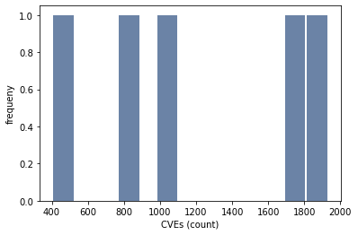
Separated Windows Systems
Could not calculate freq correctly
But the bottom values are correct
Could not figure out host to Label correctly

Slide 12
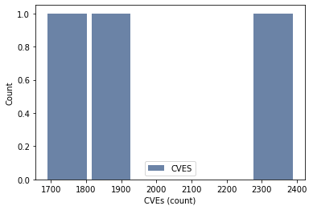
Combined Windows Systems
Could not calculate freq correctly
But the bottom values are correct
Could not figure out host to Label correctly

Slide 13
Variable Descriptive Info

Slide 14
Descriptions
 | Separated Windows | Combined WIndows
Mean | 1190 | 1983
Median | 1039 | 1871
Mode | [1871, 1747, 1039, 828, 465] | [1871, 1747, 2332]
Spread | 363370 | 95020
Tail | ???? | ????

