Slide 1
Data Retrieval via
Natural Language Processing
Marie Cho, Changxu Liu
Institute for Computing in Research
August 4, 2022

Slide 2
| Introduction & Background
| Data Processing
| Data Retrieval
| Results and Observations

Slide 3
INTRODUCTION
Many modern devices today implement a software to search for file names on the computer. However, most do not allow searches for the content within files themselves.
In this project, we create a data retrieval system that will search through the contents within .TXT files and images and return the most similar files.
Notes:
Create data retrieval system for txt files and images by searching contents vs mere filenames
Search engine for personal computer

Slide 4
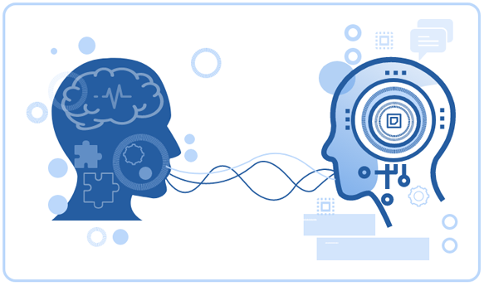
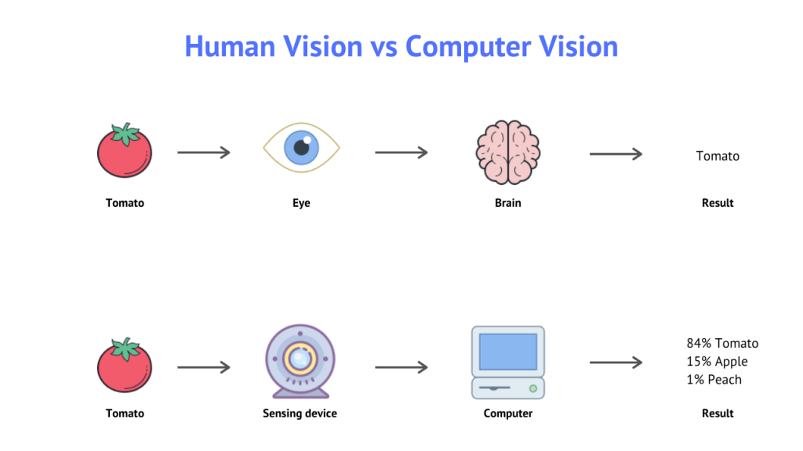
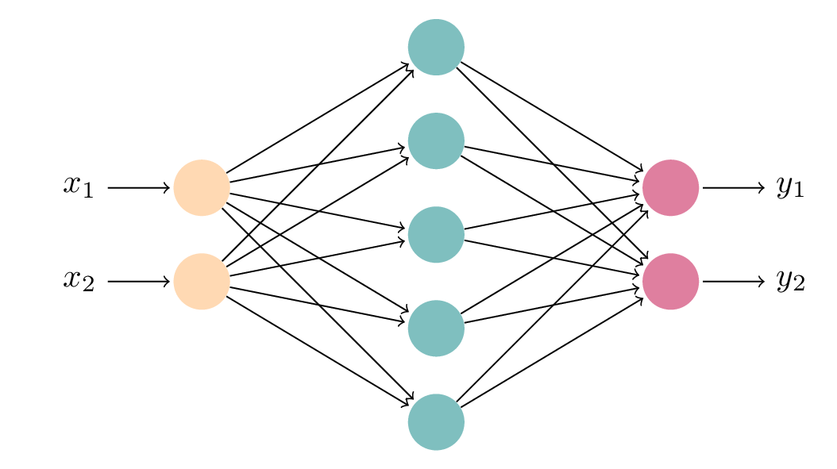
ARTIFICIAL INTELLIGENCE
Artificial Intelligence (AI): simulation of human intelligence onto machines
Natural Language Processing (NLP): the field of AI concerned with computer and human language interaction
  Transformer Models: adopts self-attention, the ability to weigh the significance of a part of a data
Artificial Neural Networks (NN): data and computer algorithms that mimic the system of neurons in the human brain
  Recurrent Neural Networks (RNN): text recognition
  Convolution Neural Networks (CNN): image analysis
Computer Vision (CV): image and video analysis
Notes:
AI seen everywhere today: automated cars, face ID, personalized recs
NLP: translators, virtual assistants like siri, spell check
Transformers: “the apple is red” ex

Slide 5
| Introduction & Background
| Data Processing
| Data Retrieval
| Results and Observations

Slide 6
TEXT EXTRACTION & CLEANING
PDF FILES
w/ text data

Slide 7
TEXT EXTRACTION & CLEANING
PDF FILES
w/ text data
PyPDF2 Text Extraction
PyPDF2: extract text from .PDF files

Slide 8
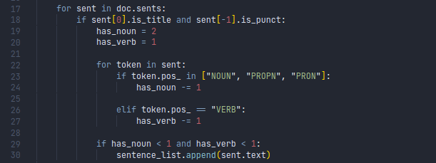
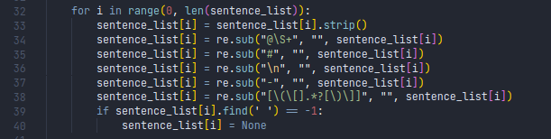
TEXT EXTRACTION & CLEANING
Text Cleaning
At least one verb?
At least 2 nouns?
PDF FILES
w/ text data
PyPDF2 Text Extraction
strings
PyPDF2: extract text from .PDF files
To clean up the text:
Any sentences without at least 2 nouns and a verb are removed.
Any symbols, including dashes and ‘\n’ are removed.

Slide 9

OPTICAL CHARACTER RECOGNITION
For PDFs with no text data, the Pytesseract module is used, which performs optical character recognition (OCR).

Slide 10
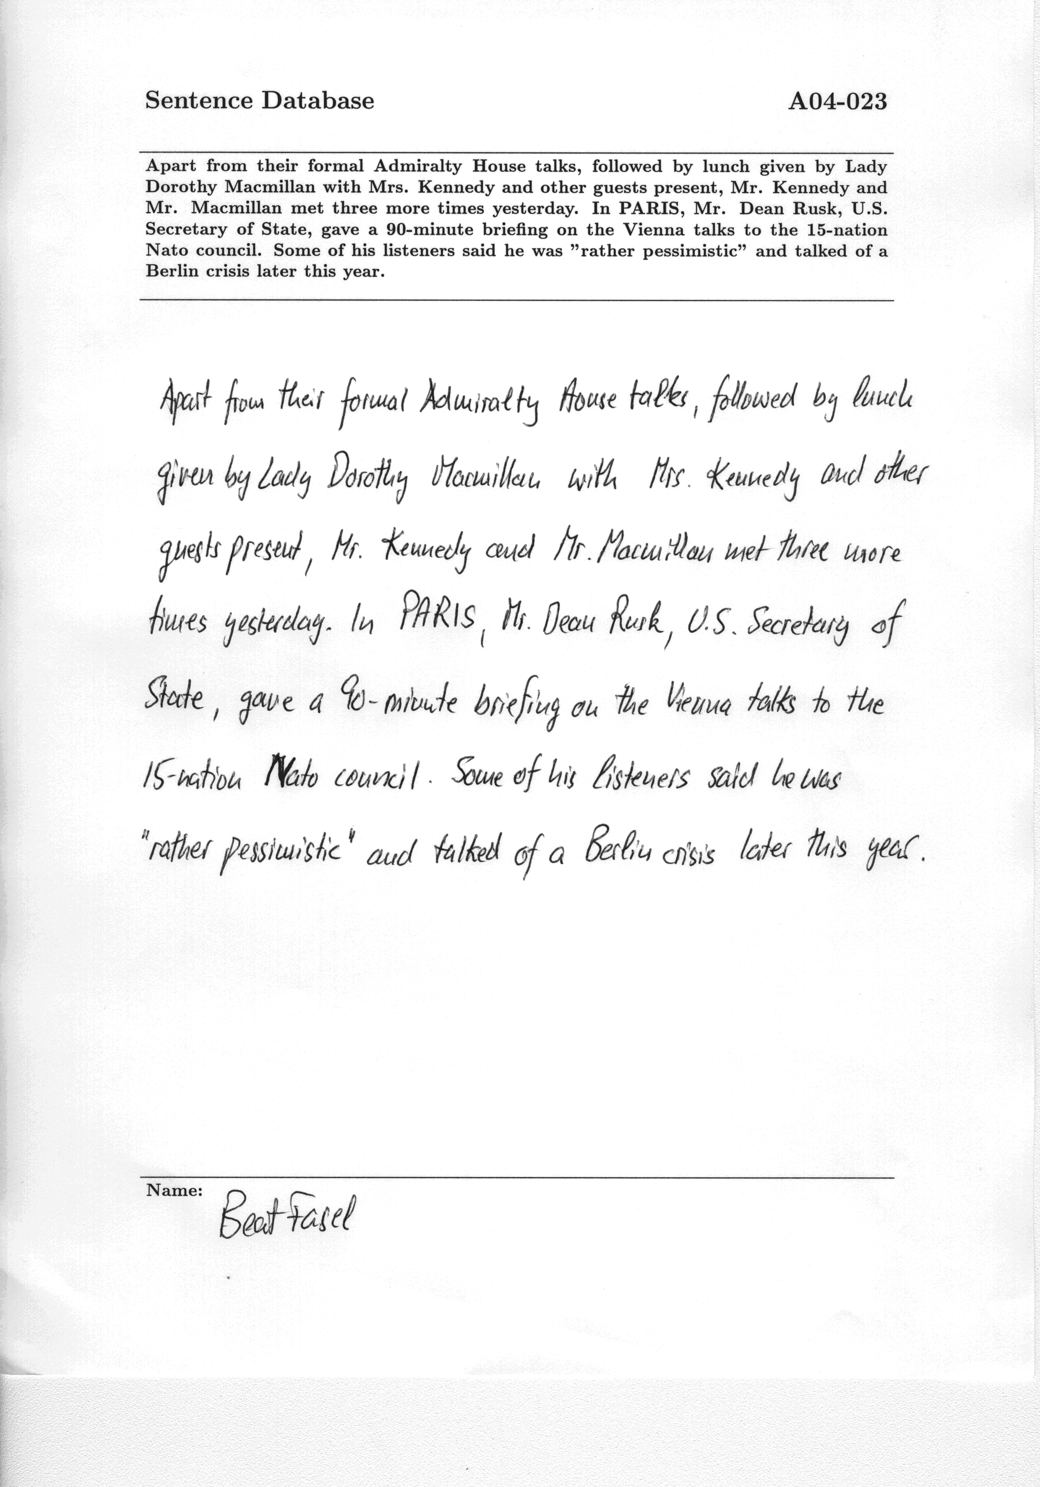
Apart from their formal Admiralty House talks, followed by lunch given by Lady
Dorothy Macmillan with Mrs. Kennedy and other guests present, Mr. Kennedy and
Mr. Macmillan met three more times yesterday. In PARIS, Mr. Dean Rusk, U.S.
Secretary of State, gave a 90-minute briefing on the Vienna talks to the 15-nation
Nato council. Some of his listeners said he was ”rather pessimistic” and talked of a
Berlin crisis later this year.

Slide 11
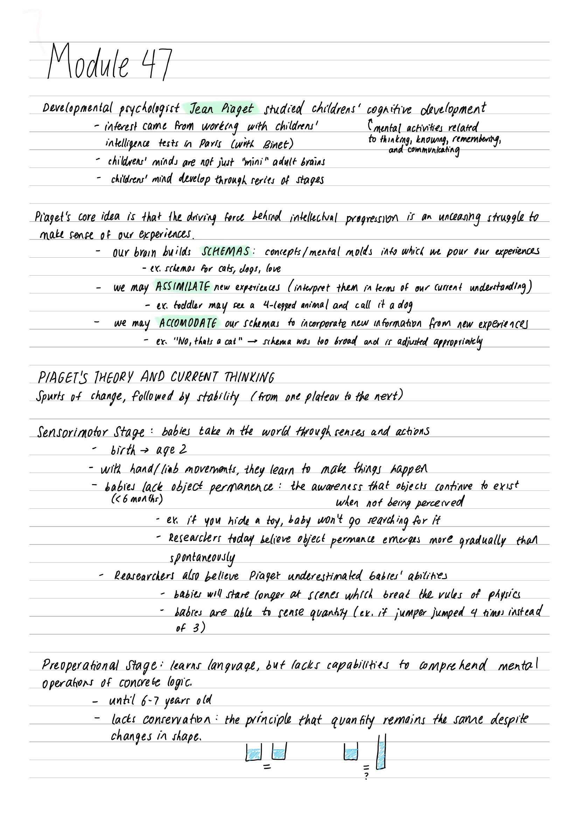
Developmental prycﬁa(agi:{ Jean Pinget studced childrens’ cognihive olevelopment
- ntevest came Fom woréeng with childrens’ Countal ackivikes velated
inkelligence tests in Pavis (wwk Binet) hf‘ﬁf@,ﬁ;ﬁT£A4Aféwmw'
< childpens’ minds gre not just “mini ™ adulé byains
- chitdrens’ mind ﬂwlap through rerits of Stages
Praget’s core idea (s that fhe driving force behinol jnteflecival progression (5_an_unteaghg stuggle fo
Mok Songe of our Cperitnces,
= our bran builds SCHEMAS : concepts /mental molds iné whicd we pour our experiences

Slide 12
HANDWRITTEN TEXT RECOGNITION
But first, where is the text?
EAST: An Efficient and Accurate Scene Text Detector within OpenCV

Slide 13
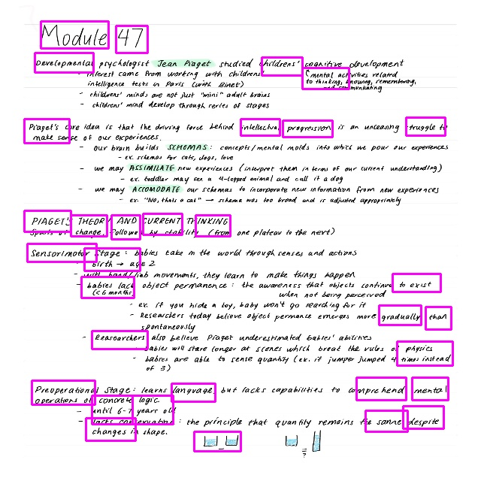
HANDWRITTEN TEXT RECOGNITION
But first, where is the text?
EAST: An Efficient and Accurate Scene Text Detector within OpenCV
Results were inconsistent.
Notes:
turn south
Not only were not all of the word boxed, there was a lot of overlap between the boxes (difficult formating
also, word-by-word vs line-by-line)

Slide 14
HANDWRITTEN TEXT RECOGNITION
To find the text...
Notes:
turn south
Not only were not all of the word boxed, there was a lot of overlap between the boxes (difficult formating
also, word-by-word vs line-by-line)

Slide 15
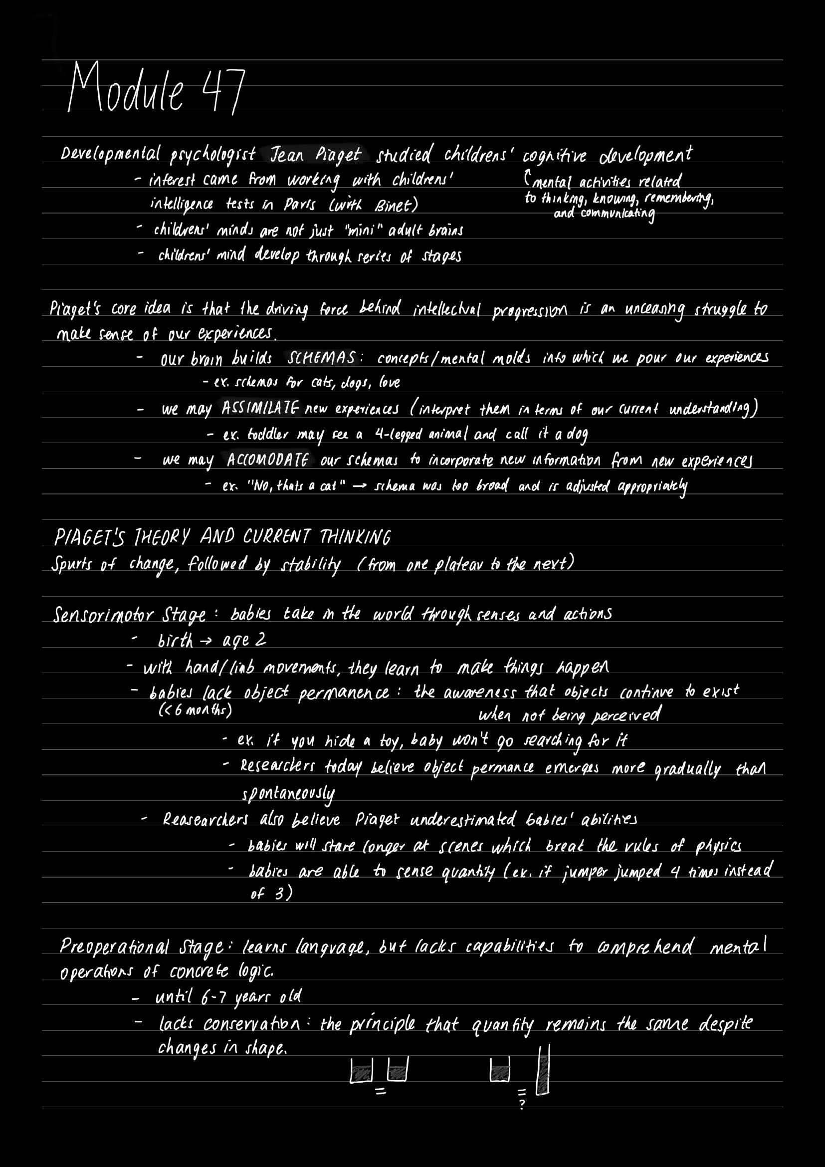
HANDWRITTEN TEXT RECOGNITION
To find the text...
Convert the image to grayscale and invert colors.
Notes:
turn south
Not only were not all of the word boxed, there was a lot of overlap between the boxes (difficult formating
also, word-by-word vs line-by-line)

Slide 16

HANDWRITTEN TEXT RECOGNITION
To find the text...
Convert the image to grayscale and invert colors.
Apply a threshold to the image.
Notes:
Improve contrast, and (for paper scans) reduce noise/artifacts and make lighting more consistent

Slide 17

HANDWRITTEN TEXT RECOGNITION
To find the text...
Convert the image to grayscale and invert colors.
Apply a threshold to the image.
Dilate the remaining contours in the x direction so that the words come together.
Notes:
turn south
Not only were not all of the word boxed, there was a lot of overlap between the boxes (difficult formating
also, word-by-word vs line-by-line)

Slide 18
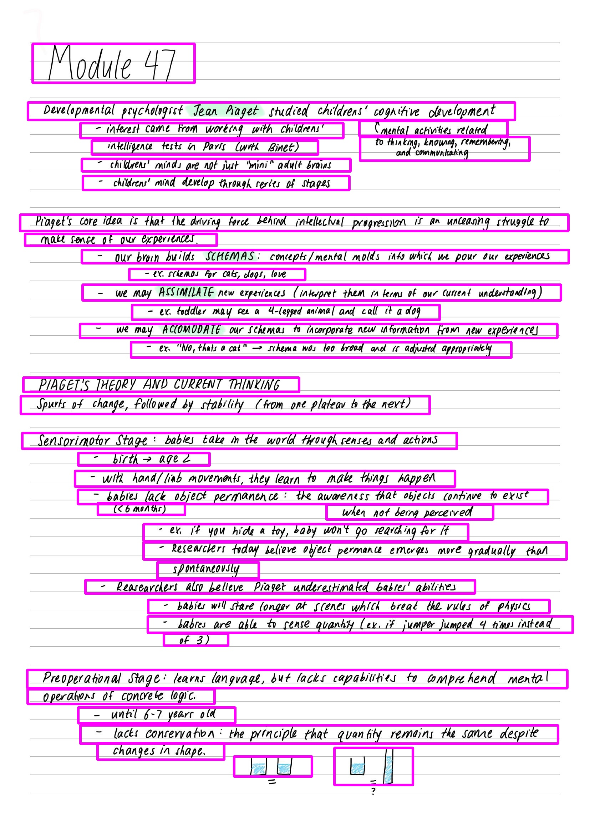

Notes:
turn south
Not only were not all of the word boxed, there was a lot of overlap between the boxes (difficult formating
also, word-by-word vs line-by-line)

Slide 19
HANDWRITTEN TEXT RECOGNITION
For each line...
Convolutional Neural Network
for feature extraction
Recurrent Neural Network
To propagate relevant information
CTC Decoder
and CTC Loss
Notes:
turn south
Not only were not all of the word boxed, there was a lot of overlap between the boxes (difficult formating
also, word-by-word vs line-by-line)

Slide 20
HANDWRITTEN TEXT RECOGNITION
CTC Decoder
and CTC Loss
Connectionist Temporal Classification (CTC) is used when a sequence isn’t perfectly spaced out.
Notes:
CNN output is feature map

Slide 21
HANDWRITTEN TEXT RECOGNITION
Connectionist Temporal Classification (CTC) is used when a sequence isn’t perfectly spaced out.
Notes:
CNN output is feature map

Slide 22
IN PROGRESS
Notes:
CNN output is feature map

Slide 23
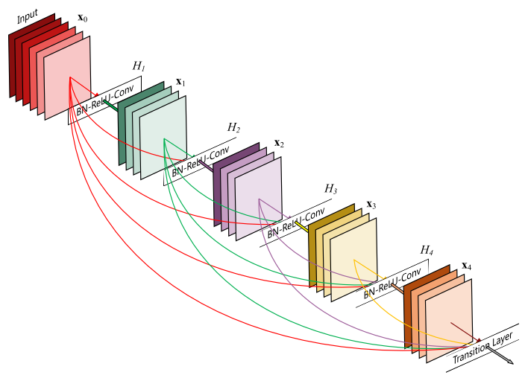
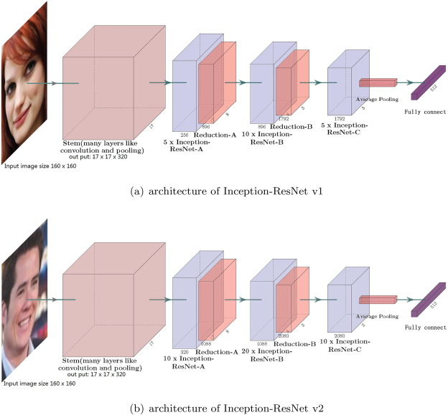
IMAGE CAPTIONING
Generate a caption for pure images and photographs.
Resnet Model: a 50 layer Convolutional Neural Network to extract image features
Passed to Recurrent Neural Network that decodes features into a caption for description

Slide 24
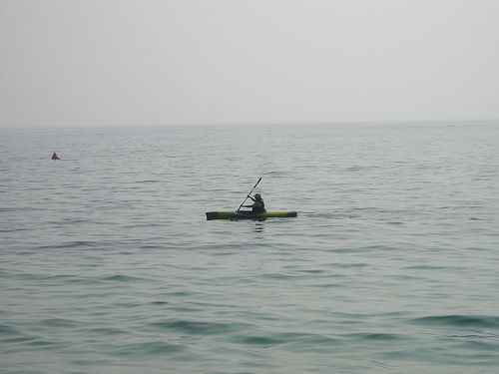
IMAGE CAPTIONING
Preparing the images...

Slide 25
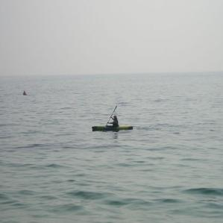
IMAGE CAPTIONING
Preparing the images...
Resizing to (299, 299)

Slide 26
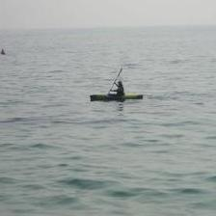
IMAGE CAPTIONING
Preparing the images...
Resizing to (299, 299)
Random Cropping to (224, 224)

Slide 27
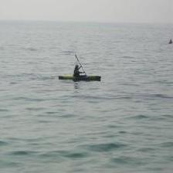
IMAGE CAPTIONING
Preparing the images...
Resizing to (299, 299)
Random Cropping to (224, 224)
Random Horizontal Flip

Slide 28
IMAGE CAPTIONING
[[[0.7333, 0.7294, 0.7294, ..., 0.8039, 0.8039, 0.8039],
[0.7333, 0.7294, 0.7294, ..., 0.8039, 0.8039, 0.8039],
[0.7333, 0.7294, 0.7294, ..., 0.8039, 0.8039, 0.8039],
...,
[0.5294, 0.5333, 0.5373, ..., 0.5804, 0.5765, 0.5765],
[0.5333, 0.5373, 0.5412, ..., 0.5961, 0.5961, 0.5922],
[0.5333, 0.5333, 0.5373, ..., 0.5804, 0.5804, 0.5804]],
[[0.7333, 0.7294, 0.7294, ..., 0.8039, 0.8039, 0.8039],
[0.7333, 0.7294, 0.7294, ..., 0.8039, 0.8039, 0.8039],
[0.7333, 0.7294, 0.7294, ..., 0.8039, 0.8039, 0.8039],
...,
[0.5451, 0.5490, 0.5529, ..., 0.6157, 0.6118, 0.6118],
[0.5490, 0.5529, 0.5569, ..., 0.6314, 0.6314, 0.6275],
[0.5490, 0.5490, 0.5529, ..., 0.6157, 0.6157, 0.6157]],
[[0.7333, 0.7294, 0.7294, ..., 0.7961, 0.7961, 0.7961],
[0.7333, 0.7294, 0.7294, ..., 0.7961, 0.7961, 0.7961],
[0.7333, 0.7294, 0.7294, ..., 0.7961, 0.7961, 0.7961],
...,
[0.5412, 0.5451, 0.5490, ..., 0.6039, 0.6000, 0.6000],
[0.5451, 0.5490, 0.5529, ..., 0.6196, 0.6196, 0.6157],
[0.5451, 0.5451, 0.5490, ..., 0.6039, 0.6039, 0.6039]]]
Preparing the images...
Resizing to (299, 299)
Random Cropping to (224, 224)
Random Horizontal Flip
Convert to Tensor
Notes:
Think of a Tensor as a 2D array with fancy name
Everything in the range [0, 255] -> [0.0, 1.0] (like a percentage) x3 (one for each color)

Slide 29
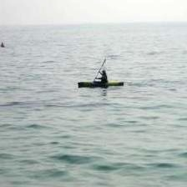
IMAGE CAPTIONING
Preparing the images...
Resizing to (299, 299)
Random Cropping to (224, 224)
Random Horizontal Flip
Convert to Tensor
Normalization
Notes:
MEAN: 0, STANDARD DEV: 1
REDUCE SKEW IN DATA, IMPROVE TRAINING and MAY HELP AGAINST EXPLODING/DIMINISHING GRADIENTS
output = ( input(channel) – meanOfChannel ) / std(channel)

Slide 30
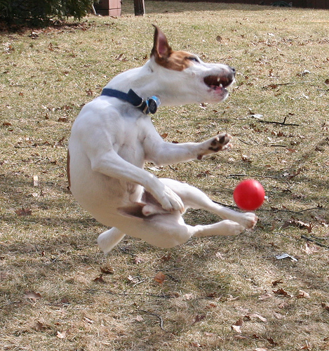
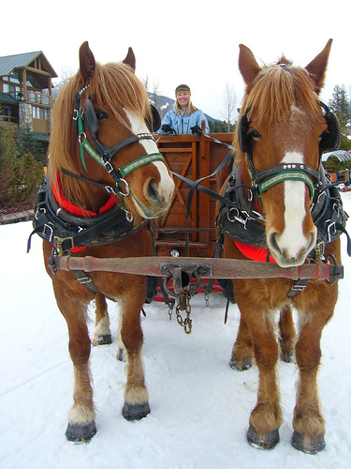
a man is rowing a boat on a lake .
a white dog is jumping up to catch a ball in a field .
Notes:
WORKS WELL
A man is rowing a boat on a lake
a white dog is jumping up to catch a ball in a field

Slide 31
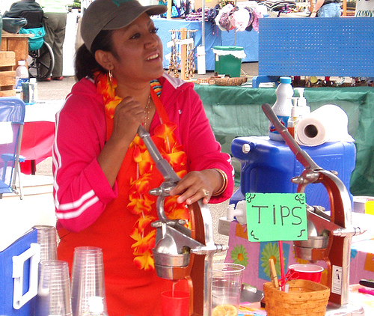
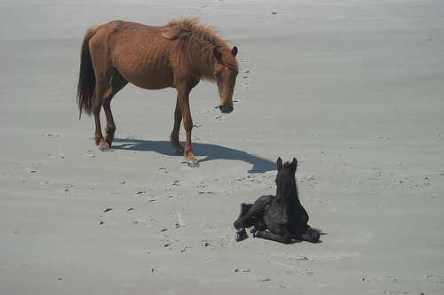
a brown and white dog is running on the beach .
a child in a red jacket is holding a stuffed animal .
Notes:
a child in a red jacket is holding a stuffed animal
a brown and white dog is running on the beach

Slide 32
a group of people are standing around a fire .
Notes:
Partial credit
a group of people are standing around a fire
If you were to imaging the image behind this caption (campfire? bbq?)

Slide 33
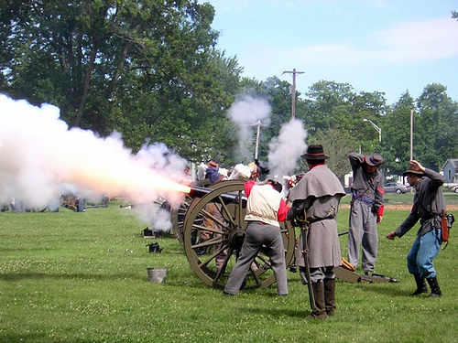
a group of people are standing around a fire .

Slide 34
| Introduction & Background
| Data Processing
| Data Retrieval
| Results and Observations
Notes:
After we’ve processed the data the next step for us to actually retrieve this data from the computer when you type in a query

Slide 35
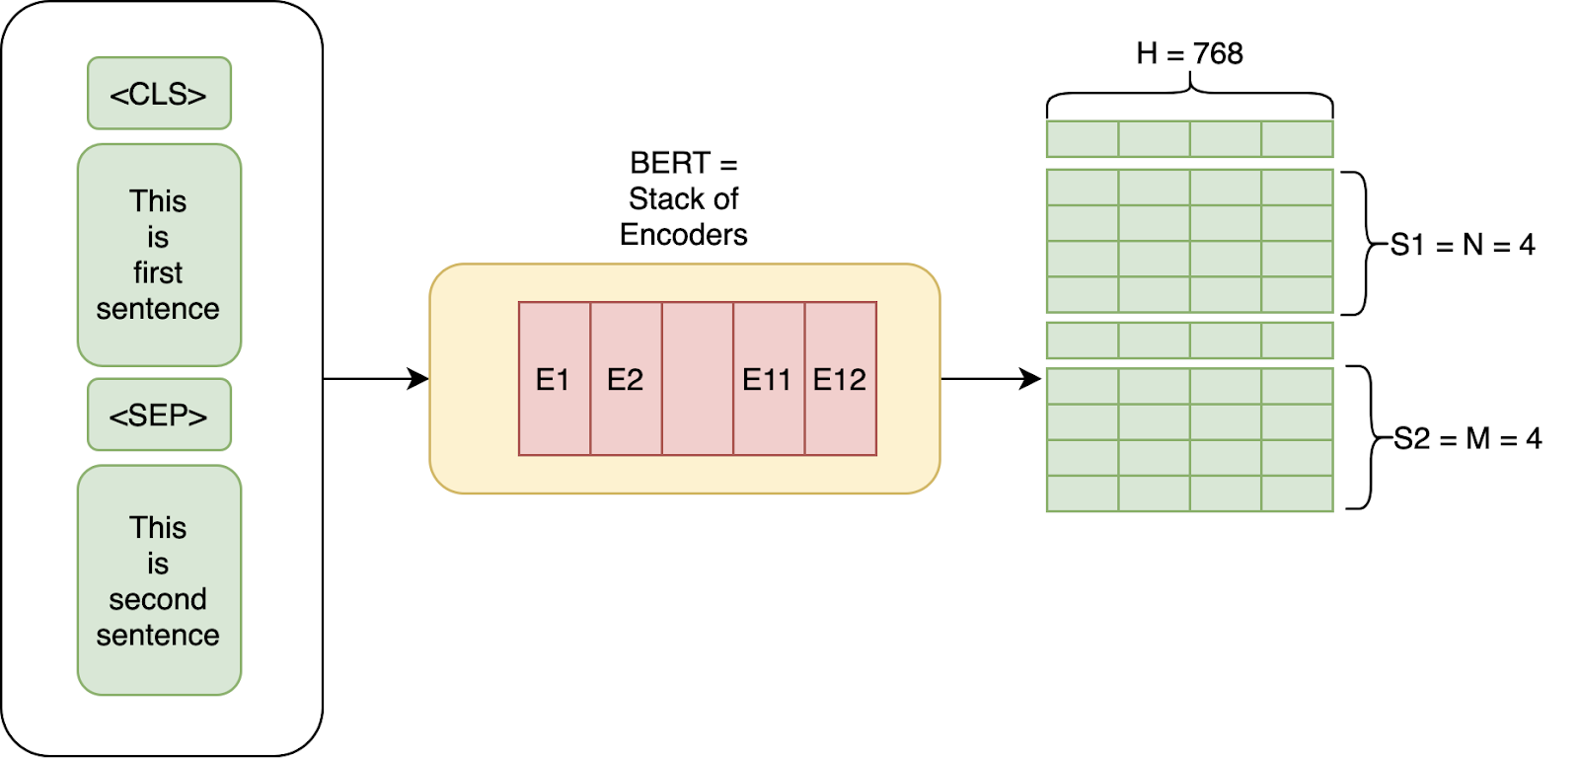
THE BERT MODEL
Bidirectional Encoder Representations from Transformers (BERT): an unsupervised Transformer-based model for NLP
Bridge between human language and semantic embeddings for numerical comparisons
Text => model => tensor vector
Normalization
Notes:
Name = transformers
Take in input text (sentence) go through a set of encoders
Output a tensor matrix for each of the words in the sentence
Vectors are averaged to create one embedding for the entire sentence
Normalized using L2 normalization for comparison
** Hugging face

Slide 36


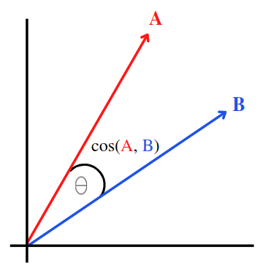
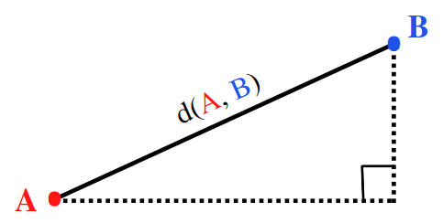
MEANS OF DETERMINING PROXIMITY
Cosine Similarity
Euclidean Distance
Measures angle between vectors
Orientation and rotation
Independent of magnitude and weight
Measures distance between two points on vectors
Dependent on magnitude and weight
Notes:
After running our query and sentences through BERT we’ll need to find a way to compare the vectors
Inversely rated = one increases other decreases
Cosine similarity measures angle between vectors = purely a judgement of orientation and rotation, no magnitude and weight
Euclidean distance: measures distance between points on vectors, yes magnitude and weight
Because two sentences can have the same meaning (same orientation) but have different lengths, cosine similarity is the better option for NLP

Slide 37
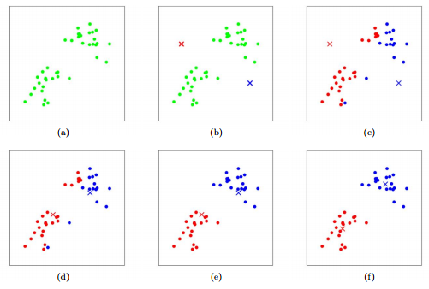
K-MEANS CLUSTERING
K-Means Clustering: an unsupervised machine learning algorithm for vector organization
Vectors in a space separated into
k groups — form k centroids and
assign each vector to the closest
centroid labeled 1, 2, 3 ... k
Centroids adjust by taking average
of the vectors in its cluster until
centroids do not move or
the adjustment is minimal
Notes:
Instead of examine each sentence, accelerate process via k-means
Limit search pool to the closest cluster to the query sentence to accelerate search
Separate vectors into k amount of groups each with its own centroid/center = mean of points in cluster
Label points into this or that group
Comes with a price of potentially inaccurate results

Slide 38
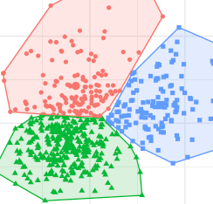
ACCELERATION THROUGH K-MEANS CLUSTERING
No risk of error Risk of error
Notes:
Take a look at these images here
Black x = query
Left = landed middle of red cluster, good
Right = landed border of red cluster near green and blue
Points in other clusters that could possibly originally be in top 5 not be considered anymore
Errors occur by chance bc clusters are formed based on random starting points and query could be anywhere
More clusters = more risk of errors

Slide 39
| Introduction & Background
| Data Processing
| Data Retrieval
| Results & Observations
Notes:
Note that following results are based on my experiment with 300k sentences
Vary depending on more or less data

Slide 40
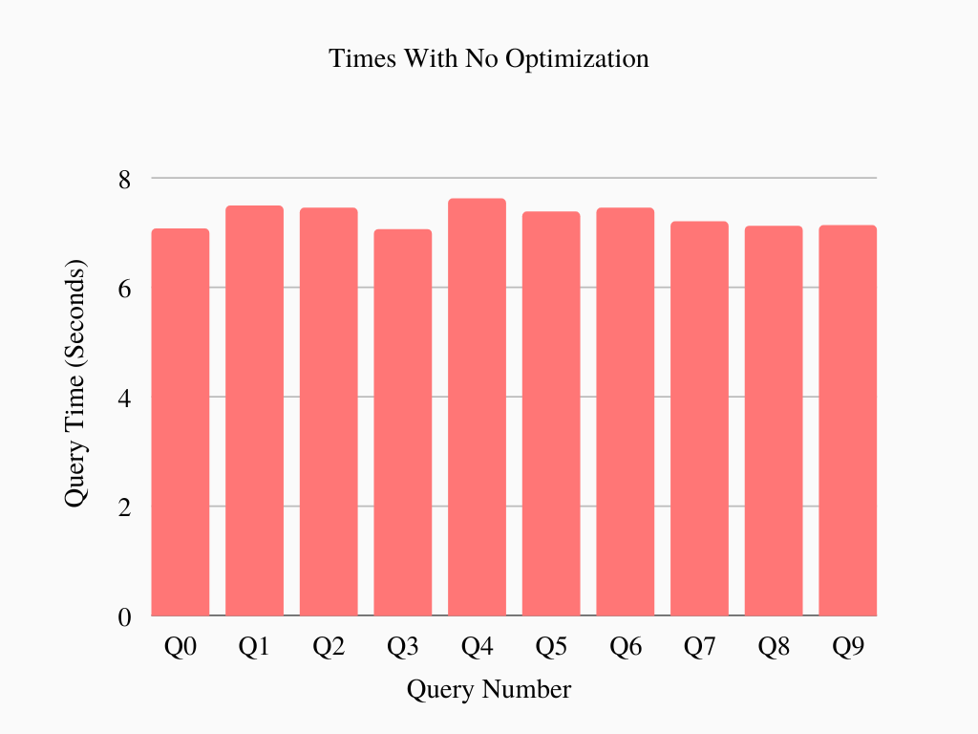
Notes:
No optimization
6-8 seconds for each search
100% accurate

Slide 41
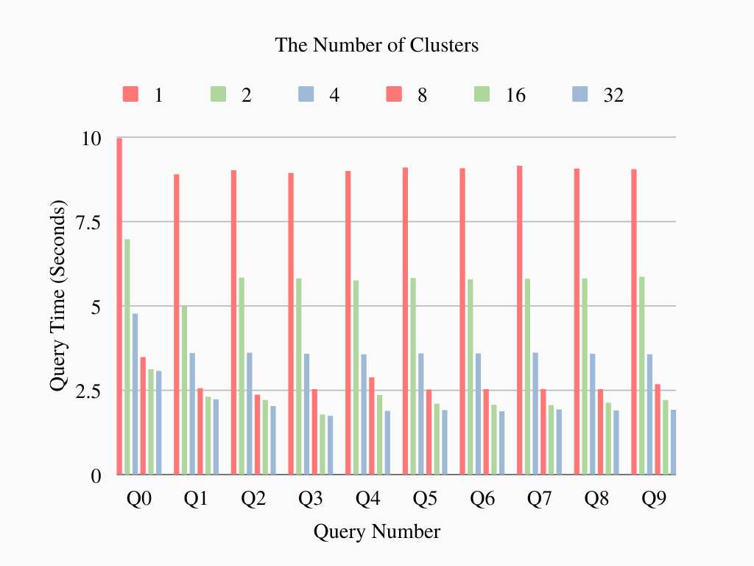
Notes:
Centroids increased = times decreased
Ideally time eventually 0 sec
Constant factor cannot be reduced = reaches limit of around 2 seconds
Always some amount of wait time but decreased by almost 4x when k=32

Slide 42
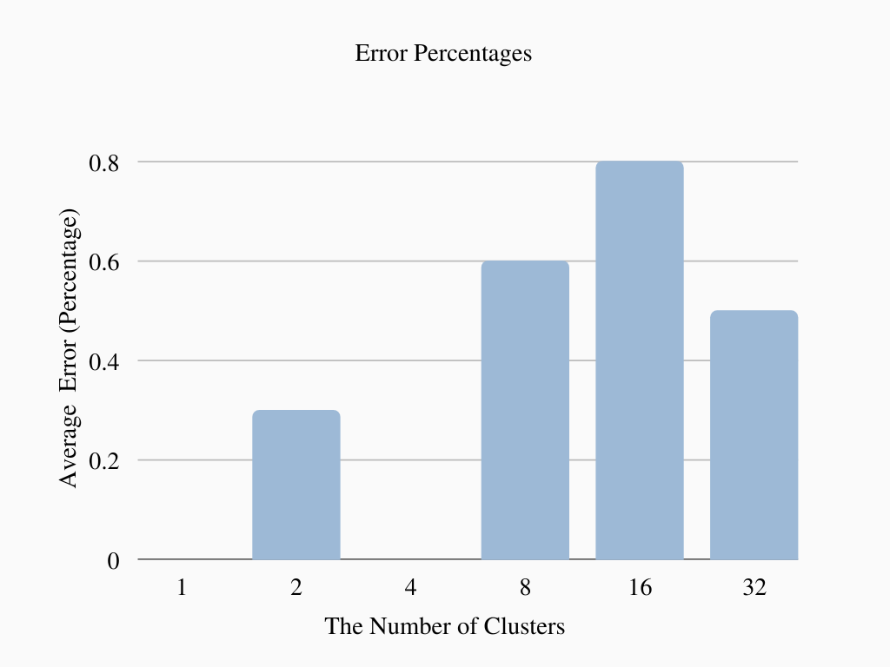
Notes:
As mentioned there is risk of inaccurate results with k-means
X-axis: number of clusters
Y-axis: average percentage error of cosine similarity scores between the optimal and accelerated process for each k
Error occur by chance = no constant pattern
Overall increases as number clusters increase
Despite that stay under 1%
Acceleration = speed 4x as fast with 99% accuracy = good trade

Slide 43
RESULTS
Query: Cognitive science is the study of the human mind and brain => 7.57 seconds (No optimization)
Result Similarity File Page Text
-----—-- ---------—- -------------------------------———————- ------ ---------------------------------------------------------------------------------------------------------------------------------------------------------------------
1 0.873885 KrillPlatekGoetzShackelford2007.txt 1 Abstract: Cognitive neuroscience, the study of brain-behavior relationships, has long attempted to map the brain.
2 0.842273 MansvelderVerhoogGoriounova2019.txt 5 One of the major goals in Neuroscience is to understand the neuronal basis of human learning and memory.
3 0.838349 Fodor1981.txt 1 Psychological explanations of behavior refer liberally to the mind and to states, operations and processes of the mind.
4 0.830323 NorenzayanHeine2005.txt 2 Cognitive science has relied heavily on the idea that the human mind is analogous to the computer (Block,1995).
5 0.83019 Chalmers2011.txt 2 The mathematical theory o f computation in the abstract is well -understood, but cognitive science and artificial intelligence
Query: Cognitive science is the study of the human mind and brain => 3.47 seconds (Optimization when k=8)
Result Similarity File Page Text
-------- ---------—--- ---------------------------------——————— ------ -----------------------------------------------------------------------------------------------------------------——————————————-----
1 0.873885 KrillPlatekGoetzShackelford2007.txt 1 Abstract: Cognitive neuroscience, the study of brain-behavior relationships, has long attempted to map the brain.
2 0.842273 MansvelderVerhoogGoriounova2019.txt 5 One of the major goals in Neuroscience is to understand the neuronal basis of human learning and memory.
3 0.838349 Fodor1981.txt 1 Psychological explanations of behavior refer liberally to the mind and to states, operations and processes of the mind.
4 0.826757 Ritter2004.txt 18 Computational explorations in cognitive neuroscience: Understanding the mind by simulating the brain.
5 0.826301 SwodenSchyns2006.txt 8 Decoding the visual and subjective contents of the human brain.
Notes:
Final outcome: file, page, text
No optimization vs optimization with 8 clusters
Yellow are diff bc not part of closest cluster that was searched in
Still relevant and serves purpose
User can receive what searching for

Slide 44
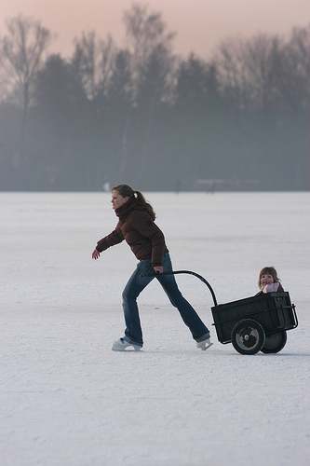
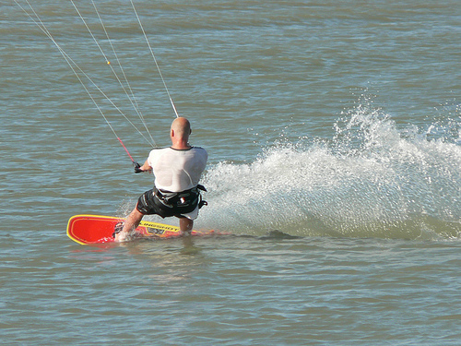
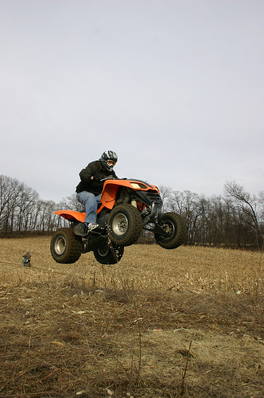
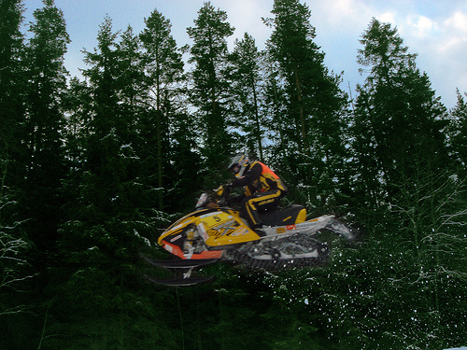
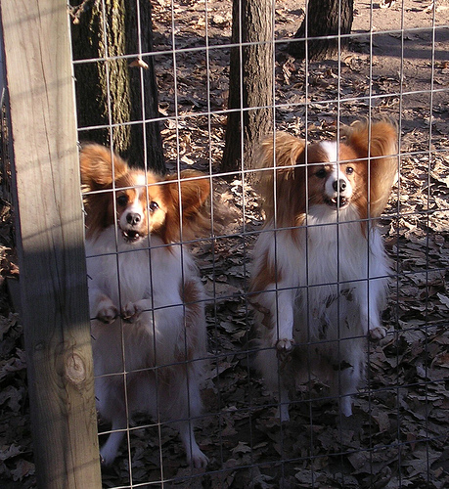
RESULTS
Query: sports
94232465_a135df2711.jpg A woman in a red jacket is skiing down a snowy hill .
49553964_cee950f3ba.jpg A man is wakeboarding in the ocean .
109823395_6fb423a90f.jpg A person on a dirt bike is riding through the air on a dirt road .
109738763_90541ef30d.jpg A person in a red jacket is snowboarding .
98377566_e4674d1ebd.jpg Two small dogs are standing in a doorway .
Notes:
Final outcome: file, page, text
No optimization vs optimization with 8 clusters
Yellow are diff bc not part of closest cluster that was searched in
Still relevant and serves purpose
User can receive what searching for

Slide 45
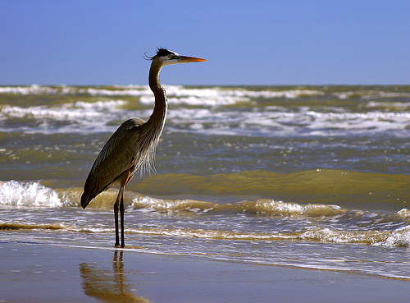
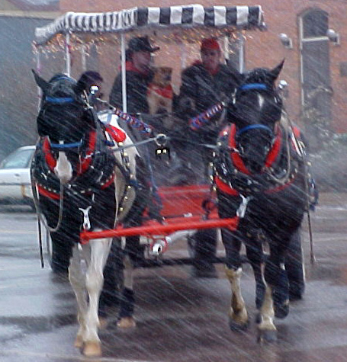
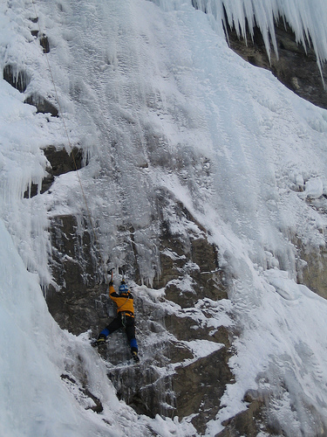
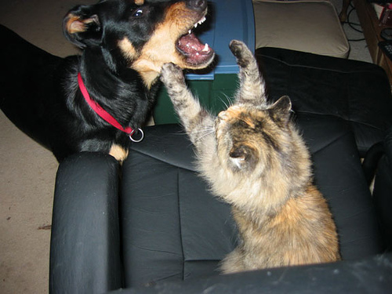
RESULTS
Query: snowy landscape
99679241_adc853a5c0.jpg A white bird is flying through the water .
98377566_e4674d1ebd.jpg Two small dogs are standing in a doorway .
97731718_eb7ba71fd3.jpg A group of horses on a track .
97577988_65e2eae14a.jpg A man in a red jacket is standing on a snowy mountain .
97406261_5eea044056.jpg A dog is biting a white dog .
Notes:
Final outcome: file, page, text
No optimization vs optimization with 8 clusters
Yellow are diff bc not part of closest cluster that was searched in
Still relevant and serves purpose
User can receive what searching for

Slide 46
FUTURE WORK
These are multiple next steps that can be taken to build on these findings:
Optimizing for the ability to search and sort through an even larger mass of files
Improving the accuracy of search results
Cleaning text: checking and removing words that aren’t words
More detailed image captions
Finishing handwritten text recognition system
Better format recognition in OCR

Slide 47
ACKNOWLEDGEMENTS
We would like to sincerely thank:
Optiver, for providing us their space during this internship
Mark Galassi and Rhonda Crespo, for running the ICR and giving us this research opportunity
Our fellow interns and Mark Emry, for being supportive along the way
Jim Davies, our mentor, for guiding us through this project.

Slide 48
THANK YOU!

