Slide 1

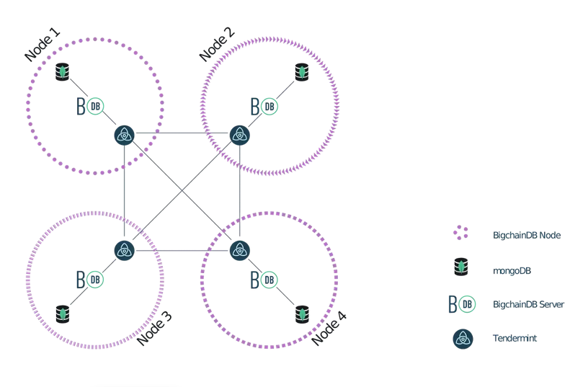


Multi-Agent System
Multi-Agent System
Agents Dimension
Velluscinum
Agents Dimension
Velluscinum
.deploy
BigChainDB Network
A1
.deploy
A1
.transfer
.transfer
A2
.stamp
A2
.stamp
.balance
An
.balance
An

