Slide 1


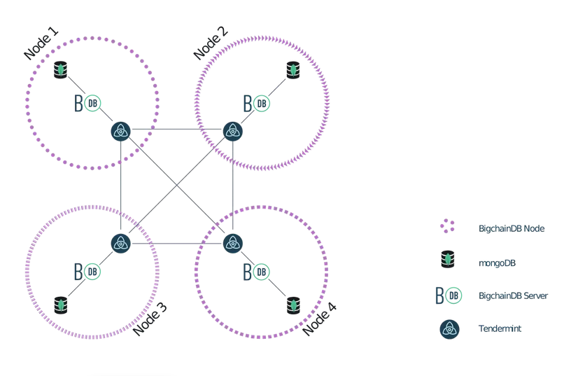

Multi-Agent System
Agents Dimension
Middleware
BigChainDB Network
.deploy
.transfer
.build
.stamp
.balance
An = Jason Agent
.action = An Internal Action
A1
A2
An

