Slide 1
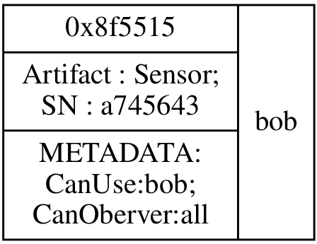
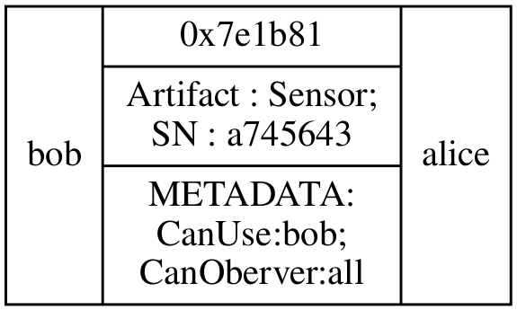
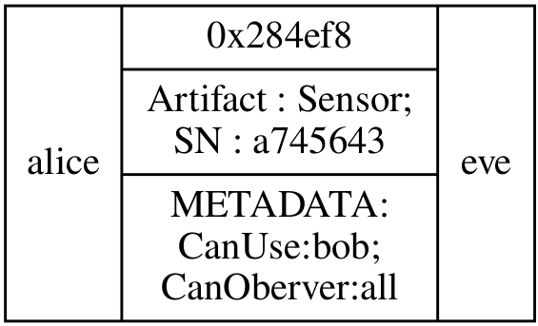
Distributed
Ledger
Technology
Multi-agent
System
Agents Dimension
Environment Dimension
Create or Transfer an Asset
Artifact
Consult an Asset
Use or Observe an Artifact
bob
alice
eve

Slide 2
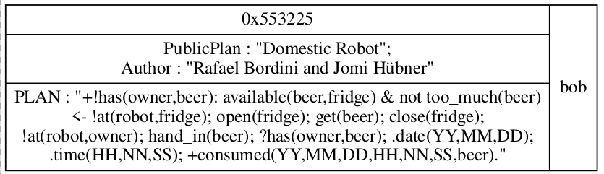
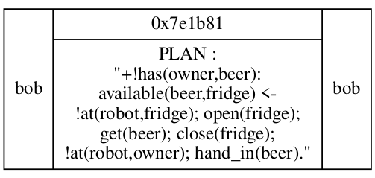
Distributed Ledger Technology
alice
Create or Transfer an Asset
eve
bob
Consult an Asset
Multi-agent
System
Multi-agent
System
Multi-agent
System

Slide 3
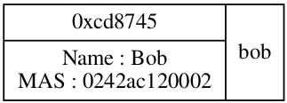
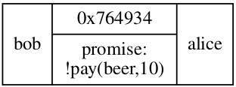
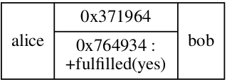
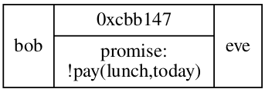
Distributed Ledger Technology
Create or Transfer an Asset
bob
alice
Consult an Asset
eve
Multi-agent
System
Multi-agent
System
Multi-agent
System

Slide 4






Distributed Ledger Technology
Create or Transfer an Asset
Multi-agent
System
Multi-agent
System
eve
alice
bob

