Slide 1



Cognitive Hardware on Network Research Group
ChonIDE Project
CHON Group^{1,2}
1. Centro Federal de Educação Tecnológica (CEFET/RJ) - 2. Universidade Federal Fluminense (UFF), Brasil
14 de Setembro 2023

Slide 2
ChonIDE
ChonIDE is an IDE to support the development of Embedded MAS considering:
Reasoning layer;
Serial layer;
Firmware layer.
It enables:
to develop and program an Embedded MAS using a single IDE;
to embed MAS and monitor their agents' remotely.
SOUZA DE JESUS, V., MORI LAZARIN, N., PANTOJA, C.E., VAZ ALVES, G., RAMOS ALVES LIMA, G., VITERBO, J. (2023). An IDE to Support the Development of Embedded Multi-Agent Systems. In: Mathieu, P., Dignum, F., Novais, P., De la Prieta, F. (eds) Advances in Practical Applications of Agents, Multi-Agent Systems, and Cognitive Mimetics. The PAAMS Collection. PAAMS 2023. Lecture Notes in Computer Science(), vol 13955. Springer, Cham. https://doi.org/10.1007/978-3-031-37616-0_297.
Notes:
<número>

Slide 3
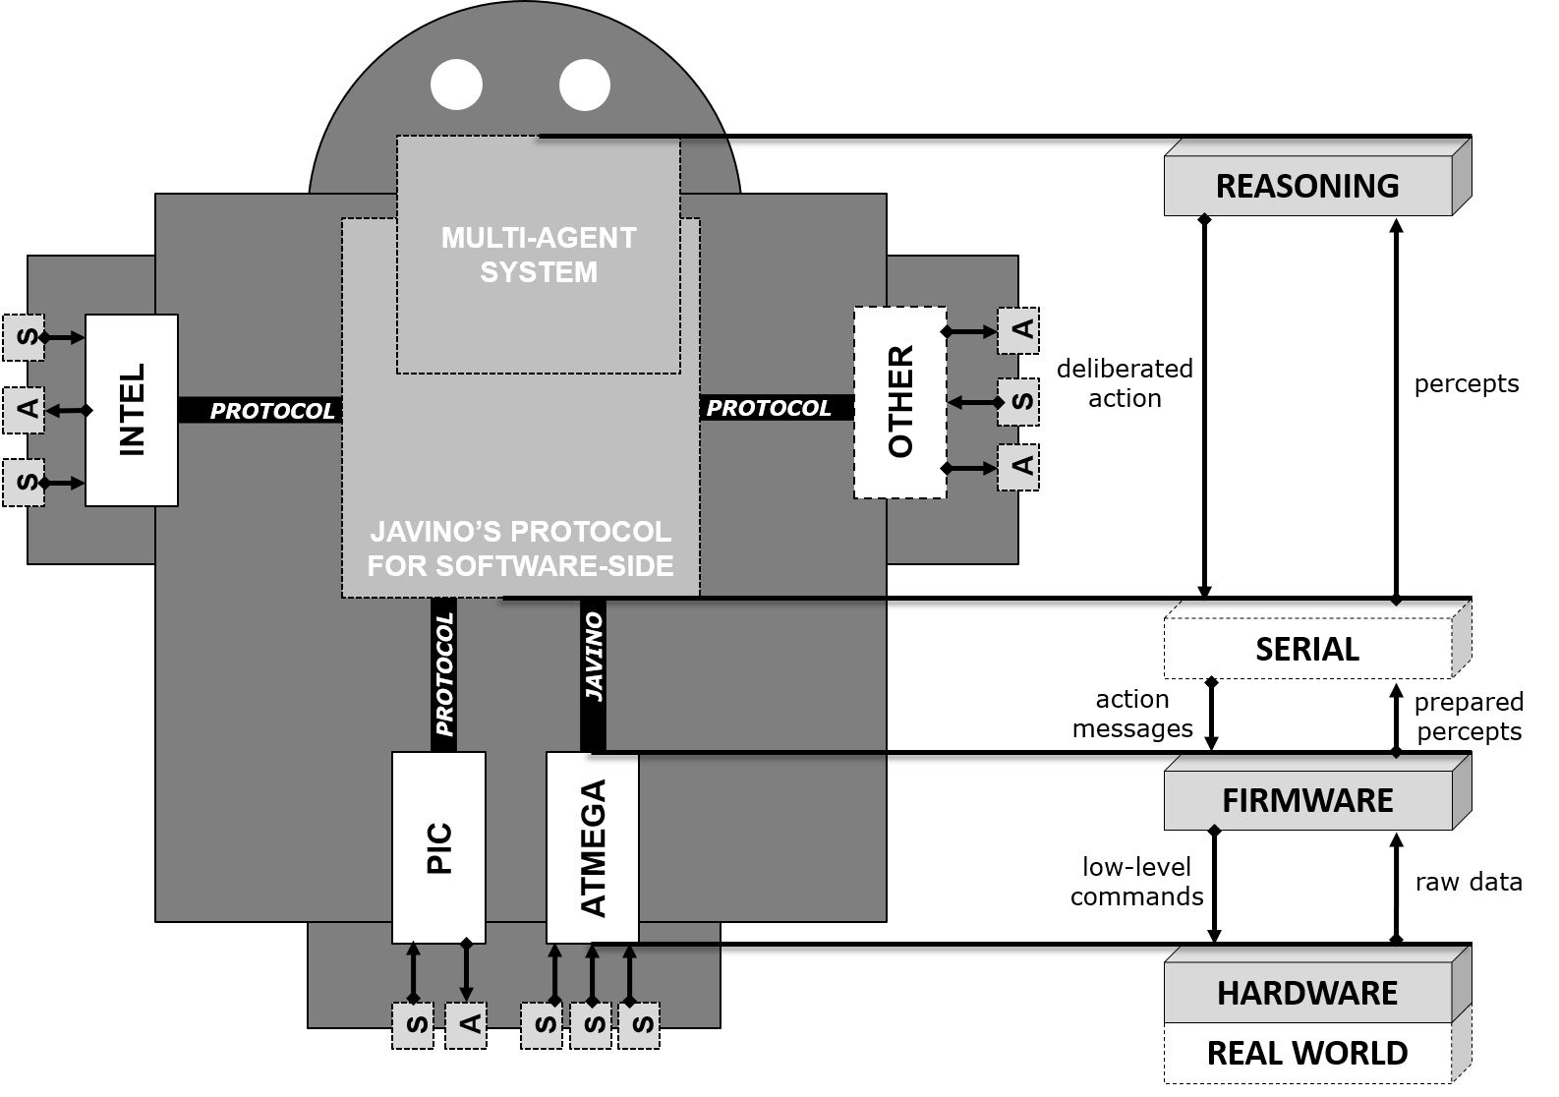




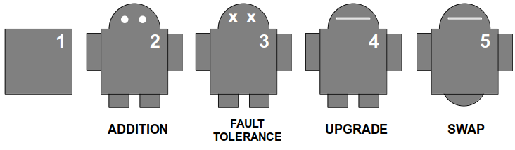
Jason Embedded and Packages
A
J
ARGO
Bio-Inspired Protocols
C
Communicators
PANTOJA, CARLOS EDUARDO; JESUS, VINICIUS SOUZA; LAZARIN, NILSON MORI; VITERBO, JOSÉ. A Spin-off Version of Jason for IoT and Embedded Multiagent Systems. In : Proceedings of the 12nd Brazilian Conference on Intelligent Systems, BRACIS 2023, Belo Horizonte, Brazil, 2023
Notes:
<número>

Slide 4
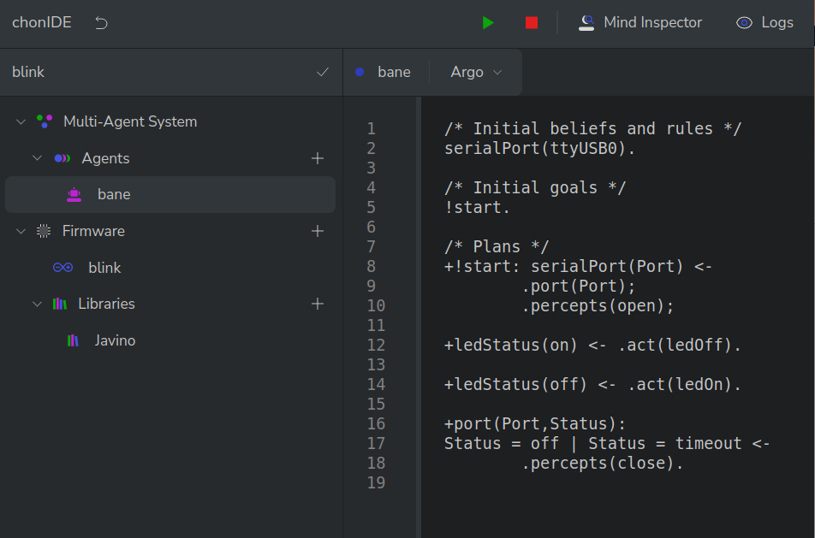
ChonIDE
Souza de Jesus, V., Mori Lazarin, N., Pantoja, C.E., Vaz Alves, G., Ramos Alves de Lima, G., Viterbo, J. (2023). An IDE to Support the Development of Embedded Multi-Agent Systems. In: Mathieu, P., Dignum, F., Novais, P., De la Prieta, F. (eds) Advances in Practical Applications of Agents, Multi-Agent Systems, and Cognitive Mimetics. The PAAMS Collection. PAAMS 2023. Lecture Notes in Computer Science(), vol 13955. Springer, Cham. https://doi.org/10.1007/978-3-031-37616-0_29
Notes:
<número>

Slide 5
IDE LATEST VERSION
Notes:
<número>

Slide 6
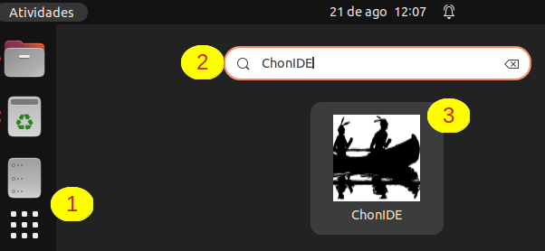
ChonIDE: Icon e How to Enter

Slide 7
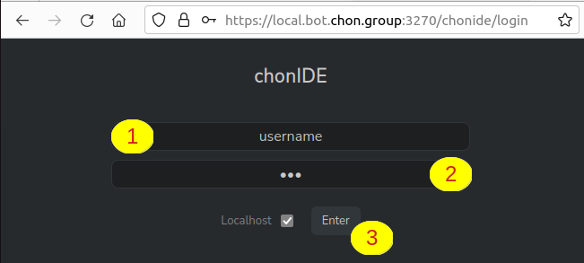
ChonIDE: Loggin In

Slide 8
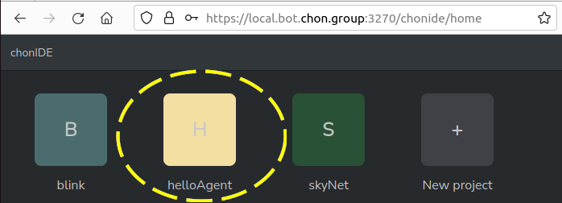
ChonIDE: Projects

Slide 9
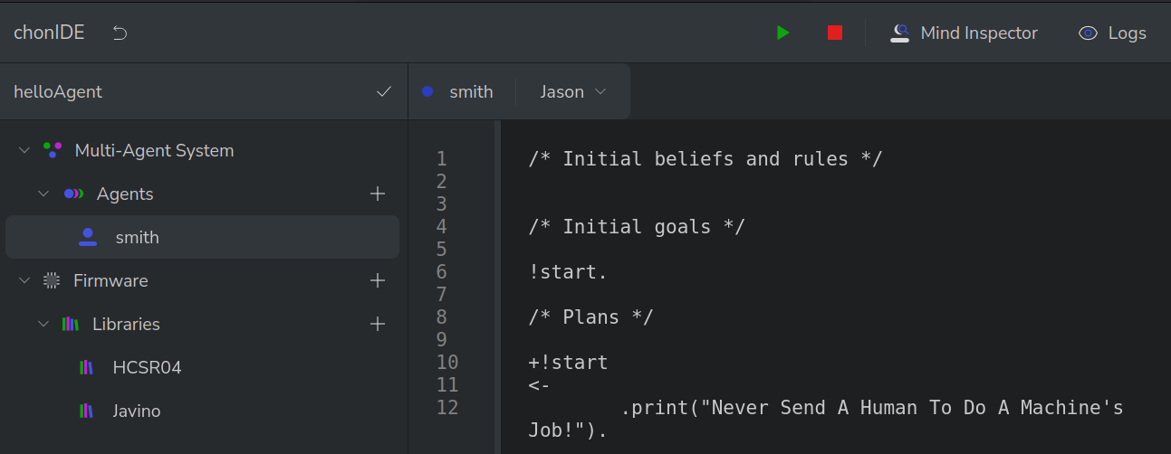
ChonIDE: Embedded Multiagent Explorer

Slide 10
ChonIDE: Agent Programming

Slide 11
ChonIDE: IDE Coder

Slide 12

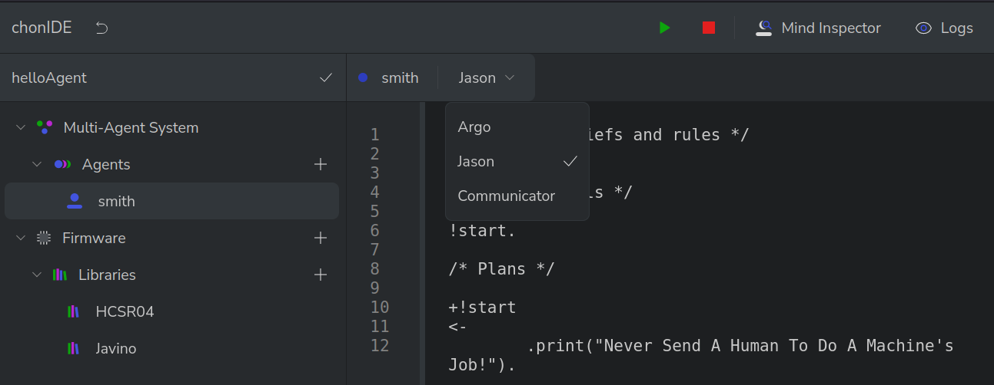
ChonIDE: Agents Type

Slide 13

ChonIDE: Running a Multiagent System

Slide 14
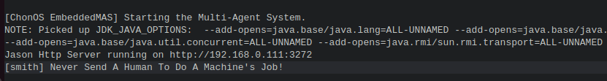
ChonIDE: Multiagent Log and Console

Slide 15
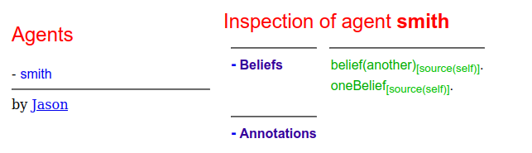
ChonIDE: Debugging a Multiagent System

Slide 16
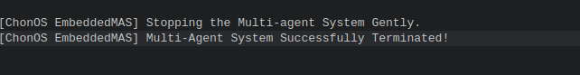
ChonIDE: Stopping a Multiagent System

Slide 17
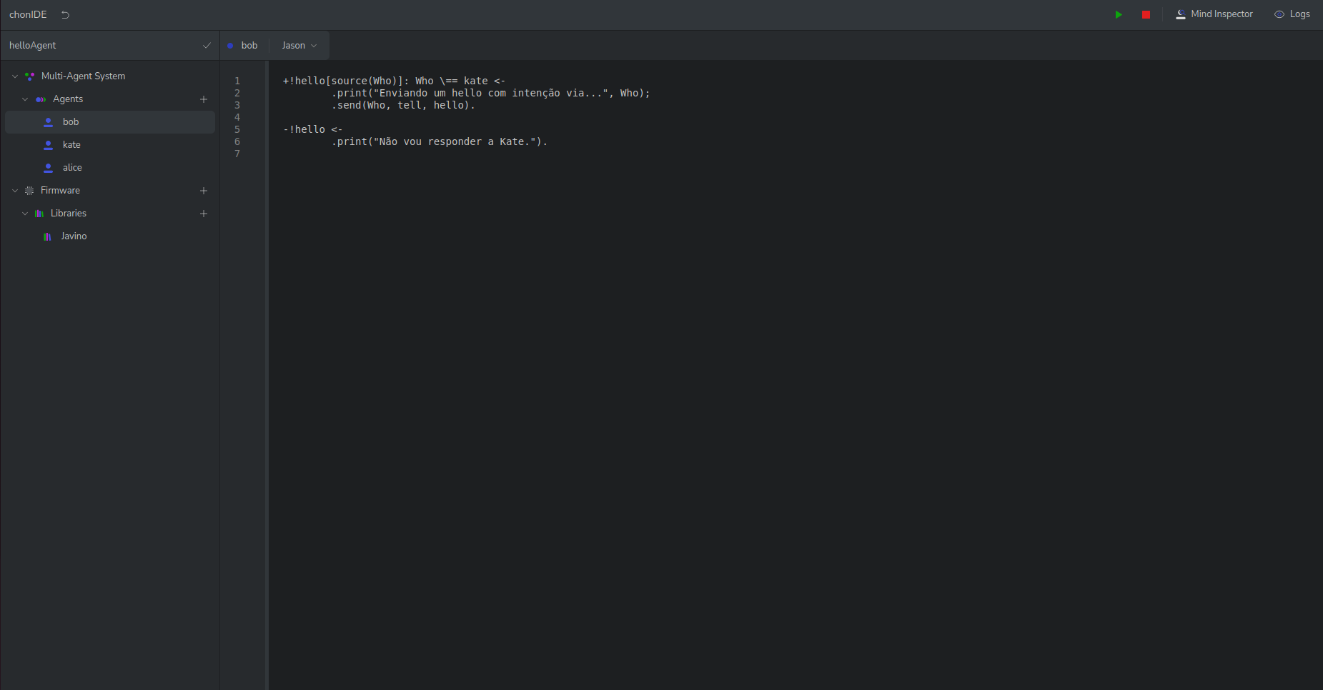
ChonIDE: Latest Version
Notes:
<número>

Slide 18
ChonIDE: Augmented Coder
Augmented Coder
Generic for AgentSpeak, Arduino C, XML, Json and Java;
Comply with Language Server Protocol (LSP);
Syntax Highlight, Code Complete and similar programmer-based functions;
Flexible Canva;
Multiple tabs.
Notes:
<número>

Slide 19
ChonIDE: Augmented Coder
Notes:
<número>

Slide 20
ChonIDE: Augmented Coder
Notes:
<número>

Slide 21
ChonIDE: Augmented Coder
Notes:
<número>

Slide 22
ChonIDE: Augmented Coder
Notes:
<número>

Slide 23
ChonIDE: Augmented Coder
Notes:
<número>

Slide 24
ChonIDE: Augmented Coder
Notes:
<número>

Slide 25
ChonIDE: Multiple Tabs
Notes:
<número>

Slide 26
ChonIDE: Multiple Tabs
Notes:
<número>

Slide 27
ChonIDE: Multiple Tabs
Notes:
<número>

Slide 28
ChonIDE: Multiple Tabs
Notes:
<número>

Slide 29
ChonIDE: Project Explorer
Project Explorer
Retractable;
Extensible and Modularized Functionalities.
Notes:
<número>

Slide 30
ChonIDE: Projects Explorer
Notes:
<número>

Slide 31
ChonIDE: Projects Explorer
Notes:
<número>

Slide 32
ChonIDE: Projects Explorer
Notes:
<número>

Slide 33
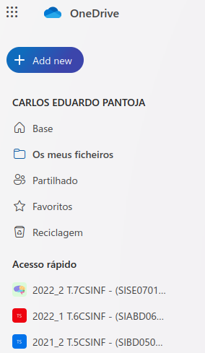
ChonIDE: Inspiration 1
Notes:
<número>

Slide 34

ChonIDE: Inspiration 1
Notes:
<número>

Slide 35

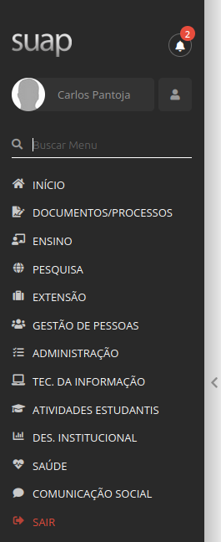
ChonIDE: Inspiration 2 and 3
Notes:
<número>

Slide 36


ChonIDE: Inspiration 2 and 3
Notes:
<número>

Slide 37
ChonIDE: Modularized Functionalities
Notes:
<número>

Slide 38
ChonIDE: Modularized Functionalities
MAS
Notes:
<número>

Slide 39
ChonIDE: Modularized Functionalities
MAS
F
Notes:
<número>

Slide 40
ChonIDE: Modularized Functionalities
MAS
F
git
Notes:
<número>

Slide 41
ChonIDE: Modularized Functionalities
MAS
F
git
Notes:
<número>

Slide 42
ChonIDE: Console & Agent Tracer
Console & Agent Tracer
Wtee openning in the main page;
Colored traces;
Flexible Canva;
OS Console.
Notes:
<número>

Slide 43
ChonIDE: Console & Agent Tracer
Notes:
<número>

Slide 44
ChonIDE: Console & Agent Tracer
Notes:
<número>

Slide 45
ChonIDE: Console & Agent Tracer
Notes:
<número>

Slide 46
ChonIDE: Console & Agent Tracer
Notes:
<número>

Slide 47
ChonIDE: Console & Agent Tracer
Notes:
<número>

Slide 48
ChonIDE: Resource Monitors
Resource Monitors
Integrated Mind Inspector (Artefacts, Societal, Agency);
Serial Communication Functionalities (Firmware, Javino Command Line);
Flexible Canva;
Notes:
<número>

Slide 49
ChonIDE: Resource Monitors
Notes:
<número>

Slide 50
ChonIDE: Resource Monitors
Mind
Notes:
<número>

Slide 51
ChonIDE: Resource Monitors
Mind
Serial
Comm
Notes:
<número>

Slide 52
ChonIDE: Resource Monitors
Mind
Serial
Comm
Notes:
<número>

Slide 53
ChonIDE: Resource Monitors
M
SC
Notes:
<número>

Slide 54
ChonIDE: Project Bar
Project Bar
Basic Functionalities (run, stop, criogenic, download, upload, etc.);
Notes:
<número>

Slide 55
ChonIDE: General Overview
Notes:
<número>

Slide 56
ChonIDE: General Overview
Project Bar
Augmented Coder
Project
Explorer
Resource
Monitor
Resource
Monitor
Console & Agent Tracer
Notes:
<número>

Slide 57
Agradecimentos
OBRIGADO!
pantoja@cefet-rj.br
nilson.lazarin@cefet-rj.br
vsjesus@id.uff.br
fabiancpbm@gmail.com
Notes:
<número>

