Slide 1






Introduction to Distributed and Embedded Multi-agent Systems
Carlos Eduardo Pantoja¹
Nilson Mori Lazarin^{1,2}
1. Centro Federal de Educação Tecnológica (CEFET/RJ) - 2. Universidade Federal Fluminense (UFF), Brasil
August 2024

Slide 2

INTRODUCTION
Notes:
<número>

Slide 3

Who we are?
The Cognitive Hardware on Networks group or
CHON Group.
Notes:
<número>

Slide 4

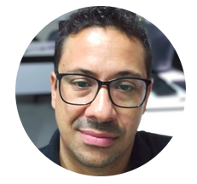
Who we are?
The Cognitive Hardware on Networks group or
CHON Group.
Prof.NILSON MORI LAZARIN
CEFET/RJ and UFF
Notes:
<número>

Slide 5
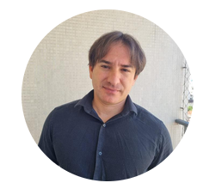
Who we are?
The Cognitive Hardware on Networks group or
CHON Group.
Prof.NILSON MORI LAZARIN
Prof. CARLOS PANTOJA
CEFET/RJ and UFF
CEFET/RJ
Notes:
<número>

Slide 6




Who we are?
The Cognitive Hardware on Networks group or
CHON Group.
Prof.NILSON MORI LAZARIN
Prof. CARLOS PANTOJA
CEFET/RJ and UFF
CEFET/RJ
Notes:
<número>

Slide 7
Where we have been?
This workshop is part of:
Notes:
<número>

Slide 8
Where we have been?
This workshop is part of:
  2 undergratuate courses (CEFET/RJ Maria da Graça and Nova Friburgo);
Notes:
<número>

Slide 9
Where we have been?
This workshop is part of:
  2 undergratuate courses (CEFET/RJ Maria da Graça and Nova Friburgo);
  1 graduate course (M.Sc. and Ph.D. at UFF);
Notes:
<número>

Slide 10
Where we have been?
This workshop is part of:
  2 undergratuate courses (CEFET/RJ Maria da Graça and Nova Friburgo);
  1 graduate course (M.Sc. and Ph.D. at UFF);
  It was presented at: UTFPR, IFSC, IFC, CEFET/RJ, UFRJ, UFF, and Estácio;
Notes:
<número>

Slide 11
Where we have been?
This workshop is part of:
  2 undergratuate courses (CEFET/RJ Maria da Graça and Nova Friburgo);
  1 graduate course (M.Sc. and Ph.D. at UFF);
  It was presented at: UTFPR, IFSC, IFC, CEFET/RJ, UFRJ, UFF, and Estácio;
  It was also presented at: WESAAC’21, WESAAC’23, and SEKE’23,
Notes:
<número>

Slide 12
Goals
This workshop goals are:
Notes:
<número>

Slide 13
Goals
This workshop goals are:
  To experience the development process of Embedded MAS using BDI Agents and Jason.
Notes:
<número>

Slide 14
Goals
This workshop goals are:
  To experience the development process of Embedded MAS using BDI Agents and Jason.
  to learn how to collaborate using IoT and embedded agents in distributed scenarios.
Notes:
<número>

Slide 15
Goals
This workshop goals are:
  To experience the development process of Embedded MAS using BDI Agents and Jason.
  to learn how to collaborate using IoT and embedded agents in distributed scenarios.
  … and the most important of all...
Notes:
<número>

Slide 16

Goals
Notes:
<número>

Slide 17

THE DEVELOPMENT
TOOLS
Notes:
<número>

Slide 18

ChonIDE
Souza de Jesus, V., Mori Lazarin, N., Pantoja, C.E., Vaz Alves, G., Ramos Alves de Lima, G., Viterbo, J. (2023). An IDE to Support the Development of Embedded Multi-Agent Systems. In: Mathieu, P., Dignum, F., Novais, P., De la Prieta, F. (eds) Advances in Practical Applications of Agents, Multi-Agent Systems, and Cognitive Mimetics. The PAAMS Collection. PAAMS 2023. Lecture Notes in Computer Science(), vol 13955. Springer, Cham. https://doi.org/10.1007/978-3-031-37616-0_29

Slide 19

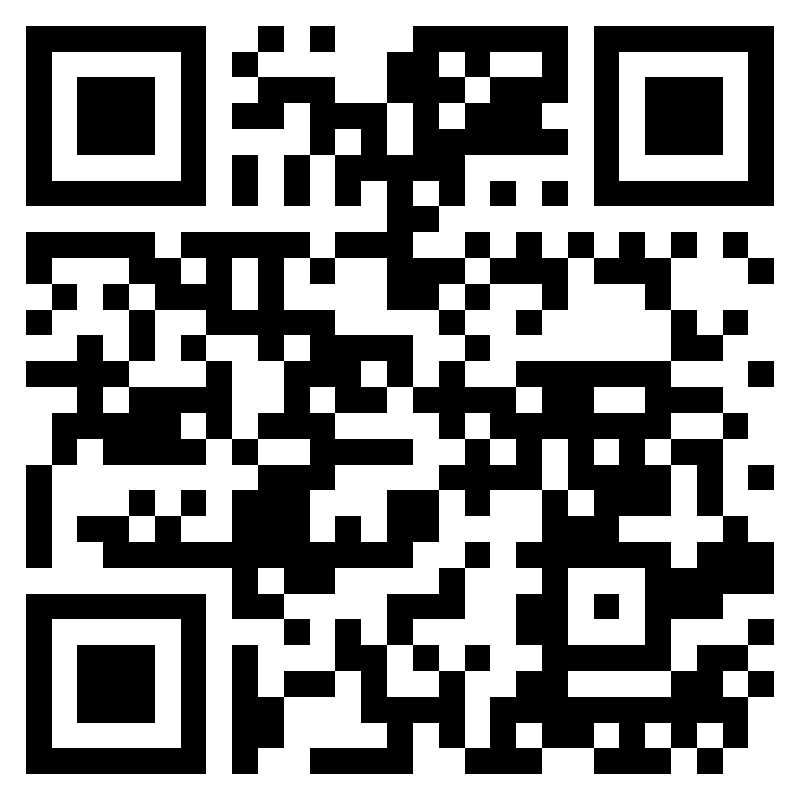
ChonIDE
How to Installhttps://github.com/chon-group/chonIDE/tree/main/doc

Slide 20
ChonIDE
How to Installhttps://github.com/chon-group/chonIDE/tree/main/doc

Slide 21
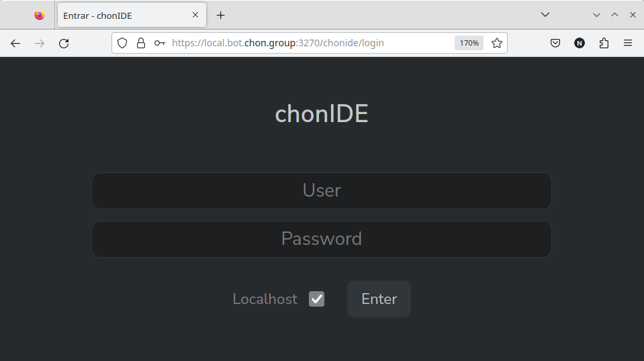
ChonIDE
Souza de Jesus, V., Mori Lazarin, N., Pantoja, C.E., Vaz Alves, G., Ramos Alves de Lima, G., Viterbo, J. (2023). An IDE to Support the Development of Embedded Multi-Agent Systems. In: Mathieu, P., Dignum, F., Novais, P., De la Prieta, F. (eds) Advances in Practical Applications of Agents, Multi-Agent Systems, and Cognitive Mimetics. The PAAMS Collection. PAAMS 2023. Lecture Notes in Computer Science(), vol 13955. Springer, Cham. https://doi.org/10.1007/978-3-031-37616-0_29

Slide 22

ChonIDE: helloAgent
Souza de Jesus, V., Mori Lazarin, N., Pantoja, C.E., Vaz Alves, G., Ramos Alves de Lima, G., Viterbo, J. (2023). An IDE to Support the Development of Embedded Multi-Agent Systems. In: Mathieu, P., Dignum, F., Novais, P., De la Prieta, F. (eds) Advances in Practical Applications of Agents, Multi-Agent Systems, and Cognitive Mimetics. The PAAMS Collection. PAAMS 2023. Lecture Notes in Computer Science(), vol 13955. Springer, Cham. https://doi.org/10.1007/978-3-031-37616-0_29

Slide 23
ChonIDE: helloAgent
Souza de Jesus, V., Mori Lazarin, N., Pantoja, C.E., Vaz Alves, G., Ramos Alves de Lima, G., Viterbo, J. (2023). An IDE to Support the Development of Embedded Multi-Agent Systems. In: Mathieu, P., Dignum, F., Novais, P., De la Prieta, F. (eds) Advances in Practical Applications of Agents, Multi-Agent Systems, and Cognitive Mimetics. The PAAMS Collection. PAAMS 2023. Lecture Notes in Computer Science(), vol 13955. Springer, Cham. https://doi.org/10.1007/978-3-031-37616-0_29

Slide 24
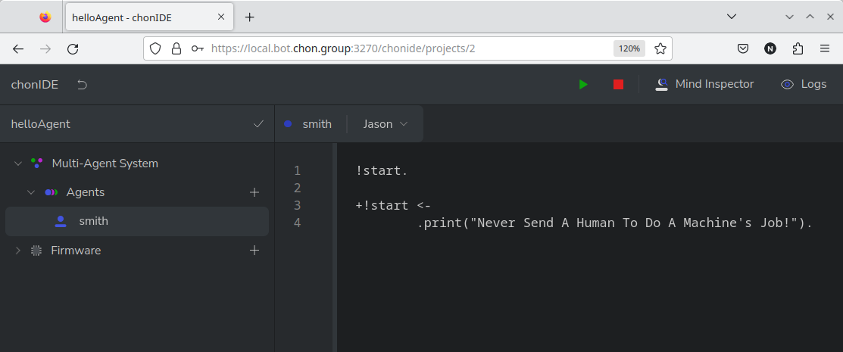
ChonIDE: helloAgent
Souza de Jesus, V., Mori Lazarin, N., Pantoja, C.E., Vaz Alves, G., Ramos Alves de Lima, G., Viterbo, J. (2023). An IDE to Support the Development of Embedded Multi-Agent Systems. In: Mathieu, P., Dignum, F., Novais, P., De la Prieta, F. (eds) Advances in Practical Applications of Agents, Multi-Agent Systems, and Cognitive Mimetics. The PAAMS Collection. PAAMS 2023. Lecture Notes in Computer Science(), vol 13955. Springer, Cham. https://doi.org/10.1007/978-3-031-37616-0_29

Slide 25
ChonIDE: helloAgent
Souza de Jesus, V., Mori Lazarin, N., Pantoja, C.E., Vaz Alves, G., Ramos Alves de Lima, G., Viterbo, J. (2023). An IDE to Support the Development of Embedded Multi-Agent Systems. In: Mathieu, P., Dignum, F., Novais, P., De la Prieta, F. (eds) Advances in Practical Applications of Agents, Multi-Agent Systems, and Cognitive Mimetics. The PAAMS Collection. PAAMS 2023. Lecture Notes in Computer Science(), vol 13955. Springer, Cham. https://doi.org/10.1007/978-3-031-37616-0_29

Slide 26
ChonIDE: helloAgent
Souza de Jesus, V., Mori Lazarin, N., Pantoja, C.E., Vaz Alves, G., Ramos Alves de Lima, G., Viterbo, J. (2023). An IDE to Support the Development of Embedded Multi-Agent Systems. In: Mathieu, P., Dignum, F., Novais, P., De la Prieta, F. (eds) Advances in Practical Applications of Agents, Multi-Agent Systems, and Cognitive Mimetics. The PAAMS Collection. PAAMS 2023. Lecture Notes in Computer Science(), vol 13955. Springer, Cham. https://doi.org/10.1007/978-3-031-37616-0_29

Slide 27
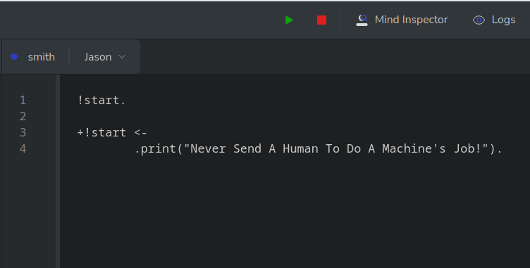
ChonIDE: helloAgent
Souza de Jesus, V., Mori Lazarin, N., Pantoja, C.E., Vaz Alves, G., Ramos Alves de Lima, G., Viterbo, J. (2023). An IDE to Support the Development of Embedded Multi-Agent Systems. In: Mathieu, P., Dignum, F., Novais, P., De la Prieta, F. (eds) Advances in Practical Applications of Agents, Multi-Agent Systems, and Cognitive Mimetics. The PAAMS Collection. PAAMS 2023. Lecture Notes in Computer Science(), vol 13955. Springer, Cham. https://doi.org/10.1007/978-3-031-37616-0_29

Slide 28

ChonIDE: helloAgent
Souza de Jesus, V., Mori Lazarin, N., Pantoja, C.E., Vaz Alves, G., Ramos Alves de Lima, G., Viterbo, J. (2023). An IDE to Support the Development of Embedded Multi-Agent Systems. In: Mathieu, P., Dignum, F., Novais, P., De la Prieta, F. (eds) Advances in Practical Applications of Agents, Multi-Agent Systems, and Cognitive Mimetics. The PAAMS Collection. PAAMS 2023. Lecture Notes in Computer Science(), vol 13955. Springer, Cham. https://doi.org/10.1007/978-3-031-37616-0_29

Slide 29

ChonIDE: helloAgent
Souza de Jesus, V., Mori Lazarin, N., Pantoja, C.E., Vaz Alves, G., Ramos Alves de Lima, G., Viterbo, J. (2023). An IDE to Support the Development of Embedded Multi-Agent Systems. In: Mathieu, P., Dignum, F., Novais, P., De la Prieta, F. (eds) Advances in Practical Applications of Agents, Multi-Agent Systems, and Cognitive Mimetics. The PAAMS Collection. PAAMS 2023. Lecture Notes in Computer Science(), vol 13955. Springer, Cham. https://doi.org/10.1007/978-3-031-37616-0_29

Slide 30
ChonIDE: helloAgent
Pantoja, C.E., Jesus, V.S.d., Lazarin, N.M., Viterbo, J. (2023). A Spin-off Version of Jason for IoT and Embedded Multi-Agent Systems. In: Naldi, M.C., Bianchi, R.A.C. (eds) Intelligent Systems. BRACIS 2023. Lecture Notes in Computer Science(), vol 14195. Springer, Cham. https://doi.org/10.1007/978-3-031-45368-7_25

Slide 31
ChonIDE: helloAgent
Pantoja, C.E., Jesus, V.S.d., Lazarin, N.M., Viterbo, J. (2023). A Spin-off Version of Jason for IoT and Embedded Multi-Agent Systems. In: Naldi, M.C., Bianchi, R.A.C. (eds) Intelligent Systems. BRACIS 2023. Lecture Notes in Computer Science(), vol 14195. Springer, Cham. https://doi.org/10.1007/978-3-031-45368-7_25

Slide 32
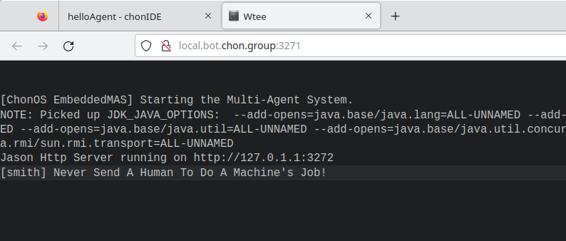
ChonIDE: helloAgent
Pantoja, C.E., Jesus, V.S.d., Lazarin, N.M., Viterbo, J. (2023). A Spin-off Version of Jason for IoT and Embedded Multi-Agent Systems. In: Naldi, M.C., Bianchi, R.A.C. (eds) Intelligent Systems. BRACIS 2023. Lecture Notes in Computer Science(), vol 14195. Springer, Cham. https://doi.org/10.1007/978-3-031-45368-7_25

Slide 33
ChonIDE: helloAgent
Bordini, R.H., Hübner, J.F. (2006). BDI Agent Programming in AgentSpeak Using Jason . In: Toni, F., Torroni, P. (eds) Computational Logic in Multi-Agent Systems. CLIMA 2005. Lecture Notes in Computer Science(), vol 3900. Springer, Berlin, Heidelberg. https://doi.org/10.1007/11750734_9

Slide 34
ChonIDE: helloAgent
Bordini, R.H., Hübner, J.F. (2006). BDI Agent Programming in AgentSpeak Using Jason . In: Toni, F., Torroni, P. (eds) Computational Logic in Multi-Agent Systems. CLIMA 2005. Lecture Notes in Computer Science(), vol 3900. Springer, Berlin, Heidelberg. https://doi.org/10.1007/11750734_9

Slide 35
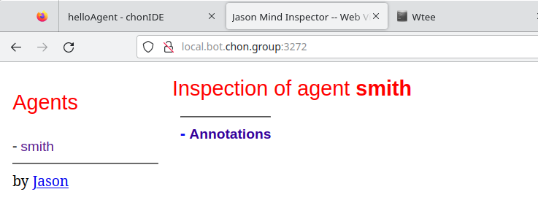
ChonIDE: helloAgent
Bordini, R.H., Hübner, J.F. (2006). BDI Agent Programming in AgentSpeak Using Jason . In: Toni, F., Torroni, P. (eds) Computational Logic in Multi-Agent Systems. CLIMA 2005. Lecture Notes in Computer Science(), vol 3900. Springer, Berlin, Heidelberg. https://doi.org/10.1007/11750734_9

Slide 36
ChonIDE: helloAgent
Souza de Jesus, V., Mori Lazarin, N., Pantoja, C.E., Vaz Alves, G., Ramos Alves de Lima, G., Viterbo, J. (2023). An IDE to Support the Development of Embedded Multi-Agent Systems. In: Mathieu, P., Dignum, F., Novais, P., De la Prieta, F. (eds) Advances in Practical Applications of Agents, Multi-Agent Systems, and Cognitive Mimetics. The PAAMS Collection. PAAMS 2023. Lecture Notes in Computer Science(), vol 13955. Springer, Cham. https://doi.org/10.1007/978-3-031-37616-0_29

Slide 37
ChonIDE: helloAgent
Souza de Jesus, V., Mori Lazarin, N., Pantoja, C.E., Vaz Alves, G., Ramos Alves de Lima, G., Viterbo, J. (2023). An IDE to Support the Development of Embedded Multi-Agent Systems. In: Mathieu, P., Dignum, F., Novais, P., De la Prieta, F. (eds) Advances in Practical Applications of Agents, Multi-Agent Systems, and Cognitive Mimetics. The PAAMS Collection. PAAMS 2023. Lecture Notes in Computer Science(), vol 13955. Springer, Cham. https://doi.org/10.1007/978-3-031-37616-0_29

Slide 38

ChonIDE: helloAgent
Souza de Jesus, V., Mori Lazarin, N., Pantoja, C.E., Vaz Alves, G., Ramos Alves de Lima, G., Viterbo, J. (2023). An IDE to Support the Development of Embedded Multi-Agent Systems. In: Mathieu, P., Dignum, F., Novais, P., De la Prieta, F. (eds) Advances in Practical Applications of Agents, Multi-Agent Systems, and Cognitive Mimetics. The PAAMS Collection. PAAMS 2023. Lecture Notes in Computer Science(), vol 13955. Springer, Cham. https://doi.org/10.1007/978-3-031-37616-0_29

Slide 39

MY FIRST
SINGLE AGENT
Notes:
<número>

Slide 40
My First Agent
Notes:
<número>

Slide 41
My First Agent
Notes:
<número>

Slide 42
My First Agent
Notes:
<número>

Slide 43

My First Agent
Belief Base
stock(S) energy(E)
payment(P) workingDay(W)
partyNight(N) lunch(L)
Notes:
<número>

Slide 44
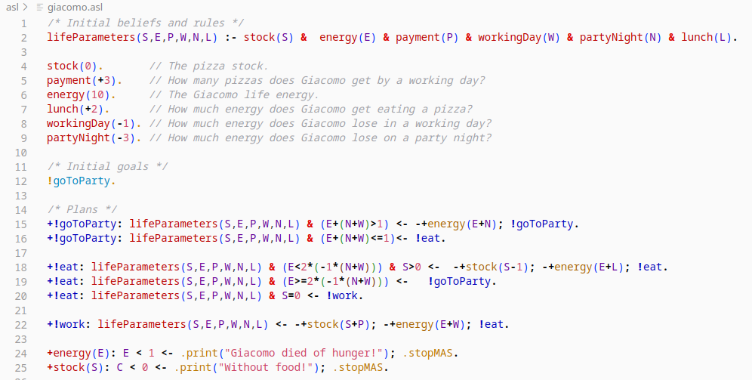
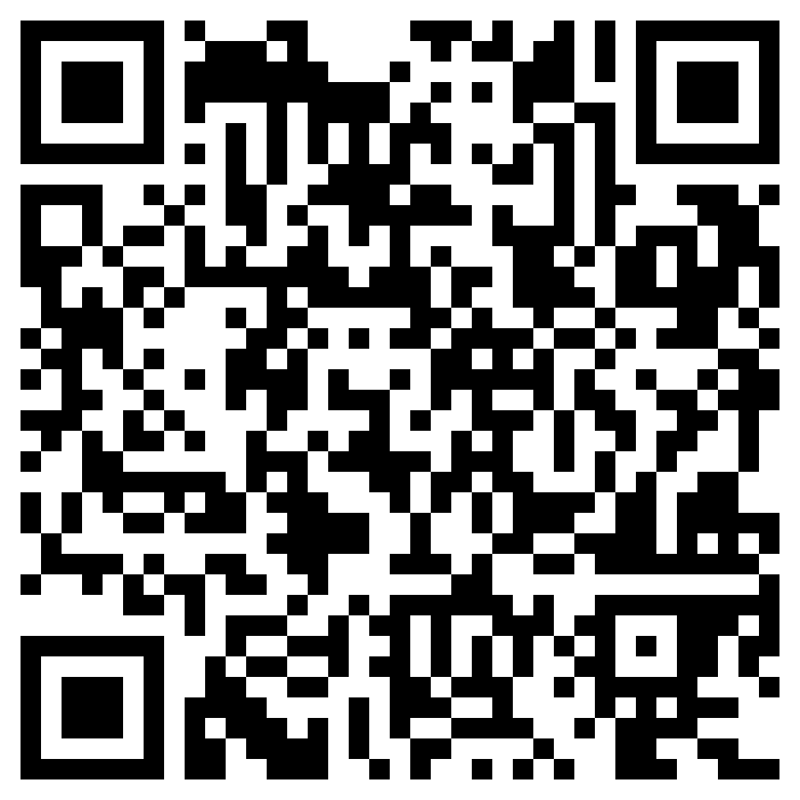
My First Agent: Code
https://github.com/chon-group/distributedAndEmbeddedAI/raw/main/course/06-MyFirstAgent/giacomoAgent.chon

Slide 45

EMBEDDED
MAS
Notes:
<número>

Slide 46
Jason Embedded
Jason Embedded is a spin-off Version of Jason for IoT and Embedded MAS:
Notes:
<número>

Slide 47
Jason Embedded
Jason Embedded is a spin-off Version of Jason for IoT and Embedded MAS:
  Autonomy as a characteristic an Embedded MAS provides to a device that does not need external architectures to control and manage it.
Notes:
<número>

Slide 48
Jason Embedded
Jason Embedded is a spin-off Version of Jason for IoT and Embedded MAS:
  Autonomy as a characteristic an Embedded MAS provides to a device that does not need external architectures to control and manage it.
  Communicability is the agent’s ability to communicate with other agents in its MAS or another MAS.
Notes:
<número>

Slide 49
Jason Embedded
Jason Embedded is a spin-off Version of Jason for IoT and Embedded MAS:
  Autonomy as a characteristic an Embedded MAS provides to a device that does not need external architectures to control and manage it.
  Communicability is the agent’s ability to communicate with other agents in its MAS or another MAS.
  Mobility as the agents’ ability to move from one MAS to another.
Notes:
<número>

Slide 50
Jason Embedded
Jason Embedded is a spin-off Version of Jason for IoT and Embedded MAS:
  Autonomy as a characteristic an Embedded MAS provides to a device that does not need external architectures to control and manage it.
  Communicability is the agent’s ability to communicate with other agents in its MAS or another MAS.
  Mobility as the agents’ ability to move from one MAS to another.
  Fault Tolerance and Adaptability are defined as the ability of an agent to identify if a physical resource is absent or not answering commands and to overcome this situation by modifying its goals.
Notes:
<número>

Slide 51
Jason Embedded
Jason Embedded also provides new types of agents to control hardware devices and to communicate with agents hosted in other MAS.
Notes:
<número>

Slide 52
Jason Embedded
Jason Embedded also provides new types of agents to control hardware devices and to communicate with agents hosted in other MAS.
  ARGO: is a customized agent architecture built on the Jason framework that extends Jason’s standard agents by adding the ability to control microcontrollers [Pantoja et al., 2016].
Notes:
<número>

Slide 53
Jason Embedded
Jason Embedded also provides new types of agents to control hardware devices and to communicate with agents hosted in other MAS.
  ARGO: is a customized agent architecture built on the Jason framework that extends Jason’s standard agents by adding the ability to control microcontrollers [Pantoja et al., 2016].
  Hermes: is another customized agent architecture built on Jason’s Standard agent by adding the ability to communicate with agents from other MAS, which also have Communicator agents [Pantoja et al., 2018].
Notes:
<número>

Slide 54
Jason Embedded
Mobility is based on bio-inspired protocols [Jesus et al., 2021].
    The protocols simulate natural behaviors that could be explored in collaborative tasks using IoT devices.
    One or more agents or even the whole MAS could move from one device to another to take control of the destination device (Predation) or to use it as a temporary non-hazardous relationship (Mutualism and Inquilinism) if both parties accept the protocol.
Notes:
<número>

Slide 55
Jason Embedded
Jason Embedded
Notes:
<número>

Slide 56
Jason Embedded
Jason Embedded
Standard
Notes:
<número>

Slide 57
Jason Embedded
Jason Embedded
Standard
Reasoning
Notes:
<número>

Slide 58
Jason Embedded
Jason Embedded
Standard
Embedded
Reasoning
Notes:
<número>

Slide 59
Jason Embedded
Jason Embedded
Standard
Embedded
Reasoning
ARGO
Notes:
<número>

Slide 60
Jason Embedded
Jason Embedded
Standard
Embedded
Reasoning
ARGO
Hardware
Notes:
<número>

Slide 61
Jason Embedded
Jason Embedded
Standard
Embedded
Reasoning
ARGO
Hermes
Hardware
Notes:
<número>

Slide 62
Jason Embedded
Jason Embedded
Standard
Embedded
Reasoning
ARGO
Hermes
Hardware
Mobility
Notes:
<número>

Slide 63
Jason Embedded
Jason Embedded
Standard
Embedded
Reasoning
ARGO
Hermes
Hardware
Mobility
Communicability
Notes:
<número>

Slide 64
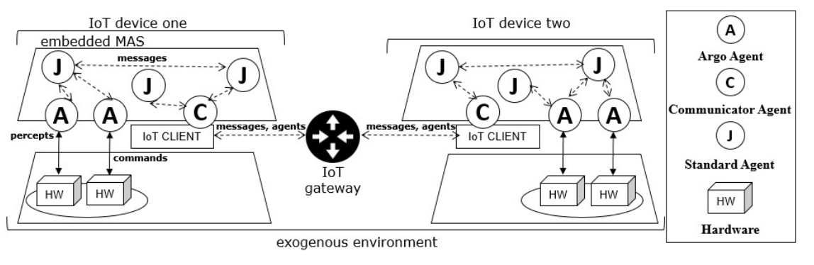
Jason Embedded
It is a spin-off Version of Jason for IoT and Embedded Multiagent Systems.
Notes:
<número>

Slide 65

ARGO
AGENT
Notes:
<número>

Slide 66
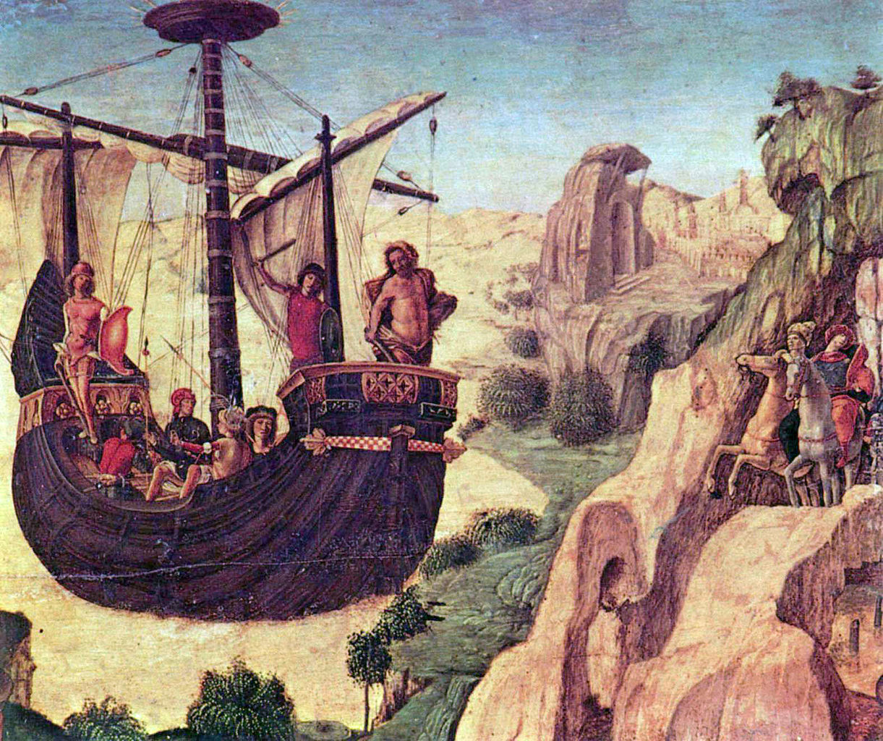
Argo for Jason
Argo was the ship Jason, and the Argonauts sailed in search of the golden fleece in Greek mythology.
The Argo
by Lorenzo Costa
Notes:
<número>

Slide 67
Argo for Jason
ARGO is a customized agent architecture that interfaces sensors and hardware actuators.
Notes:
<número>

Slide 68
Argo for Jason
ARGO is a customized agent architecture that interfaces sensors and hardware actuators.
ARGO aims to be a practical architecture for programming embedded BDI agents using Jason and microcontroller boards.
Notes:
<número>

Slide 69
Argo for Jason
The ARGO allows to:
Notes:
<número>

Slide 70
Argo for Jason
The ARGO allows to:
to direct control actuators at runtime;
Notes:
<número>

Slide 71
Argo for Jason
The ARGO allows to:
to direct control actuators at runtime;
to receive sensor perceptions within a predefined period automatically;
Notes:
<número>

Slide 72
Argo for Jason
The ARGO allows to:
to direct control actuators at runtime;
to receive sensor perceptions within a predefined period automatically;
to change which devices are being accessed at runtime;
Notes:
<número>

Slide 73
Argo for Jason
The ARGO allows to:
to direct control actuators at runtime;
to receive sensor perceptions within a predefined period automatically;
to change which devices are being accessed at runtime;
to communicate with other agents in Jason;
Notes:
<número>

Slide 74
Argo for Jason
The ARGO allows to:
to direct control actuators at runtime;
to receive sensor perceptions within a predefined period automatically;
to change which devices are being accessed at runtime;
to communicate with other agents in Jason;
whether or not to perceive the real world at runtime;
Notes:
<número>

Slide 75
Argo for Jason
The ARGO allows to:
to direct control actuators at runtime;
to receive sensor perceptions within a predefined period automatically;
to change which devices are being accessed at runtime;
to communicate with other agents in Jason;
whether or not to perceive the real world at runtime;
to change perception filters at runtime.
Notes:
<número>

Slide 76
Argo for Jason
ARGO Internal Actions:
Notes:
<número>

Slide 77
Argo for Jason
ARGO Internal Actions:
  .argo.limit(x): defines a time interval to perceive the environment.
Notes:
<número>

Slide 78
Argo for Jason
ARGO Internal Actions:
  .argo.limit(x): defines a time interval to perceive the environment.
  .argo.port(y): defines which serial port the agent should operate.
Notes:
<número>

Slide 79
Argo for Jason
ARGO Internal Actions:
  .argo.limit(x): defines a time interval to perceive the environment.
  .argo.port(y): defines which serial port the agent should operate.
  .argo.percepts(open|close): decides whether or not to perceive the real world.
Notes:
<número>

Slide 80
Argo for Jason
ARGO Internal Actions:
  .argo.limit(x): defines a time interval to perceive the environment.
  .argo.port(y): defines which serial port the agent should operate.
  .argo.percepts(open|close): decides whether or not to perceive the real world.
  .argo.act(w): sends a command to the microcontroller to be executed by an effector.
Notes:
<número>

Slide 81
Argo for Jason
ARGO Internal Actions:
  .argo.limit(x): defines a time interval to perceive the environment.
  .argo.port(y): defines which serial port the agent should operate.
  .argo.percepts(open|close): decides whether or not to perceive the real world.
  .argo.act(w): sends a command to the microcontroller to be executed by an effector.
  .argo.change_filter(filterName): defines a perception filter to restrict real-time perceptions.
Notes:
<número>

Slide 82
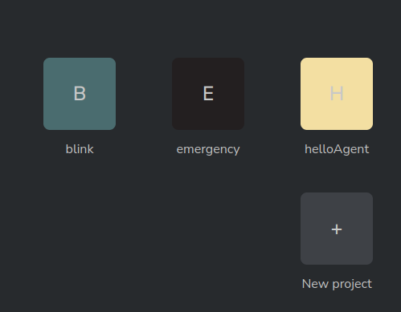
Example: blink
Notes:
<número>

Slide 83
Example: blink
Notes:
<número>

Slide 84
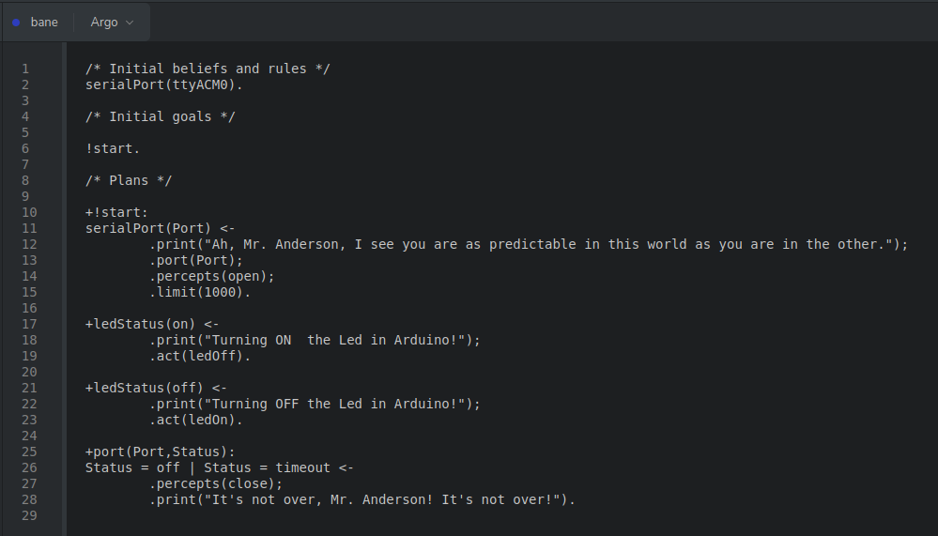
Example: blink
Notes:
<número>

Slide 85
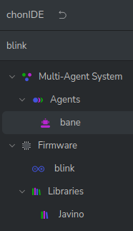
Example: blink
Notes:
<número>

Slide 86
Example: blink
Notes:
<número>

Slide 87
Example: blink
Notes:
<número>

Slide 88
Example: blink
Notes:
<número>

Slide 89
Example: blink
Notes:
<número>

Slide 90

Example: LCD
Notes:
<número>

Slide 91
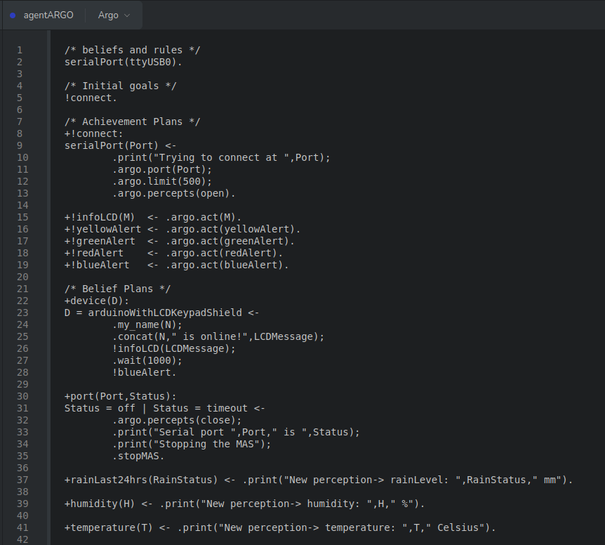
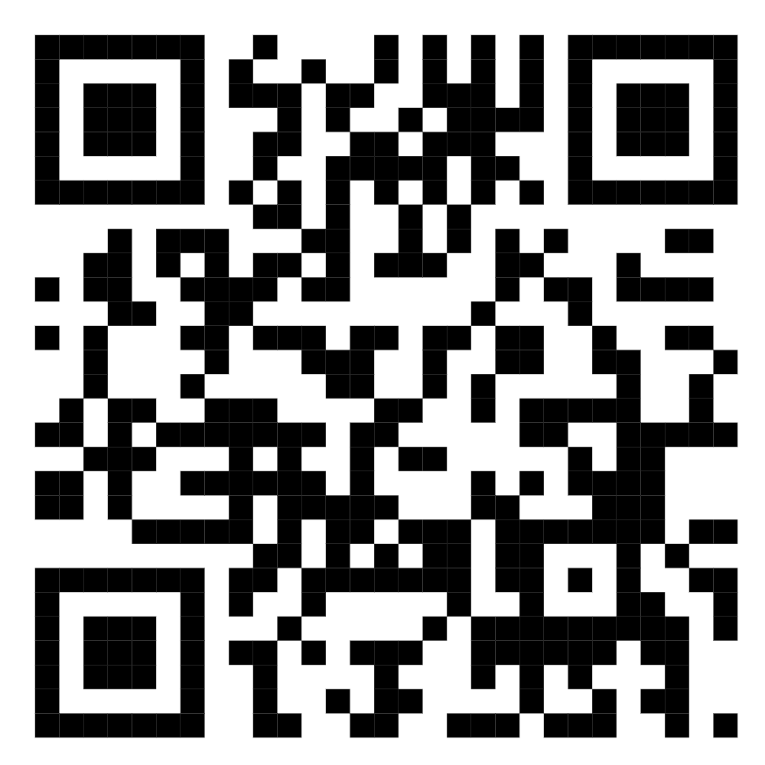
Example: LCD
https://github.com/chon-group/distributedAndEmbeddedAI/blob/main/workshops/wesaac/2024/examples/lcdKeypadProject.chon
Notes:
<número>

Slide 92
Example: LCD
Notes:
<número>

Slide 93
Example: LCD
Notes:
<número>

Slide 94
Example: LCD
Notes:
<número>

Slide 95

HERMES AGENT
(COMMUNICABILITY)
Notes:
<número>

Slide 96

Collaborative MultiAgent System
Notes:
<número>

Slide 97
Collaborative MultiAgent System
MAS
MAS
MAS
MAS
Notes:
<número>

Slide 98
Collaborative MultiAgent System
MAS
MAS
MAS
MAS
Notes:
<número>

Slide 99
Hermes Agents
MAS A
MAS B
C
C
COMMUNICATES
Pantoja, C., Soares, H.D., Viterbo, J., Seghrouchni, A.E.F. “An Architecture for the Development of Ambient Intelligence Systems Managed by Embedded Agents”. The 30th International Conference on Software Engineering and Knowledge Engineering, Hotel Pullman, Redwood City, California, USA, July 1-3, 2018, organizado por Óscar Mortágua Pereira, KSI Research Inc. and Knowledge Systems Institute Graduate School, 2018, https://doi.org/10.18293/SEKE2018-110 .
Notes:
<número>

Slide 100

Hermes Agents: Server Communication
MAS A
MAS B
C
C
ContextNet
(IoT middleware)
Endler, M., Baptista, G., Silva, L.D., Vasconcelos, R., Malcher, M., Pantoja, V., Pinheiro, V., Viterbo, J.: Contextnet: Context reasoning and sharing middleware for large-scale pervasive collaboration and social networking. In: Proceedings of the Workshop on Posters and Demos Track. PDT ’11, Association for Computing Machinery, New York, NY, USA (2011). https://doi.org/10.1145/2088960.2088962
Notes:
<número>

Slide 101
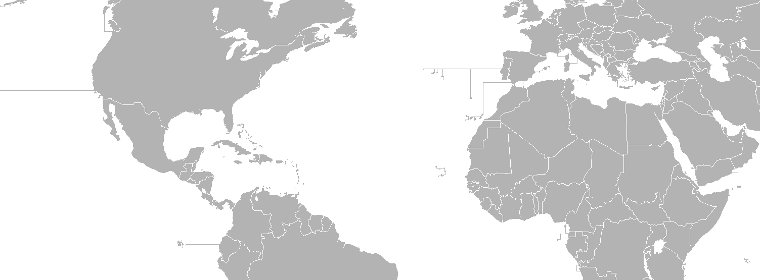

ContextNet Public Server
Address: skynet.chon.group - UDP Port: 5500
Notes:
<número>

Slide 102
Hermes Agents: Internal Actions
Hermes Internal Actions:
.sendOut(agentUuid, force, message)
sends a message from one Hermes agent to another Hermes agent in a different MAS.
.connectCN(servidor, porta, UUID)
connects to the IoT server with a specific ID for the agent.
.disconnectCN
disconnects from the currently connected IoT server.
Notes:
<número>

Slide 103

Hello SkyNet
Notes:
<número>

Slide 104

Hello SkyNet
Notes:
<número>

Slide 105

Hello SkyNet
Notes:
<número>

Slide 106
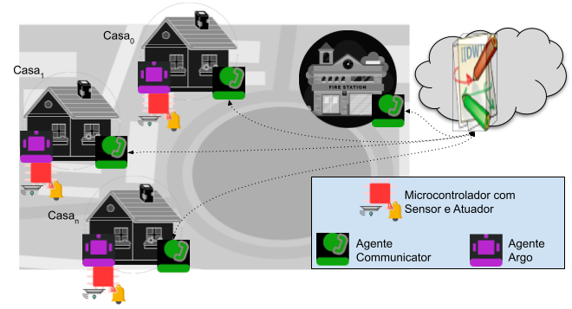
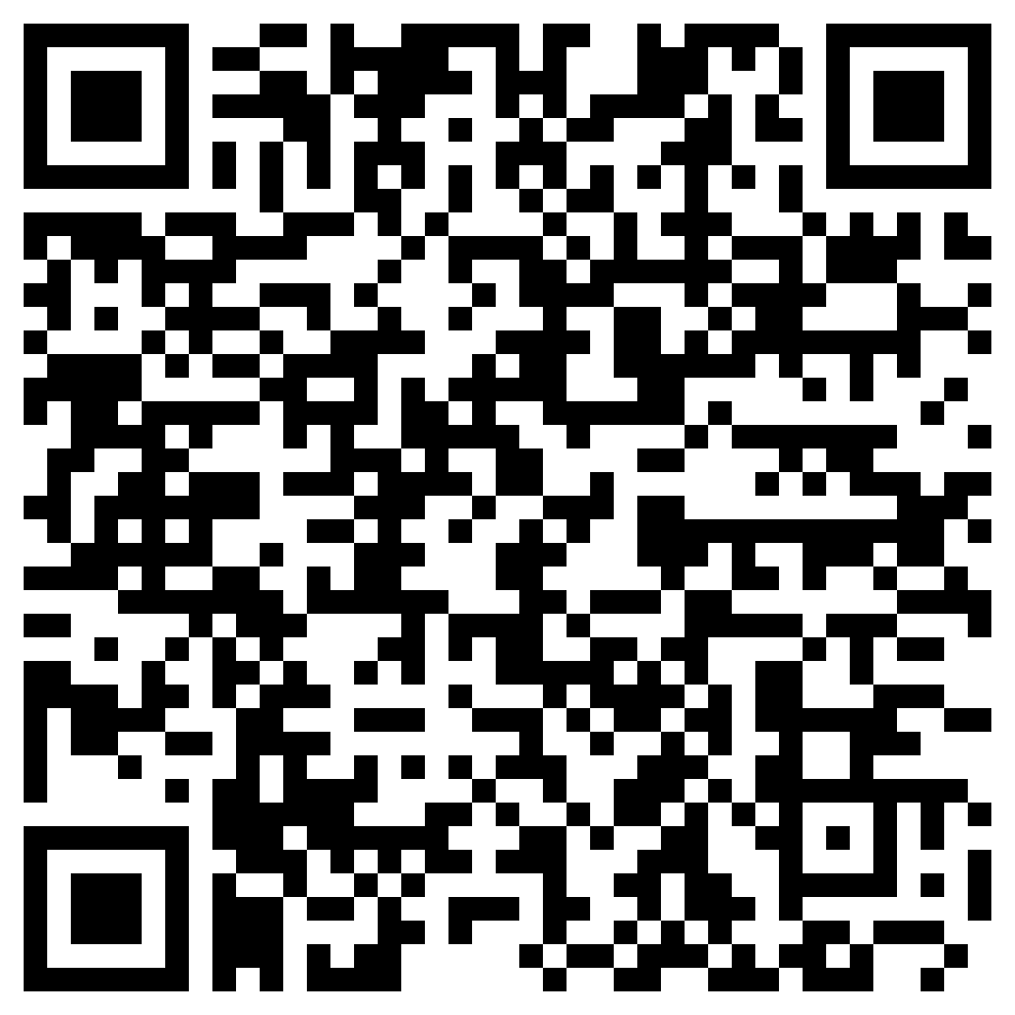
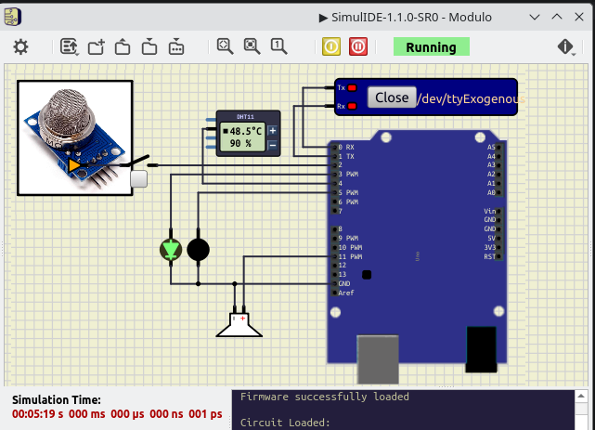
Exemplo: Colaboração entre SMA Embarcados
https://github.com/chon-group/distributedAndEmbeddedAI/tree/main/course/13-CollaborativeMultiAgentSystems/example
Notes:
<número>

Slide 107


HERMES AGENT
(MOBILITY)
Notes:
<número>

Slide 108
Agent Transfer Protocol
Mobile agents can transcend their MAS
and move to another MAS.
In Embedded MAS, an agent is part of a MAS embedded in a device. If the device is damaged, the agent and the entire MAS are at risk.
The Agent Transfer Protocol allows Jason's Hermes agents to move from system to system to collaborate and preserve acquired knowledge.
Notes:
<número>

Slide 109
Agent Transfer Protocol
The agent transfer protocol has three possible relationships between MAS.
Mutualism
Inquilinism
Predation
Notes:
<número>

Slide 110



Bio-Inspired: Mutualism
J
J
J
C
C
J
J
J
J
J
skynet
MAS
MAS
Notes:
<número>

Slide 111
Bio-Inspired: Mutualism
J
J
J
C
C
J
J
J
J
J
skynet
MAS
MAS
Notes:
<número>

Slide 112
Bio-Inspired: Mutualism
J
J
J
C
C
J
J
J
J
J
skynet
MAS
MAS
Notes:
<número>

Slide 113
Bio-Inspired: Inquilinism
J
J
C
C
J
J
skynet
MAS
MAS
Notes:
<número>

Slide 114
Bio-Inspired: Inquilinism
J
J
C
C
J
J
skynet
MAS
MAS
Notes:
<número>

Slide 115

Bio-Inspired: Inquilinism
J
J
C
C
J
J
skynet
MAS
MAS
Notes:
<número>

Slide 116
Bio-Inspired: Predation
C
J
C
J
J
J
J
J
J
J
skynet
MAS
MAS
Notes:
<número>

Slide 117
Bio-Inspired: Predation
C
J
J
C
J
J
J
J
J
J
skynet
MAS
MAS
Notes:
<número>

Slide 118

Bio-Inspired: Predation
J
J
J
C
M
J
J
J
J
J
skynet
MAS
MAS
Notes:
<número>

Slide 119
Bio-Inspired: Predation
C
J
J
J
J
skynet
MAS
MAS
Notes:
<número>

Slide 120
Hermes: Internal Actions
Hermes Internal Actions:
.moveOut(agentUuid, predation|inquilinism)
Move all agents to a different known MAS.
.moveOut(agentUuid, mutualism, agent)
Move one specific agent to a different known MAS.
Notes:
<número>

Slide 121
OTHER
TOOLS
Notes:
<número>

Slide 122

SimulIDE
González, Santiago. “SimulIDE Circuit Simulator”, 2023. https://simulide.com.

Slide 123

SimulIDE
Manual de instalaçãohttps://github.com/chon-group/dpkg-simulide

Slide 124
SimulIDE
Manual de instalaçãohttps://github.com/chon-group/dpkg-simulide

Slide 125
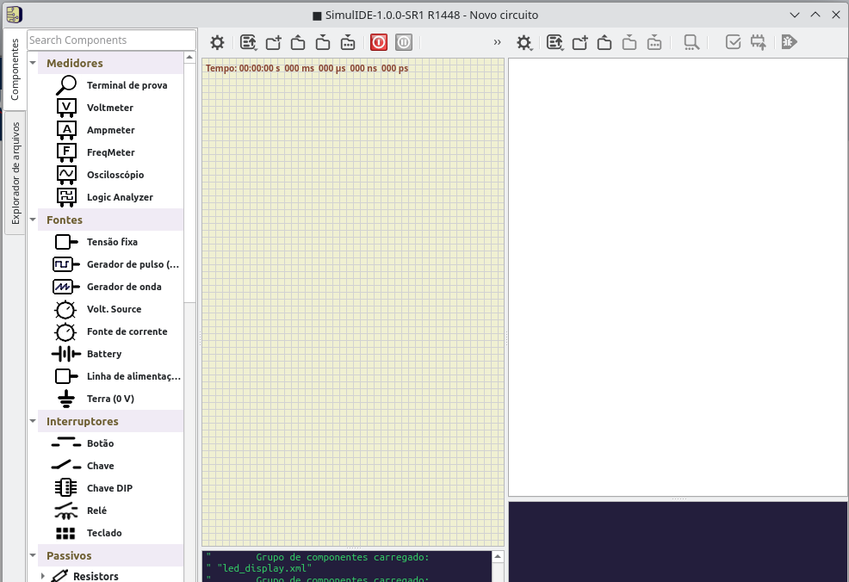
SimulIDE

Slide 126
SimulIDE

Slide 127
SimulIDE

Slide 128
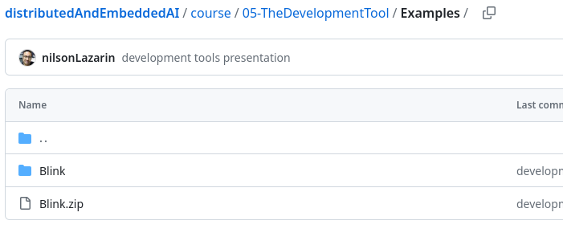
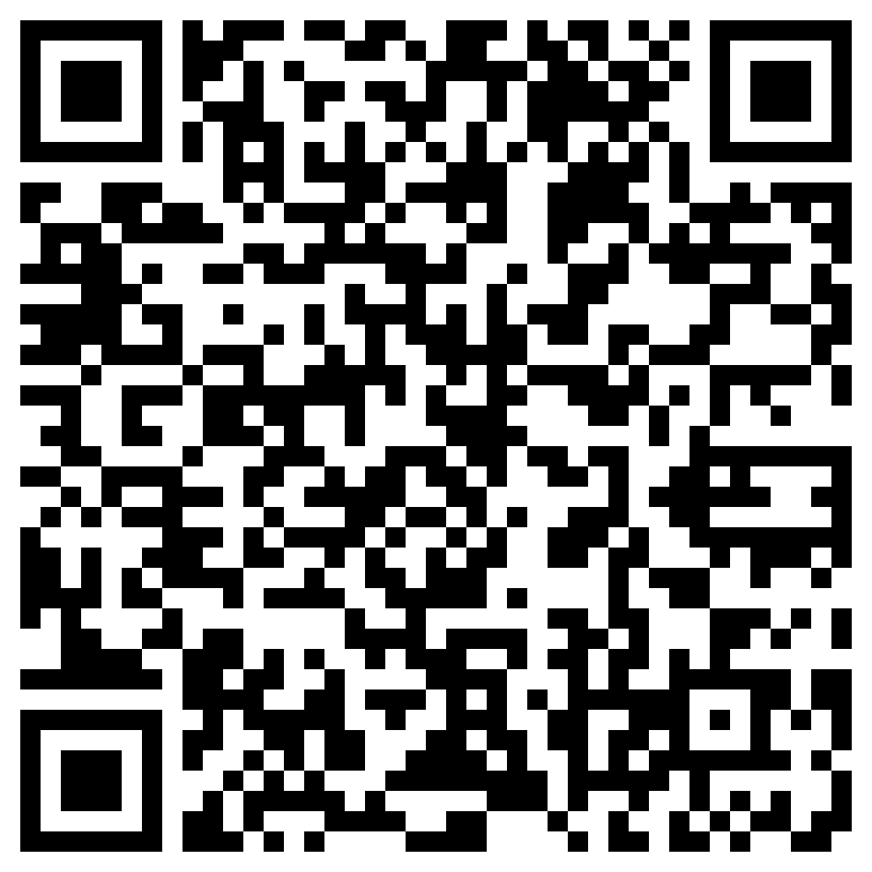
SimulIDE: Blink
https://github.com/chon-group/distributedAndEmbeddedAI/raw/main/course/05-TheDevelopmentTool/Examples/Blink.zip

Slide 129
SimulIDE: Blink
https://github.com/chon-group/distributedAndEmbeddedAI/raw/main/course/05-TheDevelopmentTool/Examples/Blink.zip

Slide 130
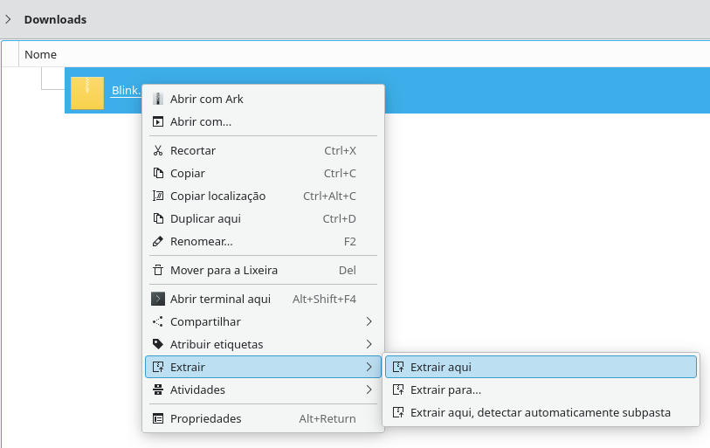
SimulIDE: Blink

Slide 131
SimulIDE: Blink

Slide 132
SimulIDE: Blink

Slide 133
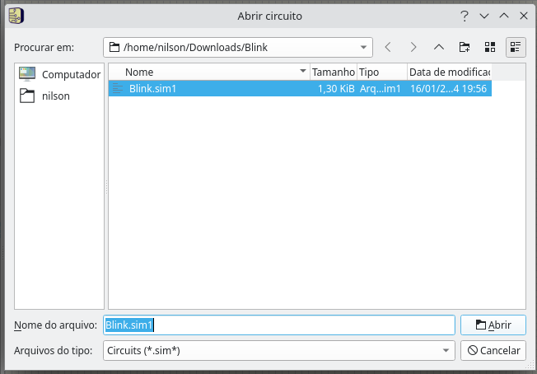
SimulIDE: Blink

Slide 134
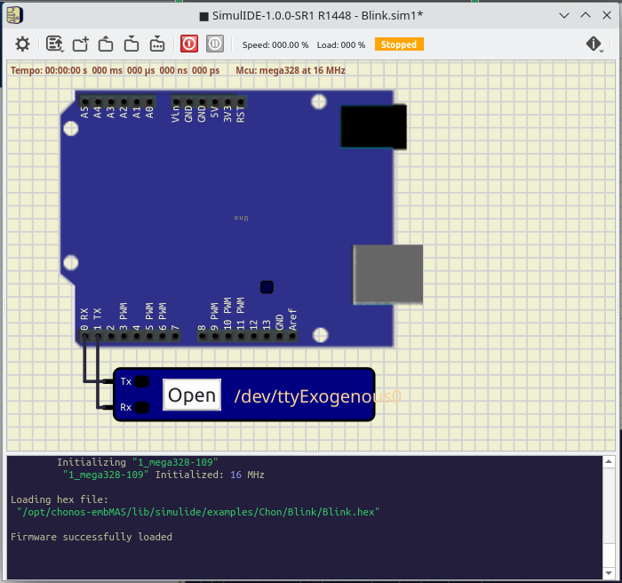
SimulIDE: Blink

Slide 135
SimulIDE: Blink

Slide 136
SimulIDE: Blink

Slide 137
SimulIDE: Blink

Slide 138
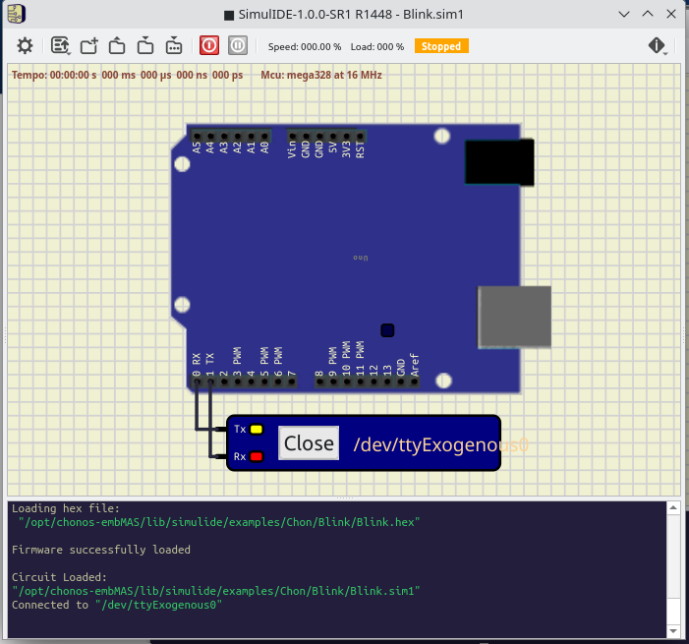
SimulIDE: Blink

Slide 139
SimulIDE: Blink

Slide 140
SimulIDE: Blink

Slide 141
SimulIDE: Blink

Slide 142
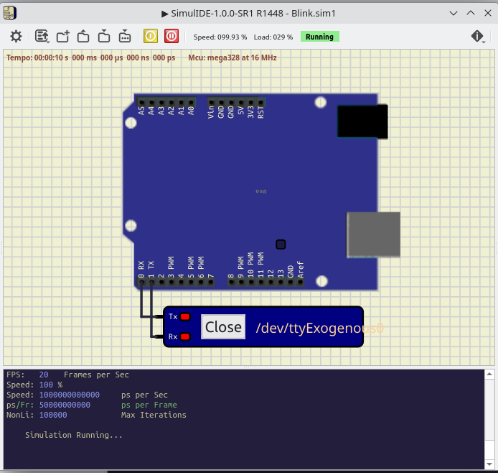
SimulIDE: Blink

Slide 143
SimulIDE: Blink

Slide 144

SimulIDE: Blink

Slide 145
SimulIDE: Blink

Slide 146
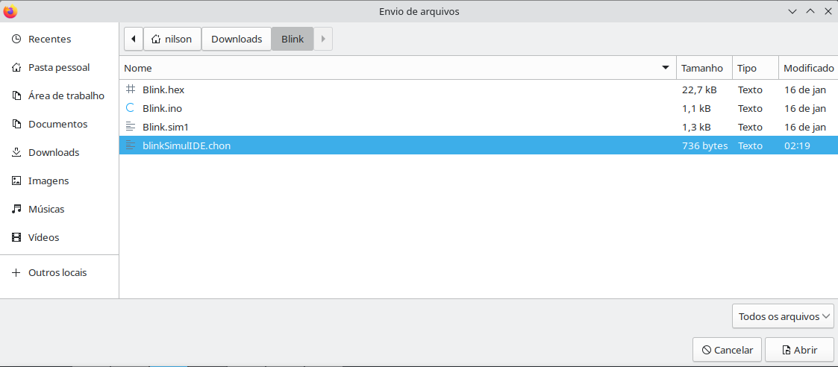
SimulIDE: Blink

Slide 147
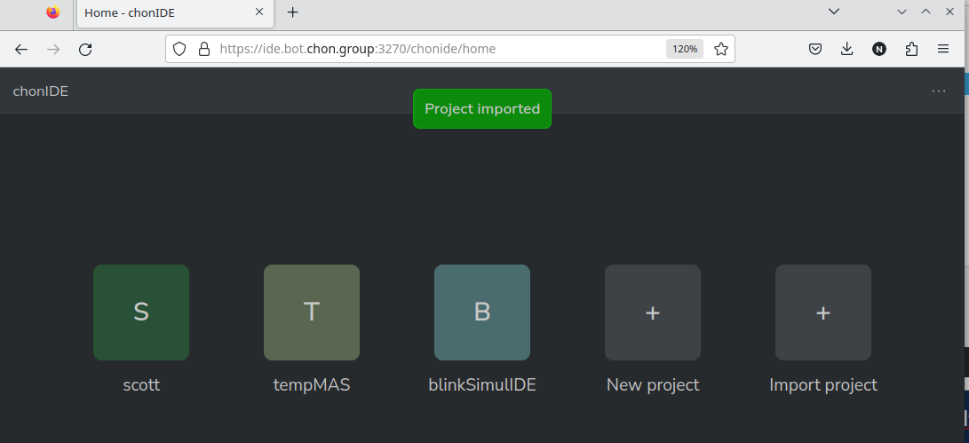
SimulIDE: Blink

Slide 148
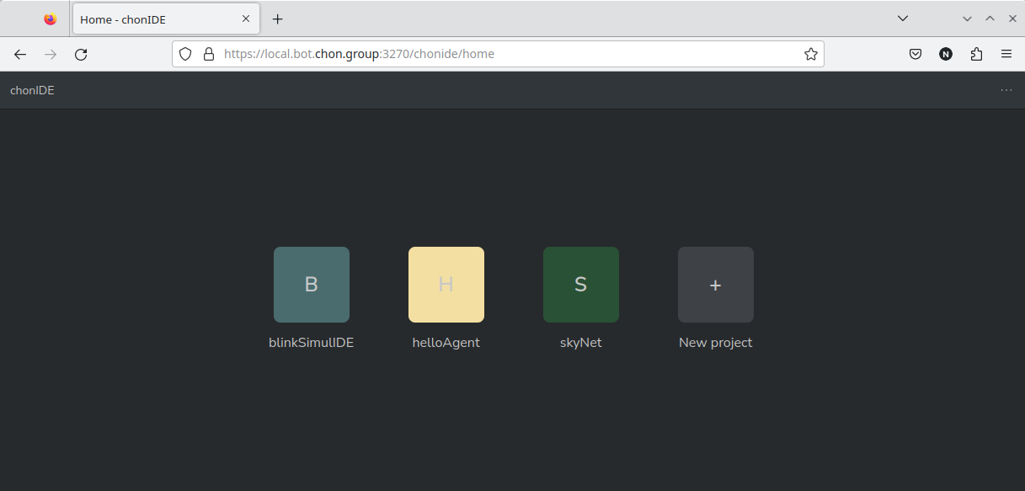
SimulIDE: Blink

Slide 149
SimulIDE: Blink

Slide 150
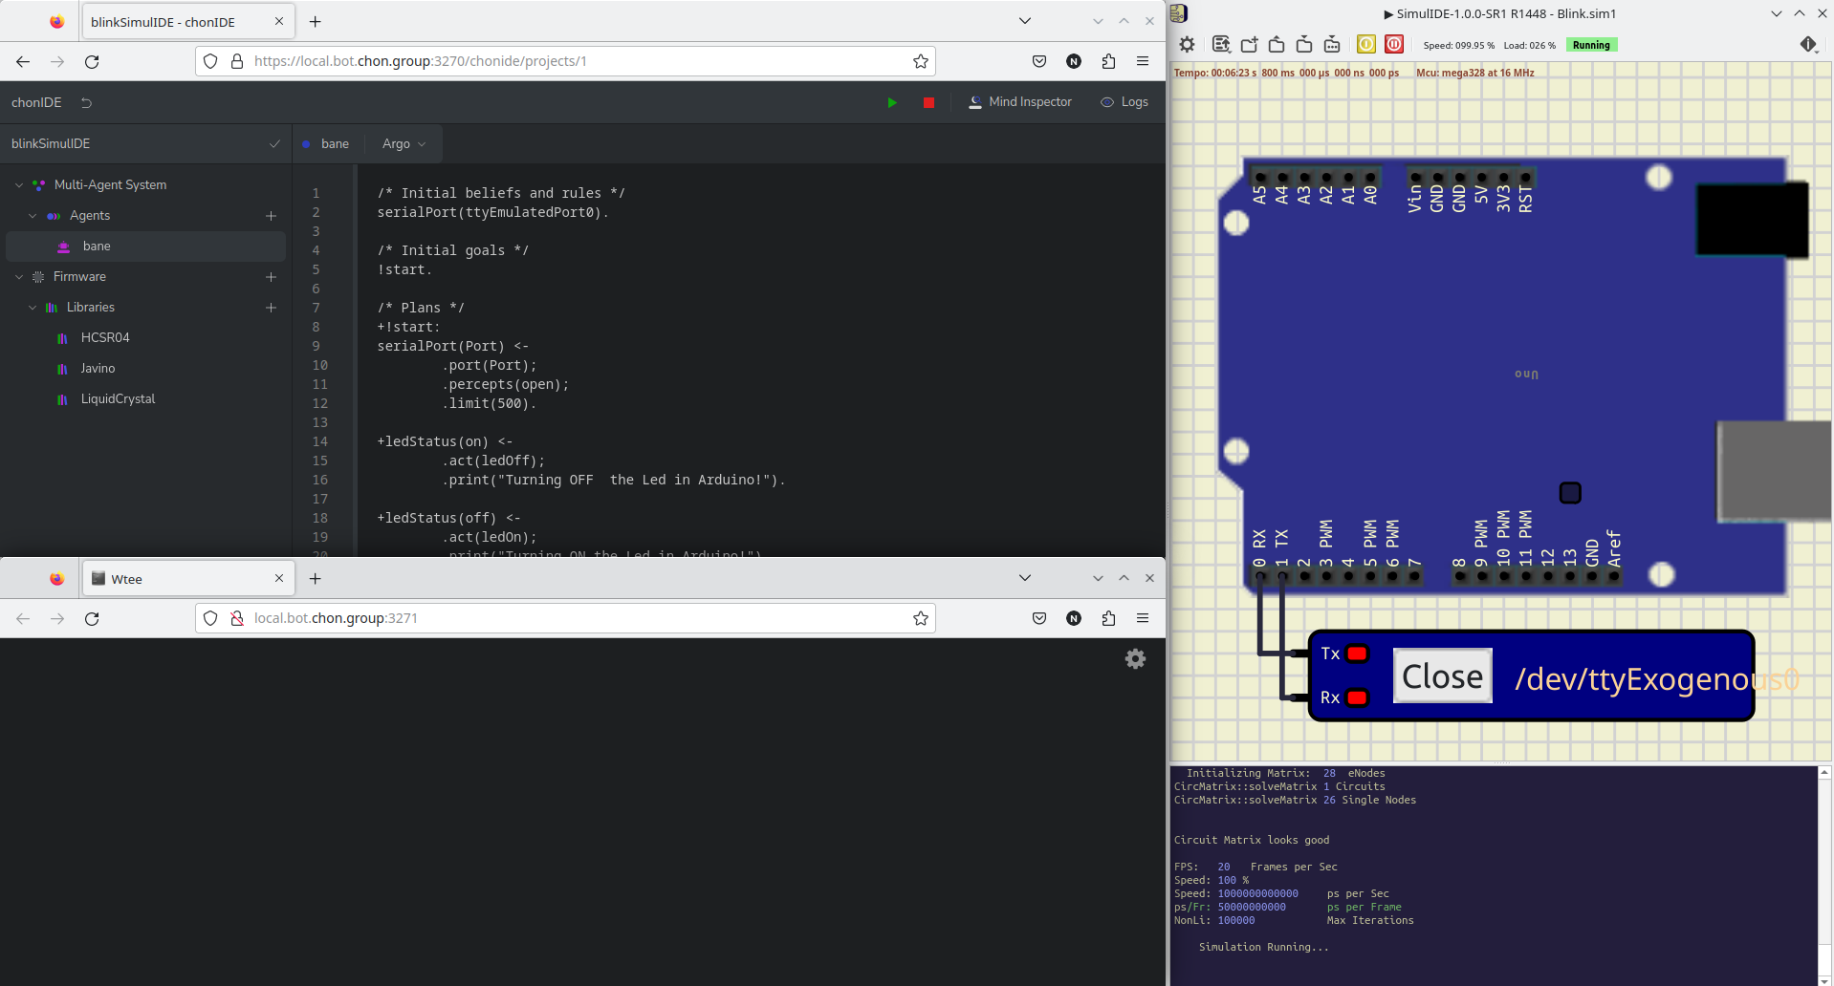
SimulIDE: Blink

Slide 151
SimulIDE: Blink

Slide 152
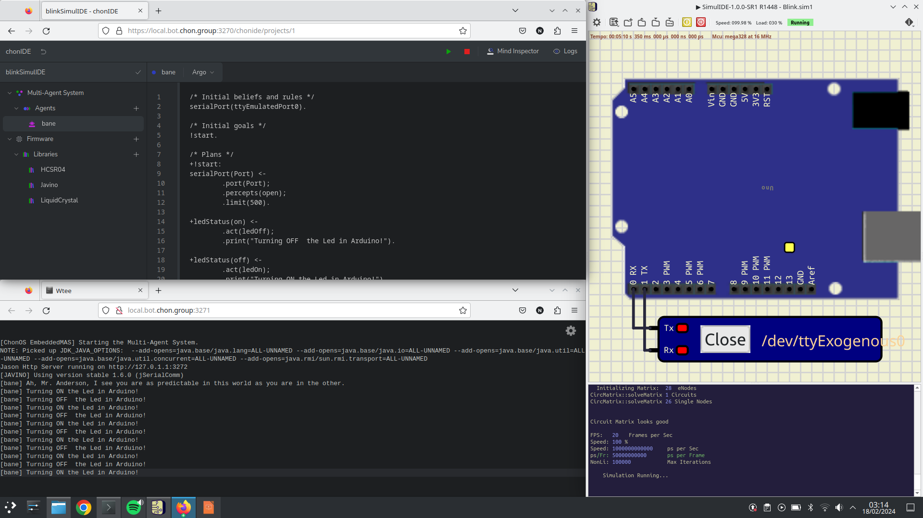
SimulIDE: Blink

Slide 153

Webots
Michel, O. (1998). Webots: Symbiosis Between Virtual and Real Mobile Robots. In: Heudin, JC. (eds) Virtual Worlds. VW 1998. Lecture Notes in Computer Science(), vol 1434. Springer, Berlin, Heidelberg. https://doi.org/10.1007/3-540-68686-X_24

Slide 154
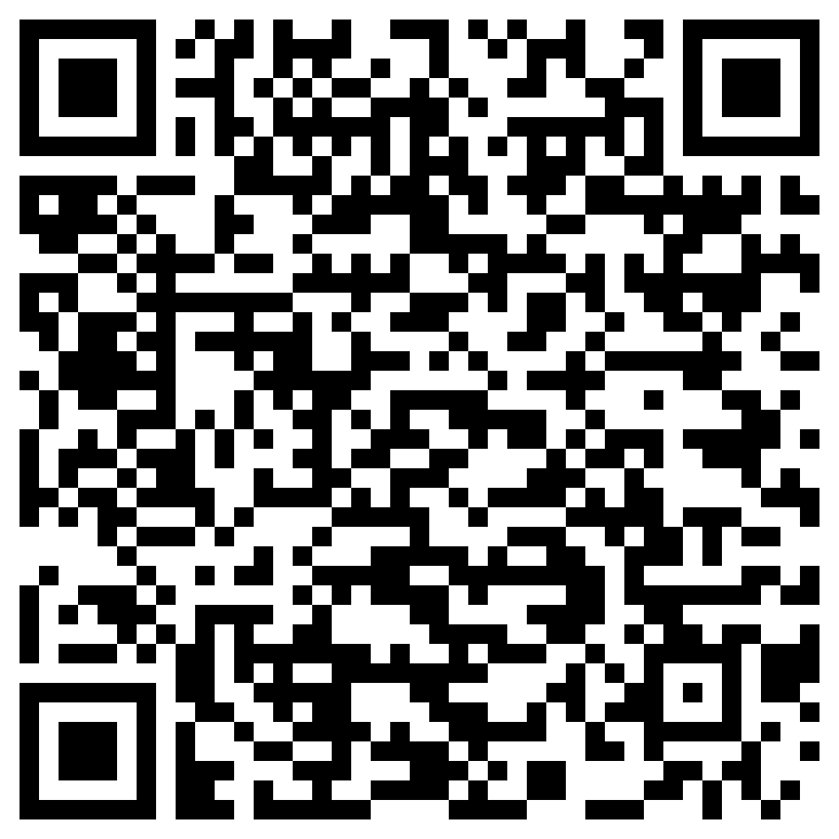
Webots
Manual de instalação
https://cyberbotics.com/doc/guide/installation-procedure#installing-the-debian-package-with-the-advanced-packaging-tool-apt

Slide 155
Webots
Manual de instalação
https://cyberbotics.com/doc/guide/installation-procedure#installing-the-debian-package-with-the-advanced-packaging-tool-apt

Slide 156

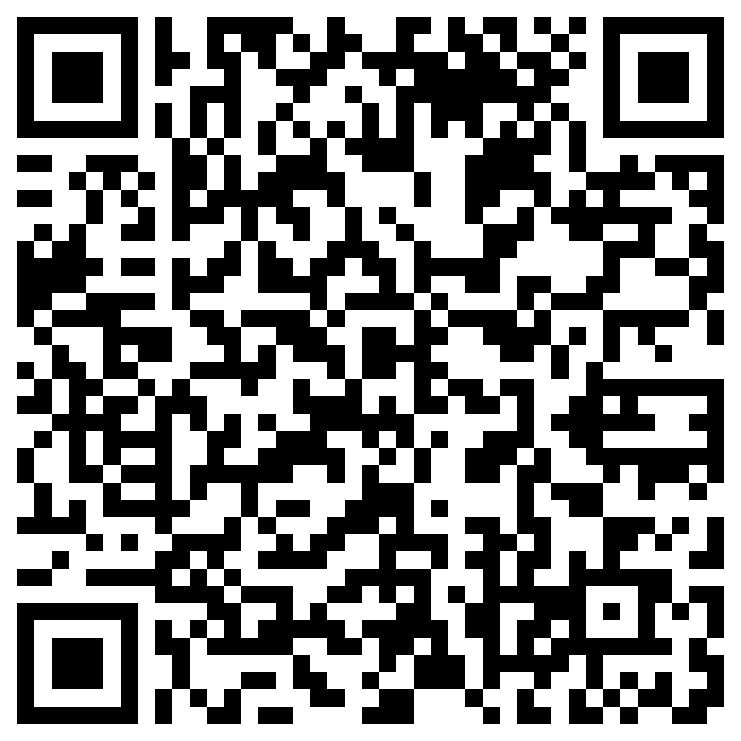
Webots
https://github.com/chon-group/distributedAndEmbeddedAI/raw/main/course/05-TheDevelopmentTool/Examples/Car4WD.zip

Slide 157
Webots
https://github.com/chon-group/distributedAndEmbeddedAI/raw/main/course/05-TheDevelopmentTool/Examples/Car4WD.zip

Slide 158

Webots

Slide 159

Webots

Slide 160
Webots

Slide 161
Webots

Slide 162
Webots

Slide 163

Webots

Slide 164

Webots

Slide 165
Webots

Slide 166
Webots

Slide 167

Webots

Slide 168

Webots

Slide 169

Webots

Slide 170
Webots

Slide 171

Webots

Slide 172
Webots

Slide 173

Webots

Slide 174
Acknowledgements
THANK YOU!
pantoja@cefet-rj.br
nilson.lazarin@cefet-rj.br
Notes:
<número>

