Slide 1

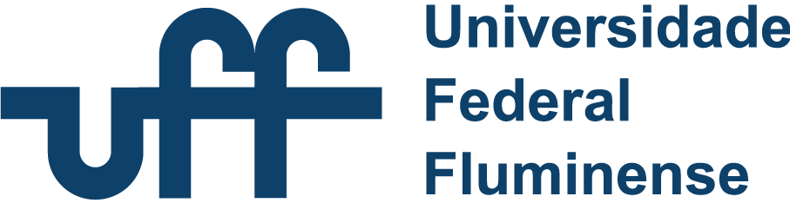

Teaching Ethical Artificial Intelligence to Computer Science Students:
A Case Study Applied to a Belief-Desire-Intention Multi-Agent System
Carlos Eduardo Pantoja, Nilson Mori, Tielle Alexandre, Flavia Bernardini, Fredrik Heintz
2026

Slide 2

Agenda
1. Introduction
2. Unified Ethical Principles Guide
3. Ethics Principles
4. Problems
5. Proposed Method
6. Application of the Method in a Case Study Using a BDI-Based MAS
7. Dissemination of a Survey to Gather Initial Impressions of the Proposed Method
25th Annual International Conference on Digital Government Research (dg.o 2024)

Slide 3
Introduction
The Three Laws of Robotics, proposed by science fiction writer Isaac Asimov, were created as principles to guide the behavior of intelligent robots.
First Law
A robot may not injure a human being or, through inaction, allow a human being to come to harm.
Second Law
A robot must obey orders given it by human beings except where such orders would conflict with the First Law.
Third Law
A robot must protect its own existence as long as such protection does not conflict with the First or Second Law.
Source: [18]
25th Annual International Conference on Digital Government Research (dg.o 2024)

Slide 4
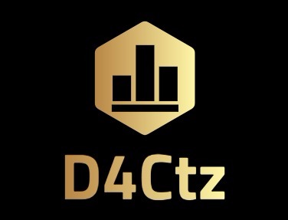
Introduction
Ethics refers to values and principles that prioritize human well-being and guide the responsible design and implementation of autonomous and intelligent systems.
Source: [1]
25th Annual International Conference on Digital Government Research (dg.o 2024)
IEEE Intelligence and Security Informatics (ISI) 2018

Slide 5
Introduction
Ethics refers to values and principles that prioritize human well-being and guide the responsible design and implementation of autonomous and intelligent systems.
Ethics in AI
Subfield of applied ethics and technology focused on the ethical issues raised by the design, development, implementation, and use of AI.
trending_up
Goal
Seek to maximize the benefits of AI systems for society and individuals.
shield
Mitigation
Prevent and minimize the potential risks and harms caused by the use of AI technology.
Source: [1]
25th Annual International Conference on Digital Government Research (dg.o 2024)
IEEE Intelligence and Security Informatics (ISI) 2018

Slide 6
Introduction
Life-Cycle Integration
Ethical principles are fundamental for developing responsible AI systems and must be considered throughout their entire life cycle.
Source: [1]
25th Annual International Conference on Digital Government Research (dg.o 2024)
IEEE Intelligence and Security Informatics (ISI) 2018

Slide 7
Introduction
Life-Cycle Integration
Ethical principles are fundamental for developing responsible AI systems and must be considered throughout their entire life cycle.
Several Ethical Guides
Numerous ethical guides exist, each offering different principles and interpretations based on their origin (e.g., government, NGO, academia) and sociocultural context.
Source: [1]
25th Annual International Conference on Digital Government Research (dg.o 2024)
IEEE Intelligence and Security Informatics (ISI) 2018

Slide 8
Introduction
Life-Cycle Integration
Ethical principles are fundamental for developing responsible AI systems and must be considered throughout their entire life cycle.
Several Ethical Guides
Numerous ethical guides exist, each offering different principles and interpretations based on their origin (e.g., government, NGO, academia) and sociocultural context.
Unified Reference Framework
Due to the lack of consensus, we have established a unified set of ethical principles as a reference to guide the development of responsible AI systems.
Source: [1]
25th Annual International Conference on Digital Government Research (dg.o 2024)
IEEE Intelligence and Security Informatics (ISI) 2018

Slide 9
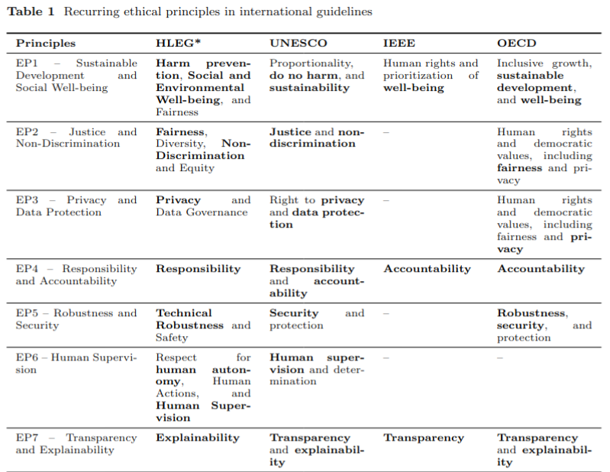
2. Unified Ethical Principles Guide
Table 1: Recurring ethical principles in international guidelines
25th Annual International Conference on Digital Government Research (dg.o 2024)

Slide 10
3. EP1 Principle: Sustainable Development and Social Welfare
public
analytics
Preservation & Well-being
AI or system must preserve human rights and provide individual and collective benefits.
It must not cause harm and should support sustainable development goals (SDGs).
Monitoring & Assessment
The economic and cultural impacts caused by AI should be continuously monitored.
Continuous assessment is vital to prevent undesirable consequences throughout its lifecycle.
Sources: [1] [2]
25th Annual International Conference on Digital Government Research (dg.o 2024)
IEEE Intelligence and Security Informatics (ISI) 2018

Slide 11
3. Examples of MAS Focused on Promoting Sustainable Development and Social Welfare
agriculture
traffic
trending_up
Smart Agriculture
Optimization of water resources and precise fertilizer application through autonomous agent monitoring.
Urban Mobility
Traffic signal control and public transport management to enhance traffic flow and reduce congestion.
Sustainable Finance
Stock trading negotiations favoring companies with sustainable practices and divesting from non-certified entities.
Sources: [3, 4, 5, 6] MAS Research Papers
25th Annual International Conference on Digital Government Research (dg.o 2024)
IEEE Intelligence and Security Informatics (ISI) 2018

Slide 12
3. EP2 Principle: Fairness and Non-Discrimination
balance
gavel
Social Justice & Equity
AI and system must promote social justice, equity, and non-discrimination in accordance with international law.
It should be accessible to all, considering specific needs and diversities of different social groups (e.g., age, culture, language, disability).
Prevention of Bias
It is fundamental that AI does not reinforce or perpetuate discriminatory or biased outcomes related to race, gender, religion, or any other characteristic.
The goal is to ensure a fair distribution of benefits and keep individuals free from prejudice.
Source: [2]
25th Annual International Conference on Digital Government Research (dg.o 2024)

Slide 13
3. Example of MAS Focused on Promoting the Principle of Justice and Non-Discrimination
gavel
Judicial Process Management
MAS were applied in the management of judicial processes, assisting in workload distribution and hearing anticipation, which contributes to improved productivity and faster access to justice.
Source: [9]
25th Annual International Conference on Digital Government Research (dg.o 2024)
IEEE Intelligence and Security Informatics (ISI) 2018

Slide 14
3. EP3 Principle: Privacy and Data Protection
security
gavel
Rights & Protection
Covers the rights of data subjects regarding the processing of their personal data within the AI context.
Data consent management
Sensitive data protection techniques
Data leakage prevention
Legal Framework
Compliance with regulations like the General Data Protection Regulation (GDPR) is essential throughout the AI lifecycle.
Ensures subjects can exercise their rights and provide informed consent for data usage.
Source: [10]
25th Annual International Conference on Digital Government Research (dg.o 2024)

Slide 15
3. Examples of MAS Focused on Promoting Privacy and Data Protection
verified_user
handshake
Data Consent
Agents must adapt and operate in compliance with data protection standards in a jurisdiction, such as Brazil or Europe.
Transition from LGPD to GDPR compliance
Context-aware regulatory adaptation
Negotiation Process
The goal is to minimize sensitive information sharing between agents without compromising agreement possibilities.
Secure multi-party computation logic
Differential privacy in agent interaction
Sources: [13, 14, 15]
25th Annual International Conference on Digital Government Research (dg.o 2024)

Slide 16
3. EP4 Principle: Responsibility and Accountability
assignment_ind
fact_check
Responsibility
This principle deals with the attribution of responsibility for decisions made by AI to the corresponding actors according to their role in the life cycle. In MAS, responsibility can be directed towards the assignment of degrees of responsibility among agents.
Accountability
Accountability refers to the ability of an agent or system to justify or inform about its actions for which it has responsibility to another agent legitimized to make this demand.
Sources: [2, 11, 12]
25th Annual International Conference on Digital Government Research (dg.o 2024)
IEEE Intelligence and Security Informatics (ISI) 2018

Slide 17
3. Examples of MAS and Adoption of the Responsibility and Accountability Principle
groups
handshake
Degrees of Responsibility
Each agent holds a portion of responsibility for the success or failure of the task.
Challenges in assigning different degrees of responsibility to agents.
Accountability Process
Accountability within the negotiation process ensures agents justify their actions.
Agents must provide justification if they violate commitments made during negotiations.
Sources: [16, 17, 18]
25th Annual International Conference on Digital Government Research (dg.o 2024)
IEEE Intelligence and Security Informatics (ISI) 2018

Slide 18
3. EP5 Principle: Robustness and Safety
security
health_and_safety
Robustness & Reliability
Ensures AI or system functions as intended even under adverse and unpredictable conditions.
Resilience & Safety
Mechanisms for prevention or mitigation of failures must minimize unexpected harm. AI must remain resilient against cyberattacks or vulnerabilities throughout its lifecycle.
Sources: [1]
25th Annual International Conference on Digital Government Research (dg.o 2024)
IEEE Intelligence and Security Informatics (ISI) 2018

Slide 19
3. Examples of MAS and Adoption of the Robustness and Safety Principle
verified_user
factory
Secure Communication
Secure communication between agents, utilizing a certificate authority service.
Ensures encryption and identity verification.
Industrial Resilience
System performance in the face of industrial failures, combined with accountability strategies applied to industrial contexts.
Focuses on fault tolerance and justification of actions.
Sources: [19, 20, 21, 22]
25th Annual International Conference on Digital Government Research (dg.o 2024)
IEEE Intelligence and Security Informatics (ISI) 2018

Slide 20
3. EP6 Principle: Human Oversight
visibility
This principle states that AI users, especially in applications that can affect people's lives and safety, must not be subject to decisions made exclusively by AI, which restricts human autonomy.
AI must place the human being at the center of decision-making, enabling oversight and control of the operations performed.
Sources: [1]
25th Annual International Conference on Digital Government Research (dg.o 2024)

Slide 21
3. Examples of MAS and Adoption of the Human Oversight Principle
Military Domain Scenario
In a military domain scenario, agents can undergo or request human intervention.
For instance, when an agent detects enemy movement, it may request human assistance to handle the situation.
military_tech
Sources: [23]
25th Annual International Conference on Digital Government Research (dg.o 2024)
IEEE Intelligence and Security Informatics (ISI) 2018

Slide 22
3. EP7 Principle: Transparency and Explainability
visibility Transparency
Focuses on information disclosure (objectives and limitations) so that stakeholders understand the AI system.
Allows those affected to challenge results by understanding the logic, data, and processes behind decisions.
psychology Explainability
Provides intelligible information regarding inputs, outputs, and internal functioning.
AI algorithms and outcomes must be fundamentally explainable and auditable.
Sources: [1]
25th Annual International Conference on Digital Government Research (dg.o 2024)
IEEE Intelligence and Security Informatics (ISI) 2018

Slide 23
4. Problems
search
Identification
How can negative ethical consequences in systems be identified?
25th Annual International Conference on Digital Government Research (dg.o 2024)

Slide 24
4. Problems
search
handyman
Identification
How can negative ethical consequences in systems be identified?
Resolution
How can such ethical consequences be addressed?
25th Annual International Conference on Digital Government Research (dg.o 2024)

Slide 25
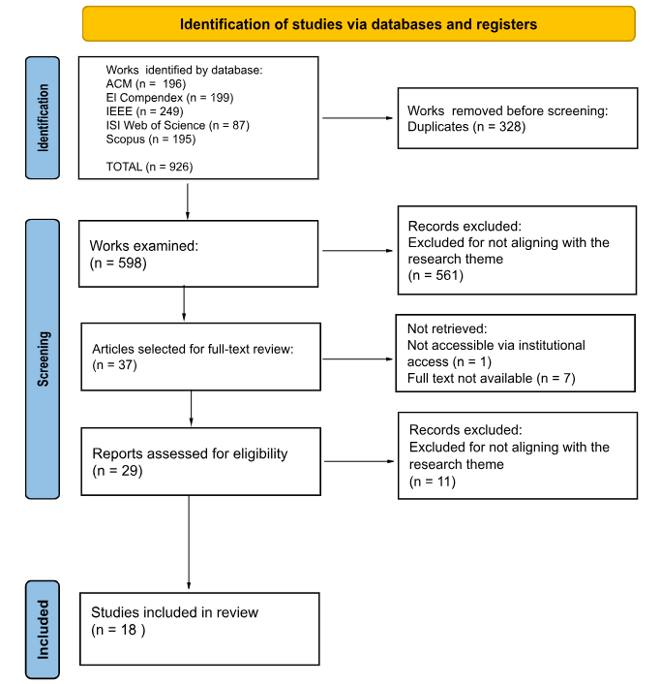
4. Problems
In a literature review, we observed that there are both theoretical and practical activities aimed at developing ethical thinking.
25th Annual International Conference on Digital Government Research (dg.o 2024)

Slide 26
4. Problems
However, none of them seeks to provide a structured approach capable of building a bridge between ethical principles, supporting the process from the identification of negative ethical consequences to their handling within the use cases of the system being analyzed.
25th Annual International Conference on Digital Government Research (dg.o 2024)

Slide 27
4. Problems
However, none of them seeks to provide a structured approach capable of building a bridge between ethical principles, supporting the process from the identification of negative ethical consequences to their handling within the use cases of the system being analyzed.
Activities | Identification of Impacted Stakeholders | Identification of Negative Ethical Consequences | Identification of Causes Associated with Ethical Consequences | Classification of consequences into actionable, influenceable, or monitorable. | Proposal of Solutions for Actionable Consequences | Creation or Modification of Use Cases
Consequence Scanning |  | X |  | X | X
Diagram Construction |  | X
Discussions | X | X
Ethical Analysis through Classical Ethical Theories |  | X |  |  | X
Hands-on Development Activities |  |  |  |  | X | X
Literature-Based Activities |  | X |  |  | X
Metacognition | X | X
Proposed Method | X | X | X | X | X | X
25th Annual International Conference on Digital Government Research (dg.o 2024)

Slide 28
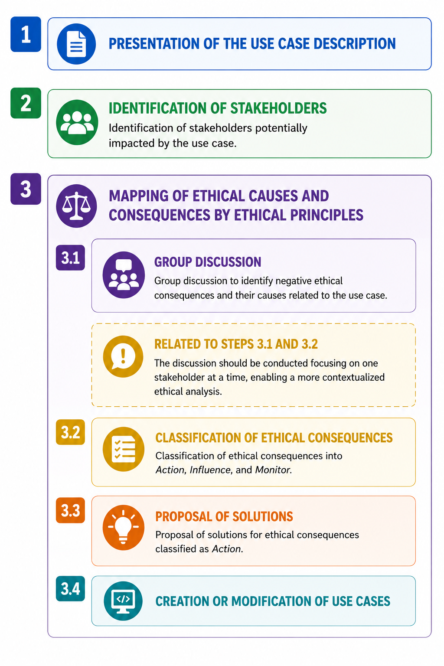
5. Proposed Method
25th Annual International Conference on Digital Government Research (dg.o 2024)

Slide 29
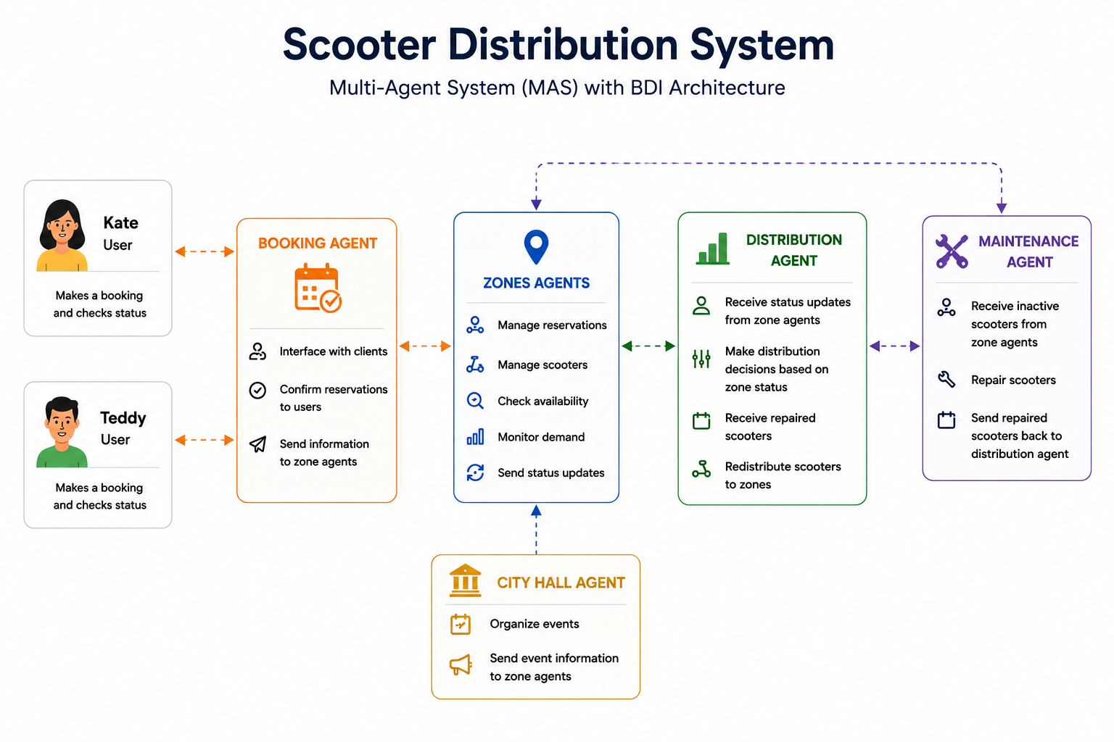
6. Application of the Method in a Case Study
A BDI-based Multi-Agent System (MAS) for Scooter Management was used as a case study to demonstrate the application of the proposed method. The study was conducted by a group composed of one researcher and two graduate students.
25th Annual International Conference on Digital Government Research (dg.o 2024)

Slide 30
Step 1: Use Case Description
Use Case 1 - Redistribute Scooters Between City Zones
Objective: Ensure that different areas of the city maintain an adequate number of available electric scooters through a Multi-Agent System (MAS) composed of autonomous agents responsible for monitoring and redistributing scooters.
Agents involved: Distributor Zones
25th Annual International Conference on Digital Government Research (dg.o 2024)

Slide 31
Step 1: Use Case Description
Use Case 1 - Redistribute Scooters Between City Zones
Main Flow Each zone sends its current status containing the following information: zone type; available scooters; demand level; unmet demand; inactive scooters; local events; user satisfaction in the zone. The Distribution Agent receives updated status information from all zones. The Distribution Agent analyzes the status of all zones and decides whether scooters should be transferred to one or more priority zones. The Distribution Agent calculates the number of scooters to be transferred to a zone based on the annual usage history of each zone. Each Zone Agent receives a calculated quantity of scooters from the Distribution Agent’s central stock.
AF1 - Lack of Available Scooters in the Distribution Agent's Central Stock Alternative Flow for Step 10 of the Main Flow If there are not enough scooters available in the Distribution Agent's Central Stock: The Distribution Agent checks whether there are zones with available scooters and low current demand. If so, it transfers available scooters from the identified zone to a priority zone
25th Annual International Conference on Digital Government Research (dg.o 2024)

Slide 32
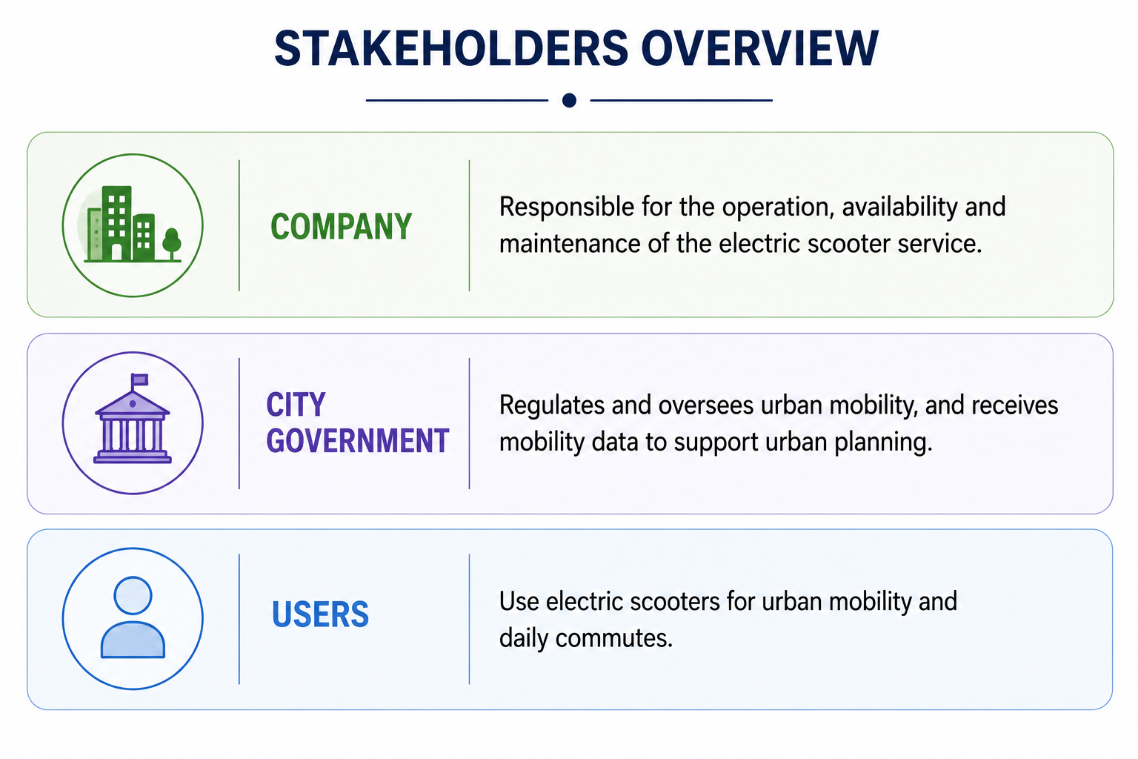
Step 2: Identification of Impacted Stakeholders
25th Annual International Conference on Digital Government Research (dg.o 2024)

Slide 33
Step 2: Identification of Impacted Stakeholders
25th Annual International Conference on Digital Government Research (dg.o 2024)

Slide 34
Step 2: Identification of Impacted Stakeholders
25th Annual International Conference on Digital Government Research (dg.o 2024)

Slide 35
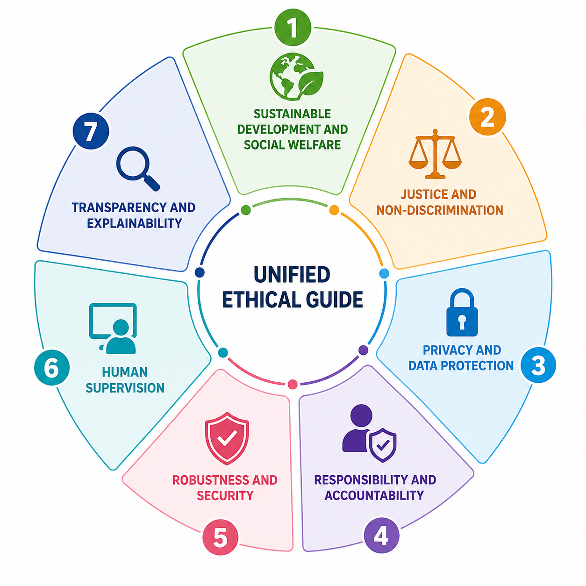
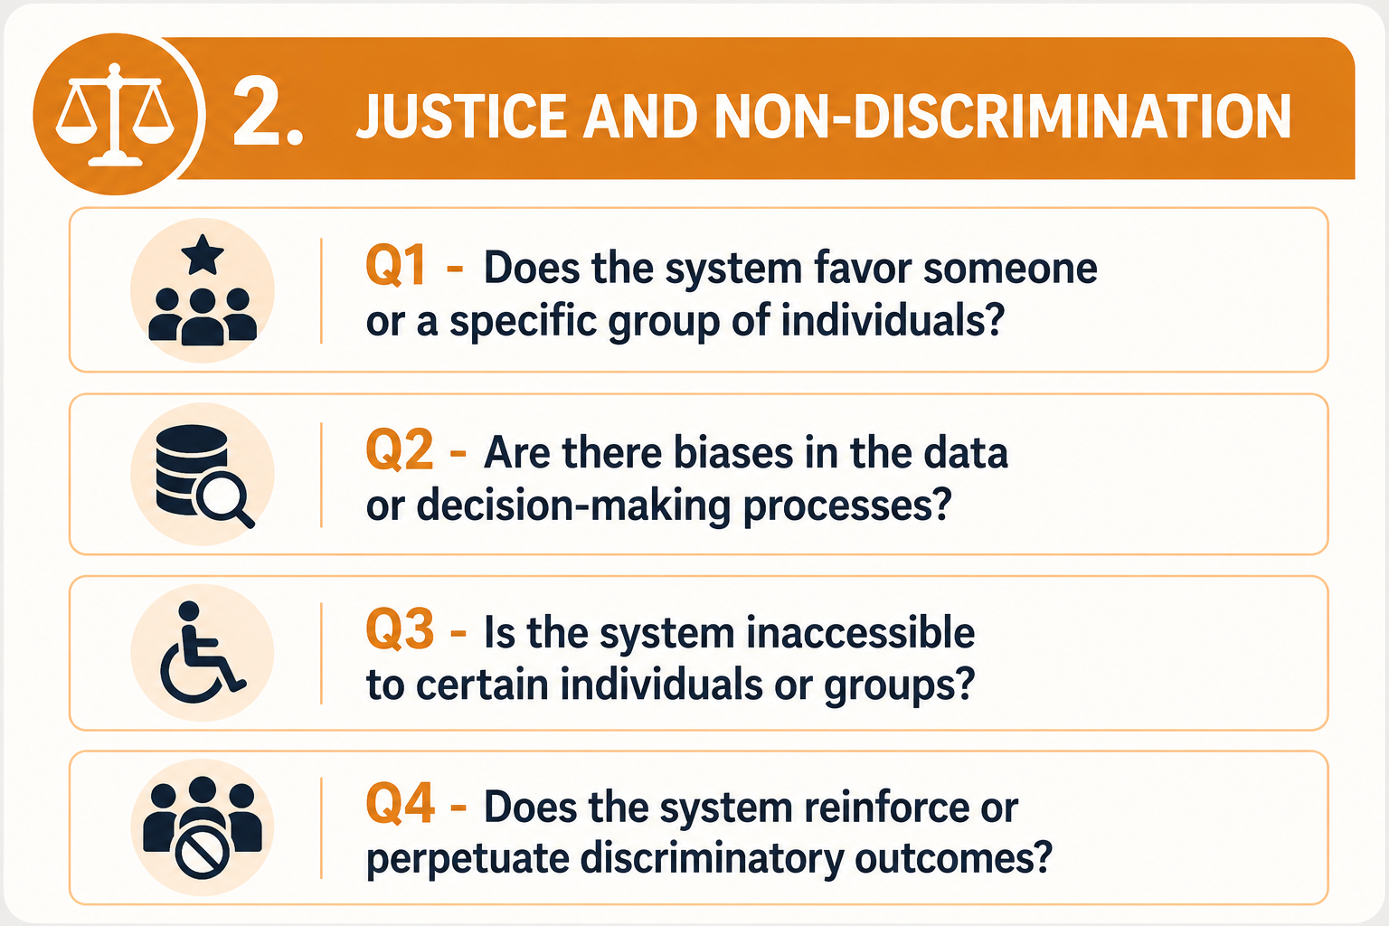
Step 3: Mapping of Ethical Causes and Consequences by Ethical Principle
Step 1: Group Activity
Group discussions were conducted to identify negative consequences and their causes associated with the use case and the ethical principles defined in the unified guideline.
groups
The Unified Ethical Guide was used as the basis for identifying negative ethical consequences.
Trigger Ethics Questions were also used to stimulate reflection on potential negative ethical consequences in the system.
25th Annual International Conference on Digital Government Research (dg.o 2024)

Slide 36
Step 3: Mapping of Ethical Causes and Consequences
Use Case 1 - Redistribute Scooters Between City Zones
Main Flow Each zone sends its current status containing the following information: zone type; available scooters; demand level; unmet demand; inactive scooters; local events; user satisfaction in the zone. The Distribution Agent receives updated status information from all zones. The Distribution Agent analyzes the status of all zones and decides whether scooters should be transferred to one or more priority zones. The Distribution Agent calculates the number of scooters to be transferred to a zone based on the annual usage history of each zone. Each Zone Agent receives a calculated quantity of scooters from the Distribution Agent’s central stock.
Justice and Non-Discrimination
Zones with historically low scooter availability may continue receiving fewer scooters, even if the demand in those areas changes over time.
AF1 - Lack of Available Scooters in the Distribution Agent's Central Stock Alternative Flow for Step 10 of the Main Flow If there are not enough scooters available in the Distribution Agent's Central Stock: The Distribution Agent checks whether there are zones with available scooters and low current demand. If so, it transfers available scooters from the identified zone to a priority zone
25th Annual International Conference on Digital Government Research (dg.o 2024)

Slide 37
Step 3: Mapping of Ethical Causes and Consequences
Use Case 1 - Redistribute Scooters Between City Zones
Main Flow Each zone sends its current status containing the following information: zone type; available scooters; demand level; unmet demand; inactive scooters; local events; user satisfaction in the zone. The Distribution Agent receives updated status information from all zones. The Distribution Agent analyzes the status of all zones and decides whether scooters should be transferred to one or more priority zones. The Distribution Agent calculates the number of scooters to be transferred to a zone based on the annual usage history of each zone. Each Zone Agent receives a calculated quantity of scooters from the Distribution Agent’s central stock.
AF1 - Lack of Available Scooters in the Distribution Agent's Central Stock Alternative Flow for Step 10 of the Main Flow If there are not enough scooters available in the Distribution Agent's Central Stock: The Distribution Agent checks whether there are zones with available scooters and low current demand. If so, it transfers available scooters from the identified zone to a priority zone
Sustainable Development and Social Welfare
An area may be left without available scooters if another zone is prioritized.
25th Annual International Conference on Digital Government Research (dg.o 2024)

Slide 38
Step 3: Mapping of Ethical Causes and Consequences
Use Case 1 - Redistribute Scooters Between City Zones
Main Flow Each zone sends its current status containing the following information: zone type; available scooters; demand level; unmet demand; inactive scooters; local events; user satisfaction in the zone. The Distribution Agent receives updated status information from all zones. The Distribution Agent analyzes the status of all zones and decides whether scooters should be transferred to one or more priority zones. The Distribution Agent calculates the number of scooters to be transferred to a zone based on the annual usage history of each zone. Each Zone Agent receives a calculated quantity of scooters from the Distribution Agent’s central stock.
Privacy and Data Protection
To calculate the demand of each zone at a given time, it is necessary to collect user data such as location and usage times
AF1 - Lack of Available Scooters in the Distribution Agent's Central Stock Alternative Flow for Step 10 of the Main Flow If there are not enough scooters available in the Distribution Agent's Central Stock: The Distribution Agent checks whether there are zones with available scooters and low current demand. If so, it transfers available scooters from the identified zone to a priority zone
25th Annual International Conference on Digital Government Research (dg.o 2024)

Slide 39
Step 3: Mapping of Ethical Causes and Consequences by Ethical Principle
Ethics Principles
1 - Sustainable Development and Social Welfare
Cause
Intermediate Effect
Ethical Consequences
Unequal access
25th Annual International Conference on Digital Government Research (dg.o 2024)

Slide 40
Step 3: Mapping of Ethical Causes and Consequences by Ethical Principle
Ethics Principles
1 - Sustainable Development and Social Welfare
Cause
If the Distribution Agent’s central stock is empty, scooters may be transferred from other zones, leaving some areas without scooters
Intermediate Effect
Ethical Consequences
Unequal access
25th Annual International Conference on Digital Government Research (dg.o 2024)

Slide 41
Step 3: Mapping of Ethical Causes and Consequences by Ethical Principle
Ethics Principles
1 - Sustainable Development and Social Welfare
There is no minimum scooter retention policy to prevent zones from becoming empty after transfers
Cause
If the Distribution Agent’s central stock is empty, scooters may be transferred from other zones, leaving some areas without scooters
Intermediate Effect
Ethical Consequences
Unequal access
25th Annual International Conference on Digital Government Research (dg.o 2024)

Slide 42
Step 3: Mapping of Ethical Causes and Consequences by Ethical Principle
Ethics Principles
1 - Sustainable Development and Social Welfare
2. Justice and Non-Discrimination
There is no minimum scooter retention policy to prevent zones from becoming empty after transfers
Cause
If the Distribution Agent’s central stock is empty, scooters may be transferred from other zones, leaving some areas without scooters
Intermediate Effect
Ethical Consequences
Unequal access
Perpetuation of biases and favoring zones
25th Annual International Conference on Digital Government Research (dg.o 2024)

Slide 43
Step 3: Mapping of Ethical Causes and Consequences by Ethical Principle
Ethics Principles
1 - Sustainable Development and Social Welfare
2. Justice and Non-Discrimination
There is no minimum scooter retention policy to prevent zones from becoming empty after transfers
Cause
If the Distribution Agent’s central stock is empty, scooters may be transferred from other zones, leaving some areas without scooters
Zones historically favored by scooter use continue to receive more scooters
Intermediate Effect
Ethical Consequences
Unequal access
Perpetuation of biases and favoring zones
25th Annual International Conference on Digital Government Research (dg.o 2024)

Slide 44
Step 3: Mapping of Ethical Causes and Consequences by Ethical Principle
Ethics Principles
1 - Sustainable Development and Social Welfare
2. Justice and Non-Discrimination
There is no minimum scooter retention policy to prevent zones from becoming empty after transfers
The calculation of the number of scooters to be transferred to each zone is based on usage annual history
Cause
If the Distribution Agent’s central stock is empty, scooters may be transferred from other zones, leaving some areas without scooters
Zones historically favored by scooter use continue to receive more scooters
Intermediate Effect
Ethical Consequences
Unequal access
Perpetuation of biases and favoring zones
25th Annual International Conference on Digital Government Research (dg.o 2024)

Slide 45
Step 3: Mapping of Ethical Causes and Consequences by Ethical Principle
Ethics Principles
1 - Sustainable Development and Social Welfare
2. Justice and Non-Discrimination
3. Privacy and Data Protection
There is no minimum scooter retention policy to prevent zones from becoming empty after transfers
The calculation of the number of scooters to be transferred to each zone is based on usage annual history
Cause
If the Distribution Agent’s central stock is empty, scooters may be transferred from other zones, leaving some areas without scooters
Zones historically favored by scooter use continue to receive more scooters
Intermediate Effect
Ethical Consequences
Unequal access
Perpetuation of biases and favoring zones
Lack of informed consent and risk of legal non-compliance
25th Annual International Conference on Digital Government Research (dg.o 2024)

Slide 46
Step 3: Mapping of Ethical Causes and Consequences by Ethical Principle
Ethics Principles
1 - Sustainable Development and Social Welfare
2. Justice and Non-Discrimination
3. Privacy and Data Protection
There is no minimum scooter retention policy to prevent zones from becoming empty after transfers
The calculation of the number of scooters to be transferred to each zone is based on usage annual history
Cause
If the Distribution Agent’s central stock is empty, scooters may be transferred from other zones, leaving some areas without scooters
Zones historically favored by scooter use continue to receive more scooters
Lack of transparency about data usage
Intermediate Effect
Ethical Consequences
Unequal access
Perpetuation of biases and favoring zones
Lack of informed consent and risk of legal non-compliance
25th Annual International Conference on Digital Government Research (dg.o 2024)

Slide 47
Step 3: Mapping of Ethical Causes and Consequences by Ethical Principle
Ethics Principles
1 - Sustainable Development and Social Welfare
2. Justice and Non-Discrimination
3. Privacy and Data Protection
There is no minimum scooter retention policy to prevent zones from becoming empty after transfers
The calculation of the number of scooters to be transferred to each zone is based on usage annual history
Collection of user data (location and usage times) to generate zone demand information
Cause
If the Distribution Agent’s central stock is empty, scooters may be transferred from other zones, leaving some areas without scooters
Zones historically favored by scooter use continue to receive more scooters
Lack of transparency about data usage
Intermediate Effect
Ethical Consequences
Unequal access
Perpetuation of biases and favoring zones
Lack of informed consent and risk of legal non-compliance
25th Annual International Conference on Digital Government Research (dg.o 2024)

Slide 48
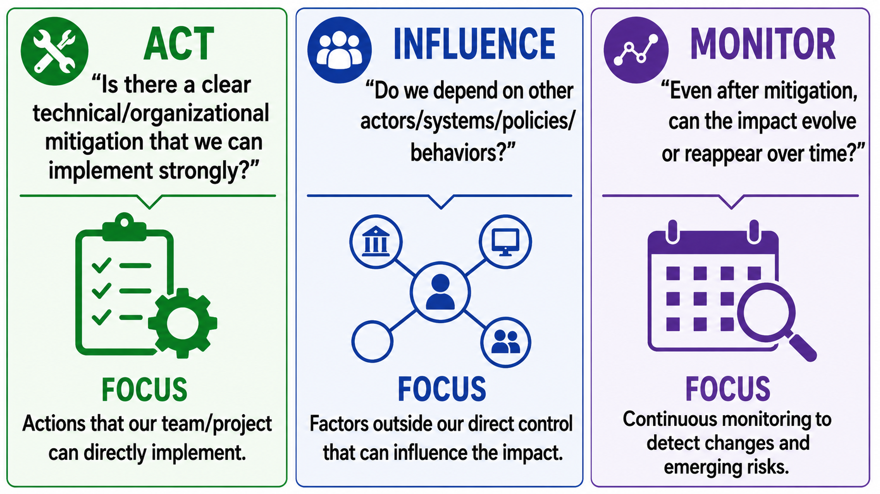
Step 3.2 : Classification of ethical negative consequences into Action, Influence, and Monitor
25th Annual International Conference on Digital Government Research (dg.o 2024)

Slide 49
Step 3.2 : Classification of ethical negative consequences into Action, Influence, and Monitor
25th Annual International Conference on Digital Government Research (dg.o 2024)

Slide 50
Step 3.2 : Classification of ethical negative consequences into Action, Influence, and Monitor
25th Annual International Conference on Digital Government Research (dg.o 2024)

Slide 51
Step 3.3: Classification of ethical consequences into Action, Influence, and Monitor
Cause
Consequences
ACTION
INFLUENCE
MONITOR
There is no minimum scooter retention policy to prevent zones from becoming empty after transfers
Unequal access
The calculation of the number of scooters to be transferred to each zone is based on usage annually history
Perpetuation of biases and favoring zones
Collection of user data (location and usage times) to generate zone demand information
Lack of informed consent and risk of legal non-compliance
25th Annual International Conference on Digital Government Research (dg.o 2024)

Slide 52
Step 3.3: Classification of ethical consequences into Action, Influence, and Monitor
Cause
Consequences
ACTION
INFLUENCE
MONITOR
There is no minimum scooter retention policy to prevent zones from becoming empty after transfers
Define a minimum scooter threshold per zone to avoid complete depletion after transfers
Unequal access
The calculation of the number of scooters to be transferred to each zone is based on usage annually history
Perpetuation of biases and favoring zones
Collection of user data (location and usage times) to generate zone demand information
Lack of informed consent and risk of legal non-compliance
25th Annual International Conference on Digital Government Research (dg.o 2024)

Slide 53
Step 3.3: Classification of ethical consequences into Action, Influence, and Monitor
Cause
Consequences
ACTION
INFLUENCE
MONITOR
There is no minimum scooter retention policy to prevent zones from becoming empty after transfers
Define a minimum scooter threshold per zone to avoid complete depletion after transfers
Continuously monitor whether all zones are receiving adequate numbers of scooters.
Unequal access
The calculation of the number of scooters to be transferred to each zone is based on usage annually history
Perpetuation of biases and favoring zones
Collection of user data (location and usage times) to generate zone demand information
Lack of informed consent and risk of legal non-compliance
25th Annual International Conference on Digital Government Research (dg.o 2024)

Slide 54
Step 3.3: Classification of ethical consequences into Action, Influence, and Monitor
Cause
Consequences
ACTION
INFLUENCE
MONITOR
There is no minimum scooter retention policy to prevent zones from becoming empty after transfers
Define a minimum scooter threshold per zone to avoid complete depletion after transfers
Continuously monitor whether all zones are receiving adequate numbers of scooters.
Unequal access
The calculation of the number of scooters to be transferred to each zone is based on usage annually history
Consider repressed demand and monthly demand when calculating scooter distribution among zones
Perpetuation of biases and favoring zones
Collection of user data (location and usage times) to generate zone demand information
Lack of informed consent and risk of legal non-compliance
25th Annual International Conference on Digital Government Research (dg.o 2024)

Slide 55
Step 3.3: Classification of ethical consequences into Action, Influence, and Monitor
Cause
Consequences
ACTION
INFLUENCE
MONITOR
There is no minimum scooter retention policy to prevent zones from becoming empty after transfers
Define a minimum scooter threshold per zone to avoid complete depletion after transfers
Continuously monitor whether all zones are receiving adequate numbers of scooters.
Unequal access
The calculation of the number of scooters to be transferred to each zone is based on usage annually history
Consider repressed demand and monthly demand when calculating scooter distribution among zones
Perpetuation of biases and favoring zones
Adjust the app’s consent request to explicitly inform users about the types of data collected and their intended purposes.
Collection of user data (location and usage times) to generate zone demand information
Lack of informed consent and risk of legal non-compliance
25th Annual International Conference on Digital Government Research (dg.o 2024)

Slide 56
Step 3.3: Classification of ethical consequences into Action, Influence, and Monitor
Cause
Consequences
ACTION
INFLUENCE
MONITOR
There is no minimum scooter retention policy to prevent zones from becoming empty after transfers
Define a minimum scooter threshold per zone to avoid complete depletion after transfers
Continuously monitor whether all zones are receiving adequate numbers of scooters.
Unequal access
The calculation of the number of scooters to be transferred to each zone is based on usage annually history
Consider repressed demand and monthly demand when calculating scooter distribution among zones
Perpetuation of biases and favoring zones
Adjust the app’s consent request to explicitly inform users about the types of data collected and their intended purposes.
Collection of user data (location and usage times) to generate zone demand information
Lack of informed consent and risk of legal non-compliance
Adjust organizational guidelines to ensure clear consent mechanisms
25th Annual International Conference on Digital Government Research (dg.o 2024)

Slide 57
Step 3.4: Creation or Modification of Use Cases
ACTION
1. Define a minimum scooter threshold per zone to avoid complete depletion after transfers
2. Consider repressed demand and monthly demand when calculating scooter distribution among zones
3. Adjust the app’s consent request to explicitly inform users about the types of data collected and their intended purposes.
25th Annual International Conference on Digital Government Research (dg.o 2024)

Slide 58
Step 3.4: Creation or Modification of Use Cases
ACTION
1. Define a minimum scooter threshold per zone to avoid complete depletion after transfers
2. Consider repressed demand and monthly demand when calculating scooter distribution among zones
3. Adjust the app’s consent request to explicitly inform users about the types of data collected and their intended purposes.
Adjusting the description of the current requirement
If so, it transfers available scooters from the identified zone to a priority zone while maintaining a minimum scooter threshold in the source zone.
25th Annual International Conference on Digital Government Research (dg.o 2024)

Slide 59
Step 3.4: Creation or Modification of Use Cases
ACTION
1. Define a minimum scooter threshold per zone to avoid complete depletion after transfers
2. Consider repressed demand and monthly demand when calculating scooter distribution among zones
3. Adjust the app’s consent request to explicitly inform users about the types of data collected and their intended purposes.
Adjusting the description of the current requirement
If so, it transfers available scooters from the identified zone to a priority zone while maintaining a minimum scooter threshold in the source zone.
Adjusting the description of the current requirement
The Distribution Agent calculates the number of scooters to be transferred to each zone based on the zone’s monthly usage history and repressed demand.
25th Annual International Conference on Digital Government Research (dg.o 2024)

Slide 60
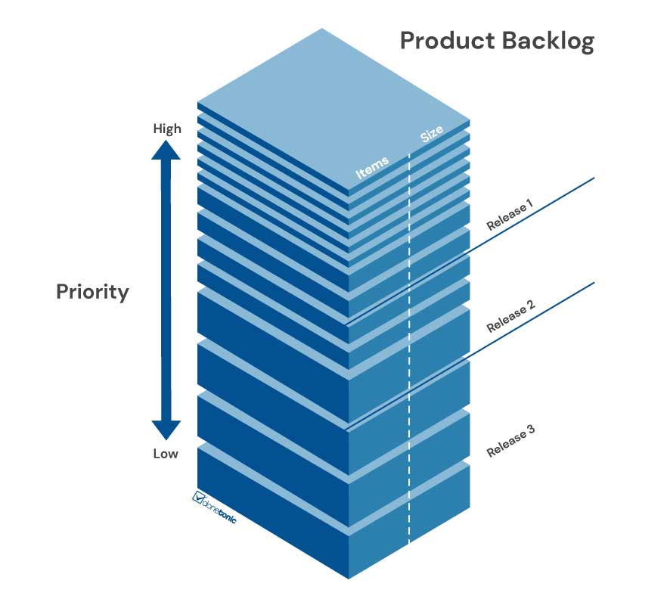
Step 3.4: Creation or Modification of Use Cases
ACTION
1. Define a minimum scooter threshold per zone to avoid complete depletion after transfers
2. Consider repressed demand and monthly demand when calculating scooter distribution among zones
3. Adjust the app’s consent request to explicitly inform users about the types of data collected and their intended purposes.
Adjusting the description of the current requirement
If so, it transfers available scooters from the identified zone to a priority zone while maintaining a minimum scooter threshold in the source zone.
Adjusting the description of the current requirement
The Distribution Agent calculates the number of scooters to be transferred to each zone based on the zone’s monthly usage history and repressed demand.
New requirement
A new requirement will be created and added to the development backlog.
25th Annual International Conference on Digital Government Research (dg.o 2024)

Slide 61
Step 3.4: Creation or Modification of Use Cases
ACTION
1. Define a minimum scooter threshold per zone to avoid complete depletion after transfers
2. Consider repressed demand and monthly demand when calculating scooter distribution among zones
3. Adjust the app’s consent request to explicitly inform users about the types of data collected and their intended purposes.
Adjusting the description of the current requirement
If so, it transfers available scooters from the identified zone to a priority zone while maintaining a minimum scooter threshold in the source zone.
Adjusting the description of the current requirement
The Distribution Agent calculates the number of scooters to be transferred to each zone based on the zone’s monthly usage history and repressed demand.
New requirement
A new requirement will be created and added to the development backlog.
25th Annual International Conference on Digital Government Research (dg.o 2024)

Slide 62
7. Dissemination of a Survey to Gather Initial Impressions of the Proposed Method
assignment
Your input is valuable!
We are conducting a survey to gather initial impressions about the proposed method for identifying and addressing negative ethical consequences in AI-based or software systems.
The questionnaire is brief, and your responses will be used exclusively for academic and research purposes.
We appreciate your participation!
Participation link: https://forms.gle/vFJEkox4tcVCETt39
25th Annual International Conference on Digital Government Research (dg.o 2024)

Slide 63
Bibliography
COMMISSION, European Union. Ethics Guidelines for Trustworthy AI. [S. l.: s. n.], jun. 2018. Accessed on April 23, 2025. Disponível em: <https://digitalstrategy.ec.europa.eu/en/library/ethics-guidelines-trustworthy-ai>.
UNESCO. Recommendation on the Ethics of Artificial Intelligence. [S. l.: s. n.], nov. 2021. Accessed on April 23, 2025. Disponível em: <https://unesdoc.unesco.org/ark:/48223/pf0000381137.locale=en>
IKIDID, Abdelouafi; EL, Fazziki Abdelaziz; SADGAL, Mohamed. Internet of things and agent-based system to improve water use efficiency in collective irrigation. Computer Science and Information Systems, v. 20, n. 1, p. 405–421, 2023
GUO, Jiaying; CHENG, Long; WANG, Shen. CoTV: Cooperative control for traffic light signals and connected autonomous vehicles using deep reinforcement learning. IEEE Transactions on Intelligent Transportation Systems, IEEE, v. 24, n. 10, p. 10501–10512, 2023.
GUO, Yida; ZHANG, Cheng. Real-time Railway Transit Management Based on Multi-Agent System (MAS). In: IOP PUBLISHING, 1. JOURNAL of Physics: Conference Series. [S. l.: s. n.], 2021. v. 1828, p. 012045.
COINTE, Nicolas; BONNET, Grégory; BOISSIER, Olivier. Ethics-based cooperation in multi-agent systems. In: ADVANCES in Social Simulation: Looking in the Mirror. [S. l.: s. n.], 2020. P. 101–116
PRIYADARSHANA, HVV et al. Developing multi-agent based micro-grid management system in jade. In: IEEE. 2019 2nd International Conference on Power and Embedded Drive Control (ICPEDC). [S. l.: s. n.], 2019. P. 552–556
CARDOSO, Rafael C; FERRANDO, Angelo; DENNIS, Louise A et al. Implementing ethical governors in BDI. In: SPRINGER. INTERNATIONAL Workshop on Engineering Multi-Agent Systems. [S. l.: s. n.], 2021. P. 22–41.
25th Annual International Conference on Digital Government Research (dg.o 2024)

Slide 64
Bibliography
DI MARTINO, Beniamino; ESPOSITO, Antonio; COLUCCI CANTE, Luigi. Multi agents simulation of justice trials to support control management and reduction of civil trials duration. Journal of Ambient Intelligence and Humanized Computing, Springer, v. 14, n. 4, p. 3645–3657, 2023.
EUROPEAN PARLIAMENT AND OF THE COUNCIL. General Data Protection Regulation (GDPR)). [S. l.: s. n.], abr. 2016. Official Journal of the European Union. Accessed on April 23, 2025. Disponível em: <https://eur-lex.europa.eu/eli/reg/2016/679/oj>.
YAZDANPANAH, Vahid; DASTANI, Mehdi et al. Multiagent task coordination as task allocation plus task responsibility. In: SPRINGER. MULTI-AGENT Systems and Agreement Technologies: 17th European Conference, EUMAS 2020, and 7th International Conference, AT 2020, Thessaloniki, Greece, September 14-15, 2020, Revised Selected Papers 17. [S. l.: s. n.], 2020. P. 571–588.
DIGNUM, Virginia. Responsible artificial intelligence: how to develop and use AI in a responsible way. [S. l.]: Springer, 2019. v. 2156.
CARDOSO, Paulo Henrique; CORREIA, Fernando et al. A Normative Multiagent Approach to Represent Data Regulation Concerns. In: ICAART (1). [S. l.: s. n.], 2023. P. 330–337.
ARHADI, Farzaneh; JENNINGS, Nicholas R. A faithful mechanism for incremental multi-agent agreement problems with self-interested and privacy-preserving agents. SN Computer Science, Springer, v. 2, n. 4, p. 272, 2021
XIE, Shangyu et al. Privacy preserving distributed energy trading. In: IEEE. 2020 IEEE 40th International Conference on Distributed Computing Systems (ICDCS). [S. l.: s. n.], 2020. P. 322–332.
YAZDANPANAH, Vahid; STEIN, Sebastian et al. Applying strategic reasoning for accountability ascription in multiagent teams, 2021.
YAZDANPANAH, Vahid; DASTANI, Mehdi et al. Multiagent task coordination as task allocation plus task responsibility. In: SPRINGER. MULTI-AGENT Systems and Agreement Technologies: 17th European Conference, EUMAS 2020, and 7th International Conference, AT 2020, Thessaloniki, Greece, September 14-15, 2020, Revised Selected Papers 17. [S. l.: s. n.], 2020. P. 571–588.
25th Annual International Conference on Digital Government Research (dg.o 2024)

Slide 65
Bibliography
18. Asimov, Isaac. "Three laws of robotics." Asimov, I. Runaround 2.3 (1941).
25th Annual International Conference on Digital Government Research (dg.o 2024)

Slide 66
Responsible Artificial Intelligence
Scooter Distribution System
Carlos Eduardo Pantoja, Nilson Mori, Tielle Alexandre, Flavia Bernardini, Fredrik Heintz
2026

