Slide 1
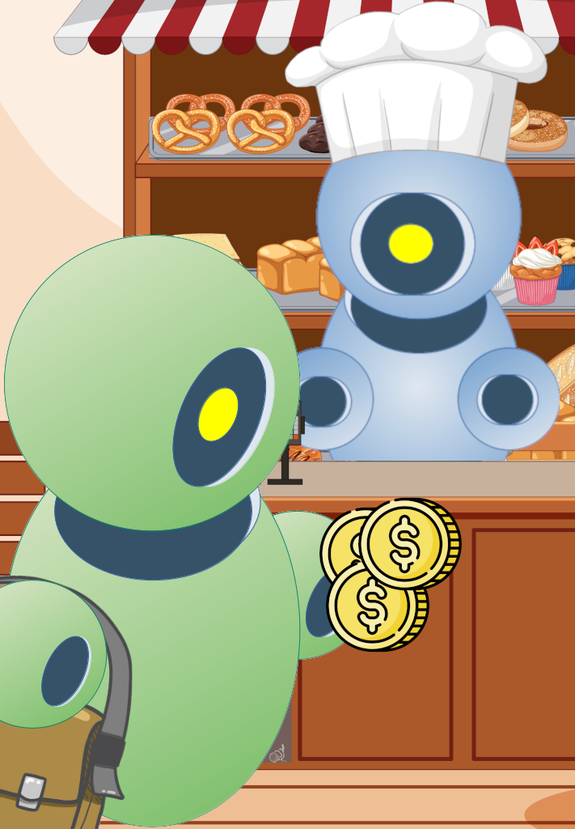
TRANSACTIONS
https://velluscinum.chon.group
Notes:
<número>

Slide 2


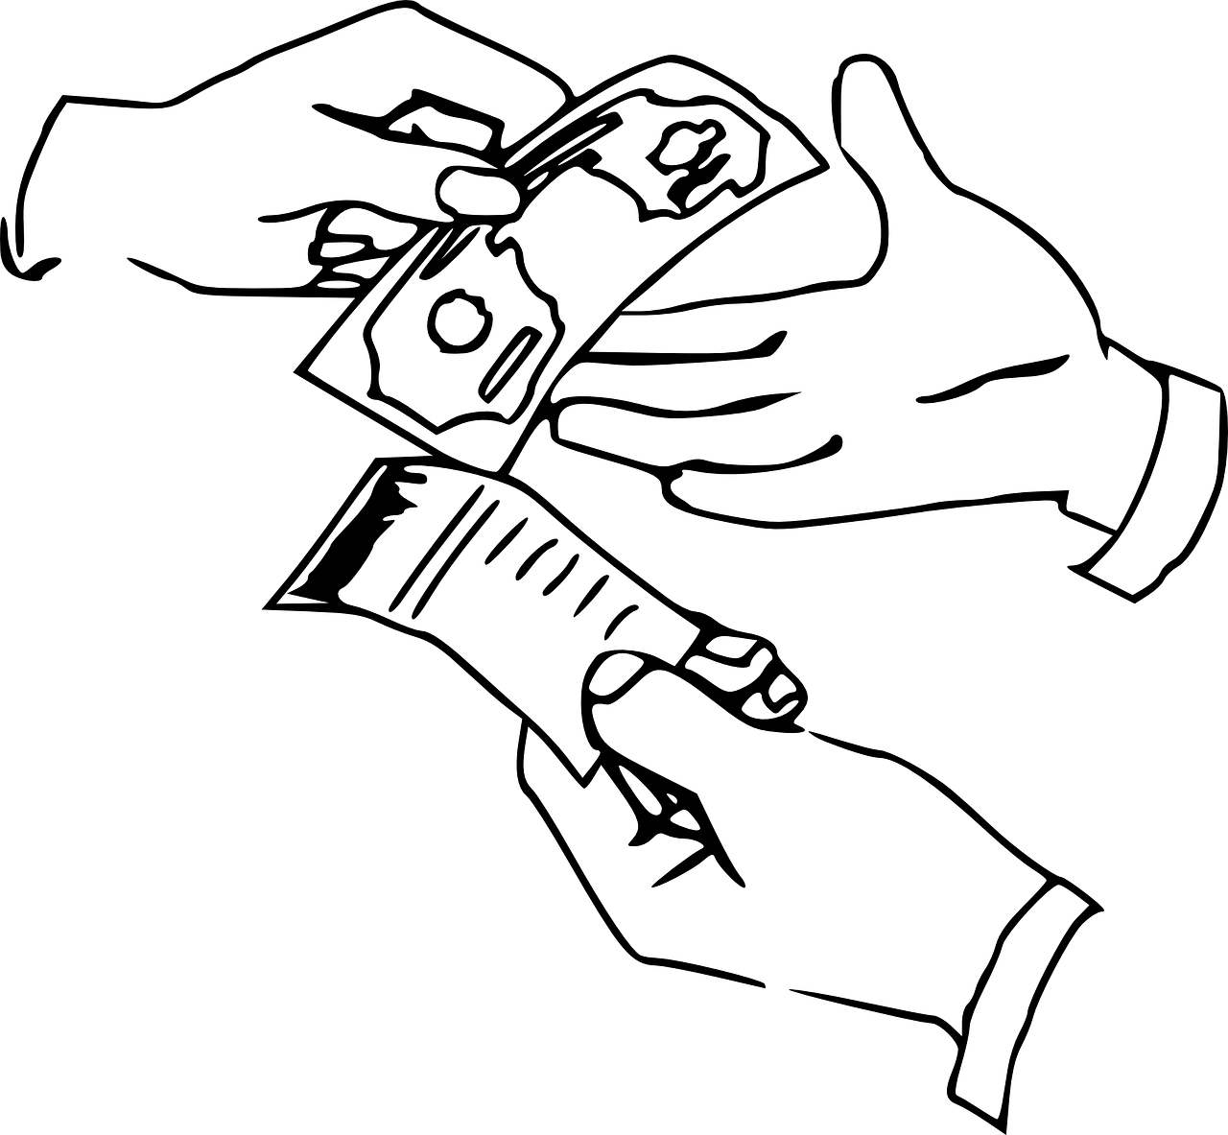




Distributed ledger technology
Using digital assets in the relationships between cognitive agents:
the transfer of funds;
registration of ownership of artifacts;
declaration of promises or agreements.
Allowing the agents to manipulate assets and wallets directly in the DLT.
Velluscinum
MAS - Agents Dimension
Notes:
The swapping of resources — addition or removal — is an interesting feature in the development of Embedded MAS because it adds adaptability at runtime for agents. The system does not need to be turned off, and agents could reason about the availability of resources.
In this way, an autonomous agent can be adaptable, continuing to perform actions to achieve its goals in case of hardware failure, for example.
This work presents a new feature for swapping physical resources at runtime in Embedded MAS.
Therefore, one embedded system that already has physical resources available may have new resources attached to it or removed, and agents will automatically be aware of these new resources or their absence.
<número>

Slide 3
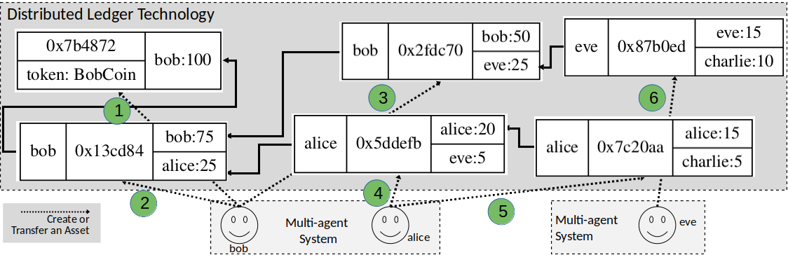
Divisible asset such as cryptocurrency

Slide 4
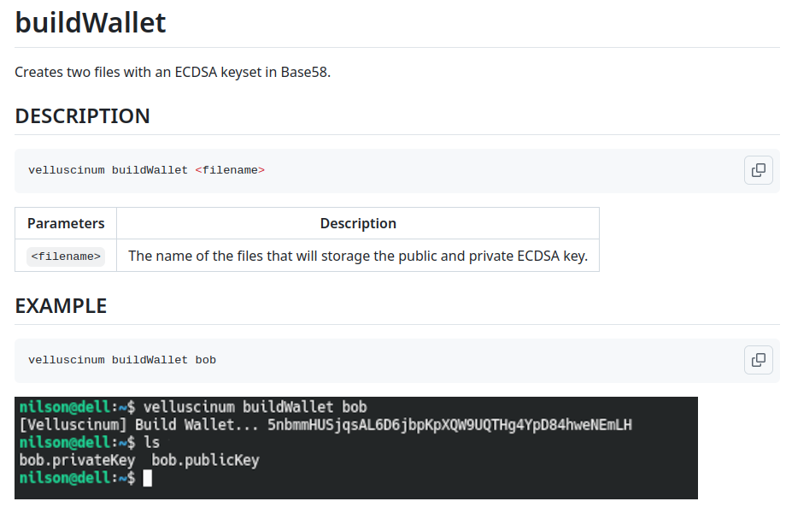
buildWallet-CLI

Slide 5
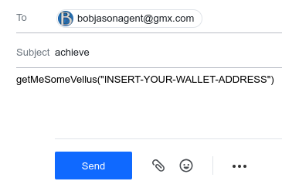
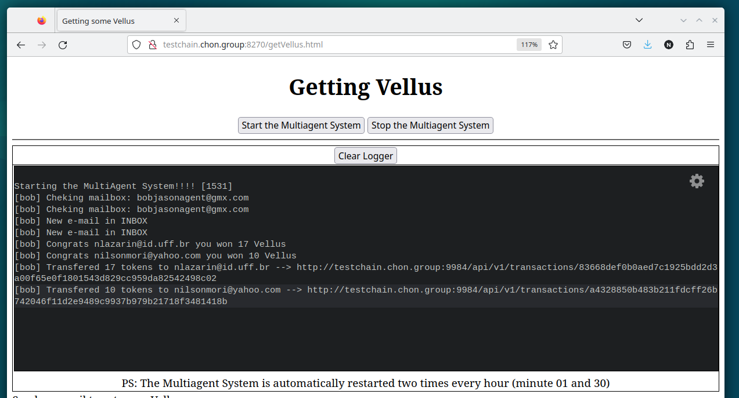
Getting some Vellus
http://testchain.chon.group:8270/getVellus.html

Slide 6

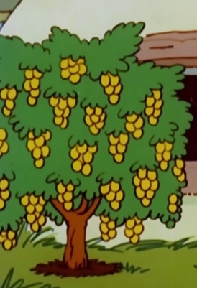

https://github.com/chon-group/distributedAndEmbeddedAI/tree/main/course/15-Negociation/example
Image credits:
https://smurfs.fandom.com/wiki/Chef_Smurf
https://smurfs.fandom.com/pt/wiki/Fominha
https://smurfs.fandom.com/pt-br/wiki/%C3%81rvore_de_Dinheiro

Slide 7
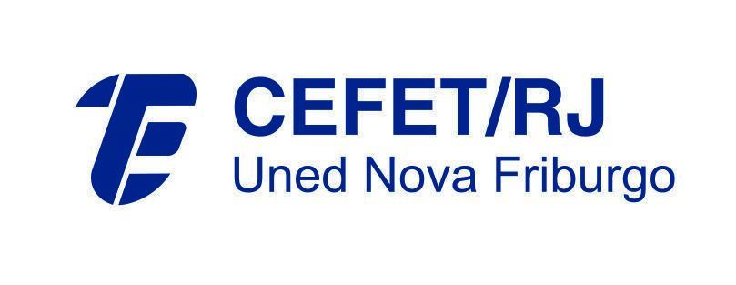
Acknowledgements
THANK YOU!
Notes:
<número>

