Slide 1



Introduction to Distributed and Embedded Multi-agent Systems
Carlos Eduardo Pantoja¹
Nilson Mori Lazarin^{1,2}
1. Centro Federal de Educação Tecnológica (CEFET/RJ) - 2. Universidade Federal Fluminense (UFF), Brasil
02/2024

Slide 2
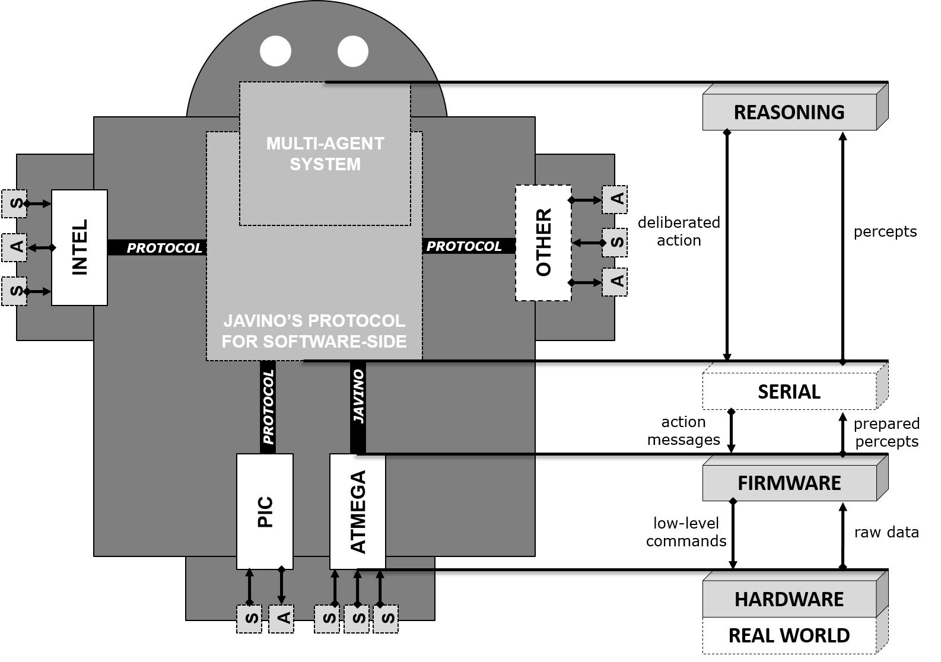
REASONING LAYER USING CHONIDE
Notes:
<número>

Slide 3
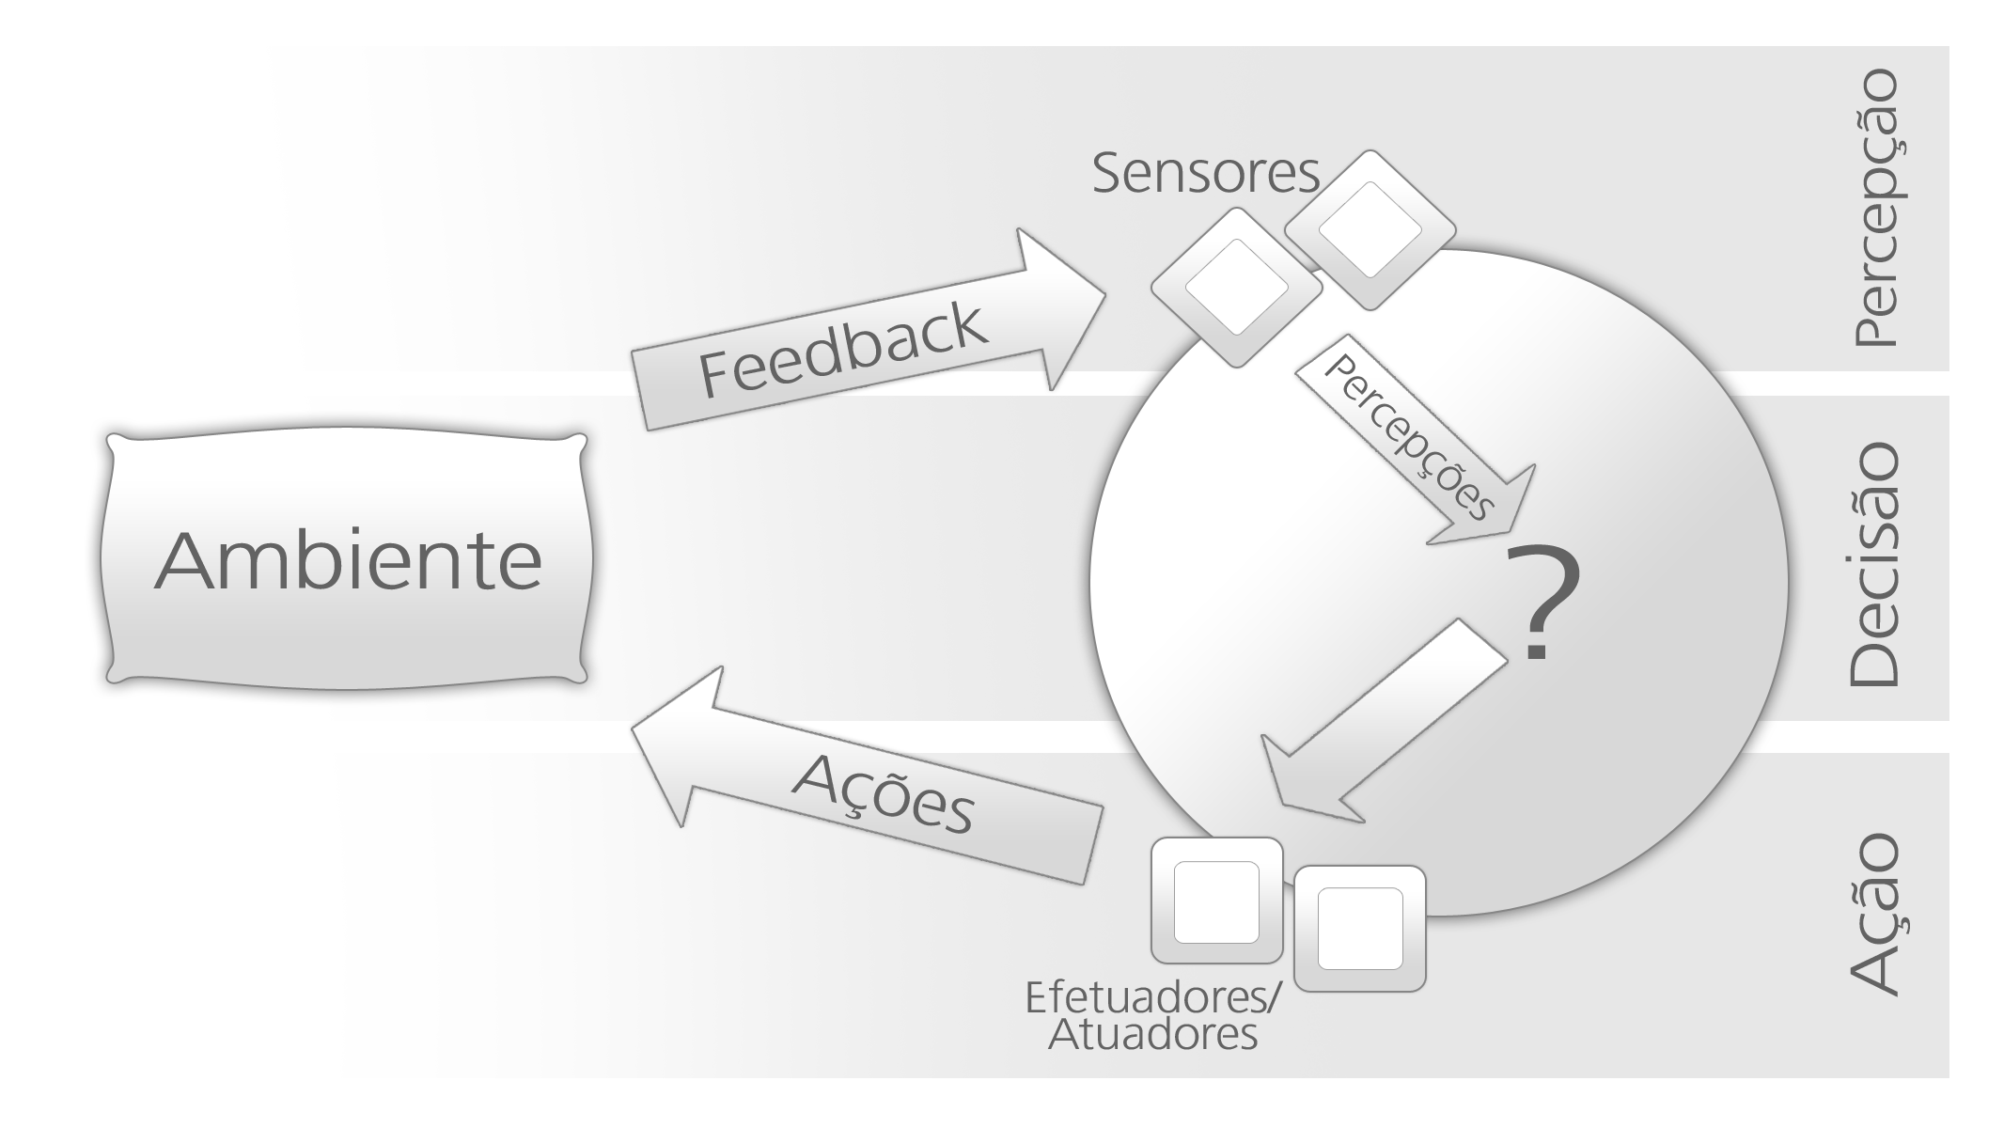
Introduction
Agent
Is a computational system capable of perceiving and acting in an environment by its deliberation based on its convictions and motivations.
WOOLDRIDGE, Michael. Intelligent Agents. Multiagent Systems: A Modern Approach to Distributed Artificial Intelligence. Cambridge, MA, USA: MIT Press, 1999. p. 27–77
MICHEL, Fabien; FERBER, Jacques; DROGOUL, Alexis. Multi-Agent Systems and Simulation: a Survey From the Agents Community's Perspective. 2009
BRATMAN, Michael. Intention, plans, and practical reason. 1987.
Notes:
<número>

Slide 4



Agradecimentos
OBRIGADO!
pantoja@cefet-rj.br
nilson.lazarin@cefet-rj.br
vsjesus@id.uff.br
fabiancpbm@gmail.com
Notes:
<número>

