Slide 1



Introduction to Distributed and Embedded Multi-agent Systems
Carlos Eduardo Pantoja¹
Nilson Mori Lazarin^{1,2}
1. Centro Federal de Educação Tecnológica (CEFET/RJ) - 2. Universidade Federal Fluminense (UFF), Brasil
1 de Setembro 2023, Pelotas, RS

Slide 2
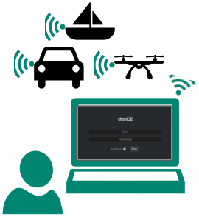
Development
Tools
Notes:
<número>

Slide 3
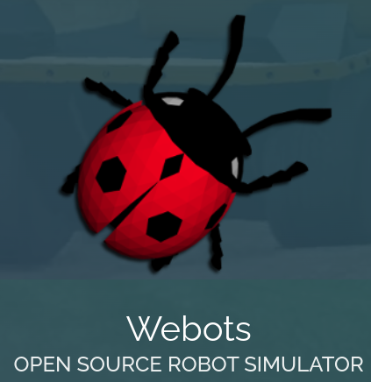
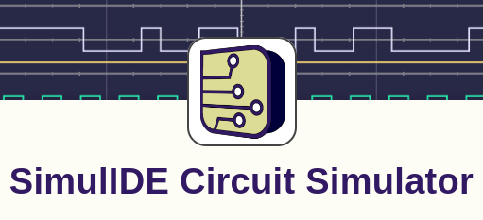

ChonIDE, SimulIDE e Webots
Souza de Jesus, V., Mori Lazarin, N., Pantoja, C.E., Vaz Alves, G., Ramos Alves de Lima, G., Viterbo, J. (2023). An IDE to Support the Development of Embedded Multi-Agent Systems. In: Mathieu, P., Dignum, F., Novais, P., De la Prieta, F. (eds) Advances in Practical Applications of Agents, Multi-Agent Systems, and Cognitive Mimetics. The PAAMS Collection. PAAMS 2023. Lecture Notes in Computer Science(), vol 13955. Springer, Cham. https://doi.org/10.1007/978-3-031-37616-0_29
Michel, O. (1998). Webots: Symbiosis Between Virtual and Real Mobile Robots. In: Heudin, JC. (eds) Virtual Worlds. VW 1998. Lecture Notes in Computer Science(), vol 1434. Springer, Berlin, Heidelberg. https://doi.org/10.1007/3-540-68686-X_24
González, Santiago. “SimulIDE Circuit Simulator”, 2023. https://simulide.com.

Slide 4
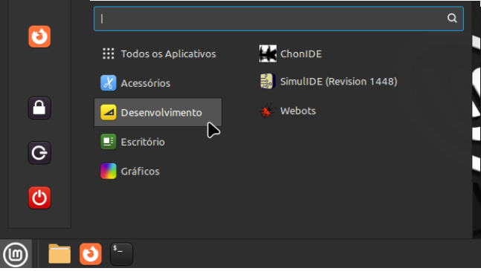
Manual de Instalação: https://github.com/chon-group/chonIDE/tree/main/doc

Slide 5
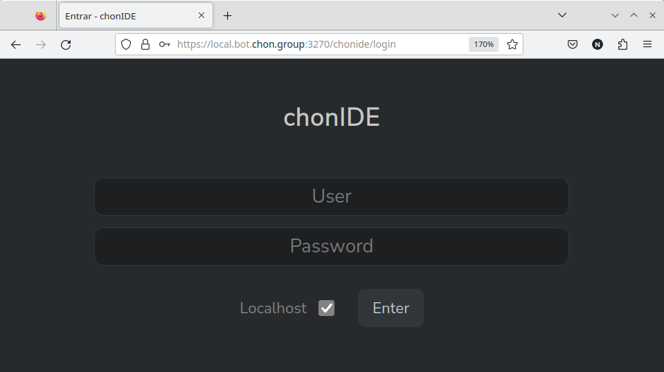
ChonIDE
Souza de Jesus, V., Mori Lazarin, N., Pantoja, C.E., Vaz Alves, G., Ramos Alves de Lima, G., Viterbo, J. (2023). An IDE to Support the Development of Embedded Multi-Agent Systems. In: Mathieu, P., Dignum, F., Novais, P., De la Prieta, F. (eds) Advances in Practical Applications of Agents, Multi-Agent Systems, and Cognitive Mimetics. The PAAMS Collection. PAAMS 2023. Lecture Notes in Computer Science(), vol 13955. Springer, Cham. https://doi.org/10.1007/978-3-031-37616-0_29

Slide 6
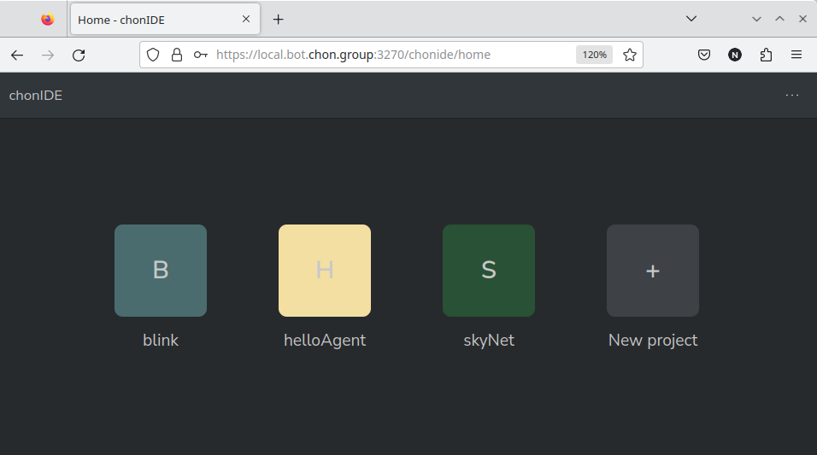
ChonIDE: helloAgent
Souza de Jesus, V., Mori Lazarin, N., Pantoja, C.E., Vaz Alves, G., Ramos Alves de Lima, G., Viterbo, J. (2023). An IDE to Support the Development of Embedded Multi-Agent Systems. In: Mathieu, P., Dignum, F., Novais, P., De la Prieta, F. (eds) Advances in Practical Applications of Agents, Multi-Agent Systems, and Cognitive Mimetics. The PAAMS Collection. PAAMS 2023. Lecture Notes in Computer Science(), vol 13955. Springer, Cham. https://doi.org/10.1007/978-3-031-37616-0_29

Slide 7
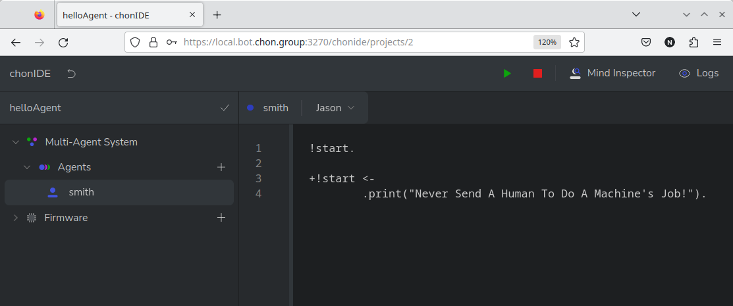
ChonIDE: helloAgent
Souza de Jesus, V., Mori Lazarin, N., Pantoja, C.E., Vaz Alves, G., Ramos Alves de Lima, G., Viterbo, J. (2023). An IDE to Support the Development of Embedded Multi-Agent Systems. In: Mathieu, P., Dignum, F., Novais, P., De la Prieta, F. (eds) Advances in Practical Applications of Agents, Multi-Agent Systems, and Cognitive Mimetics. The PAAMS Collection. PAAMS 2023. Lecture Notes in Computer Science(), vol 13955. Springer, Cham. https://doi.org/10.1007/978-3-031-37616-0_29

Slide 8
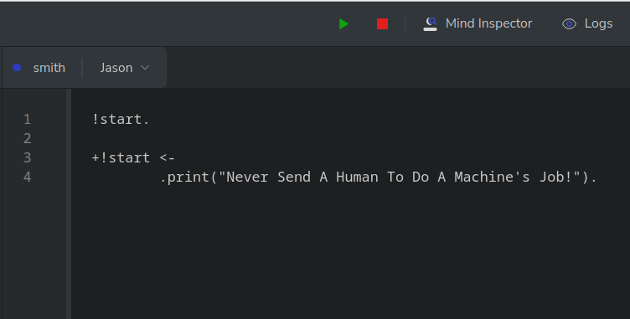


ChonIDE: helloAgent
Souza de Jesus, V., Mori Lazarin, N., Pantoja, C.E., Vaz Alves, G., Ramos Alves de Lima, G., Viterbo, J. (2023). An IDE to Support the Development of Embedded Multi-Agent Systems. In: Mathieu, P., Dignum, F., Novais, P., De la Prieta, F. (eds) Advances in Practical Applications of Agents, Multi-Agent Systems, and Cognitive Mimetics. The PAAMS Collection. PAAMS 2023. Lecture Notes in Computer Science(), vol 13955. Springer, Cham. https://doi.org/10.1007/978-3-031-37616-0_29

Slide 9
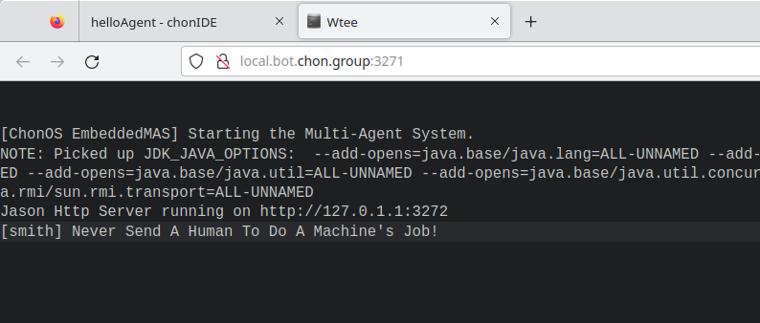
ChonIDE: helloAgent
Pantoja, C.E., Jesus, V.S.d., Lazarin, N.M., Viterbo, J. (2023). A Spin-off Version of Jason for IoT and Embedded Multi-Agent Systems. In: Naldi, M.C., Bianchi, R.A.C. (eds) Intelligent Systems. BRACIS 2023. Lecture Notes in Computer Science(), vol 14195. Springer, Cham. https://doi.org/10.1007/978-3-031-45368-7_25

Slide 10
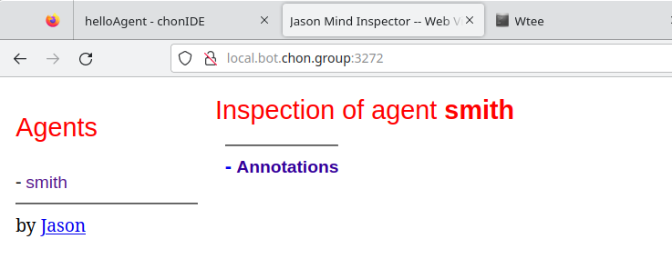
ChonIDE: helloAgent
Bordini, R.H., Hübner, J.F. (2006). BDI Agent Programming in AgentSpeak Using Jason . In: Toni, F., Torroni, P. (eds) Computational Logic in Multi-Agent Systems. CLIMA 2005. Lecture Notes in Computer Science(), vol 3900. Springer, Berlin, Heidelberg. https://doi.org/10.1007/11750734_9

Slide 11

ChonIDE: helloAgent
Souza de Jesus, V., Mori Lazarin, N., Pantoja, C.E., Vaz Alves, G., Ramos Alves de Lima, G., Viterbo, J. (2023). An IDE to Support the Development of Embedded Multi-Agent Systems. In: Mathieu, P., Dignum, F., Novais, P., De la Prieta, F. (eds) Advances in Practical Applications of Agents, Multi-Agent Systems, and Cognitive Mimetics. The PAAMS Collection. PAAMS 2023. Lecture Notes in Computer Science(), vol 13955. Springer, Cham. https://doi.org/10.1007/978-3-031-37616-0_29

Slide 13
SimulIDE
Manual de Instalação: https://github.com/chon-group/dpkg-simulide

Slide 14
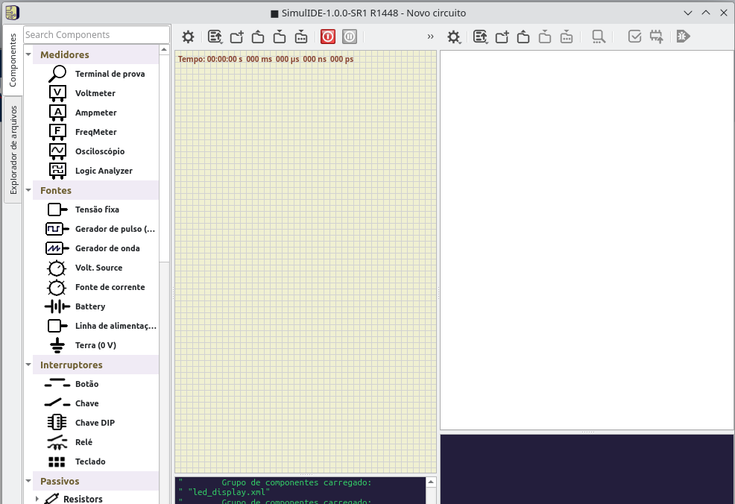
SimulIDE

Slide 15
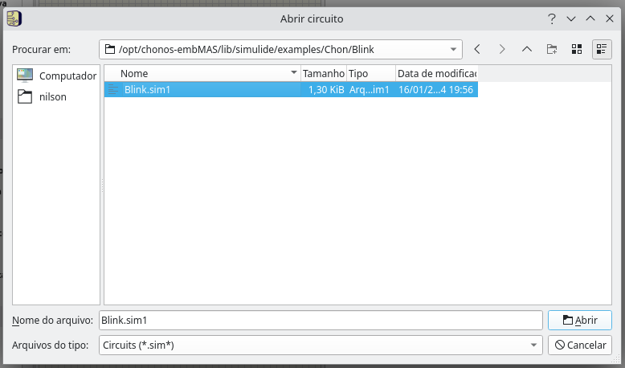
SimulIDE

Slide 16
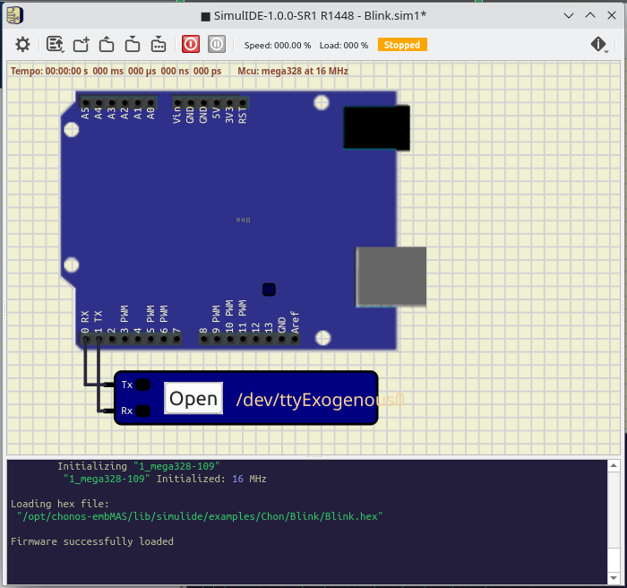
SimulIDE

Slide 17
SimulIDE

Slide 18
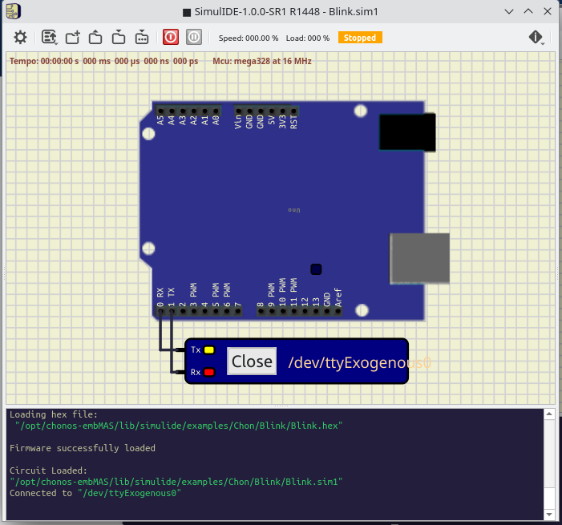
SimulIDE

Slide 19
SimulIDE

Slide 20
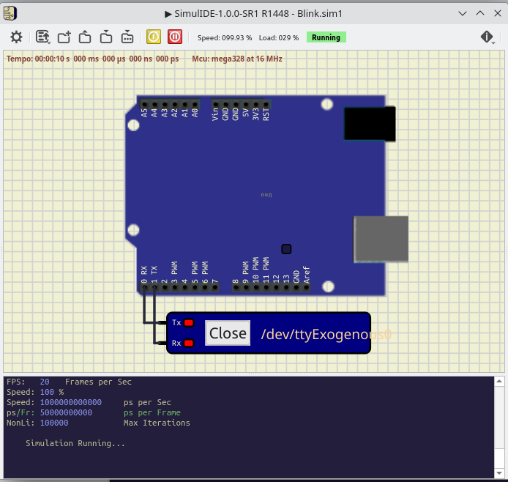
SimulIDE

Slide 22



Agradecimentos
OBRIGADO!
pantoja@cefet-rj.br
nilson.lazarin@cefet-rj.br
vsjesus@id.uff.br
fabiancpbm@gmail.com
Notes:
<número>

