Slide 1



Introduction to Distributed and Embedded Multi-agent Systems
Carlos Eduardo Pantoja¹
Nilson Mori Lazarin^{1,2}
1. Centro Federal de Educação Tecnológica (CEFET/RJ) - 2. Universidade Federal Fluminense (UFF), Brasil
Fevereiro 2024

Slide 2

THE DEVELOPMENT
TOOLS
Notes:
<número>

Slide 3

ChonIDE
Souza de Jesus, V., Mori Lazarin, N., Pantoja, C.E., Vaz Alves, G., Ramos Alves de Lima, G., Viterbo, J. (2023). An IDE to Support the Development of Embedded Multi-Agent Systems. In: Mathieu, P., Dignum, F., Novais, P., De la Prieta, F. (eds) Advances in Practical Applications of Agents, Multi-Agent Systems, and Cognitive Mimetics. The PAAMS Collection. PAAMS 2023. Lecture Notes in Computer Science(), vol 13955. Springer, Cham. https://doi.org/10.1007/978-3-031-37616-0_29

Slide 4
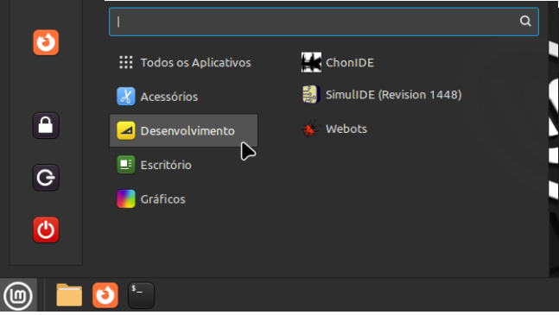
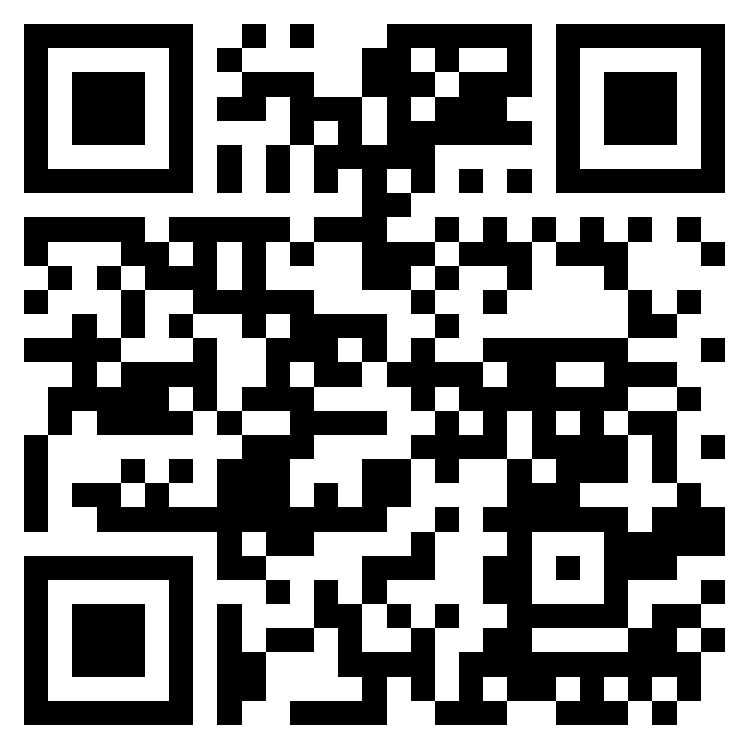
Manual de Instalaçãohttps://github.com/chon-group/chonIDE/tree/main/doc

Slide 5
Manual de Instalaçãohttps://github.com/chon-group/chonIDE/tree/main/doc

Slide 6
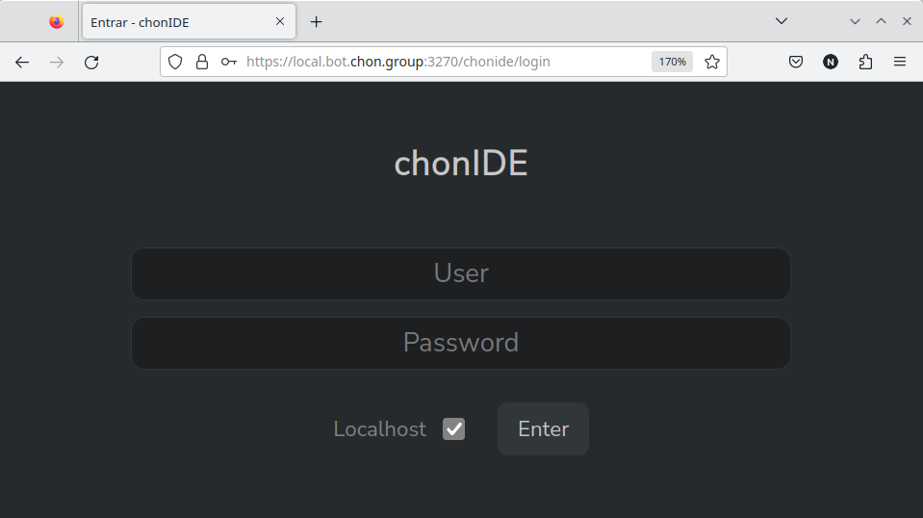
ChonIDE
Souza de Jesus, V., Mori Lazarin, N., Pantoja, C.E., Vaz Alves, G., Ramos Alves de Lima, G., Viterbo, J. (2023). An IDE to Support the Development of Embedded Multi-Agent Systems. In: Mathieu, P., Dignum, F., Novais, P., De la Prieta, F. (eds) Advances in Practical Applications of Agents, Multi-Agent Systems, and Cognitive Mimetics. The PAAMS Collection. PAAMS 2023. Lecture Notes in Computer Science(), vol 13955. Springer, Cham. https://doi.org/10.1007/978-3-031-37616-0_29

Slide 7
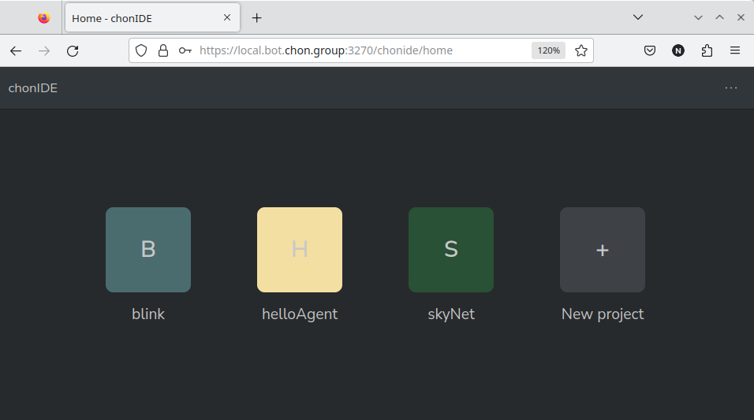
ChonIDE: helloAgent
Souza de Jesus, V., Mori Lazarin, N., Pantoja, C.E., Vaz Alves, G., Ramos Alves de Lima, G., Viterbo, J. (2023). An IDE to Support the Development of Embedded Multi-Agent Systems. In: Mathieu, P., Dignum, F., Novais, P., De la Prieta, F. (eds) Advances in Practical Applications of Agents, Multi-Agent Systems, and Cognitive Mimetics. The PAAMS Collection. PAAMS 2023. Lecture Notes in Computer Science(), vol 13955. Springer, Cham. https://doi.org/10.1007/978-3-031-37616-0_29

Slide 8
ChonIDE: helloAgent
Souza de Jesus, V., Mori Lazarin, N., Pantoja, C.E., Vaz Alves, G., Ramos Alves de Lima, G., Viterbo, J. (2023). An IDE to Support the Development of Embedded Multi-Agent Systems. In: Mathieu, P., Dignum, F., Novais, P., De la Prieta, F. (eds) Advances in Practical Applications of Agents, Multi-Agent Systems, and Cognitive Mimetics. The PAAMS Collection. PAAMS 2023. Lecture Notes in Computer Science(), vol 13955. Springer, Cham. https://doi.org/10.1007/978-3-031-37616-0_29

Slide 9
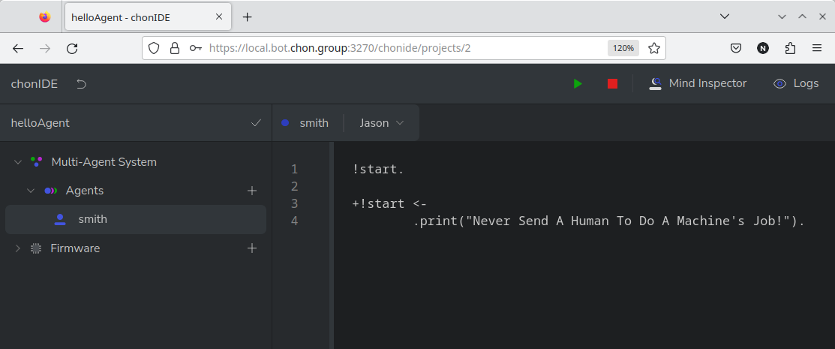
ChonIDE: helloAgent
Souza de Jesus, V., Mori Lazarin, N., Pantoja, C.E., Vaz Alves, G., Ramos Alves de Lima, G., Viterbo, J. (2023). An IDE to Support the Development of Embedded Multi-Agent Systems. In: Mathieu, P., Dignum, F., Novais, P., De la Prieta, F. (eds) Advances in Practical Applications of Agents, Multi-Agent Systems, and Cognitive Mimetics. The PAAMS Collection. PAAMS 2023. Lecture Notes in Computer Science(), vol 13955. Springer, Cham. https://doi.org/10.1007/978-3-031-37616-0_29

Slide 10
ChonIDE: helloAgent
Souza de Jesus, V., Mori Lazarin, N., Pantoja, C.E., Vaz Alves, G., Ramos Alves de Lima, G., Viterbo, J. (2023). An IDE to Support the Development of Embedded Multi-Agent Systems. In: Mathieu, P., Dignum, F., Novais, P., De la Prieta, F. (eds) Advances in Practical Applications of Agents, Multi-Agent Systems, and Cognitive Mimetics. The PAAMS Collection. PAAMS 2023. Lecture Notes in Computer Science(), vol 13955. Springer, Cham. https://doi.org/10.1007/978-3-031-37616-0_29

Slide 11
ChonIDE: helloAgent
Souza de Jesus, V., Mori Lazarin, N., Pantoja, C.E., Vaz Alves, G., Ramos Alves de Lima, G., Viterbo, J. (2023). An IDE to Support the Development of Embedded Multi-Agent Systems. In: Mathieu, P., Dignum, F., Novais, P., De la Prieta, F. (eds) Advances in Practical Applications of Agents, Multi-Agent Systems, and Cognitive Mimetics. The PAAMS Collection. PAAMS 2023. Lecture Notes in Computer Science(), vol 13955. Springer, Cham. https://doi.org/10.1007/978-3-031-37616-0_29

Slide 12
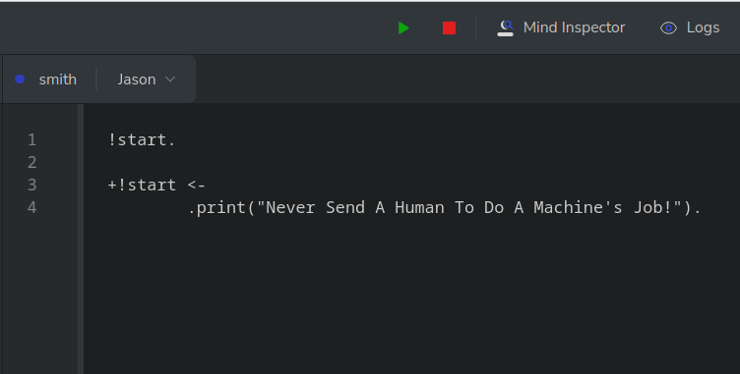
ChonIDE: helloAgent
Souza de Jesus, V., Mori Lazarin, N., Pantoja, C.E., Vaz Alves, G., Ramos Alves de Lima, G., Viterbo, J. (2023). An IDE to Support the Development of Embedded Multi-Agent Systems. In: Mathieu, P., Dignum, F., Novais, P., De la Prieta, F. (eds) Advances in Practical Applications of Agents, Multi-Agent Systems, and Cognitive Mimetics. The PAAMS Collection. PAAMS 2023. Lecture Notes in Computer Science(), vol 13955. Springer, Cham. https://doi.org/10.1007/978-3-031-37616-0_29

Slide 13

ChonIDE: helloAgent
Souza de Jesus, V., Mori Lazarin, N., Pantoja, C.E., Vaz Alves, G., Ramos Alves de Lima, G., Viterbo, J. (2023). An IDE to Support the Development of Embedded Multi-Agent Systems. In: Mathieu, P., Dignum, F., Novais, P., De la Prieta, F. (eds) Advances in Practical Applications of Agents, Multi-Agent Systems, and Cognitive Mimetics. The PAAMS Collection. PAAMS 2023. Lecture Notes in Computer Science(), vol 13955. Springer, Cham. https://doi.org/10.1007/978-3-031-37616-0_29

Slide 14

ChonIDE: helloAgent
Souza de Jesus, V., Mori Lazarin, N., Pantoja, C.E., Vaz Alves, G., Ramos Alves de Lima, G., Viterbo, J. (2023). An IDE to Support the Development of Embedded Multi-Agent Systems. In: Mathieu, P., Dignum, F., Novais, P., De la Prieta, F. (eds) Advances in Practical Applications of Agents, Multi-Agent Systems, and Cognitive Mimetics. The PAAMS Collection. PAAMS 2023. Lecture Notes in Computer Science(), vol 13955. Springer, Cham. https://doi.org/10.1007/978-3-031-37616-0_29

Slide 15
ChonIDE: helloAgent
Pantoja, C.E., Jesus, V.S.d., Lazarin, N.M., Viterbo, J. (2023). A Spin-off Version of Jason for IoT and Embedded Multi-Agent Systems. In: Naldi, M.C., Bianchi, R.A.C. (eds) Intelligent Systems. BRACIS 2023. Lecture Notes in Computer Science(), vol 14195. Springer, Cham. https://doi.org/10.1007/978-3-031-45368-7_25

Slide 16
ChonIDE: helloAgent
Pantoja, C.E., Jesus, V.S.d., Lazarin, N.M., Viterbo, J. (2023). A Spin-off Version of Jason for IoT and Embedded Multi-Agent Systems. In: Naldi, M.C., Bianchi, R.A.C. (eds) Intelligent Systems. BRACIS 2023. Lecture Notes in Computer Science(), vol 14195. Springer, Cham. https://doi.org/10.1007/978-3-031-45368-7_25

Slide 17
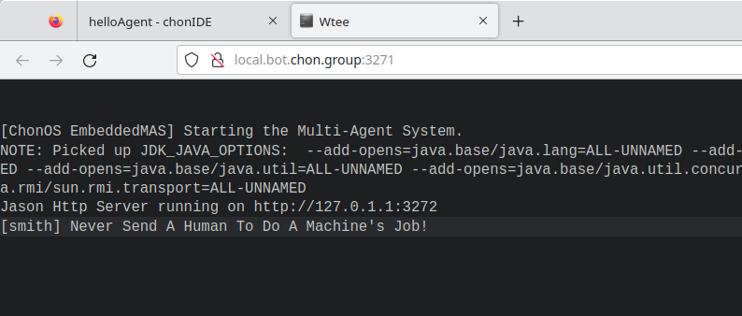
ChonIDE: helloAgent
Pantoja, C.E., Jesus, V.S.d., Lazarin, N.M., Viterbo, J. (2023). A Spin-off Version of Jason for IoT and Embedded Multi-Agent Systems. In: Naldi, M.C., Bianchi, R.A.C. (eds) Intelligent Systems. BRACIS 2023. Lecture Notes in Computer Science(), vol 14195. Springer, Cham. https://doi.org/10.1007/978-3-031-45368-7_25

Slide 18
ChonIDE: helloAgent
Bordini, R.H., Hübner, J.F. (2006). BDI Agent Programming in AgentSpeak Using Jason . In: Toni, F., Torroni, P. (eds) Computational Logic in Multi-Agent Systems. CLIMA 2005. Lecture Notes in Computer Science(), vol 3900. Springer, Berlin, Heidelberg. https://doi.org/10.1007/11750734_9

Slide 19
ChonIDE: helloAgent
Bordini, R.H., Hübner, J.F. (2006). BDI Agent Programming in AgentSpeak Using Jason . In: Toni, F., Torroni, P. (eds) Computational Logic in Multi-Agent Systems. CLIMA 2005. Lecture Notes in Computer Science(), vol 3900. Springer, Berlin, Heidelberg. https://doi.org/10.1007/11750734_9

Slide 20
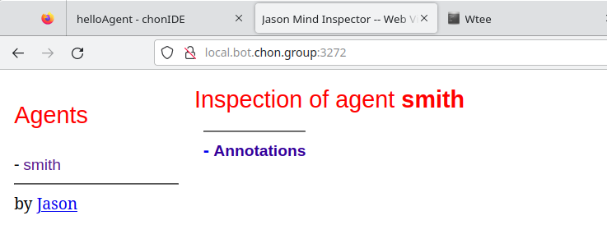
ChonIDE: helloAgent
Bordini, R.H., Hübner, J.F. (2006). BDI Agent Programming in AgentSpeak Using Jason . In: Toni, F., Torroni, P. (eds) Computational Logic in Multi-Agent Systems. CLIMA 2005. Lecture Notes in Computer Science(), vol 3900. Springer, Berlin, Heidelberg. https://doi.org/10.1007/11750734_9

Slide 21
ChonIDE: helloAgent
Souza de Jesus, V., Mori Lazarin, N., Pantoja, C.E., Vaz Alves, G., Ramos Alves de Lima, G., Viterbo, J. (2023). An IDE to Support the Development of Embedded Multi-Agent Systems. In: Mathieu, P., Dignum, F., Novais, P., De la Prieta, F. (eds) Advances in Practical Applications of Agents, Multi-Agent Systems, and Cognitive Mimetics. The PAAMS Collection. PAAMS 2023. Lecture Notes in Computer Science(), vol 13955. Springer, Cham. https://doi.org/10.1007/978-3-031-37616-0_29

Slide 22
ChonIDE: helloAgent
Souza de Jesus, V., Mori Lazarin, N., Pantoja, C.E., Vaz Alves, G., Ramos Alves de Lima, G., Viterbo, J. (2023). An IDE to Support the Development of Embedded Multi-Agent Systems. In: Mathieu, P., Dignum, F., Novais, P., De la Prieta, F. (eds) Advances in Practical Applications of Agents, Multi-Agent Systems, and Cognitive Mimetics. The PAAMS Collection. PAAMS 2023. Lecture Notes in Computer Science(), vol 13955. Springer, Cham. https://doi.org/10.1007/978-3-031-37616-0_29

Slide 23

ChonIDE: helloAgent
Souza de Jesus, V., Mori Lazarin, N., Pantoja, C.E., Vaz Alves, G., Ramos Alves de Lima, G., Viterbo, J. (2023). An IDE to Support the Development of Embedded Multi-Agent Systems. In: Mathieu, P., Dignum, F., Novais, P., De la Prieta, F. (eds) Advances in Practical Applications of Agents, Multi-Agent Systems, and Cognitive Mimetics. The PAAMS Collection. PAAMS 2023. Lecture Notes in Computer Science(), vol 13955. Springer, Cham. https://doi.org/10.1007/978-3-031-37616-0_29

Slide 24
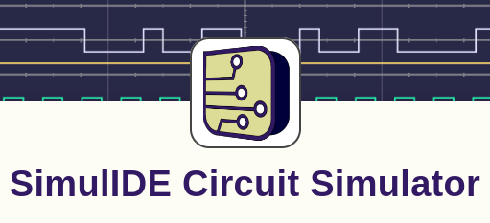
SimulIDE
González, Santiago. “SimulIDE Circuit Simulator”, 2023. https://simulide.com.

Slide 25
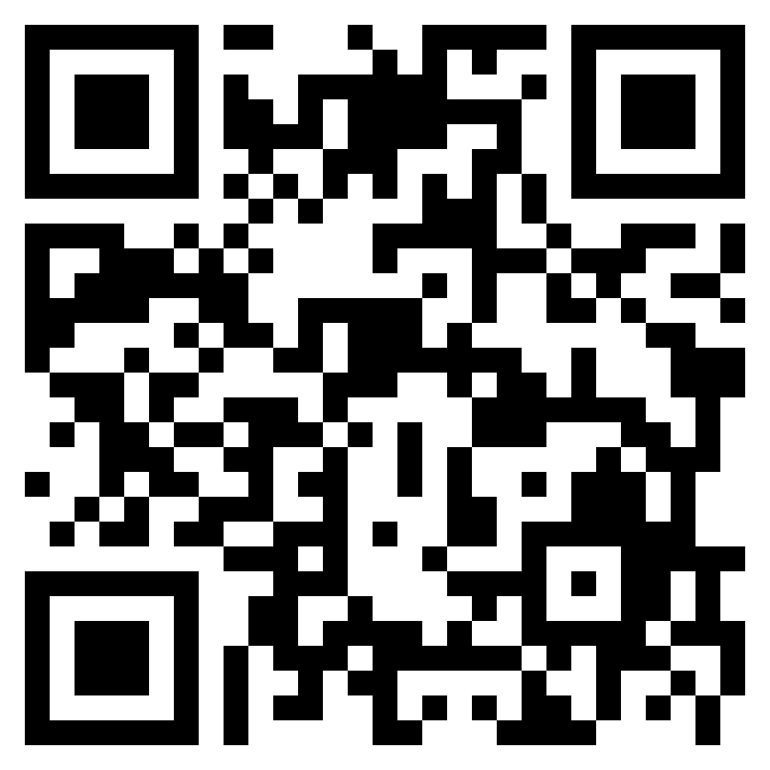
SimulIDE
Manual de instalaçãohttps://github.com/chon-group/dpkg-simulide

Slide 26
SimulIDE
Manual de instalaçãohttps://github.com/chon-group/dpkg-simulide

Slide 27
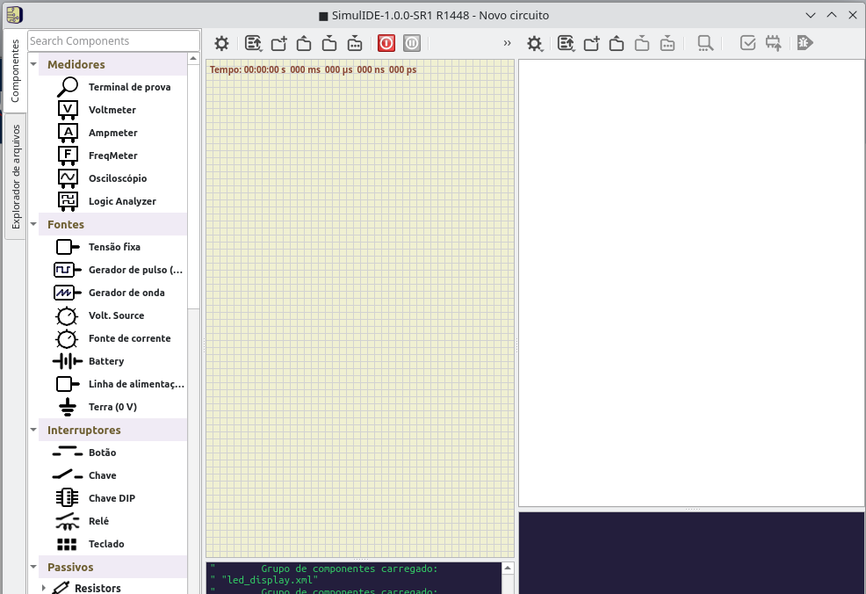
SimulIDE

Slide 28
SimulIDE

Slide 29
SimulIDE

Slide 30
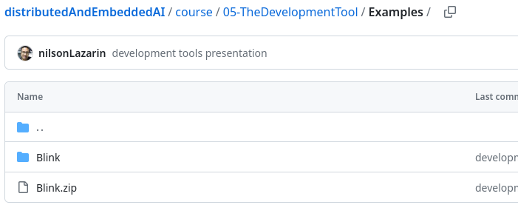
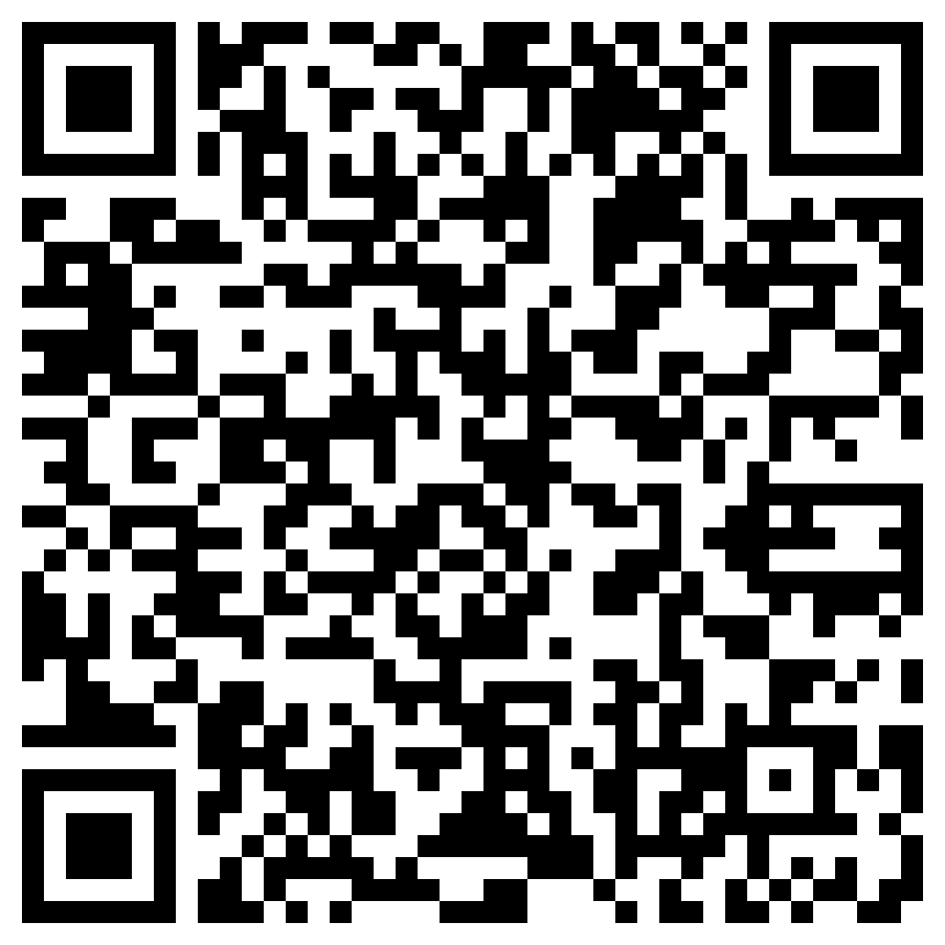
SimulIDE: Blink
https://github.com/chon-group/distributedAndEmbeddedAI/raw/main/course/05-TheDevelopmentTool/Examples/Blink.zip

Slide 31
SimulIDE: Blink
https://github.com/chon-group/distributedAndEmbeddedAI/raw/main/course/05-TheDevelopmentTool/Examples/Blink.zip

Slide 32
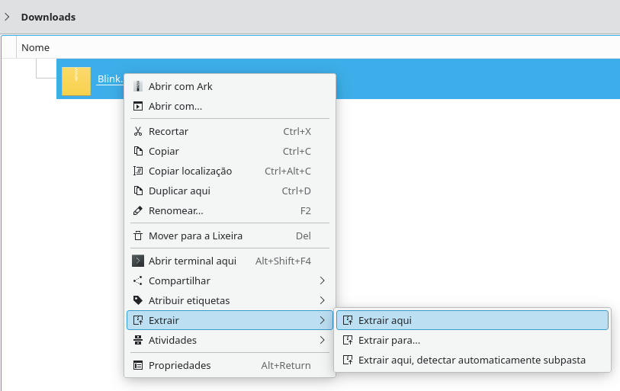
SimulIDE: Blink

Slide 33
SimulIDE: Blink

Slide 34
SimulIDE: Blink

Slide 35
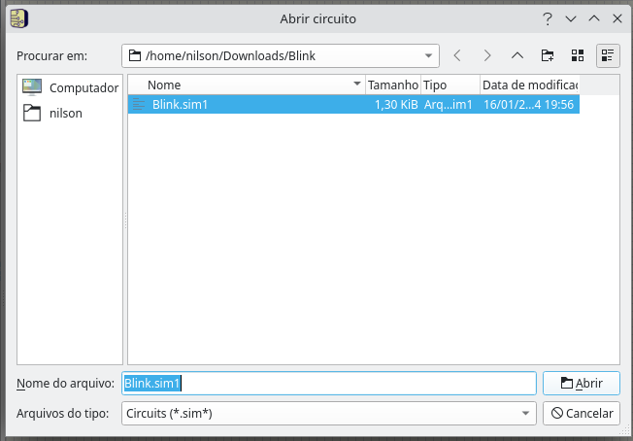
SimulIDE: Blink

Slide 36
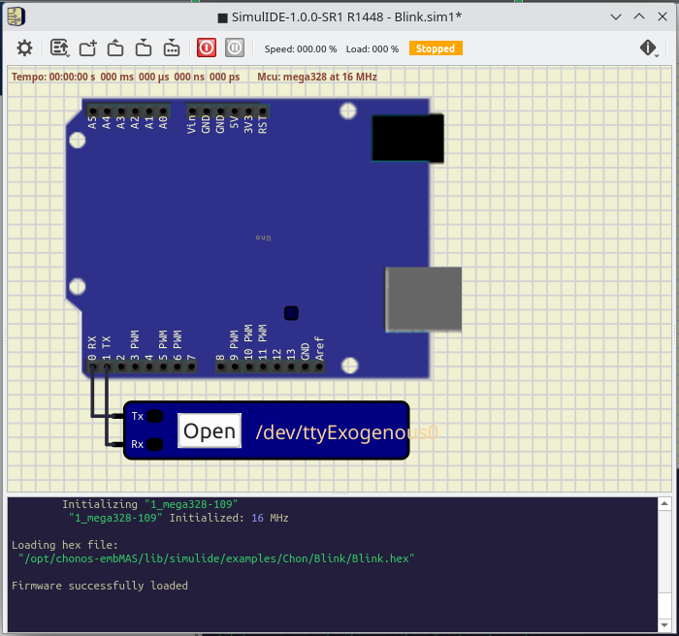
SimulIDE: Blink

Slide 37
SimulIDE: Blink

Slide 38
SimulIDE: Blink

Slide 39
SimulIDE: Blink

Slide 40
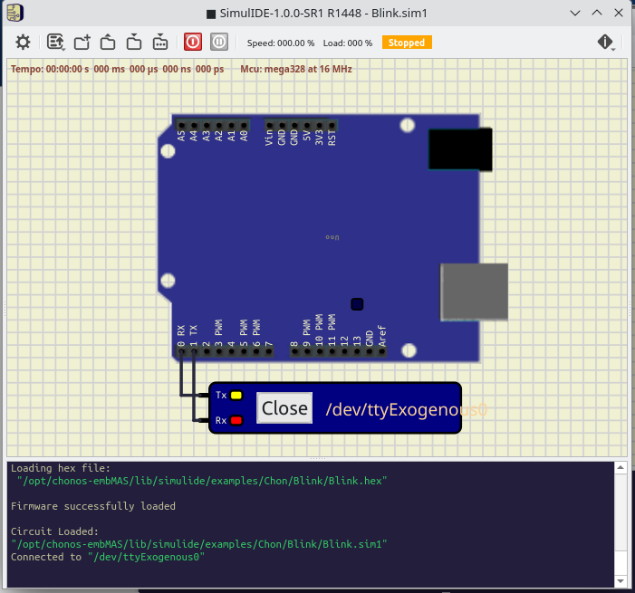
SimulIDE: Blink

Slide 41
SimulIDE: Blink

Slide 42
SimulIDE: Blink

Slide 43
SimulIDE: Blink

Slide 44
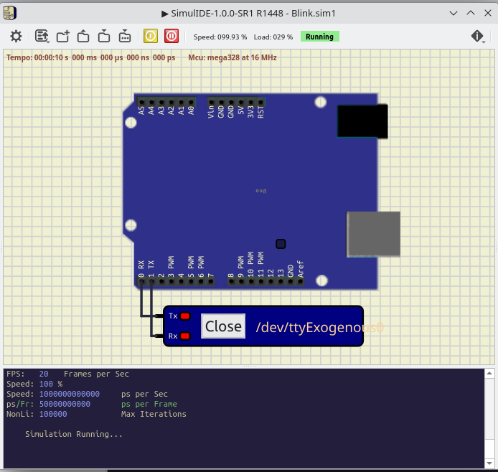
SimulIDE: Blink

Slide 45
SimulIDE: Blink

Slide 46
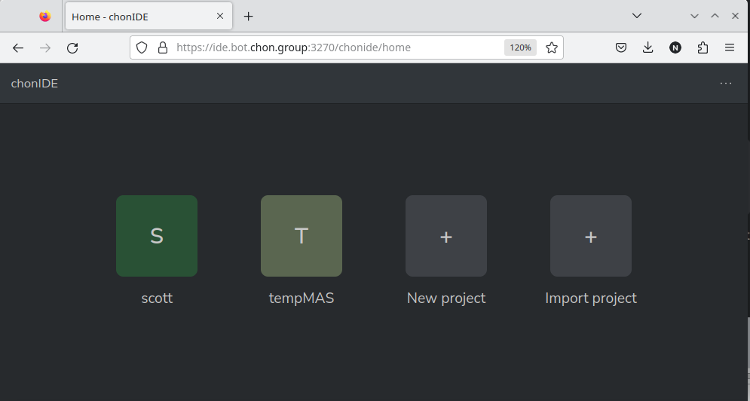
SimulIDE: Blink

Slide 47
SimulIDE: Blink

Slide 48
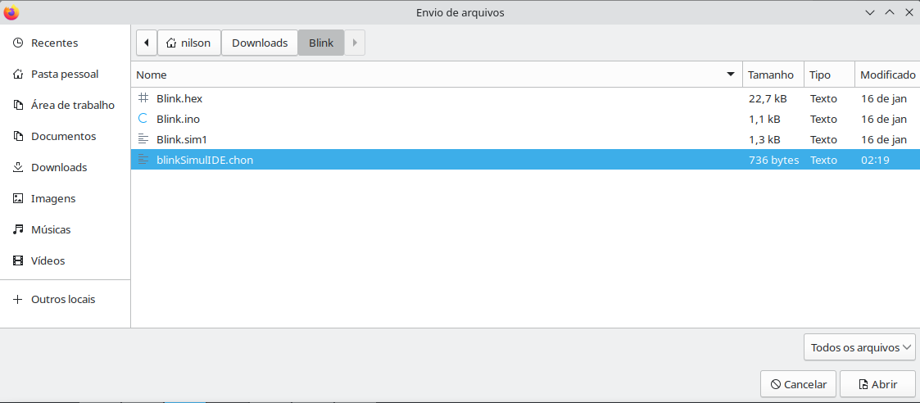
SimulIDE: Blink

Slide 49
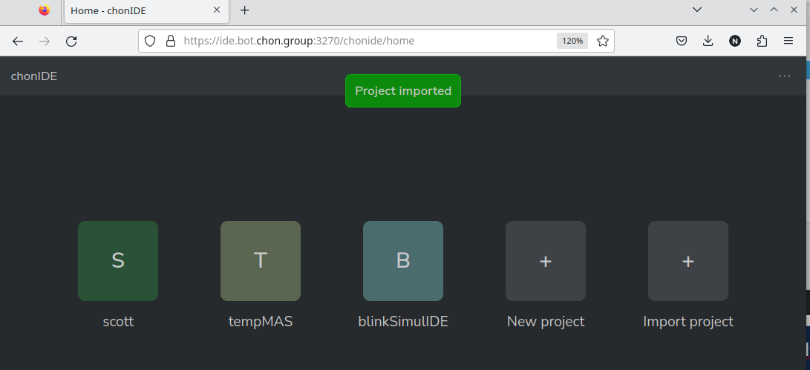
SimulIDE: Blink

Slide 50
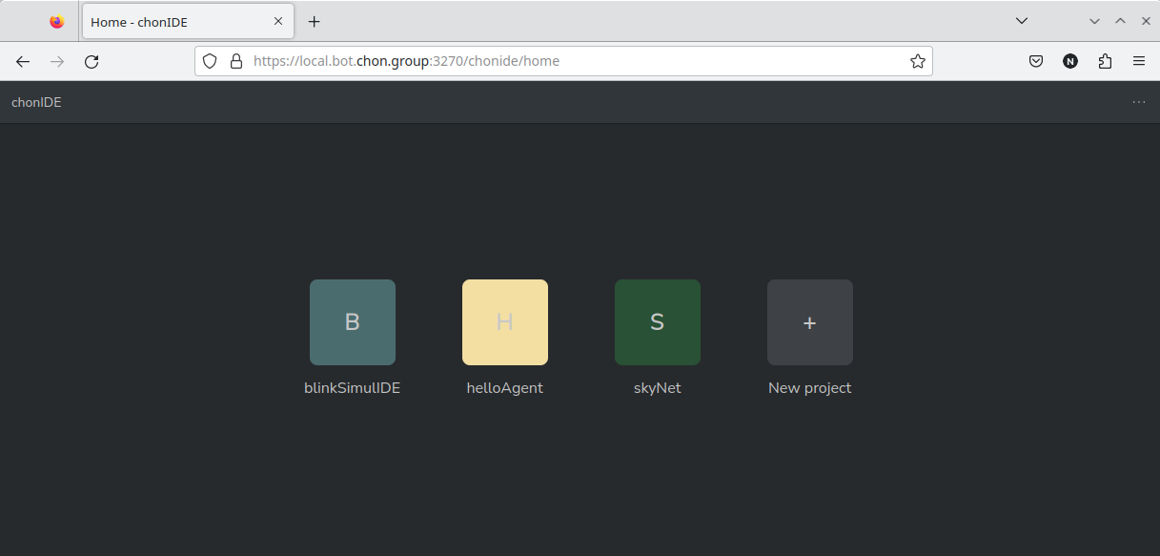
SimulIDE: Blink

Slide 51
SimulIDE: Blink

Slide 52
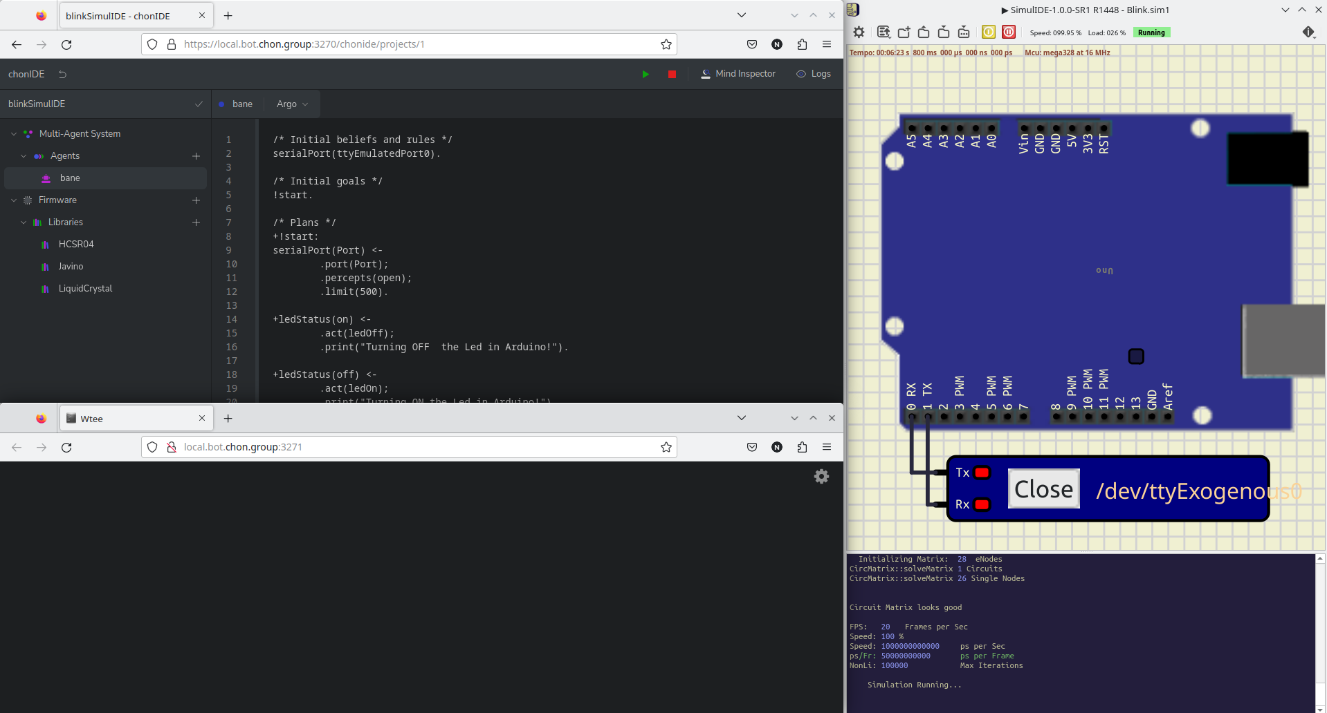
SimulIDE: Blink

Slide 53
SimulIDE: Blink

Slide 54
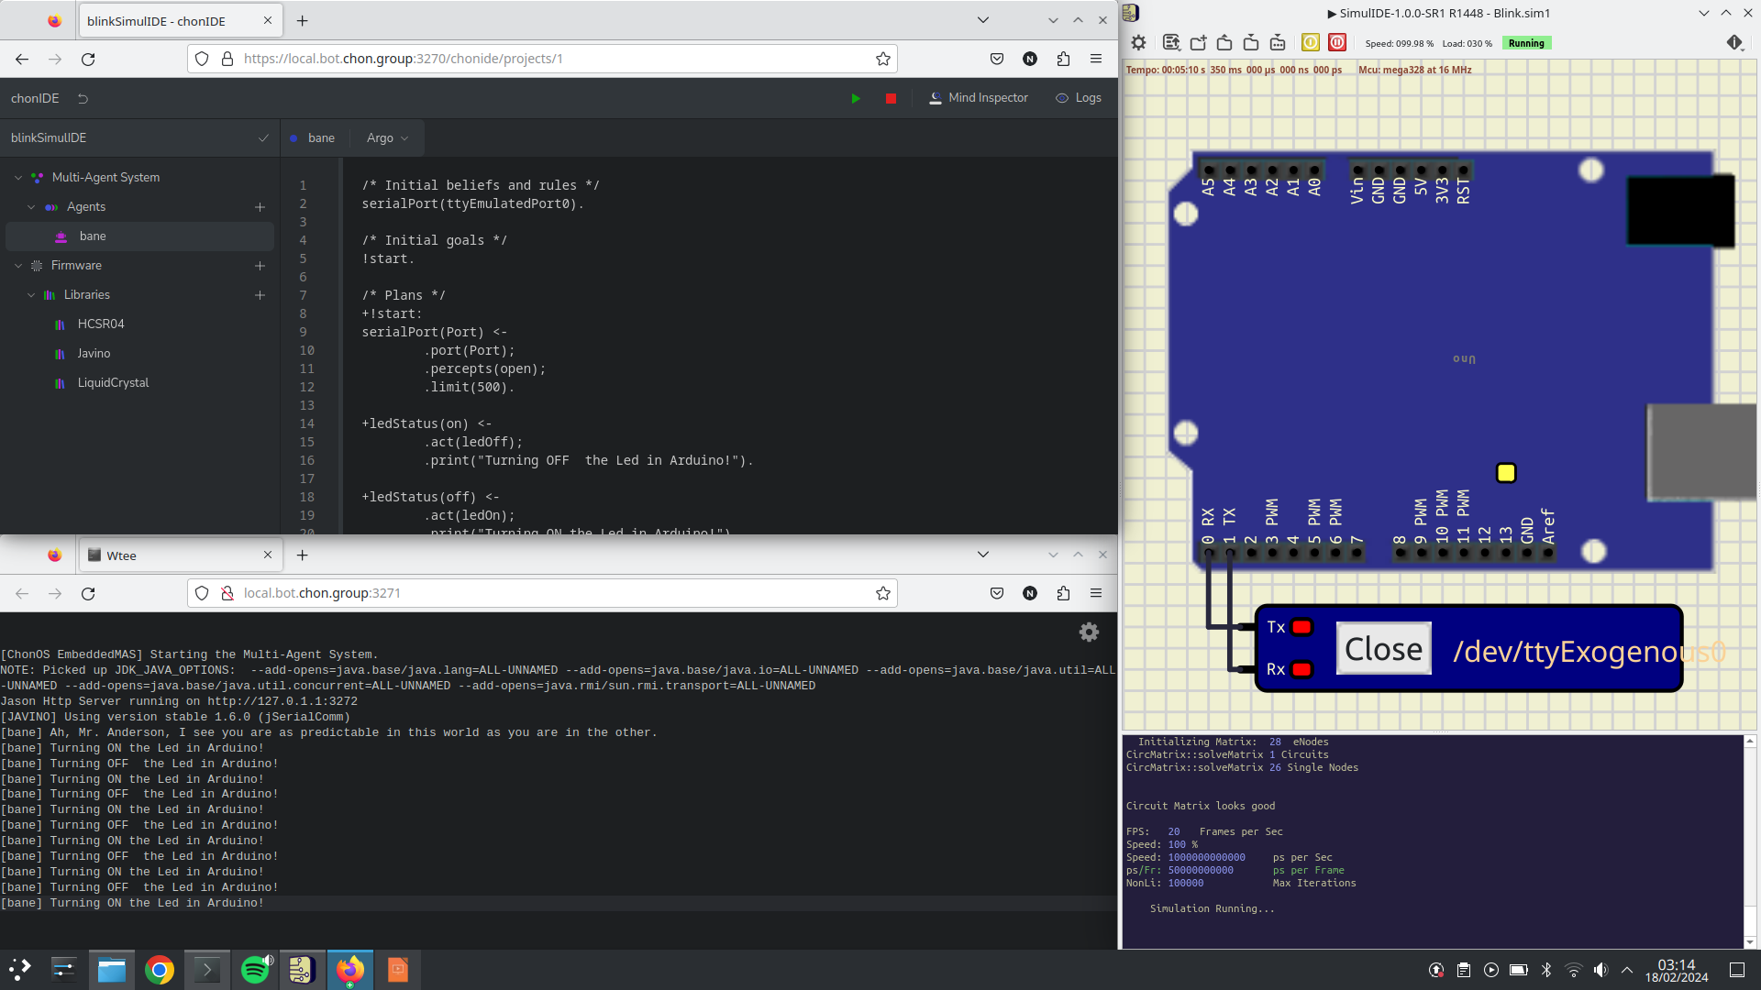
SimulIDE: Blink

Slide 55
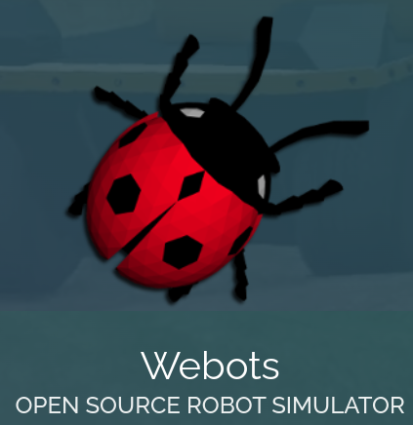
Webots
Michel, O. (1998). Webots: Symbiosis Between Virtual and Real Mobile Robots. In: Heudin, JC. (eds) Virtual Worlds. VW 1998. Lecture Notes in Computer Science(), vol 1434. Springer, Berlin, Heidelberg. https://doi.org/10.1007/3-540-68686-X_24

Slide 56
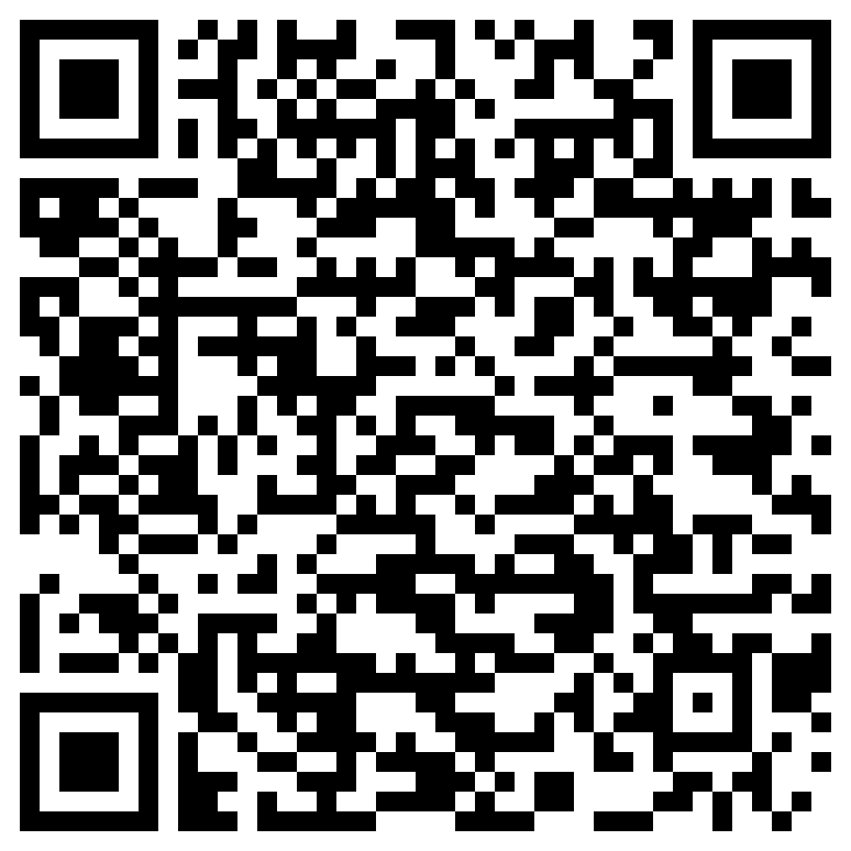
Webots
Manual de instalação
https://cyberbotics.com/doc/guide/installation-procedure#installing-the-debian-package-with-the-advanced-packaging-tool-apt

Slide 57
Webots
Manual de instalação
https://cyberbotics.com/doc/guide/installation-procedure#installing-the-debian-package-with-the-advanced-packaging-tool-apt

Slide 58
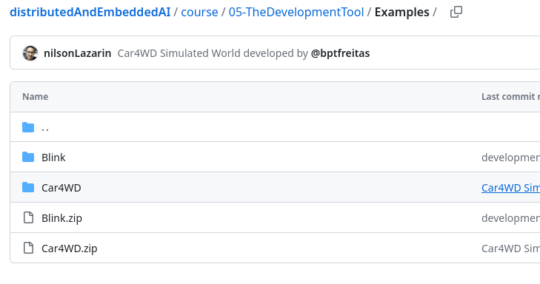
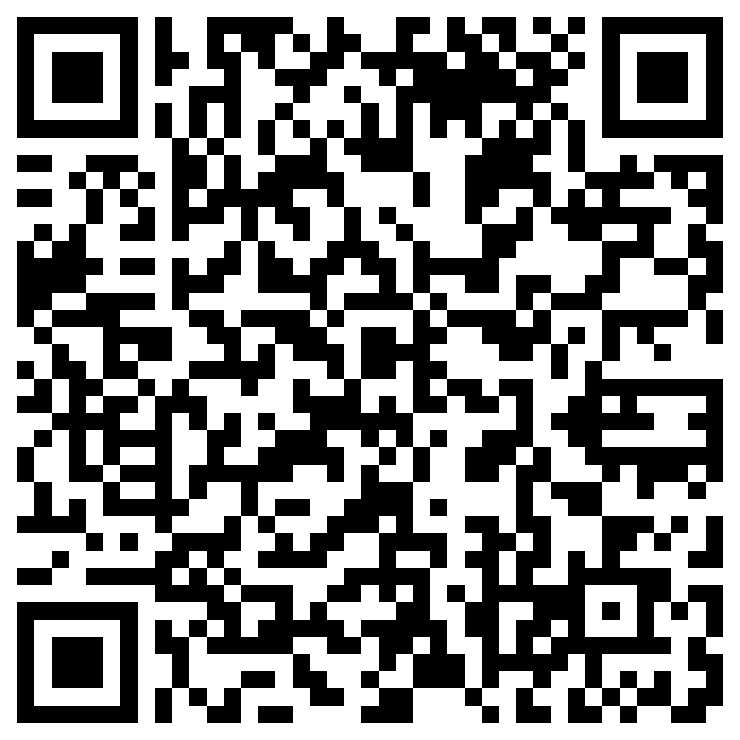
Webots
https://github.com/chon-group/distributedAndEmbeddedAI/raw/main/course/05-TheDevelopmentTool/Examples/Car4WD.zip

Slide 59
Webots
https://github.com/chon-group/distributedAndEmbeddedAI/raw/main/course/05-TheDevelopmentTool/Examples/Car4WD.zip

Slide 60
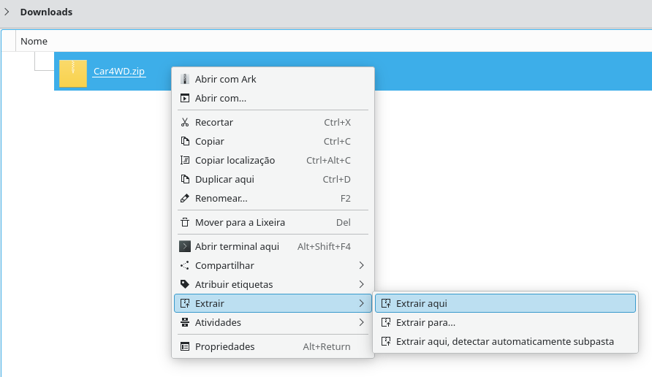
Webots

Slide 61
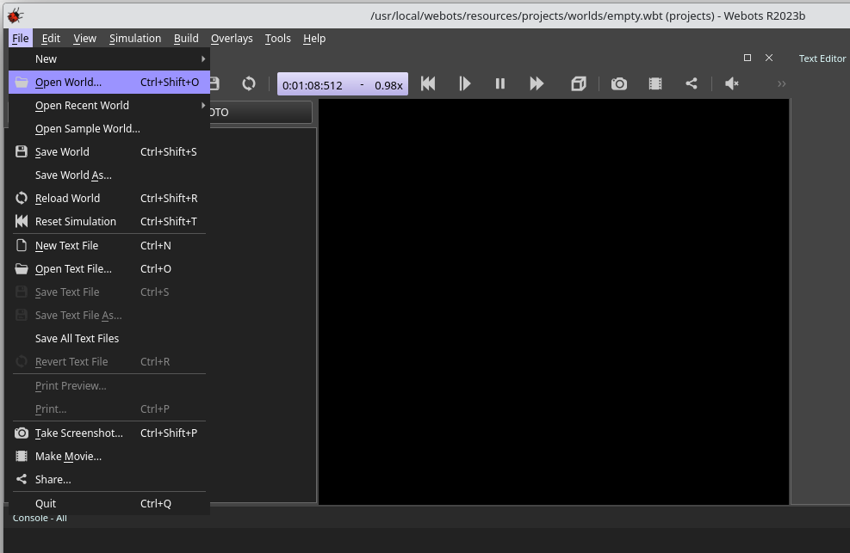
Webots

Slide 62
Webots

Slide 63
Webots

Slide 64
Webots

Slide 65
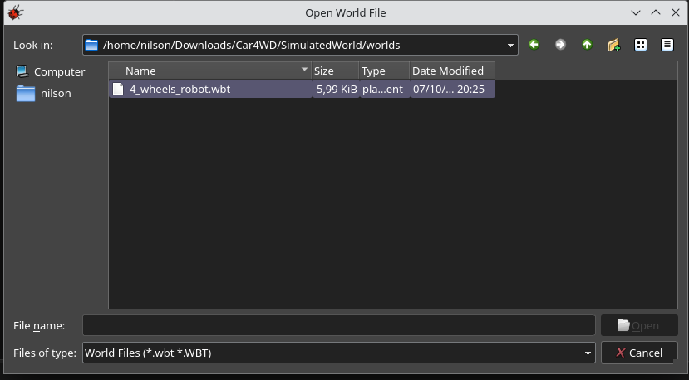
Webots

Slide 66
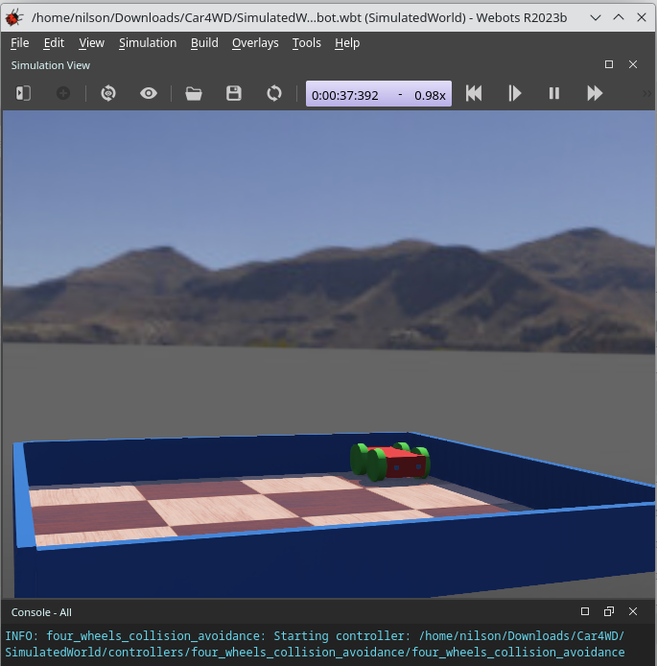
Webots

Slide 67
Webots

Slide 68
Webots

Slide 69
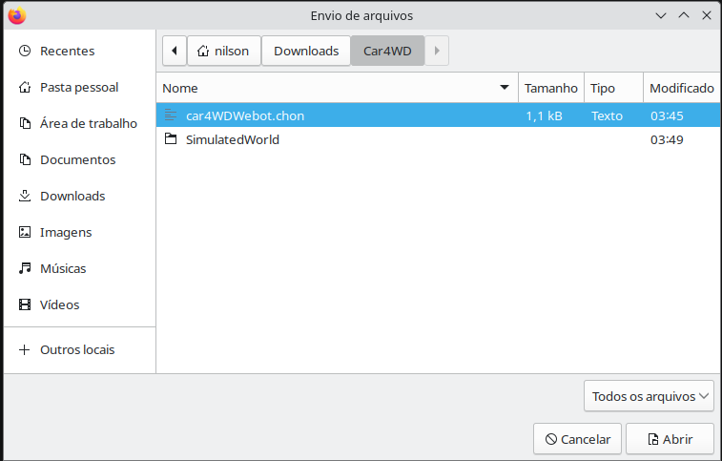
Webots

Slide 70
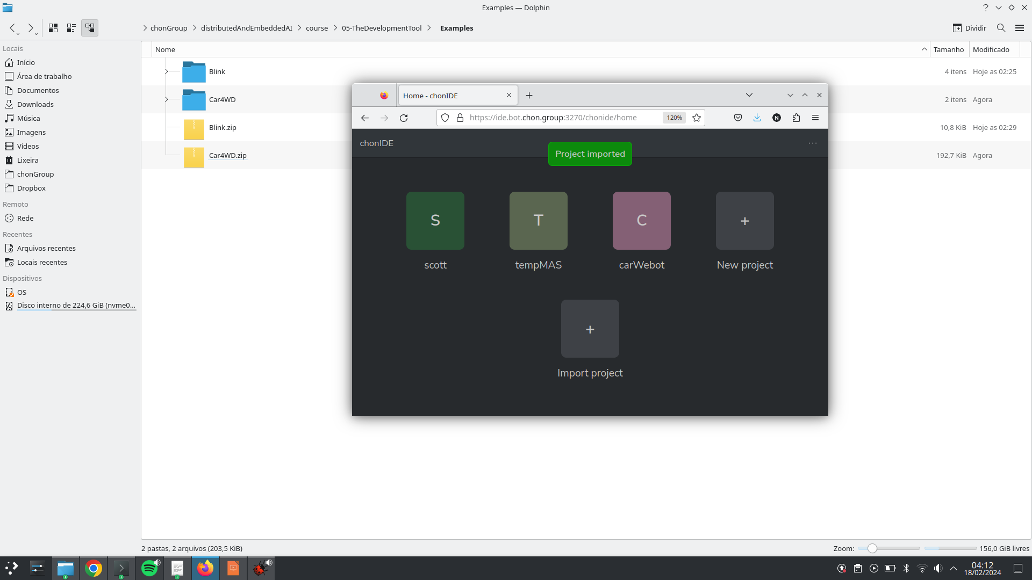
Webots

Slide 71
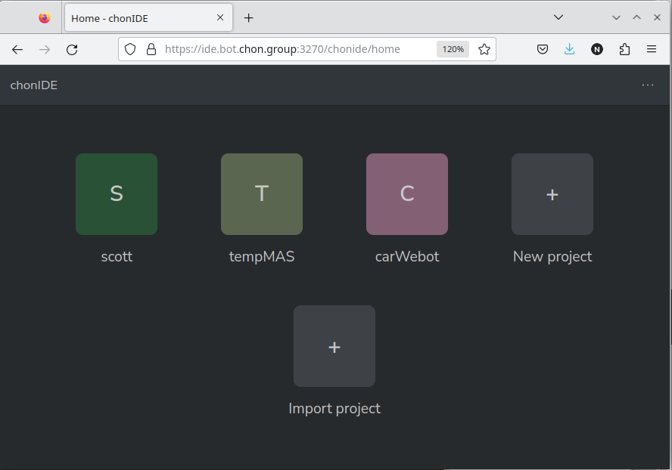
Webots

Slide 72
Webots

Slide 73
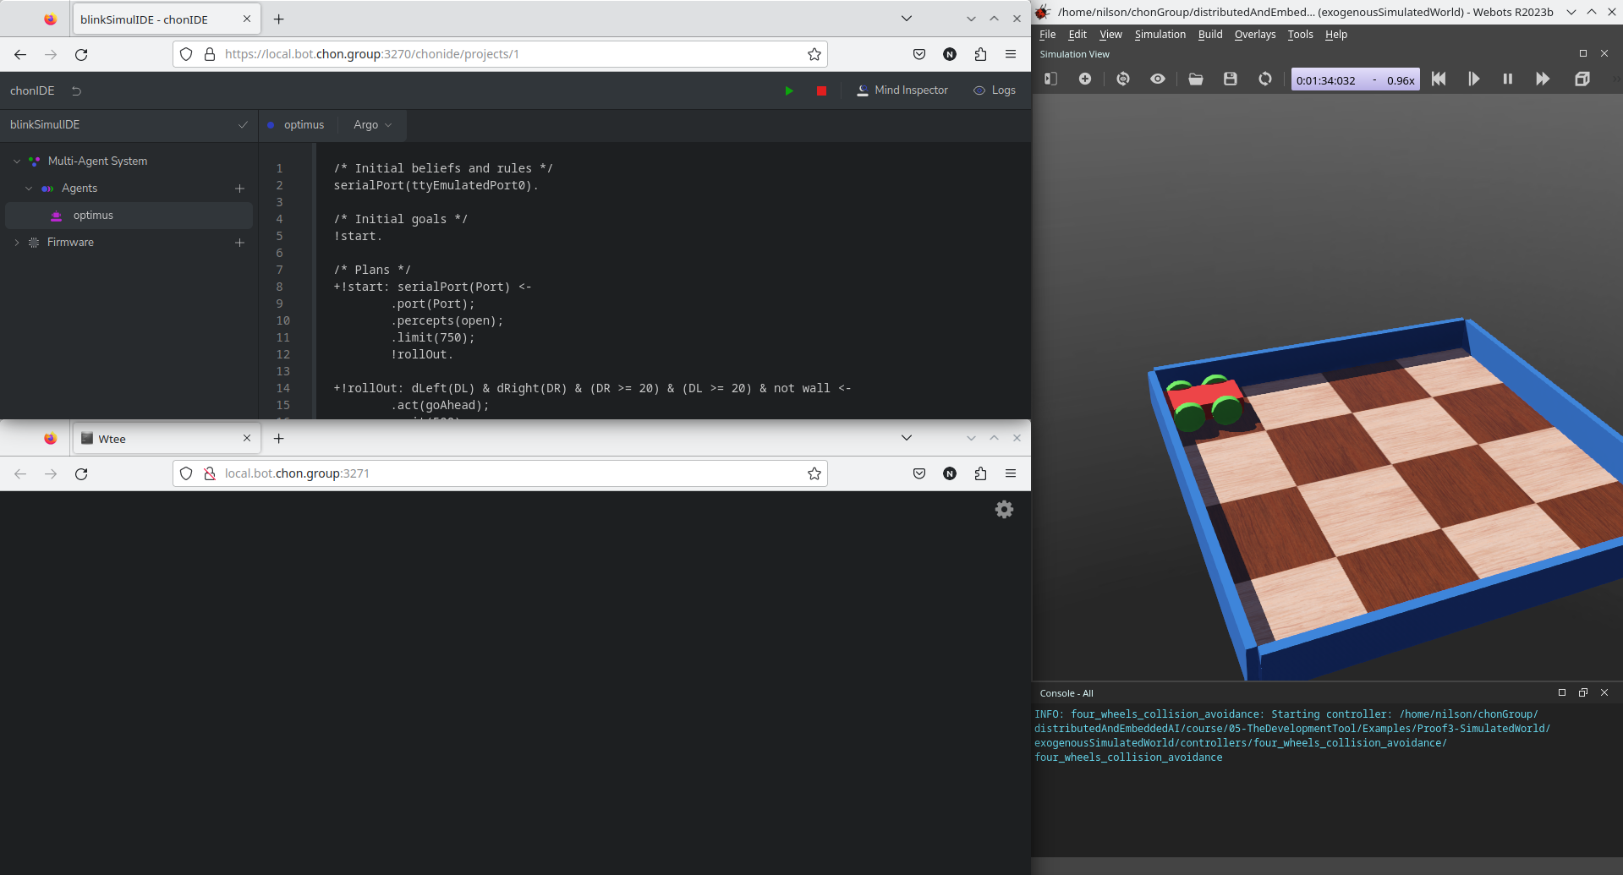
Webots

Slide 74
Webots

Slide 75
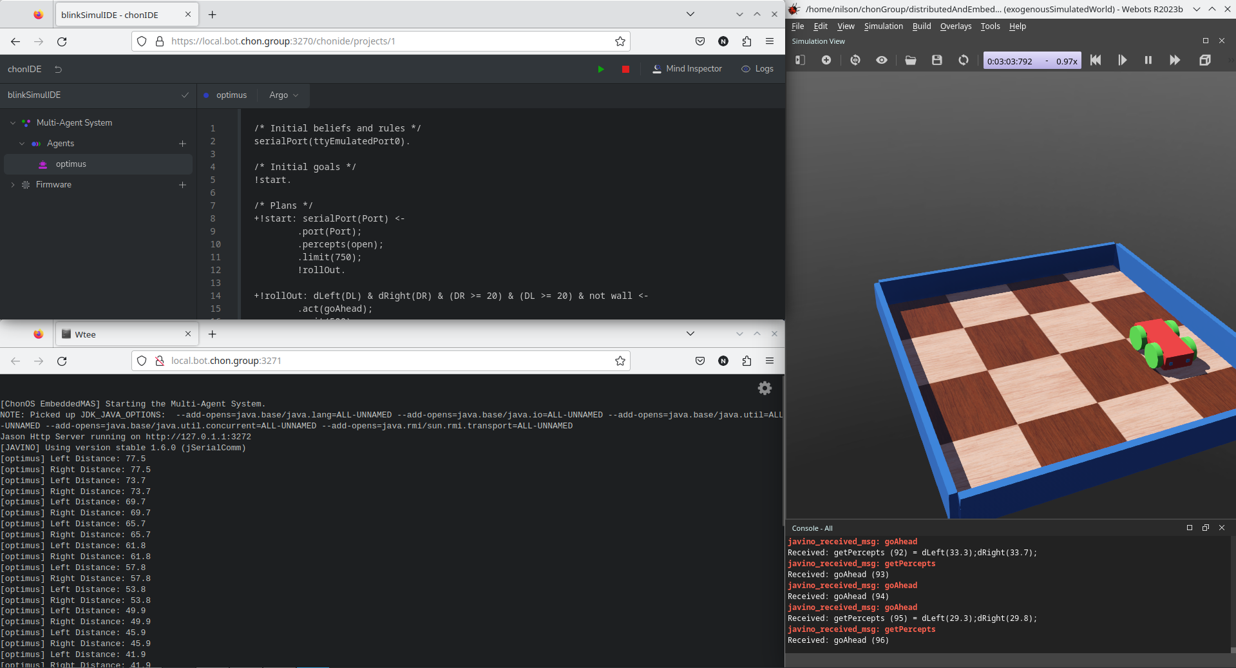
Webots

Slide 76
Agradecimentos
OBRIGADO!
pantoja@cefet-rj.br
nilson.lazarin@cefet-rj.br
Notes:
<número>

