Slide 1





Introduction to
Distributed and Embedded Multi-Agent Systems
Nilson Mori Lazarin
Centro Federal de Educação Tecnológica (CEFET/RJ)
Universidade Federal Fluminense (UFF), Brasil
https://semeso.github.io/2024/minicursos/
September 2024

Slide 2

INTRODUCTION
Notes:
<número>

Slide 3
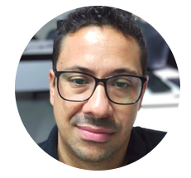

Who I am?
Prof. Me. Nilson Lazarin
Cefet/RJ - UFF
Cognitive Hardware on Networks (Chon)
Research Group
https://chon.group
Notes:
<número>

Slide 4

Where we have been?
This workshop is part of:
  Undergratuate course
        CEFET/RJ Maria da Graça and Nova Friburgo
  Graduate course
        M.Sc. and Ph.D. at UFF
It was presented at:
IFSP, UFPel, UFRJ, UFSC, UnB, UTFPR and Estácio;
https://workshops.chon.group
Notes:
<número>

Slide 5
Goals
This workshop goals are:
  To experience the development process of Embedded MAS using BDI-agents and Jason.
  to learn how to collaborate using IoT in distributed scenarios.
Notes:
<número>

Slide 6
THE AGENT ORIENTED APPROACH
Notes:
<número>

Slide 7
Agent
WOOLDRIDGE, Michael. Intelligent Agents. Multiagent Systems: A Modern Approach to Distributed Artificial Intelligence. Cambridge, MA, USA: MIT Press, 1999. p. 27–77
MICHEL, Fabien; FERBER, Jacques; DROGOUL, Alexis. Multi-Agent Systems and Simulation: a Survey From the Agents Community's Perspective. 2009
Notes:
<número>

Slide 8
Agent
WOOLDRIDGE, Michael. Intelligent Agents. Multiagent Systems: A Modern Approach to Distributed Artificial Intelligence. Cambridge, MA, USA: MIT Press, 1999. p. 27–77
MICHEL, Fabien; FERBER, Jacques; DROGOUL, Alexis. Multi-Agent Systems and Simulation: a Survey From the Agents Community's Perspective. 2009
Notes:
<número>

Slide 9
Agent
WOOLDRIDGE, Michael. Intelligent Agents. Multiagent Systems: A Modern Approach to Distributed Artificial Intelligence. Cambridge, MA, USA: MIT Press, 1999. p. 27–77
MICHEL, Fabien; FERBER, Jacques; DROGOUL, Alexis. Multi-Agent Systems and Simulation: a Survey From the Agents Community's Perspective. 2009
Notes:
<número>

Slide 10
Multi-agent System
WOOLDRIDGE, Michael. Intelligent Agents. Multiagent Systems: A Modern Approach to Distributed Artificial Intelligence. Cambridge, MA, USA: MIT Press, 1999. p. 27–77
Notes:
<número>

Slide 11
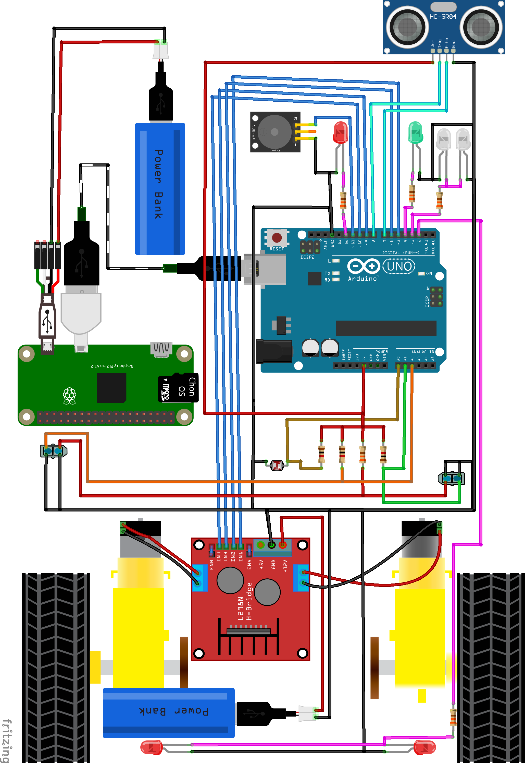

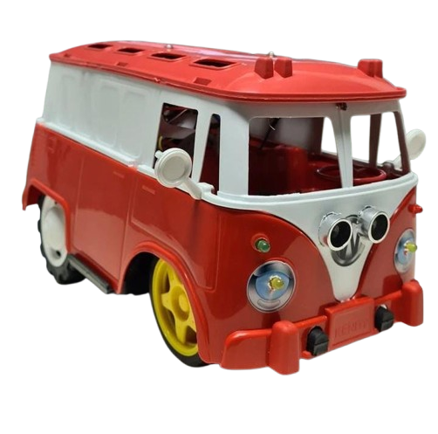
Embedded Multi-agent System
Attributes:
Hosted in a cyber-physical system with all sensors and actuator;
Acting and perceiving in the real-world;
Without remote control;
Without external processing;
Low-cost 2WD prototype model for Embedded Multi-agent Systems https://bots.chon.group
Notes:
<número>

Slide 12

THE DEVELOPMENT
TOOLS
Notes:
<número>

Slide 13


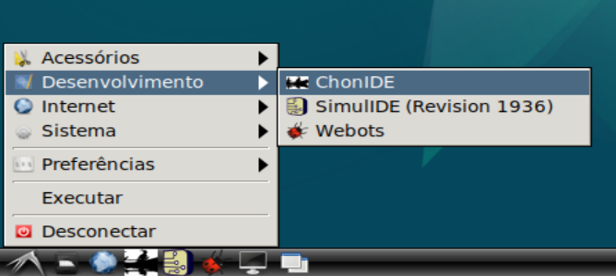
How to install? https://github.com/chon-group/chonIDE/wiki

Slide 14
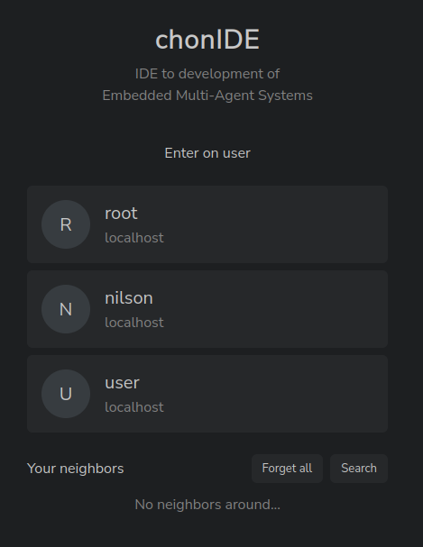
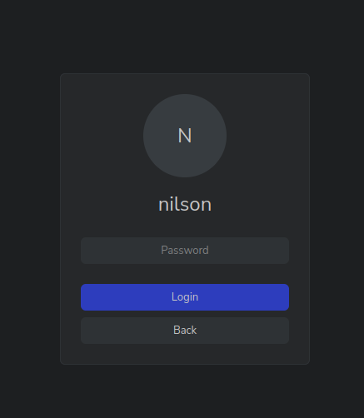
ChonIDE: login
2
1
3

Slide 15

ChonIDE: helloAgent

Slide 16
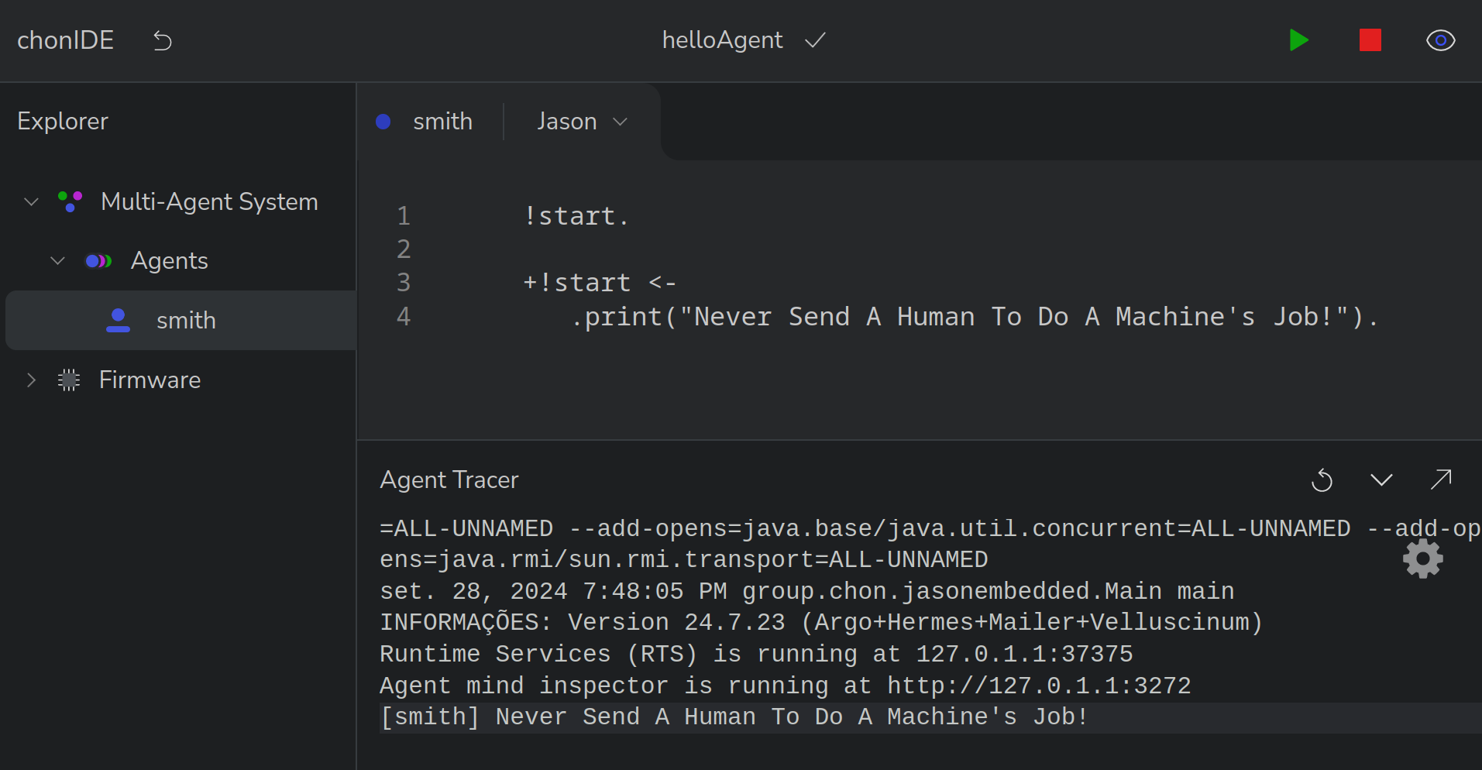
ChonIDE: helloAgent
4
5
6
7
1
2
3

Slide 17
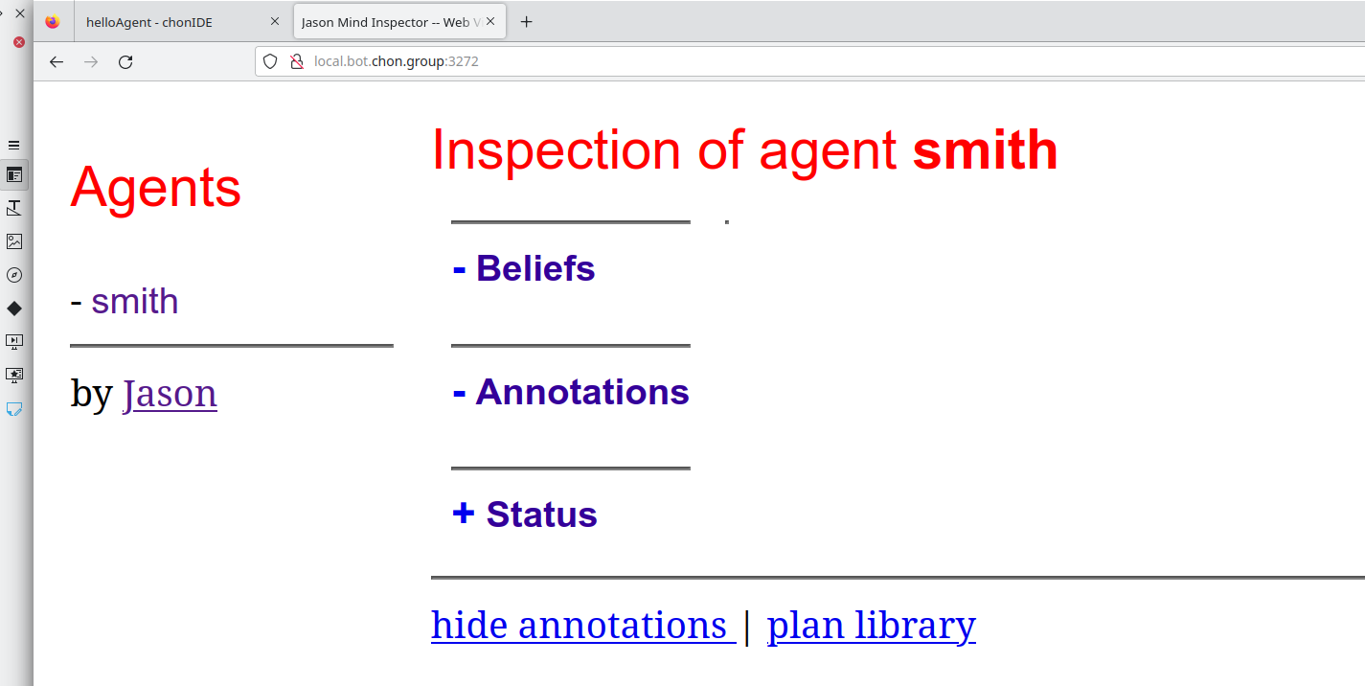
ChonIDE: helloAgent
7

Slide 18


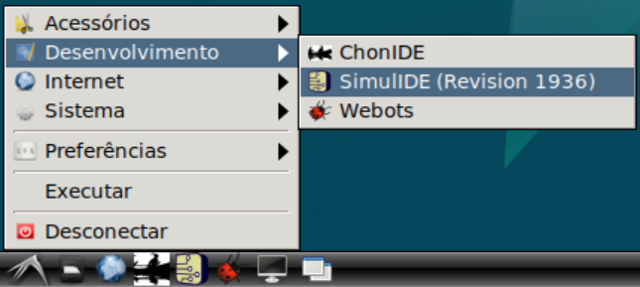
by Chon Group
How to install? https://github.com/chon-group/dpkg-simulide

Slide 19
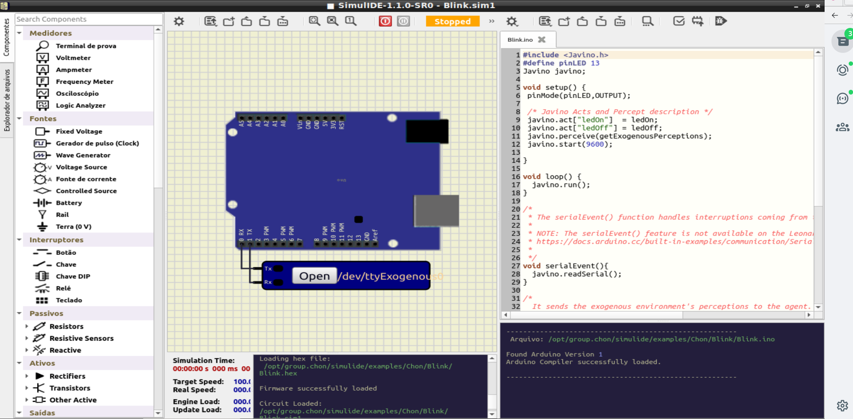
SimulIDE
1
2
3

Slide 20
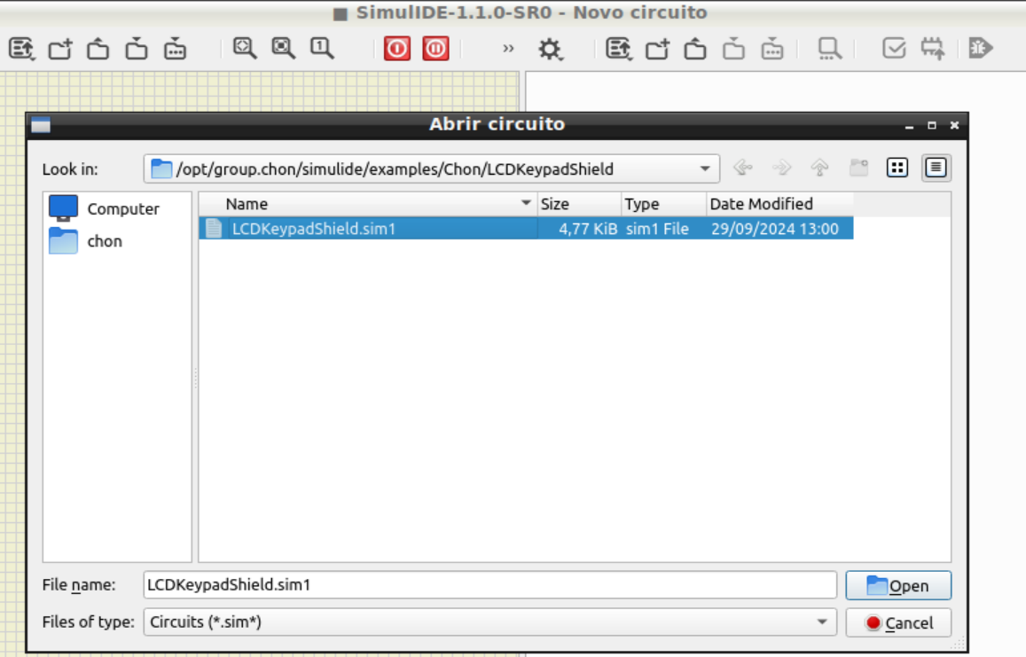
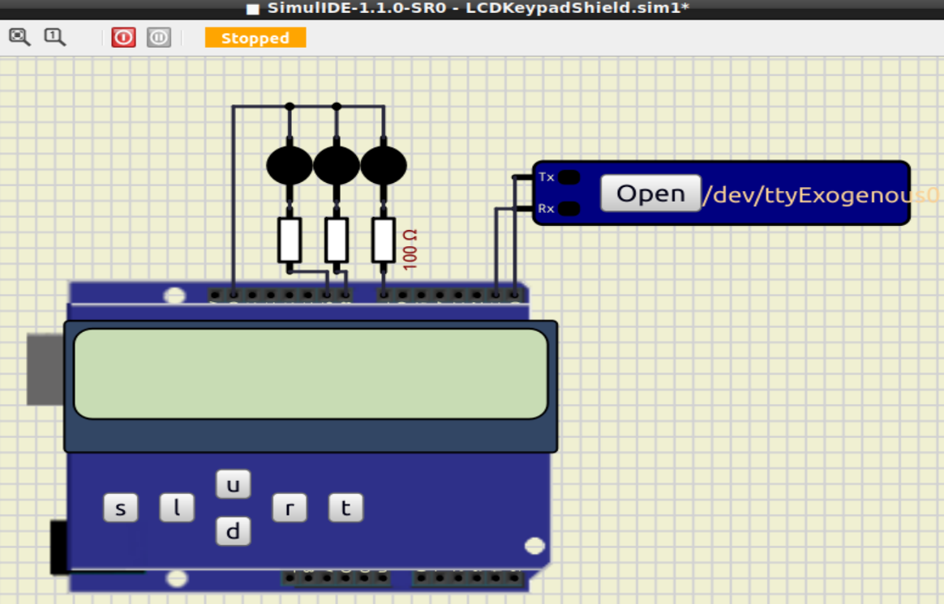
SimulIDE
1
5
2
4
3

Slide 21
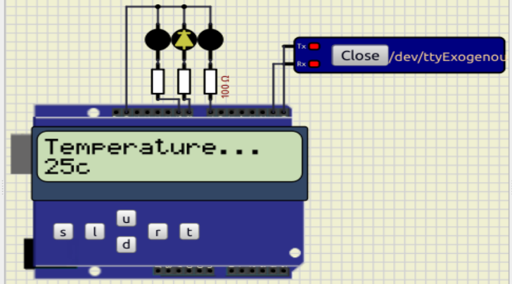
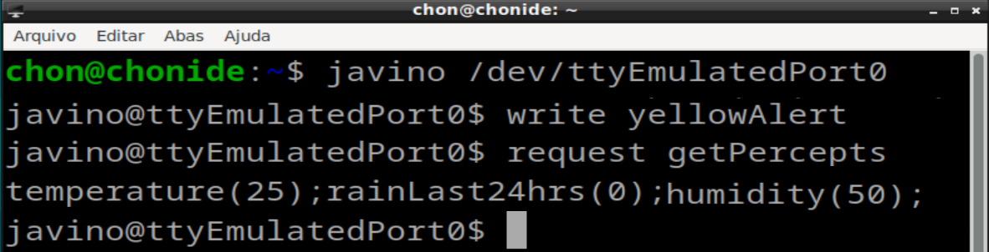
SimulIDE

Slide 22

MY FIRST
SINGLE AGENT
Notes:
<número>

Slide 23

My First Agent
Belief Base
stock(S) energy(E)
payment(P) workingDay(W)
partyNight(N)
Notes:
<número>

Slide 24
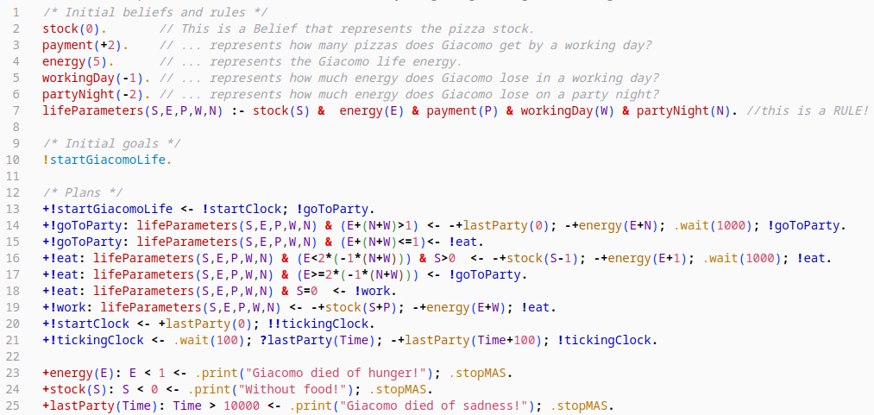

My First Agent: Code
https://github.com/chon-group/distributedAndEmbeddedAI/blob/main/course/06-MyFirstAgent/giacomoAgent.chon

Slide 25
My First Agent: Code
initial beliefs --> | energy(5). day(sunny). myPhone(“555-111111”). | belief plan --> | +day(D) <- .print(“Today is ”,D).
a rule --> | happy :- day(D) & D=sunny & money(M) & M=veryMuch. | belief plan --> mental notation search in mind (?) new goal | +day(D): D=saturday & time > 18 <- +hungry; ?pizzaPhone(Number); !callTo(Number).
initial goals --> | !start. !callTo(“555-123321”). | contantion plan -> | -!start <- .print(“without belief myPhone(T) in mind”).
achievement plan --> | +!start <- .print(“hello world”). | JASON stdlib → https://jason-lang.github.io/api/jason/stdlib/package-summary.html
achievement plan --> | +!start: myPhone(T) <- .print(“Call me:”,T). | Introdução ao Jason → https://www.researchgate.net/publication/228828757_Introducao_ao_desenvolvimento_de_sistemas_multiagentes_com_Jason

Slide 26
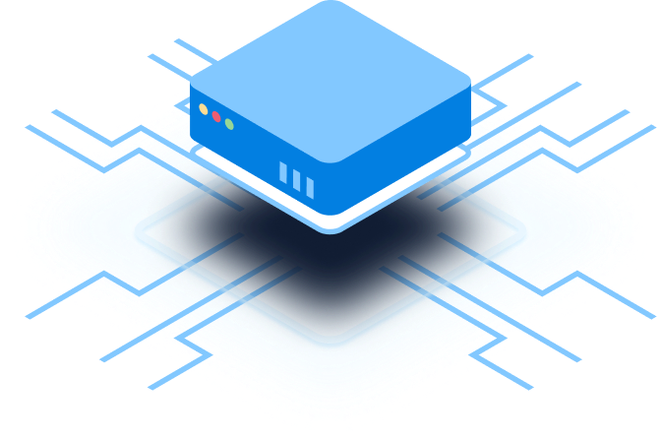
EMBEDDED
MAS
Notes:
<número>

Slide 27
Jason Embedded
Jason Embedded is a spin-off Version of Jason for IoT and Embedded MAS:
  Autonomy as a characteristic an Embedded MAS provides to a device that does not need external architectures to control and manage it.
  Communicability is the agent’s ability to communicate with other agents in its MAS or another MAS.
  Mobility as the agents’ ability to move from one MAS to another.
  Fault Tolerance and Adaptability are defined as the ability of an agent to identify if a physical resource is absent or not answering commands and to overcome this situation by modifying its goals.
  Distributed Ledger Technologies technologies to facilitate the agreement between agents.
Notes:
<número>

Slide 28
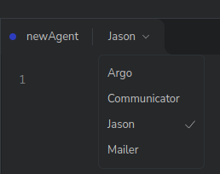
Jason Embedded
Jason Embedded also provides new types of agents to control hardware devices and to communicate with agents hosted in other MAS.
Notes:
<número>

Slide 29
Jason Embedded
Jason Embedded also provides new types of agents to control hardware devices and to communicate with agents hosted in other MAS.
  ARGO: is a customized agent architecture built on the Jason framework that extends Jason’s standard agents by adding the ability to control microcontrollers [Pantoja et al., 2016].
  Hermes (Communicator) : is another customized agent architecture built on Jason’s Standard agent by adding the ability to communicate with agents from other MAS, which also have Communicator agents [Pantoja et al., 2018].
  Mailer : agent architecture based on the Jason framework to enable secure and simplified human-agent interaction [Lazarin et al., 2024].
Notes:
<número>

Slide 30
Jason Embedded
Mobility is based on bio-inspired protocols [Jesus et al., 2021].
    The protocols simulate natural behaviors that could be explored in collaborative tasks using IoT devices.
    One or more agents or even the whole MAS could move from one device to another to take control of the destination device (Predation) or to use it as a temporary non-hazardous relationship (Mutualism and Inquilinism) if both parties accept the protocol.
Middleware that allows cognitive agents to manipulate Tokens and NFT in blockchain network [Lazarin et al., 2023].
Notes:
<número>

Slide 31
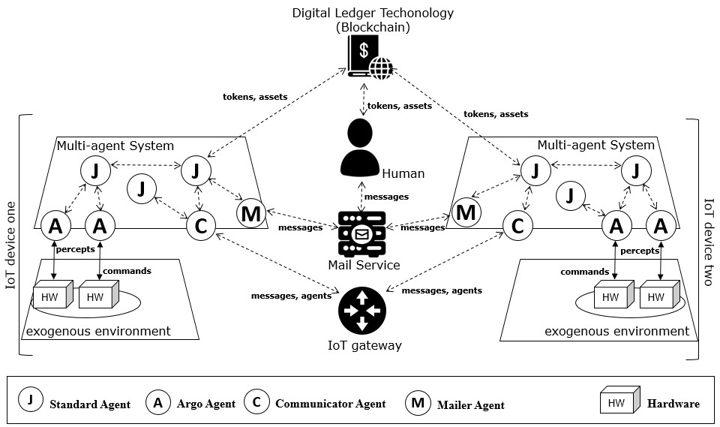
Jason Embedded
https://jasonembedded.chon.group
Notes:
<número>

Slide 32

ARGO
AGENT
https://argo.chon.group
Notes:
<número>

Slide 33
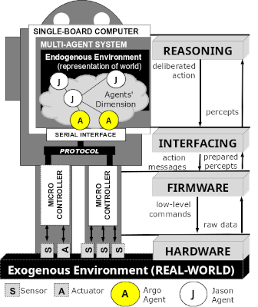
Argo for Jason
ARGO is a customized agent architecture that interfaces sensors and hardware actuators.
ARGO aims to be a practical architecture for programming embedded BDI agents using Jason and microcontroller boards.
Notes:
<número>

Slide 34
Argo for Jason
The ARGO allows to:
to direct control actuators at runtime;
to receive sensor perceptions within a predefined period automatically;
to change which devices are being accessed at runtime;
to communicate with other agents in Jason;
whether or not to perceive the real world at runtime;
to change perception filters at runtime.
Notes:
<número>

Slide 35
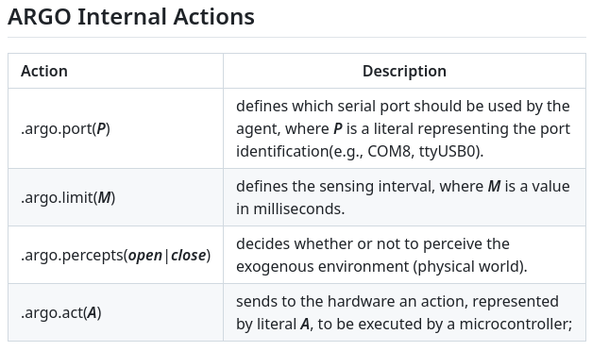
Argo for Jason
Notes:
<número>

Slide 36
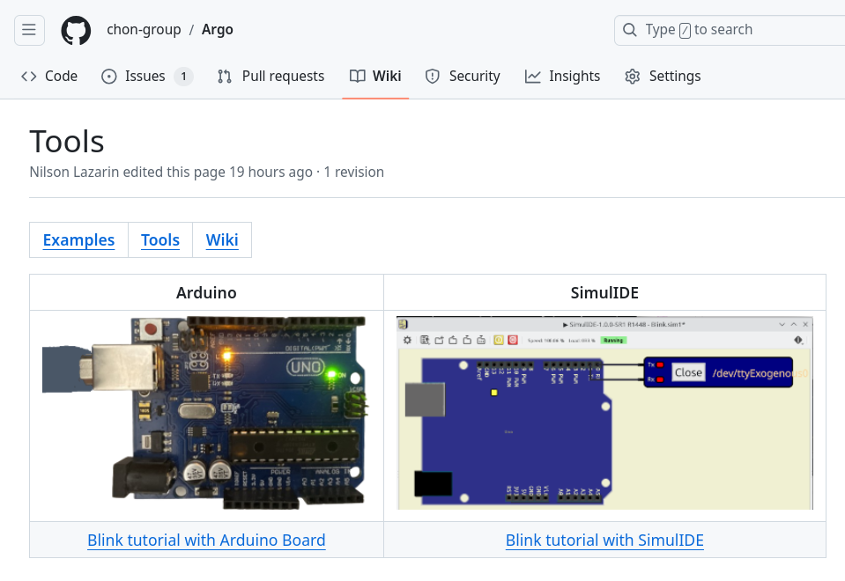
Example: blink
Notes:
<número>

Slide 37
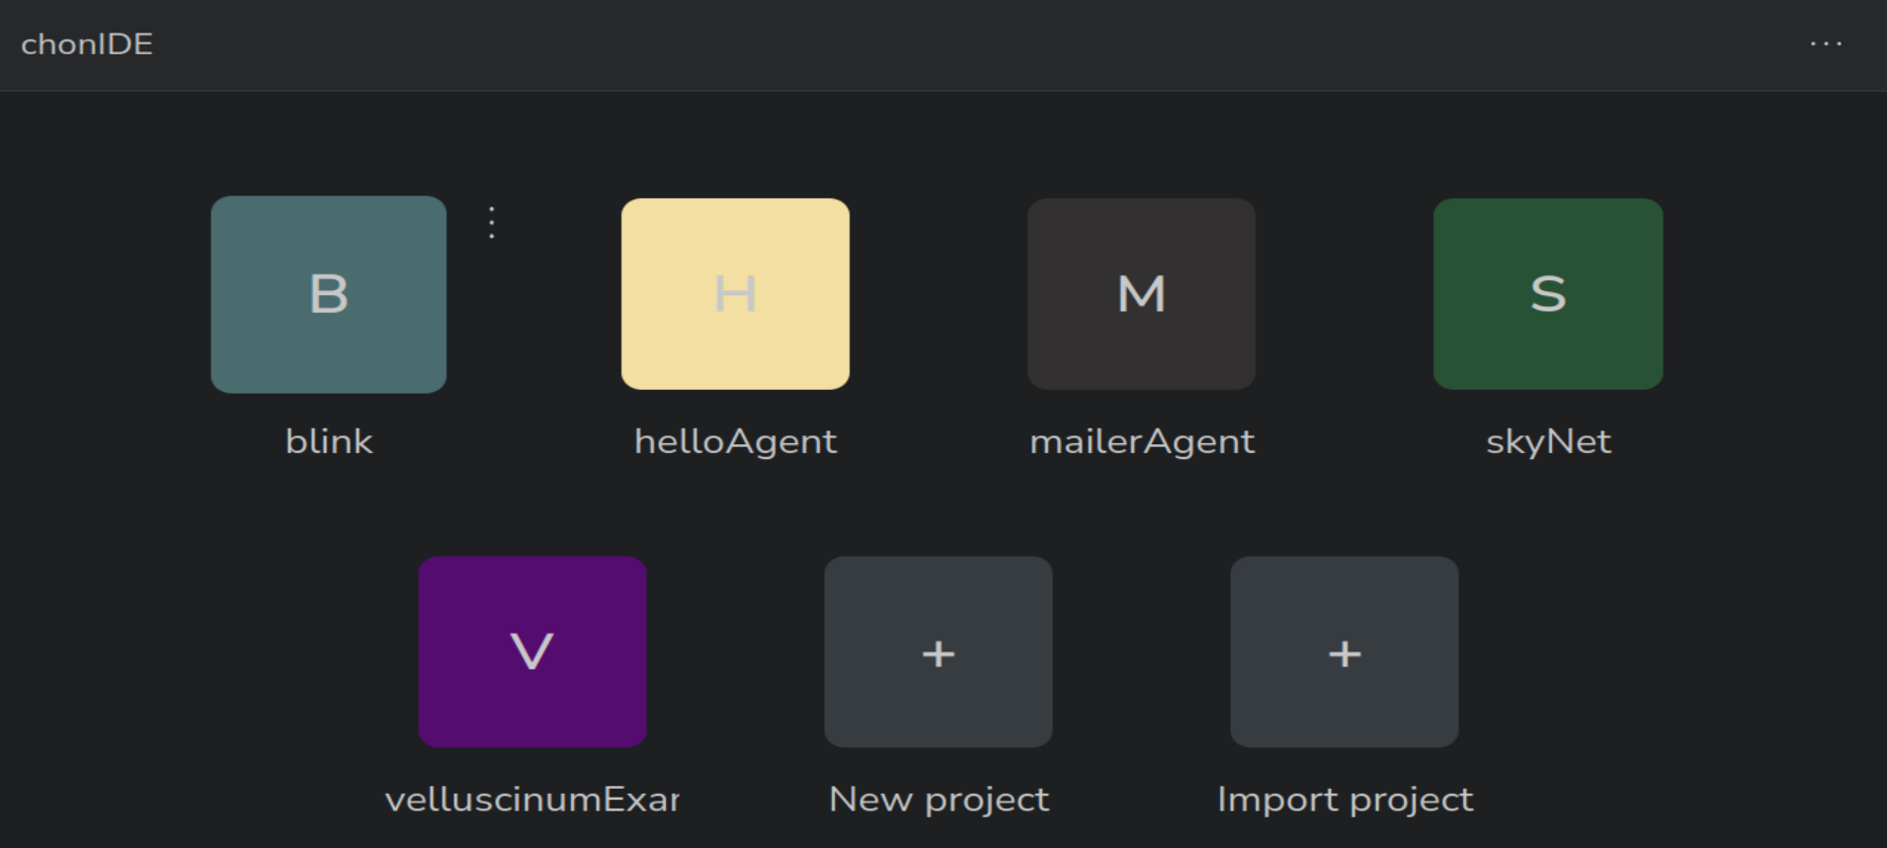
Example: blink
Notes:
<número>

Slide 38
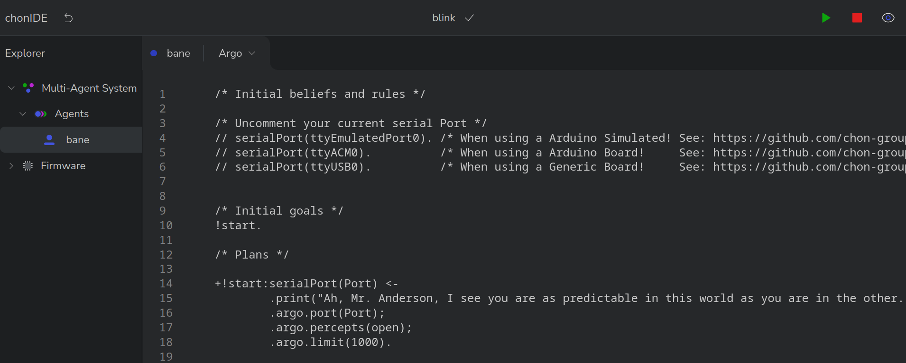
Example: blink
Notes:
<número>

Slide 39
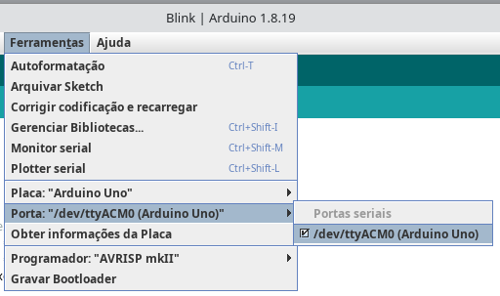
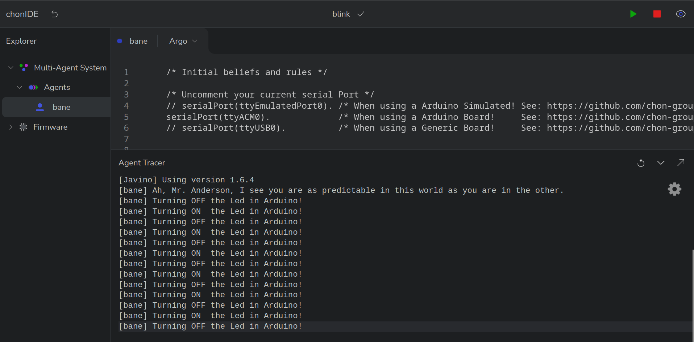
Example: blink
Notes:
<número>

Slide 40
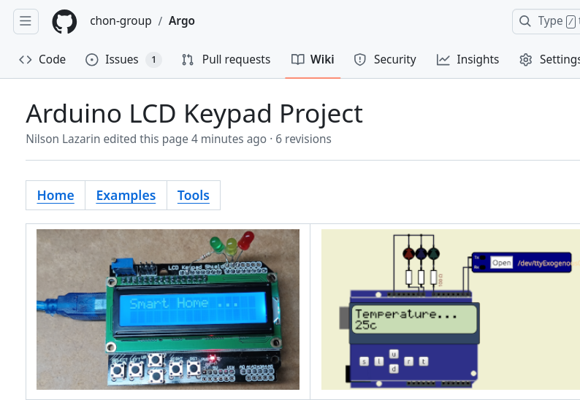
Exercise: LCD KeyPad
Adjust the ARGO agent to:
turn on the green LED if the rain intensity less than 30mm;
turn on the yellow LED if the rain intensity exceeds 50mm;
turn on the red LED if the the rain intensity exceeds 80mm;
Notes:
<número>

Slide 41

COMMUNICABILITY
Notes:
<número>

Slide 42
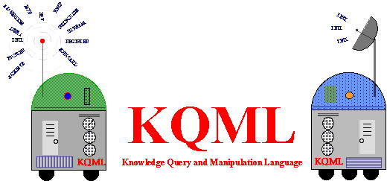
Jason Framework: Communication
Based on the theory of Speech Acts [1] and KQML [2] (Knowledge Query and Manipulation Language), a communication protocol for knowledge-based systems.
[1] M. Bierwisch, “Semantic Structure and Illocutionary Force”, em Speech Act Theory and Pragmatics, J. R. Searle, F. Kiefer, e M. Bierwisch, Orgs., Dordrecht: Springer Netherlands, 1980, p. 1–35. doi: 10.1007/978-94-009-8964-1_1.
[2] T. Finin, R. Fritzson, D. McKay, e R. McEntire, “KQML as an agent communication language”, em Proceedings of the third international conference on Information and knowledge management - CIKM ’94, Gaithersburg, Maryland, United States: ACM Press, 1994, p. 456–463. doi: 10.1145/191246.191322.

Slide 43
Jason Framework: Performatives
The performatives that are currently available for agent communication in Jason are largely inspired by KQML.
We also include some new performatives, related to plan exchange rather than communication about propositions.
The available performatives are briefly described below, where s denotes the agent that sends the message, and r denotes the agent that receives the message [1].
PERFORMATIVE | DESCRIPTION
tell | s intends r to believe (that s believes) the sentence in the message’s content to be true;
untell | s intends r not to believe (that s believes) the sentence in the message’s content to be true;
achieve | s requests that r try to achieve a state of the world where the message content is true;
unachieve | s requests that r try to drop the intention of achieving a state of the world where the message content is true;
tellHow | s informs r of a plan;
untellHow | s requests that r disregard a certain plan (i.e., delete that plan from its plan library);
askIf | s wants to know if the content of the message is true for r;
askAll | s wants all of r’s answers to a question;
askHow | s wants all of r’s plans for a triggering event;
[1] R. H. Bordini e J. F. Hübner, “BDI Agent Programming in AgentSpeak Using Jason”, em Computational Logic in Multi-Agent Systems, F. Toni e P. Torroni, Orgs., em Lecture Notes in Computer Science, vol. 3900. Berlin, Heidelberg: Springer Berlin Heidelberg, 2006, p. 143–164. doi: 10.1007/11750734_9.

Slide 44
Jason Framework: Message Structure
.send(receiver, ilf, message, answer, timeout)
.broadcast(ilf, message)
receiver
  Name of the agent receiving the message (or list of recipients)
ilf
  Illocutionary force of the speech act (KQML)
message
  Message content
asnwer
  A term that will store the response (optional field)
timeout
  Timeout in milliseconds to receive a response (optional field)

Slide 45



https://github.com/chon-group/distributedAndEmbeddedAI/blob/main/workshops/SEMESO/2024/projects/chiefGlutton.chon
Image credits:
https://smurfs.fandom.com/wiki/Chef_Smurf
https://smurfs.fandom.com/pt/wiki/Fominha

Slide 46

Collaborative MultiAgent System
MAS
MAS
MAS
MAS
Notes:
<número>

Slide 47

Hermes Agents: Server Communication
Public Server: skynet.chon.group - UDP Port: 5500
C
C
MAS A
ContextNet
(IoT middleware)
MAS B
Notes:
<número>

Slide 48
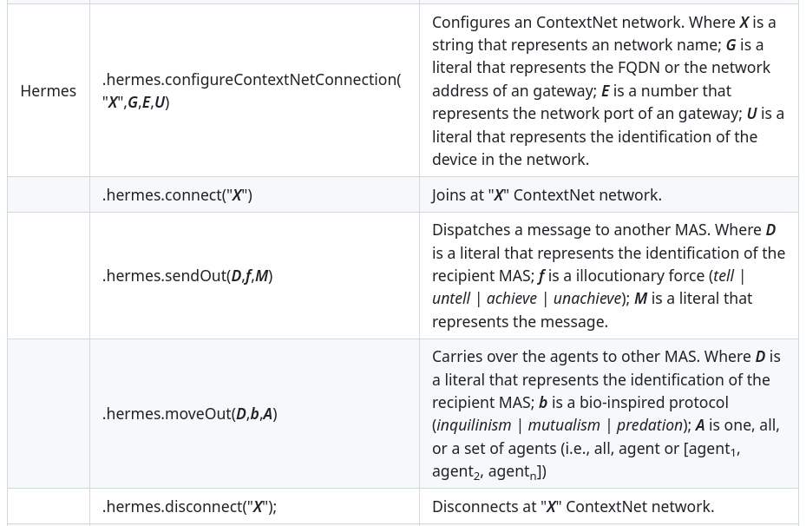
Hermes Agents: Internal Actions
Notes:
<número>

Slide 49

Hello SkyNet
Notes:
<número>

Slide 50

Hello SkyNet
Notes:
<número>

Slide 51

Hello SkyNet
Notes:
<número>

Slide 52


Example: MAS Communication
MAS 1
MAS 2
https://github.com/chon-group/distributedAndEmbeddedAI/blob/main/workshops/SEMESO/2024/projects/hermesAGENT.chon
Notes:
<número>

Slide 53
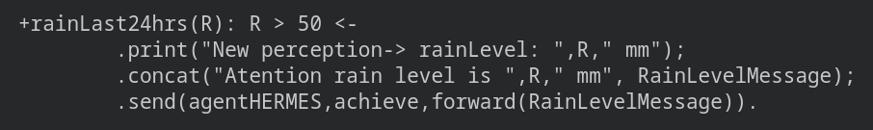
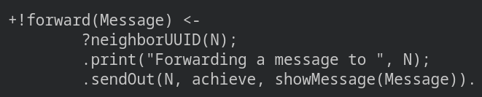
Example: MAS 1
Notes:
<número>

Slide 54
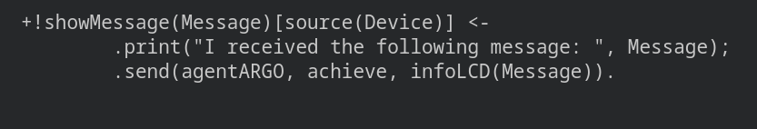
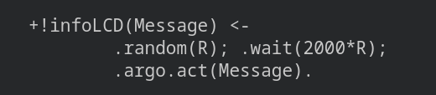
Example: MAS 2
Notes:
<número>

Slide 55
Simple Exercise
Adjust to:
  turn on the green LED in MAS 2 if the rain intensity less than 30mm in MAS 1;
  turn on the yellow LED in MAS 2 if the rain intensity exceeds 50mm in MAS 1;
  turn on the red LED in MAS 2 if the the rain intensity exceeds 80mm in MAS 1;
Notes:
<número>

Slide 56


VELLUSCINUM
https://github.com/chon-group/Velluscinum/wiki
Notes:
<número>

Slide 57


MAS + DLT
Can facilitate the agreement between agents
Taking what is registered in the Ledger as accurate;
Can be helpful to:
Manage trust relationships;
Open MAS;
Distributed scenarios.
Notes:
<número>

Slide 58

Objective
Using digital assets in the relationships between cognitive agents:
the transfer of funds;
registration of ownership of artifacts;
declaration of promises or agreements.
Allowing the agents to manipulate assets and wallets directly in the DLT.
Notes:
The swapping of resources — addition or removal — is an interesting feature in the development of Embedded MAS because it adds adaptability at runtime for agents. The system does not need to be turned off, and agents could reason about the availability of resources.
In this way, an autonomous agent can be adaptable, continuing to perform actions to achieve its goals in case of hardware failure, for example.
This work presents a new feature for swapping physical resources at runtime in Embedded MAS.
Therefore, one embedded system that already has physical resources available may have new resources attached to it or removed, and agents will automatically be aware of these new resources or their absence.

Slide 59
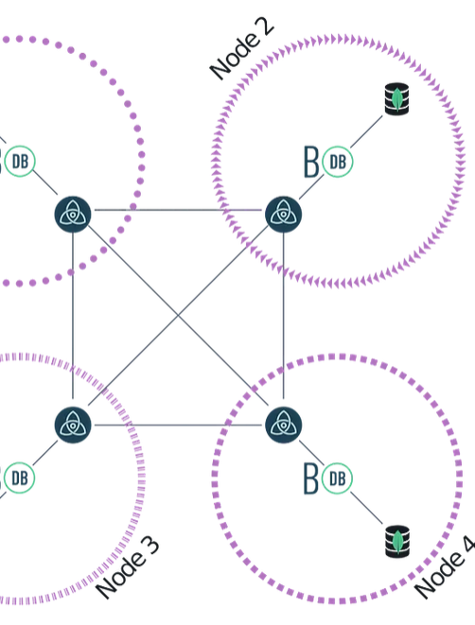
Theoretical foundation
A DLT can be considered an append-only decentralized database because it provides a storage mechanism.
However, compared with a traditional database, its performance is much lower because it has a low download rate and a high latency [13].
New approaches based on distributed databases have been used to improve the performance of permissioned DLT.
13. McConaghy, T., Marques, R., Müller, A., De Jonghe, D., McConaghy, T., Mc-Mullen, G., Henderson, R., Bellemare, S., Granzotto, A.: Bigchaindb: a scalable blockchain database. white paper, BigChainDB (2016)​
Notes:
The serial interface informs the agent about the port availability it is trying to access.
Then, whenever the agent has a new resource connected to the Embedded MAS, it perceives which port it is connected to. If the resource is removed, the next time the agent tries to gather the perceptions or act, it updates its mental state with the unavailability of the resource.
In this new version of Argo, the agent receives this information each time (in the beginning) its reasoning cycle is performed. It is also updated at the end of the cycle if it tries to perform an action using any resource.
With this perception, the agent can deliberate whether or not to pursue an intention that might be unreachable.

Slide 60
Theoretical foundation
When considering the number of transactions that a DLT can successfully execute per second:
DLT permissionless (e.g., Bitcoin or Ethereum)
  ranges between 3.45 and 4.69 TPS [24,15];
DLT permissioned (e.g., HyperLedger Fabric)
  vary between 4.28 and 10.51 TPS [7, 15];
DLT permissioned distribution database-based (e.g., BigchainDB)
  varies between 50.60 and 175 TPS [7, 10].
7. Contreras, A.F.: Benchmarking of blockchain technologies used in a decentralized data marketplace. Grado en Ingenierı́a Informática, E.T.S de Ingenieros Informáticos (UPM), Madrid, España (Jun 2019), https://oa.upm.es/55775/​
10. Ge, Z., Loghin, D., Ooi, B.C., Ruan, P., Wang, T.: Hybrid blockchain database systems: Design and performance. Proc. VLDB Endow. 15(5), 1092–1104 (may 2022). https://doi.org/10.14778/3510397.3510406​
15. Nasir, Q., Qasse, I.A., Abu Talib, M., Nassif, A.B.: Performance Analysis of Hyperledger Fabric Platforms. Security and Communication Networks 2018, 1–14 (2018). https://doi.org/10.1155/2018/3976093​
24. Tikhomirov, S.: Ethereum: State of knowledge and research perspectives. In: Imine, A., Fernandez, J.M., Marion, J.Y., Logrippo, L., Garcia-Alfaro, J. (eds.) Foundations and Practice of Security. pp. 206–221. Springer International Publishing, Cham (2018). https://doi.org/10.1007/978-3-319-75650-9_14 ​
Notes:
The serial interface informs the agent about the port availability it is trying to access.
Then, whenever the agent has a new resource connected to the Embedded MAS, it perceives which port it is connected to. If the resource is removed, the next time the agent tries to gather the perceptions or act, it updates its mental state with the unavailability of the resource.
In this new version of Argo, the agent receives this information each time (in the beginning) its reasoning cycle is performed. It is also updated at the end of the cycle if it tries to perform an action using any resource.
With this perception, the agent can deliberate whether or not to pursue an intention that might be unreachable.

Slide 61


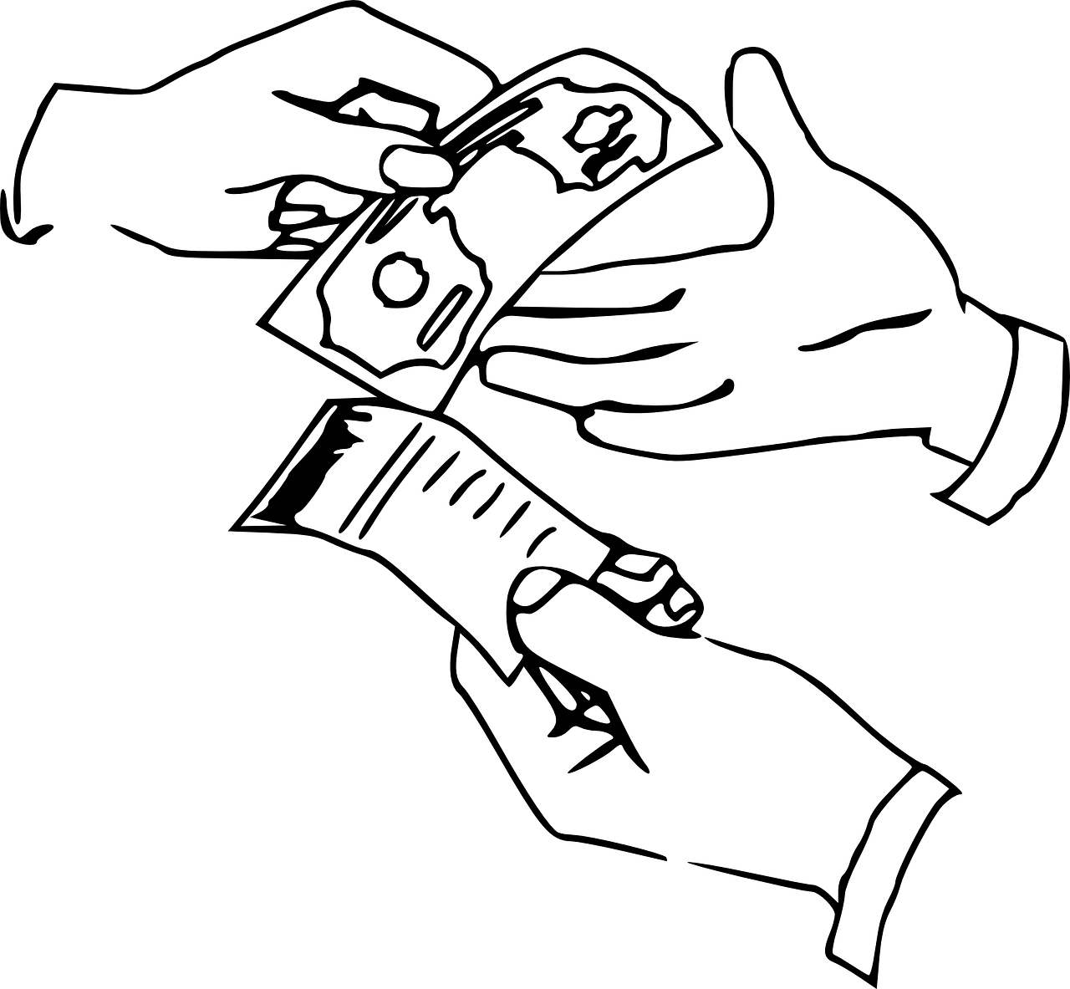




Proposed Approach
Distributed ledger technology
Use of digital assets to supporting the BDI agents’ relationship:
Indivisible assets
as property record
as promise or agreement
Divisible assets
as cryptocurrencies
Velluscinum
MAS - Agents Dimension
Notes:
We considered the scenario of a house with its water supply system managed by an Embedded MAS.
The house, has two supply sources (cistern and well) controlled by resources 1 and 2. Both have a minimum water level sensor and an actuator that controls the collection pump.
The captured water is stored in a water tank managed by resource 3 with two sensors, one to indicate the minimum level and another to indicate the maximum level.
Finally, resource 4 installed on the roof of the house consists of a sensor to indicate when it is raining.

Slide 62
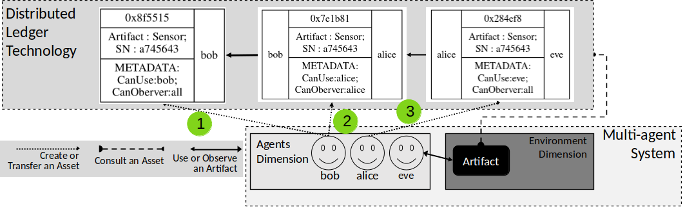
Indivisible asset such as property record

Slide 63
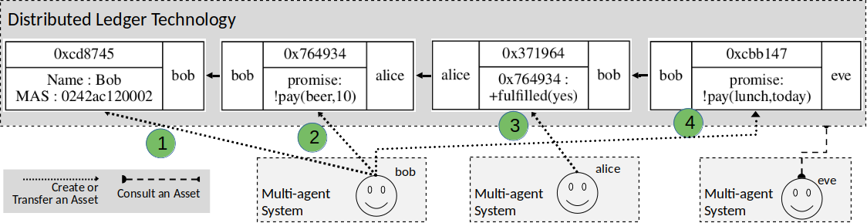
Indivisible asset such as promise or agreement

Slide 64
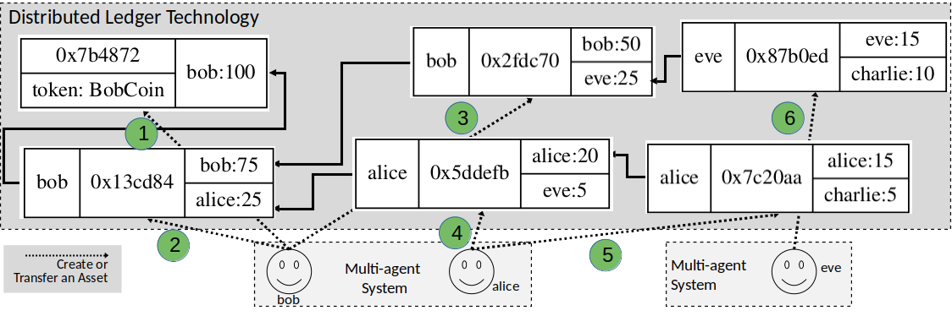
Divisible asset such as cryptocurrency

Slide 65
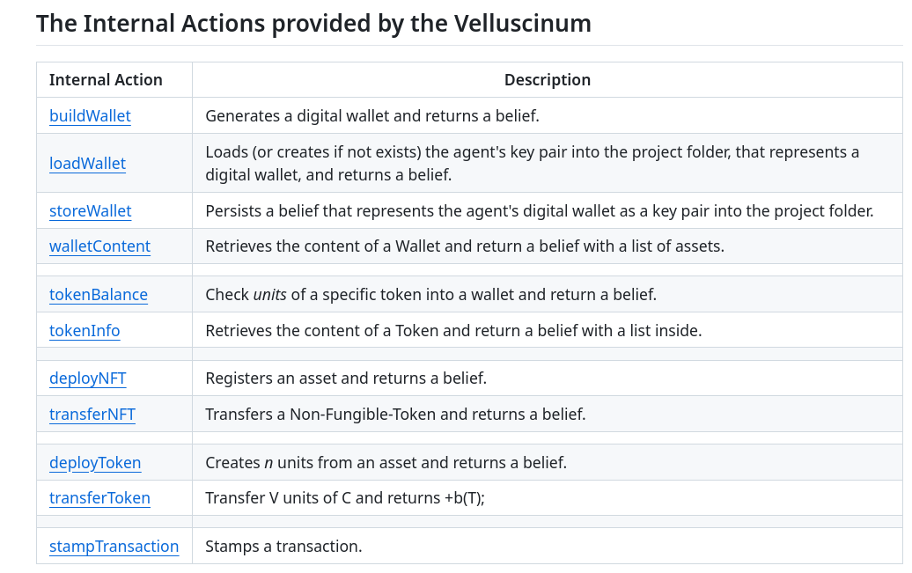
https://github.com/chon-group/Velluscinum/wiki/

Slide 66


https://github.com/chon-group/distributedAndEmbeddedAI/blob/main/workshops/SEMESO/2024/projects/chiefGlutonVellus.chon
Image credits:
https://smurfs.fandom.com/wiki/Chef_Smurf
https://smurfs.fandom.com/pt/wiki/Fominha
https://smurfs.fandom.com/pt-br/wiki/%C3%81rvore_de_Dinheiro

Slide 67
OTHER
TOOLS
Notes:
<número>

Slide 68

Webots
Michel, O. (1998). Webots: Symbiosis Between Virtual and Real Mobile Robots. In: Heudin, JC. (eds) Virtual Worlds. VW 1998. Lecture Notes in Computer Science(), vol 1434. Springer, Berlin, Heidelberg. https://doi.org/10.1007/3-540-68686-X_24

Slide 69


Webots
Manual de instalação
https://cyberbotics.com/doc/guide/installation-procedure#installing-the-debian-package-with-the-advanced-packaging-tool-apt

Slide 70
Webots
Manual de instalação
https://cyberbotics.com/doc/guide/installation-procedure#installing-the-debian-package-with-the-advanced-packaging-tool-apt

Slide 71


Webots
https://github.com/chon-group/distributedAndEmbeddedAI/raw/main/course/05-TheDevelopmentTool/Examples/Car4WD.zip

Slide 72
Webots
https://github.com/chon-group/distributedAndEmbeddedAI/raw/main/course/05-TheDevelopmentTool/Examples/Car4WD.zip

Slide 73

Webots

Slide 74


Webots

Slide 75
Webots

Slide 76

Webots

Slide 77

Webots

Slide 78

Webots

Slide 79
Webots

Slide 80

Webots

Slide 81

Webots

Slide 82

Webots

Slide 83

Webots

Slide 84
Webots

Slide 85

Webots

Slide 86
Acknowledgements
THANK YOU!
nilson.lazarin@cefet-rj.br
Notes:
<número>

