Slide 1



Introduction to Distributed and Embedded Multi-agent Systems
Carlos Eduardo Pantoja¹
Nilson Mori Lazarin^{1,2}
1. Centro Federal de Educação Tecnológica (CEFET/RJ) - 2. Universidade Federal Fluminense (UFF), Brasil
02/2024

Slide 2
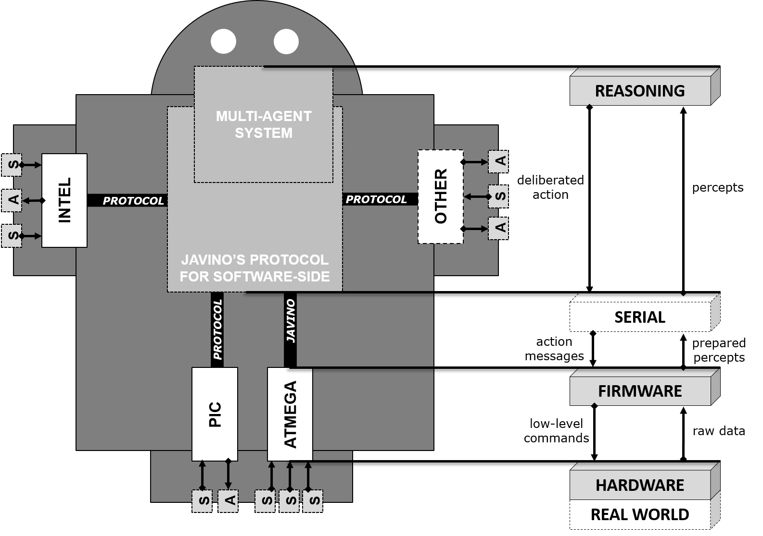
Programando um SingleAgent System
Notes:
<número>

Slide 3
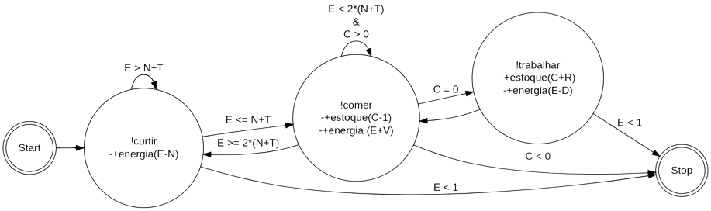
My First Agent
Base de crenças:
estoque(C) energia(E)
recompensa(R) jornada(D)
noitada(N) refeicao(V)
Notes:
<número>

Slide 4
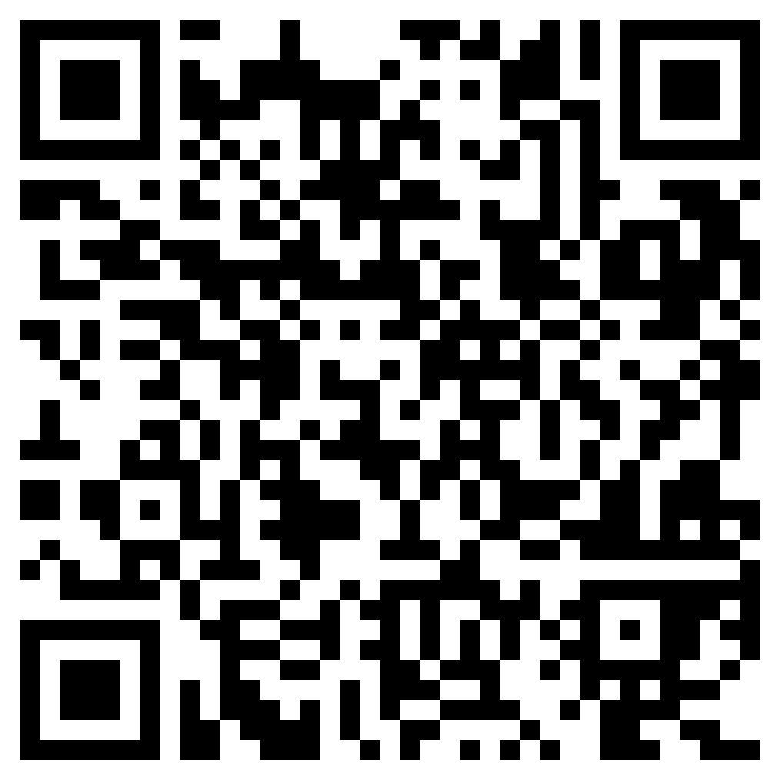
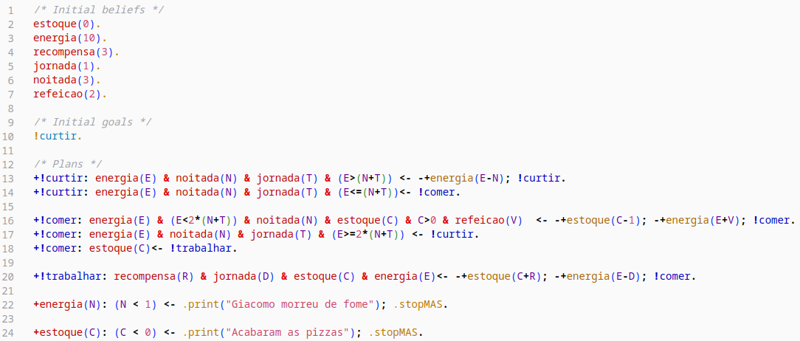
My First Agent - code
https://github.com/chon-group/distributedAndEmbeddedAI/raw/main/course/06-MyFirstAgent/giacomoAgent.zip
Notes:
<número>

Slide 5
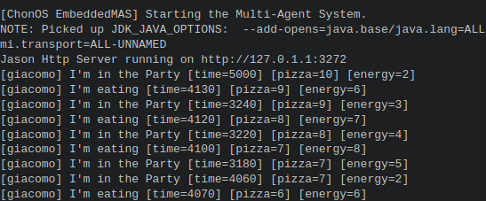
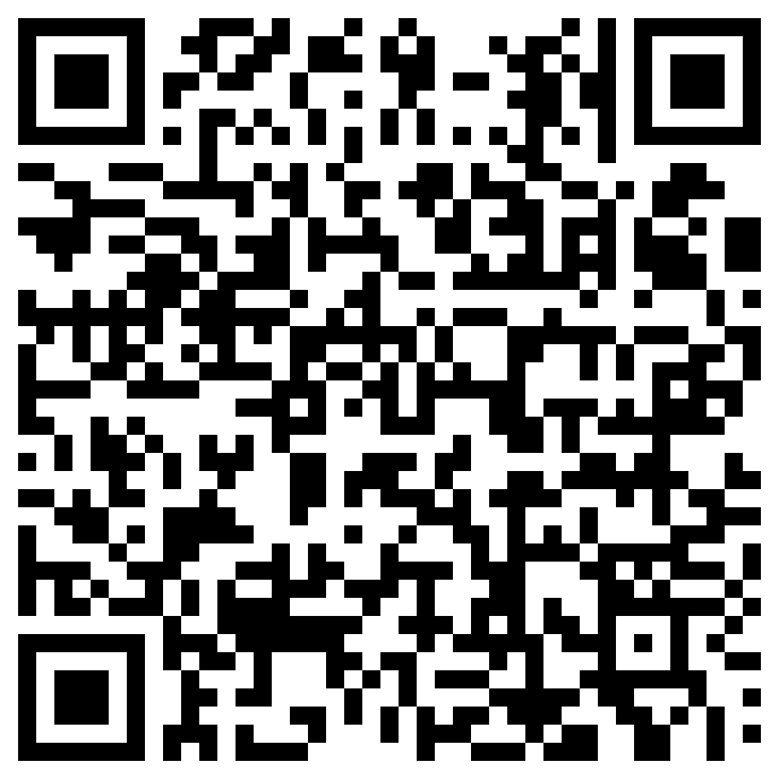
Giacamo Life - Exercise
Giacomo's health is very fragile, as:
If he has energy equal to or less than 1, he dies from starvation;
If his energy level exceeds 12, he dies from obesity;
If he doesn't dance for 5000 milliseconds, he dies of sadness.
Logic of Giacamo's life:
Each pizza he eats increases his energy bar in 4 units.
Every time he goes clubbing, his energy decreases by 3 units.
Initially, Giacomo's energy is 5 units;
Initially, Giacomo has a stock of 10 pizzas;
Each time he works, his energy decreases by 2 units, and he gains 1 pizza unit.
Giacamo can only store 20 pizzas in his house.
https://github.com/chon-group/distributedAndEmbeddedAI/blob/main/course/06-MyFirstAgent/GiacomoLife/README.md
Notes:
<número>

Slide 6



Agradecimentos
OBRIGADO!
pantoja@cefet-rj.br
nilson.lazarin@cefet-rj.br
Notes:
<número>

