Slide 1

Inteligência Artificial das Coisas com Sistemas Multiagente Distribuídos e Embarcados
Prof. Me. Nilson Mori Lazarin
http://lattes.cnpq.br/4304954704049203
Prof. Me. Bruno Policarpo Toledo Freitas
http://lattes.cnpq.br/1007295696070905
Setembro 2024

Slide 2

INTRODUCTION
Notes:
<número>

Slide 3

Who we are?
Cognitive Hardware on Networks (Chon)
Research Group
https://chon.group
Notes:
<número>

Slide 4

Where we have been?
This workshop is part of:
Undergratuate course
CEFET/RJ Maria da Graça and Nova Friburgo
Graduate course
M.Sc. and Ph.D. at UFF
It was presented at:
IFSP, IFC, UFPel, UFRJ, UFSC, UnB, UTFPR, UDESC and Estácio;
https://workshops.chon.group
Notes:
<número>

Slide 5
Goals
This workshop goals are:
To experience the development process of Embedded MAS using BDI-agents and Jason.
To learn how to collaborate using IoT in distributed scenarios.
Notes:
<número>

Slide 6
THE AGENT ORIENTED APPROACH
Notes:
<número>

Slide 7
Agent
WOOLDRIDGE, Michael. Intelligent Agents. Multiagent Systems: A Modern Approach to Distributed Artificial Intelligence. Cambridge, MA, USA: MIT Press, 1999. p. 27–77
MICHEL, Fabien; FERBER, Jacques; DROGOUL, Alexis. Multi-Agent Systems and Simulation: a Survey From the Agents Community's Perspective. 2009
Notes:
<número>

Slide 8
Agent
WOOLDRIDGE, Michael. Intelligent Agents. Multiagent Systems: A Modern Approach to Distributed Artificial Intelligence. Cambridge, MA, USA: MIT Press, 1999. p. 27–77
MICHEL, Fabien; FERBER, Jacques; DROGOUL, Alexis. Multi-Agent Systems and Simulation: a Survey From the Agents Community's Perspective. 2009
Notes:
<número>

Slide 9
Agent
WOOLDRIDGE, Michael. Intelligent Agents. Multiagent Systems: A Modern Approach to Distributed Artificial Intelligence. Cambridge, MA, USA: MIT Press, 1999. p. 27–77
MICHEL, Fabien; FERBER, Jacques; DROGOUL, Alexis. Multi-Agent Systems and Simulation: a Survey From the Agents Community's Perspective. 2009
Notes:
<número>

Slide 10
Multi-agent System
WOOLDRIDGE, Michael. Intelligent Agents. Multiagent Systems: A Modern Approach to Distributed Artificial Intelligence. Cambridge, MA, USA: MIT Press, 1999. p. 27–77
Notes:
<número>

Slide 11
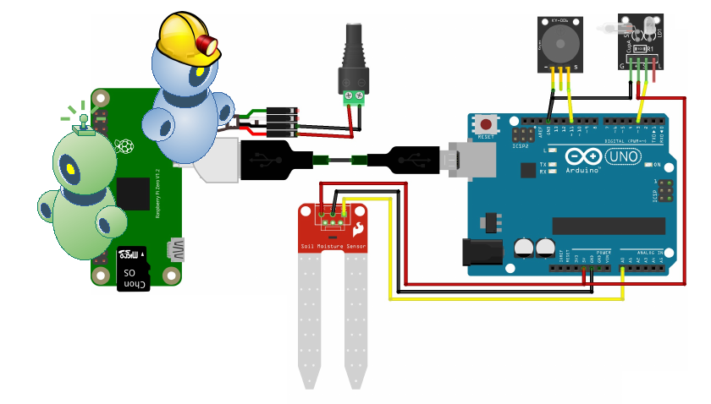
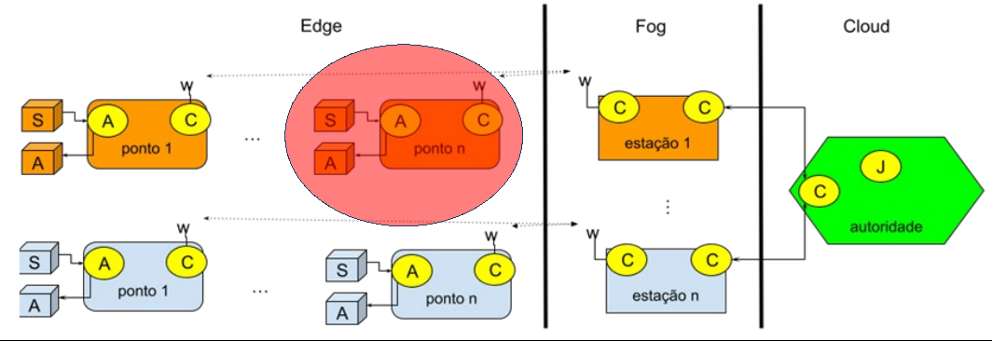
Embedded Multi-agent System
Notes:
<número>

Slide 12

THE DEVELOPMENT
TOOLS
Notes:
<número>

Slide 13


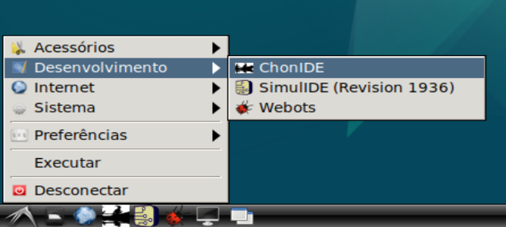
How to install? https://github.com/chon-group/chonIDE/wiki

Slide 14
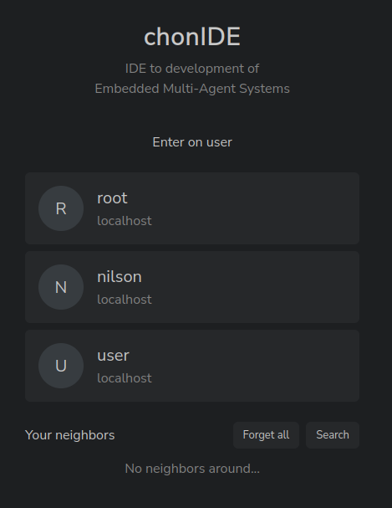
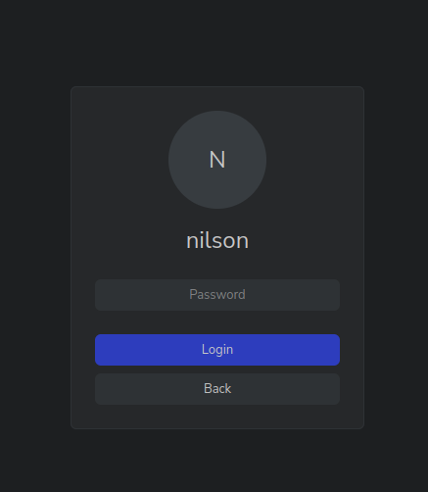
ChonIDE: login
2
1
3

Slide 15

ChonIDE: blink

Slide 16
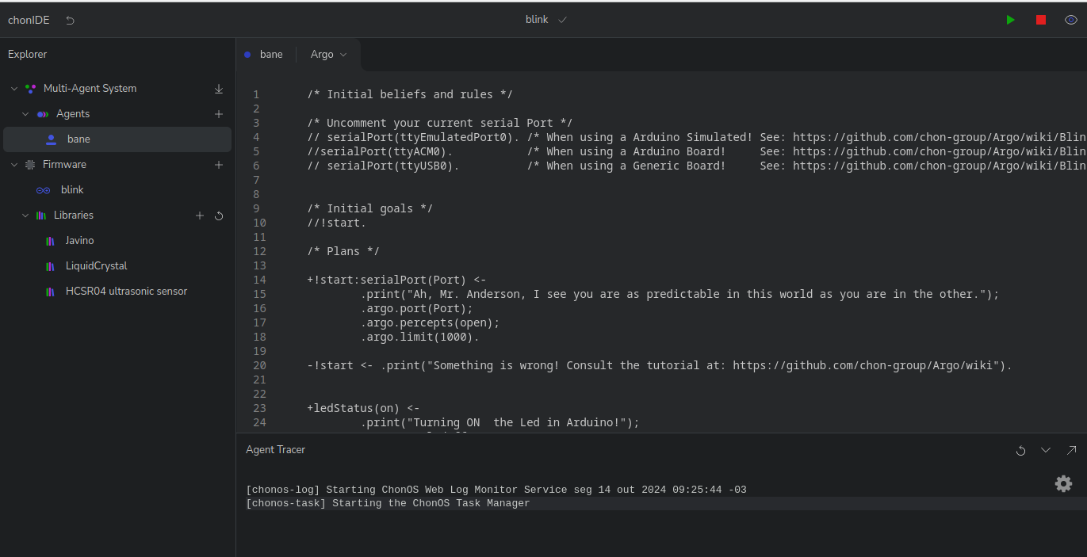
ChonIDE: blink
7
4
5
6
1
2
3

Slide 17
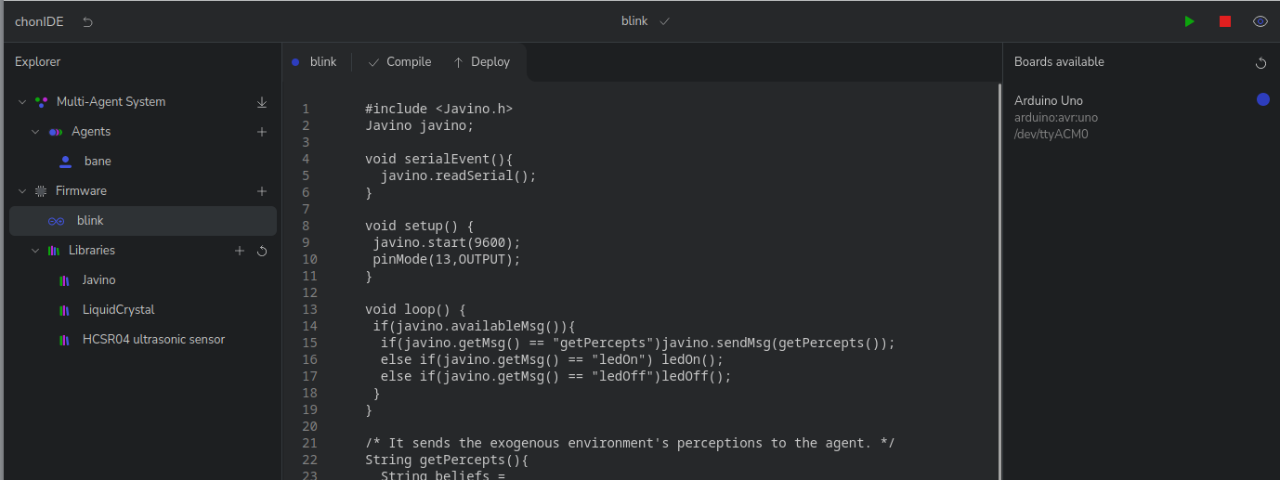
ChonIDE: blink
12
13
8
11
10
9

Slide 18
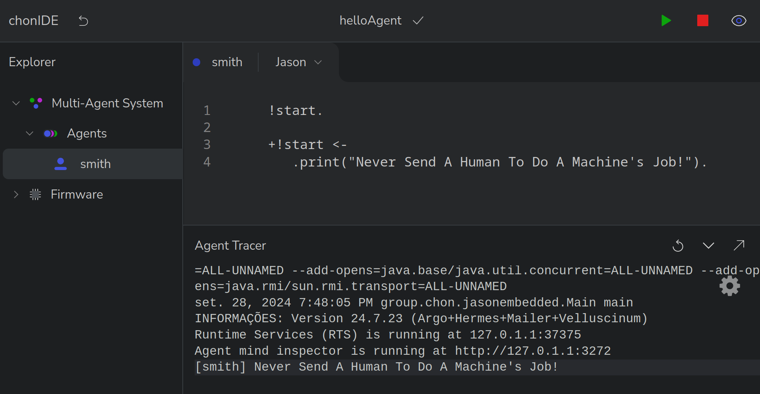
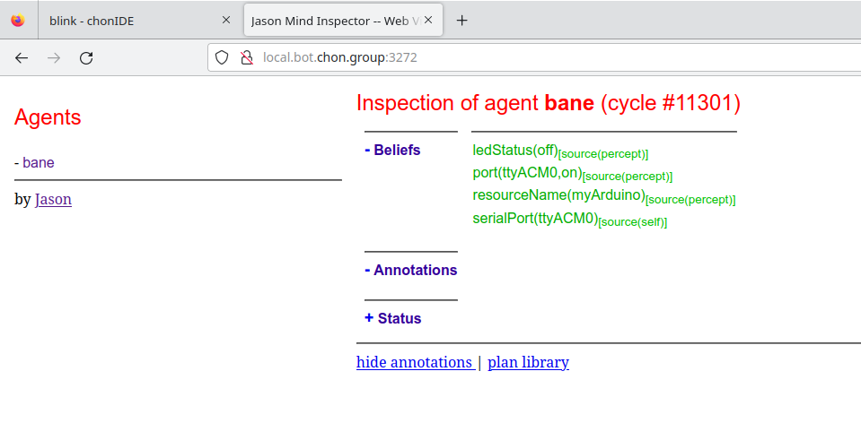
ChonIDE: mindInspector
7

Slide 19

MY FIRST
SINGLE AGENT
Notes:
<número>

Slide 20
Arquitetura BDI
O BDI possibilita a implementação de atitudes mentais em agentes cognitivos:
Crença é uma informação, ou seja, aquilo que o agente sabe sobre o ambiente, si mesmo ou outros agentes.
Desejo é um propósito que o agente busca tornar realidade.
Intenção é uma ação que o agente faz para alcançar um desejo.
HÜBNER, Jomi Fred; BORDINI, Rafael Heitor; VIEIRA, Renata. Introdução ao desenvolvimento de sistemas multiagentes com Jason. XII Escola de Informática da SBC, v. 2, p. 51–89, 2004.
Notes:
<número>

Slide 21
AgentSpeak(L)
Um agente AgentSpeak(L) possui minimamente:
Uma base de crenças;
Uma lista de objetivos;
Uma biblioteca de planos.
HÜBNER, Jomi Fred; BORDINI, Rafael Heitor; VIEIRA, Renata. Introdução ao desenvolvimento de sistemas multiagentes com Jason. XII Escola de Informática da SBC, v. 2, p. 51–89, 2004.
Notes:
<número>

Slide 22
Jason Framework: Crenças
Em Jason, um agente armazena as informações percebidas do ambiente; as informações internas; e informações de comunicação através de crenças.
As crenças são armazenadas em uma Base de Crenças (Belief Base).
As crenças são representadas como predicados da lógica tradicional. Os predicados representam propriedades particulares.
Notes:
<número>

Slide 23
Jason Framework: Beliefs Types
Mental Notes (self)
Informações adicionadas na base de crenças pelo próprio agente.
Communication (agent)
Informações obtidas pelo agente através da interação com outros agentes.
Environmental Perceptions (percepts)
Informações coletadas pelo agente que são relativas ao sensoriamento constante do ambiente.
Notes:
<número>

Slide 24
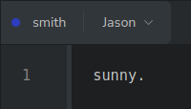
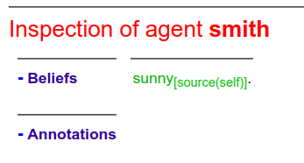
Initial Beliefs: Mental Notes
Notes:
<número>

Slide 25
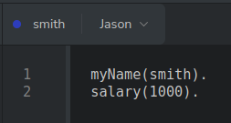
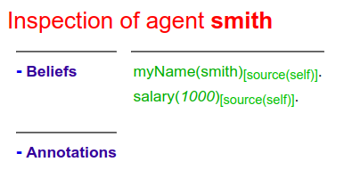
Initial Beliefs: Mental Notes
Notes:
<número>

Slide 26
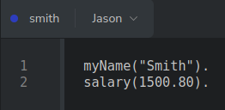
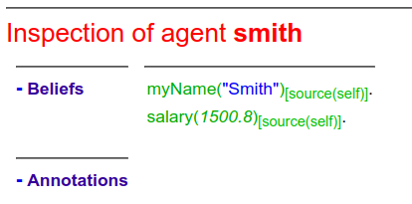
Initial Beliefs: Mental Notes
Notes:
<número>

Slide 27
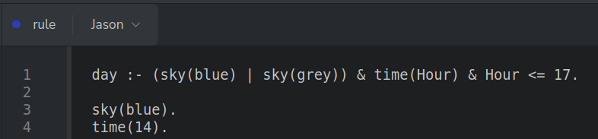
Rules: Predicate and Variable
The verified conditions.
Notes:
<número>

Slide 28
Jason Framework: Plans Format
triggering_event : context <- body.
triggering Event
Um agente pode ter diversos objetivos. Os planos são ativados baseados nos eventos que podem ser ativados em determinado momento.
context
São as condições para a ativação de um plano dentro vários eventos.
body.
É o corpo do plano. Uma sequência de ações a ser executada pelo agente.
Notes:
<número>

Slide 29
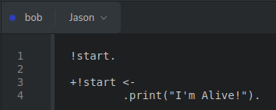

Plan: Hello World
Notes:
<número>

Slide 30

My First Agent
Belief Base
stock(S) energy(E)
payment(P) workingDay(W)
partyNight(N)
Notes:
<número>

Slide 31
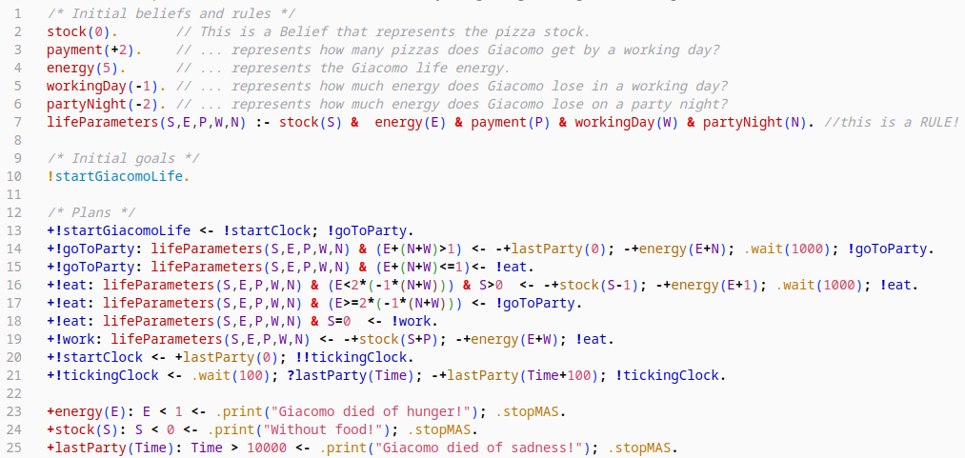
My First Agent: Code
https://github.com/chon-group/distributedAndEmbeddedAI/blob/main/workshops/sepex/2024/projects/giacomoAgent.chon

Slide 32

JASON stdlib → https://jason-lang.github.io/api/jason/stdlib/package-summary.html
Introdução ao Jason → https://www.researchgate.net/publication/228828757_Introducao_ao_desenvolvimento_de_sistemas_multiagentes_com_Jason

Slide 33

EMBEDDED
MAS
Notes:
<número>

Slide 34
Jason Embedded
Jason Embedded is a spin-off Version of Jason for IoT and Embedded MAS:
Autonomy as a characteristic an Embedded MAS provides to a device that does not need external architectures to control and manage it.
Communicability is the agent’s ability to communicate with other agents in its MAS or another MAS.
Mobility as the agents’ ability to move from one MAS to another.
Fault Tolerance and Adaptability are defined as the ability of an agent to identify if a physical resource is absent or not answering commands and to overcome this situation by modifying its goals.
Distributed Ledger Technologies technologies to facilitate the agreement between agents.
Notes:
<número>

Slide 35
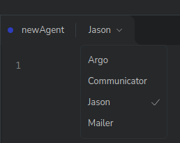
Jason Embedded
Jason Embedded also provides new types of agents to control hardware devices and to communicate with agents hosted in other MAS.
Notes:
<número>

Slide 36
Jason Embedded
Jason Embedded also provides new types of agents to control hardware devices and to communicate with agents hosted in other MAS.
  ARGO: is a customized agent architecture built on the Jason framework that extends Jason’s standard agents by adding the ability to control microcontrollers [Pantoja et al., 2016].
  Hermes (Communicator) : is another customized agent architecture built on Jason’s Standard agent by adding the ability to communicate with agents from other MAS, which also have Communicator agents [Pantoja et al., 2018].
  Mailer : agent architecture based on the Jason framework to enable secure and simplified human-agent interaction [Lazarin et al., 2024].
Notes:
<número>

Slide 37
Jason Embedded
Mobility is based on bio-inspired protocols [Jesus et al., 2021].
    The protocols simulate natural behaviors that could be explored in collaborative tasks using IoT devices.
    One or more agents or even the whole MAS could move from one device to another to take control of the destination device (Predation) or to use it as a temporary non-hazardous relationship (Mutualism and Inquilinism) if both parties accept the protocol.
Middleware that allows cognitive agents to manipulate Tokens and NFT in blockchain network [Lazarin et al., 2023].
Notes:
<número>

Slide 38
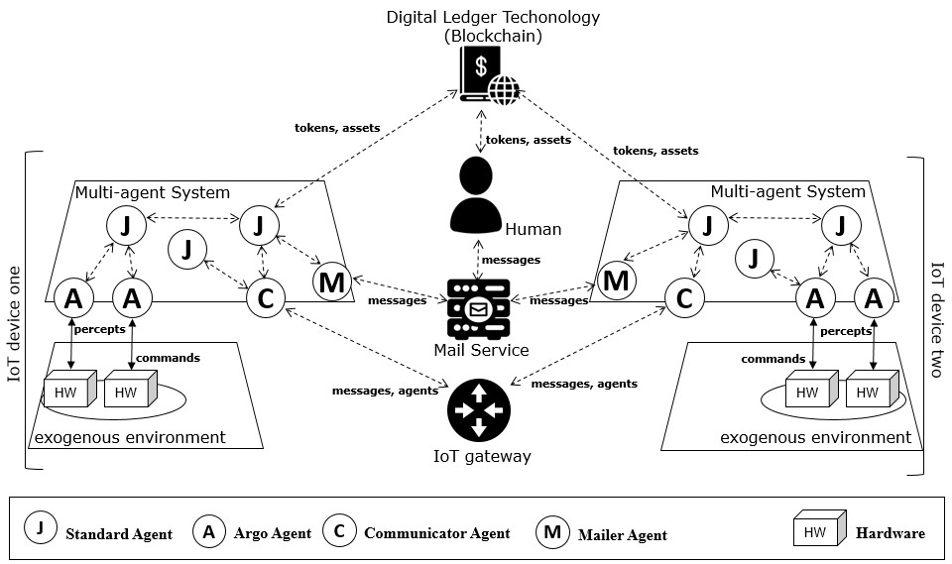
Jason Embedded
https://jasonembedded.chon.group
Notes:
<número>

Slide 39

ARGO
AGENT
https://argo.chon.group
Notes:
<número>

Slide 40
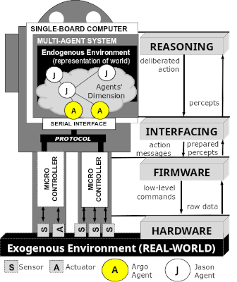
Argo for Jason
ARGO is a customized agent architecture that interfaces sensors and hardware actuators.
ARGO aims to be a practical architecture for programming embedded BDI agents using Jason and microcontroller boards.
Notes:
<número>

Slide 41
Argo for Jason
The ARGO allows to:
to direct control actuators at runtime;
to receive sensor perceptions within a predefined period automatically;
to change which devices are being accessed at runtime;
to communicate with other agents in Jason;
whether or not to perceive the real world at runtime;
to change perception filters at runtime.
Notes:
<número>

Slide 42
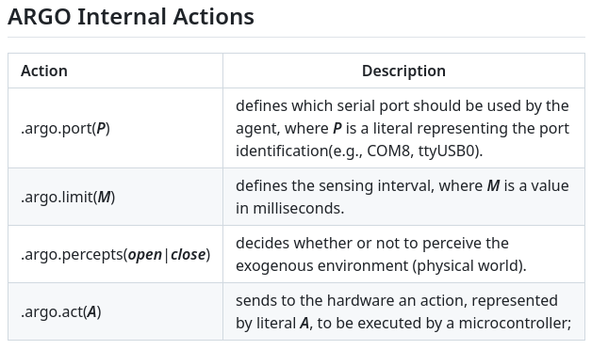
Argo for Jason
Notes:
<número>

Slide 43
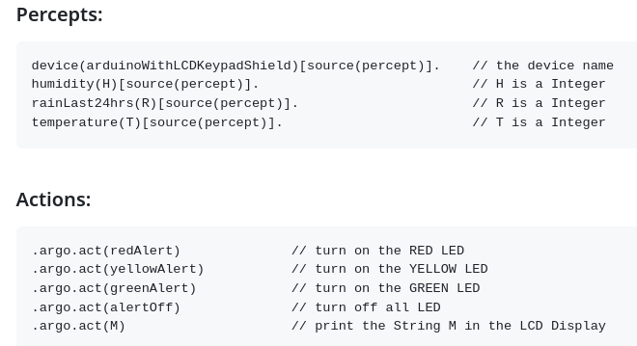
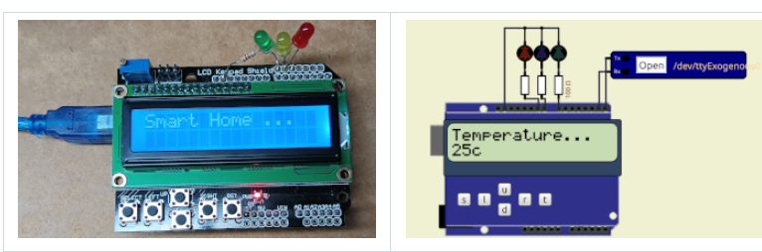
Exercise: LCD KeyPad
Adjust the ARGO agent to:
turn on the green LED if the rain intensity less than 50mm;
turn on the yellow LED if the rain intensity exceeds 50mm;
turn on the red LED if the the rain intensity exceeds 80mm;
https://github.com/chon-group/distributedAndEmbeddedAI/blob/main/workshops/sepex/2024/projects/lcdKeyPad.chon
Notes:
<número>

Slide 44

COMMUNICABILITY
Notes:
<número>

Slide 45
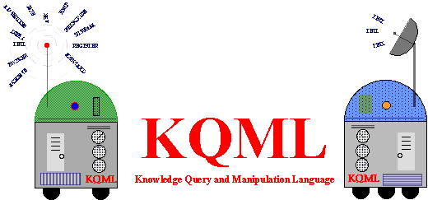
Jason Framework: Communication
Based on the theory of Speech Acts [1] and KQML [2] (Knowledge Query and Manipulation Language), a communication protocol for knowledge-based systems.
[1] M. Bierwisch, “Semantic Structure and Illocutionary Force”, em Speech Act Theory and Pragmatics, J. R. Searle, F. Kiefer, e M. Bierwisch, Orgs., Dordrecht: Springer Netherlands, 1980, p. 1–35. doi: 10.1007/978-94-009-8964-1_1.
[2] T. Finin, R. Fritzson, D. McKay, e R. McEntire, “KQML as an agent communication language”, em Proceedings of the third international conference on Information and knowledge management - CIKM ’94, Gaithersburg, Maryland, United States: ACM Press, 1994, p. 456–463. doi: 10.1145/191246.191322.

Slide 46
Jason Framework: Performatives
The performatives that are currently available for agent communication in Jason are largely inspired by KQML.
We also include some new performatives, related to plan exchange rather than communication about propositions.
The available performatives are briefly described below, where s denotes the agent that sends the message, and r denotes the agent that receives the message [1].
PERFORMATIVE | DESCRIPTION
tell | s intends r to believe (that s believes) the sentence in the message’s content to be true;
untell | s intends r not to believe (that s believes) the sentence in the message’s content to be true;
achieve | s requests that r try to achieve a state of the world where the message content is true;
unachieve | s requests that r try to drop the intention of achieving a state of the world where the message content is true;
tellHow | s informs r of a plan;
untellHow | s requests that r disregard a certain plan (i.e., delete that plan from its plan library);
askIf | s wants to know if the content of the message is true for r;
askAll | s wants all of r’s answers to a question;
askHow | s wants all of r’s plans for a triggering event;
[1] R. H. Bordini e J. F. Hübner, “BDI Agent Programming in AgentSpeak Using Jason”, em Computational Logic in Multi-Agent Systems, F. Toni e P. Torroni, Orgs., em Lecture Notes in Computer Science, vol. 3900. Berlin, Heidelberg: Springer Berlin Heidelberg, 2006, p. 143–164. doi: 10.1007/11750734_9.

Slide 47
Jason Framework: Message Structure
.send(receiver, ilf, message, answer, timeout)
.broadcast(ilf, message)
receiver : Name of the agent receiving the message (or list of recipients)
ilf : Illocutionary force of the speech act (KQML)
message : Message content
asnwer : A term that will store the response (optional field)
timeout : Timeout in milliseconds to receive a response (optional field)

Slide 48

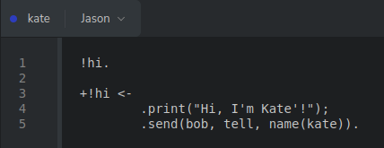
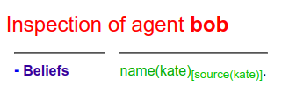



Illocutionary Forces: tell

Slide 49
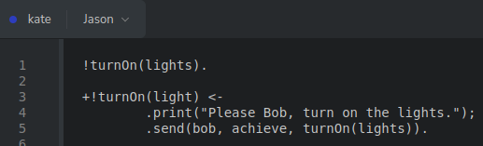
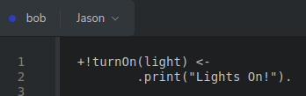
Illocutionary Forces: achieve

Slide 50
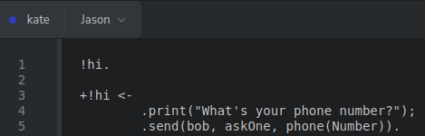
Illocutionary Forces: askOne

Slide 51
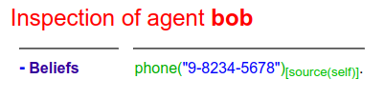
Illocutionary Forces: askOne

Slide 52
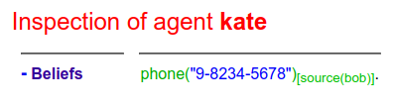
Illocutionary Forces: askOne

Slide 53


Example: Chief and Glutton
https://github.com/chon-group/distributedAndEmbeddedAI/blob/main/workshops/sepex/2024/projects/chiefGlutton.chon
Image credits:
https://smurfs.fandom.com/wiki/Chef_Smurf
https://smurfs.fandom.com/pt/wiki/Fominha

Slide 54

TRANSACTIONS
https://github.com/chon-group/Velluscinum/wiki
Notes:
<número>

Slide 55


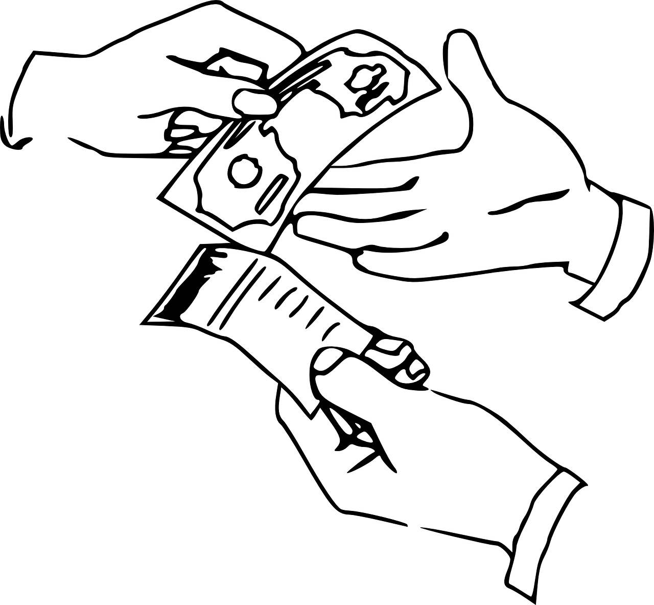




Distributed ledger technology
Using digital assets in the relationships between cognitive agents:
the transfer of funds;
registration of ownership of artifacts;
declaration of promises or agreements.
Allowing the agents to manipulate assets and wallets directly in the DLT.
Velluscinum
MAS - Agents Dimension
Notes:
The swapping of resources — addition or removal — is an interesting feature in the development of Embedded MAS because it adds adaptability at runtime for agents. The system does not need to be turned off, and agents could reason about the availability of resources.
In this way, an autonomous agent can be adaptable, continuing to perform actions to achieve its goals in case of hardware failure, for example.
This work presents a new feature for swapping physical resources at runtime in Embedded MAS.
Therefore, one embedded system that already has physical resources available may have new resources attached to it or removed, and agents will automatically be aware of these new resources or their absence.
<número>

Slide 56
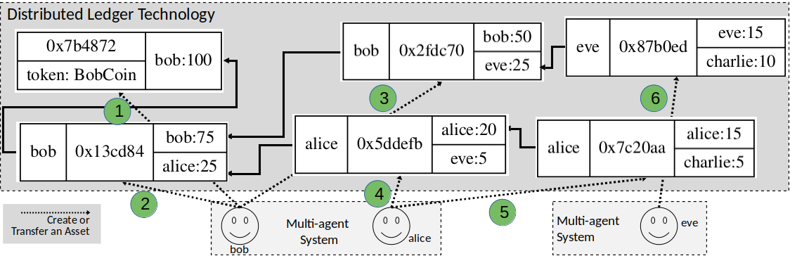
Divisible asset such as cryptocurrency

Slide 57
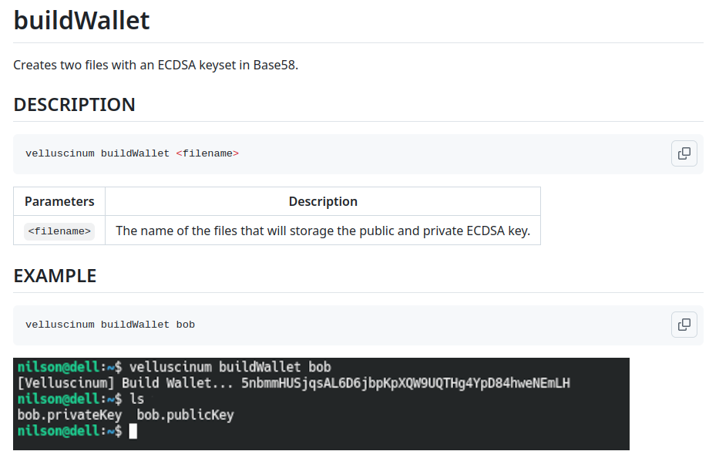
buildWallet-CLI

Slide 58
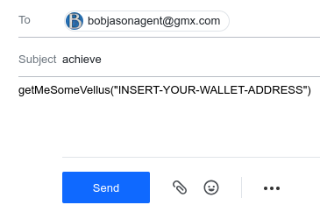
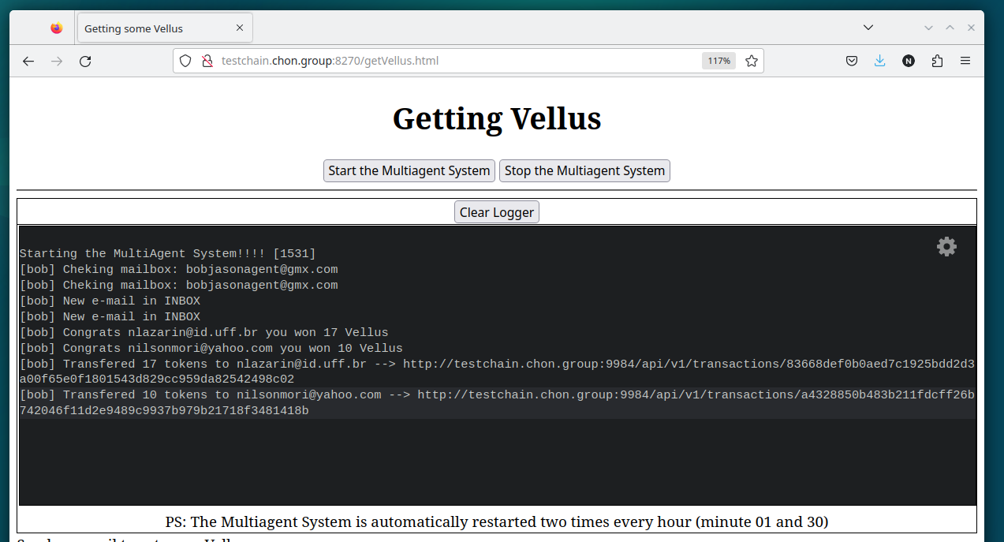
Getting some Vellus
http://testchain.chon.group:8270/getVellus.html

Slide 59

https://github.com/chon-group/distributedAndEmbeddedAI/blob/main/workshops/sepex/2024/projects/chiefGlutonVellus.chon
Image credits:
https://smurfs.fandom.com/wiki/Chef_Smurf
https://smurfs.fandom.com/pt/wiki/Fominha
https://smurfs.fandom.com/pt-br/wiki/%C3%81rvore_de_Dinheiro

Slide 60

Collaborative MultiAgent System
MAS
MAS
MAS
MAS
https://github.com/chon-group/Hermes
Notes:
<número>

Slide 61

Hermes Agents: Server Communication
Public Server: skynet.chon.group - UDP Port: 5500
C
C
MAS A
ContextNet
(IoT middleware)
MAS B
Notes:
<número>

Slide 62
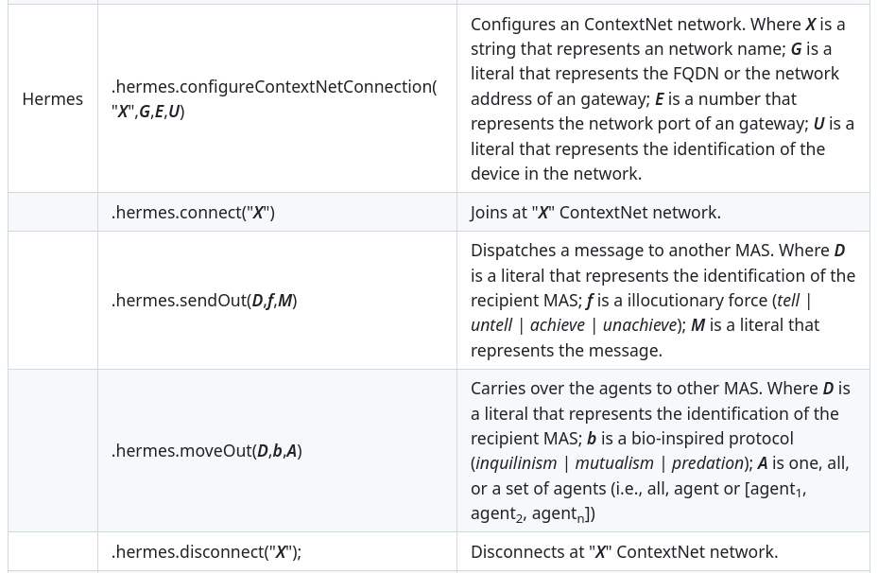
Hermes Agents: Internal Actions
Notes:
<número>

Slide 63

Hello SkyNet
Notes:
<número>

Slide 64

Hello SkyNet
Notes:
<número>

Slide 65

Hello SkyNet
Notes:
<número>

Slide 66

Example: MAS Communication
MAS 1
MAS 2
https://github.com/chon-group/distributedAndEmbeddedAI/blob/main/workshops/sepex/2024/projects/communicatorAGENT.chon
Notes:
<número>

Slide 67
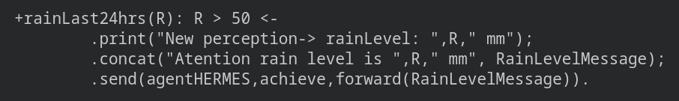
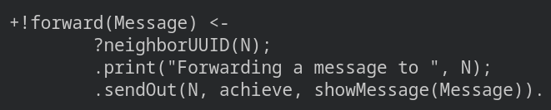
Example: MAS 1
Notes:
<número>

Slide 68
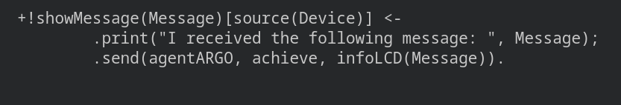
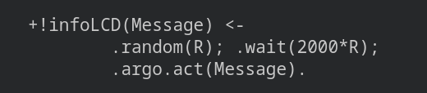
Example: MAS 2
Notes:
<número>

Slide 69
Simple Exercise
Adjust to:
  turn on the green LED in MAS 2 if the rain intensity less than 50mm in MAS 1;
  turn on the yellow LED in MAS 2 if the rain intensity exceeds 50mm in MAS 1;
  turn on the red LED in MAS 2 if the the rain intensity exceeds 80mm in MAS 1;
Notes:
<número>

Slide 70
OTHER
TOOLS
Notes:
<número>

Slide 71


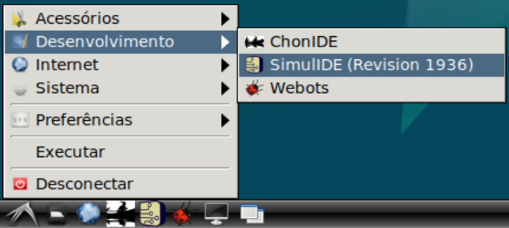
by Chon Group
How to install? https://github.com/chon-group/dpkg-simulide

Slide 72
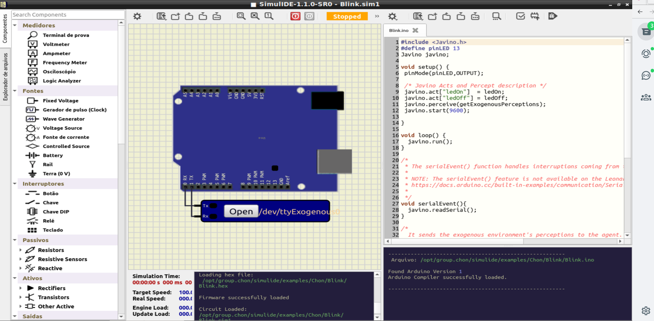
SimulIDE
1
2
3

Slide 73
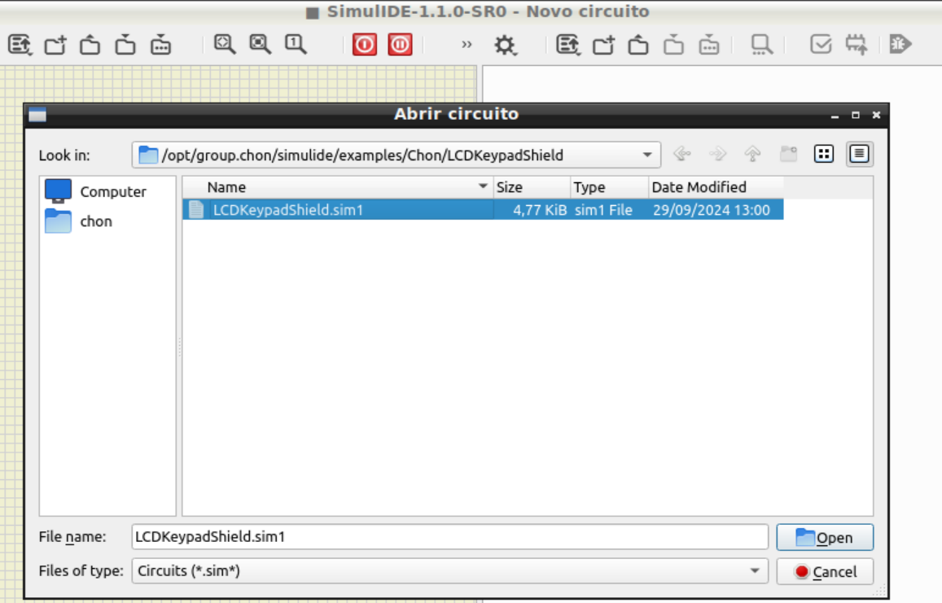
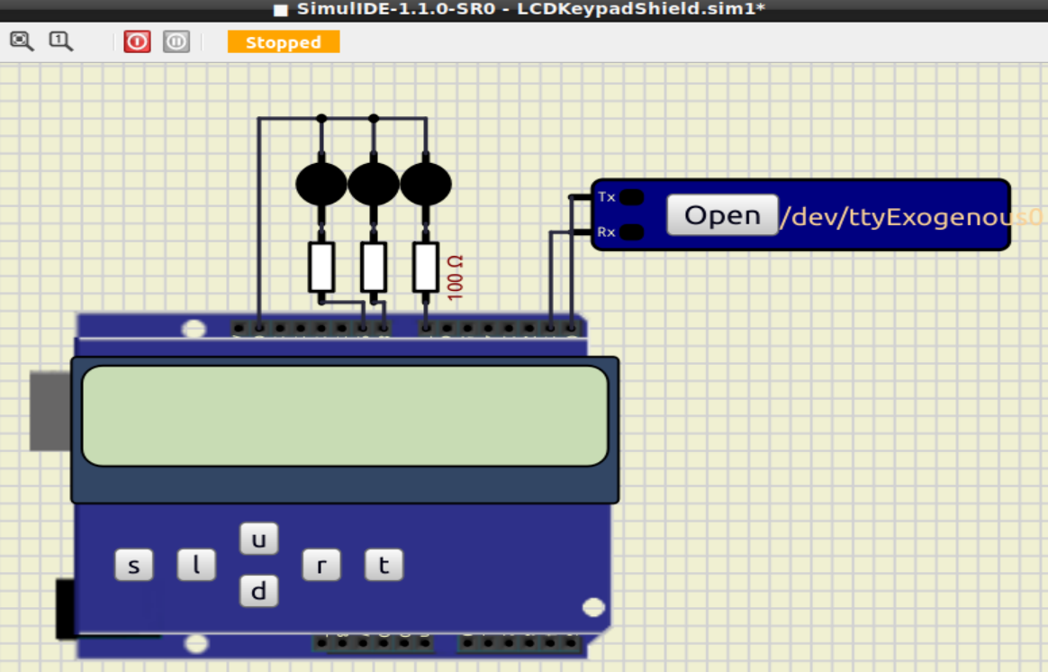
SimulIDE
1
5
2
4
3

Slide 74
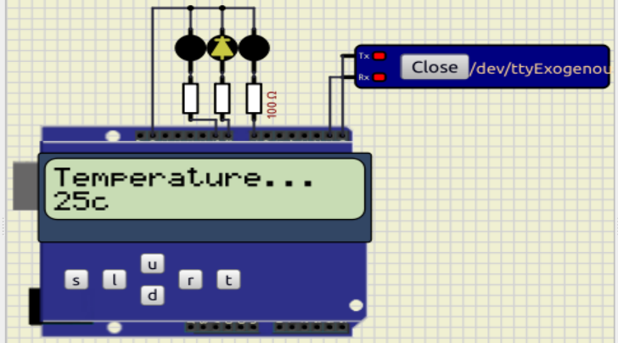
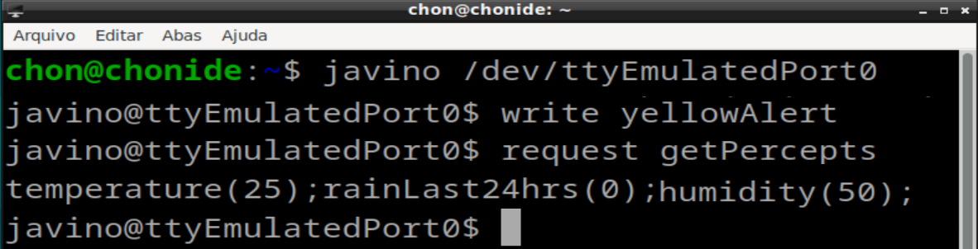
SimulIDE

Slide 75

Acknowledgements
THANK YOU!
Notes:
<número>

