Slide 1



Introduction to Distributed and Embedded Multi-agent Systems
Carlos Eduardo Pantoja¹
Nilson Mori Lazarin^{1,2}
1. Centro Federal de Educação Tecnológica (CEFET/RJ) - 2. Universidade Federal Fluminense (UFF), Brasil
Março, 2024

Slide 2

GOALS AND PLANS
Notes:
<número>

Slide 3
Jason Framework: Goals
Em Jason, os goals (objetivos) representam
os estados do mundo em que o agente deseja atingir.
Notes:
<número>

Slide 4
Jason Framework: Goals
Em Jason, os goals (objetivos) representam
os estados do mundo em que o agente deseja atingir.
realização (!)
É um objetivo para atingir determinado estado desejado pelo agente.
Notes:
<número>

Slide 5
Jason Framework: Goals
Em Jason, os goals (objetivos) representam
os estados do mundo em que o agente deseja atingir.
realização (!)
É um objetivo para atingir determinado estado desejado pelo agente.
teste (?)
É um objetivo que tem a finalidade de resgatar informações da base de crenças do agente.
Notes:
<número>

Slide 6
Goals: Format
{!|?}event [source(type)]
Notes:
<número>

Slide 7
Goals: Format
{!|?}event [source(type)]
the goal
type
Notes:
<número>

Slide 8
Goals: Format
{!|?}event [source(type)]
a predicate from logic.
Notes:
<número>

Slide 9
Goals: Format
{!|?}event [source(type)]
the source of the belief.
Notes:
<número>

Slide 10
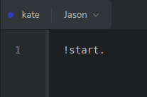
Goals: Initial Goal
Notes:
<número>

Slide 11
Goals: Initial Goal
every goal must start with an exclamation point.
Notes:
<número>

Slide 12
Goals: Initial Goal
every goal’s predicate must start with a lowercase letter.
Notes:
<número>

Slide 13
Goals: Initial Goal
and it must end with a period.
Notes:
<número>

Slide 14
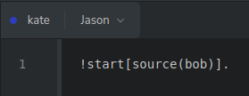
Goals: Initial Goal with a Source
Notes:
<número>

Slide 15
Goals: Initial Goal with a Source
one can define a source.
Notes:
<número>

Slide 16

Goals: Initial Goal with Predicate
Notes:
<número>

Slide 17
Goals: Initial Goal with Predicate
predicate(int)
Notes:
<número>

Slide 18
Goals: Initial Goal with Predicate
predicate(value)
Notes:
<número>

Slide 19
Goals: Initial Goal with Predicate
predicate(value)
predicate
Notes:
<número>

Slide 20
Goals: Initial Goal with Predicate
predicate(value)
predicate
int, float, String, etc.
Notes:
<número>

Slide 21
Goals: Format
predicate(predicate)
Notes:
<número>

Slide 22
Goals: Format
predicate(predicate)
Notes:
<número>

Slide 23
Goals: Format
predicate(predicate(predicate))
Notes:
<número>

Slide 24
Goals: Format
predicate(predicate(predicate))
Notes:
<número>

Slide 25
Goals: Format
predicate(predicate(predicate(...)))
Notes:
<número>

Slide 26
Logic-Based Programming
term
Notes:
<número>

Slide 27
Logic-Based Programming
term
Every construction in Jason is a term.
Notes:
<número>

Slide 28
Logic-Based Programming
term
structure
Notes:
<número>

Slide 29
Logic-Based Programming
term
it represents complex data followed by a number of terms.
structure
Notes:
<número>

Slide 30

Logic-Based Programming
term
it represents complex data followed by a number of terms.
structure
name(kate,18)
Notes:
<número>

Slide 31
Logic-Based Programming
term
structure
atom
Notes:
<número>

Slide 32
Logic-Based Programming
term
structure
any symbol starting with a lowercase letter.
atom
Notes:
<número>

Slide 33
Logic-Based Programming
term
sunny
structure
any symbol starting with a lowercase letter.
atom
Notes:
<número>

Slide 34
Logic-Based Programming
term
structure
atom
list
Notes:
<número>

Slide 35
Logic-Based Programming
term
structure
atom
list
a list of atoms or values.
Notes:
<número>

Slide 36
Logic-Based Programming
term
[kate, bob, alice]
structure
atom
list
a list of atoms or values.
Notes:
<número>

Slide 37
Logic-Based Programming
term
constant
structure
atom
list
Notes:
<número>

Slide 38
Logic-Based Programming
values.
term
constant
structure
atom
list
Notes:
<número>

Slide 39
Logic-Based Programming
values.
term
constant
structure
number
atom
list
Notes:
<número>

Slide 40
Logic-Based Programming
values.
term
constant
structure
number
string
atom
list
Notes:
<número>

Slide 41
Logic-Based Programming
values.
term
constant
structure
number
string
atom
list
Notes:
<número>

Slide 42
Logic-Based Programming
employer(kate, 3582, “kate@kate.com”, full(40))
term
constant
structure
number
string
atom
list
Notes:
<número>

Slide 43
Jason Framework: Plans Format
triggering_event : context <- body.
Notes:
<número>

Slide 44
Jason Framework: Plans Format
triggering_event : context <- body.
triggering Event
    Um agente pode ter diversos objetivos. Os planos são ativados baseados nos eventos que podem ser ativados em determinado momento.
Notes:
<número>

Slide 45
Jason Framework: Plans Format
triggering_event : context <- body.
triggering Event
    Um agente pode ter diversos objetivos. Os planos são ativados baseados nos eventos que podem ser ativados em determinado momento.
context
    São as condições para a ativação de um plano dentro vários eventos.
Notes:
<número>

Slide 46
Jason Framework: Plans Format
triggering_event : context <- body.
triggering Event
    Um agente pode ter diversos objetivos. Os planos são ativados baseados nos eventos que podem ser ativados em determinado momento.
context
    São as condições para a ativação de um plano dentro vários eventos.
body.
    É o corpo do plano. Uma sequência de ações a ser executada pelo agente.
Notes:
<número>

Slide 47
Plan: Format
{+|-}{!|?}event [source(type)]: context ←
action 1;
action 2;
action n.
Notes:
<número>

Slide 48
Plan: Format
{+|-}{!|?}event [source(type)]: context ←
action 1;
action 2;
action n.
The change
type.
Notes:
<número>

Slide 49
Plan: Format
{+|-}{!|?}event [source(type)]: context ←
action 1;
action 2;
action n.
The type of the goal.
Notes:
<número>

Slide 50
Plan: Format
{+|-}{!|?}event [source(type)]: context ←
action 1;
action 2;
action n.
The triggering event.
Notes:
<número>

Slide 51
Plan: Format
{+|-}{!|?}event [source(type)]: context ←
action 1;
action 2;
action n.
the source of the plan.
Notes:
<número>

Slide 52
Plan: Format
{+|-}{!|?}event [source(type)]: context ←
action 1;
action 2;
action n.
the beginning of the conditions.
Notes:
<número>

Slide 53
Plan: Format
{+|-}{!|?}event [source(type)]: context ←
action 1;
action 2;
action n.
the beginning of the conditions.
It is optional if there are no condintions.
Notes:
<número>

Slide 54
Plan: Format
{+|-}{!|?}event [source(type)]: context ←
action 1;
action 2;
action n.
The activation conditions.
Notes:
<número>

Slide 55
Plan: Format
{+|-}{!|?}event [source(type)]: context ←
action 1;
action 2;
action n.
The activation conditions.
It is not mandatory.
Notes:
<número>

Slide 56
Plan: Format
{+|-}{!|?}event [source(type)]: context ←
action 1;
action 2;
action n.
the beginning of the body.
Notes:
<número>

Slide 57
Plan: Format
{+|-}{!|?}event [source(type)]: context ←
action 1;
action 2;
action n.
the actions of the body.
Notes:
<número>

Slide 58
Plan: Format
{+|-}{!|?}event [source(type)]: context ←
action 1;
action 2;
action n.
the actions of the body.
Separated by semi-colon.
Notes:
<número>

Slide 59
Plan: Format
{+|-}{!|?}event [source(type)]: context ←
action 1;
action 2;
action n.
the end of the plan.
Notes:
<número>

Slide 60
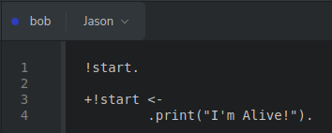
Plan: Hello World
Notes:
<número>

Slide 61
Plan: Hello World
An initial goal named start.
Notes:
<número>

Slide 62
Plan: Hello World
An achievement plan without triggering event named start.
Notes:
<número>

Slide 63
Plan: Hello World
The body of the plan.
Notes:
<número>

Slide 64
Plan: Hello World
An action that prints in the agent tracer (console).
Notes:
<número>

Slide 65
Plan: Hello World
Notes:
<número>

Slide 66

Plan: Hello World
Notes:
<número>

Slide 67
Plan: Types
Achievement Goal
    São ativados quando um plano é transformado de um desejo para uma intenção na mente do agente.
Notes:
<número>

Slide 68
Plan: Types
Achievement Goal
    São ativados quando um plano é transformado de um desejo para uma intenção na mente do agente.
Test Goal
    São objetivos que recuperam informações da base de crenças.
Notes:
<número>

Slide 69
Plan: Types
Achievement Goal
    São ativados quando um plano é transformado de um desejo para uma intenção na mente do agente.
Test Goal
    São objetivos que recuperam informações da base de crenças.
Belief Goal
    São planos ativados quando o agente adiciona ou remove uma crença da sua base de crenças.
Notes:
<número>

Slide 70
Plans: Achievement Goal
{+|-}!event[source(type)]: context ←
action 1;
action 2;
action n.
Notes:
<número>

Slide 71
Plans: Achievement Goal
{+|-}!event[source(type)]: context ←
action 1;
action 2;
action n.
defines if it is an addition (+) or a deletion (-) plan.
Notes:
<número>

Slide 72
Plans: Achievement Goal
specifies the achievement plan
{+|-}!event[source(type)]: context ←
action 1;
action 2;
action n.
Notes:
<número>

Slide 73
Plans: Addition Achievement Goal
+!event[source(type)]:
context ←
action 1;
action 2;
action n.
Notes:
<número>

Slide 74
Plans: Addition Achievement Goal
+!event[source(type)]:
context ←
action 1;
action 2;
action n.
defines an addition plan.
Notes:
<número>

Slide 75
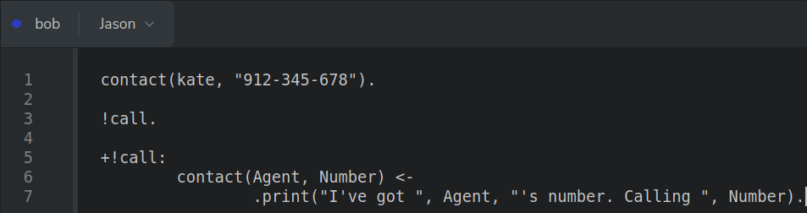
Addition Achievement Goal: Predicate
Notes:
<número>

Slide 76
Addition Achievement Goal: Predicate
A predicate as a goal...
Notes:
<número>

Slide 77
Addition Achievement Goal: Predicate
… which activates a plan with the same name...
Notes:
<número>

Slide 78
Addition Achievement Goal: Predicate
… if the context is satisfied.
Notes:
<número>

Slide 79
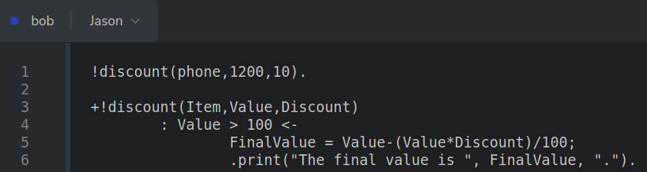
Addition Achievement Goal: One Plan
Notes:
<número>

Slide 80
Addition Achievement Goal: One Plan
An initial goal with predicate and values.
Notes:
<número>

Slide 81
Addition Achievement Goal: One Plan
It activates this addition achievement goal...
Notes:
<número>

Slide 82
Addition Achievement Goal: One Plan
… if the context is satisfied.
Notes:
<número>

Slide 83
Addition Achievement Goal: One Plan
Then, the actions run.
Notes:
<número>

Slide 84
Addition Achievement Goal: One Plan
Notes:
<número>

Slide 85

Addition Achievement Goal: One Plan
Notes:
<número>

Slide 86
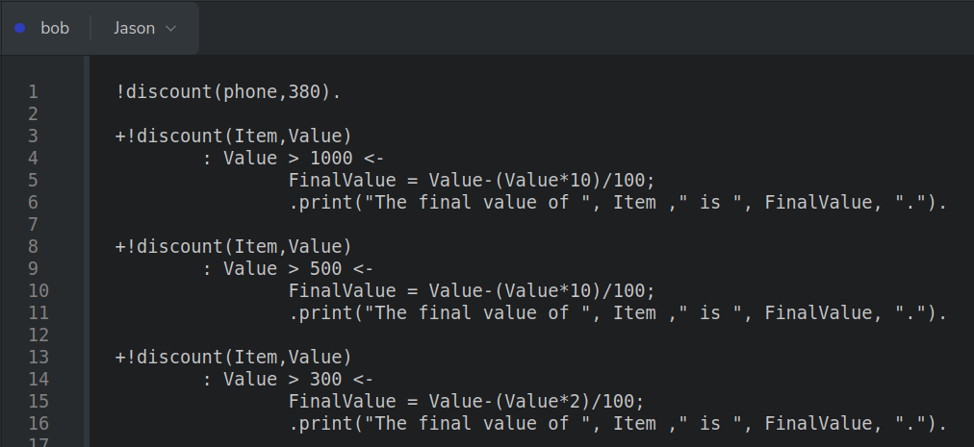
Addition Achievement Goal: More Than One Plan
Notes:
<número>

Slide 87
Addition Achievement Goal: More Than One Plan
The goal
pursued.
Notes:
<número>

Slide 88
Addition Achievement Goal: More Than One Plan
The possible plans.
Notes:
<número>

Slide 89
Addition Achievement Goal: More Than One Plan
Notes:
<número>

Slide 90
Addition Achievement Goal: More Than One Plan
The activated plan.
Notes:
<número>

Slide 91
Addition Achievement Goal: More Than One Plan
Notes:
<número>

Slide 92

Addition Achievement Goal: More Than One Plan
Notes:
<número>

Slide 93
Addition Achievement Goal: More Than One Plan
When there are more plans with the same event name, the agent will try them
one by one...
Notes:
<número>

Slide 94
Addition Achievement Goal: More Than One Plan
+!event[source(type)]: context ← (…).
+!event[source(type)]: context ← (…).
+!event[source(type)]: context ← (…).
.
.
.
+!event[source(type)]: context ← (…).
Notes:
<número>

Slide 95
Addition Achievement Goal: More Than One Plan
+!event[source(type)]: context ← (…).
+!event[source(type)]: context ← (…).
+!event[source(type)]: context ← (…).
.
.
.
+!event[source(type)]: context ← (…).
Notes:
<número>

Slide 96
Addition Achievement Goal: More Than One Plan
+!event[source(type)]: context ← (…).
+!event[source(type)]: context ← (…).
+!event[source(type)]: context ← (…).
.
.
.
+!event[source(type)]: context ← (…).
Notes:
<número>

Slide 97
Addition Achievement Goal: More Than One Plan
+!event[source(type)]: context ← (…).
+!event[source(type)]: context ← (…).
+!event[source(type)]: context ← (…).
.
.
.
+!event[source(type)]: context ← (…).
Notes:
<número>

Slide 98
Addition Achievement Goal: More Than One Plan
… until it finds one that satisfies the context.
Notes:
<número>

Slide 99
Addition Achievement Goal: More Than One Plan
+!event[source(type)]: context ← (…).
+!event[source(type)]: context ← (…).
+!event[source(type)]: context ← (…).
.
.
.
+!event[source(type)]: context ← (…).
Notes:
<número>

Slide 100
Addition Achievement Goal: More Than One Plan
When there are two or more plans that could be activated at the same time...
Notes:
<número>

Slide 101
Addition Achievement Goal: More Than One Plan
+!event[source(type)]: context ← (…).
+!event[source(type)]: context ← (…).
+!event[source(type)]: context ← (…).
.
.
.
+!event[source(type)]: context ← (…).
Notes:
<número>

Slide 102
Addition Achievement Goal: More Than One Plan
+!event[source(type)]: context ← (…).
+!event[source(type)]: context ← (…).
+!event[source(type)]: context ← (…).
.
.
.
+!event[source(type)]: context ← (…).
Notes:
<número>

Slide 103
Addition Achievement Goal: More Than One Plan
… it chooses the first one that fits the context.
Notes:
<número>

Slide 104
Addition Achievement Goal: More Than One Plan
+!event[source(type)]: context ← (…).
+!event[source(type)]: context ← (…).
+!event[source(type)]: context ← (…).
.
.
.
+!event[source(type)]: context ← (…).
Notes:
<número>

Slide 105
Addition Achievement Goal: More Than One Plan
However, when no one is activated, the agent finds a goal for which
no relevant plan
is available.
Notes:
<número>

Slide 106
Plans: Deletion Achievement Goal
-!event[source(type)]:
context ←
action 1;
action 2;
action n.
Notes:
<número>

Slide 107
Plans: Deletion Achievement Goal
-!event[source(type)]:
context ←
action 1;
action 2;
action n.
defines a deletion plan.
Notes:
<número>

Slide 108
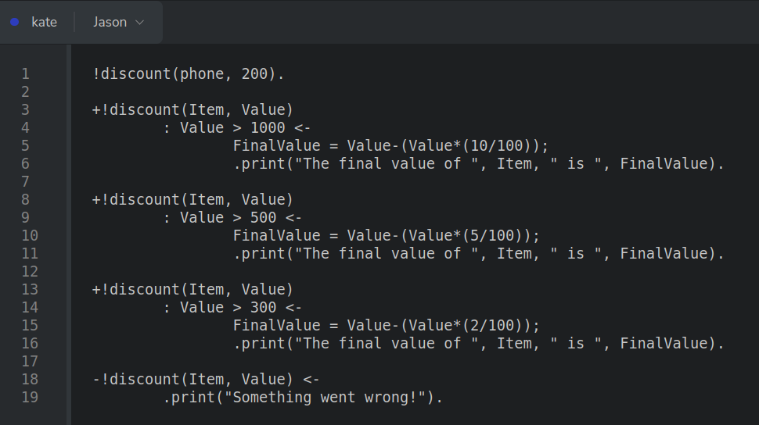
Plans: Deletion Achievement Goal
Notes:
<número>

Slide 109
Plans: Deletion Achievement Goal
By using these values...
Notes:
<número>

Slide 110
Plans: Deletion Achievement Goal
… none of the available plans activate.
Notes:
<número>

Slide 111
Plans: Deletion Achievement Goal
Then, a contingency plan activates.
Notes:
<número>

Slide 112
Plans: Deletion Achievement Goal
Notes:
<número>

Slide 113

Plans: Deletion Achievement Goal
Notes:
<número>

Slide 114
Plans: Deletion Achievement Goal
In this case, another addition achievement plan can cover the
missing context.
Notes:
<número>

Slide 115
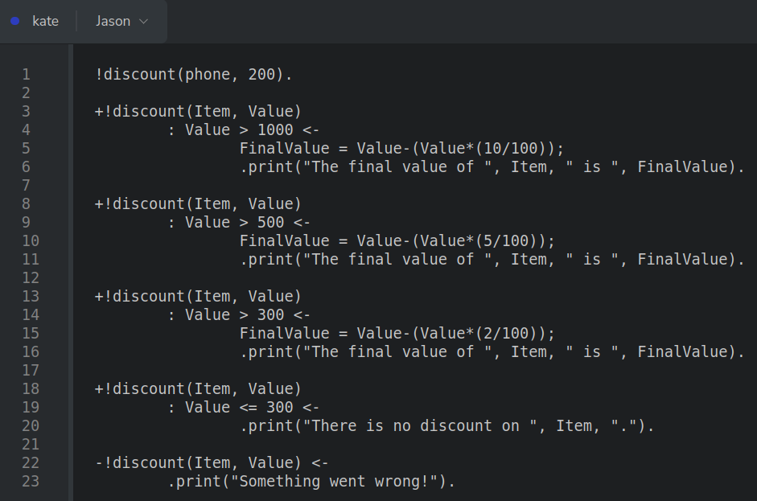
Plans: Deletion Achievement Goal
Notes:
<número>

Slide 116
Plans: Deletion Achievement Goal
So, this plan activates.
Notes:
<número>

Slide 117
Plans: Deletion Achievement Goal
It only activates if the activated plan fails.
Notes:
<número>

Slide 118
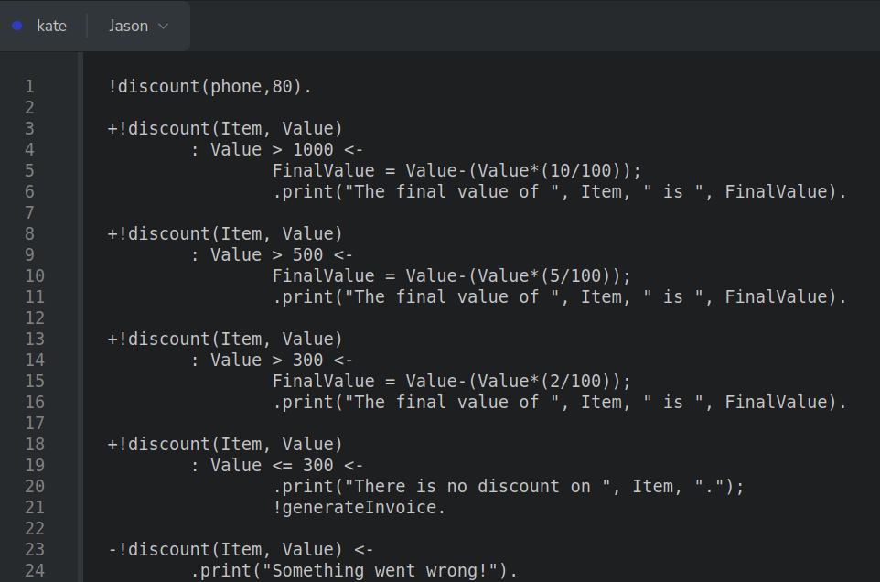
Plans: Deletion Achievement Goal
Notes:
<número>

Slide 119
Plans: Deletion Achievement Goal
The agent tries to commit with generateInvoice, but it does not have a relevant plan.
Notes:
<número>

Slide 120
Plans: Deletion Achievement Goal
As the previous plan fails, the contingency plan is activated.
Notes:
<número>

Slide 121
Plans: Deletion Achievement Goal
Deletion plans can also have a context.
Notes:
<número>

Slide 122
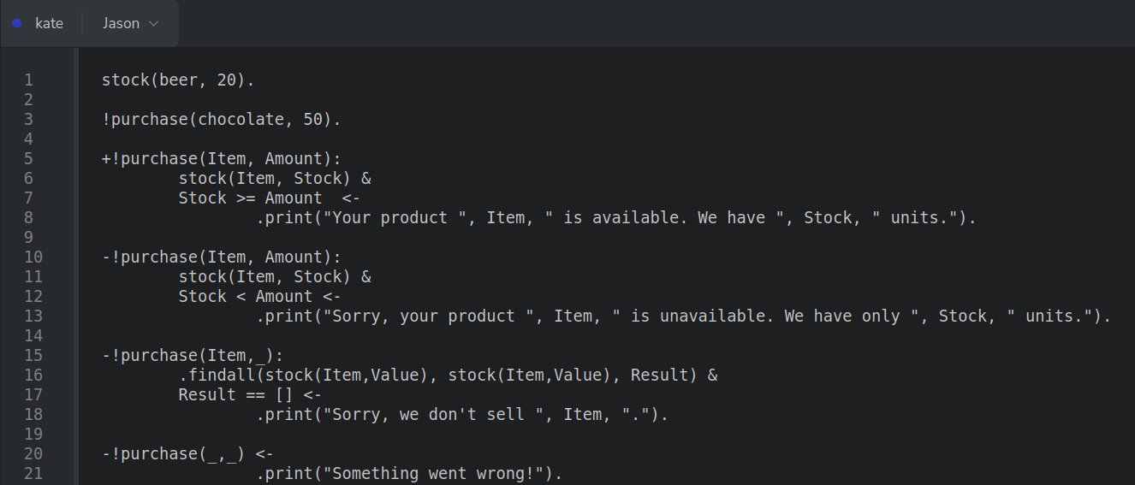
Plans: Deletion Achievement Goal
Notes:
<número>

Slide 123
Plans: Deletion Achievement Goal
Deletion
plans with context...
Notes:
<número>

Slide 124
Plans: Deletion Achievement Goal
… and one without context.
Notes:
<número>

Slide 125
Plans: Deletion Achievement Goal
+!event[source(type)]: context ← (…).
Notes:
<número>

Slide 126
Plans: Deletion Achievement Goal
+!event[source(type)]: context ← (…).
+!event[source(type)]: context ← (…).
Notes:
<número>

Slide 127
Plans: Deletion Achievement Goal
+!event[source(type)]: context ← (…).
+!event[source(type)]: context ← (…).
.
.
.
+!event[source(type)]: context ← (…).
Notes:
<número>

Slide 128
Plans: Deletion Achievement Goal
+!event[source(type)]: context ← (…).
+!event[source(type)]: context ← (…).
.
.
.
+!event[source(type)]: context ← (…).
-!event[source(type)]: context ← (…).
Notes:
<número>

Slide 129
Plans: Deletion Achievement Goal
+!event[source(type)]: context ← (…).
+!event[source(type)]: context ← (…).
.
.
.
+!event[source(type)]: context ← (…).
-!event[source(type)]: context ← (…).
-!event[source(type)]: context ← (…).
Notes:
<número>

Slide 130
Plans: Deletion Achievement Goal
+!event[source(type)]: context ← (…).
+!event[source(type)]: context ← (…).
.
.
.
+!event[source(type)]: context ← (…).
-!event[source(type)]: context ← (…).
-!event[source(type)]: context ← (…).
.
.
.
-!event[source(type)]: context ← (…).
Notes:
<número>

Slide 131
Plans: Test Goal
{+|-}?event[source(type)]: context ←
action 1;
action 2;
action n.
Notes:
<número>

Slide 132
Plans: Test Goal
{+|-}?event[source(type)]: context ←
action 1;
action 2;
action n.
defines if it is an addition (+) or a deletion (-) plan.
Notes:
<número>

Slide 133
Plans: Test Goal
specifies the test goal plan.
{+|-}?event[source(type)]: context ←
action 1;
action 2;
action n.
Notes:
<número>

Slide 134
Plans: Addition Test Goal
+?event[source(type)]:
context ←
action 1;
action 2;
action n.
Notes:
<número>

Slide 135
Plans: Addition Test Goal
+?event[source(type)]:
context ←
action 1;
action 2;
action n.
defines an addition plan.
Notes:
<número>

Slide 136
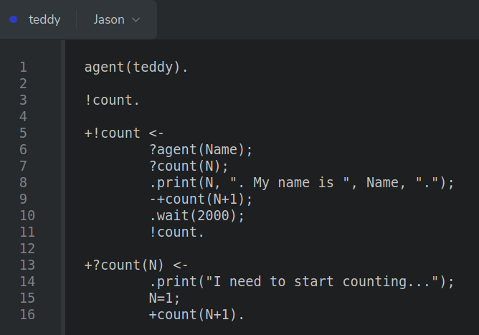
Plans: Addition Test Goal
Notes:
<número>

Slide 137
Plans: Addition Test Goal
Notes:
<número>

Slide 138
Plans: Addition Test Goal
Notes:
<número>

Slide 139
Plans: Addition Test Goal
Notes:
<número>

Slide 140
Plans: Addition Test Goal
Notes:
<número>

Slide 141
Plans: Deletion Test Goal
-?event[source(type)]:
context ←
action 1;
action 2;
action n.
Notes:
<número>

Slide 142
Plans: Deletion Test Goal
-?event[source(type)]:
context ←
action 1;
action 2;
action n.
defines a deletion plan.
Notes:
<número>

Slide 143
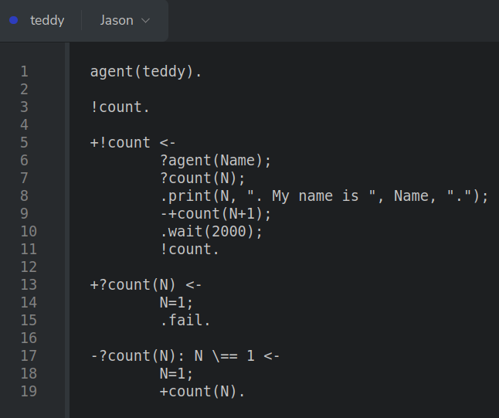
Plans: Deletion Test Goal
Notes:
<número>

Slide 144
Plans: Belief
{+|-}event[source(type)]: context ←
action 1;
action 2;
action n.
Notes:
<número>

Slide 145
Plans: Belief
{+|-}event[source(type)]: context ←
action 1;
action 2;
action n.
defines if it is an addition (+) or a deletion (-) plan.
Notes:
<número>

Slide 146
Plans: Additi
+event[source(type)]:
context ←
action 1;
action 2;
action n.
Notes:
<número>

Slide 147
Plans: Addition Belief Goal
+event[source(type)]:
context ←
action 1;
action 2;
action n.
defines an addition plan.
Notes:
<número>

Slide 148
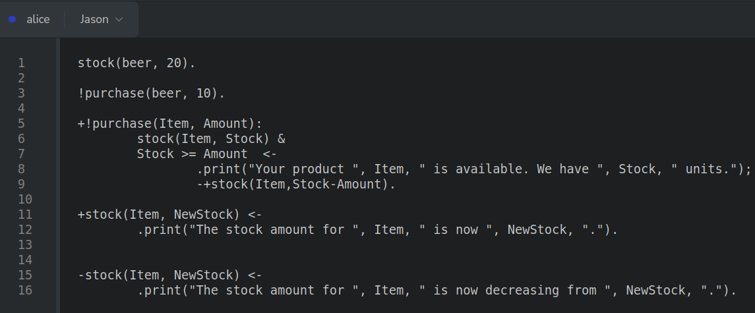
Plans: Addition Belief Goal
Notes:
<número>

Slide 149
Plans: Addition Belief Goal
Notes:
<número>

Slide 150
Plans: Addition Belief Goal
Notes:
<número>

Slide 151
Plans: Deleti
-event[source(type)]:
context ←
action 1;
action 2;
action n.
Notes:
<número>

Slide 152
Plans: Deletion Belief Goal
-event[source(type)]:
context ←
action 1;
action 2;
action n.
defines a deletion plan.
Notes:
<número>

Slide 153
Plans: Deletion Belief Goal
Notes:
<número>

Slide 154
Plans: Deletion Belief Goal
Notes:
<número>

Slide 155
Plans: Deletion Belief Goal
Notes:
<número>

Slide 156
Agradecimentos
OBRIGADO!
pantoja@cefet-rj.br
nilson.lazarin@cefet-rj.br
Notes:
<número>

