Slide 1



Introduction to Distributed and Embedded Multi-agent Systems
Carlos Eduardo Pantoja¹
Nilson Mori Lazarin^{1,2}
1. Centro Federal de Educação Tecnológica (CEFET/RJ) - 2. Universidade Federal Fluminense (UFF), Brasil
02/2024

Slide 2
Jason StdLib
Notes:
<número>

Slide 3
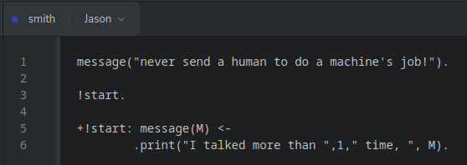
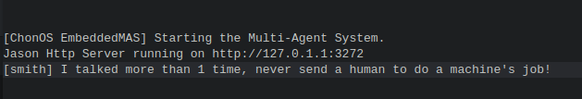
.print(parameters)
used for printing messages to the console where the system is running.
It receives any number of parameters, which can be not only strings but also any AgentSpeak term (including variables).
https://jason-lang.github.io/api/jason/stdlib/print.html

Slide 4
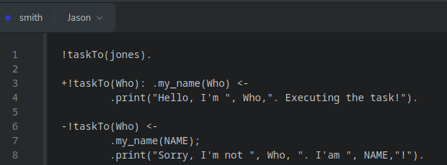

.my_name(atom | VAR)
gets the agent's unique identification in the multi-agent system.
This identification is given by the runtime infrastructure of the system.
https://jason-lang.github.io/api/jason/stdlib/my_name.html

Slide 5
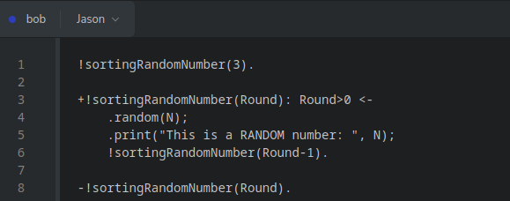

.random(VAR)
unifies VAR with a random number between 0 and 1.
https://jason-lang.github.io/api/jason/stdlib/random.html

Slide 6
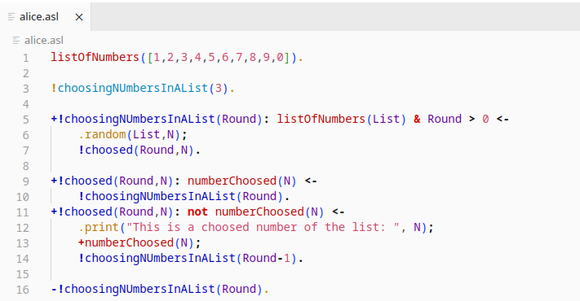

.random([t1,t2, … ,tn],VAR)
unifies VAR with a random value from the list.
https://jason-lang.github.io/api/jason/stdlib/random.html

Slide 7
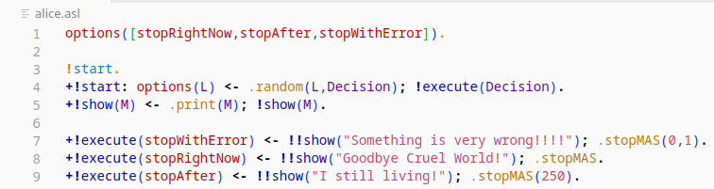
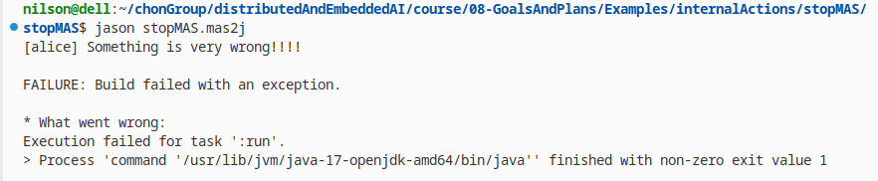
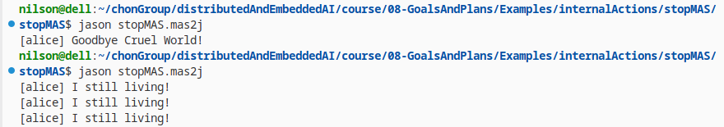
.stopMAS | .stopMAS(Delay) | .stopMAS(Delay,sucess|fail)
aborts the execution of all agents in the multi-agent system.
return 0 in the main function means that the program executed successfully.
return 1 in the main function means that the program does not execute successfully and there is some error.
https://jason-lang.github.io/api/jason/stdlib/stopMAS.html

Slide 8
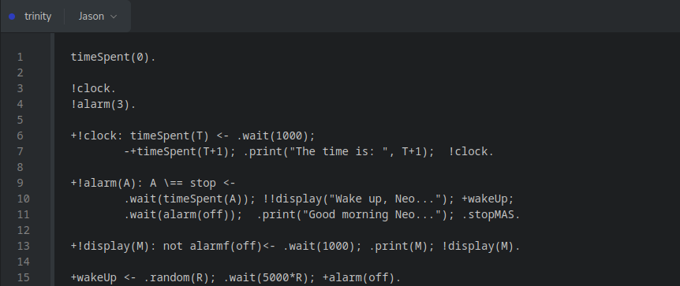
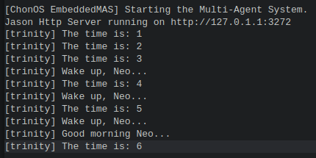
.wait(miliseconds) | .wait(Predicate)
suspend the intention for the time specified by in milliseconds
Suspend the intention until the Predicate is added in the belief base.
https://jason-lang.github.io/api/jason/stdlib/wait.html

Slide 9
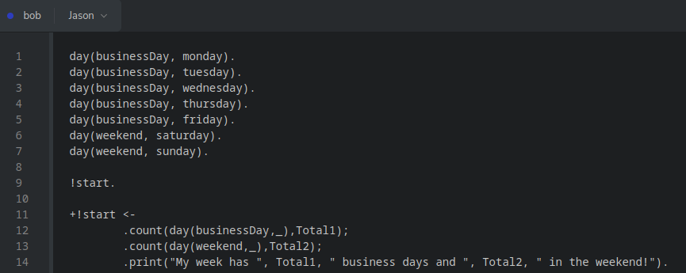

.count(predicate(term,_),Unify)
counts the number of occurrences of a particular belief (pattern) in the agent's belief base.
https://jason-lang.github.io/api/jason/stdlib/count.html

Slide 10
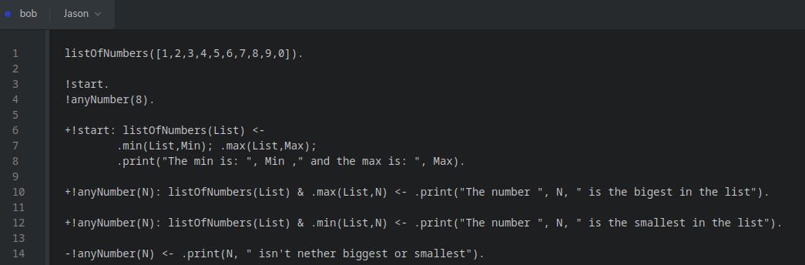

.min(List,Unify) | .max(List,Unify)
gets the maximum value within a list of terms.
https://jason-lang.github.io/api/jason/stdlib/min.html
https://jason-lang.github.io/api/jason/stdlib/max.html

Slide 11

Agradecimentos
OBRIGADO!
pantoja@cefet-rj.br
nilson.lazarin@cefet-rj.br
Notes:
<número>

