Slide 1
第十一章 MySQL
What is MySQL?
Working with MySQL
Getting MySQL
Operations:
  Create a database/tables
  Queries: SELECT/WHERE clause/ORDER BY keyword
  Update tables/Delete information from tables

Slide 2
What is MySQL?
MySQL is developed by a company called MySQL AB.
MySQL: The “My” part comes from the name of its fouder’s child.
As mentioned in the previous set of slides, SQL stands for Structured Query Language.
MySQL is a multi-user SQL DBMS (DataBase Management System)

Slide 3
第十一章 MySQL
What is MySQL?
Working with MySQL
Getting MySQL
Operations:
  Create a database/tables
  Queries: SELECT/WHERE clause/ORDER BY keyword
  Update tables/Delete information from tables

Slide 4
Working with MySQL
In our course, we will use MySQL to perform the operations we talked about previously.
This includes:
  Creating databases that consist of one or more tables.
  Inserting information into tables.
  Building queries by selecting data from tables.

Slide 5
第十一章 MySQL
What is MySQL?
Working with MySQL
Getting MySQL
Operations:
  Create a database/tables
  Queries: SELECT/WHERE clause/ORDER BY keyword
  Update tables/Delete information from tables

Slide 6
Getting MySQL
You can download MySQL for free from this Web site: http://www.mysql.com/downloads/index.html.
Follow the instructions to install.
MySQL can work alone or with other technologies like PHP.
How to use MySQL with PHP will be left to the next set of slides.
The next few slides will handle how to use MySQL Command Line Client for building, populating and querying databases.

Slide 7
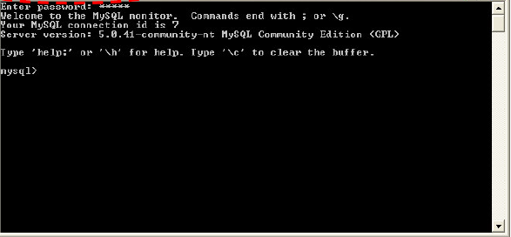
Starting MySQL

Slide 8
第十一章 MySQL
What is MySQL?
Working with MySQL
Getting MySQL
Operations:
  Create a database/tables
  Queries: SELECT/WHERE clause/ORDER BY keyword
  Update tables/Delete information from tables

Slide 9
Database Operations
We will talk about these operations:
  Create a database
  Create tables
  Data types
  Insert information into tables
  Queries: SELECT / WHERE clause / ORDER BY keyword

Slide 10
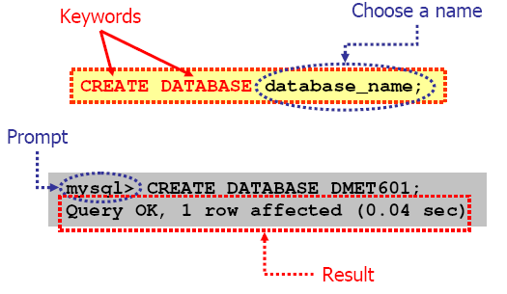
Create a Database

Slide 11
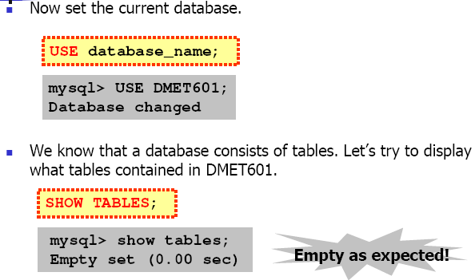
Create a Database

Slide 12
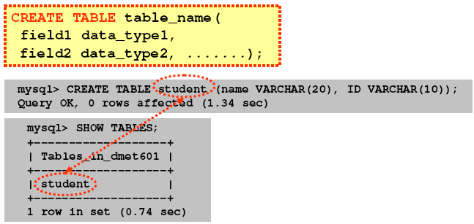
Create Tables

Slide 13
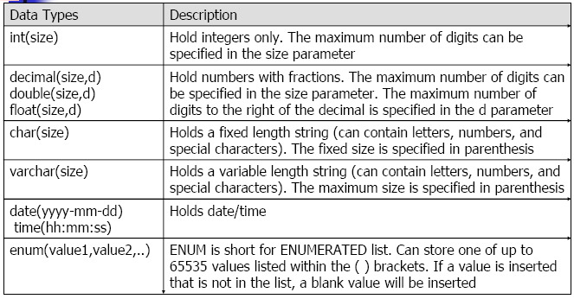
Data Types

Slide 14
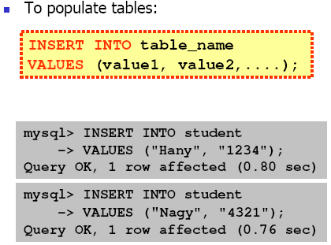
Insert Information into Tables

Slide 15
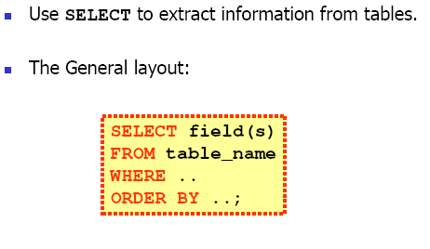
Queries: Select

Slide 16
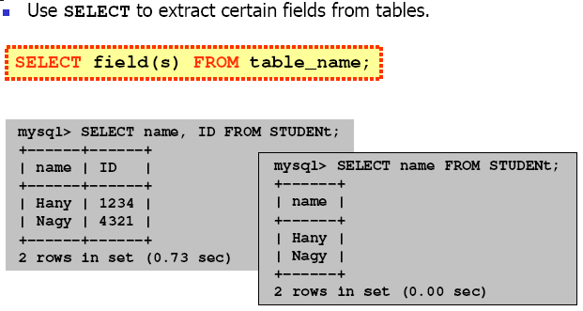
Queries: Select

Slide 17
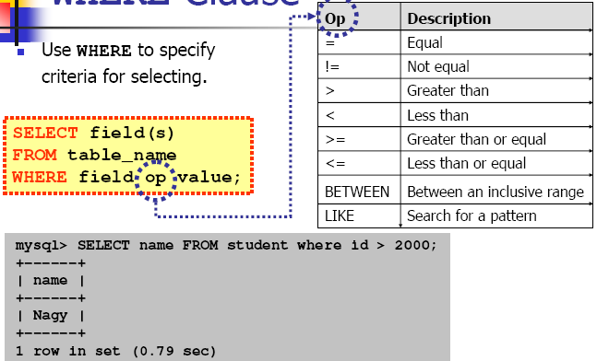
Queries: WHERE Clause

Slide 18
Queries: WHERE Clause

Slide 19
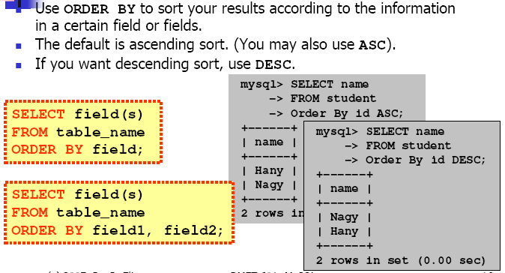
Queries: ORDER BY Keyword

Slide 20
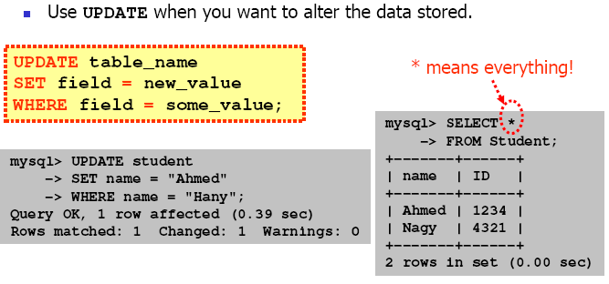
Update Tables

Slide 21
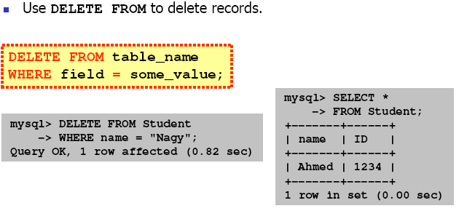
Delete Information from Tables

