Slide 1
OPERATING SYSTEM CONCEPTS
操作系统概念
10.File-System Interface
张 柏 礼
bailey_zhang@sohu.com
东南大学计算机学院

Slide 2
10.File-System Interface
Objectives
  To explain the function of file systems
  To describe the interfaces to file systems
  To discuss file-system design tradeoffs, including access methods, file sharing, file locking, and directory structures
  To explore file-system protection

Slide 3
10.File-System Interface
10.1 File Concept
10.2 Access Methods
10.3 Directory Structure
10.4 File-System Mounting
10.5 File Sharing
10.6 Protection

Slide 4
10.1 File Concept
Main memory is usually too small to accommodate all the data and programs permanently
The computer systems use secondary storage to back up main memory
  Disks, tapes, optical disks, floppy disks, flash
    Those secondary storage devices vary in many aspects

Slide 5
10.1 File Concept
  The OS provides a uniform logical view of information storage
    abstracts from the physical properties of its storage devices to define a logical storage unit——the file
    Files are mapped onto physical devices by the OS
File
  A file is named collection of related information that is recorded on secondary storage
  Commonly, files represent programs (both source and object forms) and data
  Program or data cannot be written to secondary storage unless they are within a file.

Slide 6
10.1 File Concept
  File types (on Content )
    Data file
      numeric、alphabetic、alphanumeric、binary
    Program file
      source programs、Object forms、executable program
  File types (on form )
    Free form
      Such as text files
      The meaning is defined by the file’s creator and user
    Formatted rigidly
      database

Slide 7
10.1 File Concept
File attributes
  Name
    The symbolic file name in human-readable form
  Identifier
    unique tag (number) identifies file within file system
  Type
    needed for systems that support different types
  Location
    pointer to file location on device
  Size
    current file size
  Protection
    controls who can do reading, writing, executing
  Time, date, and user identification
    data for protection, security, and usage monitoring
Information about files are kept in the directory structure, which is maintained on the disk

Slide 8
10.1 File Concept
File operations
  Six basic operations
    Create: to allocate the file space and allocate the directory entry
    Read/Write/Seek: to find the directory entry and keep a read/write pointer or seek to a new position.
    Delete: to find the directory entry and release all file space and erase the directory entry
    Truncate: to erase the contents of a file but keep its attributes except for it’s length (→0, release the file space)

Slide 9
10.1 File Concept
  Other common operations
    Appending
    Renaming
    Get/set the file attributes
  Can be performed by combining the six primitive operations

Slide 10
10.1 File Concept
  Assistant operations
    Open(F) :
      search the directory structure on disk for entry F
        Most of the file operations involve searching the directory for the entry associated with the named file
      copy the directory entry into the open-file table
        The open-file table contain information about all open files
        When a file operation is requested, the file is specified via an index（ descriptor：文件句柄） into this table, so no searching is required
      allocate a file descriptor.
    System call “open( )” is used prior to other operations to avoid the constant search

Slide 11
10.1 File Concept
    Close (F) : copy the directory entry in the open-file table to the directory structure on disk and free the file descriptor
      When the file is no longer being actively used, it is closed by the process, and the OS removes its entry from the open-file table

Slide 12
10.1 File Concept
    The implement of open( ) and close( ) is more complicated in an environment where several different applications open same file at the same time
      A per-process table: tracks all files that a process has open
      A system-wide table: contains process-independent information
        The location of the file on disk、Access dates、File size
      Single user: Per-process file table → secondary storage
      Multiple-users: Per-process file table → system-wide table → secondary storage

Slide 13
10.1 File Concept
    Several pieces of data are needed to manage open files:
      File pointer: pointer to last read/write location, is unique to per process that has opened the file
      File-open count: number of times that file is opened —— to allow removal of data from open-file table when last process closes it
      Disk location of the file: be kept in memory
      Access rights: per-process access mode information

Slide 14
10.1 File Concept
    Open File Locking
      Provided by some operating systems and file systems
      Mediates access to a file
        Shared lock: reader lock
        Exclusive lock: writer lock
      Mandatory or advisory:
        Mandatory – once a process acquires an exclusive lock, any other access is denied
        Advisory – processes can find status of locks and decide what to do
      File Locking Example – Java API

Slide 15
10.1 File Concept
import java.io.*;
import java.nio.channels.*;
public class LockingExample {
public static final boolean EXCLUSIVE = false;
public static final boolean SHARED = true;
public static void main(String arsg[]) throws IOException {
FileLock sharedLock = null;
FileLock exclusiveLock = null;
try {
RandomAccessFile raf = new RandomAccessFile("file.txt", "rw"); // get the channel for the file
FileChannel ch = raf.getChannel();
// this locks the first half of the file - exclusive
exclusiveLock = ch.lock(0, raf.length()/2, EXCLUSIVE);

Slide 16
10.1 File Concept
/** Now modify the data . . . */
// release the lock
exclusiveLock.release();
// this locks the second half of the file - shared
sharedLock = ch.lock(raf.length()/2+1, raf.length(), SHARED);
/** Now read the data . . . */
// release the lock
sharedLock.release();
} catch (java.io.IOException ioe) {
System.err.println(ioe);
}finally {
if (exclusiveLock != null)
exclusiveLock.release();
if (sharedLock != null)
sharedLock.release();
}
}
}

Slide 17
10.1 File Concept
File types
  If an OS recognizes the type of a file, it can then operate on the file in reasonable ways.
  Some common file types (See the next slide)
  The TOPS-20 OS:
    If the user tries to execute an object program whose source file has been modified (or edited) since the object file was produced, the source file will be recompiled automatically.
  The Apple Macintosh OS:
    Each file has a type and also has a creator attribute containing the name of the program that created it.
  The Linux:
    File types are just hints. How to determine a file type depends on the Linux.

Slide 18

10.1 File Concept

Slide 19
10.1 File Concept
File structures
  File types can be used to indicate the internal structure of the file
    .txt, .pdf, .cpp, .exe, .obj
  Certain files must conform to a required structure that is understood by the OS
    E.g. the OS required that an executable file have a specific structure, so that it can determine
      where in memory to load the file
      what the location of the first instruction is
  Some OS extend this idea into a set of system-supported file structures
    E.g. DEC’s VMS
      supports three defined file structures

Slide 20
10.1 File Concept
  The disadvantages of OS supporting multiple file structures
    Need the additional code to support different file structures
      The size of OS is cumbersome
    Every file need to be definable as one of the system-supports file types
      If new applications need new structures that OS don’t support, severe problems may result

Slide 21
10.1 File Concept
  Some OS provide a minimal number of file structure
    UNIX, MS-DOS, etc.
      Executable files
      Other files: each file is a sequence of 8-bit bytes
    Macintosh
      Resource fork
      1）information of interest to the user
      2）allow modification of the data in the resource fork
      3）no need to recompile the source code
      Data fork
      program code or data

Slide 22
10.1 File Concept
Internal file structure
  Disk systems typically have a well defined block size
  All disk I/O is performed in units of one block
  Packing
    Logical records may even vary in length
      E.g. in UNIX the logical record size is 1 byte
    Packing a number of logical records into physical blocks is a common solution
    The packing can be done either by the user’s application program or by the OS

Slide 23
10.1 File Concept
  Internal fragmentation
    Disk space is always allocated in blocks
    Some portion of the last block of each file is generally wasted

Slide 24
10.File-System Interface
10.1 File Concept
10.2 Access Methods
10.3 Directory Structure
10.4 File-System Mounting
10.5 File Sharing
10.6 Protection

Slide 25
10.2 Access Methods
Files access
  Files store information, when it is used, the information must be accessed and read into memory
  The information in the file can be accessed in several ways
    Sequential Access
    Direct Access
    Other access

Slide 26

10.2 Access Methods
Sequential Access
  record in the file are processed in order
read next
write next
reset
  Based on a tape model of a file

Slide 27
10.2 Access Methods
Direct Access
  Records are read and written rapidly in no particular order
  read n
  write/rewrite n
  position to n
  read next
  write next
  n = relative block number
  Based on a disk model of a file, and be allowed to access to any file block

Slide 28

10.2 Access Methods
  Not all OS support both sequential and direct access for files
    To simulate sequential access by direct access is easy
    To simulate direct access by sequential access is NOT easy

Slide 29

10.2 Access Methods
Other Access methods
  These methods generally involve the construction of an index for the file
  To find a record in the file, the index is searched first and use the pointer to access the file directly and to find the desired record

Slide 30
10.2 Access Methods
  To large files, the index file itself may become too large to be kept in memory
    One solution is to create an index for the index file
    A example：IBM---ISAM
      Master index points to disk blocks of a secondary index
      The secondary index blocks point to the actual file blocks
      Indexed Sequential---Access Method from IBM

Slide 31
10.File-System Interface
10.1 File Concept
10.2 Access Methods
10.3 Directory Structure
10.4 File-System Mounting
10.5 File Sharing
10.6 Protection

Slide 32
10.3 Directory Structure
Motivation
  Store millions of files on terabytes of disk
  To manage these data, directories can be used
Storage structure
  File System
    Directories
      Contain information about the files in the file system
      Information: name, location, size, type …
    Files
  A disk can be used for one file system entirely
  or
  A disk can be used for multiple file systems
    Fat32， NTFS，ext2，NFS，SWAP，RAW
  Multiple disk can be for a file system

Slide 33
10.3 Directory Structure
  A disk → partitions / minidisks / slices
    A file system can be created on each part of the disk
    The parts can be combined to form larger structures — Volumes
      For clarity, a chunk of storage that holds a file system as a volume (a virtual disk)
    Volumes can store multiple OS (each OS may contain multiple file systems )

Slide 34
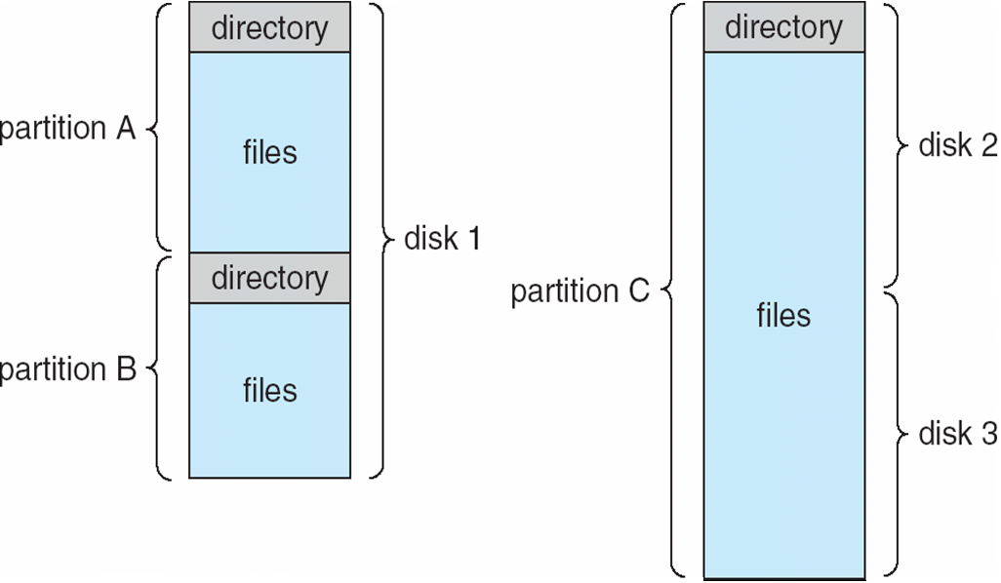
10.3 Directory Structure
    A Typical File-system Organization

Slide 35
10.3 Directory Structure
Both the directory structure and the files reside on disk
Directory
Files
F 1
F 2
F 3
F 4
F n

Slide 36
10.3 Directory Structure
Directory overview
  The directory is used to organize files (and directories)
  The directory can be viewed as a symbol table that translates file names into their directory entries.
  The operations on directories
    Search a file
    Create a file
    Delete a file
    List a directory
    Rename a file
    Traverse the file system

Slide 37
10.3 Directory Structure
  Criteria: Organization methods the Directory
    Efficiency – locating a file quickly
    Naming – convenient to users
      Two users can have same name for different files
      The same file can have several different names
    Grouping – logical grouping of files by properties, (e.g., all Java programs, all games, …)

Slide 38

10.3 Directory Structure
Single-Level Directory
  A single directory for all users
  Naming problem: each file must have an unique name
  Grouping problem: confusion for different users

Slide 39

10.3 Directory Structure
Two-Level Directory
  Separate directory for each user——UFD
  The system’s master file directory (MFD) is indexed by user name, and each entry points to a UFD
  Can have the same file name for different user

Slide 40
10.3 Directory Structure
  Path name
    A user name and a file name defines a path from the root to the leaf
  System directory
    A common directory to contain the system files
  Positive
    Efficient searching
  Negative
    No grouping capability
    Difficult to share file among different users

Slide 41

10.3 Directory Structure
Tree-Structured Directories

Slide 42
10.3 Directory Structure
  Allow users to create their own subdirectories
    Directories for different topic files
      Book pdf, lecture ppt， exercise, examination, experiments
    Directories for different information form files
      Src, dat, bin
  A directory or subdirectory can contain a set of files or subdirectories
    A directory is simply another file, but it is treated in a special way
    One bit in each directory entry defines the entry as
      0: a file
      1: a subdirectory

Slide 43
10.3 Directory Structure
  Current directory (working directory)
    Change the current directory
      cd /spell/mail/prog
      type list
    Creating a new file or Delete a file is done in current directory
      rm <file-name>
    Creating a new subdirectory or Delete a subdirectory is done in current directory
      mkdir <dir-name>
      if in current directory /mail， mkdir count
      Deleting “mail” ⇒ deleting the entire subtree rooted by “mail”

Slide 44
10.3 Directory Structure
mail
prog
copy
prt
exp
count
  Absolute or relative path name
    Absolute: begin at the root
    Relative: from the current directory
  Positive
    Efficient searching
    Grouping Capability
  Negative
    Difficult to share file among different users

Slide 45

10.3 Directory Structure
Acyclic-Graph Directories(无环图目录)
  Tree-structured directory + shared subdirectories or files
    The same files or subdirectories may be in two different directories

Slide 46
10.3 Directory Structure
  Several ways to implement sharing
    1）Created a new directory entry called a link
      Adopted by many of UNIX systems
      A link is effectively a pointer to another file or directory
        A link :An absolute or a relative path name
        Be named indirect pointer
        If the directory entry is marked as a link, the name of real file is included in the link information.
      Is ignored when traversing directory tree to preserve the acyclic structure of the system(维持无环结构)

Slide 47
10.3 Directory Structure
    2）Duplicate all share information in both sharing directories
      Make the original and the copy indistinguishable
      It is different to maintain consistency when a file is modified

Slide 48
10.3 Directory Structure
  The acyclic-graph structure is more flexible than tree structure, but it is more complex. Potential problems:
    To traverse the file system
      A file may have multiple absolute names (aliasing), distinct file names may refer to the same file
      When find a file, or to accumulate statistics on all files, or to copy all files to backup storage，May traverse shared structures more than once

Slide 49
10.3 Directory Structure
    To delete a file
      Remove the file whenever anyone deletes it
        this action may leave dangling pointers to the nonexistent file
        Worse, the remaining file pointers contain actual disk address, and the space is reused for other files，these pointers may point to other files

Slide 50
10.3 Directory Structure
      One solution (for symbolic link):
        If the file entry is deleted,
        Search for its dangling links and remove them（expensive search）
        or
        Leave the links until an attempt is made to use them
        link is treated just as other illegal file name

Slide 51
10.3 Directory Structure
      Another solution
        Preserve the file until all reference to it are deleted
        Need to keep a list of all references to the file
        Variable and large size of the file-reference list
        file-reference list --→reference count

Slide 52
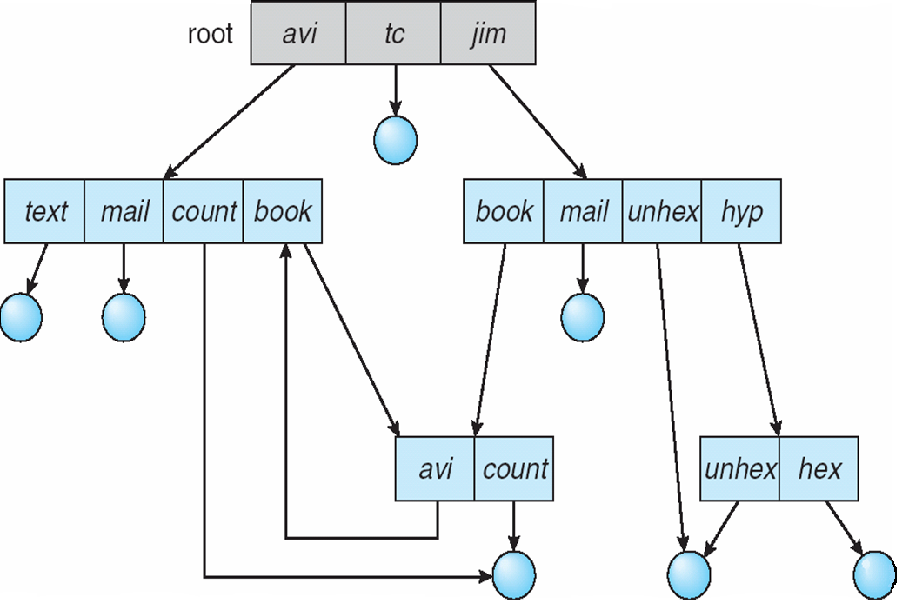
10.3 Directory Structure
General Graph Directory(通用图-有环)
  Add the links to an existing tree-structure directory

Slide 53
10.3 Directory Structure
  Traversing the graph
    need to avoid searching any component twice
    a poorly designed algorithm might result in an infinite loop
    A simpler algorithm is to bypass links during directory traversal
  Deleting a file or directory
    Normally, reference count =0
    Self-reference, need Garbage collection, it is time consuming
  So Acyclic-Graph structure is much easier to use than General graph directory, but
    The difficulty is to avoid cycles as new links are added

Slide 54
10.File-System Interface
10.1 File Concept
10.2 Access Methods
10.3 Directory Structure
10.4 File-System Mounting
10.5 File Sharing
10.6 Protection

Slide 55
10.4 File-System Mounting
Mount
  A file system must be mounted before it can be accessed
  Just as a file must be opened before it is used
Mount point
  A un-mounted file system can be mounted at a mount point
    i.e. Fig. 11-11(b)
  Mount point: the location in the file structure
Unix
  Mount/unmount
  Mount point: /users /mount
Windows
  Mount when booting

Slide 56

10.4 File-System Mounting
(a) Existing system (b) Unmounted Partition

Slide 57

10.4 File-System Mounting
Mount Point

Slide 58
10.File-System Interface
10.1 File Concept
10.2 Access Methods
10.3 Directory Structure
10.4 File-System Mounting
10.5 File Sharing
10.6 Protection

Slide 59
10.5 File Sharing
File sharing
  For multi-user OS, Sharing of files on multi-user systems is desirable.
  There are many issues on file sharing
    Allowing multiple users to share file
      sharing, naming and protection become preeminent
    Extend sharing to multiple file system, including remote file system
    Conflicting actions on shared files---consistency semantics

Slide 60
10.5 File Sharing
Multiple Users
  To implement sharing and protection, System must maintain more file and directory attributes
  1) Owner
    User IDs identify user, who can change of the file and grant access
  2) Group
    Group IDs allow users to be in groups, permitting group access rights

Slide 61
10.5 File Sharing
Remote File Systems
  On distributed systems, files may be shared across a network
  File sharing over the network
    Manually via programs like FTP
    Semi automatically via the world wide web
    Automatically, using distributed file systems （DFS）
      Remote directories are visible from a local machine
      DFS involves a much tighter integration

Slide 62
10.5 File Sharing
  Client-server model
    Allows a computer to mount one or more file systems from one or more remote machines
      The server: the machine contain the files
      The client: the machine seeking access to the files
    A server can serve multiple clients. a client can use multiple servers
    The server usually specifies the available files on a volume or directory level

Slide 63
10.5 File Sharing
    Client and user-on-client identification is insecure or complicated
      A client can be specified by IP address or other identifier
      But these can be spoofed (欺骗)
      Authentication meet many challenges
    For Unix and its NFS
      NFS is standard UNIX client-server file sharing protocol
      The user’s IDs on client and server must match
      The server must trust the client to present the correct ID

Slide 64
10.5 File Sharing
  Distributed Information Systems
    Distributed naming services （DNS）is needed to manage the C/S systems
    implement unified access to information needed for remote computing
      DNS provides host-name-to-network-address translations for the entire Internet
      SUN’s NIS centralizes storage of user names, host names, printer information, but it uses insecure authentication methods
      Microsoft’s CIPS and Active Directory
      LDAP (lightweight directory-access protocol)

Slide 65
10.5 File Sharing
  Failure Modes
    Local file system can fail for a variety of reasons
      Disk failure
      Corruption of the directory structure or metadata
      Disk-controller failure
      Cable failure
      Host-adapter failure
    Remote file systems
      add new failure modes, due to network failure, server failure
      Recovery from failure can involve state information about status of each remote request
      Stateless protocols such as NFS include all information in each request, allowing easy recovery but less security

Slide 66
10.5 File Sharing
Consistency Semantics
  Consistency semantics specify how multiple users are to access a shared file simultaneously
  Similar to process synchronization algorithms
    These complex algorithms are not suitable due to disk I/O and network latency (for remote file systems)
    Andrew File System (AFS) implemented complex remote file sharing semantics
  Unix file system (UFS) implements:
    Writes to an open file visible immediately to other users of the same open file
    Sharing the pointer of current location in the file

Slide 67
10.File-System Interface
10.1 File Concept
10.2 Access Methods
10.3 Directory Structure
10.4 File-System Mounting
10.5 File Sharing
10.6 Protection

Slide 68
10.6 Protection
File owner/creator should be able to control:
  what can be done
  by whom
Types of access
  Read
  Write
  Execute
  Append
  Delete
  List
  Others: rename, copy, edit---these high-level functions may be implemented by a system program

Slide 69
10.6 Protection
Access control
  The most common approach: access dependent on the identity of the user
  ACL: access-control list
    Each file or directory has an ACL
    Specifying user names and types of access allowed for each user
Other protection approaches
  Associate a password with each file

Slide 70
exercise
10.1
10.6
10.9
Notes:
10.6

