Slide 1
OPERATING SYSTEM CONCEPTS
操作系统概念-11
张 柏 礼
bailey_zhang@sohu.com
东南大学计算机学院

Slide 2
11. File-System Implementation
Objectives
  To describe the details of implementing local file systems and directory structures
  To describe the implementation of remote file systems
  To discuss block allocation and free-block algorithms and trade-offs

Slide 3
11. File-System Implementation
11.1 File-System Structure
11.2 File-System Implementation
11.3 Directory Implementation
11.4 Allocation Methods
11.5 Free-Space Management
11.6 Efficiency and Performance
11.7 Recovery
11.8 Log-Structure File System
11.9 NFS
11.10 Example: WAFL File System

Slide 4
11.1 File-System Structure
Disks provide the bulk of secondary storage on which a file system is maintained
  Disks can be written in place (原地修改)
  Sequential access and direct access
  I/O transfers between memory and disk are performed in blocks not in bytes
    Each block has one or more sectors
    Sector usually are 512 bytes

Slide 5
11.1 File-System Structure
File system resides on secondary storage (disks)
  It provides efficient and convenient access to disk by allowing data to be stored, located, retrieved easily
  It poses two quite different design problems
    To define how the File System should look to the user
      How to define a file and its attributes, the operations, the directory structure
    To create algorithms and data structures to map the logical File System onto the physical secondary-storage devices.

Slide 6

11.1 File-System Structure
File system organized into layers
Notes:
*

Slide 7
11.1 File-System Structure
  1）The logical file system
    manages metadata information (all the FS structure except the actual data)
      To manage the directory structure
      To manage the file structures via FCB
      FCB: file control blocks
        Contains information such as ownership, permissions, location of the file contents
        Responsible for protection and security.

Slide 8
11.1 File-System Structure
  2）The file-organization module
    knows about the files and their logical blocks, as well as physical blocks.
    To translate a file’s logical block addresses to its physical block addresses.
      Each file’s logical block addresses are numbered from 0 (or 1) through N.
      Each file’s physical block addresses are different, are unique within a partition.
    Free-space manager:
      Tracks unallocated blocks
      And provides these blocks when requested.

Slide 9
11.1 File-System Structure
  3）Basic file system
    issues generic commands to the appropriate device driver to read and write physical blocks on the disk
    Input: retrieve block 123
    Output: retrieve drive 1, cylinder 73, head 2, sector 10

Slide 10
11.1 File-System Structure
  4）I/O control
    consists of device drivers and interrupt handlers to transfer information between the main memory and the disk system.
    A device driver can be regarded for a translator
      Input: retrieve drive 1, cylinder 73,head 2, sector 10
      Output: low-level, hardware-specific instructions that are used by the hardware controller

Slide 11
11.1 File-System Structure
Most OS support more than one File-System Structure
  Windows:
    FAT (File Allocation Table) (FAT, FAT32)
    NTFS (Windows NT File System)
    CD-ROM，floppy-disk
  UNIX/Linux:
    UFS (Unix File system) → ext2 → ext3

Slide 12
11. File-System Implementation
11.1 File-System Structure
11.2 File-System Implementation
11.3 Directory Implementation
11.4 Allocation Methods
11.5 Free-Space Management
11.6 Efficiency and Performance
11.7 Recovery
11.8 Log-Structure File System
11.9 NFS
11.10 Example: WAFL File System

Slide 13
11.2 File-System Implementation
Overview
  Data structures for implementing a FS
    On-disk structures
    In-memory structures

Slide 14
11.2 File-System Implementation
  On-Disk structures
    Boot control block
      UFS：boot block, NTFS：partition boot sector
      Used to boot an OS from that partition.
    Partition control block
      UFS： super block, NTFS： Master File Table(MFT)
      Block numbers, block size, free-block count, free-block pointers, free FCB count and FCB pointers
    Directory structure
      used to organized the files
      UFS: include file names and i-node numbers

Slide 15

11.2 File-System Implementation
    FCB
      File permissions, ownership, size, location of the data blocks
      A Typical File Control Block

Slide 16
11.2 File-System Implementation
  In-memory structures
  used for both file-system management and performance improvement via caching
    In-memory partition table containing information about each mounted partition (volume).
    In-memory directory structures containing the directory information of recently accessed directories.
    System-wide open-file table containing a copy of the FCB of each open file as well as other information.
    Per-process open file-tables containing a pointer to the appropriate entry in the system-wide open-file table, as well as other information.

Slide 17
11.2 File-System Implementation
  To create a new file
    An application program calls the logical file system
    The logical file system
      To allocate a new FCB
      To read the appropriate directory into memory
        UNIX treats a directory exactly as a file.
        Windows NT treats a directory as a record inside the MFT
      To add a new entry in directory
      To fill in the new entry with the filename and the new FCB
      To write the updated directory back to the disk

Slide 18

11.2 File-System Implementation

Slide 19
11.2 File-System Implementation
  To close a file
    To remove the entry in the per-process open-file table
    To decrement the system-wide open-file entry’s open count.
      If open count is 0, copy the updated file information to the disk-based directory structure and delete this entry
  Other issues
    To use the file system as interface to other system aspects, such as networking.
    To use caches to speed up the file operations
      BSD UNIX

Slide 20
11.2 File-System Implementation
partitions and mounting
  Partitions vs. disks
    A disk can be sliced into multiple partitions
      Each partition can containing a different type of file system and a different operating system
    A partition can span multiple disks （RAID）
  Partitions can either be “raw” or “cooked”
    Raw partition:
      No file system， Use their own format on disk
      swap space, database，RAID

Slide 21
11.2 File-System Implementation
    Cooked partition: Has a file system
      Boot partition
        Store boot information
        Boot information has its own format, and is a usually a sequential series of blocks (boot blocks), loaded as an image into memory at boot time
        Boot block(s) can be used for selective booting, once loaded, the boot loader can boot one of the operation systems available on the disk
      Root partition
        Contains the operating-system kernel and some-times other system files
        Be mounted at boot time

Slide 22
11.2 File-System Implementation
  Mounting the partitions
    To mount a partition before using its FS
      Manual mounting vs. automatic mounting
    How to mount a partition
      To read in the super block via its device driver
      To verify its consistency
      To repair it if necessary (fsck)
      To add an entry in the in-memory mount table structure.
    How to mount a partition for Windows
      To mount at boot
      C:, D:

Slide 23
11.2 File-System Implementation
    How to mount a partition for UNIX
      To mount a partition at a directory
      To add a entry at the mount-table
      To let one field of the mount-table entry point to the super block of the FS on that device
      To set a field in the in-memory copy of the i-node for that directory, indicating which device is mounted there.

Slide 24
11.2 File-System Implementation
Virtual File Systems (VFS)
  Problems with multiple FS
    How to support multiple FS？
    How to integrate many FS into a directory structure?
    How to seamlessly move among various FS?
  solutions
  （1） To write directory and file routines for each types
  （2）To use VFS

Slide 25
11.2 File-System Implementation
  VFS provide an object-oriented way of implementing file systems
    The API is to the VFS interface, rather than any specific type of file system
    VFS allows the same system call interface (the API) to be used for different types of file systems.

Slide 26

11.2 File-System Implementation

Slide 27
11.2 File-System Implementation
  Top layer: file-system interface
    Open, read, write, and close and file descriptors
  The middle layer: VFS
    To separate FS generic operations from their implementation by defining a clean VFS interface
    The VFS is based on a file-representation structure, called a vnode, that contains a numerical designator for a network-wide unique file. (UNIX inodes are unique within only a single file system)
  The bottom layer
    Various FS implementation
      Ext3
      NFS

Slide 28
11. File-System Implementation
11.1 File-System Structure
11.2 File-System Implementation
11.3 Directory Implementation
11.4 Allocation Methods
11.5 Free-Space Management
11.6 Efficiency and Performance
11.7 Recovery
11.8 Log-Structure File System
11.9 NFS
11.10 Example: WAFL File System

Slide 29
11.3 Directory Implementation
Directory Implementation
  Selecting the directory-allocation and directory-management algorithm
Linear list （线性列表）
  To use a linear list of file names with pointers to the data blocks
  To find a file
    To require a linear search.
  To create a file
    To search the directory to make sure no existing file has the same file name.
    To add a new entry at the end of the directory.

Slide 30
11.3 Directory Implementation
  To delete a file
    To search the directory for the file.
    To remove the entry.
    To free the space allocated to this file.
  To reuse a directory entry
    To mark the entry as unused.
    or
    To attach it to a list of free directory entries.
    To decrease the length of the directory.
  Discussion:
    Simple to program, time-consuming to execute
    The searching is expensive
      Binary search

Slide 31
11.3 Directory Implementation
Hash Table
  To use a linear list to store the directory entries and to use a hash table to quickly find out the directory entry given a file name.
  Collisions allowed (Each hash entry has a list of multiple values)
    Use a hash function to map file name to a hash value
    use this value to index the hash table and then search the list to find out the directory entry.
    Faster.

Slide 32
11.3 Directory Implementation
  No collisions allowed (Each hash entry has a single value)
    Use a hash function to map file name to a hash value.
    Hash function should be dynamically changed.
    Fastest.
  Discussion：decreases directory search time

Slide 33
11. File-System Implementation
11.1 File-System Structure
11.2 File-System Implementation
11.3 Directory Implementation
11.4 Allocation Methods
11.5 Free-Space Management
11.6 Efficiency and Performance
11.7 Recovery
11.8 Log-Structure File System
11.9 NFS
11.10 Example: WAFL File System

Slide 34
11.4 Allocation Methods
Allocation Methods
  An allocation method refers to how disk blocks are allocated for files:
    Contiguous allocation
    Linked allocation
    Indexed allocation

Slide 35
11.4 Allocation Methods
Contiguous Allocation
  Each file occupies a set of contiguous blocks on the disk
  The directory for a file consists only starting location (block #) and length (number of blocks) are required（ Simple to implement ）
  Supports both sequential access and direct access （Random access）
  External fragmentation
    Wasteful of space (dynamic storage-allocation problem)

Slide 36

11.4 Allocation Methods

Slide 37
11.4 Allocation Methods
  Files cannot grow
  how to specify an initial size for a file
    If too little space, the file can not be extended
    If too much space, space is wasted
  Extent-based file system
    A contiguous chunk of space is allocated initially
    If that amount proves not to be enough, an extent is added
      An extent is a contiguous block of disks
      A file consists of one or more extents

Slide 38
11.4 Allocation Methods
  Many newer file systems (I.e. Veritas File System) use a modified contiguous allocation scheme.
  Contiguous allocation can be combined with other allocation methods.
    Contiguous allocation for small files
    Other allocations for large files.

Slide 39
11.4 Allocation Methods
Linked Allocation
  Each file is a linked list of disk blocks: blocks may be scattered anywhere on the disk.
  The directory contains a pointer to the first and last blocks of the file.
  Disk block
block
pointer

Slide 40

11.4 Allocation Methods

Slide 41
11.4 Allocation Methods
  Map
    Block to be accessed is the Qth block in the linked chain of blocks representing the file.
Q
LA/1024
R
Notes:
LA 逻辑地址
Displacement into block = R --------块内偏移量

Slide 42
11.4 Allocation Methods
  Discuss
    Simple
      Easy to allocate or reclaim blocks
      need only starting address
    No external fragmentation
    No random access
    Pointers waste space: to use clusters rather than sectors
      To improve usage
      To speed up
    Poor reliability
      Imagine the pointer is messed up.
Notes:
Free-space management system – no waste of space

Slide 43
11.4 Allocation Methods
  File-allocation table (FAT) – disk-space allocation used by MS-DOS and OS/2.
    FAT duplicated
    Supports direct access
    Cached
    Poor disk utilization
Notes:
FAT：把链表信息放到了一个单独的FAT表中，而不是各个数据块中，且进行备份

Slide 44

11.4 Allocation Methods
Notes:
FAT 在内存中，且只保存物理块号，不像链表需要到磁盘上去查询

Slide 45
11.4 Allocation Methods
Indexed Allocation
  Problems:
    Contiguous allocation：external fragmentation and size-declaration
    linked allocation ：Direct access
  ➔Indexed allocation
    Bringing all the pointers together into one location: index block (See the next slide)
    Logical view
      Each file has its own index block
      The directory contains the address of the index block
index table
Notes:
目录 指向 索引表 索引表再指向 各物理块。类似于 每个进程的页表

Slide 46
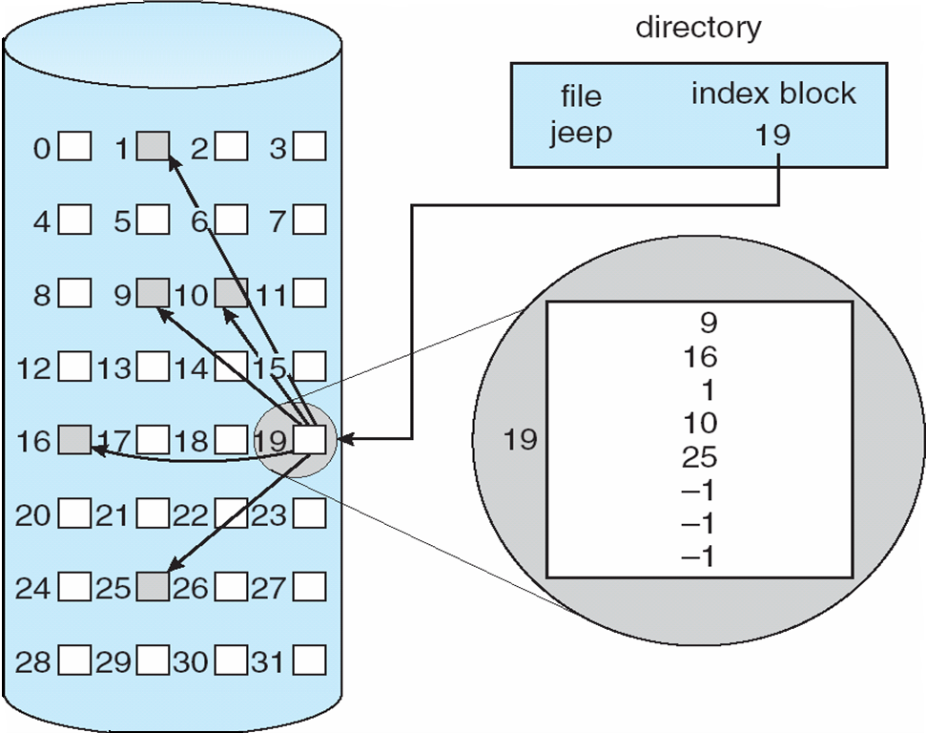
11.4 Allocation Methods

Slide 47
11.4 Allocation Methods
    Access methods
      sequential access and direct access.
    Need index block
      A index block (4K byte)
        1K pointers (4bytes)
        A file of maximum size of 4M
        Q = displacement into index table
        R = displacement into block
      Index blocks waste space
Q
LA/1024
R

Slide 48
11.4 Allocation Methods
    Solutions to large files
      1).Linked scheme
      2).Multilevel index
      3).Combined scheme
  1). Linked scheme
    Link blocks of index table (no limit on size)
    For a small file, one index block
    For a large file, more index blocks can be linked together.

Slide 49
11.4 Allocation Methods
  2). Multilevel index
    Block : 4K can store 1K 4-byte pointers
      1-level index block: 1024*4KB=4M
      2-level index block: 1024x1024*4KB=4G
      3-level index block: 1024x1024*1024*4KB=4T
    similar to paging

Slide 50
11.4 Allocation Methods

outer-index
index table
file

Slide 51
11.4 Allocation Methods
  Combined scheme
    UNIX UFS (4K bytes per block)
      12 for direct pointers (12×4k=48K)
      1 single-indirect block(4M)
      1 double-indirect block(4G)
      1 triple-indirect block(4T)

Slide 52

11.4 Allocation Methods

Slide 53
11.4 Allocation Methods
Performance
  Two criteria:
    Storage utilization efficiency
    Data block access time
  Contiguous allocation: Good for known-size file
  Linked allocation: Good for storage utilization
  Indexed allocation: Access time depends on index structure, file size, block position
  Conclusion:
    Combining contiguous allocation and linked allocation (Some OS)
    Combining contiguous allocation and index allocation (SUN)

Slide 54
11. File-System Implementation
11.1 File-System Structure
11.2 File-System Implementation
11.3 Directory Implementation
11.4 Allocation Methods
11.5 Free-Space Management
11.6 Efficiency and Performance
11.7 Recovery
11.8 Log-Structure File System
11.9 NFS
11.10 Example: WAFL File System

Slide 55
11.5 Free-Space Management
Bit vector
  The free-space list is implemented as a bit map or bit vector.
  Each block is represented by 1 bit.
    If the block is free, the bit is 1;
    if the block is allocated, the bit is 0.
  An example
      0 1 2 3 4 5 6 7 8 9 10 11 12 13 14 15
      0 0 1 1 1 1 0 0 1 1 1 1 1 1 0 0
      Block number calculation=(number of bits per word) *(number of 0-value words) +offset of first 1 bit
0
1
2
n-1
…

Slide 56
11.5 Free-Space Management
  Discussion:
    Simple to implement
    Efficient to find the first free block
    Bit map requires extra space.
      Example:
    block size =4K
    disk size = 2⁸*2³⁰ bytes (256 Gigabyte)
    n = 2³⁸/2¹² = 2²⁶ bits (or 8M bytes)
      Inefficient unless the entire vector is kept in main memory

Slide 57

11.5 Free-Space Management
Linked Lists (free list)
  Inefficient when traversing the list
  No waste of space

Slide 58
11.5 Free-Space Management
Grouping (adapted in Unix)
  The first free block store the addresses of n free blocks
  The first n-1 of n free blocks are free blocks
  The last block of n free blocks contains the address of another n free blocks
  ➔Easier to find a large number of free blocks

Slide 59
11.5 Free-Space Management
Counting
  Every entry is a pair of (starting address, contiguous block number) rather than just a address
  ➔The total list is smaller.

Slide 60
11. File-System Implementation
11.1 File-System Structure
11.2 File-System Implementation
11.3 Directory Implementation
11.4 Allocation Methods
11.5 Free-Space Management
11.6 Efficiency and Performance
11.7 Recovery
11.8 Log-Structure File System
11.9 NFS
11.10 Example: WAFL File System

Slide 61
11.6 Efficiency and Performance
Efficiency
  Efficiency dependent on:
  （1）Disk allocation and directory algorithms
  Example A: pre-allocating
    Pre-allocating the i-node on a partition and spreading them across the partition (UNIX FS)
    Try to keep a file’s data blocks near the file’s i-node block to reduce seek time
  Example B : varying the cluster size
    Different cluster size (BSD UNIX)
      Large are used where they can be filled
      Small are used for small files and the last cluster of a file
    To reduce the fragmentation

Slide 62
11.6 Efficiency and Performance
  （2）Types of data kept in file’s directory entry
  Example A : “Last access date”
    Whenever the file is read, a field in the directory structure must be written to
    The block of directory entry must be read into memory, and be written back out to disk
    This requirement can be inefficient for frequently accessed files

Slide 63
11.6 Efficiency and Performance
  Example B : pointer size
    The pointer sizes limit the length of a file
      16-bit pointer to 2¹⁶(64K)
      32-bit pointer to 2³²(4G)
      64-bit pointer to 2⁶⁴
    Long pointer take more space to store
      The allocation and free-space-management methods (linked lists, indexes, and so on) use more disk space
    One of difficulties in choosing a pointer size is planning for the effects of changing pointer size

Slide 64
11.6 Efficiency and Performance
  Example C : SUN Solaris
    Originally, many data structures were of fixed length, allocated at system startup
    Since Solaris 2, almost all kernel structures have been allocated dynamically, eliminating these artificial limits on system performance

Slide 65
11.6 Efficiency and Performance
Performance
Besides the basic file-system algorithms, we can still improve performance in several ways
  Most disk controller include local memory to form an on-board cache
  Maintain a separate section of main memory for a buffer cache
  Cache file data using a page cache
    Using virtual memory techniques (memory-mapped files) to cache file data as pages rather than as file-system-oriented blocks

Slide 66
11.6 Efficiency and Performance
  Provide a unified buffer cache
    Two alternatives for opening and accessing a file
      The standard system calls：read( ) and write( )
        Use the buffer cache
      Memory mapping
        Use page cache and the buffer cache (known as double caching)
        Require caching file-system data twice
        Not only waste memory but also waste CPU and I/O cycles due to the extra data movement within system memory
        Inconsistencies between the two caches can result in corrupt files

Slide 67
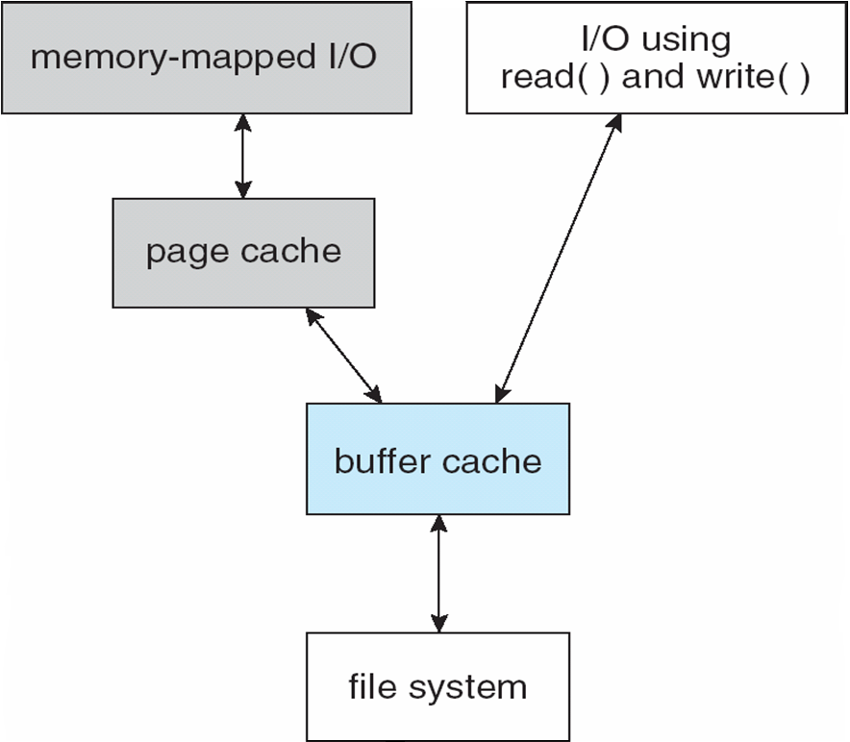
11.6 Efficiency and Performance

Slide 68
11.6 Efficiency and Performance
    a unified buffer cache is used to avoid double caching, and allows the virtual memory system to manage file-system data
      A unified buffer cache uses the same page cache to cache both memory-mapped pages and ordinary file system I/O

Slide 69
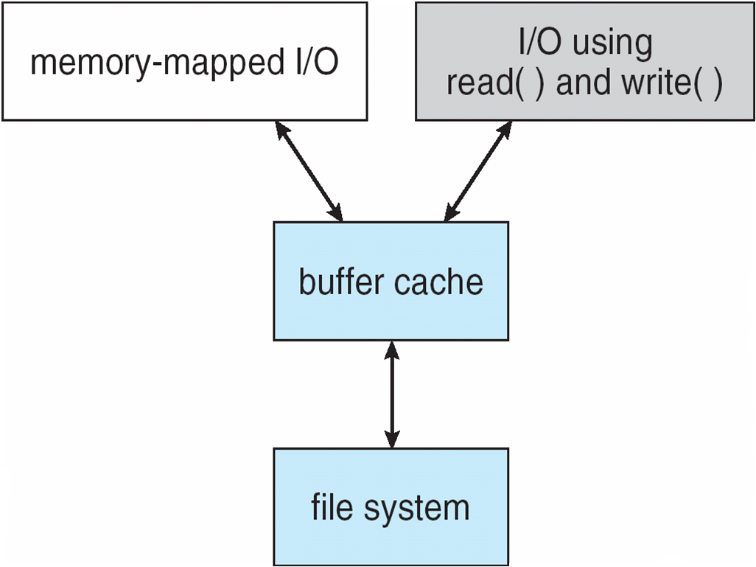
11.6 Efficiency and Performance

Slide 70
11.6 Efficiency and Performance
  Synchronous / Asynchronous writes
    Synchronous
      the writes are not buffered
      The calling routine must wait for the data to reach the disk drive before it can process
    Asynchronous
      The data are stored in the cache, and control return to the calling routine
    Metadata writes can be synchronous
    Operating systems frequently include a flag in the open（） system call to allow a process to request that writes be performed synchronously

Slide 71
11.6 Efficiency and Performance
  Caching replacement algorithm
  Different replacement algorithms are used depending on the access type of the file
    Random access
      LRU seems a reasonable general-purpose algorithm for block or page replacement
      E.g. Solaris
    Sequentially access
      Free-behind
        Remove a page from the buffer as soon as the next page is requested
      Read-ahead
        A requested page and several subsequent pages are read and cached

