Slide 1
OPERATING SYSTEM CONCEPTS
操作系统概念-12
Mass-Storage Systems
张 柏 礼
bailey_zhang@sohu.com
东南大学计算机学院

Slide 2
12. Mass-Storage Systems
Objectives
  Describe the physical structure of secondary and tertiary storage devices and the resulting effects on the uses of the devices
  Explain the performance characteristics of mass-storage devices
  Discuss operating-system services provided for mass storage, including RAID and HSM

Slide 3
12. Mass-Storage Systems
12.1 Overview of Mass Storage Structure
12.2 Disk Structure
12.3 Disk Attachment
12.4 Disk Scheduling
12.5 Disk Management
12.6 Swap-Space Management
12.7 RAID Structure
12.8 Stable-Storage Implementation
12.9 Tertiary Storage Structure
Notes:
13.10 Operating System Support
13.11 Performance Issues

Slide 4
12.1 Overview of Mass Storage Structure
File system is consist of three parts logically
  (1) The user and programmer interface to the file system
  (2) Internal data structures and algorithms to implement the interface
  (3) the lowest level of the file system: the secondary and tertiary storage structures

Slide 5
12.1 Overview of Mass Storage Structure
Magnetic disks
  provide bulk of secondary storage of modern computers
  Structure
    Disk platter(盘片): covered with magnetic material
      rotate at 60 to 200 times per second
    Track(磁道): the surface of platter is logically divided into circular track
    Sector(扇区): each track is subdivided into several sectors
    Cylinder(柱面): is the set of tracks that are at one arm position
    A read-write head: “flies” just above each surface of every platter
      Head crash results from disk head making contact with the disk surface
    Disk arm: move all the head as a unit

Slide 6

12.1 Overview of Mass Storage Structure

Slide 7
12.1 Overview of Mass Storage Structure
  Disk speed
    Transfer rate
      rate at which data flow between drive and computer
      Several megabytes of data per second
    Positioning time (random-access time):
      seek time: time to move disk arm to desired cylinder
      rotational latency : time for desired sector to rotate under the disk head
      ——several milliseconds
  Disks can be removable
    Floppy disks

Slide 8
12.1 Overview of Mass Storage Structure
  I/O bus
    A set of wires, by it a disk drive attached to computer
    Kinds of buses
      EIDE, ATA, SATA, SCSI （SAS）
      USB, Fibre Channel, fireware

Slide 9
12.1 Overview of Mass Storage Structure
    Host controller
      At the computer end of the I/O bus
      The CPU puts a command into the host controller using memory-mapped I/O ports
      The host control sends the command via the message to the disk control
    Disk controller
      At the disk drive end of the I/O bus
      built into each disk drive or storage array
      Operates the disk-drive hardware to carry out the command

Slide 10
12.1 Overview of Mass Storage Structure
Magnetic tape
  Was early secondary-storage medium
  Relatively permanent and holds large quantities of data
    20-200GB typical storage
  Random access about 1000 times slower than disk
  Once data under head, transfer rates comparable to disk
  Mainly used for backup, storage of infrequently-used data, transfer medium between systems
  Kept in spool and wound or rewound past read-write head
  Common technologies are 4mm, 8mm, 19mm, LTO-2 and SDLT

Slide 11
12. Mass-Storage Systems
12.1 Overview of Mass Storage Structure
12.2 Disk Structure
12.3 Disk Attachment
12.4 Disk Scheduling
12.5 Disk Management
12.6 Swap-Space Management
12.7 RAID Structure
12.8 Stable-Storage Implementation
12.9 Tertiary Storage Structure
Notes:
13.10 Operating System Support
13.11 Performance Issues

Slide 12
12.2 Disk Structure
logical blocks
  is the smallest unit of transfer, usually 512 byte----4K
  Disk drives are addressed as large 1-dimensional arrays of logical blocks
The 1-dimensional array of logical blocks is mapped into the sectors of the disk sequentially
  Sector 0 is the first sector of the first track on the outermost cylinder

Slide 13
12.2 Disk Structure
Address translation
  converting a logical block number into an old-style disk address that consists of a cylinder number, a track(/head) number within that cylinder, and a sector number within that track
In practice, address translation is difficult
  (1) most disks have some defective sectors, but the mapping hides this by substituting spare sectors from elsewhere on the disk

Slide 14
12.2 Disk Structure
  (2) the number of sectors per track is not a constant on some drivers
    CLV : constant linear velocity (恒定线速度)
      CD-ROM， DVD-ROM
      The density of bits per track is uniform
      Tracks in the outermost zone hold more sectors
      The drive increases its rotation speed as the head moves from the outer to the inner to keep the same rate of data moving under the head

Slide 15
12.2 Disk Structure
    CAV: constant angular velocity (恒定角速度)
      Hard disk
      The disk rotation speed can stay constant
      The density of bits decreases from inner tracks to outer tracks to keep the data rate constant

Slide 16
12. Mass-Storage Systems
12.1 Overview of Mass Storage Structure
12.2 Disk Structure
12.3 Disk Attachment
12.4 Disk Scheduling
12.5 Disk Management
12.6 Swap-Space Management
12.7 RAID Structure
12.8 Stable-Storage Implementation
12.9 Tertiary Storage Structure
Notes:
13.10 Operating System Support
13.11 Performance Issues

Slide 17
12.3 Disk Attachment
How to attach a disk
  Host-attached storage
  Network-attached storage
  Storage-area network

Slide 18
12.3 Disk Attachment
Host-attached storage
  accessed through local I/O ports
  I/O port technologies ( bus types )
    IDE or ATA :Supports two drivers per I/O bus
    SATA
    SCSI (Small Computer System Interface): supports up to 16 devices on one cable
      1 controller card in host, the SCSI initiator
      15 storage devices, the SCSI targets
        Each target can have up to 8 logical units
        15*8 logical units (usually disks) per I/O bus
    SAS
Notes:
A SCSI disk is common SCSI target
Each logical unit may be a component of RAID array or a components of a removable media library

Slide 19
12.3 Disk Attachment
    FC (fiber channel) is high-speed serial architecture
      Can operate over optical fiber or over a four-conductor copper cable
      Can be switched fabric with 24-bit address space – the basis of storage area networks (SANs) in which many hosts attach to many storage units (2^24 devices)
      Can be arbitrated loop (FC-AL) of 126 devices
  Storage devices suitable for use as host-attached storage
    Hard disk drivers
    RAID arrays
    CD,DVD
    Tape drivers

Slide 20
12.3 Disk Attachment
Network-Attached Storage (NAS)
  is a special-purpose storage system that is accessed remotely over a network rather than over a local connection (such as a bus)
  Clients/Hosts access NAS via a RPC interface such as NFS (UNIX) and CIFS (Windows)
    Is usually implemented as a RAID array with software that implements the RPC interface
    New iSCSI protocol uses IP network to carry the SCSI protocol
  trends to be less efficient and have lower performance
Notes:
A system using NAS would RPC over TCP/IP

Slide 21

12.3 Disk Attachment

Slide 22
12.3 Disk Attachment
Storage Area Network (SAN)
  NAS consume bandwidth on the data network
  SAN is a private network (using storage protocol) connecting servers/hosts and storage units
  Multiple hosts attached to multiple storage arrays - flexible
  Common in large storage environments (and becoming more common)

Slide 23
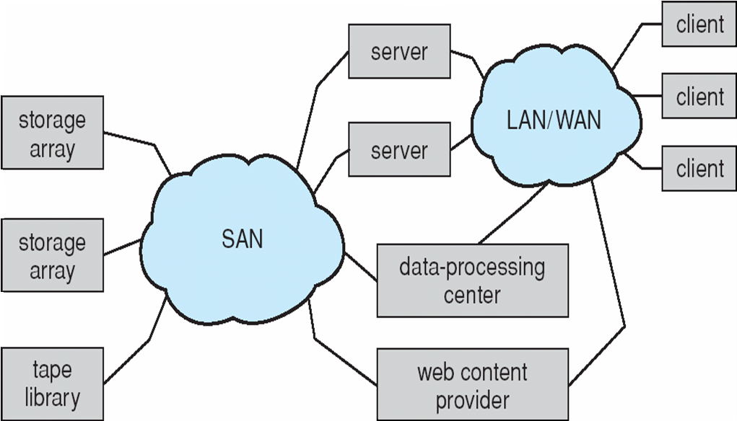
12.3 Disk Attachment
Notes:
2012-5-23

Slide 24
12. Mass-Storage Systems
12.1 Overview of Mass Storage Structure
12.2 Disk Structure
12.3 Disk Attachment
12.4 Disk Scheduling
12.5 Disk Management
12.6 Swap-Space Management
12.7 RAID Structure
12.8 Stable-Storage Implementation
12.9 Tertiary Storage Structure
Notes:
13.10 Operating System Support
13.11 Performance Issues

Slide 25
12.4 Disk Scheduling
For the disk drives，OS is responsible for having fast access time and large disk bandwidth
  Access time has two major components
    Seek time is the time for the disk are to move the heads to the cylinder containing the desired sector
      Minimize seek time
      Seek time ≈ seek distance
    Rotational latency is the additional time waiting for the disk to rotate the desired sector to the disk head
  Disk bandwidth
    The total number of bytes transferred divided by the total time between the first request for service and the completion of the last transfer

Slide 26
12.4 Disk Scheduling
  Can improve access time and bandwidth by
    Scheduling the servicing of disk I/O requests in a good order
  Disk I/O request
    If the desired disk drive and controller are available, the request can be serviced immediately
    If the drive or controller is busy
      Any new requests will be put in the queue of pending request for that drive
      The disk queue may often have several pending requests
    When one request is completed, OS choose which pending request to service next?

Slide 27
12.4 Disk Scheduling
A example
  A disk request queue for I/O to blocks on cylinders (0-199)
    98, 183, 37, 122, 14, 124, 65, 67
  Disk head is initially at cylinders 53
FCFS Scheduling
  The first-come, first served, the simplest algorithm
  The total head movement of 640 cylinders
Notes:
穿越多少个柱面

Slide 28

12.4 Disk Scheduling
Notes:
(183-53)+(183-37)+(122-37)+(122-14)+(124-14)+(124-65)+(67-65)

Slide 29
12.4 Disk Scheduling
SSTF：Shortest-seek-time-first (SSTF)
  Selects the request with the minimum seek time from the current head position
  SSTF scheduling is a form of SJF scheduling
    may cause starvation of some requests
  the total head movement of 236 cylinders
Notes:
最短寻道时间优先 往返跑---距离很短，但速度不一定很快

Slide 30

12.4 Disk Scheduling
Notes:
53—37---14---183： 53-14+183-14=208

Slide 31
12.4 Disk Scheduling
SCAN
  Sometimes called the elevator algorithm.
  The disk arm starts at one end of the disk, and moves toward the other end, servicing requests as it reaches each cylinder
  At the other end, the head movement is reversed and servicing continues
  The head continuously scans back and forth across the disk.
  236 cylinders.

Slide 32

12.4 Disk Scheduling
Notes:
53+183=236

Slide 33
12.4 Disk Scheduling
C-SCAN (Circular SCAN)
  Provides a more uniform wait time than SCAN
  The head moves from one end of the disk to the other, servicing requests as it goes
    When it reaches the other end, however, it immediately returns to the beginning of the disk, without servicing any requests on the return trip
  Treats the cylinders as a circular list that wraps around from the last cylinder to the first one

Slide 34

12.4 Disk Scheduling
Notes:
199--→0 很快，不能用cylinder数量来衡量

Slide 35
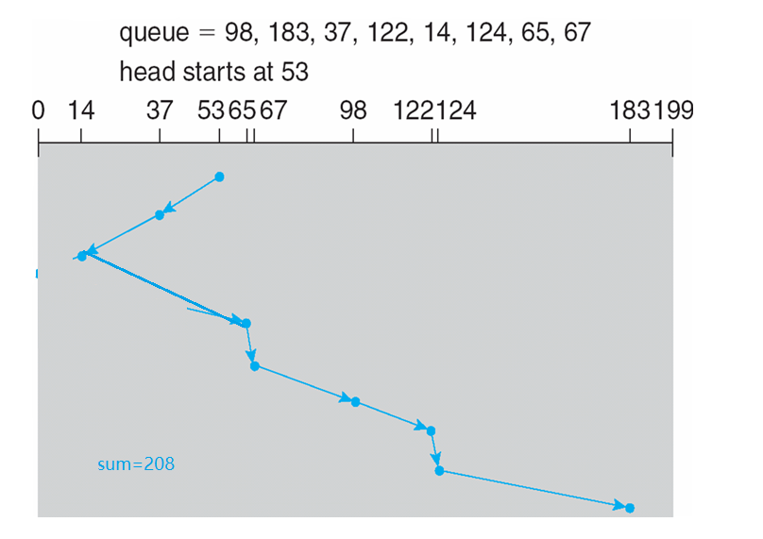
12.4 Disk Scheduling
LOOK / C-LOOK
  Similar to SCAN/C-SCAN
  Arm only goes as far as the last request in each direction, then reverses direction immediately, without first going all the way to the end of the disk.
Notes:
LOOK / C_LOOK

Slide 36

12.4 Disk Scheduling
Notes:
C-look c-scan的距离都不是太好计算

Slide 37
12.4 Disk Scheduling
Selecting a Disk-Scheduling Algorithm
  Performance depends on the number and types of requests
    SCAN and C-SCAN perform better for systems that place a heavy load on the disk
    Requests for disk service can be influenced by the file-allocation method
  The disk-scheduling algorithm should be written as a separate module of the operating system, allowing it to be replaced with a different algorithm if necessary
    Either SSTF or LOOK is a reasonable choice for the default algorithm

Slide 38
12. Mass-Storage Systems
12.1 Overview of Mass Storage Structure
12.2 Disk Structure
12.3 Disk Attachment
12.4 Disk Scheduling
12.5 Disk Management
12.6 Swap-Space Management
12.7 RAID Structure
12.8 Stable-Storage Implementation
12.9 Tertiary Storage Structure
Notes:
13.10 Operating System Support
13.11 Performance Issues

Slide 39
12.5 Disk Management
Disk formatting
  Low-Level Formatting (physical formatting )
    Dividing a disk into sectors that the disk controller can read and write.
    Every sector consists of a header, a data area (usually 512 in size), and a trailer.
    The data area size can be chosen.
    The header and trailer contain information used by disk controller, such as a sector number and an error-correcting code (ECC).
    Low-level formatting is usually done by vendors.

Slide 40
12.5 Disk Management
  Partition and logical Formatting
    To hold files, the operating system still needs to record its own data structures on the disk, it does so in two step
      Partition
      logical Formatting
    Partition
      Partition the hard disk into one or more groups of cylinders
      The OS can treat each partition as though it was a separate disk

Slide 41
12.5 Disk Management
    Logical Formatting
      Creation of a file system
      Build the metadata structures for a file system
        Maps of free and allocated space
        a initial empty directory

Slide 42
12.5 Disk Management
  Cluster
    To increase efficiency most file systems group blocks into clusters
      Disk I/O is done via blocks
      File I/O is done via clusters, assuring that I/O has more sequential-access and fewer random-access
  Raw disk
    Disk without any file-system data structures
    Allowing certain applications implement their own special-purpose storage services on a raw partition
      Database systems
      SWAP

Slide 43
12.5 Disk Management
Boot block
  Booting process
    Be powered up or rebooted
    The bootstrap program is run
    Initialized all aspects of system
      CPU registers
      Device controllers
      The contents of main memory
    Start the OS
      Finds the OS kernel on disk
      Load the kernel into memory
      Jumps to an initial address of OS
Notes:
bootstrap program：引导程序

Slide 44
12.5 Disk Management
  Boot block
    The bootstrap program is stored in the ROM (BIOS for PC)
    ROM is read only, so changing this bootstrap code requires changing the ROM hardware chips
    Store a tiny bootstrap loader program in the ROM whose job is to bring in a full bootstrap program from disk
    The full bootstrap is stored in “the boot blocks” at a bootable partition on a boot disk or system disk

Slide 45
12.5 Disk Management
  A example: windows 2000
    bootstrap loader program in the ROM
    Boot code (MBR, master boot record) is stored in the first sector (boot sector)
    Boot partition contains the OS and device drivers

Slide 46

12.5 Disk Management

Slide 47
12.5 Disk Management
Bad blocks
  Disks have moving parts and are prone to failure
  Failure
    The disk is fail completely
    Some sectors is defective---bad block
  For IDE, bad blocks are handled manually.
  For SCSI, bad blocks are handled smartly.
    Sector sparing
    Sector slipping.

Slide 48
12. Mass-Storage Systems
12.1 Overview of Mass Storage Structure
12.2 Disk Structure
12.3 Disk Attachment
12.4 Disk Scheduling
12.5 Disk Management
12.6 Swap-Space Management
12.7 RAID Structure
12.8 Stable-Storage Implementation
12.9 Tertiary Storage Structure
Notes:
13.10 Operating System Support
13.11 Performance Issues

Slide 49
12.6 Swap-Space Management
Swapping
  Traditional swapping
    When the amount of physical memory reaches a critically low point
    One or more processes are move entirely from memory to swap space of the hard disk
  Modern swapping
    Combine swapping with virtual memory techniques
    Swap part of process such as pages, not entire processes
    Is equal to paging in many system

Slide 50
12.6 Swap-Space Management
Swap space management
  Virtual memory uses disk space as an extension of main memory
  Disk access is much slower than memory access
  The main goal for design and implementation of swap space is to provide the best throughout for virtual memory system

Slide 51
12.6 Swap-Space Management
Swap-Space Use
  Swap space can be used to hold
    Entire process image，including the code and data segments
    or
    Pages
  Swap space size
    Depend on
      The amount of physical memory
      The amount virtual memory
      The usage method of virtual memory
    Over-estimating is safer (waste disk space)
    Under-estimating is dangerous

Slide 52
12.6 Swap-Space Management
Swap-Space Location
  Swap-space can reside in one of two places
    be carved out of the normal file system
      Easy to implement
      Is inefficient
        Navigating the directory structure and the disk-allocation data structures takes time and extra accessed
      Win3.1, Windows 2K/XP

Slide 53
12.6 Swap-Space Management
    Be in a separate disk partition
      Be created in a separate raw partition
      A separate swap-space storage manager is used to allocate and de-allocate the blocks
      Algorithms optimized for speed rather than for storage efficiency
      Solaris，Linux
    Both
      Linux

Slide 54
12.6 Swap-Space Management
An example：UNIX
  Traditional UNIX: swapping the entire processes
  Later UNIX: combination of swapping and paging
    4.3BSD allocates swap space when process starts; holds text segment (the program) and data segment
    Solaris 1 uses swap space as a backing store for pages of anonymous memory (stack, heap, etc)
    Solaris 2 allocates swap space only when a page is forced out of physical memory, not when the virtual memory page is first created
  Kernel uses swap maps to track swap-space use

Slide 55
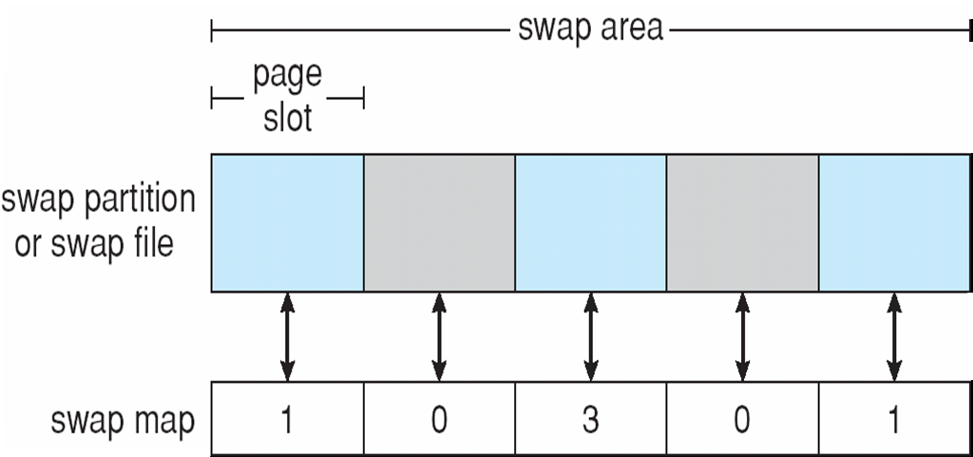
12.6 Swap-Space Management
    Data Structures for Swapping on Linux Systems

Slide 56
12. Mass-Storage Systems
12.1 Overview of Mass Storage Structure
12.2 Disk Structure
12.3 Disk Attachment
12.4 Disk Scheduling
12.5 Disk Management
12.6 Swap-Space Management
12.7 RAID Structure
12.8 Stable-Storage Implementation
12.9 Tertiary Storage Structure
Notes:
13.10 Operating System Support
13.11 Performance Issues

Slide 57
12.7 RAID Structure
RAID
  Used to address the performance and reliability issues of hard disk
  In the past
    RAID: Redundant Array of Inexpensive Disks
    Composed of small, cheap disks views as cost-effective alternative to large, expensive disk
  Today
    RAID: Redundant Array of Independent Disks
    Used for their higher reliability and higher data-transfer rate(performance), rather than for economic reason
  Frequently combined with NVRAM (Non-Volatile Random Access Memory) to improve write performance

Slide 58
12.7 RAID Structure
Improvement of reliability via redundancy
  Without redundancy
    Suppose that the mean time to failure of a single disk is 100,000 hours
    the mean time to failure of some disk in an array of 100 disks will be 100,000/100 = 1000 hours = 41.66 days
  With redundancy
    Mirroring
      p is failure probability for one disk
      p*p is the failure probability for two disks at the same time.

Slide 59
12.7 RAID Structure
Improvement of performance via parallelism
  1). Mirroring
    Read requests can be sent to either disk
    Both disks can be serviced for different read requests at a time, so the number of reads per unit time can be doubled

Slide 60
12.7 RAID Structure
  2). Data striping
    Bit-level striping
      Splitting the bits of each byte across multiple disks
      For example, having an array of four disks
        Bits i and bits 4+i of each byte write to disk i
        Every disk participates in every access
        The array of 4 disks can be treated as a single disk with sectors that are 4 times the normal access rate and size

Slide 61
12.7 RAID Structure
    Byte-level striping
    Sector-level striping
    Block-level striping
      Blocks of a file are striped across multiple disks
      With n disks, block i of a file writes to disk (i mod n)+1
      It is the most common
  Parallelism in a disk system, as achieved through data striping, have two main goals
    Increase the throughput of multiple small access (that is, page accessed) by load balancing
    Reduce the response time of large accesses

Slide 62
12.7 RAID Structure
RAID Levels
  cost-performance trade-offs
    Mirroring provides high reliability, but expensive
    Data striping provides high data-transfer rates, but not improve reliability
    Numerous schemes have different cost-performance trade-offs and are classified to RAID levels

Slide 63
12.7 RAID Structure
  RAID 0
    Disk arrays with data striping at the level of blocks but without any redundancy
  RAID 1
    Disk mirroring

Slide 64
12.7 RAID Structure
  RAID 2
    Bit-level striping or Byte-level striping
    Memory-style error-correcting-code (ECC) organization
      There are two or more extra parity bit
      All single-bit errors can be detected and reconstructed
    The disks labeled C store the data via data striping
    The disks labeled P store the error-correction bits
      Requires only three disks’ overhead for four disks data
    If one of disks fails, the remaining bits of the byte and the associated error-correction bits can be read from other disks and used to reconstruct the damaged data

Slide 65
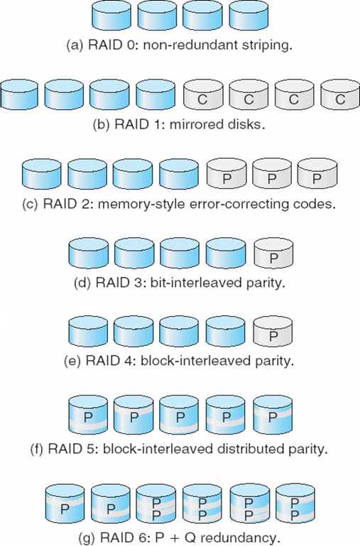
12.7 RAID Structure

Slide 66
12.7 RAID Structure
  RAID 3
    Bit-interleaved parity organization
    Unlike memory systems, disk controllers can detect whether a sector has been read correctly, so a single parity bit can be used for error correction
      If one of the sectors is damaged, we know exactly which sector it is
      We can figure out whether any bit in the sector is a 1 or 0 with the related bits in the other disk and parity bit
    RAID 3 is as good as RAID 2, but is less expensive in the number of extra disks

Slide 67
12.7 RAID Structure
    RAID 3 vs. RAID 1
      Advantages
        Only one parity disk is needed
        The transfer rate of reading or writing a block is N times as fast as with RAID 1 (for data stripping)
      Negative side
        Every disk has to participate in every I/O request, RAID 3 supports fewer I/Os at one time
        The expense of computing and writing the parity

Slide 68
12.7 RAID Structure
  RAID 4
    Block-interleaved parity organization
    Uses block-level striping, keep a parity block on a separate disk
    A block read access only one disk, allowing other disk to serviced for other requests
    The data-transfer rate for each access is slower, but multiple read access can proceed in parallel, leading to a higher overall I/O rate
    That write of data smaller than a block cannot be performed in parallel
      Read-modify-write cycle
      A single write requires four disk access: two read for data block and parity block, two write for data block and parity block

Slide 69
12.7 RAID Structure
  RAID 5
    Block-interleaved distributed parity
    Spreading data and parity among all N+1 disks
    A example: an array of five disks
      The parity for the 0 block is stored in the 0th block of disk 1
      The 0th block of the other disk (0,2,3,4) store actual 0 block’s data
    By spreading the parity across all the disks in the set, RAID 5 avoids the potential overuse of a single parity disk that can occur with RAID 4
    RAID 5 is the most common parity RAID system

Slide 70
12.7 RAID Structure
  RAID 6
    P+Q redundancy scheme
    Stores extra redundant information to guard against multiple disk failures
    2 bits of redundant data are stored for every 4 bits of data, the system can tolerate two disk failures

Slide 71
12.7 RAID Structure
  RAID 0+1 & RAID 1+0
    A combination of RAID 0 and 1
    RAID 0 provides the performance
      Is better than RAID 5
    RAID 1 provides the reliability
      Is more expensive
    RAID 0+1
      A set of disks (SET A) are striped to form RAID 0
      The stripe is mirrored to another (SET B) to form RAID 1
      A single disk fails in SET A
        the entire stripe is inaccessible
        Meanwhile a disk fail in SET B, the array is all unavailable

Slide 72
12.7 RAID Structure
    RAID 1+0
      Two disks are mirrored in pairs (PAIR A) to form RAID 1
      The pairs are striped to form RAID 0
      A single disk fails in PAIR A
        the pair is still available
        Meanwhile a disk fail in PAIR B or C or D, the array is still available

Slide 73
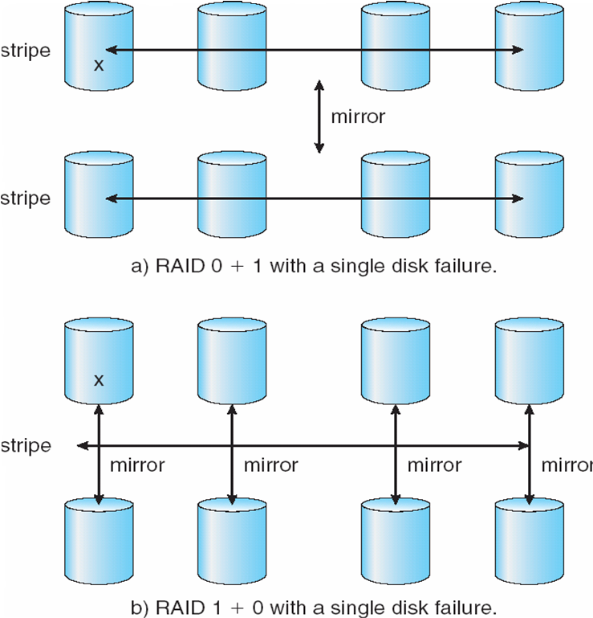
12.7 RAID Structure
Notes:
RAID 0+1 是先分布后镜像，镜像是整体镜像，每个磁盘不一一对应，任一磁盘的失效导致一组磁盘的失效
而RAID 1+0 是先镜像再分布，每个磁盘一一对应

Slide 74
12.7 RAID Structure
  The implement of RAID
    Can be implemented volume-management software in the kernel or at system software layer
    Can be implemented in the host bus-adapter (HBA) hardware
    Can be implemented in the hardware of storage array
    Can be implemented in the SAN interconnect layer by disk virtualization devices

Slide 75
12.7 RAID Structure
  Replication and snapshots
    RAID within a storage array can still fail if the array fails
    replication involves the automatic duplication of writes between separate sites for redundancy and disaster recovery
    Synchronous replication
      Each block must be written locally and remote before the write is considered complete
    Asynchronous replication
      The writes are grouped together and written periodically
  Frequently, a small number of hot-spare disks are left unallocated, automatically replacing a failed disk and having data rebuilt onto them
Notes:
还是可能发生整组的损害（火灾、水灾、地震）
hot-spare: 热备份

Slide 76
12.7 RAID Structure
Selecting a RAID Level
  One consideration is rebuild performance
    Rebuilding is easiest for RAID 1
    For other levels, need to access all the other disks in the array to rebuild data in a failed disk
    The rebuild performance may be an important factor if a continuous supply of data is required
      High-performance or interactive database systems
  RAID 0 is used in high-performance application where data loss is critical
  RAID 1 is used for applications the require high reliability with fast recovery

Slide 77
12.7 RAID Structure
  RAID 0+1 & RAID 1+0 are used where both performance and reliability are important
  RAID 5 is often preferred for storing large volumes of data
Extensions
  The concepts of RAID have been generalized to other storage devices
    Arrays of tapes
      To recover data even if one of the tapes in an array is damaged
    The broadcast of data over wireless systems
      A block of data is split into short units and is broadcast along with a parity unit
      If one the unit is not received for any reason, it can be reconstructed

Slide 78
12.7 RAID Structure
Problems with RAID
  RAID does not always assure that data are available for OS and its users
    A point to a file could be wrong
    Incomplete writes
    RAID protects against physical media errors, but not other hardware and software errors
      There are large of software and hardware bugs

Slide 79
12.7 RAID Structure
Solaris ZFS
  adds checksums of all data and metadata
  Checksums are not kept with the their block, and the pointer to that block are stored with the checksum
  Can detect and correct data and metadata corruption
  ZFS also removes volumes, partititions
    Disks allocated in pools
    Filesystems with a pool share that pool, use and release space like “malloc” and “free” memory allocate / release calls

Slide 80
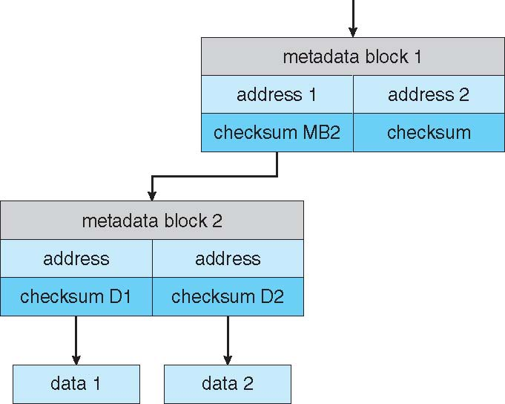
12.7 RAID Structure

Slide 81
12.7 RAID Structure

Slide 82
12. Mass-Storage Systems
12.1 Overview of Mass Storage Structure
12.2 Disk Structure
12.3 Disk Attachment
12.4 Disk Scheduling
12.5 Disk Management
12.6 Swap-Space Management
12.7 RAID Structure
12.8 Stable-Storage Implementation
12.9 Tertiary Storage Structure
Notes:
13.10 Operating System Support
13.11 Performance Issues

Slide 83
12.8 Stable-Storage Implementation
stable storage
  Information residing in stable storage is never lost
  Write-ahead log scheme requires stable storage
To implement stable storage:
  Replicate information on more than one nonvolatile storage media with independent failure modes
  Update information in a controlled manner to ensure that we can recover the stable data after any failure during data transfer or recovery

Slide 84
12. Mass-Storage Systems
12.1 Overview of Mass Storage Structure
12.2 Disk Structure
12.3 Disk Attachment
12.4 Disk Scheduling
12.5 Disk Management
12.6 Swap-Space Management
12.7 RAID Structure
12.8 Stable-Storage Implementation
12.9 Tertiary Storage Structure
Notes:
13.10 Operating System Support
13.11 Performance Issues

Slide 85
12.9 Tertiary Storage Structure
Tertiary Storage Devices
  Low cost is the defining characteristic of tertiary storage
  Generally, tertiary storage is built using
    removable media
      floppy disks
      A magneto-optic disk
      Optical disks
        CD-ROM and DVD
        WORM (“Write Once, Read Many Times”) disks
    Tapes

Slide 86
12.9 Tertiary Storage Structure
OS support
  Application interface
  File name
  Hierarchical Storage Management (HSM)
Performance Issues
  Speed
  Reliability
  cost

