Slide 1
OPERATING SYSTEM CONCEPTS
操作系统概念
张 柏 礼
bailey_zhang@sohu.com
东南大学计算机学院

Slide 2
3. Processes
Objectives
  To introduce the notion of a process -- a program in execution, which forms the basis of all computation
  To describe the various features of processes, including scheduling, creation and termination, and communication
  To describe communication in client-server systems

Slide 3
3. Processes
3.1 Process Concept
3.2 Process Scheduling
3.3 Operations on Processes
3.4 Interprocess Communication
3.5 Examples of IPC Systems
3.6 Communication in Client-Server Systems
Notes:
IPC： interprocess communication

Slide 4
3.1 Process Concept
How to name the CPU activities
  Job：in the batch system
  Program or task: in time-shared system
  There may be many programs at one times in a computer
    Users programs: word processor、web browser and e-mail package
    System programs: memory management、file management
    ---We call all of them processes
  Textbook uses the terms job and process almost interchangeably

Slide 5

3.1 Process Concept
Process include:
  Program code
    text section
  program counter and processors’ registers
  Stack
    Function parameters
    Return address
    Local variables
  data section
    Global variables
  Heap
    Dynamically allocated memory

Slide 6
3.1 Process Concept
Process vs. program
  Program is a passive entity
    Executable file: containing a list of instructions stored on disk
  Process is an active entity, with
    a programmer counter specifying the next instruction to execute
    A set of associated resources
  A program becomes a process
    When an executable file is loaded into “memory”
      Double-click or Enter the command
    Though two processes may be associated with one program, they are considered two separate execution sequences

Slide 7
3.1 Process Concept
Process state
As a process executes, it changes state
  new: The process is being created
  running: Instructions are being executed
    Only one process can be running on any processor at any instant
  Waiting(Blocking): The process is waiting for some event to occur
  ready: The process is waiting to be assigned to a processor
  terminated: The process has finished execution

Slide 8

3.1 Process Concept

Slide 9

3.1 Process Concept
Process control block（PCB）
containing the following information associated with each process
  Process number
  Process state
  Program counter
  CPU registers
  CPU scheduling information
  Memory-management information
  Accounting information
  I/O status information
Notes:
Memory-management information: 是否在内存中，内存中的页面号，对换区位置

Slide 10
3.1 Process Concept
Threads
  Traditional process model
    One process allow a single thread of execution
    A single thread of instruction is being executed
  Modern process model
    One process allow multiple threads of execution
    e.g. in one word-processor process
      The thread of typing in characters
      The thread of spelling checker
      They run simultaneously

Slide 11
3. Processes
3.1 Process Concept
3.2 Process Scheduling
3.3 Operations on Processes
3.4 Interprocess Communication
3.5 Examples of IPC Systems
3.6 Communication in Client-Server Systems
Notes:
原则上 主要研究 单cpu，单线程进程的调度问题

Slide 12
3.2 Process Scheduling
The function of process scheduling
  The objective of multiprogramming
    is to have some process running at all times, to maximize CPU utilization
  The objective of time sharing
    is to switch the CPU among processes so frequently that users can interact with each process
  In a single-processor system, process scheduler selects a process for running on the CPU
    there will be only one running process
    The rest will have to “wait” until the CPU is free and can be rescheduled

Slide 13

3.2 Process Scheduling
Notes:
Interrupt include timer---硬中断
System call –软中断

Slide 14
3.2 Process Scheduling
Scheduling queues
  Job queue
    set of all processes in the system
    As processes/job enter the system，they are put into the job queue
  Ready queue
    set of all processes residing in “(main) memory”, ready and “waiting” to execute
  Device queues
    set of processes waiting for an I/O device

Slide 15

3.2 Process Scheduling

Slide 16
3.2 Process Scheduling
Queuing diagram
  Elements
    Each rectangular box represents a queue
      Ready-queue
      Device-queues
    The circles represent the resources that serve the queues
    The arrows indicate the flow of processes in the system

Slide 17
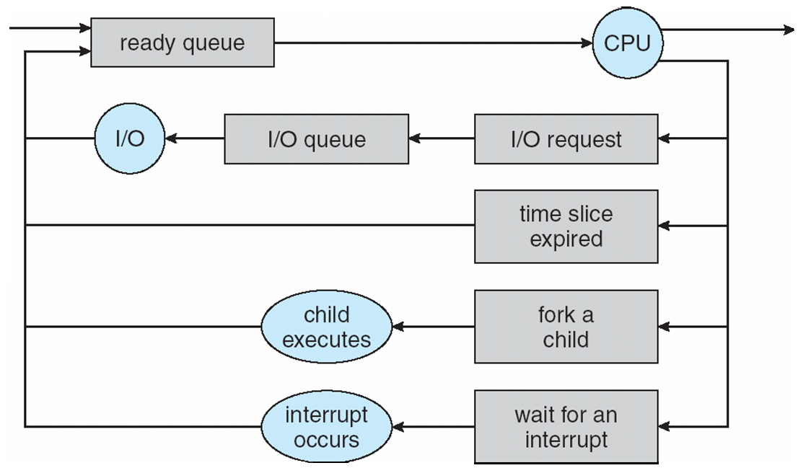
3.2 Process Scheduling

Slide 18
3.2 Process Scheduling
  Flow
    A new process is initially put in the ready queue
    It waits there until it is dispatched
    Once the process is allocated the CPU and is executing, one of several events could occur:
      The process could issue an I/O request and then be put in an I/O queue (waiting state)
      The process could create a new sub-process and wait for the sub-process’s termination (waiting state)
      The process could be removed forcibly from the CPU, as result of an interrupt, and be put back in the ready queue (ready state)
    A process continues this cycle until it terminates, at which time it is removed from all queue and has its PCB and resources de-allocated

Slide 19
3.2 Process Scheduling
Scheduler(调度器)
  A process migrates among the various queues throughout its lifetime
    The OS must select processes from these queues in some fashion
    Selecting processes is carried out by the appropriate scheduler

Slide 20
3.2 Process Scheduling
  Long-term scheduler
    or job scheduler：长程调度
    selects which processes should be brought into the ready queue from the job queue
      Often, in a batch system, more jobs are submitted than can be executed immediately
      These jobs are spooled to a disk
      The long-term scheduler selects processes from this pool and loads them into memory

Slide 21
3.2 Process Scheduling
    The long-term scheduler executes much less frequently
      The degree of multiprogramming (the number of processes in memory) is stable generally
      The average rate of process creation must be equal to the average departure rate of processes leaving the system
      So it may need to be invoked only when a process leaves the system, and has more time to decide which process should be selected
Notes:
Multiprogramming： 多道，多程序

Slide 22
3.2 Process Scheduling
    It is important to make a careful selection for the long-term scheduler
      Processes can be described as either:
        I/O-bound process (I/O密集型) – spends more time doing I/O than computations, many short CPU bursts
        CPU-bound process（计算密集型） – spends more time doing computations; few very long CPU bursts
Notes:
CPU执行脉冲；； I/O intensive

Slide 23
3.2 Process Scheduling
      Selecting a good mix of I/O-bound and CPU-bound processes will lead to the best system performance
        If all processes are I/O bound, the ready queue will almost always be empty (all in devices queues), and the short-term scheduler will have little to do
        If all processes are CPU-bound, the devices (I/O waiting) queues will almost be empty, devices will be free and have nothing to do
        It’s good to have a combination of CPU-bound and I/O-bound processes

Slide 24
3.2 Process Scheduling
    The long-term scheduler may be absent on some systems
      Time-sharing system such as UNIX and Windows
      They simply put every new process in memory for the short-term scheduler
      The stability of these systems depends either on a physical limitation or the self-adjusting nature of users

Slide 25
3.2 Process Scheduling
  Short-term scheduler
    Or CPU scheduler: 短程调度、CPU调度、进程调度
    selects which process should be executed next and allocates CPU
    It must select a new process for CPU frequently, the selection must be fast
      Often, it executes at least once every 100ms
      If it takes 10ms to select a process to execute 100ms
      Then about 9% CPU is wasted for scheduling the work
        overhead

Slide 26
3.2 Process Scheduling

Slide 27
3.2 Process Scheduling
  Medium-term scheduler
    Or swapping: 中程调度
    Sometimes, removes processes from memory to disk and reduces the degree of multiprogramming
    Later, the process can be reintroduced into memory, and its execution can be continued where it left off
    Swapping may be necessary to improve the process mix or free up the available memory

Slide 28

3.2 Process Scheduling

Slide 29
3.2 Process Scheduling
Context Switch
  When CPU switches to another process
    the system must save the state of the old process and load the saved state for the new process via a context switch
  Context of a process is represented in the PCB
  Context-switch time is pure overhead(管理开销)
    the system does no useful work while switching
    Context-switch time are highly dependent on hardware support
    Typical speeds are a few milliseconds

Slide 30
3. Processes
3.1 Process Concept
3.2 Process Scheduling
3.3 Operations on Processes
3.4 Interprocess Communication
3.5 Examples of IPC Systems
3.6 Communication in Client-Server Systems

Slide 31
3.3 Operations on Processes
The processes can be created and deleted dynamically
  The system must provide a mechanism for process creation and termination
Process creation
  Tree of processes
    A process may create several new processes, during the course
    The creating process is called a parent process
    The new processes are called the children of that process
    Each of these new processes in turn create other processes, forming a tree of processes
  Generally, OS identify and manage process via a unique process identifier (pid)

Slide 32
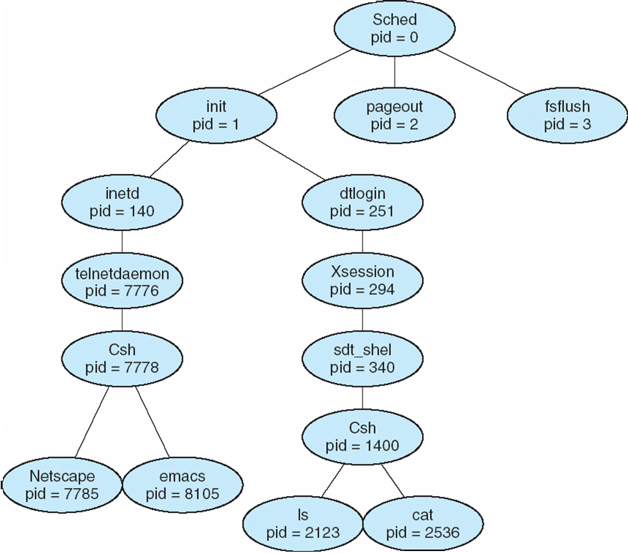
3.3 Operations on Processes

Slide 33
3.3 Operations on Processes
  In general, a process will need certain resources to accomplish its task
    CPU time、memory、files、I/O devices
  When a process creates a sub-process
    The sub-process may be able to obtain its resources directly from the operating system
    Or it may be constrained to a subset of the resources of the parent process
      The parent may have to partition its resources among its children
      Or it may be able to share some resources among its children
    that prevents any process from overloading the system by creating too many sub-processes

Slide 34
3.3 Operations on Processes
  Initialization data may be passed along by the parent process to child process
    E.g. the open files, input/output device
  When a process create a new process, two possibilities in term of execution:
    The parent continues to execute concurrently with its children
    The parent waits until some or all of its children have terminated

Slide 35
3.3 Operations on Processes
  There are two possibilities in terms of the address space of the new process
    The child process is a duplicate of the parent process
      it has same program code and data as the parent
    The child has a new program loaded into it.

Slide 36
3.3 Operations on Processes
  UNIX examples
    fork() system call creates new process
      The new process consists of a copy of the address space of the original process
      Both process continue execution at the instruction after the fork(), with one difference:
        The return code for the fork() is zero for the child process
        The nonzero code is for the parent
    exec() system call used after a fork to replace the process’ memory space with a new program
      The exec() system call loads a binary file into memory (replace the memory image of the program invoking the exec() ) and starts its execution

Slide 37
3.3 Operations on Processes
    int main()
    {
    pid_t pid;
    pid = fork(); /* fork another process */
    if (pid < 0) { /* error occurred */
    fprintf(stderr, "Fork Failed");
    exit(-1);
    }
    else if (pid == 0) { /* child process */
    execlp("/bin/ls", "ls", NULL);
    }
    else { /* parent process */
    wait (NULL);/* parent will wait for the child to complete */
    printf ("Child Complete");
    exit(0);
    }
    }
Notes:
父进程调用wait（）则进入wait队列，否则进入到ready队列

Slide 38
3.3 Operations on Processes
int main()
{
pid_t pid;
pid = fork();
if (pid < 0) {
fprintf(stderr, "Fork Failed");
exit(-1);
}
else if (pid == 0){
execlp("/bin/ls", "ls", NULL);
}
else {
wait (NULL);
printf ("Child Complete");
exit(0);
}
}
int main()
{
pid_t pid;
pid = fork();
if (pid < 0) {
fprintf(stderr, "Fork Failed");
exit(-1);
}
else if (pid == 0){
execlp("/bin/ls", "ls", NULL);
}
else {
wait (NULL);
printf ("Child Complete");
exit(0);
}
}

Slide 39
3.3 Operations on Processes
    int main(){
    pid_t pid; int a=5, b=7;
    pid = fork(); /* fork another process */
    if (pid < 0) { /* error occurred */
    fprintf(stderr, "Fork Failed");
    exit(-1);
    }
    else if (pid == 0) { /* child process */
    a=a*2;
    printf (“this is Child process, a=%d, b=%d\n”,a,b);
    }
    else { /* parent process */
    printf (“this is parent process, a=%d, b=%d\n”,a,b);
    wait (NULL);/* parent will wait for the child to complete */
    a=a+1; b=b+3;
    printf (“Child Complete, a=%d, b=%d\n”,a,b);
    exit(0);
    } }

Slide 40
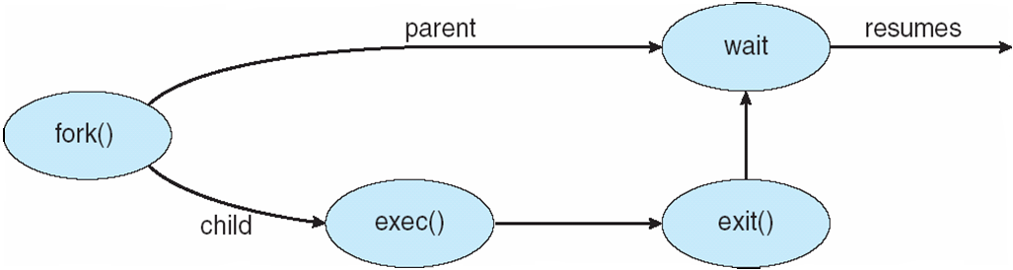
3.3 Operations on Processes

Slide 41
fork(), exec()
#include "stdio.h"
#include "sys/types.h"
#include "unistd.h"
int main() {
pid_t pid1;
pid_t pid2;
  pid1 = fork();
pid2 = fork();
printf("pid1:%d, pid2:%d\n", pid1, pid2);
}
要求如下：
已知从这个程序执行到这个程序的所有进程结束这个时间段内,没有其它新进程执行。
1、请说出执行这个程序后,将一共运行几个进程。
2、如果其中一个进程的输出结果是“pid1:1001, pid2:1002”,写出其他进程的输出结果(不考虑进程执行顺序),并加以解释。

Slide 42
3.3 Operations on Processes
Process termination
  Process executes last statement and asks the operating system to delete it (exit)
    Return a status value to parent process (via wait)
    Process’ resources are de-allocated by operating system
      Physical and virtual memory, open files, and I/O buffers
  Parent may terminate execution of children processes (abort)
    Child has exceeded allocated resources
    Task assigned to child is no longer required
    If parent is exiting
      Some operating system do not allow child to continue if its parent terminates
      All children terminated - cascading termination（级联终止）

Slide 43
3. Processes
3.1 Process Concept
3.2 Process Scheduling
3.3 Operations on Processes
3.4 Interprocess Communication
3.5 Examples of IPC Systems
3.6 Communication in Client-Server Systems

Slide 44
3.4 Interprocess Communication
Processes within a system may be independent or cooperating
  Independent
    Can not affect or be affected by the other processes
    Any process that doesn’t share data with any other process is independent

Slide 45
3.4 Interprocess Communication
  Cooperating
    can affect or be affected by the other processes
    Any process that shares data with any other process is a cooperating process
    Reasons for cooperating processes:
      Information sharing
      Computation speedup
      Modularity
      Convenience
    Cooperating processes need
    interprocess communication (IPC)

Slide 46
3.4 Interprocess Communication
  Two models of IPC
    Shared memory
      A share region of memory is established
      Processes can exchange information by reading and writing data to the shared region
      Allows maximum speed and convenience of communication, as it can be done at memory speed
        System calls are required only when establishing shared-memory regions
        Once shared memory is established, all accesses are treated as routine memory accesses

Slide 47
3.4 Interprocess Communication
    Message passing
      Communication takes place by means of message exchanged between the cooperating processes
      Is useful for exchanging smaller amounts of data
      Is easier to implement than shared memory
      Is slower than the shared memory
        Is implemented using system call, require the more time-consuming task of kernel intervention

Slide 48

3.4 Interprocess Communication
Notes:
A：消息传递 B：共享内存

Slide 49
3.4 Interprocess Communication
Shared memory system
  Establishing shared memory
    Typically, a shared-memory region resides in the address space of the process creating the shared-memory segment
    Other processes must attach shared-memory segment to their address space
      Normally, the OS prevent one process from accessing another process’s memory
      Shared memory requires that two or more processes agree to remove this restriction

Slide 50
3.4 Interprocess Communication
    The form of data and the location in shared memory are determined by these processes and are not under the OS’s control
    The processes are responsible that they are not writing to the same location simultaneously

Slide 51
3.4 Interprocess Communication
  Producer-Consumer Problem
    A classical paradigm for cooperating processes
    A producer process produces information that is consumed by a consumer process
      Print program → print driver
      Compiler → assembler → loader
      A web server → the client web browser
    The producer and consumer must be synchronized
      The consumer does not try to consume an item that has not yet been produced
Notes:
）

Slide 52
3.4 Interprocess Communication
    One solution: shared memory
      A buffer pool: reside in the shared memory of the producer and consumer processes，filled by the producer and emptied by the consumer
      （1）unbounded-buffer places no practical limit on the size of the buffer
        The consumer may have to wait for new items
        The producer can always produce new items
      （2）bounded-buffer assumes that there is a fixed buffer size
        The consumer must wait if the buffer is empty
        The producer must wait if the buffer is full

Slide 53
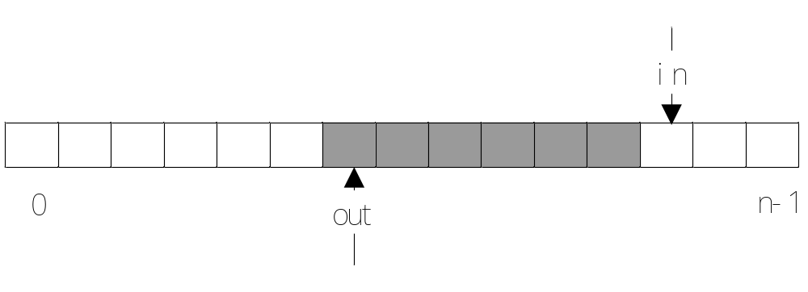
3.4 Interprocess Communication
      Shared data
        #define BUFFER_SIZE 10
        typedef struct {
        . . .
        } item;
        item buffer[BUFFER_SIZE];
        int in = 0;
        int out = 0;

Slide 54
3.4 Interprocess Communication
      Producer process
      item nextProduced;
      while (1)
      {
      while(((in + 1)%BUFFER_SIZE) == out);
      /* do nothing */
      buffer[in] = nextProduced;
      in = (in + 1) % BUFFER_SIZE;
      }

Slide 55
3.4 Interprocess Communication
      Consumer Process
      item nextConsumed;
      while (1) {
      while (out == in); /* do nothing */
      nextConsumed = buffer[out];
      out = (out + 1) % BUFFER_SIZE;
      }
    Question
      Solution is correct, but can only use BUFFER_SIZE-1 elements
      Not concerns the synchronization among the processes

Slide 56
3.4 Interprocess Communication
Message-passing systems
  Allow processes to communicate and to synchronize the actions
    Without sharing the same address space
    Is useful in a distributed environment
  At least provides two operations:
    send(message) and receive(message)

Slide 57
3.4 Interprocess Communication
  message size can be fixed or variable
    If only fixed-sized messages can be sent,
      the system-level implementation is easy
      The programming task becomes more difficult
    If variable-sized messages can be sent,
      the system-level implementation is complex
      The programming task becomes simpler

Slide 58
3.4 Interprocess Communication
  If P and Q wish to communicate, they need to:
    establish a communication link between them
    exchange messages via send/receive
  Implementation of communication link
    physical implementation
      shared memory, hardware bus, network
    logical implementation (by logical properties)
      direct or indirect communication (by naming)
      Synchronous or Asychronous communication
      Automatic or explicit buffering（自动或显式缓存）

Slide 59
3.4 Interprocess Communication
  Classification by Naming
  （1）Direct communication
    Must explicitly name the recipient or sender
    Symmetry in addressing
      send (P, message) – send a message to process P
      receive(Q, message) – receive a message from process Q
      Properties of communication link
        Links are established automatically
        A link is associated with exactly one pair of communicating processes(每个链路只与两个进程相连)
        Between each pair of processes, there exists exactly one link(每对进程只有一个链路)

Slide 60
3.4 Interprocess Communication
    Asymmetry in addressing
      Send (P, message)
      Receive (&id, message)
      Receive a message from any process
      the variable id is set to the name of the process with which communication has taken place.
    The disadvantage of symmetry and asymmetry
      If changing the identifier of a process, all references to the old identifier must be found, and be modified to the new identifier (hard-coding technique)

Slide 61
3.4 Interprocess Communication
  （2）Indirect communication
    The messages are sent to and received from mailbox or ports
    A mailbox can be viewed abstractly as an object
      Each mailbox has a unique id
      Messages can be placed into
      Messages can be removed from
    Processes can communicate if they share a mailbox
    Primitives are defined as:
      send(A, message) – send a message to mailbox A
      receive(A, message) – receive a message from mailbox A
Notes:
Processes can communicate only if they share a mailbox

Slide 62
3.4 Interprocess Communication
    Properties of communication link
      Link established only if processes share a common mailbox
      A link may be associated with many processes
      Each pair of processes may share several communication links, with each link corresponding to one mailbox.
    How about three processes?
      P₁, P₂, and P₃ share mailbox A.
      P₁, sends; P₂ and P₃ receive.
      Who gets the message?

Slide 63
3.4 Interprocess Communication
    Solutions
      Allow a link to be associated with at most two processes.
      Allow only one process at a time to execute a receive operation.
      Allow the system to select arbitrarily the receiver. The sender is notified who the receiver was.

Slide 64
3.4 Interprocess Communication
    Mailbox can be owned by a process or OS.
      If mailbox is owned by a process,
        It’s owner( 邮箱所有人 )
        i）a unique process, who can receive messages through this mailbox
        ii）when this process terminates, the mailbox disappears
        Any user（邮箱的其他使用人）
        can only send messages to the mailbox
Notes:
The user is the process who can only send messages to the mailbox

Slide 65
3.4 Interprocess Communication
      If mailbox is owned by OS
      any process can
        i）create a new mailbox
        by default the process is that mailbox’s owner who is unique receiving process of mailbox
        The ownership and receiving privilege may passed to other processes, it results in multiple receivers for each mailbox
      ii）send and receive messages through mailbox
      iii）destroy a mailbox

Slide 66
3.4 Interprocess Communication
  Classification by Synchronization
    Message passing may be either blocking or non-blocking
    Blocking is considered synchronous
      Blocking send
        the sender is blocked until the message is received by the receiving process or by the mailbox
      Blocking receive
        the receiver is blocked until a message is available

Slide 67
3.4 Interprocess Communication
    Non-blocking is considered asynchronous
      Non-blocking send
        the sender send the message and continue
      Non-blocking receive
        the receiver receive a valid message or null
    Different combinations
      Blocking send and blocking receive
        Have a rendezvous(同步点) between the sender and the receiver
        Used to solve the Producer-Consumer Problem
      Non-blocking send and blocking receive
        Is the most common one.

Slide 68
3.4 Interprocess Communication
  Classification by Buffering(缓冲)
    Whether communication is direct or indirect, message exchanged by processes reside in a temporary queue—buffering
    Implemented in one of three ways.
      Zero capacity – 0 messages
      Sender must wait for receiver (rendezvous).
      Bounded capacity – finite length of n messages
      Sender must wait if link full.
      Unbounded capacity – infinite length
      Sender never waits.

Slide 69
3. Processes
3.1 Process Concept
3.2 Process Scheduling
3.3 Operations on Processes
3.4 Interprocess Communication
3.5 Examples of IPC Systems
3.6 Communication in Client-Server Systems

Slide 70
3.5 Examples of IPC Systems
POSIX Shared Memory
  Process first creates shared memory segment
  segment_id=
  shmget(IPC_PRIVATE,size,S_IRUSR|S_IWUSR);
    a new shared-memory segment is created
    IPC_PRIVATE:the key of shared-memory segment
    Size:the size of the shared-memory segment
    The used mode: reading, writing or both
      S_IRUSR: reading
      S_IWUSR: writing
    segment_id: the integer identifier

Slide 71
3.5 Examples of IPC Systems
  Process wanting access to that shared memory must attach to it
  shared_memory =(char*)shmat(segment_id,NULL, 0);
    The integer identifier: segment_id
    The point location: the location in this process’s address space for attaching the shared-memory
      NULL: let OS select
    The used mode: read-only or read-write
      0: read-write

Slide 72
3.5 Examples of IPC Systems
  Now the process could write to the shared memory
    sprintf(shared_memory, "Writing to shared memory");
  When done a process can detach the shared memory from its address space
    shmdt(shared_memory);
  A shared-memory can be removed from the system
    shmctrl(segment_id,IPC_RMID,0);
Notes:
其实得到内存地址后，就可以如 正常数组和变量那样去访问，不需要再调用系统调用，这样反而更慢

Slide 73
3.5 Examples of IPC Systems
Mach
  Most communication in Mach is carried out by message
    Even system calls are messages
    Messages are sent to and received from mailbox (called ports in Mach)
  Each task gets two mailboxes at creation
    Kernel mailbox
      Is used by the kernel to communicate with task
    Notify mailbox
      The kernel sends notification of event occurrences to the notify mailbox

Slide 74
3.5 Examples of IPC Systems
  Only three system calls needed for message transfer
    msg_send()
    msg_receive()
    msg_rpc()
      execute remote procedure calls(RPCs)
      Send a message and waits for exactly one return message
      Models a typical subroutine procedure call (模拟了子程序的过程调用)and work between remote systems

Slide 75
3.5 Examples of IPC Systems
  System call for mailbox creation
    port_allocate()
      Creates a new mailbox and allocates space for its queue of messages
      The task that creates the mailbox is that mailbox’s owner and can receive from the mailbox

Slide 76
3.5 Examples of IPC Systems
  Synchronization
    When a message is sent to a mailbox
    If the mailbox is not full
      the message is copied to the mailbox, and then sending process/thread continues
    If the mailbox is full
      （1）wait infinitely until there is room in the mailbox
      or（2）wait at most n milliseconds
      or（3）do not wait at all, but rather return immediately
      the message can be cached by OS, only one such message to a full mailbox can be pending at any time for a given sending thread

Slide 77
3.5 Examples of IPC Systems
Windows XP
  Application programs communicate via a message-passing mechanism
    The application programs can be considered clients of the Windows XP subsystem server
  LPC: local procedure call facility（本地过程调用）
    Is message-passing facility in XP only between two processes on the same machine
    Uses ports (like mailboxes) to establish and maintain communication channels between two processes
    Uses two types of ports
      Connection ports
      Communication ports

Slide 78
3.5 Examples of IPC Systems
  Communication works as follows:
    The client opens a handle to the subsystem’s connection port object（子系统连接端口的句柄）
    The client sends a connection request
    The server creates two private communication ports and returns the handle to one of them to the client
    The client and server use the corresponding port handle to send messages or callbacks and to listen for replies

Slide 79
3.5 Examples of IPC Systems
  Two types of message-passing techniques
    The simplest
      Used for small messages, 256 bytes can be sent
      Uses the port’s message queue as intermediate storage and copies the message from one process to the other
    The more complicated
      Used for sending larger message
      It passed the message through a section object
        Which sets up a region of shared memory
        Avoid data copying
Notes:
The RPC is indirectly handled through a LPC sometimes

Slide 80

3.5 Examples of IPC Systems

Slide 81
3. Processes
3.1 Process Concept
3.2 Process Scheduling
3.3 Operations on Processes
3.4 Interprocess Communication
3.5 Examples of IPC Systems
3.6 Communication in Client-Server Systems

Slide 82
3.6 Communication in Client-Server Systems
Strategies for Communication in Client-Server Systems
  Shared memory
  Message passing
  Sockets
  Remote procedure calls (RPCs)
  Java’s remote method invocation (RMI)
Notes:
Shared memory 不同主机之间，需要RPC的支持

Slide 83
3.6 Communication in Client-Server Systems
Sockets
  A socket is defined as an endpoint for communication.
    A pair of processes communicating over a network employ a pair of sockets—one for each process
    A socket is identified by an IP address with a port number
  In general, sockets uses a client-server architecture
    The server waits for incoming client requests by listening to a specified port
      Once a request is received, the server accepts a connection from the client socket to complete the connection
      All ports below 1024 are considered well known, we can use them to implement standard service
Notes:
A socket is identified by an IP address concatenated(连接) with a port number

Slide 84

3.6 Communication in Client-Server Systems

Slide 85
3.6 Communication in Client-Server Systems
    When a client process initiates a request for a connection, it is assigned a port by host computer
    Socket is considered a low-level form of communication
      Common and efficient
      Only allow an unstructured stream of bytes to be exchanged
    RPCs and RMI are two higher-level methods of communication

Slide 86
3.6 Communication in Client-Server Systems
Remote procedure calls (RPCs)
  Is a way to abstract the procedure-call mechanism for use between processes on networked systems
    Must use a message-based communication scheme to provide remote service
    Each message is addressed to an PRC daemon listening to a port on the remote system
    The messages exchanged in RPC communication are well structured
      Each contains an identifier of the function to execute and the parameters to pass to that function
      The function is then executed as requested, and any output is sent back to the requester in a separate message
Notes:
addressed to 写给

Slide 87
3.6 Communication in Client-Server Systems
  Stub(桩)
    Is the client-side proxy for the actual procedure on the server
    RPC allow a client to invoke a procedure on a remote host as it would invoke a procedure locally
Notes:
(桩)—存根

Slide 88
3.6 Communication in Client-Server Systems
    PRC hide the details by providing a stub on the client side
      A separate stub exists for each separate remote procedure
      When the client invokes a remote procedure, the RPC call the appropriate stub
      The stub locates the port on the server and marshals (编组)the parameters
      The stub then transmits a message to the server using message passing
      The server-side stub receives this message, unpacks the marshaled parameters, and performs the procedure on the server
      If necessary, return values are passed back
Notes:
The stub locates the port。 Stub 设法定位服务器测的port

Slide 89
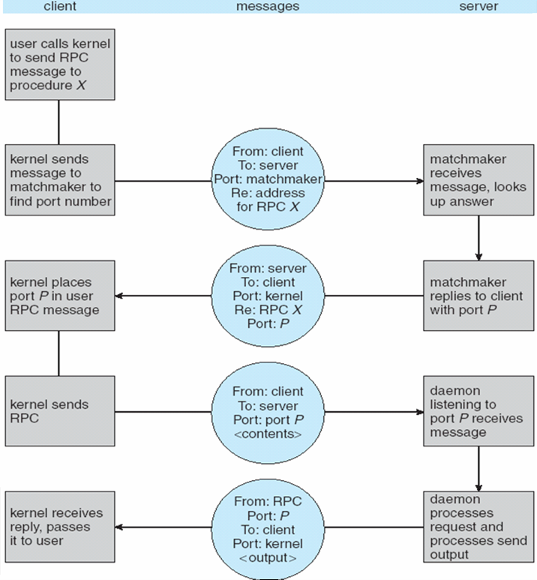

Slide 90
3.6 Communication in Client-Server Systems
    Some issues
      Differences in data representation on the client and server----XDR
      “at most once” and “exactly once”
      binding the client and the server port ——
      a procedure call’s name is replaced by the memory address of a procedure call
        （1）at compile time, an RPC call has a fixed port number associated with it
        （2） matchmaker (中介) daemon
        a client send a message containing the RPC’s name to the matchmaker daemon requesting the port address of the RPC it needs it, and the port number is returned

Slide 91
3.6 Communication in Client-Server Systems
Remote Method Invocation (RMI)
  Allows a thread to invoke a method on a remote object
    object is considered remote if they reside in a different JVM
    It may be on the same computer or on a remote host connected by a network
  RMI vs. RPC
    RPC
      only supports the invoking of remote procedure or function
      The parameters are ordinary data structures
    RMI
      supports the invoking of methods on remote objects
      The parameters can be objects
      Can develop Java application that are distributed across a network

Slide 92
3.6 Communication in Client-Server Systems
  Stub and skeleton
    To make remote methods transparent to both the client and the server
    Stub
      Is a proxy for the remote object, it resides with the client
      When a remote method is invoked, a corresponding stub is called
      Stub creates a parcel consisting of the name of the method and marshaled parameters
      Stub send the parcel to the server, and the skeleton for the remote method receive it

Slide 93
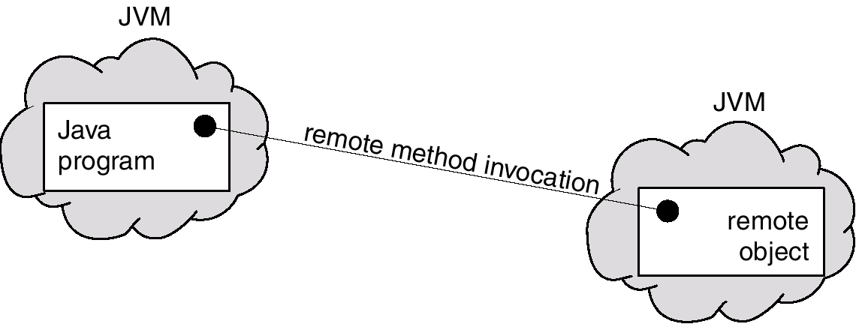
3.6 Communication in Client-Server Systems
    Skeleton
      Is responsible for unmarshalling the parameters and invoking the desired method on the server
      Return value to the stub
      The stub unmarshals the return value

Slide 94
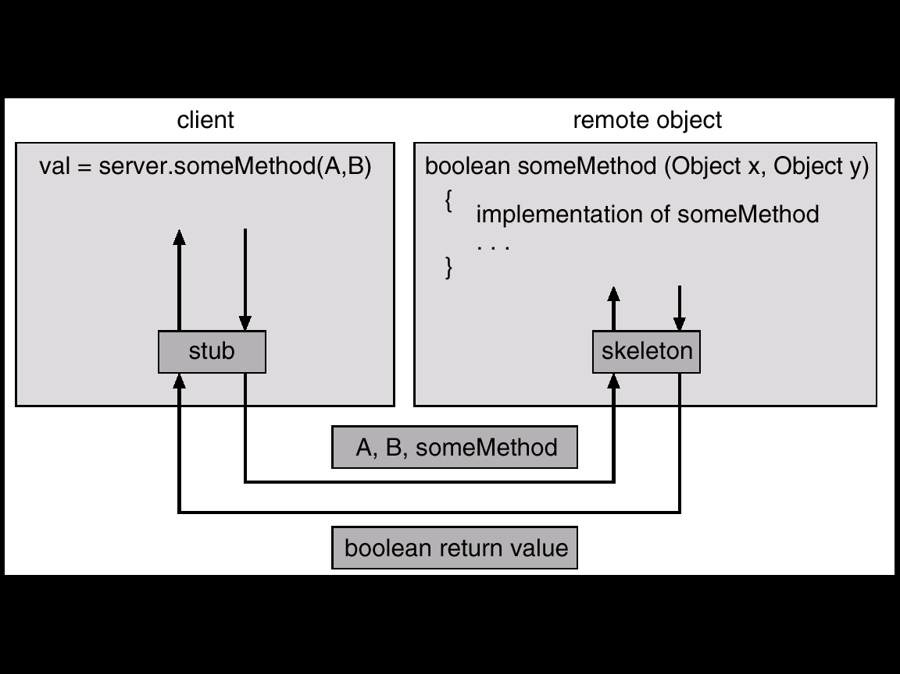
3.6 Communication in Client-Server Systems

Slide 95
experiment
3.10
Producer-Consumer Problem

Slide 96
exercises
3.1
3.2
3.6 or 3.7

