Slide 1
OPERATING SYSTEM CONCEPTS
操作系统概念
张 柏 礼
bailey_zhang@sohu.com
东南大学计算机学院

Slide 2
4. Threads
Objectives
  To introduce the notion of a thread — a fundamental unit of CPU utilization that forms the basis of multi-threaded computer systems
  To discuss the APIs for the Pthreads, Win32, and Java thread libraries
  To examine issues related to multi-threaded programming
Notes:
Utilization: 使用，占用，分配的基本单位

Slide 3
4. Threads
4.1 Overview
4.2 Multi-threading Models
4.3 Thread Libraries
4.4 Threading Issues
4.5 Operating System Examples

Slide 4
4.1 Overview
A thread is a basic unit of CPU utilization
  It comprises
    A thread ID
    A program counter
    A register set
    A stack
  It shares with other threads belonging to the same process
    Code section
    Data section
    Other OS resources, such as open files and signals

Slide 5

4.1 Overview
  A traditional (or heavyweight) process has a single thread of control
  A lightweight process has multiple threads of control, it can perform more than one task at a time

Slide 6
4.1 Overview
Motivation
  Examples of multi-threaded program:
    web browser
    word processor
    database server
    web server
Notes:
web browser：负责文本的，负责图片的，负责视频的，负责网络的

Slide 7
4.1 Overview
Benefits
  Responsiveness
    Interactive application may continue running when part of it is blocked or is performing a lengthy operation
  Resource sharing
    Threads share the memory and the resource of process to which they belong
    To allow an application to have several different threads of activity within the same address space
  Economy
    creation 30:1, context switching 5:1
  Utilization of multiprocessor architectures

Slide 8
4. Threads
4.1 Overview
4.2 Multithreading Models
4.3 Thread Libraries
4.4 Threading Issues
4.5 Operating System Examples

Slide 9
4.2 Multithreading Models
User Threads vs. Kernel Threads
  User Threads
    Provided by a thread library at the user level
    POSIX Pthreads, Mach C-threads, Solaris UI-threads
  Kernel Threads
    Provided and managed by the OS directly
    Linux， Solaris2, Windows, BeOS
  Relationship between kernel threads and user threads
    Many-to-one model
    One-to-one model
    Many-to-many model

Slide 10

4.2 Multithreading Models
Many-to-one model
  Many user-level threads mapped to single kernel thread

Slide 11
4.2 Multithreading Models
    Threads management is done by the thread library in user space, so it is efficient (no often to invoke system call)
    The entire process will block if a thread makes blocking system call
    Only one thread can access the kernel at a time, multiple threads are unable to run in parallel on multiprocessors
  Example:
    Green threads for Solaris2.
    GNU Portable Threads

Slide 12

4.2 Multithreading Models
One-to-one model
  Each user-level thread maps to a kernel thread

Slide 13
4.2 Multithreading Models
    Provides more concurrency by allowing another thread to run when a thread makes a blocking system call
    Allows multiple threads to run in parallel on multiprocessors
    Creating a user thread requires creating the corresponding kernel thread
      The overhead of creating kernel threads can burden the performance of an application
  Examples
    Windows NT/XP/2000
    Linux
    Solaris 9 and later

Slide 14

4.2 Multithreading Models
Many-to-Many Model
  Allows many user level threads to be mapped to many kernel threads.
Notes:
控制某一个时刻，只能有n个线程进入 系统态

Slide 15
4.2 Multithreading Models
  Allows the operating system to create a sufficient number of kernel threads
    The number of kernel threads may be specific to
    （1）A particular application
    （2）A particular machine
      A application may be allocated more kernel threads on a multiprocessor than on an uni-processor

Slide 16
4.2 Multithreading Models
  Advantages
    Developers can create as many users threads as necessary, and the corresponding kernel threads can run in parallel on a multiprocessor
    When a thread performs a blocking system call, the kernel can scheduler another thread for execution
  Two-level Model
    Variation on the many-to-many model
      Numbers of user threads is larger or equal to the numbers of kernel threads
      A user thread (important task) can be bound to a kernel thread

Slide 17
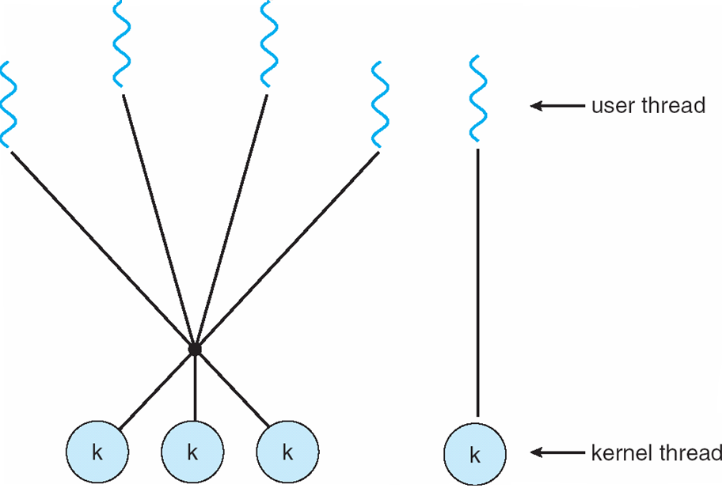
4.2 Multithreading Models
  Examples
    Solaris 2
    IRX
    HP-UX
Notes:
创建 线程时可以人为指定 多对多，或是一对一

Slide 18
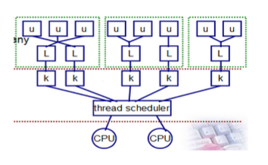
4.2 Multithreading Models

Slide 19
4. Threads
4.1 Overview
4.2 Multithreading Models
4.3 Thread Libraries
4.4 Threading Issues
4.5 Operating System Examples

Slide 20
4.3 Thread Libraries
Thread library
  provides the programmer an API for creating and managing threads
  Two primary ways of implementing
    Library entirely in user space
      All code and data structures for the library exist in user space
      Invoking a function in library results in a local function call in user space and not a system call
    Kernel-level library supported by the OS
      All code and data structures for the library exist in kernel space
      Invoking a function in library results in a local function call in a system call to the kernel
Notes:
如创建线程，不是系统调用

Slide 21
4.3 Thread Libraries
  Three main thread libraries
    POSIX Ptheads
      The threads extension the POSIX standard
      May be provided as either a user- or kernel-level library
    Win32
      Is kernel-level library available on Window systems
    Java
      JVM is running on top of a host operating system
      The Java thread API is typically implemented using a thread library available on host system
        On Windows systems, Java threads are typically implemented using the Win32 API
        On Linux and UNIX, often use Pthreads

Slide 22
4. Threads
4.1 Overview
4.2 Multithreading Models
4.3 Thread Libraries
4.4 Threading Issues
4.5 Operating System Examples

Slide 23
4.4 Threading Issues
The fork() and exec() system calls
  Two versions of fork() in UNIX systems
    To duplicate all the threads
    To only duplicate the thread that invoked the fork() system call
  Which of the two versions of fork() to use
    If exec() is called immediately after forking, then only to duplicate the calling threads
    If exec() is not called after forking, then to duplicate all threads

Slide 24
4.4 Threading Issues
Thread cancellation
  Terminates a thread before it has completed
  Two general approaches for cancellation of a target thread
    Asynchronous cancellation
      one thread immediately terminates the target thread
    Deferred cancellation
      the target thread can periodically check if it should terminate, allowing it an opportunity to terminate itself in an orderly fashion.

Slide 25
4.4 Threading Issues
  The difficulty with cancellation occurs in situations
  （1）Resources have been allocated to a canceled thread
  （2）A thread is canceled while in the midst of updating data which is sharing with other threads
    This becomes especially troublesome with asynchronous cancellation
    Deferred cancellation can be executed at cancellation points when it can be canceled safely
Notes:
（1）必须设法释放，否则显示一直被占用

Slide 26
4.4 Threading Issues
Signal handling
  A Signal is used in UNIX systems to notify a process that a particular event has occurred, it follows the pattern:
    A signal is generated by the occurrence of a particular event
    A generated signal is delivered to a process
    Once delivered, it must be handled

Slide 27
4.4 Threading Issues
  A signal may be either synchronous or asynchronous
    Synchronous signals are delivered to the same process that performed the operation that caused the signals
      E.g. illegal memory access
      E.g. division by 0
    An asynchronous signal is sent to another process
      E.g. terminating a a process with specific keystrokes
      E.g having a timer expire

Slide 28
4.4 Threading Issues
  Signal handling
    A default signal handler
      Every signal has a default signal handler
      It can be overridden by a user-defined signal handler
    A user-defined signal handler
  Handling signal in single-threaded programs is straightforward
    Signals are always delivered to a process
  Where should a signal be delivered in multithreaded programs?

Slide 29
4.4 Threading Issues
    To the thread to which the signal applies
    To every thread in the process
    To certain threads in the process
    Assign a specific thread to receive all signals for the process.
  APCs：asynchronous procedure calls
    Used in Windows
    Is roughly equivalent to an asynchronous signal in Unix
    An APC is delivered to a particular thread rather than a process

Slide 30
4.4 Threading Issues
Thread Pools
  Create a number of threads at process startup and place them into a pool where they wait for work
    When a server receives a request, it awakens a thread from the pool, and passes it the request
    Once the thread completes its service, it returns to the pool
    If the pool contains no available thread, the server waits until one becomes free
  Advantages:
    Usually slightly faster to service a request with an existing thread than to create a new thread
    Allows the number of threads in the application(s) to be bound to the size of the pool

Slide 31
4.4 Threading Issues
Thread-specific Data (线程特有/自有数据)
  Threads belongoing to a process share the data of the process
  Also each thread is allowed to have its own copy of data
    For (int j=0; j<20;j++; )
    {
    }

Slide 32
4.4 Threading Issues
Scheduler Activations（激活）
  Both M:M and Two-level models require communication between kernel threads and user threads (library)
    to maintain the appropriate number of kernel threads allocated to the application
    to help ensure the best performance
  LWP
    Light-weight process or virtual processor
    Intermediate date structure between user thread and kernel thread
    Each LWP is attached to a kernel thread
    The application can schedule a user thread on a LWP
    CPU scheduler allocates the CPUs to the kernel threads

Slide 33
4.4 Threading Issues
  Efficiency Problem
    If a kernel thread blocks, the LWP blocks as well.
    The user thread attached to the LWP also blocks
    If there are many blocked kernel threads, applications can not run efficiently whose threads must wait for the LWPs
  Scheduler activation
    a communication mechanism from the kernel to the thread library (user thread library)
    It works as follows:
      1)The kernel provides an application with a set of LWPs
      2)The application can schedule users threads onto the LWPs

Slide 34
4.4 Threading Issues
      3)If an application thread is about to block, the kernel will trigger an upcall
        This upcall is handled by an upcall handler (LWPs scheduler)
        The upcall handler is allocated ( !=created ) a new LWP to finish thread context switch.
        Then the upcall handler terminates, this LWP is allocated to another users thread

Slide 35
4.4 Threading Issues
      4) I/O is completed，another upcall will be triggered.
        A LWP will be preempted to run upcall handler
        and then application (upcall handler) will schedules an eligible thread to run on this LWP
    This communication allows an application to maintain the correct number kernel threads

Slide 36
4. Threads
4.1 Overview
4.2 Multithreading Models
4.3 Thread Libraries
4.4 Threading Issues
4.5 Operating System Examples

Slide 37
4.5 Operating System Examples
Windows XP Threads
  Implements the one-to-one mapping, kernel-level
  Each thread contains
    A thread id
    Register set
    Separate user and kernel stacks
    Private data storage area
  The register set, stacks, and private storage area are known as the context of the threads
Notes:
Private data storage area：局部变量 for（int j=0;j<3 。。。

Slide 38
4.5 Operating System Examples
  The primary data structures of a thread include:
    ETHREAD (executive thread block)
      A pointer to the father process, thread start address, a pointer to the KTHREAD
    KTHREAD (kernel thread block)
      Scheduling and synchronization information, kernel stack, a pointer to the TEB
    TEB (thread environment block)
      The thread identifier, a user-mode stack, local data

Slide 39
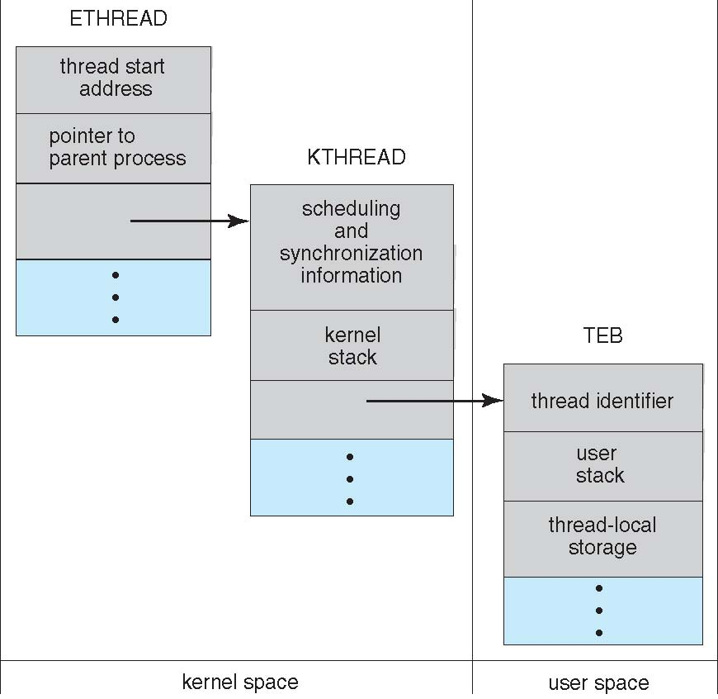
4.5 Operating System Examples

Slide 40
4.5 Operating System Examples
Linux Thread
  Linux refers to them as tasks rather than threads
  Thread creation is done through clone() system call
  clone() allows a child task to share the address space of the parent task (process)

Slide 41
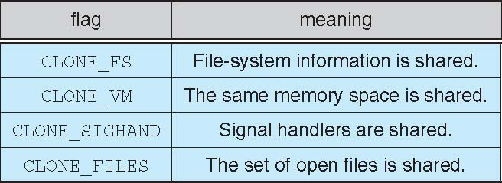
4.5 Operating System Examples

Slide 42
4.5 Operating System Examples
4.3
4.4
助教邮箱：

