Slide 1
OPERATING SYSTEM CONCEPTS
操作系统概念
张 柏 礼
bailey_zhang@sohu.com
东南大学计算机学院

Slide 2
5. CPU Scheduling
Objectives
  To introduce CPU scheduling, which is the basis for multi-programmed operating systems
  To describe various CPU-scheduling algorithms
  To discuss evaluation criteria for selecting a CPU-scheduling algorithm for a particular system

Slide 3
5. CPU Scheduling
5.1 Basic Concepts
5.2 Scheduling Criteria
5.3 Scheduling Algorithms
5.4 Multiple-Processor Scheduling
5.5 Thread Scheduling
5.6 Operating Systems Examples
5.7 Algorithm Evaluation

Slide 4
5.1 Basic Concepts
The objective of multi-programming is to have some process running at all times, to maximize CPU utilization
  Several processes are kept in memory at one time
  When a running process has to wait, the OS takes the CPU away from that process and gives the CPU to another process
  Scheduling of this kind is fundamental OS function
CPU Scheduling is central to operating-system design

Slide 5

5.1 Basic Concepts
CPU & I/O Burst Cycle
  Process execution consists of a sequence of
    （1）CPU execution
      CPU burst
    （2） wait for I/O
      I/O burst
  Process alternate between these two states

Slide 6

5.1 Basic Concepts
  CPU burst distribution
    A larger number of short CPU burst and small number of long CPU burst
    This distribution is important to select the CPU-scheduling algorithm： 80 percent of the CPU burst should be shorter than the time quantum (rule)

Slide 7
5.1 Basic Concepts
CPU Scheduler
  Short-term scheduler（or CPU scheduler ）
    Selects from among the processes in memory that are ready to execute, and allocates the CPU to one of them
  A ready queue can be implemented as
    A FIFO queue
    A priority queue
    A tree
    An unordered queue
  All the processes in the ready queue are lined up waiting for chance to run on the CPU

Slide 8
5.1 Basic Concepts
Scheduling
  CPU scheduling decisions may take place when a process:
    （1）Switches from running to waiting state
      The result of an I/O request
      An invocation of wait for the termination of one of the child processes （e.g. wait(NULL);）
    （2）Switches from running to ready state
      When a interrupt occurs
    （3）Switches from waiting to ready
      Completion of I/O
    （4）Terminates

Slide 9
5.1 Basic Concepts
  Non-preemptive (非剥夺)
    Scheduling takes place only under
      （1） and （4）
    Once the CPU has been allocated to a process, the process keeps the CPU until it releases the CPU
      either by terminating
      or by switching to the waiting state (I/O 主动放弃CPU)
    Can be used on certain hardware platforms for no requiring the special hardware (for example, timer is not needed)
    Windows 3.x

Slide 10
5.1 Basic Concepts
  Preemptive(剥夺)
    Scheduling takes place under all condition (1)---(4)
    Win 9x, Win NT/2K/XP, Linux，Mac OS X
    Incurs a cost associated with access to shared data (chapter 6)
      Updating data is not finished
      Need a mechanisms to avoid data inconsistent
    Affects the design of the operating-system kernel

Slide 11
5.1 Basic Concepts
Dispatcher
  Is the module that gives the CPU control to the process selected by CPU scheduler
  this involves:
    switching context (saving context and restoring context)
    switching to user mode (from monitor mode → user mode)
    jumping to the proper location in the user program to restart that program (PC counter)
  Dispatch latency – the time it takes for the dispatcher to stop one process and start another running.

Slide 12
5. CPU Scheduling
5.1 Basic Concepts
5.2 Scheduling Criteria（准则）
5.3 Scheduling Algorithms
5.4 Multiple-Processor Scheduling
5.5 Thread Scheduling
5.6 Operating Systems Examples
5.7 Algorithm Evaluation

Slide 13
5.2 Scheduling Criteria
Many criteria have been suggested for comparing CPU scheduling algorithms.
Include the following:
  CPU utilization (利用率)
    keep the CPU as busy as possible.
  CPU throughput (吞吐量)
    number of processes that complete their execution per time unit.
  Process turnaround time (周转时间)
    amount of time to execute a particular process
    From the time of submission of a process to the time of completion, include
      Waiting to get into memory
      Waiting in the ready queue
      Executing on the CPU
      Doing I/O

Slide 14
5.2 Scheduling Criteria
  Process waiting time (等待时间)
    amount of time that a process spent waiting in the ready queue.
    The CPU scheduling algorithm
      does not affect the amount of time during which a process executes or does I/O
      only affects the waiting time
  Process response time (响应时间)
    In an interactive system, turnaround time may not be the best criterion
    amount of the time from the submission of a request until the first response/result is produced
      Is the time it takes to start responding
      Is not the time it takes to output the result

Slide 15
5.2 Scheduling Criteria
It is desirable to
  Maximize CPU utilization.
  Maximize CPU throughput.
  Minimize process turnaround time.
  Minimize process waiting time.
  Minimize process response time
In most cases
  We optimize the average measure
Under some circumstance
  It is desirable to optimize the minimum or maximum value rather than the average
  For example, to guarantee that all users get good service, we want to minimize the maximum response time

Slide 16
5.2 Scheduling Criteria
For interactive systems (such as time sharing system)
  Minimize the variance(波动) in response time than to minimize the average response time
  A system with reasonable and predictable response time may be considered more desirable than a system that is faster on the average time but is highly variable

Slide 17
5. CPU Scheduling
5.1 Basic Concepts
5.2 Scheduling Criteria
5.3 Scheduling Algorithms
5.4 Multiple-Processor Scheduling
5.5 Thread Scheduling
5.6 Operating Systems Examples
5.7 Algorithm Evaluation

Slide 18
5.3 Scheduling Algorithms
Scheduling algorithms
  （1）First come first served (FCFS)
    先来先服务调度
  （2）Shortest job first (SJF)
    短作业优先调度
  （3）Priority scheduling
    优先权调度
  （4）Round robin (RR)
    轮转法调度
  （5）Multilevel queue algorithm
    多级队列调度
  （6）Multilevel feedback queue algorithm
    多级反馈队列调度
Notes:
/ FIFO

Slide 19
5.3 Scheduling Algorithms
（1） FCFS
  First-Come, First-Served Scheduling
    The process that requests CPU first is allocated the CPU first
    The implementation of the FCFS policy is easily managed by a FIFO queue
  examples

Slide 20
5.3 Scheduling Algorithms
    The average waiting time under FCFS policy is often quite long
      Process Burst Time (CPU耗时 ms)
      P₁ 24
      P₂ 3
      P₃ 3
    Suppose that the processes arrive in the order: P₁ , P₂ , P_{3 。}The Gantt Chart for the schedule is:
    Waiting time for P₁ = 0; P₂ = 24; P₃ = 27
    Average waiting time: (0 + 24 + 27)/3 = 17(ms)
P₁
P₂
P₃
0
24
27
30

Slide 21
5.3 Scheduling Algorithms
    Suppose that the processes arrive in the order
    P₂ , P₃ , P₁ .The Gantt chart for the schedule is:
    Waiting time for P₁ = 6; P₂ = 0; P₃ = 3.
    Average waiting time: (6 + 0 + 3)/3 = 3 (ms)
    Much better than previous case.
    the variance in average waiting time is great
  The average waiting time under an FCFS policy may vary substantially if the process’s CPU burst times vary greatly
P₂
P₃
P₁
0
3
6
30
Notes:
3-28

Slide 22
5.3 Scheduling Algorithms
  Convoy effect (护航效应) :
    All the other processes wait for the one big processes to get off the CPU
    This effect results in lower CPU and device utilization than might be possible if the shorter processes were allowed to go first
  The FCFS scheduling algorithm is non-preemptive.
    It would be disastrous to allow one process to keep the CPU for an extended period.

Slide 23
5.3 Scheduling Algorithms
（2） SJF
  Shortest-Job-First Scheduling
  next CPU burst (下一个CPU执行期长度)
    Associate the length of its next CPU burst with each process
    When the CPU is available, it is assigned to the process with the shortest next CPU burst
    If the next CPU bursts of two processes are the same, FCFS scheduling is used

Slide 24
5.3 Scheduling Algorithms
  SJF is provably optimal in that it gives the minimum average waiting time for a given set of processes
    Moving a short process before a long one decreases the waiting time of the short process more than it increases the waiting time of the long process

Slide 25
5.3 Scheduling Algorithms
  Example 1
    Process Burst Time(ms)
    P₁ 6
    P₂ 8
    P₃ 7
    P₄ 3
    The Gantt chart for the schedule is:
    Average waiting time = (3+16+9+0)/4 = 7(ms)
      Using FCFS =10.25(ms)
P₄
P₁
P₃
P₂
0
3
9
16
24

Slide 26
5.3 Scheduling Algorithms
  SJF can be either preemptive or non-preemptive
    Preemptive SJF allows to preempt the currently executing process
    Preemptive SJF is sometimes called shortest-remaining-time-scheduling

Slide 27

5.3 Scheduling Algorithms
  Example 2 （preemptive）
    Process Arrival Time Burst Time
    P₁ 0.0 8
    P₂ 1.0 4
    P₃ 2.0 9
    P₄ 3.0 5
    The Gantt chart for the schedule is:
    Average waiting time = (9+0+15+2)/4 = 26/4=6.5

Slide 28
5.3 Scheduling Algorithms
  The difficulty is knowing the length of the next CPU burst
    Suitable for long-term scheduling in a batch system
      Use the process time limit as the length
      Users are motivated to estimate the process time limit accurately for a lower value meaning faster response
      SJF is used frequently in long-term scheduling
    Not very good for short-term scheduling
      No way to know the next CPU burst

Slide 29
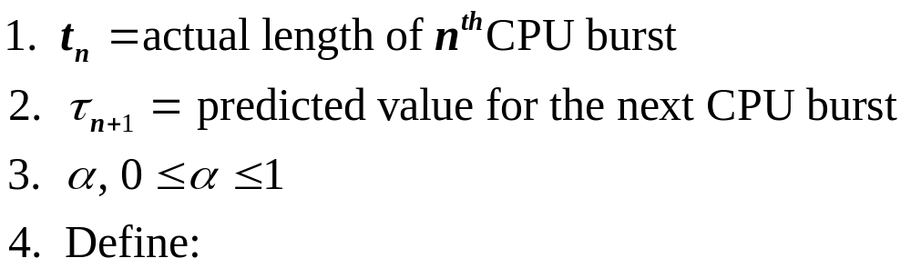
5.3 Scheduling Algorithms
      Try to approximate SJF scheduling---predict the next CPU burst
        Can be done by using the length of previous CPU bursts, using exponential averaging
      τ_{n+1} = α t_{n}+(1 - α) τ_{n}

Slide 30
5.3 Scheduling Algorithms
    α =0
      τ_{n+1} = τ_{n.} Recent history does not count.
    α =1
      τ_{n+1} = t_{n:} Only the actual last CPU burst counts.
    If we expand the formula, we get:
        τ_{n+1} = α t_{n}+(1 - α) α t_{n} ₋₁ + …
        +(1 - α )^{j} α t_{n} _{-j} + …
        +(1 - α )^{n=1} τ₀
    Since both α and (1 - α) are less than or equal to 1, each successive term has less weight than its predecessor.

Slide 31

5.3 Scheduling Algorithms
Notes:
曲线是预测曲线

Slide 32
5.3 Scheduling Algorithms
（3）Priority Scheduling
  A priority number (integer) is associated with each process
    SJF is a priority scheduling where priority is the predicted next CPU burst time
  The CPU is allocated to the process with the highest priority
  (in this book, smallest integer ≡ highest priority)
    Preemptive
    Non-preemptive
  Priority is defined by
    Time limits
    Memory requirements
    The number of open files
    The ratio of average I/O burst
    Average CPU burst
    ……

Slide 33
5.3 Scheduling Algorithms
  Problem
    Starvation (饥饿) – low priority processes may never execute
  Solution
    Aging (时效) – as time progresses increase the priority of the process

Slide 34
5.3 Scheduling Algorithms
（4）Round Robin (RR)
  Is designed for especially for time-sharing systems
  Each process gets a small unit of CPU time (time slice or time quantum:时间片)
    usually 10-100 milliseconds
    After this time has elapsed
    the process is preempted and added to the end of the ready queue.

Slide 35
5.3 Scheduling Algorithms
  If there are n processes in the ready queue and the time quantum is q
    each process gets 1/n of the CPU time（ at most q time units at once）
    No process waits more than (n-1)q time units.

Slide 36
5.3 Scheduling Algorithms
  A example（q=4）
    Process Burst Time
    P₁ 24
    P₂ 3
    P₃ 3
    The Gantt chart is:
    The average waiting time=17/3=5.66
    Typically, higher average turnaround than SJF, but better response
P₁
P₂
P₃
P₁
P₁
P₁
P₁
P₁
0
4
7
10
14
18
22
26
30
Notes:
Response time=？2 （n-1)q

Slide 37

5.3 Scheduling Algorithms
  The performance of RR depends heavily on the size of the time slice q
    q large ⇒ FCFS
    q small ⇒ q must be large with respect to context switch, otherwise overhead is too high
    A rule: 80 percent of the CPU burst should be shorter than the time quantum

Slide 38

5.3 Scheduling Algorithms
    Turnaround time of RR also depends on the size of the time slice q

Slide 39
5.3 Scheduling Algorithms
（5）Multilevel Queue
  Ready queue is partitioned into several separate queues, for example:
    foreground (interactive) processes
    background (batch) processes
    --- they have different response-time requirements and different scheduling needs
  Each queue has its own scheduling algorithm
    foreground – RR
    background – FCFS

Slide 40
5.3 Scheduling Algorithms
  Scheduling must be done between the queues
    Fixed priority scheduling
      The foreground queue may have absolute priority（优先权） scheduling over the background
      Possibility of starvation
    Time slice scheduling
      each queue gets a certain amount of CPU time which it can schedule among its processes
        80% to foreground in RR
        20% to background in FCFS

Slide 41
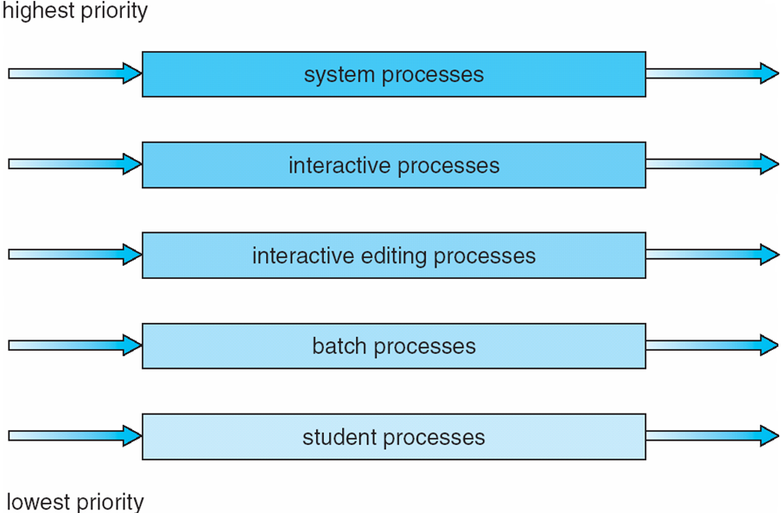
5.3 Scheduling Algorithms
Another example

Slide 42
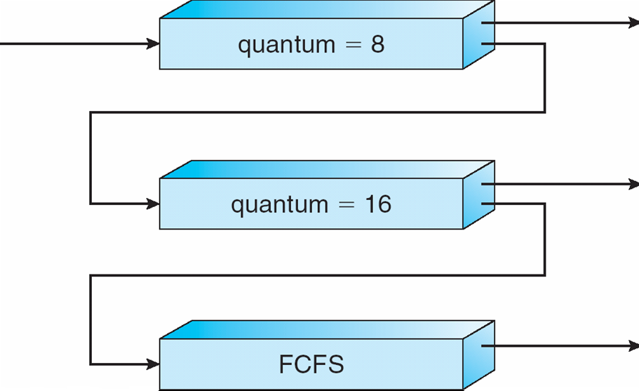
5.3 Scheduling Algorithms
（6） Multilevel Feedback Queue
  A process can move between the various queues
    A process uses too much CPU time, it will be moved to a lower-priority queue
    A process waits too long in a low-priority queue, it may be moved to a high-priority queue
    aging (时效) can be implemented by this way

Slide 43
5.3 Scheduling Algorithms
  Multilevel-feedback-queue scheduler defined by the following parameters:
    number of queues
    scheduling algorithms for each queue
    method used to determine when to upgrade a process
    method used to determine when to demote a process
    method used to determine which queue a process will enter when that process needs service
  Multilevel-feedback-queue scheduler is the most general scheduling algorithm, and it is also the most complex algorithm

Slide 44
5. CPU Scheduling
5.1 Basic Concepts
5.2 Scheduling Criteria
5.3 Scheduling Algorithms
5.4 Multiple-Processor Scheduling
5.5 Thread Scheduling
5.6 Operating Systems Examples
5.7 Algorithm Evaluation

Slide 45
5.4 Multiple-Processor Scheduling
CPU scheduling more complex when multiple CPUs are available
  As single-processor CPU scheduling, no one best solution
  Homogeneous(同构) vs. heterogeneous(异构) CPUs
    Homogeneous：the processors are identical, can use any available processor to run any process in the queue

Slide 46
5.4 Multiple-Processor Scheduling
Approaches to multiple-processor scheduling
  Asymmetric multiprocessing （AMP,非对称）
    only one processor (the master server) has all scheduling decision, I/O processing
    The other processors execute only user code
    Is simple because only one processor accesses the system data structures, reducing the need for data sharing
  Symmetric multiprocessing (SMP，对称)
    each processor is self-scheduling
    all processes in common ready queue or each processor has its own private queue of ready processes
    Windows, Solaris, Linux, and Mac OS X

Slide 47
5.4 Multiple-Processor Scheduling
Processor affinity(耦合)
  Process has affinity for processor on which it is currently running
    Most SMP system attempt to keep a process running on the same processor
  soft affinity
    Not guaranteeing
  hard affinity
    guaranteeing

Slide 48
5.4 Multiple-Processor Scheduling
Loading balancing
  Keep the workload evenly distributed across all processors in an SMP system
  Two general approaches
    Push migration
      A specific task pushes processes from overload to idle or less-busy processors
    Pull migration
      An idle processor pulls a waiting task from a busy processor

Slide 49
5.4 Multiple-Processor Scheduling
Symmetric multithreading
  SMT(对称多线程) or Hyper-threading technology(超线程技术)
  To create multiple logical processors on same physical processor
    Share the resources of its physical processors
  To present a view of several logical processors to OS
    Each logical processor
      has general-purpose and machine-state registers
      Is responsible for its own interrupt handling
  SMT is provided in hardware, not software
  (different from VM)

Slide 50
5. CPU Scheduling
5.1 Basic Concepts
5.2 Scheduling Criteria
5.3 Scheduling Algorithms
5.4 Multiple-Processor Scheduling
5.5 Thread Scheduling
5.6 Operating Systems Examples
5.7 Algorithm Evaluation

Slide 51
5.4 Thread Scheduling
Distinction between user-level and kernel-level threads
  It is kernel-level threads—not processes—that are being scheduled by OS
  user-level threads are managed by a thread library
  To run on a CPU, user-level threads must ultimately be mapped to an associated kernel-level thread
Contention scope
  process-contention scope (PCS)
  system-contention scope (SCS)

Slide 52
5.4 Thread Scheduling
  process-contention scope (PCS)
    Many-to-one and many-to-many models, thread library schedules user-level threads to run on LWP（虚拟CPU）
    competition for “CPU”（LWP） takes place among threads belonging to the same process
    Scheduling user threads onto available LWPs don’t mean that the thread running on a CPU
    It require the OS to schedule the kernel thread onto a physical CPU
    Typically, PCS is done according to priority

Slide 53
5.4 Thread Scheduling
  system-contention scope (SCS)
    To decide which kernel thread to schedule onto a CPU
    Competition for the CPU among all threads in system
    System using the one-to-one model schedules threads only using SCS
      Such as Windows XP, Solaris 9, and Linux

Slide 54
5.4 Thread Scheduling
POSIX Pthread Scheduling
  API allows specifying either PCS or SCS during thread creation
    PTHREAD_SCOPE_PROCESS schedules threads using PCS scheduling
    PTHREAD_SCOPE_SYSTEM schedules threads using SCS scheduling.

Slide 55
5.4 Thread Scheduling
      #include <pthread.h>
      #include <stdio.h>
      #define NUM_THREADS 5
      int main(int argc, char *argv[])
      {
      int i;
      pthread_t tid[NUM_THREADS];
      pthread_attr_t attr;
      /* get the default attributes */
      pthread_attr_init(&attr);
      /* set the scheduling algorithm to PROCESS or SYSTEM */
      pthread_attr_setscope(&attr, PTHREAD_SCOPE_SYSTEM);
      /* set the scheduling policy - FIFO, RT, or OTHER */
      pthread attr setschedpolicy(&attr, SCHED OTHER);
Notes:
FIFO =FCFS RT ---RR

Slide 56
5.4 Thread Scheduling
      /* create the threads */
      for (i = 0; i < NUM THREADS; i++)
      pthread create(&tid[i],&attr,runner,NULL);
      /* now join on each thread */
      for (i = 0; i < NUM THREADS; i++)
      pthread join(tid[i], NULL);
      }
      /* Each thread will begin control in this function */
      void *runner(void *param)
      {
      printf("I am a thread\n");
      pthread exit(0);
      }

Slide 57
5. CPU Scheduling
5.1 Basic Concepts
5.2 Scheduling Criteria
5.3 Scheduling Algorithms
5.4 Thread Scheduling
5.5 Multiple-Processor Scheduling
5.6 Operating Systems Examples
5.7 Algorithm Evaluation

Slide 58
5.6 Operating Systems Examples
Solaris scheduling
  Is the scheduling of kernel threads
  Uses priority-based thread scheduling, has defined four classes of scheduling
    Real time
    System
    Time sharing
    Interactive
Notes:
classes(等级)

Slide 59
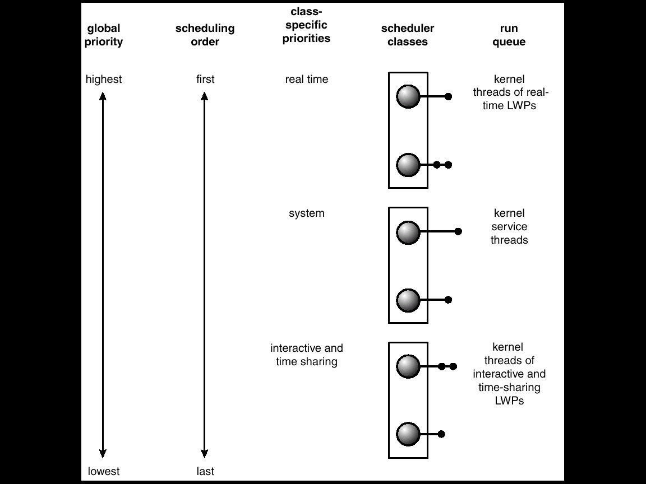
5.6 Operating Systems Examples

Slide 60
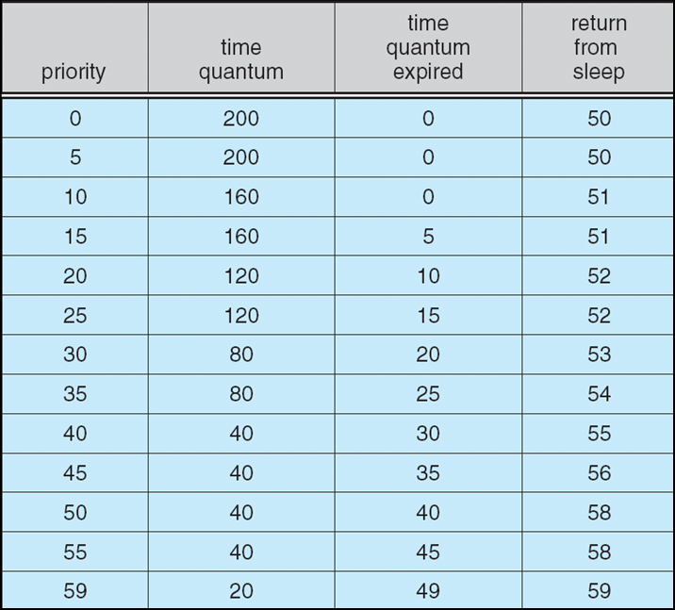
5.6 Operating Systems Examples
  Solaris Dispatch Table

Slide 61
5.6 Operating Systems Examples
Windows XP
  Using a priority-based, preemptive scheduling algorithm
  Dispatcher
    Handles scheduling
    Ensures that the highest-priority thread will always run

Slide 62
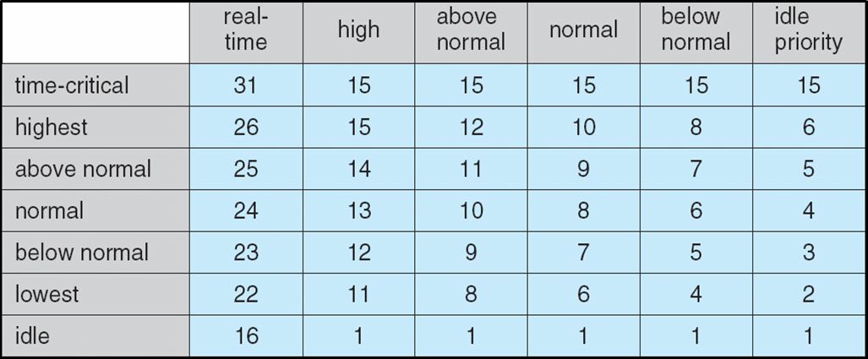
5.6 Operating Systems Examples
  Windows XP Priorities
    Real-time class(16-31)
    Variable class(1-15)
    idle

Slide 63
5.6 Operating Systems Examples
Linux Scheduling
  Features
    Task: not distinguish between processes and threads
    Constant order O(1) scheduling time regardless of the number of tasks on the system
    Support for SMP
      Processor affinity and load balancing
  Be a preemptive, priority-based algorithm, with two priority ranges
    Real-time range from 0 to 99
    nice value from 100 to 140
    Lower values indicated higher priorities

Slide 64
5.6 Operating Systems Examples
  Difference from other system
    Assigns higher-priority tasks longer time quanta and lower-priority tasks shorter time quanta
    When a task has exhausted its time slice, it is considered expired and is not eligible for execution again until all other tasks have exhausted their time quanta

Slide 65
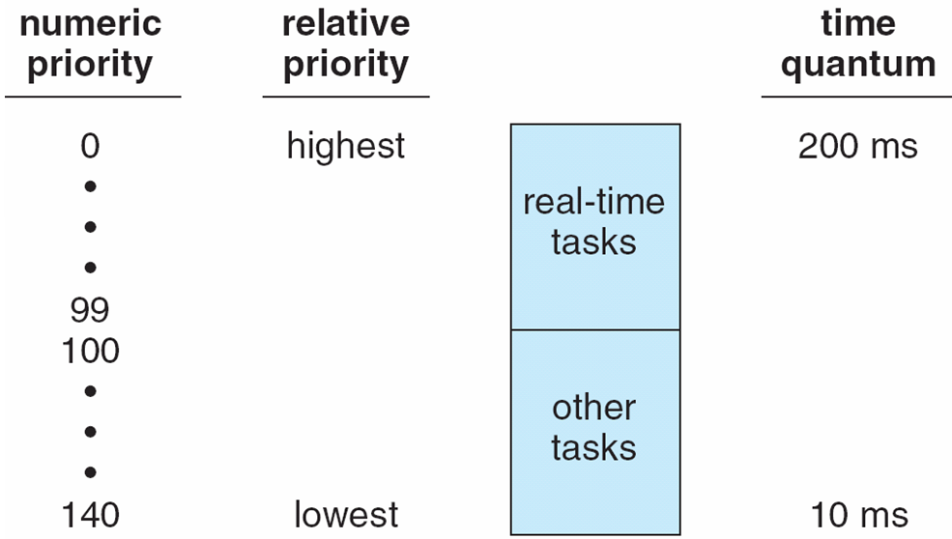
5.6 Operating Systems Examples

Slide 66
5. CPU Scheduling
5.1 Basic Concepts
5.2 Scheduling Criteria
5.3 Scheduling Algorithms
5.4 Thread Scheduling
5.5 Multiple-Processor Scheduling
5.6 Operating Systems Examples
5.7 Algorithm Evaluation

Slide 67
5.7 Algorithm Evaluation
Deterministic modeling（确定性建模）
  takes a particular predetermined workload and defines the performance of each algorithm for that workload
  To describe scheduling algorithms and provide examples
  Simple and fast, but too specific to be useful

Slide 68
5.7 Algorithm Evaluation
Queueing models（排队模型）
  Queueing-network analysis
    The computer system is described as a network of servers.
    Each server has a queue of waiting process.
    The CPU is a server with its ready queue, as is the I/O system with its device queues
    Knowing arrival rates and service rates, we can compute utilization, average queue length, average wait time, and so on.
      n = λ ×W （队列长度=达到率×等待时间）
  Useful for comparing scheduling algorithms
  Real distributions are difficult to work with
  Some assumptions required.

Slide 69
5.7 Algorithm Evaluation
Simulations(模拟)
  involve programming a model of the computer system.
    Software data structures represent the major components of the system.
    The simulator has a variable representing a clock
    as this variable ‘s value is increased, the simulator modifies the system to reflect the activities of the device, the processes, and the scheduler.
    As the simulation executes, statistics that indicate algorithm performance are gathered and printed.
  Artificial data or trace tapes
  Useful but expensive.

Slide 70
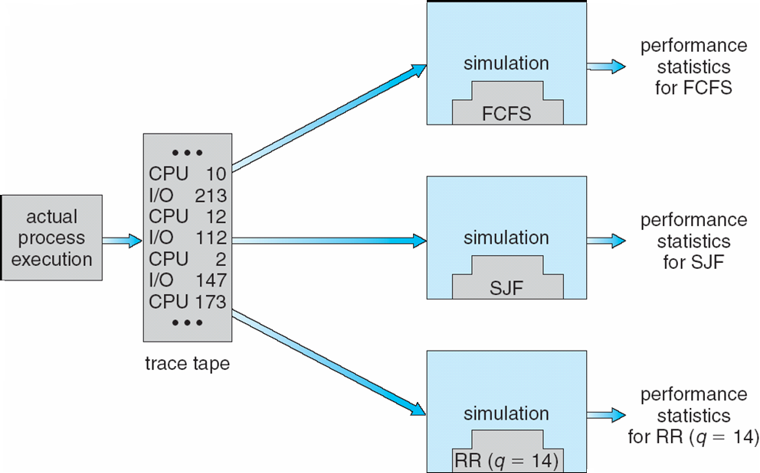
5.7 Algorithm Evaluation

Slide 71
5.7 Algorithm Evaluation
Implementation(实现)
  To code the algorithm
  To put it in the OS
  To see how it works
Costly
➔ A Perfect Scheduling Algorithm Is Not Easy To Found.
Notes:
➔ In Practice, We Don’t Really Need The Perfect Scheduling Algorithm.

Slide 72
exercises
5.1
5.2
5.4
5.5
5.10

