Slide 1
OPERATING SYSTEM CONCEPTS
操作系统概念
张 柏 礼
bailey_zhang@sohu.com
东南大学计算机学院

Slide 2
7 Deadlocks
Objectives
  To develop a description of deadlocks, which prevent sets of concurrent processes from completing their tasks
  To present a number of different methods for preventing or avoiding deadlocks in a computer system

Slide 3
7 Deadlocks
7.1 System Model
7.2 Deadlock Characterization
7.3 Methods for Handling Deadlocks
7.4 Deadlock Prevention
7.5 Deadlock Avoidance
7.6 Deadlock Detection
7.7 Recovery from Deadlock

Slide 4
7.1 System Model
The Deadlock Problem
  Example1
    System has 2 tape drivers
    P₁ and P₂ each hold one tape driver and each needs another one
  Example2
    semaphores A and B, initialized to 1
        P₀ P₁
        wait (A); wait(B)
        wait (B); wait(A)

Slide 5
7.1 System Model
  Example3: bridge crossing
    Traffic only in one direction on the bridge.
    Each section of a bridge can be viewed as a resource.
    If a deadlock occurs, it can be resolved if one car backs up (preempt resources and rollback).
    Several cars may have to be backed up if a deadlock occurs.
    Starvation is possible.

Slide 6
7.1 System Model
System model
  Resource are partitioned into several types
  R₁, R₂, . . ., R_{m}
    CPU cycles
    memory space
    I/O devices: prints, tape drivers
  Each resource type R_{i} may have W_{i} instances.
    To process, all instances of this type are identical(等同的)

Slide 7
7.1 System Model
  Each process utilizes a resource as follows:
    request
      If the request can’t be granted immediately, the process must wait until it can acquire the resource.
    use
    Release
  A set of processes is in a deadlock state
    Each is holding a resource and waiting to acquire a resource held by another process in the set

Slide 8
7 Deadlocks
7.1 System Model
7.2 Deadlock Characterization
7.3 Methods for Handling Deadlocks
7.4 Deadlock Prevention
7.5 Deadlock Avoidance
7.6 Deadlock Detection
7.7 Recovery from Deadlock

Slide 9
7.2 Deadlock Characterization
Necessary conditions（死锁的必要条件）
  Mutual exclusion (存在互斥)
    To non-sharable resource(临界资源)
    1）only one process at a time can use the resource（临界资源）
    2）If another process requests that resource, it must wait until the resource has been released
  Hold and wait（保持等待）
    a process holding at least one resource is waiting to acquire additional resources held by other processes
  No preemption（非剥夺性）
    Resources can’t be preempted
    a resource can be released only voluntarily(自愿地) by the process holding it, after that process has completed its task

Slide 10
7.2 Deadlock Characterization
  Circular wait（循环等待）
    there exists a set {P₀, P₁, …, P_{n}} of waiting processes such that
      P₀ is waiting for a resource that is held by P₁,
      P₁ is waiting for a resource that is held by P₂,
      …,
      P_{n–1} is waiting for a resource that is held by P_{n},
      and P_{n} is waiting for a resource that is held by P₀
    It implies the hold-and-wait condition
    All four conditions must hold for deadlock to occur

Slide 11
7.2 Deadlock Characterization
Resource-Allocation Graph(资源分配图)
  Be a directed graph, can describe the deadlocks precisely
  A set of vertices V and a set of edges E.
    V is partitioned into two types:
      P = {P₁, P₂, …, P_{n}}, the set consisting of all the processes in the system
      R = {R₁, R₂, …, R_{m}}, the set consisting of all resource types in the system
    request edge – directed edge P_{i} → R_{j}
    assignment edge – directed edge R_{j} → P_{i}

Slide 12
7.2 Deadlock Characterization
    Process
    Resource Type with 4 instances
    P_{i} requests instance of R_{j}
    P_{i} is holding an instance of R_{j}
P_{i}
P_{i}
R_{j}

Slide 13


7.2 Deadlock Characterization
  Example
    P1→R1→P2→R3→P3→R2→P1
    P2→R3→P3→R2→P2

Slide 14

7.2 Deadlock Characterization
  If graph contains no cycles ⇒ no deadlock
  If graph contains a cycle ⇒
    if only one instance per resource type, then deadlock
    if several instances per resource type, possibility of deadlock

Slide 15
7 Deadlocks
7.1 System Model
7.2 Deadlock Characterization
7.3 Methods for Handling Deadlocks
7.4 Deadlock Prevention
7.5 Deadlock Avoidance
7.6 Deadlock Detection
7.7 Recovery from Deadlock

Slide 16
7.3 Methods for Handling Deadlocks
Three ways
  1）Prevention or avoidance (预防或避免)
    Use a protocol to prevent or avoid deadlocks
    Ensure that the system will never enter a deadlock state
    Prevention
      Provides a set of methods for ensuring that at least one of necessary conditions cannot be held
    Avoidance
      using the addition information
      Decide whether the current request can be satisfied or must be delay

Slide 17
7.3 Methods for Handling Deadlocks
  2）Detection and recovery
    Allow the system to enter a deadlock state
    Detect it and then recover
  3）Ignorance
    Ignore the problem and pretend that deadlocks never occur in the system
    used by most operating systems, including UNIX and windows
      It is cheaper than other methods
      Deadlocks occur infrequently
      If necessarily, the application developer can write programs to hand deadlocks
Notes:
Comments
None of basic approaches alone is appropriate four the entire spectrum of resource-allocation problem in operating systems
The basic approaches can be combined
Allowing us to select an optimal approach for each class of resources in system

Slide 18
7 Deadlocks
7.1 System Model
7.2 Deadlock Characterization
7.3 Methods for Handling Deadlocks
7.4 Deadlock Prevention
7.5 Deadlock Avoidance
7.6 Deadlock Detection
7.7 Recovery from Deadlock

Slide 19
7.4 Deadlock Prevention
Mutual Exclusion
  must hold for non-sharable resources(临界资源)

Slide 20
7.4 Deadlock Prevention
Hold and Wait
  Solution protocols: must guarantee that whenever a process requests a resource, it does not hold any other resources
  ☆Need process to request and be allocated all its resources before it begins execution
  Or
  ☆ Allow process to request resources only when the process has none
    Before requesting, any resources that have allocated to the process must be release
  Low resource utilization; starvation possible

Slide 21
7.4 Deadlock Prevention
No Preemption
  Solution Protocol 1（谦让型 released）：
    If a process P1 that is holding some resources requests another resource that cannot be immediately allocated to it (must wait)
      all resources currently being held by P1 are released/preempted
      Preempted resources are added to the list of resources for which the process is waiting
      Process P1 will be restarted only when it can regain its old resources, as well as the new ones that it is requesting

Slide 22
7.4 Deadlock Prevention
  Solution Protocol 2（抢夺型 preempt）：
    If a process requests some resource, we first check whether they are available
      If they are not and are allocated to the waiting processes
      Preempt these resource from the waiting processes
  Be applied to the resources whose state can be easily saved and restored later.
    Such as CPU registers or memory

Slide 23
7.4 Deadlock Prevention
Circular Wait
  Solution Protocol
    impose a total ordering of all resource types
    require that each process requests resources in an increasing order of enumeration
    Using this protocol can be proven that the circular-wait cannot hold
    Example: witness
    An appropriate ordering of all resource types is defined difficultly
Notes:
必须按顺序申请，如要申请地序号的必须释放已占有的高序号资源 enumeration [i,nju:mə‘reiʃən]n. 计算, 列举-----------------编程带来很大的不方便
可用在 应用固定的场合，可以定制，这样方便选择一个比较适合的排序

Slide 24
7 Deadlocks
7.1 System Model
7.2 Deadlock Characterization
7.3 Methods for Handling Deadlocks
7.4 Deadlock Prevention
7.5 Deadlock Avoidance
7.6 Deadlock Detection
7.7 Recovery from Deadlock

Slide 25
7.5 Deadlock Avoidance
Side effects of deadlock prevention
  low device utilization and reduce system throughput.
Deadlock avoidance
  For every request
    The system requires additional information
      the resources currently available
      the resources currently allocated, and
      the future requests and releases of each process
    The system decides whether the current request can be satisfied or must wait to avoid a possible future deadlock

Slide 26
7.5 Deadlock Avoidance
  The simplest and most useful deadlock avoidance model
    requires that each process declare the maximum number of resources of each type that it may need.
      Using the priori information to construct an deadlock-avoidance algorithm
      Resource-allocation state is defined by the number of available and allocated resources, and the maximum demands of the processes
    The algorithm dynamically examines the resource-allocation state to ensure that there can never be a circular-wait condition

Slide 27
7.5 Deadlock Avoidance
Safe State
  When a process requests an available resource, system must decide if immediate allocation leaves the system in a safe state
  System is in safe state if there exists a safe sequence。
  —A sequence of processes <P₁, P₂, …, P_{n}> is a safe sequence:
    for P1, the resources that P1 can still request can be satisfied
    for each P_{i}, the resources that P_{i} can still request can be satisfied by currently available resources + resources held by all the P_{j}, with j < i. That is:

Slide 28
7.5 Deadlock Avoidance
    That is:
      If the resources that P_{i} needs are not immediately available, then P_{i} can wait until all P_{j} have finished (j < i)
      When P_{j} is finished, P_{i} can obtain needed resources, execute, return allocated resources, and terminate
      When P_{i} terminates, P_{i +1} can obtain its needed resources, and so on

Slide 29

7.5 Deadlock Avoidance
  Avoidance ⇒ ensure that a system will never enter an unsafe state.
    If a system is in safe state ⇒ no deadlocks
    If a system is in unsafe state ⇒ possibility of deadlock

Slide 30
7.5 Deadlock Avoidance
Two avoidance algorithms
  Resource allocation graph algorithm
    every resource type has a single instance.
  Banker’s algorithm
    every type has any number of instances

Slide 31
7.5 Deadlock Avoidance
Resource allocation graph algorithm
  Claim edge(需求边)
    Claim edge P_{j}→ R_{j} indicated that process P_{j} may request resource R_{j}
    represented by a dashed line
    Claim edge converts to request edge when a process requests a resource
  Request edge converted to an assignment edge when the resource is allocated to the process
  When a resource is released by a process, assignment edge reconverts to a claim edge
  Resources must be claimed a priori in the system

Slide 32
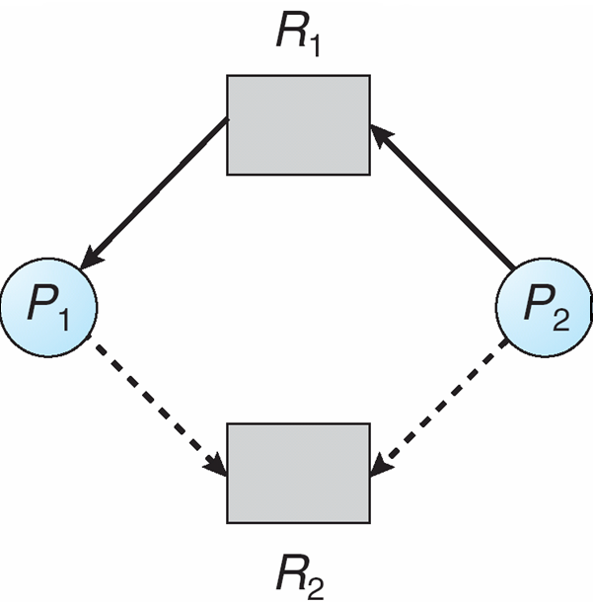
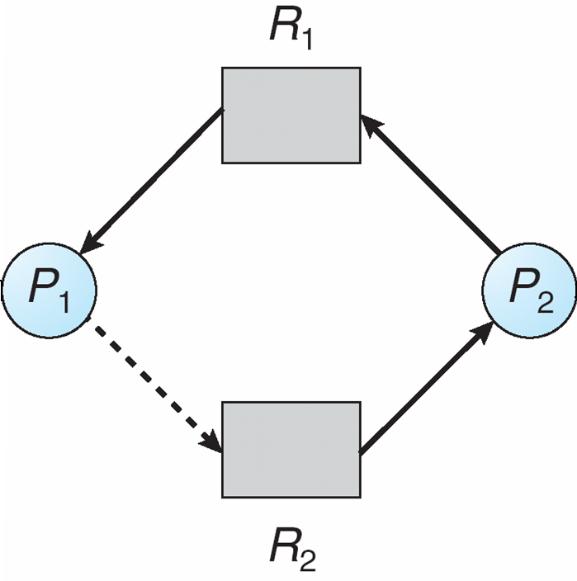
7.5 Deadlock Avoidance
  If no cycle exists, the allocation of the resource will leave the system in a safe state
  If cycle exists, the allocation of the resource will put the system in an unsafe state
    If P2 requests R2
    R2 can’t be allocated to P2
  The request can be granted only if converting the request edge to an assignment edge does not result in the formation of a cycle in the resource allocation graph

Slide 33
7.5 Deadlock Avoidance
Banker’s Algorithm
  precondition
    Multiple instances of each resource type
    Each process must a priori claim maximum use.
    When a process requests a resource, it may have to wait （for judging）.
    When a process gets all its resources, it must return them in a finite amount of time.

Slide 34
7.5 Deadlock Avoidance
  Data Structures
      Let n = number of processes, and m = number of resources types
    Available(可用资源向量):
      Vector of length m
      If available [j] = k, there are k instances of resource type R_{j} available
    Max(最大需求矩阵):
      nⅹm matrix.
      If Max [i,j] = k, then process P_{i} may request at most k instances of resource type R_{j}

Slide 35
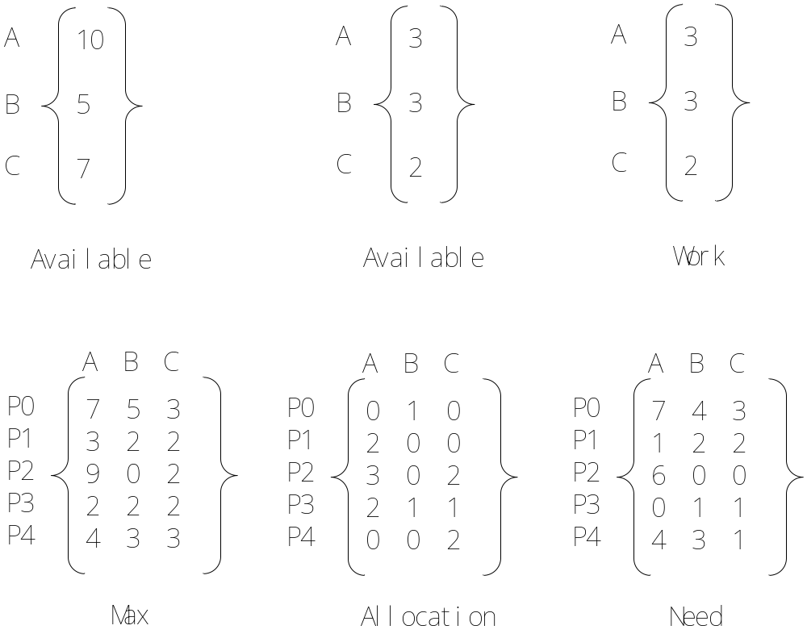
7.5 Deadlock Avoidance

Slide 36
7.5 Deadlock Avoidance
    Allocation(分配矩阵):
      n ⅹ m matrix.
      If Allocation[i,j] = k then P_{i} is currently allocated k instances of R_{j}
    Need(需求矩阵):
      n ⅹ m matrix.
      If Need[i,j] = k, then P_{i} may need k more instances of R_{j} to complete its task
      Need [i,j] = Max[i,j] – Allocation [i,j]

Slide 37
7.5 Deadlock Avoidance
    Work(工作向量)
      Vector of length m
      If Work [j] = k, there are k instances of resource type R_{j} after satisfying resource requests
    Finish(完成向量)
      Vector of length n
      If finish[i]=true, then P_{i} can finish successfully
    Request(请求向量)
      Vector of length n
      If Request[j] = k, then process P_{x} wants k instances of resource type R_{j}

Slide 38
7.5 Deadlock Avoidance
  Safety Algorithm（安全状态检测算法）
    1. Initialize:
      Work = Available
      Finish [i] = false for i = 0, 1, …, n- 1
    2. Find an i such that both:
      (a) Finish [i] = false
      (b) Need_{i} ≤ Work
      If no such i exists, go to step 4
    3. Work = Work + Allocation_{i} //P_{i} 可以完成并释放资源
    Finish[i] = true
    go to step 2
    4. If Finish [i] == true for all i, then the system is in a safe state. otherwise, the system is in an unsafe state.

Slide 39
7.5 Deadlock Avoidance
  Resource-Request Algorithm
    1. If Request_{i} ≤ Need_{i} go to step 2.
      Otherwise, raise error condition, since process has exceeded its maximum claim
    2. If Request_{i} ≤ Available go to step 3.
      Otherwise，P_{i} must wait, since resources are not available
    3. Pretend to allocate requested resources to P_{i} by modifying the state as follows:
      Available = Available – Request;
      Allocation_{i} = Allocation_{i} + Request_{i};
      Need_{i} = Need_{i} – Request_{i};
    4. invoke Safety Algorithm
      If safe ⇒ the resources are allocated to P_{i}
      If unsafe ⇒ P_{i} must wait, and the old resource-allocation state is restored

Slide 40
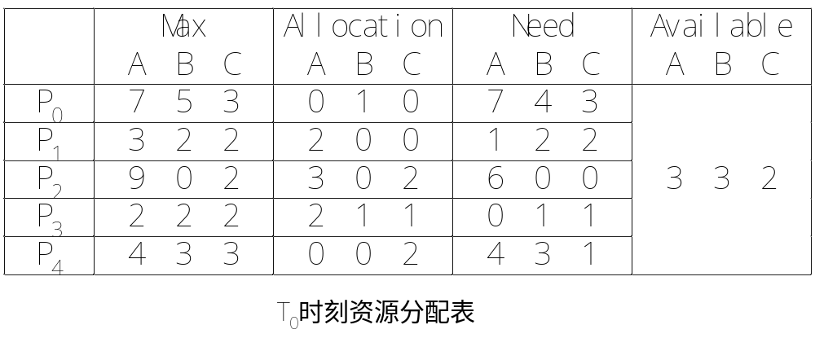
7.5 Deadlock Avoidance
  Example of Banker’s Algorithm
    Initialization
      5 processes: {P₀, P₁,P₂,P₃,P₄}
      3 resource types: A (10 instances), B (5instances), and C (7 instances)
    Snapshot at time T₀:
      Need = Max – Allocation

Slide 41
7.5 Deadlock Avoidance
    The system is in a safe state since many sequences satisfies safety criteria
      < P₁, P₃, P₄, P₂, P₀>
      < P₃, P₄, P₁, P₂, P₀>
      …
    Request₁=（1, 0, 2); then Check that Request ₁≤ Need₁ and Request ₁≤ Available
      (1,0,2) ≤ (1,2,2) ⇒ true
      (1,0,2) ≤ (3,3,2) ⇒ true

Slide 42
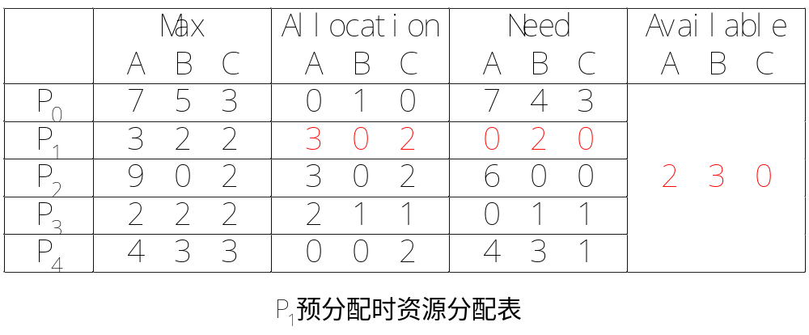
7.5 Deadlock Avoidance
    Pretend to allocate
      Available = Available – Request ₁;
      Allocation ₁ = Allocation ₁ + Request ₁;
      Need ₁ = Need ₁ – Request ₁;

Slide 43
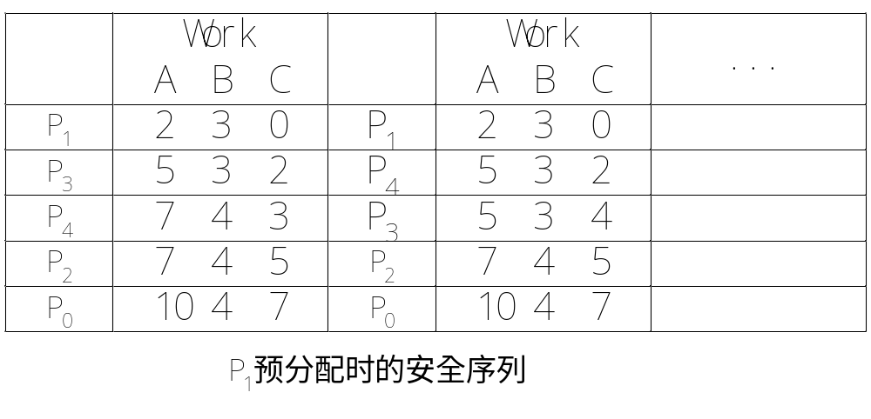
7.5 Deadlock Avoidance

Slide 44
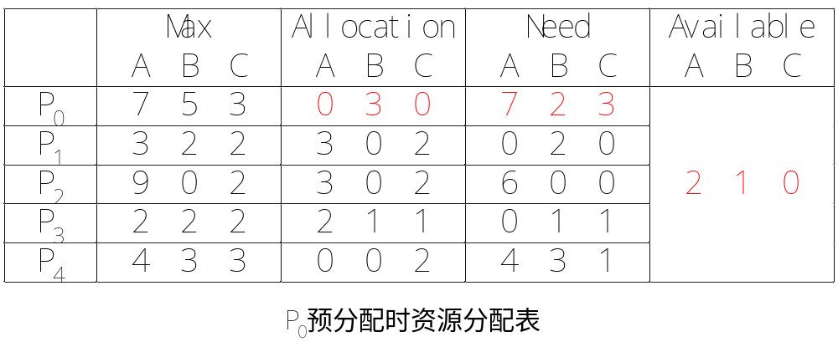
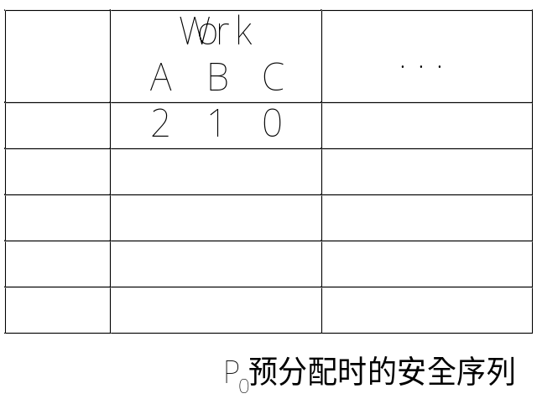
7.5 Deadlock Avoidance
    Executing safety algorithm shows that sequence < P₁, P₃, P₄, P₀, P₂> satisfies safety requirement
    Can request for (0,2,0) by P₀ be granted?
    Can request for (3,3,0) by P₄ be granted?

Slide 45
7 Deadlocks
7.1 System Model
7.2 Deadlock Characterization
7.3 Methods for Handling Deadlocks
7.4 Deadlock Prevention
7.5 Deadlock Avoidance
7.6 Deadlock Detection
7.7 Recovery from Deadlock

Slide 46
7.6 Deadlock Detection
If allowing system to enter deadlock state, the system should provide
  Detection algorithm
    An algorithm that examines the state of the system to determine whether a deadlock has occurred.
  Recovery algorithm
    An algorithm to recover from the deadlock.

Slide 47
7.6 Deadlock Detection
Two detection algorithms
  Wait-for graph
    Every type has one single instance
  Detection-algorithm
    Be similar to safety algorithm
    Every type has any number of instances

Slide 48
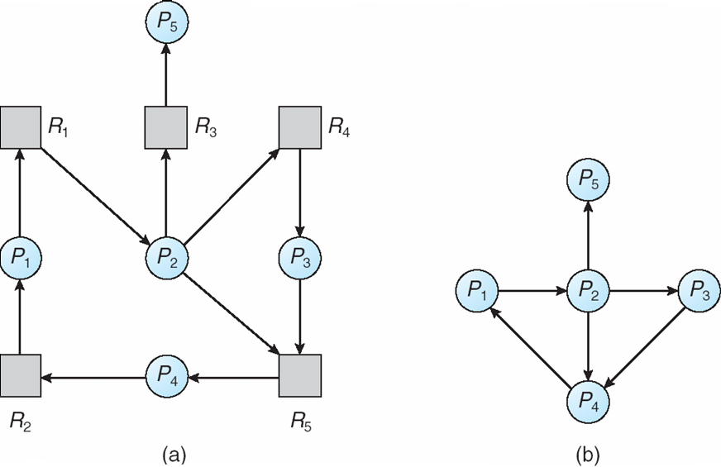
7.6 Deadlock Detection
Wait-for graph
  Generate a wait-for graph from its corresponding resource allocation graph
    Remove the resource nodes and collapse the appropriate edges
    Nodes are processes, P_{i} → P_{j} if P_{i} is waiting for P_{j}.

Slide 49
7.6 Deadlock Detection
  Periodically invoke an algorithm that searches for a cycle in the graph.
    An algorithm to detect a cycle in a graph requires an order of n² operations, where n is the number of vertices in the graph.

Slide 50
7.6 Deadlock Detection
Banker’s Algorithm
  Use for several Instances of a Resource Type
  Data structure
    Available: A vector of length m indicates the number of available resources of each type
    Allocation: An n x m matrix defines the number of resources of each type currently allocated to each process
    Request: An n x m matrix indicates the current request of each process. If Request [i_{j}] = k, then process P_{i} is requesting k more instances of resource type. R_{j}.

Slide 51
7.6 Deadlock Detection
  Algorithm
    1. Let Work and Finish be vectors of length m and n, respectively Initialize:
      (a) Work = Available
      (b) For i = 1,2, …, n,
      if Allocation_{i} ≠ 0, then Finish[i] = false;
      otherwise, Finish[i] = true;
    2. Find an index i such that both:
      (a)Finish[i] == false
      (b)Request_{i} ≤ Work
      If no such i exists, go to step 4
    3. Work = Work + Allocation_{i} //P_{i} 可以完成并释放资源
    Finish[i] = true
    go to step 2
    4. If Finish[i] == false, for some i, 1 ≤ i ≤ n,
    then the system is in deadlock state.
    Moreover, if Finish[i] == false, then P_{i} is deadlocked

Slide 52
7.6 Deadlock Detection
Detection-Algorithm Usage
  When, and how often, to invoke detection algorithm. it depends on:
    How often a deadlock is likely to occur?
    How many processes will need to be rolled back?
      At least one for each disjoint cycle
  If detection algorithm is invoked for every resource request
    Incur a considerable overhead
  If detection algorithm is invoked arbitrarily
    there may be many cycles in the resource graph
    so we would not be able to tell which of many deadlocked processes “caused” the deadlock

Slide 53
7 Deadlocks
7.1 System Model
7.2 Deadlock Characterization
7.3 Methods for Handling Deadlocks
7.4 Deadlock Prevention
7.5 Deadlock Avoidance
7.6 Deadlock Detection
7.7 Recovery from Deadlock

Slide 54
7.7 Recovery from Deadlock
Process Termination
  Abort all deadlocked processes
  Abort one process at a time until the deadlock cycle is eliminated
  In which order should we choose to abort?
    Priority of the process
    How long process has computed, and how much longer to completion
    Resources the process has used
    Resources process needs to complete
    Is process interactive or batch?
    How many processes will need to be terminated

Slide 55
7.7 Recovery from Deadlock
Resource Preemption
  Selecting a victim – minimize cost
  Rollback – return to some safe state, restart process for that state
  Starvation
    same process may always be picked as victim
    Solution：
      A process can be picked as a victim a finite number of times
      Including number of rollback in cost factor when picking the victim

Slide 56
Exercise
7.2
7.5
7.11

Slide 57
Experiment
7.13

