Slide 1
OPERATING SYSTEM CONCEPTS
操作系统概念-8
张 柏 礼
bailey_zhang@sohu.com
东南大学计算机学院

Slide 2
8. Main Memory
Objectives
  To provide a detailed description of various ways of organizing memory hardware
  To discuss various memory-management techniques, including paging and segmentation
  To provide a detailed description of the Intel Pentium, which supports both pure segmentation and segmentation with paging

Slide 3
8. Main Memory
8.1 Background
8.2 Swapping
8.3 Contiguous Memory Allocation
8.4 Paging
8.5 Structure of the Page Table
8.6 Segmentation
8.7 Example: The Intel Pentium

Slide 4
8.1 Background
Memory is central to the operation of a modern computer system
  Main memory and registers are only storage CPU can access directly
  Program must be brought (from disk) into memory
  Instruction-execution cycle
    CPU fetches an instruction from memory according to the value of the program counter
    The instruction is then decoded and may cause operands to be fetch from memory
    After the instruction has been executed, the results may be stored back in memory

Slide 5
8.1 Background
  Speed of accessing memory
    Register access in one cycle of CPU clock
    Main memory access can take many cycles
    Cache sits between main memory and CPU registers to accommodate a speed difference

Slide 6
8.1 Background
Memory address
  Memory consist of a larger array of words or bytes, each with its own address
  We do ignore how a program generates a memory address
  We are interested only in the sequence of memory address

Slide 7
8.1 Background
Protection of memory address
  Need to
    Protect the operating system from access by user processes
    Protect the user process from others
  Firstly need to make sure that each process has separate memory space
    Need to determine the range of legal address of process
    Need to ensure that the process can access only these legal addresses

Slide 8

8.1 Background
  A pair of base and limit registers define the address space
    The base register hold the smallest legal physical memory address
    The limit register specifies the size of the range
    The CPU hardware compare every address generated in user mode with the registers

Slide 9
8.1 Background
Address binding
  The normal procedure of a process
    The processes on the disk that are waiting to be brought into memory for execution form input queue
    Select one process in the input queue and load the process into memory
    It accesses instructions and data from memory
    As the process terminates, its memory space is declared available

Slide 10
8.1 Background
  Address may be represented in different way
  E.g.
    Address are generally symbolic addresses in source program
      E.g. goto loop1
    A compiler will typically bind these symbolic addresses to re-locatable addresses
      E.g. 14: 14 bytes from the beginning of this module
    The linkage editor or loader will in turn bind the re-locatable addresses to absolute addresses
      0x0007 4014
    Each bind is a mapping from a address space to another

Slide 11
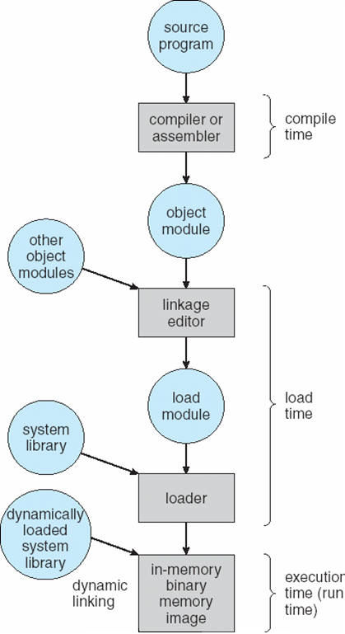
Multi-step Processing of a User Program

Slide 12
8.1 Background
  Binding of instructions and data to memory addresses can happen at three different stages
    Compile time
      If memory location known at compile time, absolute code can be generated
      must recompile code if starting location changes
      E.g. The MS-DOS .COM-format programs
    Load time （+linkage time）
      If memory location is not known at compile time, Must generate re-locatable code
      if memory location is known at load time, absolute code can be generated at this time
      if starting location changes, only need reload the code

Slide 13
8.1 Background
    Execution time
      If memory location is not known at compile time and load time, Binding is delayed until run time
      absolute code must be generated at run time, if the process can be moved during its execution from one memory segment to another
      Need hardware support for address mapping (e.g., base and limit registers)
      Most general-purpose OS use this method

Slide 14
8.1 Background
Logical vs. Physical Address Space
  Physical address
    The address seen by the memory unit (与物理内存单元直接相关的地址，直接装入到寻址寄存器中的地址)
    Load into the memory-address register of memory
  Logical address
    generated by the CPU
    also referred to as virtual address

Slide 15
8.1 Background
  Logical and physical addresses are the same in compile-time and load-time address-binding schemes
    Before the run-time, addresses have been mapped to absolute code
    In the run-time, addresses seen by CPU are identical to that seen by the memory unit
  logical (virtual) and physical addresses differ in execution-time address-binding scheme
    re-locatable code are seen by CPU
    absolute code are seen by the memory unit

Slide 16
8.1 Background
  Memory-Management Unit (MMU)
    Hardware device that maps virtual address to physical address in the run-time
    There are many different methods to accomplish such mapping
      In a simple MMU scheme, the value in the relocation register is added to every address generated by a user process (CPU) at the time it is sent to memory.
      The user program deals with logical addresses; it never sees the real physical addresses
  The concept of a logical address space
    that is bound to a separate physical address space
    is central to proper memory management

Slide 17

8.1 Background

Slide 18
8.1 Background
Dynamic Loading
  Should the entire program and data of a process be in physical memory for the process to execute?
  Routine is not loaded until it is called
    Better memory-space utilization; unused routine is never loaded
    Useful when large amounts of code are needed to handle infrequently occurring cases，such as error routines
  No special support is required from the operating system
    OS provides library routines to help programmer to implement the dynamic loading

Slide 19
8.1 Background
Dynamic linking and shared libraries
  Static linking
    System language libraries are treated like any other object module
      and are combined by the loader into the binary program image
    Each program on a system must include a copy of its language library (or at least the routines referenced by the program) in the executable image
      Waste both disk space and main memory

Slide 20
8.1 Background
  Dynamic linking
    Linking is postponed until execution time
    Stub
      Is small piece of code and is included in the image for each library routine reference
      It used to
        locate the appropriate memory-resident library routine
        Or used to load the library if the routine is not already present

Slide 21
8.1 Background
      When the stub is executed,
        Operating system needed to check if routine is in processes’ memory address
        it replaces itself with the address of the routine, and executes the routine
        The next time, the library routine is executed directly, incurring no cost for dynamic linking

Slide 22
8.1 Background
  Library update
    A library may be updated
      To dynamic linking, all programs that reference it will automatically use the new version
      To static linking, all relative programs would need to be relinked to gain access to the new library
    Shared library ?
  Dynamic linking requires help from the OS
    If the processes memory are protected,
    the OS is the only entity
      that can check to see whether the needed routine is in another process memory space
      or that can allow multiple processes to access the same memory address.

Slide 23
8. Main Memory
8.1 Background
8.2 Swapping
8.3 Contiguous Memory Allocation
8.4 Paging
8.5 Structure of the Page Table
8.6 Segmentation
8.7 Example: The Intel Pentium

Slide 24
8.2 Swapping
Swapping(对换)
  A process can be swapped temporarily out of memory to a backing store
  and then brought back into memory for continued execution
  A example
    A multiprogramming environment with a round-robin algorithm
    When a quantum expires, the memory manager will start
      to swap out the running process and
      to swap another process into the memory space

Slide 25
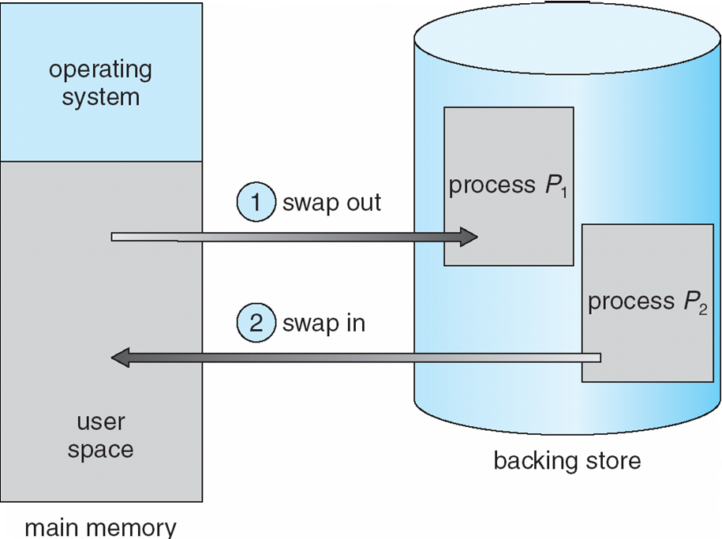
8.2 Swapping

Slide 26
8.2 Swapping
  Another example:Roll out, roll in(换进,换出)
    A variant of swapping used for priority-based scheduling algorithms
    Lower-priority process is swapped out so higher-priority process can be loaded and executed
    When higher-priority process finishes, the lower-priority process can be swapped back

Slide 27
8.2 Swapping
Backing store (对换区)
  fast disk is large enough to accommodate copies of all memory images for all users
  must provide direct access to these memory images
  Ready queue
    Is consisted of all processes whose memory images are on the backing store or in memory and are ready to run
    The dispatcher checks whether the next process in the queue is not in memory and need to swap in
  If a process is waiting for (doing) I/O operation, the process cannot be swapped

Slide 28
8.2 Swapping
Swap time
  Context-switch time
    Swap out, swap in
  To round-robin CPU-scheduling algorithm,
    the time quantum should be larger than swap time to allow reasonable computing to be done between swaps
  Major part of swap time is transfer time if there is no seek time
    total transfer time is directly proportional to the amount of memory swapped
    The size of process : 10M
    The disk transfer speed : 40M/S
    10 / 40 = 1/4 seconds = 250ms

Slide 29
8.2 Swapping
Modified versions of swapping are found on many systems
  UNIX
  Windows 3.1

Slide 30
8. Main Memory
Category of Memory Management
  Entire program in physical memory
    Contiguous memory allocation
      Fixed-sized contiguous partition
      Dynamic contiguous partition
    Non-contiguous memory allocation
      Paging
      Segmentation
      Segmentation paging
  Part program in physical memory（Virtual memory）
    Demand paging
    Demand segmentation paging

Slide 31
8. Main Memory
8.1 Background
8.2 Swapping
8.3 Contiguous Memory Allocation
8.4 Paging
8.5 Structure of the Page Table
8.6 Segmentation
8.7 Example: The Intel Pentium

Slide 32
8.3 Contiguous Memory Allocation
Need to allocate the main memory in the most efficient way
  The main memory must accommodate
    both the operating system
    and the various user processes
  The main memory is usually divided into two partitions:
    One for the resident operating system, usually held in low memory with interrupt vector
    The other for user processes, then held in high memory

Slide 33
8.3 Contiguous Memory Allocation
Memory mapping and protection
  Relocation register
    Contains the value of the smallest physical address
  Limited register
    Contains the range of logical addresses
    Each logical address must be less than the limit register
  The MMU(Memory-Management Unit) maps the logical address dynamically
    By adding the value in the relocation register
  To use relocation registers and limit registers to protect user processes from each other, and from changing operating-system code and data

Slide 34

8.3 Contiguous Memory Allocation

Slide 35
8.3 Contiguous Memory Allocation
  How to allocate available memory to the processes in the input queue waiting for entering memory
  For contiguous memory allocation, each process is contained in a single contiguous section of memory
    Fixed-sized contiguous partition(固定分区)
    Dynamic Contiguous partition（可变分区）

Slide 36
8.3 Contiguous Memory Allocation
Memory allocating
  Fixed-sized contiguous partition(固定分区)
    Divide memory into several fixed-sized partition at system generation time
      Equal-size partitions
      Unequal-size partitions
    Each partition may contain exactly one process
      The degree of multi-programming is bounded by the number of partitions
      When the partition is free, a process is selected from the input queue and is loaded into the free partition

Slide 37
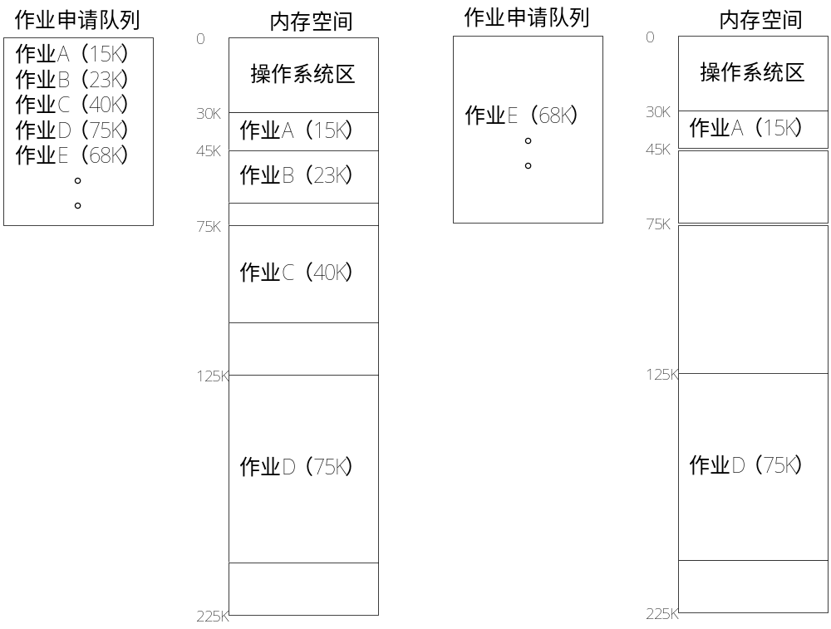
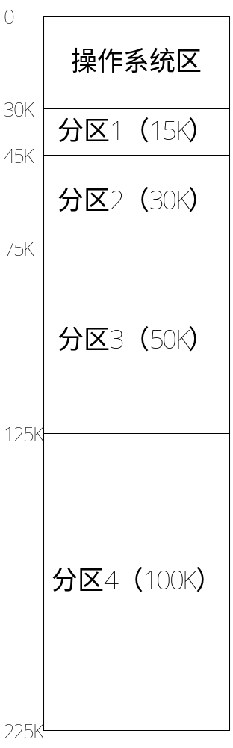
8.3 Contiguous Memory Allocation

Slide 38
8.3 Contiguous Memory Allocation
      Memory allocation table
p-no | size | start addr | status
1 | 15K | 30K | 1
2 | 30K | 45K | 0
3 | 50K | 75K | 0
4 | 100K | 125K | 1

Slide 39
8.3 Contiguous Memory Allocation
    Conclusion for Fixed-Sized Contiguous Partition
      Strengths (advantages)
        Simple to implement
        little overhead
      Weaknesses(drawbacks)
        internal fragmentation
        allocated memory may be larger than requested memory
        fixed number of processes
      Be used for early OS or special OS

Slide 40
8.3 Contiguous Memory Allocation
  Dynamic Contiguous partition（可变分区）
    Partitions are created dynamically
      each process can be loaded into a partition of exactly the same size as that process.
    Hole – block of available memory
      Initially, all memory is available for processes and is considered as a hole
      When a process arrives
        it is allocated memory from a hole to exactly accommodate it，the rest is returned to form a smaller hole

Slide 41
8.3 Contiguous Memory Allocation
OS
OS
OS
OS
process 5
process 5
process 5
process 9
process 9
process 8
process 10
process 2
process 2
process 2
process 2
      With the processes arrive and terminate, holes of various size are scattered throughout memory

Slide 42
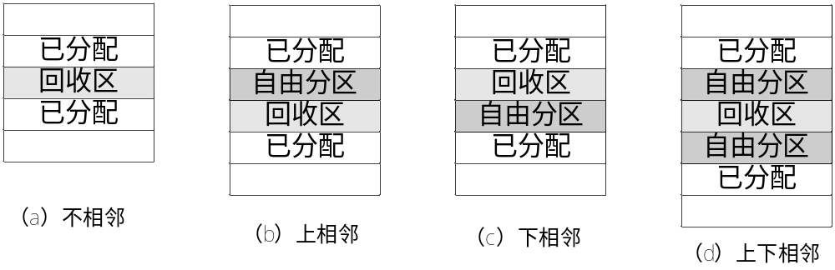
8.3 Contiguous Memory Allocation
      When a process terminate
        return the memory
        merge the holes if the new hole is adjacent to other holes

Slide 43
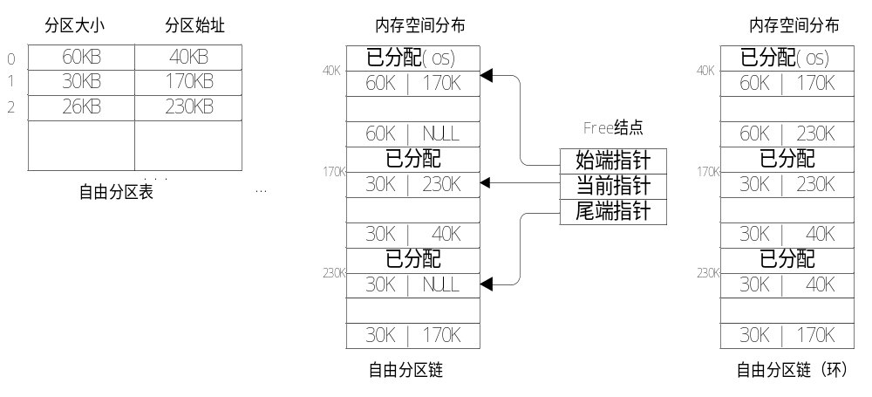
8.3 Contiguous Memory Allocation
    The OS keeps a table indicating
      free partitions (holes)
        Which parts of memory are available
        Free partition table(自由分区表)，free partition chain(自由分区链)

Slide 44
8.3 Contiguous Memory Allocation
    Allocation algorithms
    to satisfy a request of size n from a list of free holes
      first-fit
        Allocate the first hole that is big enough for the process
        Searching can start at
        either the beginning of the set of holes
        or where the previous first-fit search ended

Slide 45
8.3 Contiguous Memory Allocation
      best-fit
        Allocate the smallest hole that is big enough for the process
        Need to search all entire list, unless the list is ordered by size
        This strategy produces the smallest leftover hole that may be wasted

Slide 46
8.3 Contiguous Memory Allocation
      worst-fit
        Allocate the largest hole
        Need to search all entire list, unless the list is ordered by size
        This strategy produces the largest leftover hole that may be useful
    First-fit and best-fit better than worst-fit in terms of allocation speed and storage utilization

Slide 47
8.3 Contiguous Memory Allocation
Fragmentation（碎片）
  External Fragmentation
    As processes are loaded and removed from memory, the free memory space is fragmented into a large number of small holes
    There is enough total memory space to satisfy a request, but it is not contiguous
    50-percent rule
      For first fit, even with some optimization, given N allocated blocks, another 0.5 N blocks will be lost to fragmentation

Slide 48
8.3 Contiguous Memory Allocation
  Internal Fragmentation
    allocated memory may be slightly larger than requested memory
      A hole of 18,464 bytes
      The process request 18,400 bytes
      A hole of 64 bytes is left, the overhead to manage this hole will be larger than the hole itself
      The 64 byte will be allocated to the process
    This size difference forms Internal Fragmentation
      memory is internal to a partition, but not being used

Slide 49
8.3 Contiguous Memory Allocation
  Solutions to fragmentation
    Compaction(紧凑)
      To reduce external fragmentation
      Shuffle memory contents to place all free memory together in one large block
      It is done at execution time， it’s possible only if relocation is dynamic, and
      May be expensive in moving the processes and the holes
    Paging(分页) and segmentation(分段)
      Another possible solution to the external fragmentation

Slide 50
8. Main Memory
8.1 Background
8.2 Swapping
8.3 Contiguous Memory Allocation
8.4 Paging
8.5 Structure of the Page Table
8.6 Segmentation
8.7 Example: The Intel Pentium

Slide 51
8.4 Paging
Disadvantage of Contiguous Memory Allocation
  Fragmentation in main memory
  Fragmentation in the backing store connecting with main memory except that access is much slower
    Compaction is impossible on the disk
Paging
  An important memory-management scheme
  Permits the physical address space of a process to be noncontiguous

Slide 52
8.4 Paging
Basic method
  frame(帧、块)
    Divide physical memory into fixed-sized blocks
  page(页)
    Divide logical memory into fixed-sized blocks
    page size is equal to frame size
    Finding n free frames for loading a program of size n pages

Slide 53
8.4 Paging
  Translating logical address to physical address
    Every logical address generated by CPU is divided into:
      Page number (p: 页号) – used as an index into a page table (页表) which contains base address of each page in physical memory (f:块号)
      Page offset (d: 偏移) – combined with base address (f:块号) to define the physical memory address that is sent to the memory unit
    Physical address
      frame number（f: 帧号、块号)
      page offset (d:页偏移、块偏移)

Slide 54
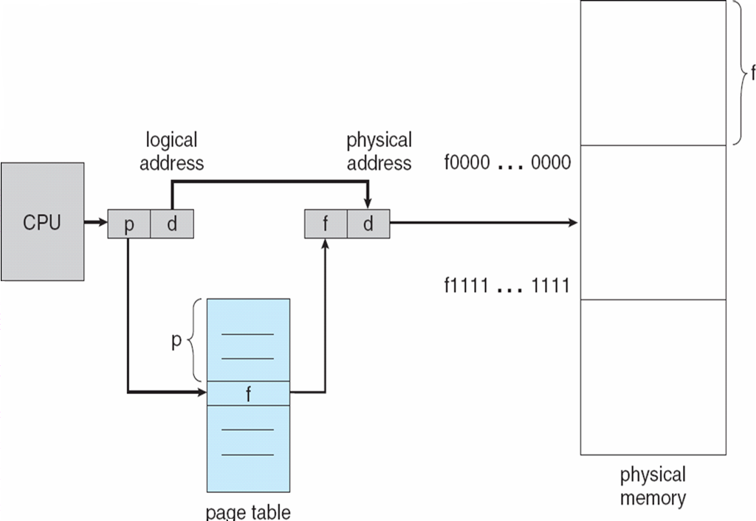
8.4 Paging

Slide 55

8.4 Paging

Slide 56
8.4 Paging
    The page size is defined by hardware
      between 512 bytes and 16M bytes
      is power of 2, for translating the logical address to p and d particularly easy
        If the address space is 2^{m} and the page size is 2^{n}
        Then p =address/2^{n} is equal to m-n bit of the address
        d =address%2^{n} is equal to n bit of the address
page number
page offset
p
d
m - n
n

Slide 57

8.4 Paging
A concrete （minuscule） example

Slide 58
8.4 Paging
  A concrete （minuscule） example
    Condition
      Page size: 4 byte
      The size of physical memory: 32byte, 8 block
    Address mapping
      Logical address 0 → (5x4)+0 physical address
      Logical address 1 → (5x4)+1 physical address
      Logical address 2 → (5x4)+2 physical address
      Logical address 3 → (5x4)+3 physical address
      Logical address 4 → (6x4)+0 physical address
      Logical address 5 → (6x4)+1 physical address
      Logical address 13 → (2x4)+2 physical address

Slide 59
8.4 Paging
  Paging is a form of dynamic relocation
    Every logical address is bound by the paging hardware to some physical address
    Using paging is similar to using a table of base (or relocation) registers, one for each frame of memory (就像基址寄存器，页表中的每一条对应一个物理帧)
  Fragmentation
    No external fragmentation for paging scheme
    Internal fragmentation may exist
      for the last frame may not be completely full
      Expect internal fragmentation to average one-half page per process
      So the small page sizes are desirable

Slide 60
8.4 Paging
  How to select page sizes?
    Internal fragmentation
      the small page sizes are desirable
    Page table size
      Overhead with each page-table entry is reduces as the size of the pages increases
    Disk I/O
      Disk I/O is more efficient when the page size is larger
    ➔ Generally page sizes have grown over time as processes, data, and main memory have become larger.

Slide 61
8.4 Paging
  Physical memory management
    Usually, each page-table entry is 4 bytes long
      Can point to one of 2³² physical page frames
      If frame size(= page size) is 4KB, the system can address 2⁴⁴ bytes(2³²×2¹²=16TB) of physical memory
    New-process memory allocation
      When a process arrives, its size expressed in pages
      If it requires n pages and n frame are available in memory
        The first page of the process is loaded into one of the allocated frames
        The frame number is put in the page table for this process
        The next page is loaded into another frame

Slide 62

8.4 Paging

Slide 63
8.4 Paging
    An important aspect of paging
      The clear separation between the user’s view of memory and the actual physical memory
      The user program views memory as one single contiguous space, contain one program
      In fact, the user program is scattered throughout physical memory, which also holds other program
      The difference is reconciled by the paging address-translate hardware

Slide 64
8.4 Paging
    The responsibility of the OS
      must be aware that user processes operate in user space
      must maintain a copy of the page table for each process
        When a process is to be allocated the CPU, the copy is used by the CPU dispatcher to define the hardware page table .
        Paging increases the context-switch time
      must be aware of the allocation details of physical memory
        Which frames are allocated?
        Which frames are available?
        ------------ Frame table (主存分块表)

Slide 65
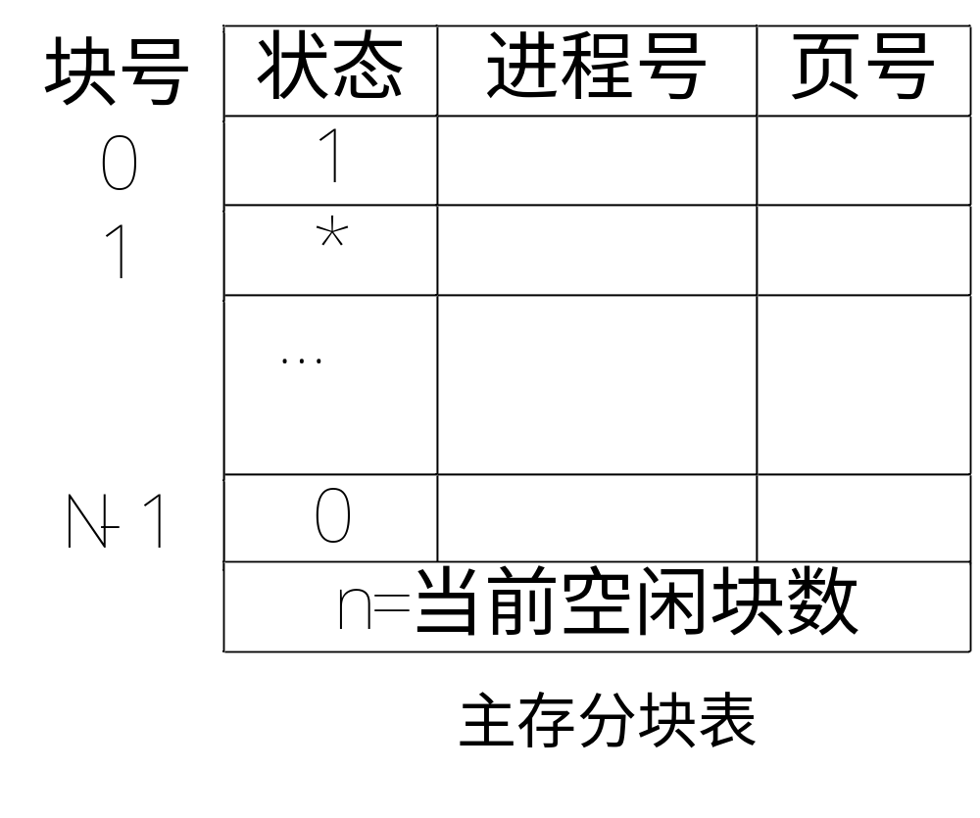
8.4 Paging
    Frame table (主存分块表)
      Has one entry for each physical page frame
        Indicating whether the frame is free
        or
        Indicating it is allocated to which process.

Slide 66
8.4 Paging
Hardware implementation of Page Table
  Kept in Registers
    The page table is kept in fast registers if the page table is reasonable small (e.g. less 256 entries)
    Efficient and expensive
    DEC PDP-11
    The page tables of many processes may be very large (e.g. 1 million entries)
    The use of fast and expensive registers to implement the page table is no feasible

Slide 67
8.4 Paging
  kept in main memory
    The page table is kept in main memory
    Page-table base register (PTBR：页表基址寄存器)
      The register points to the page table
      When process switches, loading the page table requires only changing PTBR, substantially reducing the context-switch
      every data/instruction access requires two memory accesses
        One for the page table
        One for the data/instruction.
        Memory access is slowed by a factor of 2

Slide 68
8.4 Paging
  TLB(联想寄存器)
    To solve the two memory access problem
    a special fast-lookup hardware cache called translation look-aside buffer (TLB) or associative memory
      The TLB contains only a few of page-table entries
      TLB– parallel search

Slide 69


Slide 70
8.4 Paging
      If the page number p of a logical address is found in the TLB
        its frame number f is immediately gotten and is used to access memory
      If the page number p is not found in the TLB(TLB miss)
        get frame number from page table in memory
        and the page number and frame number is added to the TLB
        If the TLB is full, some replacement mechanism are needed
        TLB entries of kernel code of OS are wired down in the TLB （固定下来，不能被置换）

Slide 71
8.4 Paging
    Some TLBs store address-space identifiers (ASIDs) in each TLB entry
      The TLB can contain entries for several different processes simultaneously
      ASIDs uniquely identifies each process to provide address-space protection for that process
      If the TLB does not support separate ASIDs, then every time a new page table is selected , the TLB must be flushed
    Effective Access Time
      hit ratio = 0.8
        Effective Access Time= 0.80*120 + 0.20*220 = 140 ns
      hit ratio = 0.98
        EAT = 0.98*120 + 0.02*220 = 122 ns

Slide 72
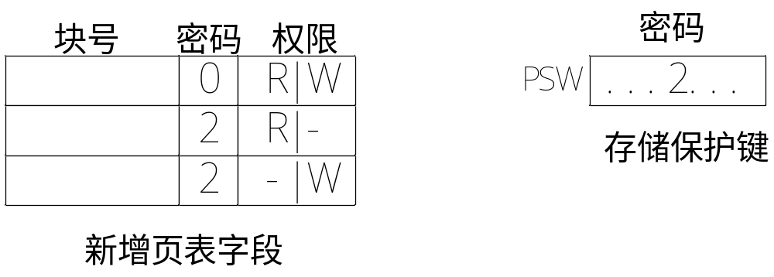
8.4 Paging
Memory Protection
  implemented by associating protection bit with each frame
    Read-write or read-only or executed only
    illegal attempts will be trapped to the OS

Slide 73
8.4 Paging
  Valid-invalid bit attached to each entry in the page table:
    “valid” indicates that the associated page is in the process’ logical address space, and is thus a legal page.
    “invalid” indicates that the page is not in the process’ logical address space.

Slide 74

8.4 Paging

Slide 75
8.4 Paging
Shared Pages
  Shared code
    One copy of read-only (reentrant) code shared among processes (i.e., text editors, compilers, window systems).
    Shared code must appear in same location in the logical address space of all processes
  Private code and data
    Each process keeps a separate copy of the code and data
    The pages for the private code and data can appear anywhere in the logical address space

Slide 76
8.4 Paging
  In a time-sharing environment,
    40 users execute a text editor. One text editor process consists 150KB code and 50 KB data.
    Without sharing
      (150KB + 50KB)*40 = 200KB * 40 = 8000KB
    With sharing
      50KB*40 + 150KB = 2000KB + 150KB = 2150KB

Slide 77
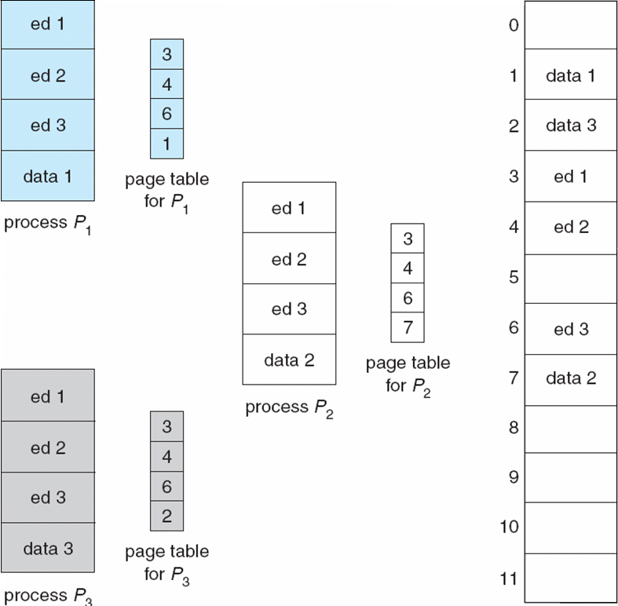
8.4 Paging

Slide 78
8. Main Memory
8.1 Background
8.2 Swapping
8.3 Contiguous Memory Allocation
8.4 Paging
8.5 Structure of the Page Table
8.6 Segmentation
8.7 Example: The Intel Pentium

Slide 79
8.5 Structure of the Page Table
Problem
  The page table can be excessively large
  For a 32 bit CPU
    page size：4k (=2^12)
    Table size：2^32/2^12=1M entries
    4 MB （each entries 4 bytes）
  Each process may need up to 4M of physical memory for its page table
    4M / 4k = 1024
    i.e. may need up to 1k physical block for page table
    No suitable to allocate the page table contiguously in main memory

Slide 80
8.5 Structure of the Page Table
  Solution
  ——Divide the page table into smaller pieces
    Hierarchical Paging （分层页表）
    Hashed Page Tables（哈希页表）
    Inverted Page Tables（反置页表）

Slide 81
8.5 Structure of the Page Table
Hierarchical Paging
  Break up the logical address space into multiple page tables
  Two-level page table (forward-mapped page table)
    A logical address (on 32-bit machine with 4K page size) is divided into:
      a page number consisting of 20 bits
      a page offset consisting of 12 bits
    Since the page table is paged, the page number is further divided into:
      a 10-bit page number ：is an index into the outer page table
      a 10-bit page offset：is the displacement within the page of the outer page table

Slide 82

8.5 Structure of the Page Table
page number
page offset
p₁
p₂
d
10
10
12

Slide 83
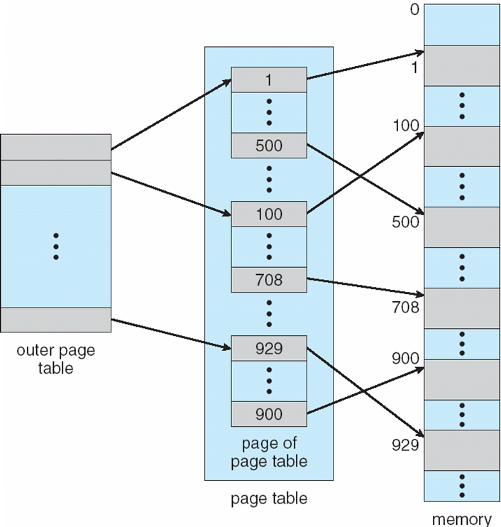
8.5 Structure of the Page Table

Slide 84


8.5 Structure of the Page Table
  Three-level paging table
    on 64-bit machine with 1K page size
    The outer page table is 2⁴²bytes in size
    The outer page table is still 2³²bytes in size
    For 64-bit architectures, hierarchical page tables are inappropriate

Slide 85
8.5 Structure of the Page Table
Hashed Page Tables
  Common used for address spaces > 32 bits
  The (virtual) page number is hashed into a page table
  This page table contains a chain of elements hashing to the same location
  (Virtual) page numbers are compared in this chain searching for a match
    If a match is found, the corresponding physical frame is extracted

Slide 86

8.5 Structure of the Page Table

Slide 87
8.5 Structure of the Page Table
Inverted Page Table(反置页表/主存分块表)
  The drawback of standard page table
    Each process has an associated page table
    Each page table may consist of millions of entries
    These tables may consume large amounts of physical memory
  Inverted Page Table
    Only a page table in the system
    One entry for each real page (or physical frame) of memory
    Each entry consists of <process-id, page-number>
      process-id: address-space identifier
      page-number: the virtual address of the page

Slide 88

8.5 Structure of the Page Table
    Decreases memory needed to store each page table, but increases time needed to search the table when a page reference occurs
      Use hash table to limit the search to one — or at most a few — page-table entries
    Lead to memory share difficulty

Slide 89

8.5 Structure of the Page Table

Slide 90
8. Main Memory
8.1 Background
8.2 Swapping
8.3 Contiguous Memory Allocation
8.4 Paging
8.5 Structure of the Page Table
8.6 Segmentation
8.7 Example: The Intel Pentium

Slide 91
8.6 Segmentation
Segmentation is a memory-management scheme that supports user view of memory
User’s View of a Program
  A program is a collection of segments，a segment is a logical unit such as:
main program
procedure ，function，method，object
local variables, global variables
common block
stack
symbol table
arrays

Slide 92

8.6 Segmentation

Slide 93
8.6 Segmentation
  How to segment
    By programmer
    By compiler
  Logical address consists of a two tuple:
<segment-number, offset>
  How to map logical addresses <segment-number, offset> to physical address?

Slide 94
8.6 Segmentation
1
1
4
2
3
2
4
3
user space
physical memory space

Slide 95
8.6 Segmentation
Segment table – maps two-dimensional addresses to one-dimensional physical address
  each table entry has:
    base – contains the starting physical address where the segments reside in memory
    limit – specifies the length of the segment
  The segment number s is used as an index into the segment table.
  The offset d must be between 0 and the segment limit (length)
    If invalid, illegal memory access.
    If valid, base + d → physical address.

Slide 96
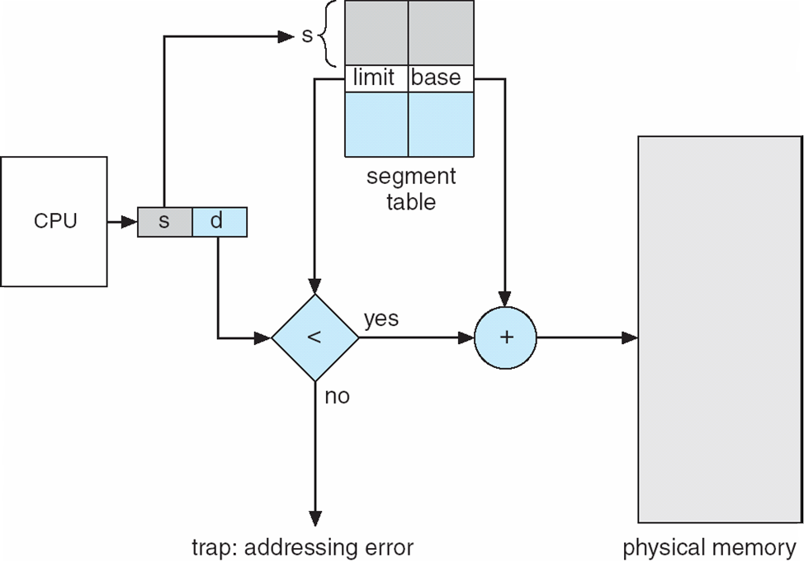
8.6 Segmentation

Slide 97

8.6 Segmentation

Slide 98
8. Main Memory
8.1 Background
8.2 Swapping
8.3 Contiguous Memory Allocation
8.4 Paging
8.5 Structure of the Page Table
8.6 Segmentation
8.7 Example: The Intel Pentium

