Slide 1
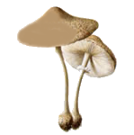
Data Mining a Mushroom Dataset
Project III
Raymond Borges
Jarilyn Hernandez

Slide 2
Outline
Background
Introduction
Hypotheses
Methodology
Results
Conclusions
Future Work

Slide 3
Background
Previous Work

Slide 4
The Mushroom Dataset
Hypothetical examples of 23 species from Agaricus and Lepiota families
Class attribute: Edibility
Edible(4,208)51.8%
Poisonous(3,916)48.2%
Data Set Characteristics: | Multivariate | Number of Instances: | 8124 | Area: | Life
Attribute Characteristics: | Categorical | Number of Attributes: | 22 | Date Donated: | 1987

Slide 5
Benchmark ruleset
1. Odor = not almond or anise or none
(120 poisonous cases missed, 98.52% accuracy)
2. Spore-print-color =green
(48 cases missed, 99.41% accuracy)
3. Odor=none and stalk-surface-below-ring = scaly
and stalk-color-above-ring= not brown
(8 cases missed, 99.90% accuracy)
4. Habitat= leaves and cap-color=white or
4. Population=clustered and cap-color=white
(100% accuracy)

Slide 6
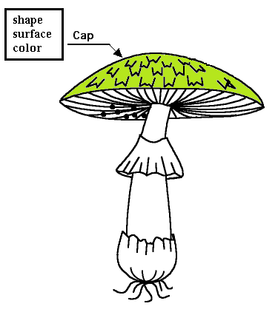
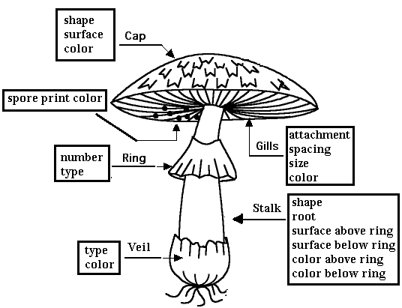
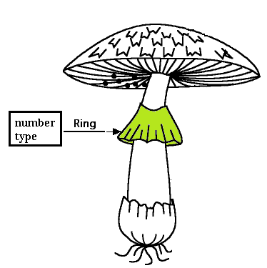
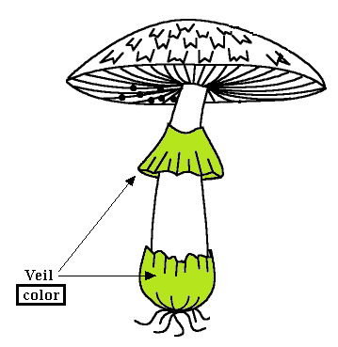
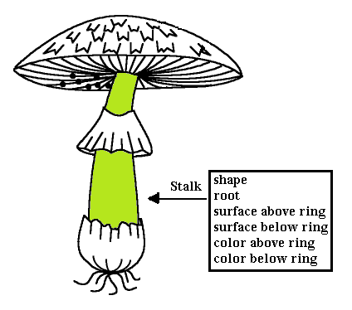
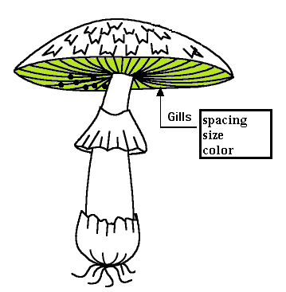
The Mushroom Dataset
22 Attributes
18 Visually
on Mushroom
4 Others
1 Habitat
1 Population
1 Bruises
1 Odor

Slide 7
Accuracy with 1R

Slide 8
Visual Attribute ruleset Only 4 attrib.(100% accuracy)
Stalk surface above ring = not silky and ring number = not one, (79% accuracy JRIP)
Population not clustered(80% accuracy J48)
Once retrieved test these two rules:
Odor = not bad, (98% accuracy J48)
Spore print color = not green, (100% J48)

Slide 9
Results
Odor and spore color may be the best attributes statistically but not in the field
Focused on visual-queue attributes, e.g.
habitat, population, cap and stalk
Obtained a more practical classification

Slide 10
Introduction
Project III

Slide 11
Introduction
Taking into account human perception
Based on:
Lighting conditions
Mushroom stage in lifecycle
Humidity
Seasons
Human senses?
other unknown factors…

Slide 12
Introduction
Some attributes difficult to discern
Textures, Shapes or
Colors like:
Brown
Chocolate
Buff
Cinnamon

Slide 13
Hypotheses
Complex attributes = Higher error probability
Human senses + external factors = Big impact
So…
Ruleset will change to approach reality
Some attributes will fair much better than others

Slide 14
Methodology

Slide 15
Methodology
Collect survey responses:
Evaluate species in different conditions
Measure overall accuracy
Weight attributes based on survey performance

Slide 16
Methodology part 1
Take 3 mushroom species
Agaricus Abruptibulbus
Agaricus Augustus
Lepiota Rubrotincta
Place under 2 distinct set of conditions

Slide 17
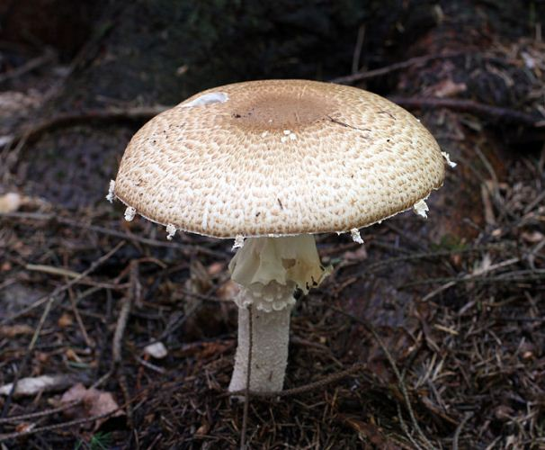
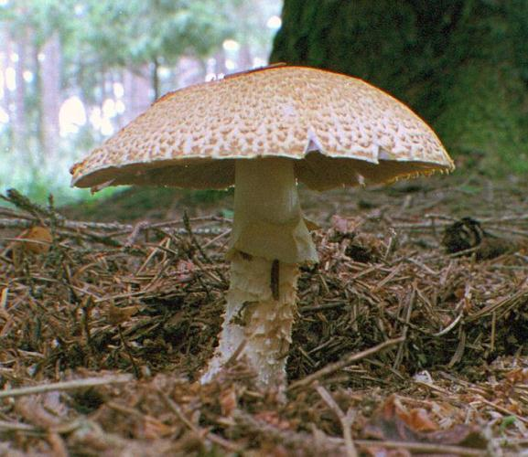
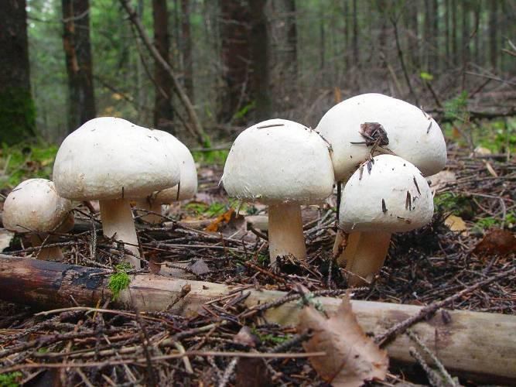
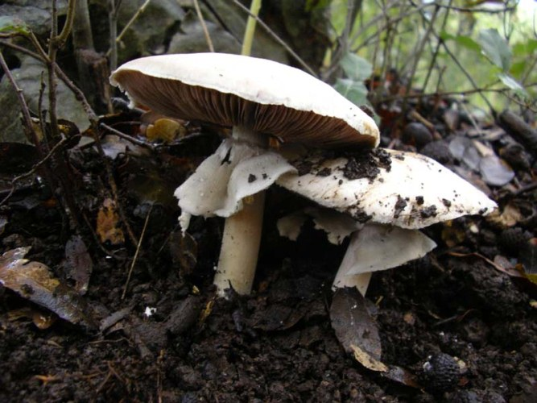
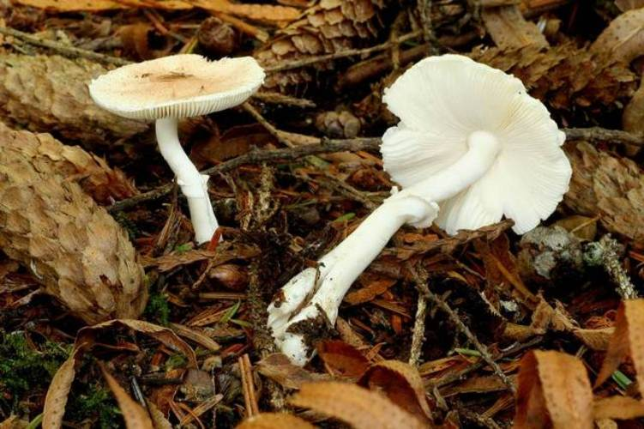
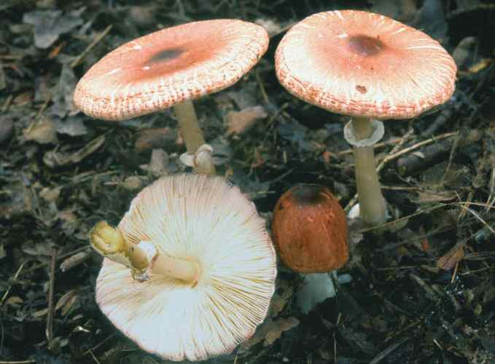
Methodology part 2
5 questions per species in each condition
Augustus
under conditions X
Rubrotincta
under conditions X
Augustus
under conditions Y
Abruptibulbus
under conditions X
Rubrotincta
under conditions Y
Abruptibulbus
under conditions Y

Slide 18

Methodology part 3
Design Tutorial (SurveyMonkey.com)
Design Website (Weebly.com)
Get people to take survey (hardest part)
Designed Flyers
Poster boards
Business cards

Slide 19
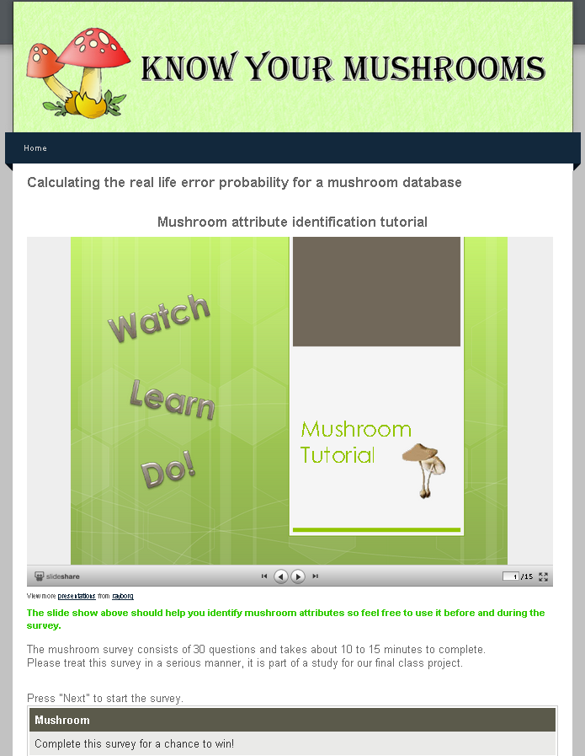
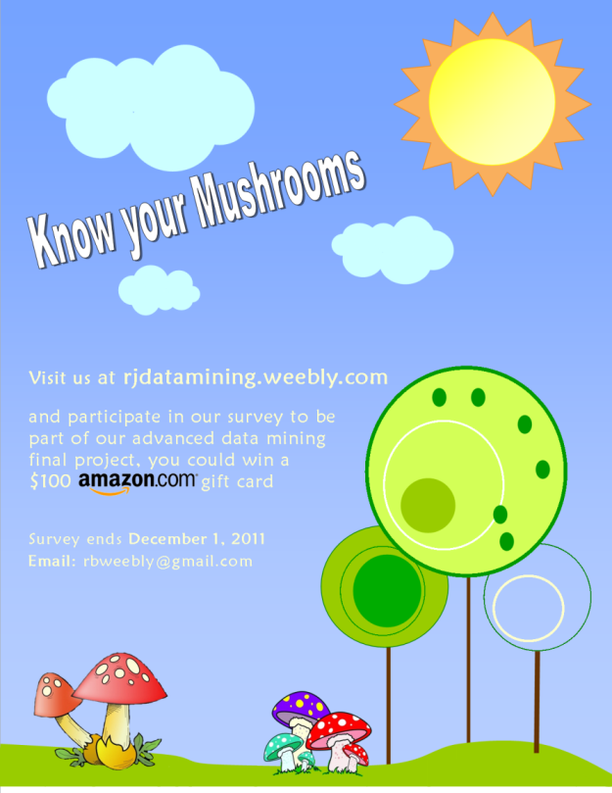

Slide 20
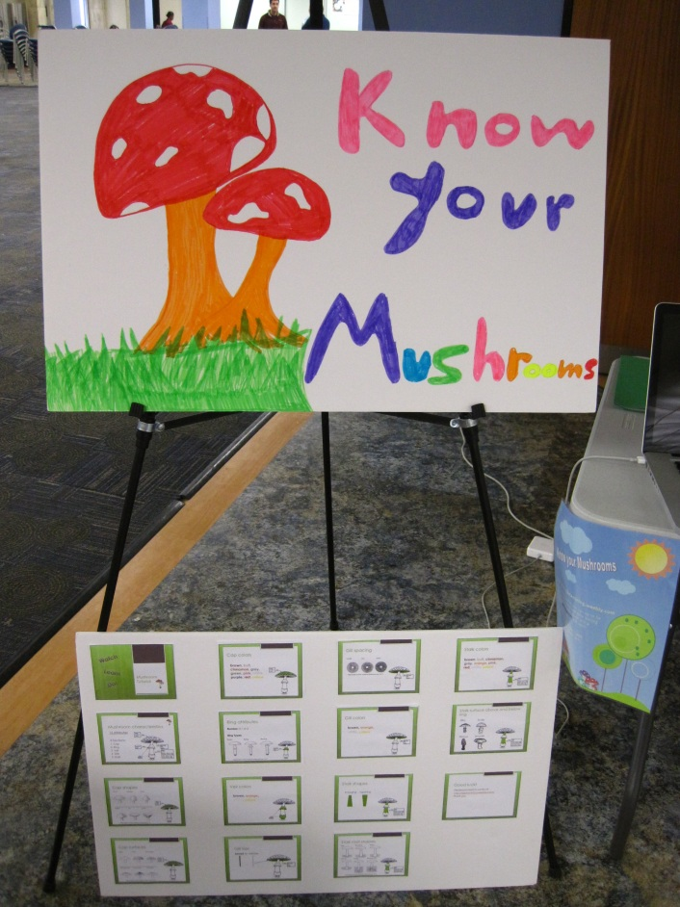
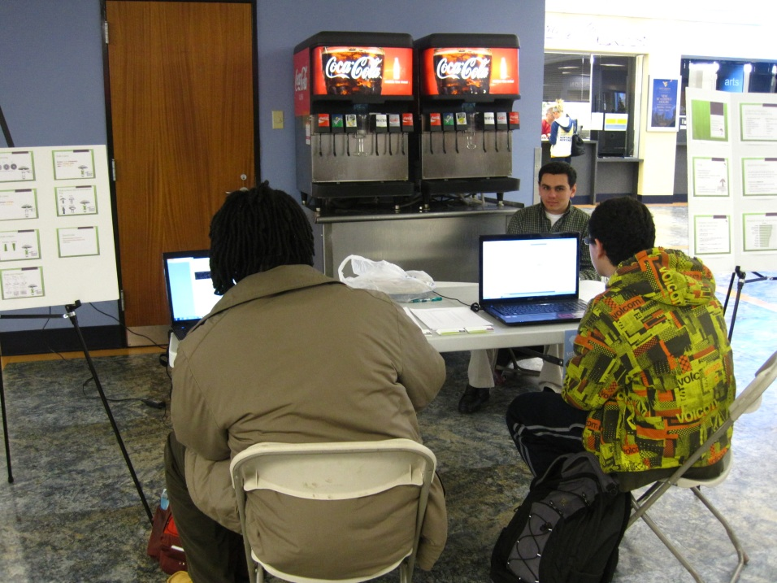
Survey at Mountainlair

Slide 21
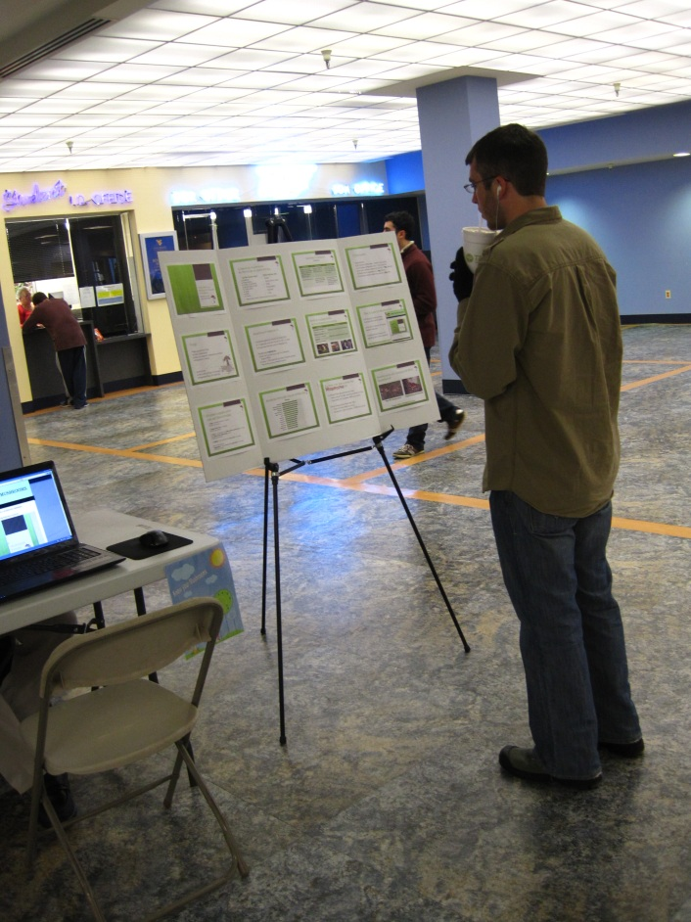
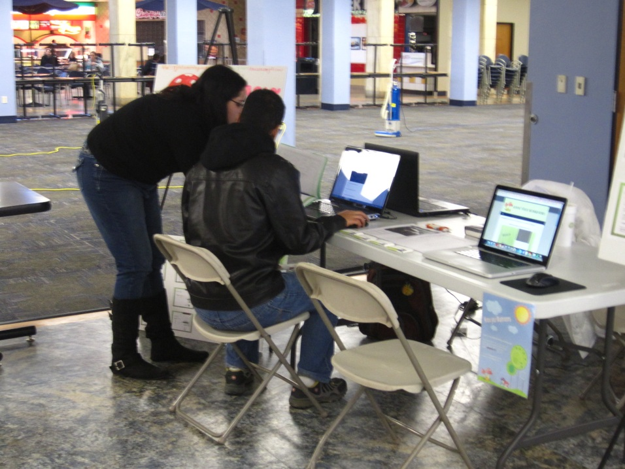
Survey at Mountainlair

Slide 22
Methodology 4
Calculate survey test scores
Calculate species’ accuracy variation
Calculate attributes’ accuracy variation
Calculate attribute weights
Use data mining tools to find best ruleset

Slide 23
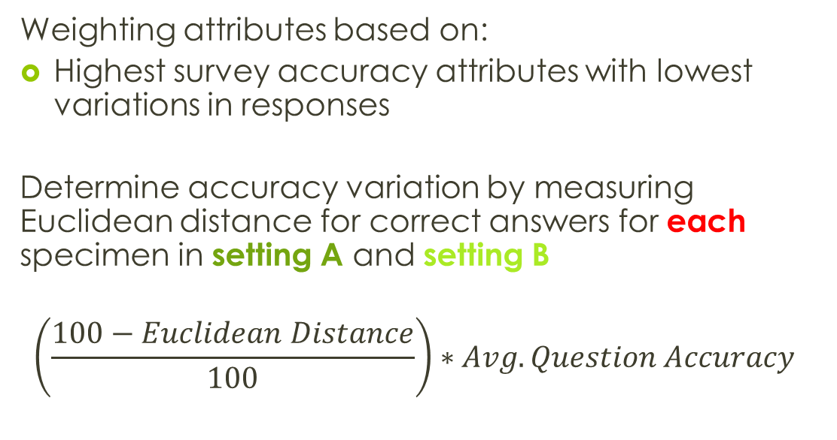
Weighting Methodology
Weighting attributes based on:
Highest survey accuracy attributes with lowest variations in responses
Determine accuracy variation by measuring Euclidean distance for correct answers for each specimen in setting A and setting B
$$\left(\frac{100−Euclidean Distance}{100}\right)∗Avg. Question Accuracy$$

Slide 24
Results

Slide 25
Overall Survey Results
30 questions per survey
15 Attributes measured
37 completed surveys
1,110 answered questions
Overall
Survey Grades
Highest was 24 out of 30 correct answers

Slide 26
Results

Slide 29
J48 Tree 99.6% Classification
3 Attributes
E = Edible
P = Poisonous
Odor
E
P
P
E
P
P
P
P
almond
creosote
foul
anise
musty
none
pungent
spicy
fishy
Spore print color
E
E
E
E
P
E
E
E
black
brown
buff
chocolate
green
orange
purple
white
yellow
Stalk surface below ring
E
P
E
E
silky
scaly
fibrous
smooth

Slide 30
J48 Tree 99.9% Classification
4 Attributes
E = Edible
P = Poisonous
Odor
E
P
P
E
P
P
P
P
almond
creosote
foul
anise
musty
none
pungent
spicy
fishy
Spore print color
E
E
E
E
P
E
E
E
black
brown
buff
chocolate
green
orange
purple
white
yellow
Stalk surface below ring
E
E
E
Ring type
scaly
fibrous
silky
smooth
P
P
P
P
P
P
P
E
evanescent
flaring
zone
sheathing
none
large
cobwebby
pendant

Slide 32
Conclusions

Slide 33
Conclusion
Complex attributes = Higher error probability
Hypothesis 1: False
They are actually more accurate the more complex the attribute
Fat spheres = Complex attributes
Height = Survey accuracy

Slide 34
Conclusion
Human senses + external factors = Big impact
Hypothesis 2: True
24% change in correctly identifying attributes due to ambient environment conditions
1.2 questions answered incorrectly out of 5 due to ambient environments of mushrooms

Slide 35
Future Work
Evaluate mushroom expertise for increase in mushroom attribute identification accuracy
Measure Spore print color and Odor in surveys?

Slide 36
Questions?

