Slide 1

Midterm Project MileStone 4
team 3
Team members: Chong chen, Tianyang Leng
Date: 11/12/2023

Slide 2
https://www.ypppt.com/
CONTENT
PART 1
Introduction
PART 2
Main features
PART 3
Operation result
PART 4
Contributions

Slide 3
01
Introduction

Slide 4

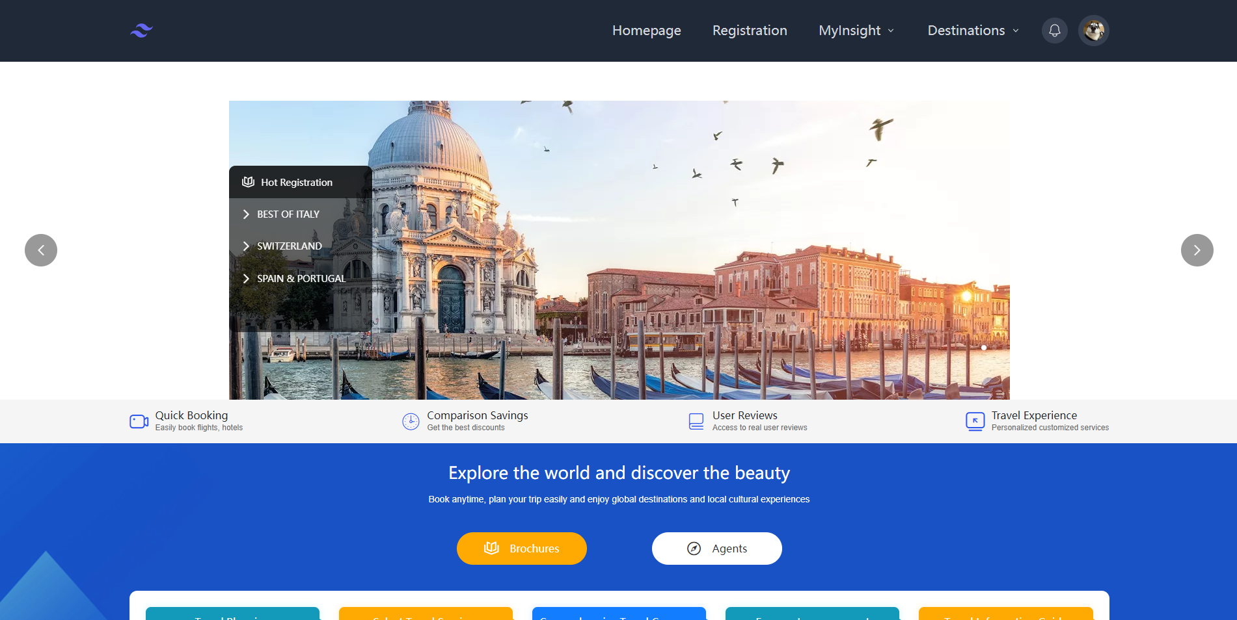
Introduction
Travel Website
Designed to provide users with a convenient, diverse selection of travel sites.This user-friendly system built on react implements user login and registration, provides multiple destinations to choose from, sign up for trips, etc.
Ensuring regulatory compliance, the system follows React philosophy. The team writes reusable components for common UI. Props are passed down properly.

Slide 5
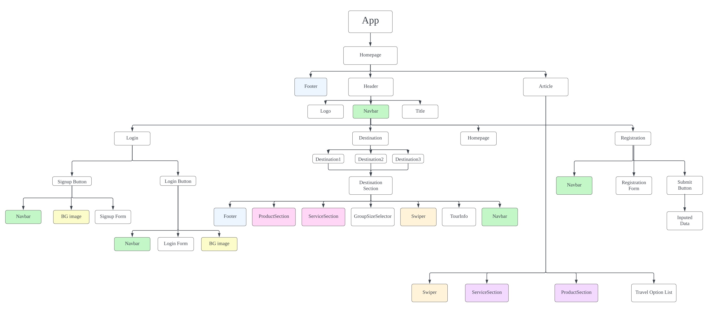
Introduction Sitemap

Slide 6
02
Main features

Slide 7
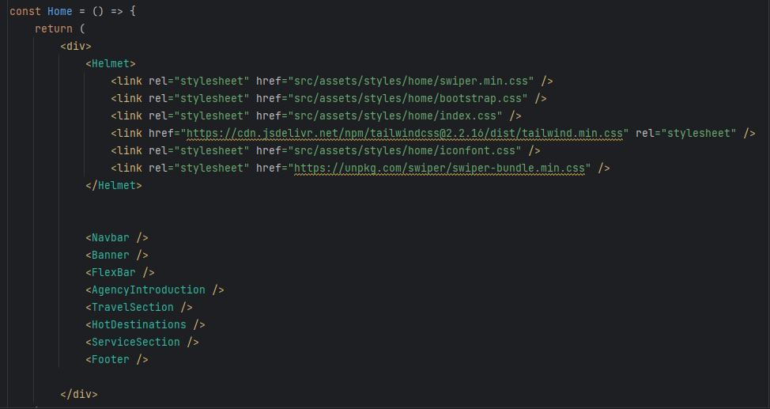
Homepage Main Components

Slide 8
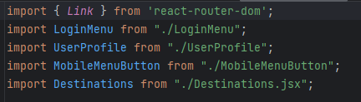
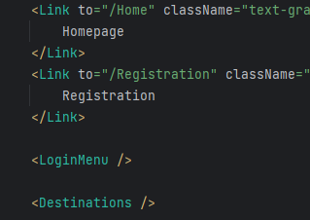




Homepage React router & Component Nesting

Slide 9
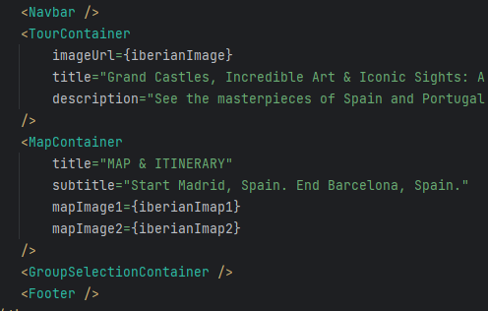
Destination Main Components
Displaying Spain as an example.
All components are reusable and used in other destination pages.
Props are passed down properly such as title, description and image URL.

Slide 10

Destination Usestate hook
State variable that stores the currently selected group type
Defined ‘class’ as the initial value for ‘selectgroup’
Compared the value of selectedGroup with the identifiers of each group option ('classic' or 'small')

Slide 11
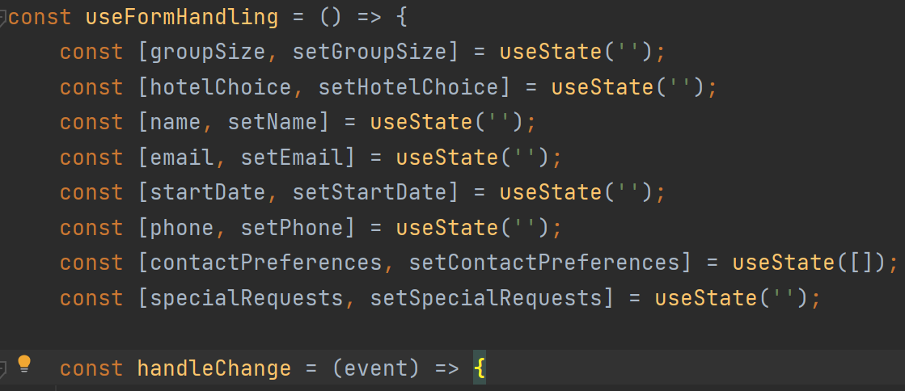

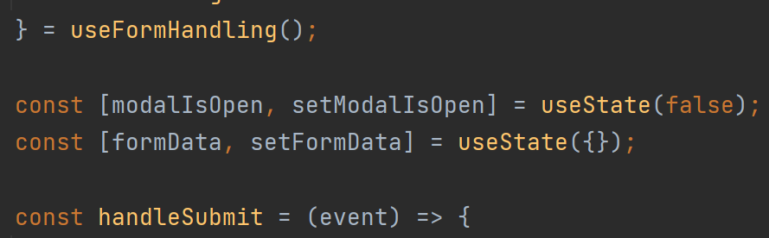
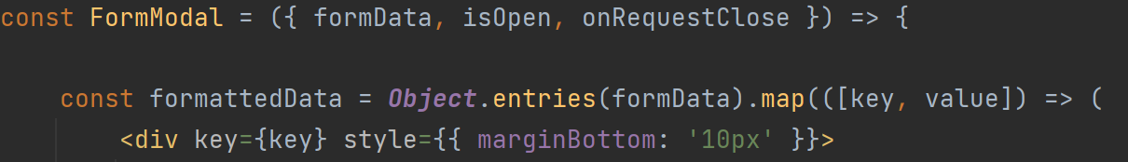
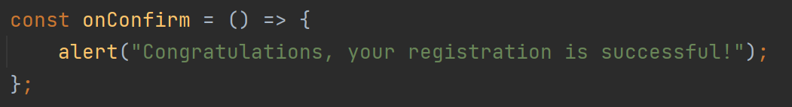

Registration
useFormHandling Hook
Registration page
RegistrationForm Component
FormModal Component

Slide 12
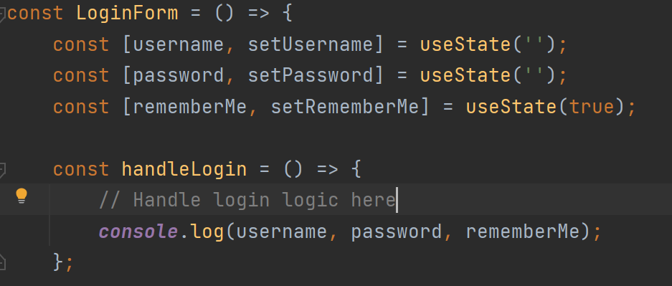
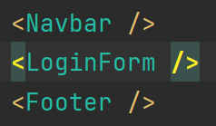
Login/Signup
Login page
LoginForm Component

Slide 13
03
Operation
Result

Slide 14
04
Contributions
& Learnings

Slide 15
Skills
Mastered the front-end skills——HTML5,CSS3,Javascript
React
Learned how to build react-based web pages with components
Contributions
Learnings
Cooperation
Completed assignments more efficiently and thoroughly through multiple team works
Tools
Used various tools such as kanban, lucid, tailwind, bootstrap

Slide 16
Member Contributions
Tianyang Leng
01
Part of the homepage component coding.
Implemented the login page component.
Implemented the destination pages.
Overall project modification and optimization
Creating PowerPoint
In-class presentation.
Chong Chen
02
Building the React project structure.
Part of the homepage component coding.
Implemented the Navbar and Footer component.
Registration page component coding.
Overall project modification and optimization.
In-class presentation.
.

Slide 17
Thank You!

