Slide 1
PRINCIPLES OF INTERNET PROGRAMMING (IT205N) ASSIGNMENT 2
TEAM MEMBER:
Wayne Ng, Chin See Ying, Tan Chong How

Slide 2

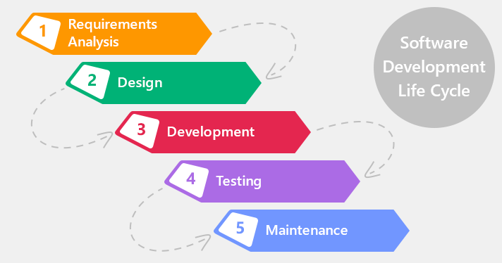
The flow of the assignment

Slide 3
Require analysis
Software development tools
Adobe XD, Sublime Text 3, XAMPP
Programming Language
HTML5 , CSS3 , MYSQL, PHP, JAVASCRIPT

Slide 4
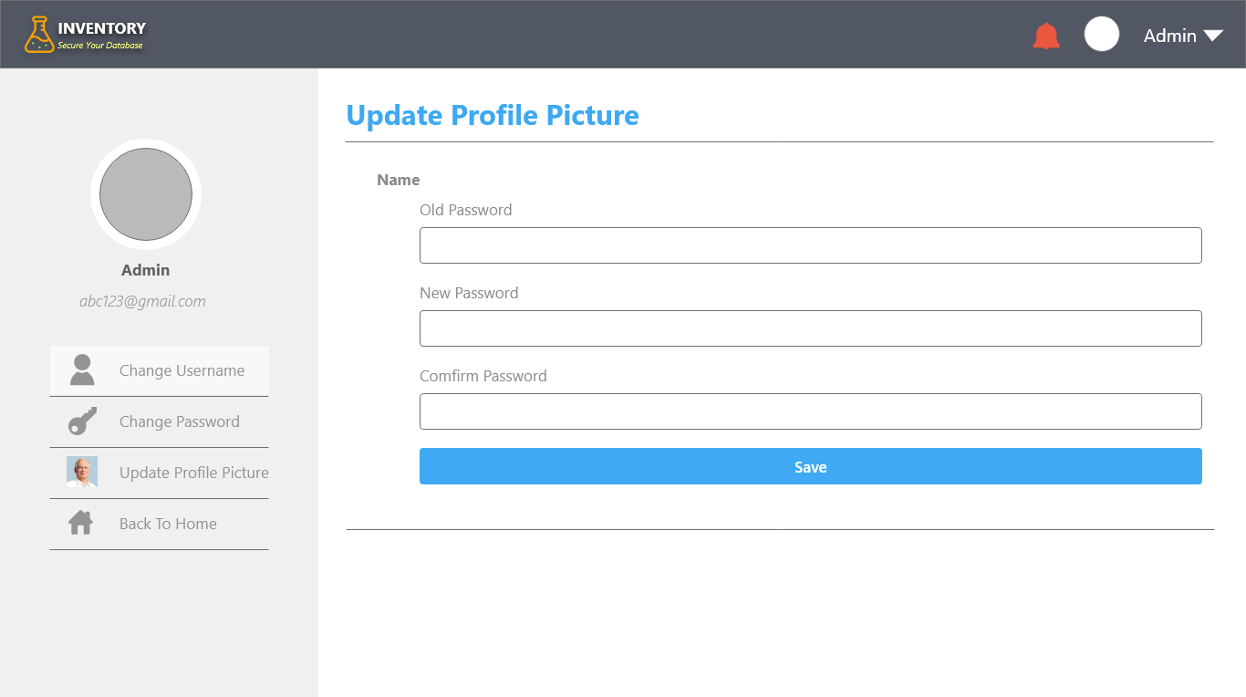

Design
Refer some design UI by using google image
Discussing which UI are better and making a decision
Hand- in the final design to the Front-End Developer

Slide 5

Development (Front End)
Web Based System
Using HTML for body and styling using css to customize the theme

Slide 6
Development (Back End)
Design database
1
Set the data Column , allocate data size, data type, decided which is the primary key.
Using php and mysqli
2
For doing password encryption, login system , and able to view, add, insert, delete database

Slide 7
Testing
All the hyperlink/redirect are working fine
All the textboxes in form mode are not allowed to insert empty data
Validation of Email, Text and number

Slide 8
Thank You

