Slide 1

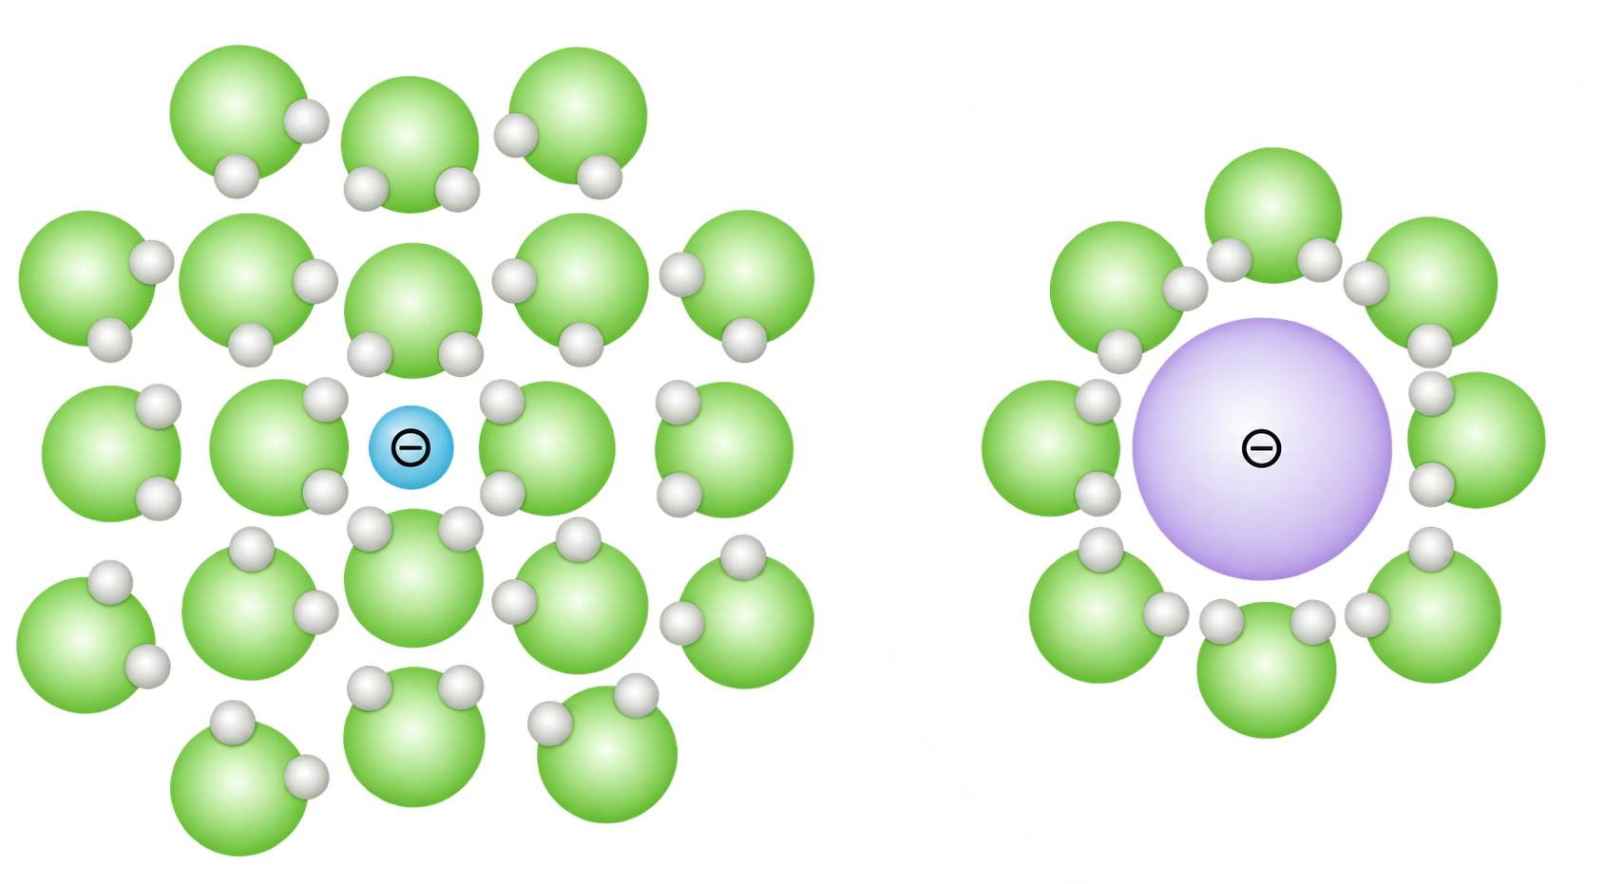




a Define a transferable reaction objective
b Organize literature by chemical role
Selective defluorinative coupling
Tier 1
Reaction precedents
139
A source-linked evidence record
Tier 2
Elementary steps
101
Observation
N, O, S and other donor forms
Substrate, conditions and outcome
Tier 3
Species and medium
88
Interpretation
Trifluoroethyl carbonyl substrate
Monofluorovinyl connectivity
Proposed elementary steps
Tier 4
Competing pathways
42
Scope
Required premises and exceptions
c Translate chemical relationships into experiments
01
02
03
04
05
Infer and review
Four principles
100 candidates
Human evaluation
HTE and BO
Source-linked LLM calls
Chemical relationships
Structure + donor form
108 input pairs
96-condition grid
Literature evidence constrains the reacting site, accessible species and target endpoint.
d
RP1
Acceptor activation
RP2
Reactive Donor Generation
Resonance
Steric effects
Solvation
Coordination
Resonance stabilizes donor reactivity
Steric hindrance modulates reactivity
Solvation influences speciation and reactivity
Coordination changes donor nucleophilicity
Selective defluorinative functionalization
RP3
Intermediate Pathway Control
RP4
Product Stabilization
Anionic or
metal-associated pathway
Subsequent coupling
Reagent stoichiometry
Hydrogen sources
Acid-base effects
Reaction conditions influence product accumulation
β-F elimination
C=C restored
Hydrofluorination
Key intermediate
Radical pathway
Difluorinated
byproduct
Further defluorination
H-atom transfer

Slide 2
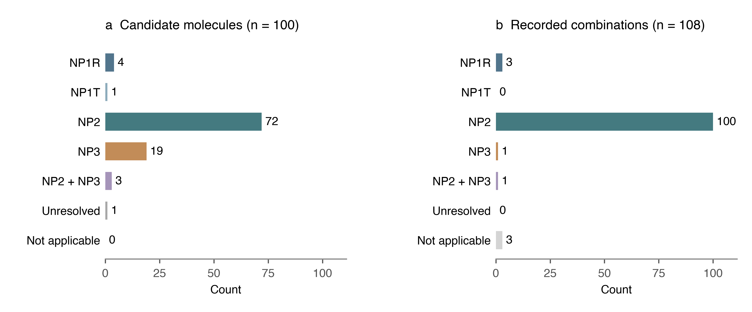


a Candidate diversity across reacting centres
b Donor form expands the search
C
32
N
16
O
15
C048 Aniline
C045 Lithium anilide
S
17
P
17
Se
1
C051 Phenol
C064 Sodium phenoxide
C/O
1
C/N
1
0
10
20
30
C082 Thiophenol
Co78 Diphenyl disulfide
Candidate molecules
c Each molecule retains a chemical hypothesis
100
115
124
Candidate molecules
Route or site hypotheses
Proposed product options
Nucleophilic addition
β-F elimination
Protonation/HAT
Structurally diverse monofluoroalkenes
•••
Competing pathways
d Each molecule retains a chemical hypothesis

Slide 3




