Slide 1
Classification of Mushroom Data Set
Name: Chong Jun Hui
Class: DAAA/FT/2A/02

Slide 2
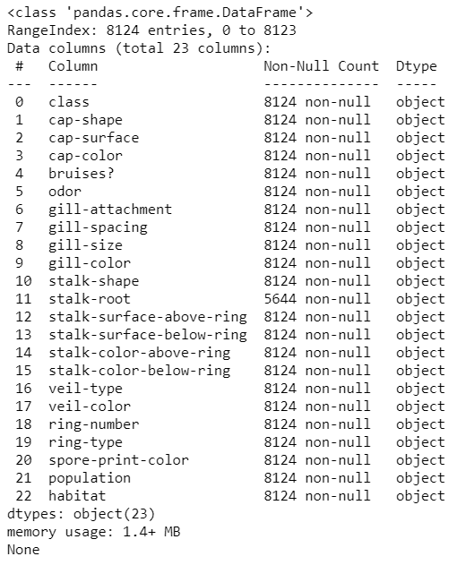
What is inside this dataset?
There are 22 features (all columns except for ‘class’), and 1 response (‘class’) variable. The goal is to predict the classes for the mushrooms, if it is edible or poisonous.
The 22 features are all nominally valued and the values are all categorical.
There are 2480 null values in the feature ‘stalk-root’.
There are 4208 instances of mushrooms being edible, and 3916 instances of mushrooms being poisonous, adding up to 8124 instances together in this dataset.
There are no duplicates in the data.
No additional source of data.

Slide 3
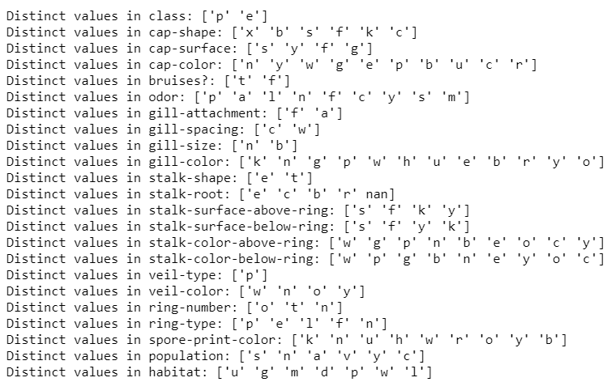
What is inside this dataset?
Looking at the distinct values of the features, we can see that the features range from having 2 to 12 different values. The only feature that only has 1 value is ‘veil-type’.
I will be removing as it makes no difference for the model to predict the classes and it may even worsen my model.

Slide 4
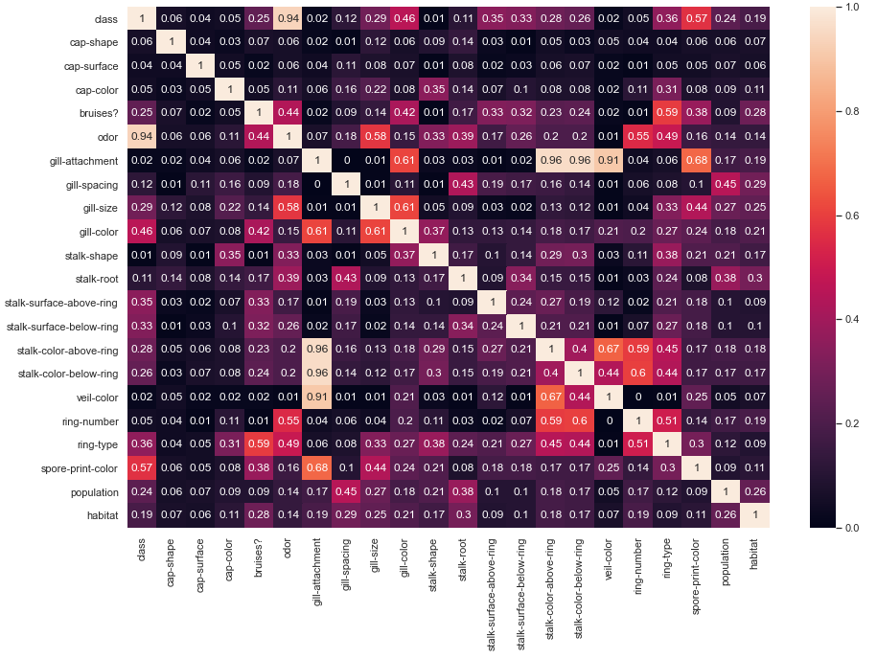
Information on dataset
This shows the correlation between all the features and I used Cramer’s V to find the correlation between all the categorical features.
As seen, features that have high correlation with class is odor followed spore-print-color and gill-color.
gill-attachment and stalk-color-above-ring, veil-color, ring-number are highly correlated to each other.

Slide 5
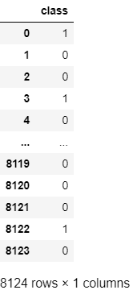
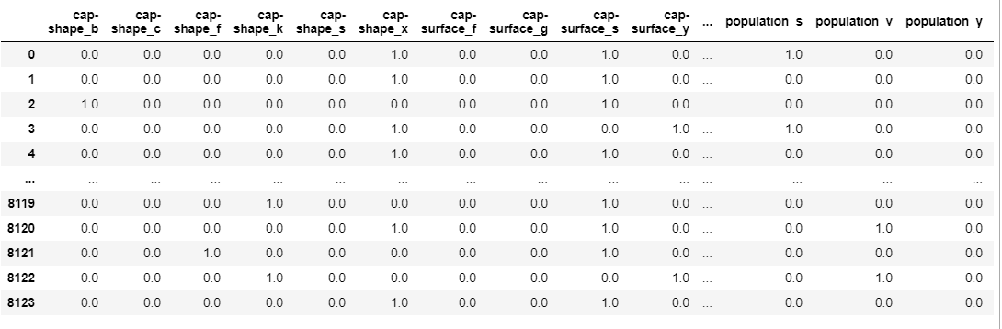
Data Processing
There are 2 parts to this data processing.
Firstly, I used kNN Imputation for the categorical missing values. There are null values in the feature ‘stalk-root’. I replaced the null values by using KNNImputer which predicts the null values by using completed values of neighbouring observations.
Secondly, I used one hot encoder to encode all of the categorical features as numerical values are needed to proceed with model training and testing. As for class labels, I used Label encoding.
Categorical features after one hot encoding:
Class labels after label encoding:

Slide 6
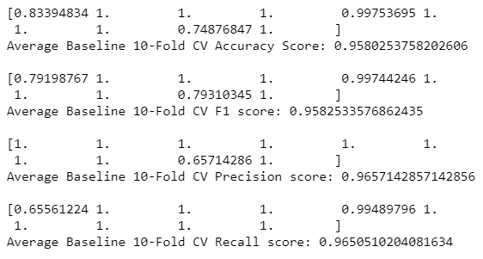
Baseline model
I used Logistic Regression as my baseline model as it is one of the simplest classification model.
I used 10-fold cross validation on my data and looking at the mean accuracy of the model, I can tell that this model is able to predict the classes 95.8% correctly.
The mean precision score is 0.96 and it means that out of the mushrooms that were predicted as poisonous (class is 1, positive prediction) the model has made, 96% of them were actually poisonous.
The mean recall score is 0.9 which means that out of all the mushrooms that were actually poisonous, the model is able to predict 96% of them correctly.

Slide 7
Voting Classifier
I chose Voting Classifier as my model.
I implemented 3 models for voting classifier:
Logistic Regression
Decision Tree
Support Vector Classifier
The predictions of voting classifier is the mode of all the predictions made by the 3 models.
In every classifier, I searched through the hyper-parameter space for the best hyperparameters. I did a 10 fold cross validation for each classifier. Accuracy score, F1 score, precision score and recall score is printed for every classifier.

Slide 8
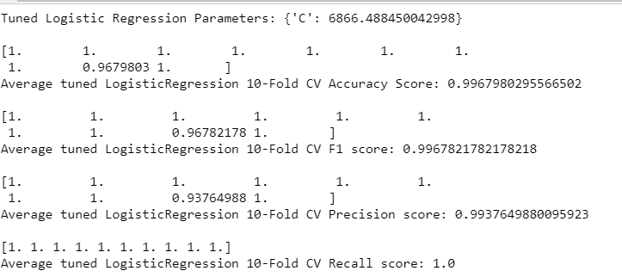
Voting Classifier – Logistic Regression
The best value for C is 6866.
99.6% of the time the model predicts the mushroom is poisonous or edible correctly.
Out of all the predicted poisonous mushrooms, 99.3% of them are correct.
For every mushroom that is actually poisonous, the model is able to predict 100% correctly all the time.

Slide 9
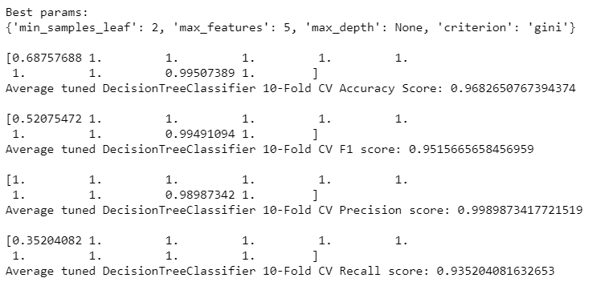
Voting Classifier – Decision Tree
The best value for min_samples_leaf is max_features is 5, max depth is none and criterion is gini.
96.8% of the time the model predicts the mushroom is poisonous or edible correctly.
99.8% of the mushrooms being predicted as poisonous were truly poisonous.
93.5% of the mushrooms that are poisonous are predicted correctly.
Decision Tree does not work as well as logistic regression.

Slide 10
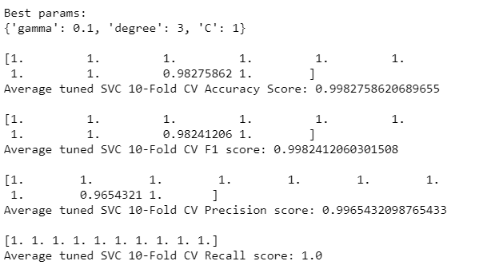
Voting Classifier – Support Vector Classification
The best hyperparameters is gamma being 0.1, degree is 3 and C is 1.
The accuracy of the predictions is 99.8%.
99.6% of the mushrooms were true positives out of all the mushrooms that were labelled positive.
The model correctly identified 99.6% as positives out of all the positives.
Out of the 3 classifiers, SVC returned the best accuracy score in 10 fold cross validation score.

Slide 11
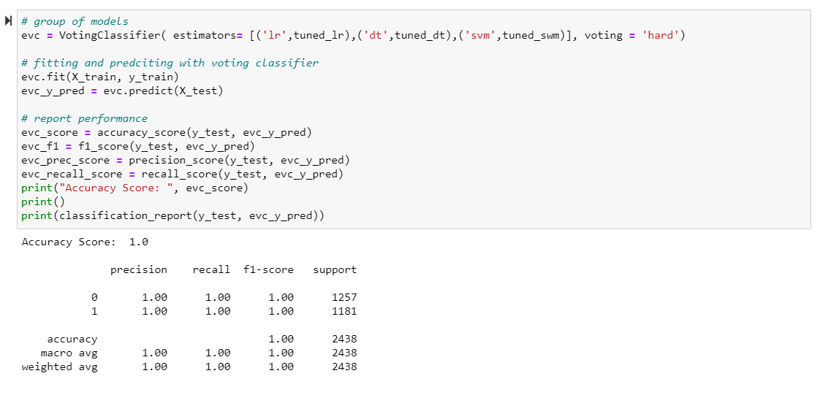
Voting Classifier
Lastly, I combined the 3 classifiers and I used hard voting which returns the majority of the class labels that are predicted by the 3 classifiers.
This time, I printed the classification report and we can see that all of our scores are 1.
The voting classifier model definitely performs better than the baseline model.

Slide 12
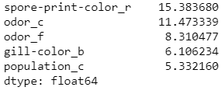
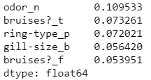
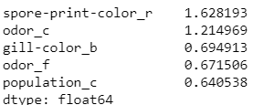
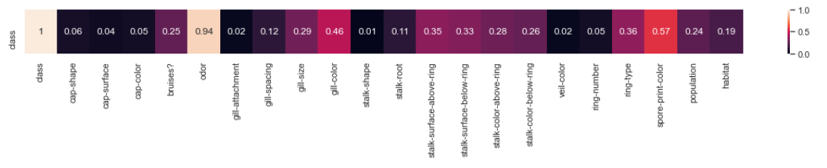
Feature Importance
I printed out the 5 features that contributed the most to each classifier used in voting classifier
Odor, spore-print-color, population, bruises?, gill-color are the common features that contributed to each classifier.
Looking at the correlation heatmap, we can see that odor does have a strong correlation with class. spore-print-color and gill-color has moderate correlation with class. population and bruises? have weak correlation with class.
So we can conclude that the variables that contribute more to the model prediction may not be the same variables that have strong correlation with class.
Support Vector Classification
Logistic regression
Decision Tree

Slide 13
Regression of House Sale Prices for King County Data Set
Name: Chong Jun Hui
Class: DAAA/FT/2A/02

Slide 14
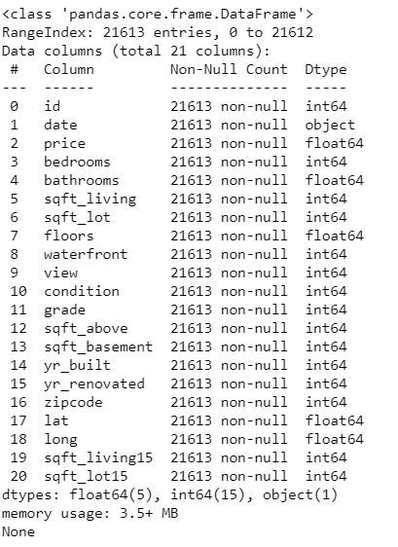
What is inside this dataset?
There are 21 features (all columns except for ‘price’), and 1 response (‘price’) variable. The goal is to predict the classes for the mushrooms, if it is edible or poisonous.
The prediction task is to predict the house sale prices. The house sale prices are based on the features on the house.
The features are either discrete or continuous.
There no null values.
There are 21612 observations in total.

Slide 15
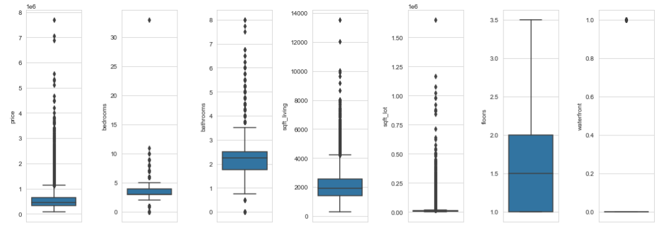
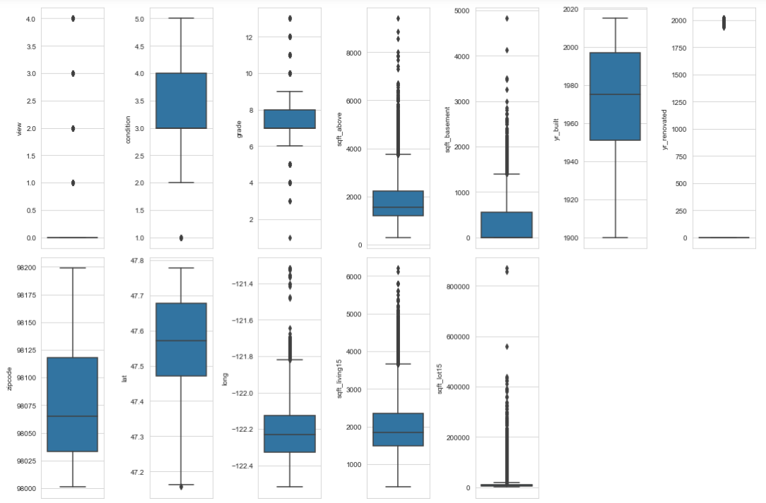
Outliers
Looking at the boxplots (I excluded id and date), there is a lot of outliers observed. However, it seems that these outliers happen for a reason.
Outliers of:
Price: 8000000
Bedrooms: 35 (approx.)
Sqft_lot: 1500000
Waterfront: 1
View:4
Since the outliers of price corresponds with the outliers of other features of the house, I shall not remove the outliers.

Slide 16
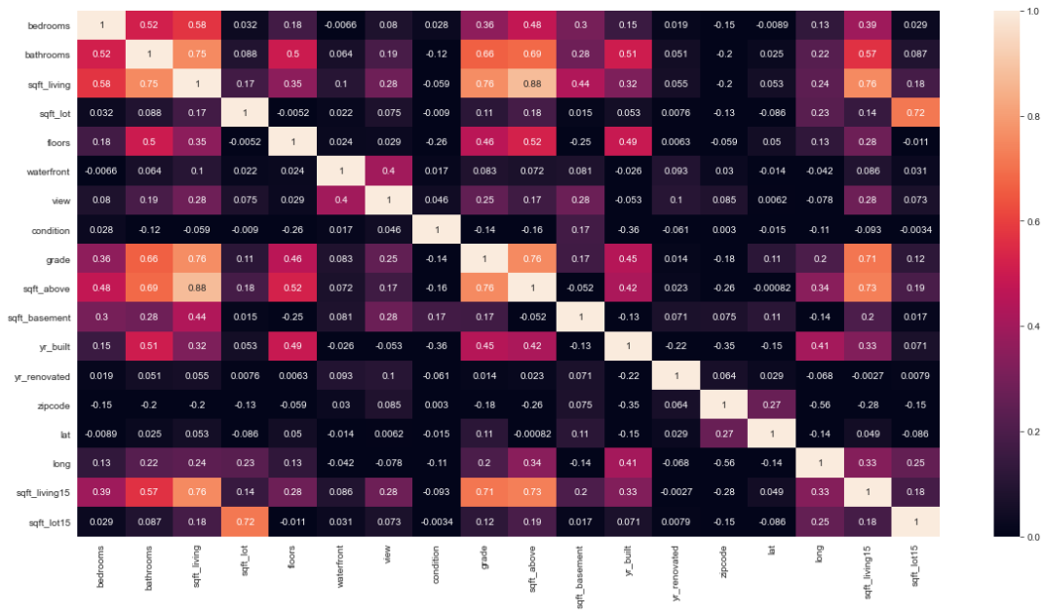
Correlation between features
This correation heatmap excludes ‘id’ and ‘price’. There are few features that are strongly correlated (correlation > 0.75) to each other:
‘sqft_living’ and ‘bathrooms’
‘grade’ and ‘sqft_living’
‘sqft_above’ and ‘grade’
‘sqft_above’ and ‘sqft_living’
‘sqft_living15’ and ‘sqft_living’
This shows that multicollinearity is present in this data.

Slide 17
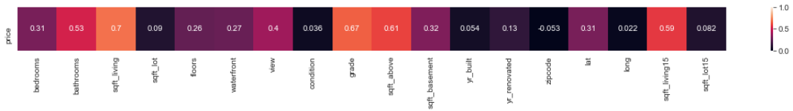
Correlation between price and features
As we can see, there are no features that are strongly correlated to price (strongest correlated is sqft_living, 0.7). Surprisingly for me, the number of bedrooms have a weak correlation with price and the condition of the house had ≈0 correlation with price.

Slide 18
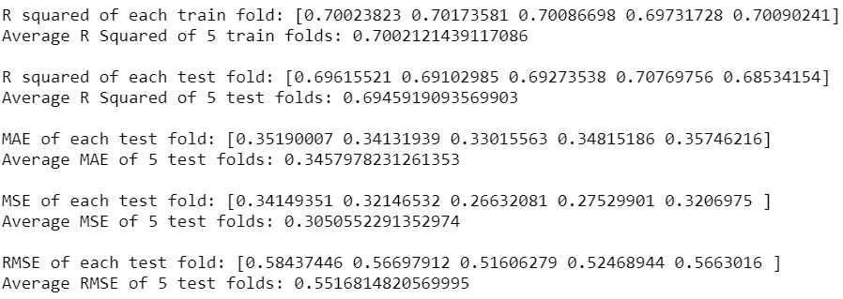
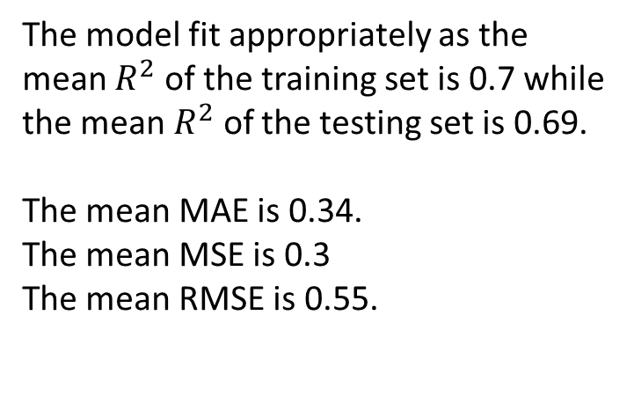
Baseline Model
Before implementing the baseline mode, I standardized the predictors and the target because they have different ranges and different measurement units.
For the baseline model, I chose Ridge Regression because ridge regression deals with multicollinearity.
The model fit appropriately as the mean $R^{2}$ of the training set is 0.7 while the mean $R^{2}$ of the testing set is 0.69.
The mean MAE is 0.34.
The mean MSE is 0.3
The mean RMSE is 0.55.

Slide 19
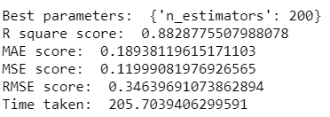
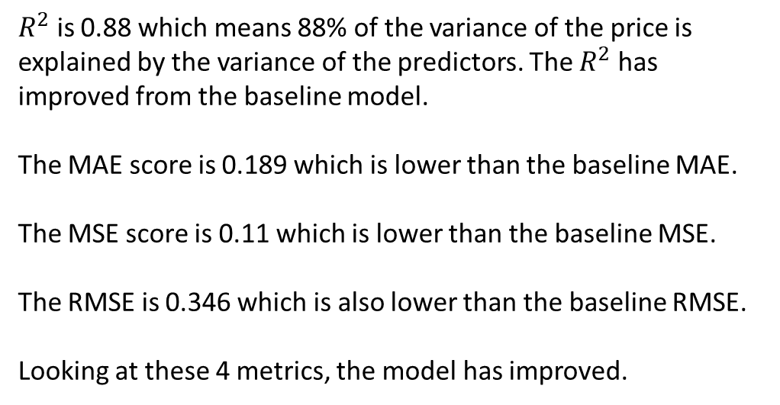
Bagging Regressor
For the estimator for Bagging Regressor, I used the default decision tree regressor. I used grid search to find the best n_estimators. The n_estimators are 10,50,100,200. The best value for n_estimators is 200.
$R^{2}$ is 0.88 which means 88% of the variance of the price is explained by the variance of the predictors. The $R^{2}$ has improved from the baseline model.
The MAE score is 0.189 which is lower than the baseline MAE.
The MSE score is 0.11 which is lower than the baseline MSE.
The RMSE is 0.346 which is also lower than the baseline RMSE.
Looking at these 4 metrics, the model has improved.

Slide 20
Thank You

