Slide 1

ST1508-Practical For AI CA2 Assignment Phase 2
Done by: Jumana Haseen (2021627), Chong Jun Hui (2021094), Tushita Govindaraj (2012155)

Slide 2
Background Information
Taxi has become a very important part of our lives. Without taxis it would be very hard to get to one place from another efficiently.
According to a research on Evaluating Safety Issues for Taxi Transport Management, 52.5% of taxi drivers have dangerous driving behavior and 46% of these behaviors are done repeatedly.
Purpose: As part of the Data Science team of the Just Taxi company, we would be analysing taxi trip data in order to provide insights in the bigger picture of our company by addressing questions concerning driving safety.

Slide 3
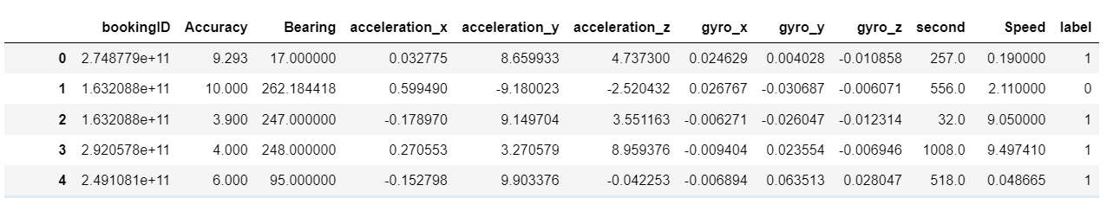
Data Description
Name: JustTaxi.csv
Columns: 12
Rows: 7,194,164
Size: 996MB
Features and labels are merged to form one big dataset during phase 1.
Dataset contains information for each trip and statistical data such as accelerometer and gyroscope readings, GPS accuracy and bearing , speed as well as time of record in seconds. The labels column indicates whether a trip is considered safe or dangerous.

Slide 4
Data Description
No. | Name | Description | Data Type
1 | featuresID | Identifies each record in column | Int
2 | bookingID | Identifies each trip by taxi | Float
3 | Accuracy | Accuracy inferred by GPS (in metres) | Float
4 | Bearing | GPS bearing (in metres) | Float
5 | acceleration_x | Accelerometer reading at x axis (m/s2) | Float
6 | acceleration_y | Accelerometer reading at y axis (m/s2) | Float
7 | acceleration_z | Accelerometer reading at z axis (m/s2) | Float
8 | gyro_x | Gyroscope reading in x axis (rad/s) | Float
9 | gryo_y | Gyroscope reading in y axis (rad/s) | Float
10 | gryo_z | Gyroscope reading in z axis (rad/s) | Float
11 | second | Time of the record by number of seconds | Float
12 | Speed | Speed measured by GPS in m/s | Float
13 | Label | 1: Dangerous trip, 0: Safe trips | Int

Slide 5
Data Exploration and Wrangling

Slide 6
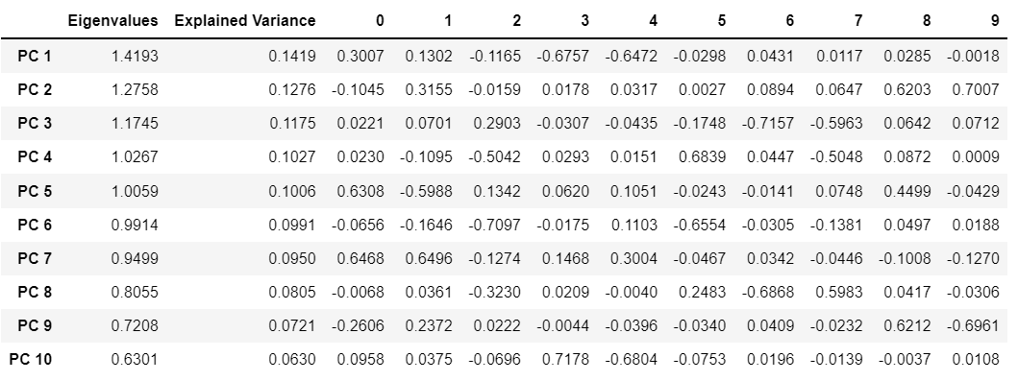

Data Exploration – PCA Visualization

Slide 7
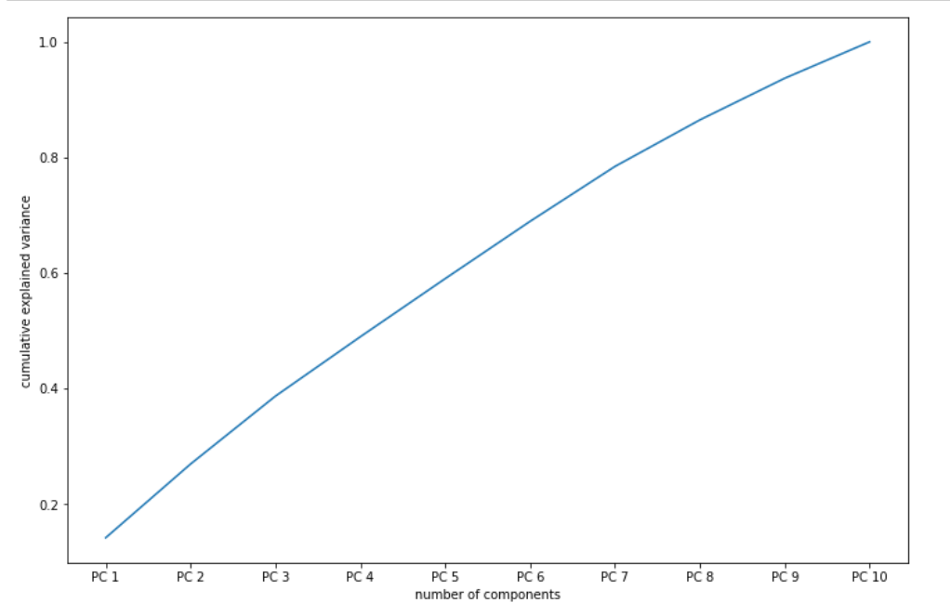
Data Exploration – PCA Visualization

Slide 8
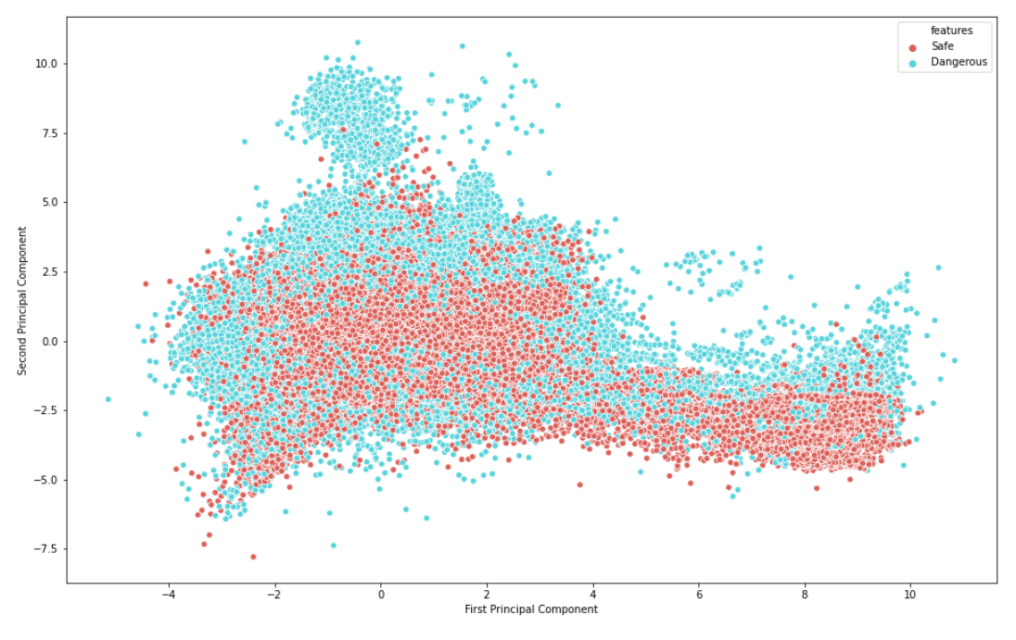
Data Exploration – PCA Visualization

Slide 9
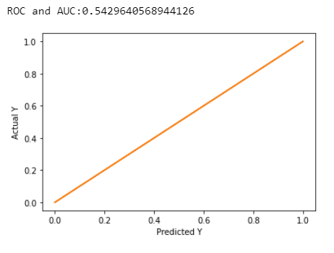
Data Wrangling – Outlier Detection Algorithm
Baseline: Logistic Regression
ROC AUC score is 0.543.
Baseline model not very good at differentiating between safe and dangerous trips.
Notes:
ROC is a probability curve and AUC represents the degree or measure of separability. It tells how much the model can distinguish between classes. Higher the AUC, the better the model is at predicting safe and dangerous trips.

Slide 10

Data Wrangling – Outlier Detection Algorithm
After removal, ROC AUC score improved to 0.646.
The model will be able to classify safety of trips better.
A total of 482,009 records were removed from the training data.
Notes:
ROC is a probability curve and AUC represents the degree or measure of separability. It tells how much the model can distinguish between classes. Higher the AUC, the better the model is at predicting safe and dangerous trips.

Slide 11
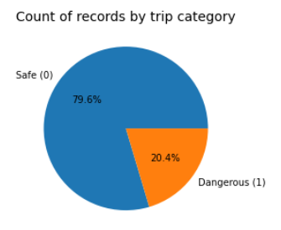

Data Wrangling – Combatting Imbalanced Class

Slide 12
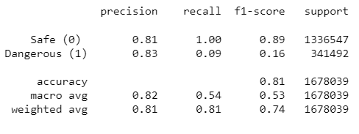
Data Wrangling – Combatting Imbalanced Class
Classification report of Baseline: Logistic Regression

Slide 13

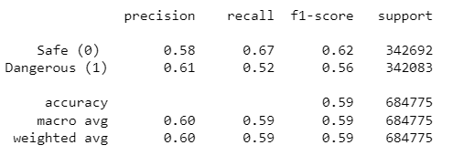
Data Wrangling – Combatting Imbalanced Class
Random Under Sampling
Shape of dataset:

Slide 14

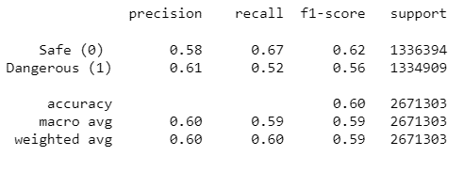
Data Wrangling – Combatting Imbalanced Class
Random Over Sampling
Shape of dataset:

Slide 15
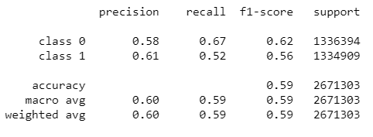
Data Wrangling – Combatting Imbalanced Class
SMOTE

Slide 16
Data Wrangling – Combatting Imbalanced Class
SMOTE

Slide 17
Data Wrangling – Combatting Imbalanced Class
Comparing all three methods…
Random Under-Sampling has greatly reduced the size of the dataset, from 6712155 to 2739098.
Random Over-Sampling and SMOTE, the number of records have been increased to 10685212.
Combining Random Under-Sampling with Random Over-Sampling or SMOTE seem to be the ideal choice for us.

Slide 18
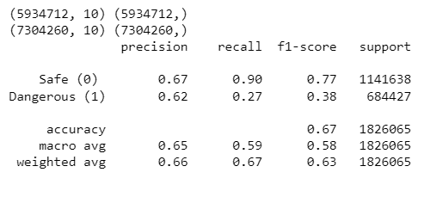
Data Wrangling – Combatting Imbalanced Class
Shape of dataset after RUS:
Shape of dataset after ROS:
Combining Random Under Sampling and Random Over Sampling

Slide 19
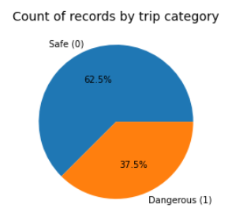
Data Wrangling – Combatting Imbalanced Class
Final Evaluation
777443 records removed from the majority class.
1369548 duplicates records to the minority class.
Final dataset has 7260964 records.
The ratio of the classes have now changed to 3:5.

Slide 20
Machine Learning

Slide 21
Baseline Models
5 different classification models were implemented - KNN, Decision Tree, Gaussian Naïve Bayes, SGD, Logistic Regression.
Best 2 models will be chosen to tune their hyperparameters and improve their performance.

Slide 22
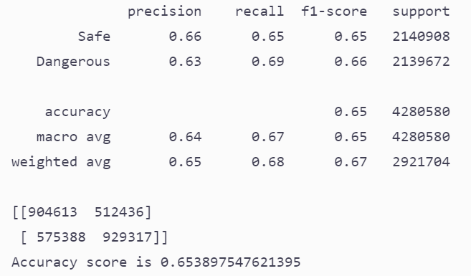
Baseline Models
KNN

Slide 23
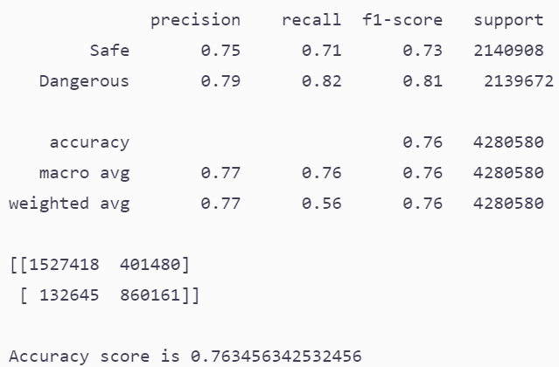
Baseline Models
Decision Tree

Slide 24
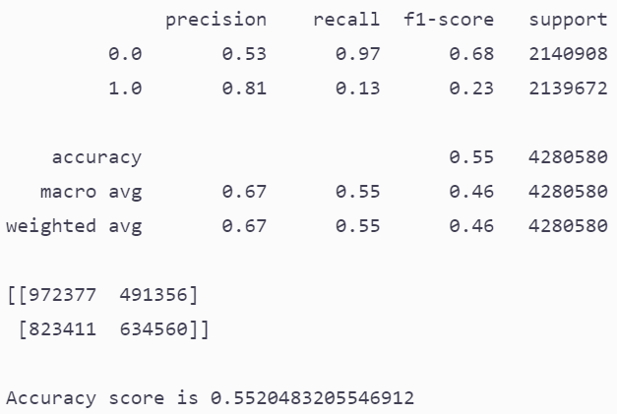
Baseline Models
Gaussian Naïve Bayes

Slide 25
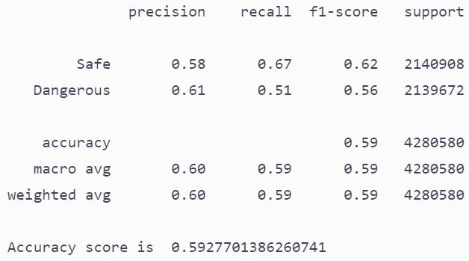
Baseline Models
Logistic Regression

Slide 26
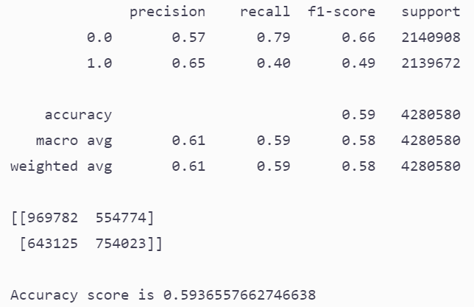
Baseline Models
SGD

Slide 27
Optimization of Better Models
Better models are Decision tree (0.76) and KNN (0.65).
Hence we will be further tuning these 2 models.
The model with highest accuracy will be taken as the final model.

Slide 28
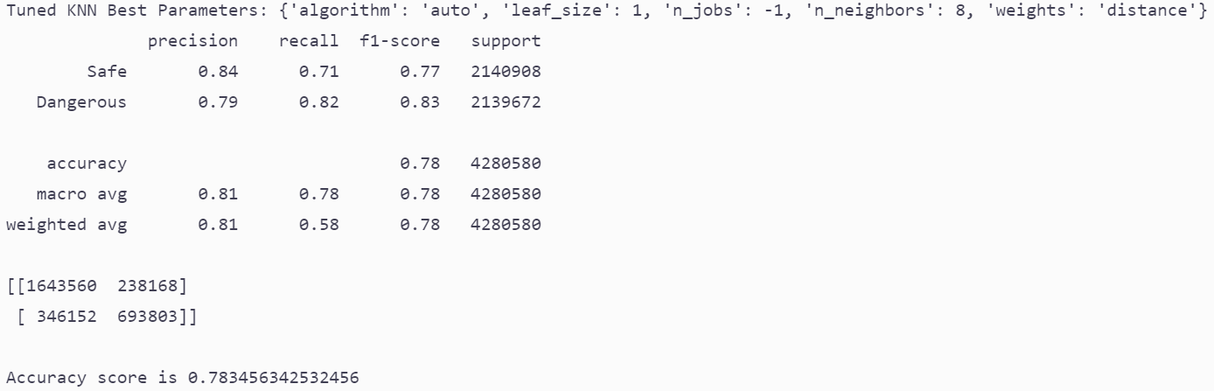
Optimization of Better Models
KNN Tuning

Slide 29
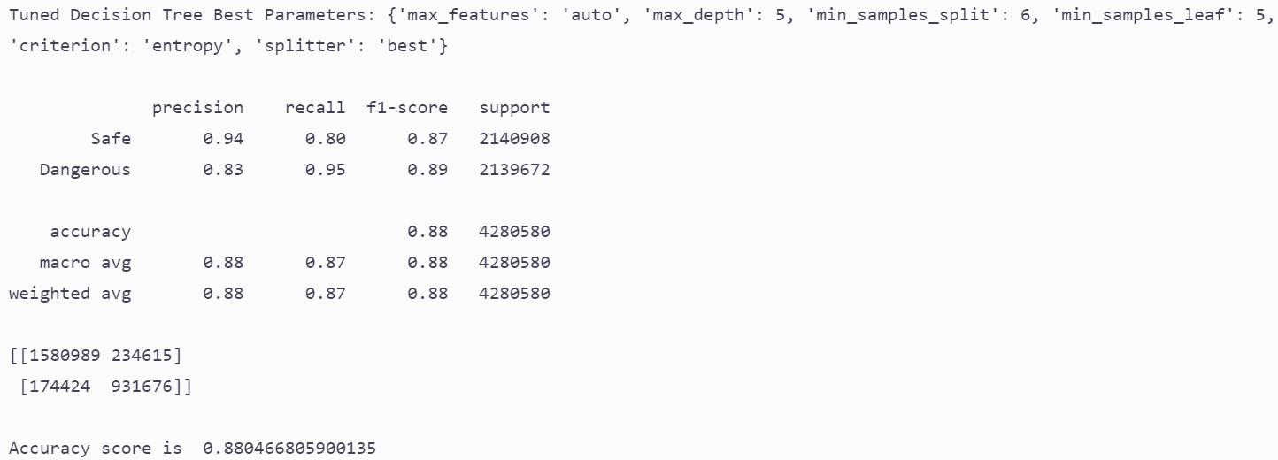
Optimization of Better Models
Decision Tree Tuning

Slide 30
Final Model
Comparing KNN and Decision Tree…
KNN final accuracy is 80%.
Decision tree final accuracy is 86%.
Decision tree is a better model than KNN since overall it has higher score for all the metrics in comparison.
Best model is decision tree.

Slide 31
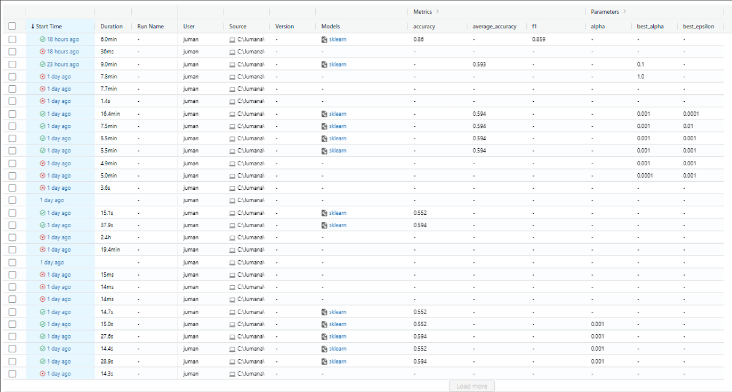
MLFLOW
MLFlow was used to monitor the changes in metrics of model like the accuracy, as well as experimenting with the various hyperparameters of different models.

Slide 32
Deployment of Prediction Models in GUI

Slide 33
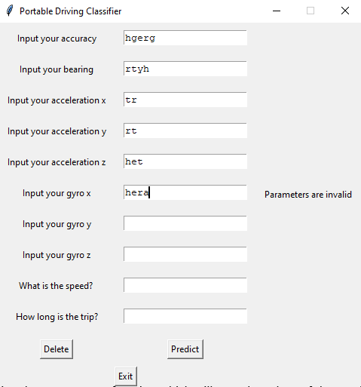
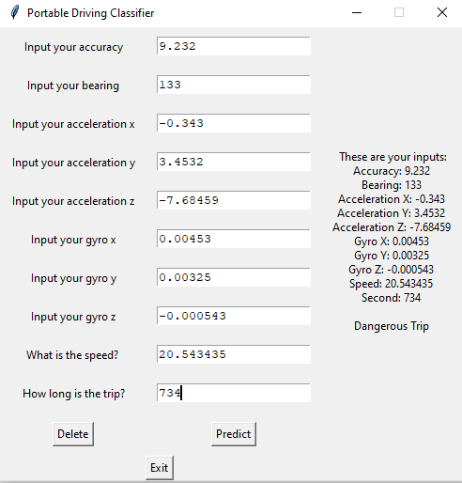
Graphical User Interface Demo

Slide 34
THE END
Thank you

