Slide 1
PDA-OTA practice UNMC workshop afternoon session
Chongliang (Jason) Luo, PhD
Assistant Professor
Division of Public Health Sciences
Washington University in St. Louis
May 2, 2025, @UNMC

Slide 2
Workshop materials
Practice R code:
https://github.com/chongliang-luo/UNMC_workshop/
PDA Over-The-Air (OTA) platform:
https://pdamethods.org/
https://pda-ota.pdamethods.org/login
Install R and Rstudio:
https://posit.co/download/rstudio-desktop/
Interactive whiteboard: Canva

Slide 3
Overview
PDA software
PDA-OTA platform
Practice project 1: COVID length of stay (DLMM)
Practice project 2: fetal loss and medication (ODAL)
Practice project 3: opioid use disorder (ODACH)

Slide 4
PDA software
Development starts in 2019.
Incorporates commonly used statistical models, and still growing.
Available on CRAN and GitHub.
Supports methodological development and applicational usage.

Slide 5

PDA software
PDA
Robust One-shot Distributed Algorithms for Logistic regression
Robust-ODAL
ODAL
One-shot Distributed Algorithms for Logistic regression
1
$$y$$
0
Notes:
with algorithms for modeling binary outcomes,
IDEA:
1. Small circle gradually or jump to a big circle.
2. Then, we have the full name under or besides the circle.
3. Finally, the capital letters merge to the abbreviation, at the same time the full name faded away

Slide 6
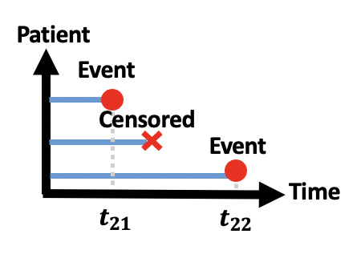
PDA software
One-shot Distributed Algorithms for Cox regression
ODAC/
ODACH
PDA
Robust-ODAL
ODAL
Notes:
time to event outcomes,
IDEA:
1. Small circle gradually or jump to a big circle.
2. Then, we have the full name under or besides the circle.
3. Finally, the capital letters merge to the abbreviation, at the same time the full name faded away

Slide 7
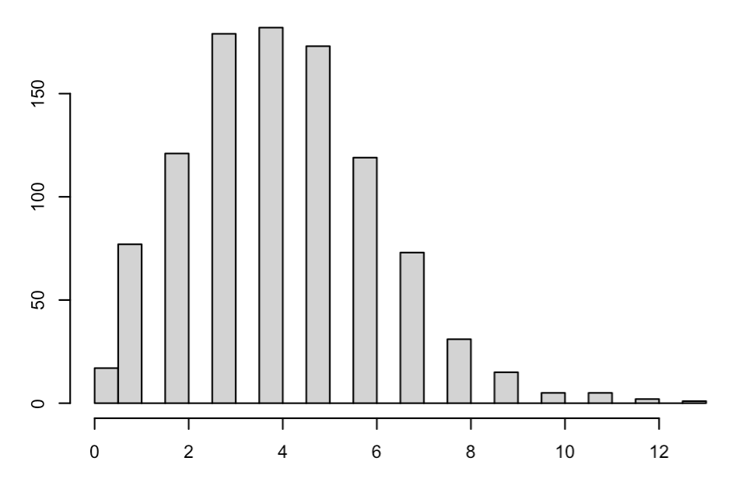
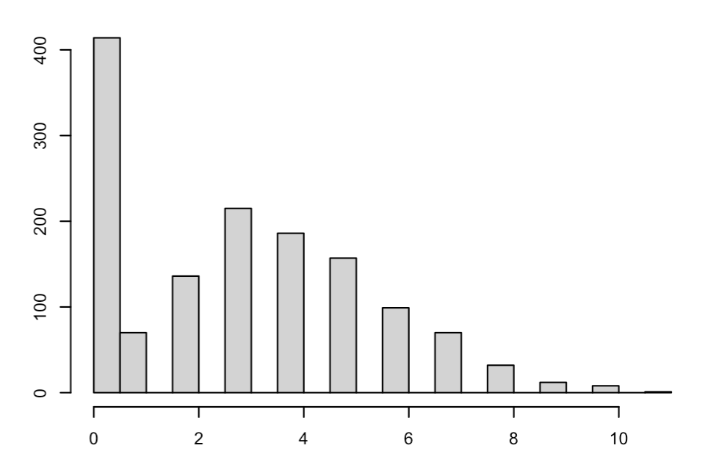
PDA software
One-shot Distributed Algorithms for Poisson regression
One-shot Distributed Algorithms for Hurdle regression
ODAP
ODAH
ODAC/
ODACH
PDA
Robust-ODAL
ODAL
Notes:
and count outcomes.
IDEA:
1. Small circle gradually or jump to a big circle.
2. Then, we have the full name under or besides the circle.
3. Finally, the capital letters merge to the abbreviation, at the same time the full name faded away

Slide 8
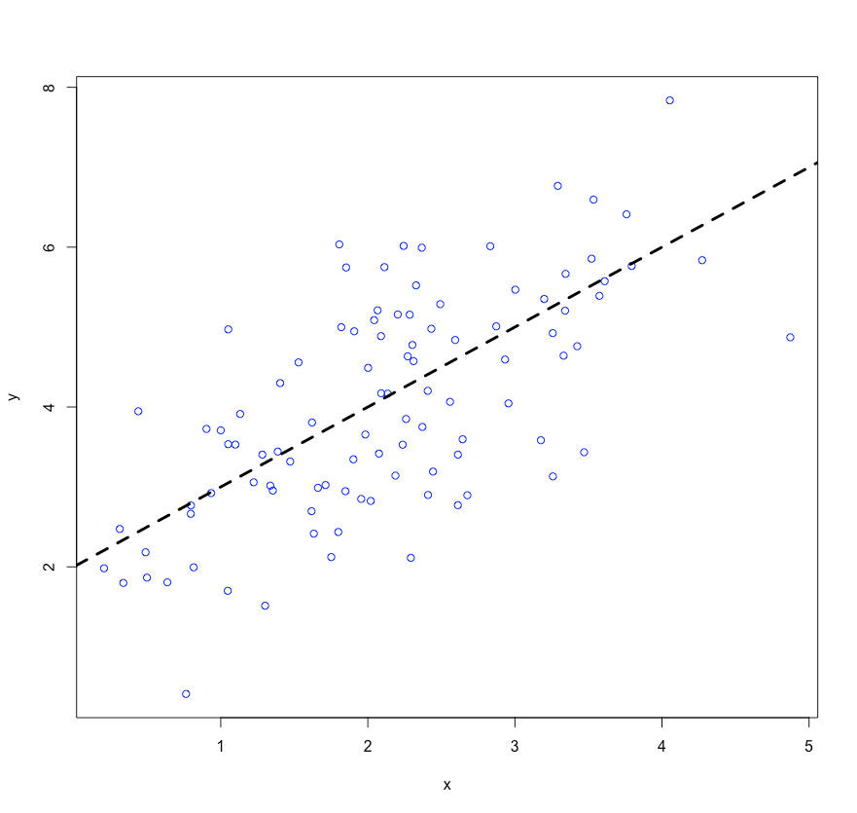
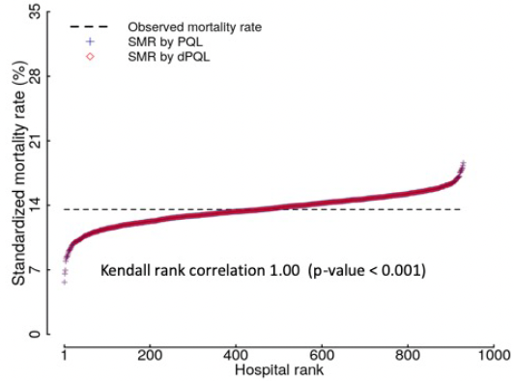
PDA software
ODAP
ODAH
Distributed Linear Mixed Model
ODAC
PDA
DLMM
Robust-ODAL
Distributed Penalized Quasi-Likelihood
DPQL
DPQL
ODAL
Notes:
We are expanding our work to many other types of statistical or machine-learning models.
IDEA:
1. Small circle gradually or jump to a big circle.
2. Then, we have the full name under or besides the circle.
3. Finally, the capital letters merge to the abbreviation, at the same time the full name faded away

Slide 9
PDA software
ODAP
ODAH
ODAC
PDA
DLMM
dGEM: hospital profiling
dPLR: semi-parametric reg
ADAP: high-d regression
dMLCA: latent clustering
DisC2o-HD: causal inference
dGAMLSS: additive models
…
Robust-ODAL
DPQL
ODAL
…
Notes:
IDEA:
1. Small circle gradually or jump to a big circle.
2. Then, we have the full name under or besides the circle.
3. Finally, the capital letters merge to the abbreviation, at the same time the full name faded away

Slide 10





Mission
Privacy-preserving
Requires AD rather than IPD
PDA
Notes:
While we develop our algorithms, we keep four principles in mind: privacy preservation

Slide 11
Mission
Privacy-preserving
Accurate
Requires AD rather than IPD
Obtains results close to
pooled IPD analysis
PDA
Notes:
accuracy

Slide 12
Mission
Privacy-preserving
Accurate
Requires AD rather than IPD
Obtains results close to
pooled IPD analysis
Communication-efficient
Only requires one round
of AD communication
PDA
Notes:
efficiency

Slide 13
Mission
Privacy-preserving
Accurate
Requires AD rather than IPD
Obtains results close to
pooled IPD analysis
Communication-efficient
Heterogeneity-aware
Only requires one round
of AD communication
Accounts for the heterogeneity
of data across sites
PDA
Notes:
We hope you enjoy exploring this website and learning more about the PDA as a next-generation data sharing strategy.

Slide 14
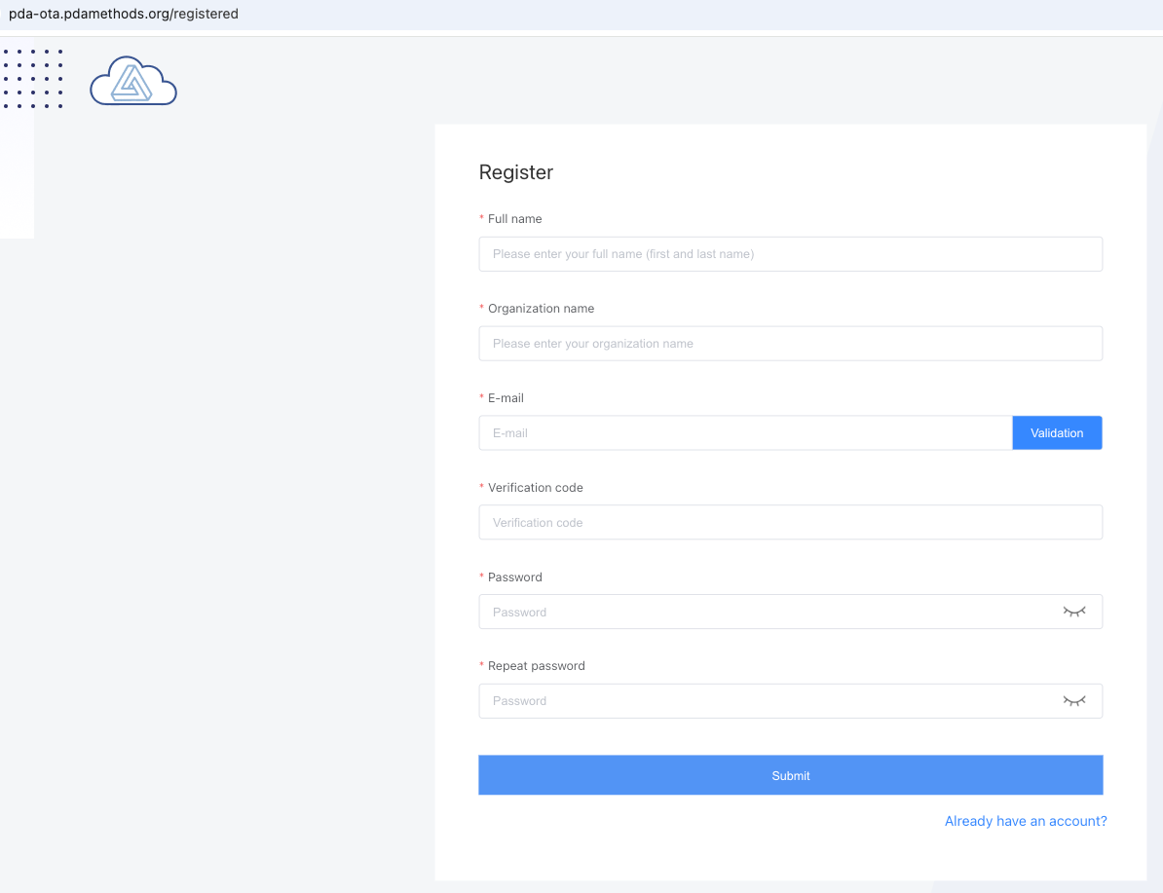
PDA-OTA platform

Slide 15
PDA software

Slide 16
PDA-OTA platform

Slide 17
PDA-OTA platform

Slide 18


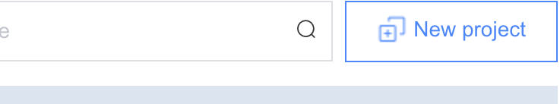
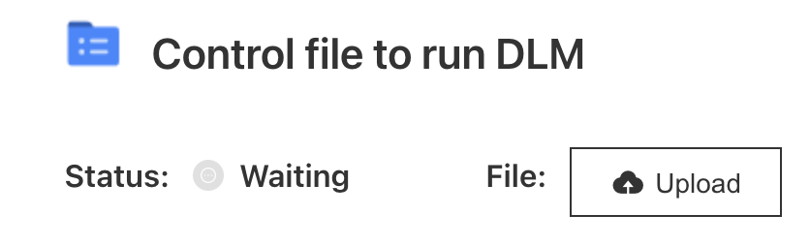
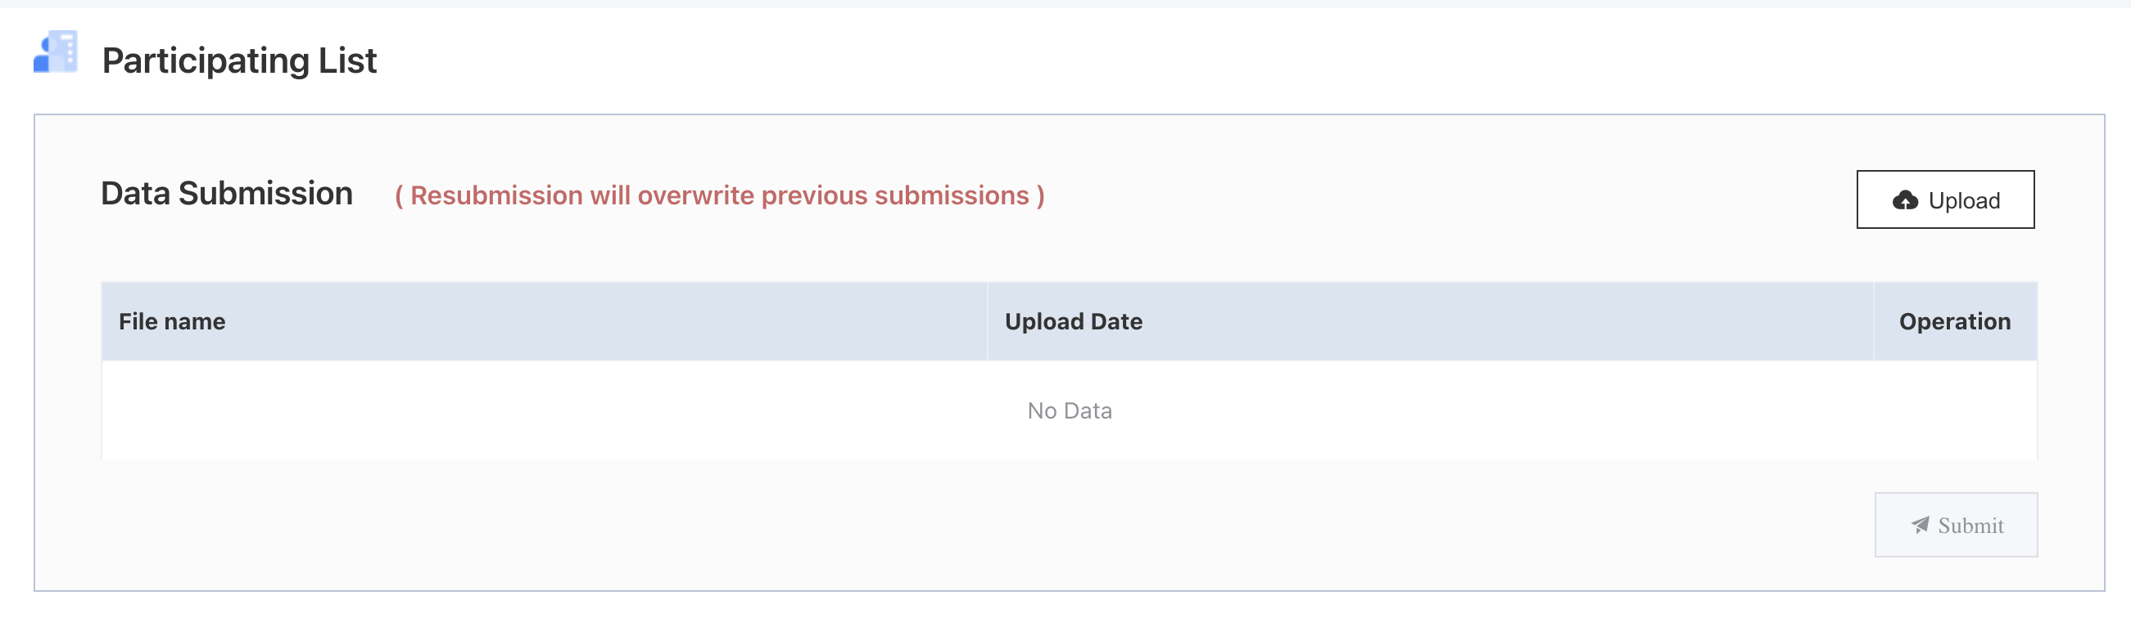


Participants
Operation
PDA-OTA
Step 0: All the sites prepare a study protocol, and designate one site as the “lead” site.
Step 1.1: Lead site create an OTA project, setup participants.
Step 1.2: Lead site create and upload control.json file.
control.json
Step 2.1: Collab sites download control.json file.
Step 2.2: Collab sites run R script with the control file and their IPD, produce AD (*_initialize.json ) and upload it.
control.json
*_initialize.json
Step 3.1: Lead site download all AD files (*_initialize.json ).
Step 3.2: Lead site run R script with the AD files, obtain result (*_estimate.json ) file and upload it.
Step 3.3: Lead site close the project and conclude.
*_initialize.json
*_estimate.json
Lead
Collab

Slide 19
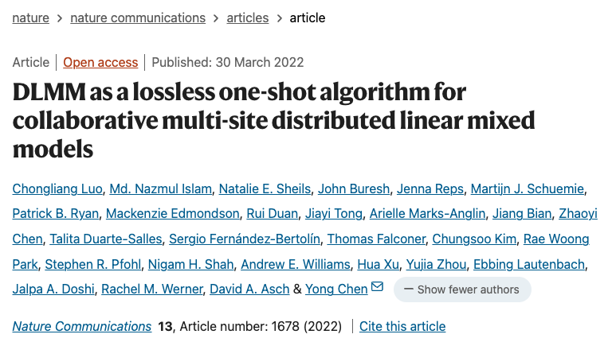
Practice project 1: COVID length of stay (DLMM)
https://www.nature.com/articles/s41467-022-29160-4

Slide 20
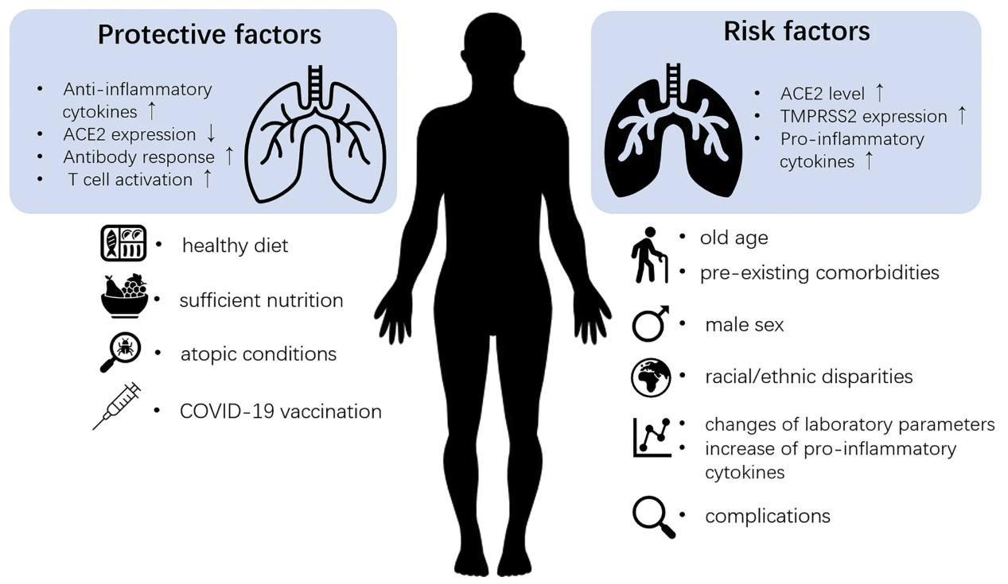
Practice project 1: COVID length of stay (DLMM)
Outcome = length of stay in days (year 2020).
Risk factors:
Age,
Gender,
CCI (Charlson Comorbidities Index),
Admission time,
Comorbidities: Cancer, COPD, Hyperlipidemia, Hypertension, KidneyDisease, Obesity, HeartDisease, Diabetes.

Slide 21
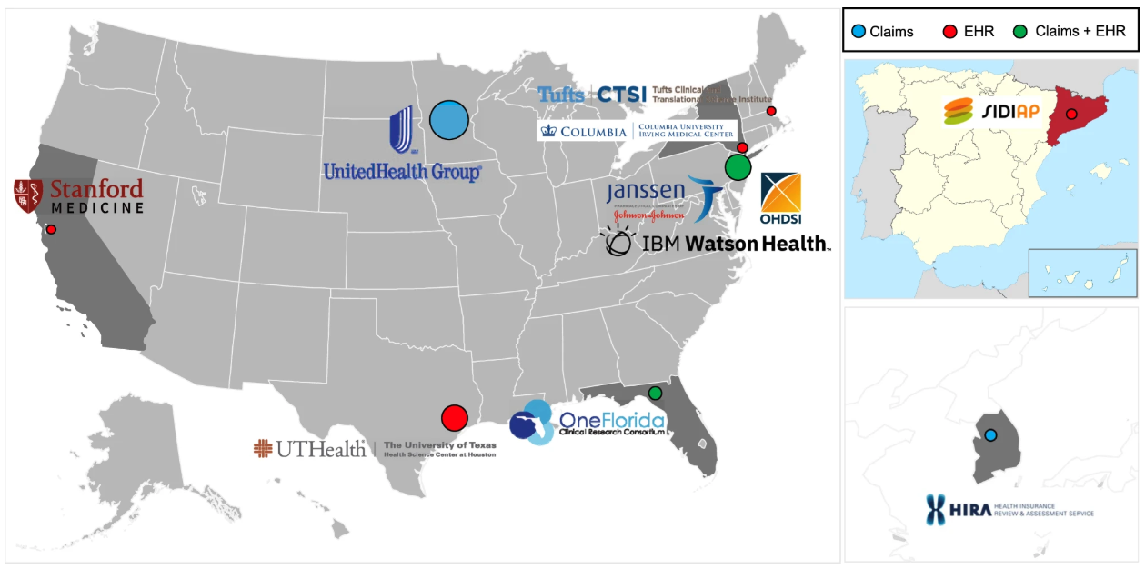

120,609 COVID-19 patients from 11 collaborative data sources worldwide

Slide 22
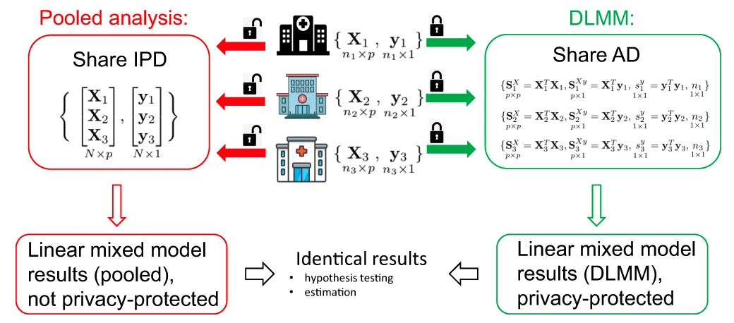
Practice project 1: COVID length of stay (DLMM)

Slide 23
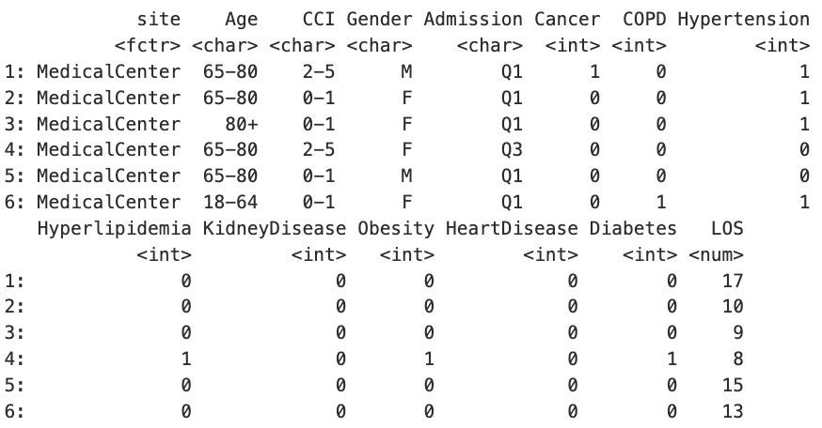
Practice project 1: COVID length of stay (DLMM)
Synthetic data

Slide 24
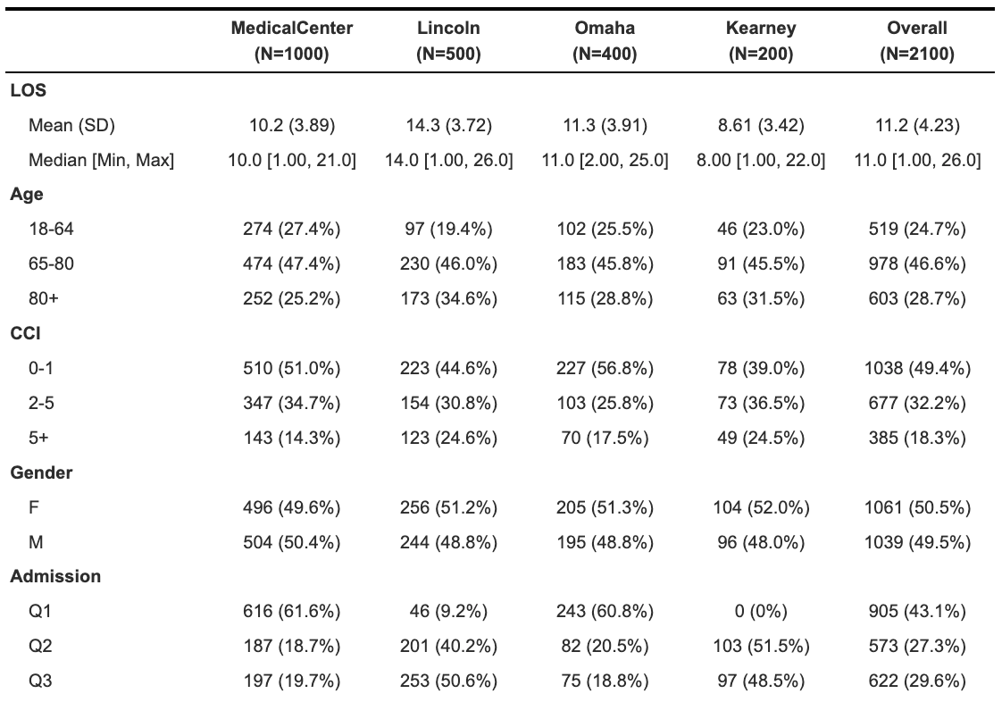
Practice project 1: COVID length of stay (DLMM)

Slide 25
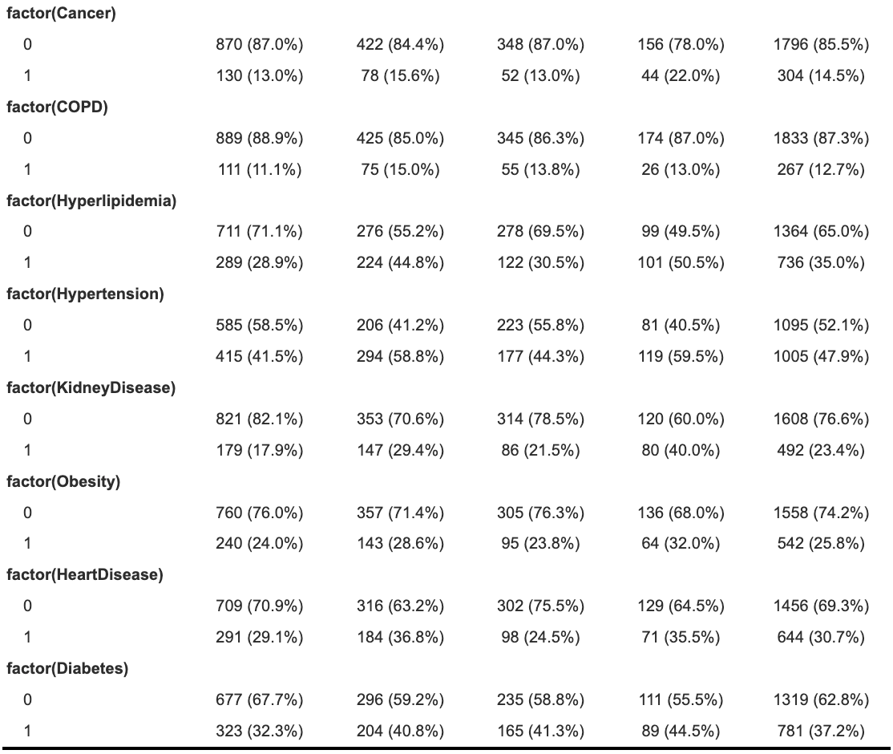
Practice project 1: COVID length of stay (DLMM)

Slide 26
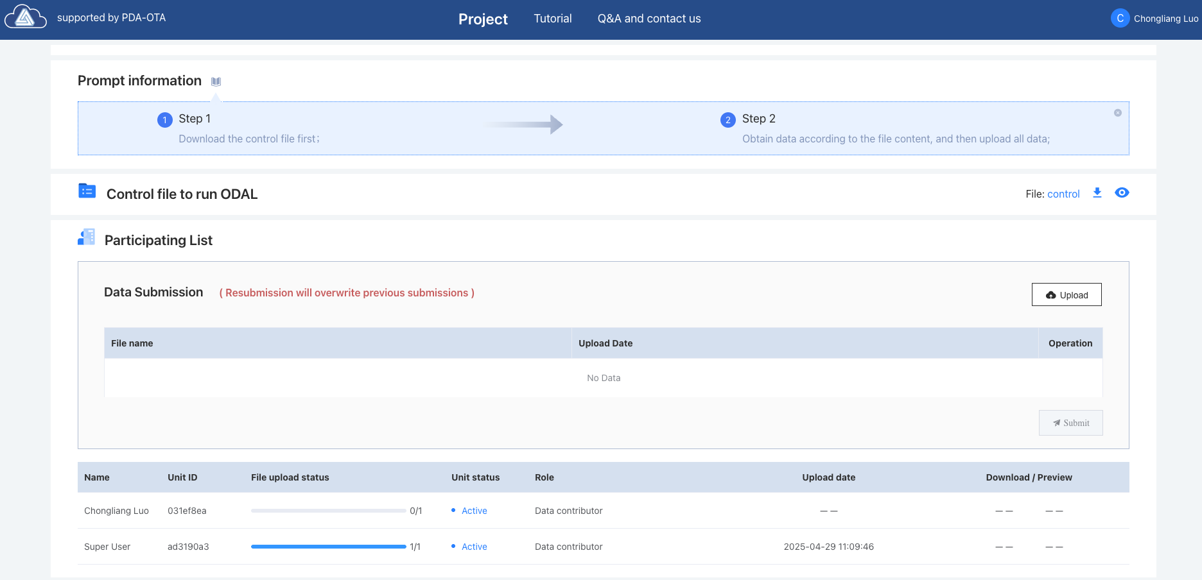
Practice project 1: COVID length of stay (DLMM)

Slide 27
Practice project 1: COVID length of stay (DLMM)

Slide 28
Practice project 1: COVID length of stay (DLMM)

Slide 29
Practice project 2: fetal loss and medication (ODAL)
The ODAL (One-shot Distributed Algorithm for Logistic regression) method was published at JAMIA in 2020. ODAL effectively utilizes the information from the lead site (where the patient-level data are accessible) and incorporates the aggregate data (i.e. the first- and second-order gradients of the likelihood function) from other sites to construct an estimator without requiring iterative communication across sites or transferring patient-level data. ODAL was evaluated via simulation and a study on fetal loss and use of 100 medications with EHR data from the University of Pennsylvania Health System. The estimation accuracy was evaluated by comparing it with the gold standard estimator based on the pooled individual participant data (IPD).

Slide 30
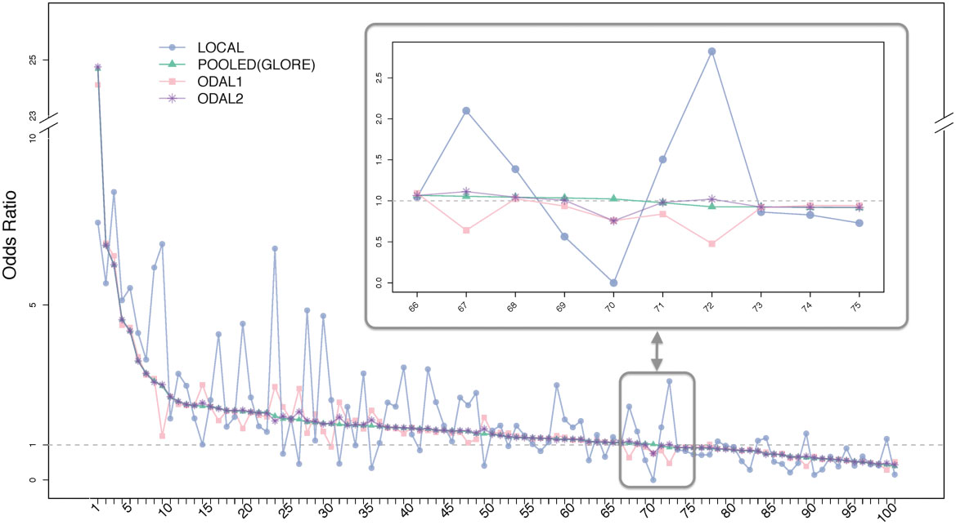
Practice project 2: fetal loss and medication (ODAL)

Slide 31
Practice project 2: fetal loss and medication (ODAL)
Among the 10 identified “harmful” drugs, 6 were category D or X (meaning have known evidence of increase fetal loss risk, based on the FDA’s A-X category system), with 4 being known contraceptives. Three drugs were category C pain relievers. In the 10 medications that are “protective” of fetal loss, 8 are prenatal vitamins, as well as folic acid, that are commonly considered beneficial for pregnancy. In summary, the ODAL algorithms provide estimates that are highly consistent with the pooled estimates, and the identified associations are consistent with current understanding of these medications.

Slide 32
Practice project 2: fetal loss and medication (ODAL)
For simplicity of this practice, we will use a synthetic data of fetal loss FetalLoss and ONE category X medication MedX. Other risk factors include Race, Age, Weight, and BMI. The data are from 4 sites, e.g.MedicalCenter, Lincoln, Omaha, and Kearney. The data is summarized as below.

Slide 33
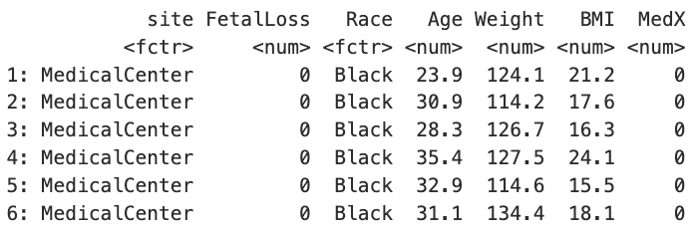
Practice project 2: fetal loss and medication (ODAL)

Slide 34
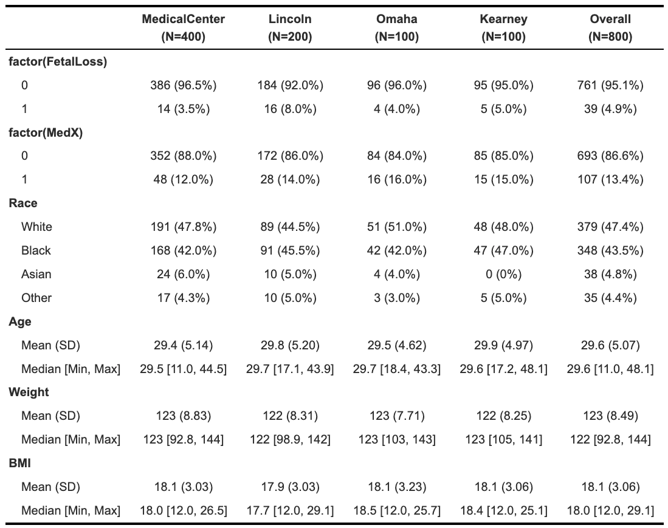
Practice project 2: fetal loss and medication (ODAL)

Slide 35
Practice project 2: fetal loss and medication (ODAL)
We will use the logistic regression model to estimate the odds ratio (OR) of the risk factors on fetal loss. First, assume we have all the patients data pooled together, we can run a pooled logistic regression. This will give us gold-standard estimator.

Slide 37
We now use ODAL to conduct a federated logistic regression. ODAL combined the IPD from the lead site and AD from the collaborating sites. We assume MedicalCenter is the lead site and the other 3 sites (Lincoln, Omaha, Kearney) are the collaborating sites. The diagram below demonstrate the ODAL workflow.

Slide 38
The ODAL workflow starts with setting up a control file for coordinating all the calculation and data communication between sites. This control file can be derived from a protocol with discussion between all sites.

Slide 39
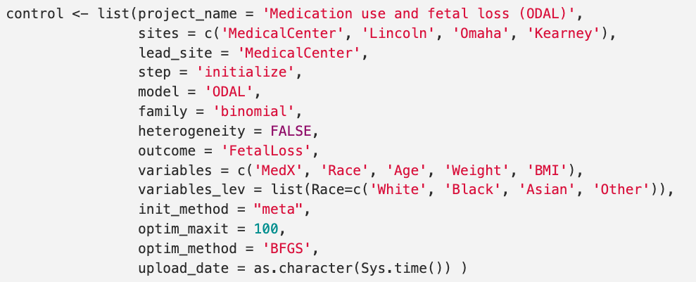

Slide 40
The lead site upload the control file in the pda-ota cloud.

Slide 41
Practice project 3: opioid use disorder (ODACH)

Slide 42
Practice project 3: opioid use disorder (ODACH)

Slide 43
Practice project 3: opioid use disorder (ODACH)

Slide 44
Practice project 3: opioid use disorder (ODACH)

Slide 45
Practice project 3: opioid use disorder (ODACH)

Slide 46
Practice project 3: opioid use disorder (ODACH)

Slide 47
Practice project 3: opioid use disorder (ODACH)

