Slide 1
UEEN4113
Network Security Management
Introduction to Virtualization

Slide 2
Defining virtualization
Virtualization is the creation of a virtual version of a hardware platform, operating system (OS), storage device, or computer network resources.

Slide 3
Hardware / Platform Virtualization
Creation of a virtual machine (VM)
  which emulates the functionality of a hardware platform or an operating system.
Host, guest and hypervisor
  host machine is the actual physical machine on which the virtualization takes place
  guest machine is the virtual machine
  software that creates and runs the virtual machine on the host machine is called a hypervisor or virtual machine monitor (VMM)
Guest software is usually a complete OS
  along with a full suite of applications

Slide 4
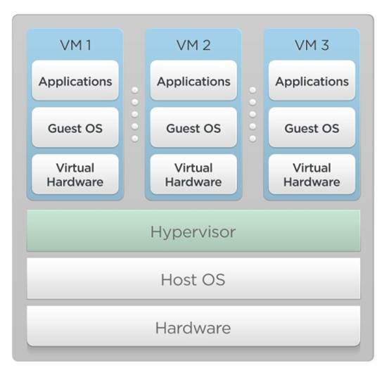
Hardware / Platform Virtualization
2GB RAM,
1-core, 100 GB
2GB RAM,
1-core, 100 GB
2GB RAM,
1-core, 100 GB
2GB RAM, 1-core, 200 GB
8GB RAM, 4-core, 500 GB

Slide 5
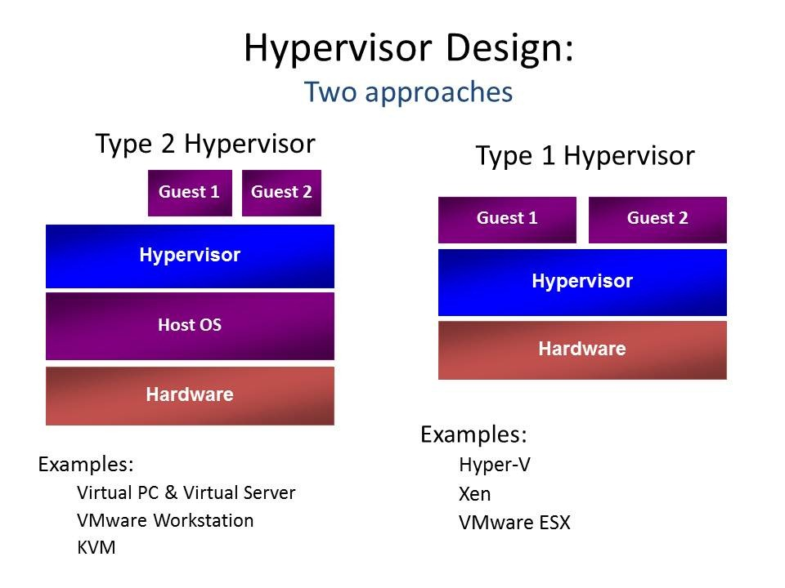
Types of hypervisors

Slide 6
Isolation from the host machine
Guest software (e.g. OS) is isolated from the hardware resources of the host machine.
  can have direct access to the host machine processor and memory.
Limited access to physical system resources
  network access, display, keyboard, and disk storage is more restricted.
  limited to a subset of the device's native capabilities

Slide 7
Performance issues
Performance drawback
  host resources required to run the hypervisor
  reduced performance of the guest software on the virtual machine compared to running native on the physical machine.
Concurrent multiple VMs on the same host machine
  each VM may exhibit a varying performance depending on the workload of other VMs.

Slide 8
Types of hardware virtualization
Full virtualization
Paravirtualization
Operating system level virtualization

Slide 9
Full virtualization
Creation of a virtual machine completely simulates the functionality of an actual hardware platform
  every key feature of the hardware platform simulated must be supported
  full instruction set of the processor, input/output operations, memory access, and hardware elements
  an operating system intended for stand-alone use can run in this virtual machine without any modification.
Full virtualization usually requires both hardware and software elements working together

Slide 10
Software virtualization
Examples of popular platform virtualization software
  Parallels Desktop for Mac, Parallels Workstation, VMware Workstation, VMware Server, VirtualBox
Software virtualization may be used in tandem with hardware assisted virtualization
  to provide the most efficient virtualization.
  VMware Workstation (for 64-bit guests only), Linux KVM and Microsoft Hyper-V.

Slide 11
Hardware-assisted virtualization
Uses special hardware features
  implemented in the host machine processors that enables efficient full virtualization
  was added to x86 processors (Intel VT-x or AMD-V) in 2006.

Slide 12
Snapshot
State of a virtual machine, and generally its storage devices, at an exact point in time.
  enables the virtual machine's state at the time of the snapshot to be restored later
  useful as a backup technique
Consists of three things:
  complete copy of the VM settings, including the hardware configuration
  complete state of all the virtual disks attached to the machine is preserved.
  snapshot of an actively running virtual machine saves the memory state of the machine

Slide 13
Snapshots and virtual hard drives
Virtual hard drives of a VM are mapped to a hard disk image file
Creating snapshots works similarly to the incremental backup technique.
  everytime a snapshot is taken, hypervisor creates differencing images which contain only the changes since the snapshot were taken
  when the snapshot is restored, the hypervisor throws away that differencing image, thus going back to the previous state.
  faster and uses less disk space.

