Slide 1
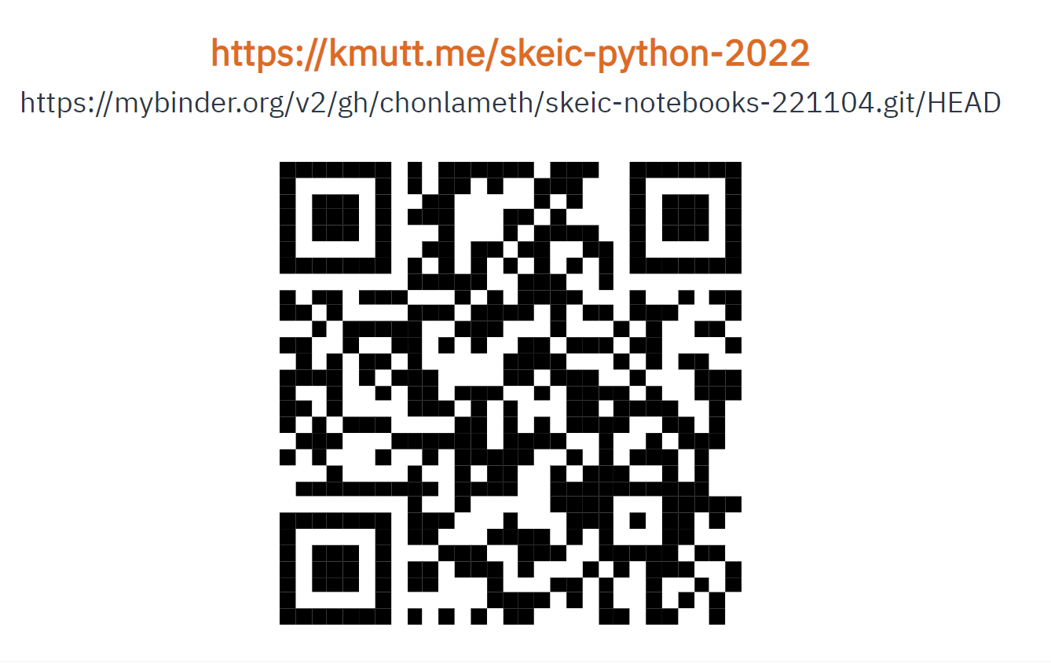
https://mybinder.org/v2/gh/chonlameth/skeic-notebooks-221104.git/HEAD

Slide 2
Codingbat.com
Go to https://codingbat.com
สร้าง account
เลือก Prefs > Teacher Share
Share to chonlameth@sit.kmutt.ac.th
กด Share button
เลือก Prefs > Memo
Memo รหัสนักเรียน_ชื่อ
กด Update Memo button

Slide 4
Slides for Chapter 2
Note to Instructors
This Keynote document contains the slides for “The Python Workbench”, Chapter 2 of Explorations in Computing: An Introduction to Computer Science and Python Programming.
The book invites students to explore ideas in computer science through interactive tutorials where they type expressions in Python and immediately see the results, either in a terminal window or a 2D graphics window.
Instructors are strongly encouraged to have a Python session running concurrently with Keynote in order to give live demonstrations of the Python code shown on the slides.
License
The slides in this Keynote document are based on copyrighted material from Explorations in Computing: An Introduction to Computer Science and Python Programming, by John S. Conery.
These slides are provided free of charge to instructors who are using the textbook for their courses.
Instructors may alter the slides for use in their own courses, including but not limited to: adding new slides, altering the wording or images found on these slides, or deleting slides.
Instructors may distribute printed copies of the slides, either in hard copy or as electronic copies in PDF form, provided the copyright notice below is reproduced on the first slide.
© 2015 John S. Conery

Slide 5
Interactive Python Examples
Example: a “hello world” program:
>>> print("hello")
hello
Python statement typed by user
result printed by Python
Python’s prompt

Slide 6
Arithmetic Expressions (นิพจน์คำนวณ)
The simplest statements in Python are arithmetic expressions
arithmetic expressions contain numbers (operands) and operators
The symbols used for operators are commonly used in other languages and applications (e.g. spreadsheets)
add: +
subtract: -
multiply: *
divide: /
>>> 5 + 12 17
>>> 3 + 4 * 5 23
>>> 4 * 4 / 2 8.0

Slide 7
Arithmetic Expressions (cont’d)
Use parentheses if you want to alter the standard order
Note that Python converts integer values to real numbers as needed (more on the next slide)
>>> 3 + 4 * 5 23
>>> (3 + 4 ) * 5 35
>>> 19 / 3 6.333333333333333
>>> 19 // 3 6

Slide 8
Floating Point Numbers (จำนวนจุดลอยตัว)
Numbers inside a computer are finite approximations
real numbers like 1/3 have an infinite number of digits
Python and other programming languages have a finite number of digits
From http://www.joyofpi.com/pi.html:
π = 3.141592653589793238462643383279...
In Python:
>>> from math import pi
>>> pi 3.141592653589793
In computer science finite approximations of real numbers are known as floating point numbers (or “floats”)
Python’s math library includes a definition of π

Slide 9



Variables (ตัวแปร)
To motivate the next topic, suppose you want to compute the surface area of a counter top
you know the counter is a square with a triangular piece missing
you also know each side of the triangle is half as long as the side of the square
Using some simple geometry will give you an equation for the area of the counter

Slide 10
Variables (cont’d)
Suppose you measure one edge of the square to get x = 109 cm
Python can compute the area for you:
>>> 109 * 109 - ((109/2)*(109/2) / 2) 10395.875
You can simplify this a little bit by using the exponentiation operator
to compute x² type x**2
>>> 109**2 - (109/2)**2 / 2 10395.875

Slide 11
Variables in Python
You can make the equation even simpler by using a variable
create a value named x, and then write the equation using x
>>> x = 109
>>> x**2 - (x/2)**2 / 2 10395.875
The first expression defines a variable named x, and the second uses the value of x to compute the area
An expression of the form “x = ...” is known as an assignment statement
put the name of a variable on the left side of the assignment operator
put any expression on the right side
Python evaluates the expression and saves the result

Slide 12
Variables Can Be Updated
You can change the value of a variable
simply assign it a new value in another assignment statement:
>>> x = 109
>>> x**2 - (x/2)**2 / 2 10395.875
>>> x = 111
>>> x**2 - (x/2)**2 / 2 10780.875

Slide 13
Variable Names (ชื่อตัวแปร)
There are a few rules for defining names for variables:
names can be as long as you want
>>> supercalifragilisticexpialadocious = 3.14
3.14
>>> supercalifragilisticexpialadocious * supercalifragilisticexpialadocious
9.8596
case is important (a is not the same as A)
names must start with a letter, but can have digits or underscores
note: by convention variable names in Python start with lower case letters

Slide 14
Strings
Numbers aren’t the only type of data found in programs
We’ve already seen that Python can print a sentence:
>>> print("hello, world")
hello, world
A set of letters enclosed in quotes is known as a string
We can store strings in variables:
>>> s = "hello"
>>> print(s) hello

Slide 15
String Operators (ตัวดำเนินการ String)
There are lots of things we can do with strings
Example: when the operands are strings, the + operator attaches one string to the other:
>>> s 'hello'
>>> s + ", world" 'hello, world'
We’ll come back to strings later in this chapter
For now, just know that Python has several different types of data; the ones we’ve seen so far are
integers
reals (“floats”)
strings

Slide 16
Strings
Earlier examples showed that Python can work with pieces of text as well as numbers
>>> s = 'Hello'
>>> t = "Who's there?"
In programming terminology these objects are known as strings
Python strings can begin and end with single quote or double quotes
typically strings have to fit on a single line in a program
later we’ll see another way of writing strings that can span multiple lines

Slide 17
Operators and Strings
When the operands in an expression are numbers the + and * operators have their usual meaning
But when used with strings the operators do something different
The plus symbol joins two strings into a single longer string
>>> s 'Hello'
>>> s + '?' 'Hello?'
The asterisk repeats a string a specified number of times
>>> s * 3 'HelloHelloHello'

Slide 18
Conditional Execution
Often an algorithm needs to make a decision
which steps are executed next depend on the outcome
Example: when computing tax rates compare a person’s income
if the income is above a certain minimum use one tax rate, otherwise use a lower rate
In Python an if statement allows us to test conditions and execute different steps depending on the outcome
def tax_rate(income):
if income < 10000:
return 0.0
else:
return 5.0
The value returned by this function depends on the value passed as a parameter

Slide 19
Syntax of if Statements
The structure of an if statement is similar to a def statement
if income < 10000:
return 0.0
else:
return 5.0
the words if and else are keywords
note the colon at the end of the if and else statements
note also how the statements to be executed are indented
we can have as many statements as we want in each section but they all have to be indented the same

Slide 20
Multiple Choice
When an algorithm needs to choose among more than two alternatives it can use an elif statement
elif is short for “else if”
This function distinguishes between three tax categories
def marginal_tax_rate(income):
if income < 10000:
return 0.0
elif income < 20000:
return 5.0
else:
return 7.0
We can use as many elif parts as we want

Slide 21
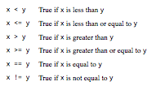
Boolean Expressions
The expressions in if and elif statements are special kinds of expressions
the result of these expressions is either True or False
An expression that evaluates to True or False is called a Boolean expression
Boolean expressions often involve comparison operators

