Slide 1
Activity Recognition
Nothing's gonna stop us now

Slide 2



Diagram
netpie
Topic: bads
Subscribe and produce
Prediction
model

Slide 3
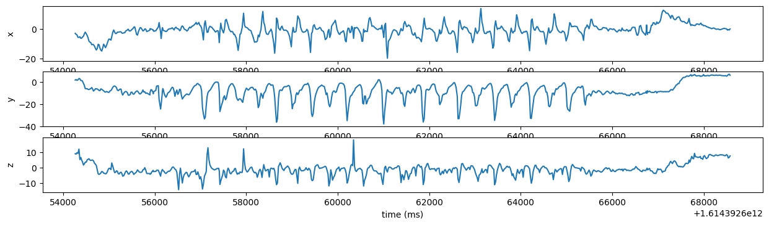
Training Data
Compute standard deviation (SD) of X, Y, Z every 15 row
…
X sd
Y sd
Z sd
activity
X sd
Y sd
Z sd
activity
X sd
Y sd
Z sd
activity
X sd
Y sd
Z sd
activity
X sd
Y sd
Z sd
activity
X sd
Y sd
Z sd
activity
X sd
Y sd
Z sd
activity
X sd
Y sd
Z sd
activity

Slide 4
Training Data
Compute standard deviation (SD) of X, Y, Z every 15 row
…
X sd
Y sd
Z sd
activity
X sd
Y sd
Z sd
activity
X sd
Y sd
Z sd
activity
X sd
Y sd
Z sd
activity

Slide 5
Training Model
Features:
sd x, sd y, sd z
Label:
activity (stand, walk, run)
Number of data: 9923 rows
walk 3926 rows
run 3786 rows
stand 2211 rows
Train model by PySpark

Slide 6
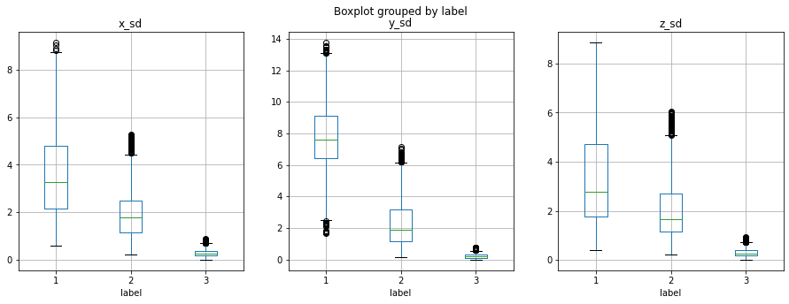
Boxplot
1 run
2 walk
3 stand

Slide 7
Model Evaluation
 |  | decision tree | random forest | logistic regression
walk | precision | 0.893 | 0.899 | 0.972
 | recall | 0.962 | 0.960 | 0.913
 | F1 | 0.926 | 0.929 | 0.941
run | precision | 0.973 | 0.972 | 0.958
 | recall | 0.906 | 0.913 | 0.944
 | F1 | 0.939 | 0.941 | 0.951
stand | precision | 0.981 | 0.981 | 0.975
 | recall | 0.975 | 0.975 | 0.990
 | F1 | 0.978 | 0.978 | 0.982

Slide 8
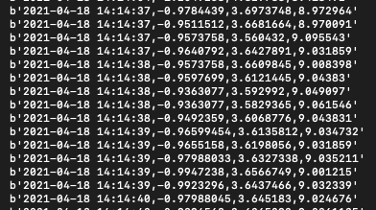

Real Time Analytics
Windows time 5 sec
sd x
sd y
sd z
model

