Slide 1
Apple vs Tesla
Machine learning Project

Slide 2
Dataset Overview
This dataset provides a detailed look at Market trends over five years (2019-2024), focusing on the price changes and trading volumes of various assets. It includes data on commodities like natural gas and crude oil, metals such as copper, platinum, silver, and gold, cryptocurrencies like Bitcoin and Ethereum, and major stock indices and companies, including the S&P 500, Nasdaq 100, Apple, Tesla, Microsoft, Google, Nvidia, Berkshire Hathaway, Netflix, Amazon, and Meta Platforms. This dataset is a useful resource with valuable information that can be used to analyze global market trends and patterns.

Slide 3
Goal
The goal of this project was:
To analyze the historical stock price trends of Apple and Tesla between 2019-2024.
To investigate the correlation between trading volume and stock prices for Apple and Tesla.
To develop and evaluate machine learning models for predicting prices of Apple and Tesla stocks using technical indicators such as moving averages.
To identify the optimal number of clusters using the Elbow method in order to plot individual graphs of price vs volume.

Slide 4
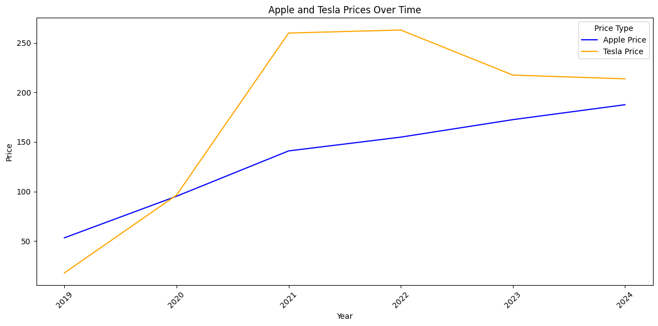
Apple and Tesla Prices Over Time
The line graph shows that the Apple prices steadily Increased from 2019-2021, then plateaus from 2021-2024 with just a very slight increase.
In comparison, the Tesla prices seem to sky rocket from 2019-2021, then plateaus from 2021-2022. After that the prices drop all the way to 2024.
We can conclude that Tesla prices have been more volatile than Apple prices which seem to have been more steady over the 4 year period.

Slide 5
Calculating the Correlation Coefficient
Correlation coefficients between the trading volumes and prices for Apple and Tesla are calculated. The correlation between 'Apple_Volume' and 'Apple_Price' is found to be approximately -0.47, indicating a moderate negative relationship. Similarly, the correlation between 'Tesla_Volume' and 'Tesla_Price' is approximately -0.45, also indicating a moderate negative relationship.
Correlation between Apple Volume and Apple Price: -0.46876330831957586
Correlation between Tesla Volume and Tesla Price: -0.447560875507868

Slide 6
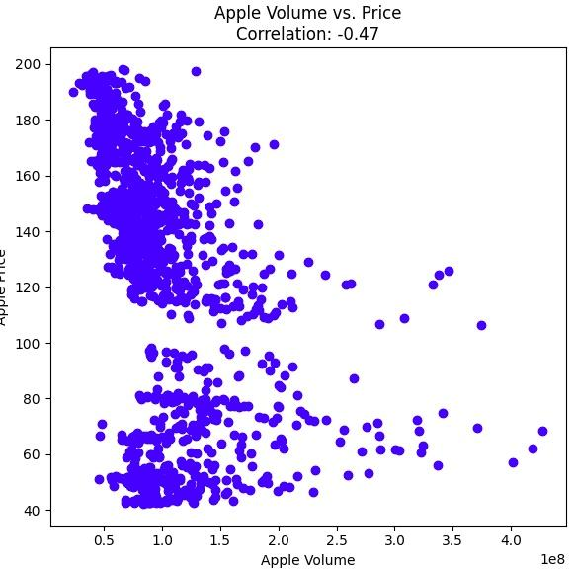
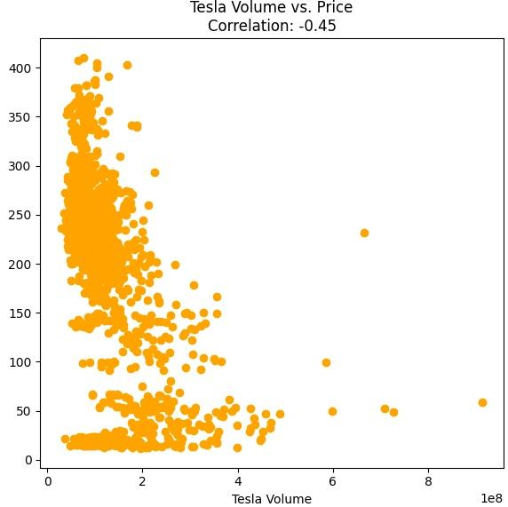
Correlation between Apple and Tesla Volume and Stock prices
From the scatter plots shown, there is a negative correlation between the volume and stock prices of Apple and Tesla.
The more the volume of both increases, the more the stock prices of both decreases.

Slide 7
Calculating the Moving Averages for Apple and Tesla Prices
Moving Average (MA) - A stock indicator utilized in technical analysis which is used to smooth out price data by creating a constantly updated average price. It calculates the average value of a series of data points within a moving/sliding window, where the window moves forward one data point at a time.
MA helps smooth out short-term ups and downs which help highlight long-term trends and patterns. This makes it easier to see the overall direction of prices without being distracted by daily changes.
Finding the MA was a necessary step for us to apply to Features and Targets in order to move on to the next step.

Slide 8
Splitting and Standardizing the Data
Splitting the data enabled us to divide the dataset into training(80%) and testing(20%) sets for both Apple and Tesla stock price predictions.
This means that the models are trained on one part and tested on another part to see how well they perform. We used randon_state=42 which ensured that the data was split the same way every time.
Our next step was to standardize the data. This is a process of transforming the data so that it has a mean of 0 and a standard deviation of 1. This is done to ensure that all features contribute equally to the analysis and modelling process.

Slide 9
Data Modeling
Linear Regression - An algorithm used to predict the value of unknown data by using another related and known data value.
Random Forest - An algorithm that combines the output of multiple decision trees to reach a single result. It is used for classification and regression tasks.
Long Short-Term Memory Networks (LSTM) - This is a type of recurrent neural network (RNN). LSTMs have memory cells that regulate the flow of information. This allows them to store or forget information based on how important or relevant the information is.

Slide 10

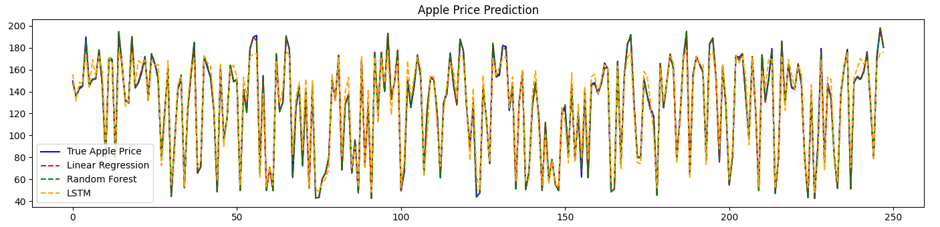
Apple Price Prediction

Slide 11
Apple Price Prediction Explained
For both Linear Regression and Random Forest models, their MSE is lower (approximately 1.32 to 1.92). This indicates that they are more accurate predictions.
The LSTM model has a much higher MSE of around 76.66, this suggests that its not good at predicting stock prices compared to the other two models.
We can therefore conclude that Linear Regression and Random forest models are better at predicting stock prices and are more accurate than the LSTM model.

Slide 12

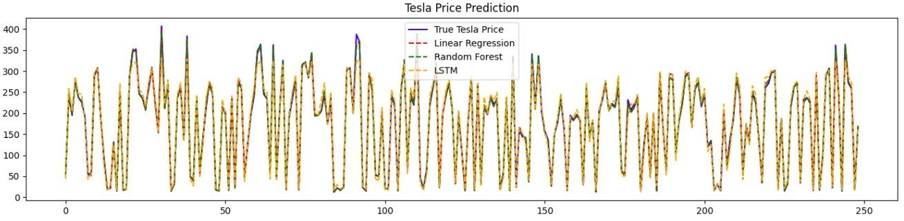
Tesla Price Prediction

Slide 13
Tesla Price Prediction
For both Linear Regression and Random Forest models, their MSE is high (approximately 15.93 to 28.65). This indicates that they are less accurate predictions.
The LSTM model has a much higher MSE of around 211.88, this suggests that its not good at predicting stock prices compared to the other two models.
We can therefore conclude that Linear Regression and Random forest models are better at predicting stock prices and are more accurate than the LSTM model.

Slide 14
Elbow Method for Optimal K
For the Elbow method, we utilized the following variables:
Inertia - This shows how tightly clustered the data points are. Low inertia means tighter clusters which is what our goal is when we are clustering.
K-means - It performs the division of objects into clusters that share similarities and are not similar to the objects that belong to another cluster.
K_range -This refers to a range of values for the number of clusters (denoted as “k”) that are being evaluated.

Slide 15
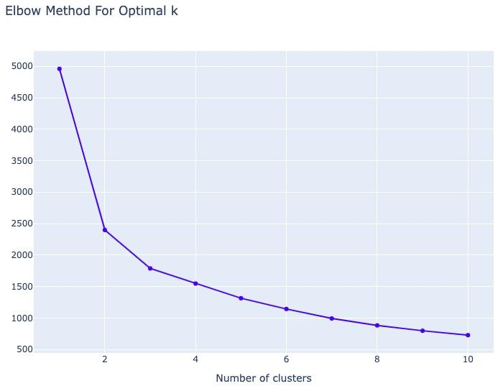
Elbow Method Graph
Once the clusters have been formed and the centroids have been determined , We decided that the optimal k = 3 which represents the number of clusters.

Slide 16
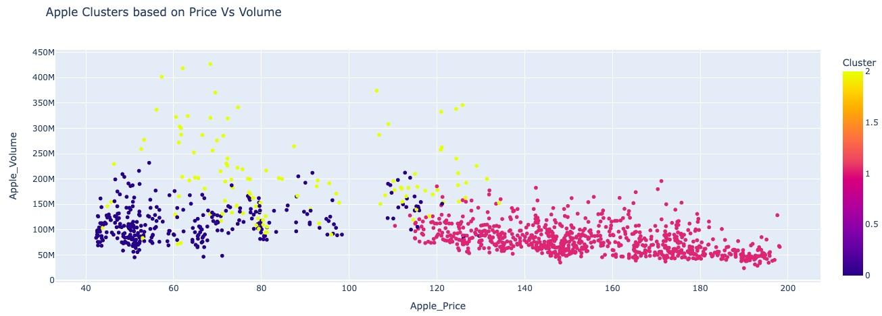
Apple Clusters based on Price vs Volume

Slide 17
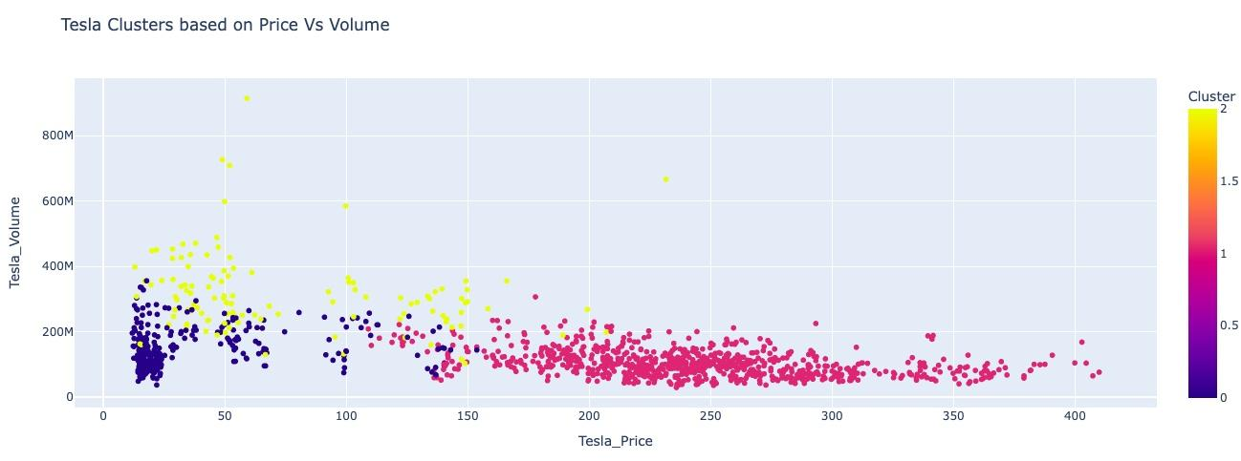
Tesla Clusters based on Price vs Volume

Slide 18
Apple and Tesla Clusters based on Price vs Volume
After we plotted our Elbow graph and determined that our optimal “k” is 3, we have come to a conclusion that out of the 3 clusters visualized, the yellow clusters appear to be more widespread than the other two clusters. This implies that there are distinct groups within the data provided.
Therefore , this means that the data points are more similar to each other than the other two clusters (Red and Blue). The yellow clusters show a clear separation based on the features that we used (Apple_Price, Apple_Volume, Telsa_Price and Tesla_Volume).

Slide 19
Challenges
Trying to decide what visualizations that would best represent our data and findings.
Trying to implement everything we have learnt especially with Machine Learning since it’s a very detailed and complex branch of Artificial Intelligence (AI).

Slide 20
Sources
https://www.kaggle.com/datasets/saketk511/2019-2024-us-stock-market-data

