Slide 1
Airline Reviews and Ratings Presentation

Slide 2
Introduction
The Airlines Reviews and Ratings dataset is an insightful collection of passenger experiences and opinions about their flights. It's like a big book of feedback, where travelers share their thoughts on different aspects of air travel. This dataset is a valuable tool for airlines and travel companies to understand what their customers think and feel.
In this dataset, you'll find information like the type of aircraft used for each flight, along with detailed reviews and ratings from passengers. Passengers rate various services, such as how friendly the cabin staff was, the quality of food and drinks, how comfortable the seats were, and whether they felt they got good value for their money.

Slide 3
Dataset Columns
Aircraft Type: Information about the specific aircraft used for each flight.
Service Ratings: Ratings given by passengers from a scale of 1-5 for various categories such as cabin staff service, food & beverages, seat comfort, value for money and more.
Recommend: Shows whether customers would recommend taking the airline (yes/no).
Seat types: what type of airplane class the customer took (Business class, Economy class, Premium class, First class).

Slide 4
Goals
The goals of this project were:
To find out what seat types e.g Business class, Economy class, etc, were most preferred by passengers based on Cabin staff service.
To find out what aircraft type was highly rated based on the cost of the flight and did they get their money’s worth?
To compare the different airlines and find out how food and beverages impacted the ratings of those airlines.
Which of the airlines was the most recommended.
To find out passenger ratings of the different aircrafts based on the seat types, e.g Business class, First class etc.

Slide 5
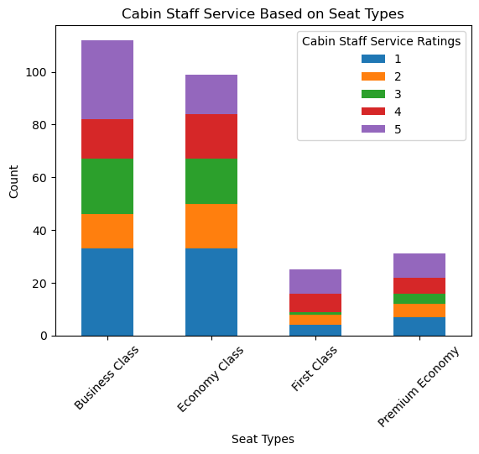
Ratings on seat types based on service
From our analysis, we can conclude that Business class and Economy class had the top ratings. Although, business class was rated highest by passengers based on the service they received from the cabin staff.
We can also conclude that Premium Economy passengers were not well pleased with their Cabin staff service and hence had the highest number of the lowest rating.

Slide 6
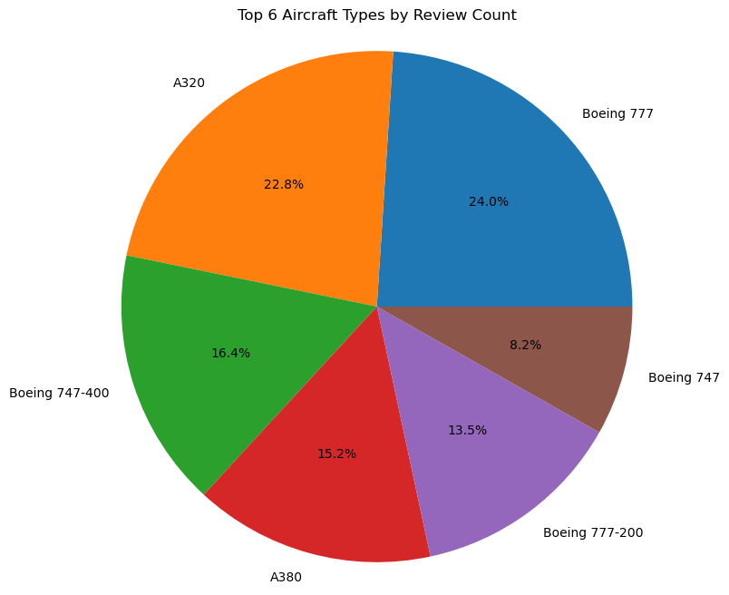
2. Aircraft type vs Value for Money
Our analysis shows that based on the Top 6 aircrafts that were rated, passengers preferred to fly with Boeing 777 with the ratio being 24%.
It also showed that passengers were the least satisfied with Boeing 747 with the ratio being 8.2%.

Slide 7
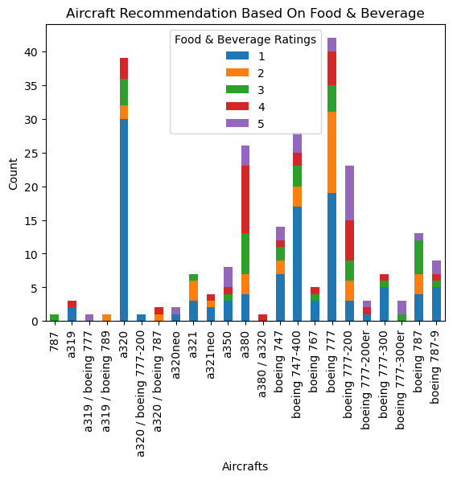
3.Aircraft ratings based on Food & Beverages
Our analysis shows that a320 had the lowest food and beverage ratings among all of the aircrafts.
In contrast, boeing 777-200 had the highest food and beverage rating among the other aircrafts.

Slide 8
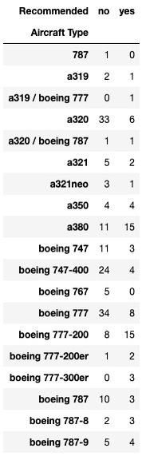
4. Most recommended Aircraft Type
Based on the table, the aircrafts that were recommend most to fly were a380 and boeing 777-200 both of them having 15 yes counts.
On the other hand, the aircrafts that were recommended not to fly were boeing 777 and a320. Both having 34 and 33 no’s respectively.

Slide 9
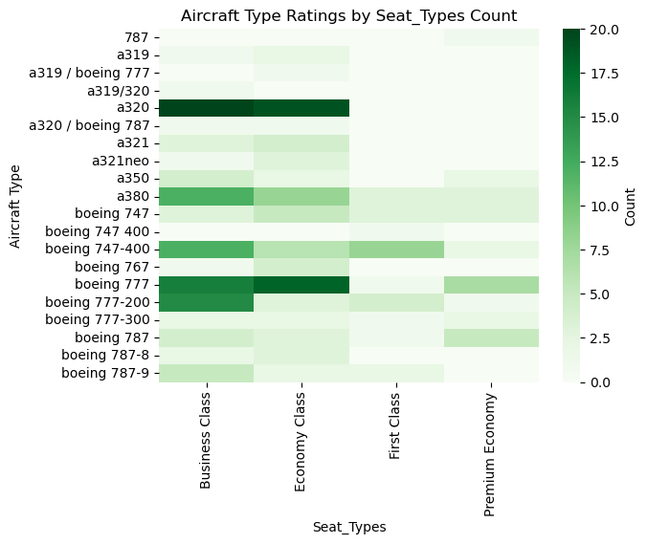
5. Seat type Popularity based on Aircraft type
Based on our heat map analysis, we can conclude that the aircraft that had the most number of passengers based on seat types was the airline a320 and those seat types were Business and Economy.

Slide 10
Challenges
We were unable to upload our csv files to PostgreSQL.
Where were unable to use all of the columns from both datasets. For instance, we didn’t use the “author” column because they used actually people’s names and we wanted to keep them confidential.
There was more data available for analysis on the Business and Economy classes, compared to the Premium and First classes.
It appeared that some passengers did not give reviews for certain categories (such as “wifi & connectivity”), hence a misrepresentation on some of the analysis.

Slide 11
Ethical Considerations
1.We made sure that we handled personal and sensitive information with care by ensuring that we did not use the column with the passengers names but still managed to execute the project effectively.
2. We also made sure to acknowledge the sources from which the data was obtained and also that the source was credible.
3. We made sure the data was complete and accurate by taking the necessary steps to clean the data, e.g, remove duplicates and correct any errors.

Slide 12
Sources
https://www.kaggle.com/datasets/anandshaw2001/airlines-reviews-and-rating
https://www.kaggle.com/datasets/juhibhojani/airline-reviews

